Slide 1
John H. Van Vleck’s Legacy to Radio Astronomy
by
Jim Moran
CfA
Innovation and Discovery in Radio Astronomy:
A Celebration of the Career of Ron Ekers
Queenstown, New Zealand
13–17 September 2016

Slide 2
John H. Van Vleck (1899–1980)
Professor of physics, Harvard, 1936–1980
PhD in physics, Harvard (under E.C. Kemble), 1922
First American thesis on quantum theory
Grandson of John Monroe Van Vleck
Professor of astronomy and mathematics,
Wesleyan University, 1853–1912
Main interests
Quantum theory of magnetism (Nobel Prize* 1977)
Quantum theory of molecules (Van Vleck line shape)
*with Nevill Mott and Philip Anderson

Slide 3
Nobel Prize Lecture “The Key to Understanding Magnetism”
“This brings me up to the years of World War II, during which very little was done in the way of pure research.”
But Van Vleck wrote two classified reports that had great impact on the later development of radio astronomy.
“The Atmospheric Absorption of Microwaves”
Report 43-2, Radiation Laboratory, MIT
April 27, 1942 (declassified August 1960)
“The Spectrum of Clipped Noise”
Report 51, Radio Research Laboratory, Harvard University
July 21, 1943 (declassified March 1946)

Slide 4
Rotational Spectrum of Water Vapor
First accurate measurements with infrared spectroscopy by Randall et al., 1937

Slide 5
Atmospheric Absorption Due to Water Vapor and Oxygen

Slide 6
Cover of Van Vleck’s Classified Memo on Clipped Noise

Slide 7
Fourier Transform Paradigm

Slide 8
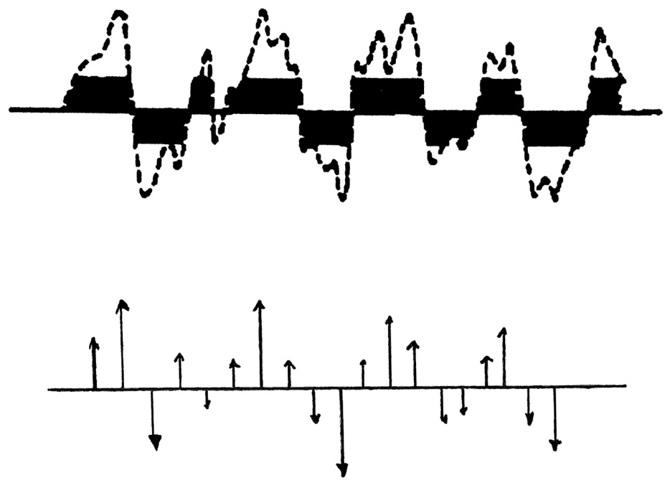
Van Vleck Clipping Correction
Random voltage
(Van Vleck, 1943, fig. 1)
Digital representation
σ²ρ(τ)
Clipped representation
1101011100111001100
ρ_{c}(τ)
[
]
ρ(τ) = sin ρ_{c}(τ)
π
2

Slide 9
Van Vleck’s Derivation of the “Arcsine” Relation

Slide 10
Digital Spectrometers for Radio Astronomy
1943
1950
1966
1963
1963
1965
1974
1984
1997
2005
Van Vleck
Lawson & Uhlenbeck
Van Vleck & Middleton
Weinreb
Goldstein
Cooley-Tukey
Yen
Chikada
Escoffier (ALMA) Bunton et al.
[
]
ρ(τ) = sin ρ_{c}(τ)
Summary of VV
Publication of VV
MIT/DI line
JPL/Venus radar
FFT algorithm, t = n log n
Urged use of FFT
First FX correlator
Last XF correlator (?)
FX (& PFBs)
π
2

Slide 11
Windows for the FX and XF Schemes
Gaussian noise segment
time
FX: segment blocks
time
XF: delay window
delay (lag)

Slide 12
Comparison of Window and Spectral Responses
Lag Density (number of multiplications) Spectral response functions
Solid line: FX, dotted line: XF

Slide 13
SNR Ratio (FX/XF) vs. Linewidth Simulation

