Slide 1
The Origins of VLBI or 1967 – The Summer of Love
James Moran
Harvard-Smithsonian Center for Astrophysics
Black Hole Astrophysics with VLBI: Past, Present, and Future
Workshop in Honor of Professor Makoto Inoue’s Retirement
March 27–29, 2017
Tokyo, Japan

Slide 2
Collaborations with Inoue-san 17 Papers (1991–2016)
Early millimeter-wavelength VLBI
NGC4258 megamaser
Event Horizon Telescope (EHT)

Slide 3
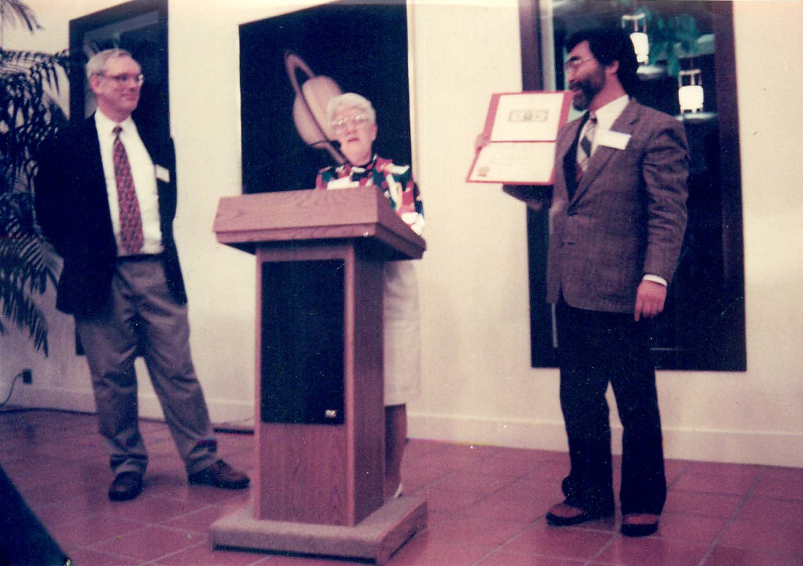
Vera Rubin Presenting Makoto Inoue and Jim Moran (on Behalf of the NGC4258 Group*) the Rubin Prize, March 1995
*Miyoshi, Moran, Herrnstein, Greenhill, Nakai, Diamond, Inoue

Slide 4
Scientific Motivation for VLBI in the Mid-1960s
Quasars
Unresolved on Jodrell Bank to Malvern baseline of 127 km at 5-cm wavelength
Smaller than 0.025″
Interplanetary Scintillation, less than 0.01″
OH Masers
Unresolved on Haystack to Harvard baseline
Baseline of 13 km at 18-cm wavelength and Jodrell Bank to Malvern
Smaller than 0.1″

Slide 5
VLBI Technology Precursors
One‐bit sampling theory (Van Vleck, 1943)
One‐bit digital correlator (Weinreb, 1961)
Rubidium clock (Varian/Hewlett‐Packard, 1964)
Hydrogen maser (Ramsey, Vessot, 1964)
Video tape recorder (Ampex, 1963)
IBM 6250 digital recorder (1964)
Loran C and traveling clocks for time sync (1946)

Slide 6
Some Intellectual Roots of VLBI
1963
1965
1966
1965
Lovell travels to USSR to discuss VLBI
Kellermann and Cohen noted that newly released Varian R-20 Rb frequency standard would make VLBI easy. “VLB” after “VLA”
(term “VLBI” ~1970+)
University of Florida group plans VLBI at 18 MHz using audio tape recorders
Matveenko, Kardashev, Sholomitskii paper

Slide 7
First Published Paper Describing Radio Interferometry with Independent Local Oscillators and Tape Recorders
“The further apart the antennas, the smaller the required
stability. In particular, for baselines of about 1000 km,
crystal oscillators are sufficient.”

Slide 8
Early VLBI Experiments
Canadian VLBI Group
April 1967 published: Broten et al., Nature, July 1, 1967
Algonquin–Penticton; 448 MHz, 3074 km, res = 0.04″
Analog system; bw = 1 MHz
Cornell-NRAO Group
May 1967 published: Bare et al., Science, July 14, 1967
Green Bank–Maryland Point; 610 MHz, 220 km, res = 0.5″
Mk1 digital system (1 bit/sample); bw = 360 KHz
MIT Group
June 1967 published: Moran et al., Science, August 11, 1967
Green Bank–Haystack; 1665 MHz, 845 km, res = 0.045″
Modified MkI (5 and 120 KHz bw)

Slide 9
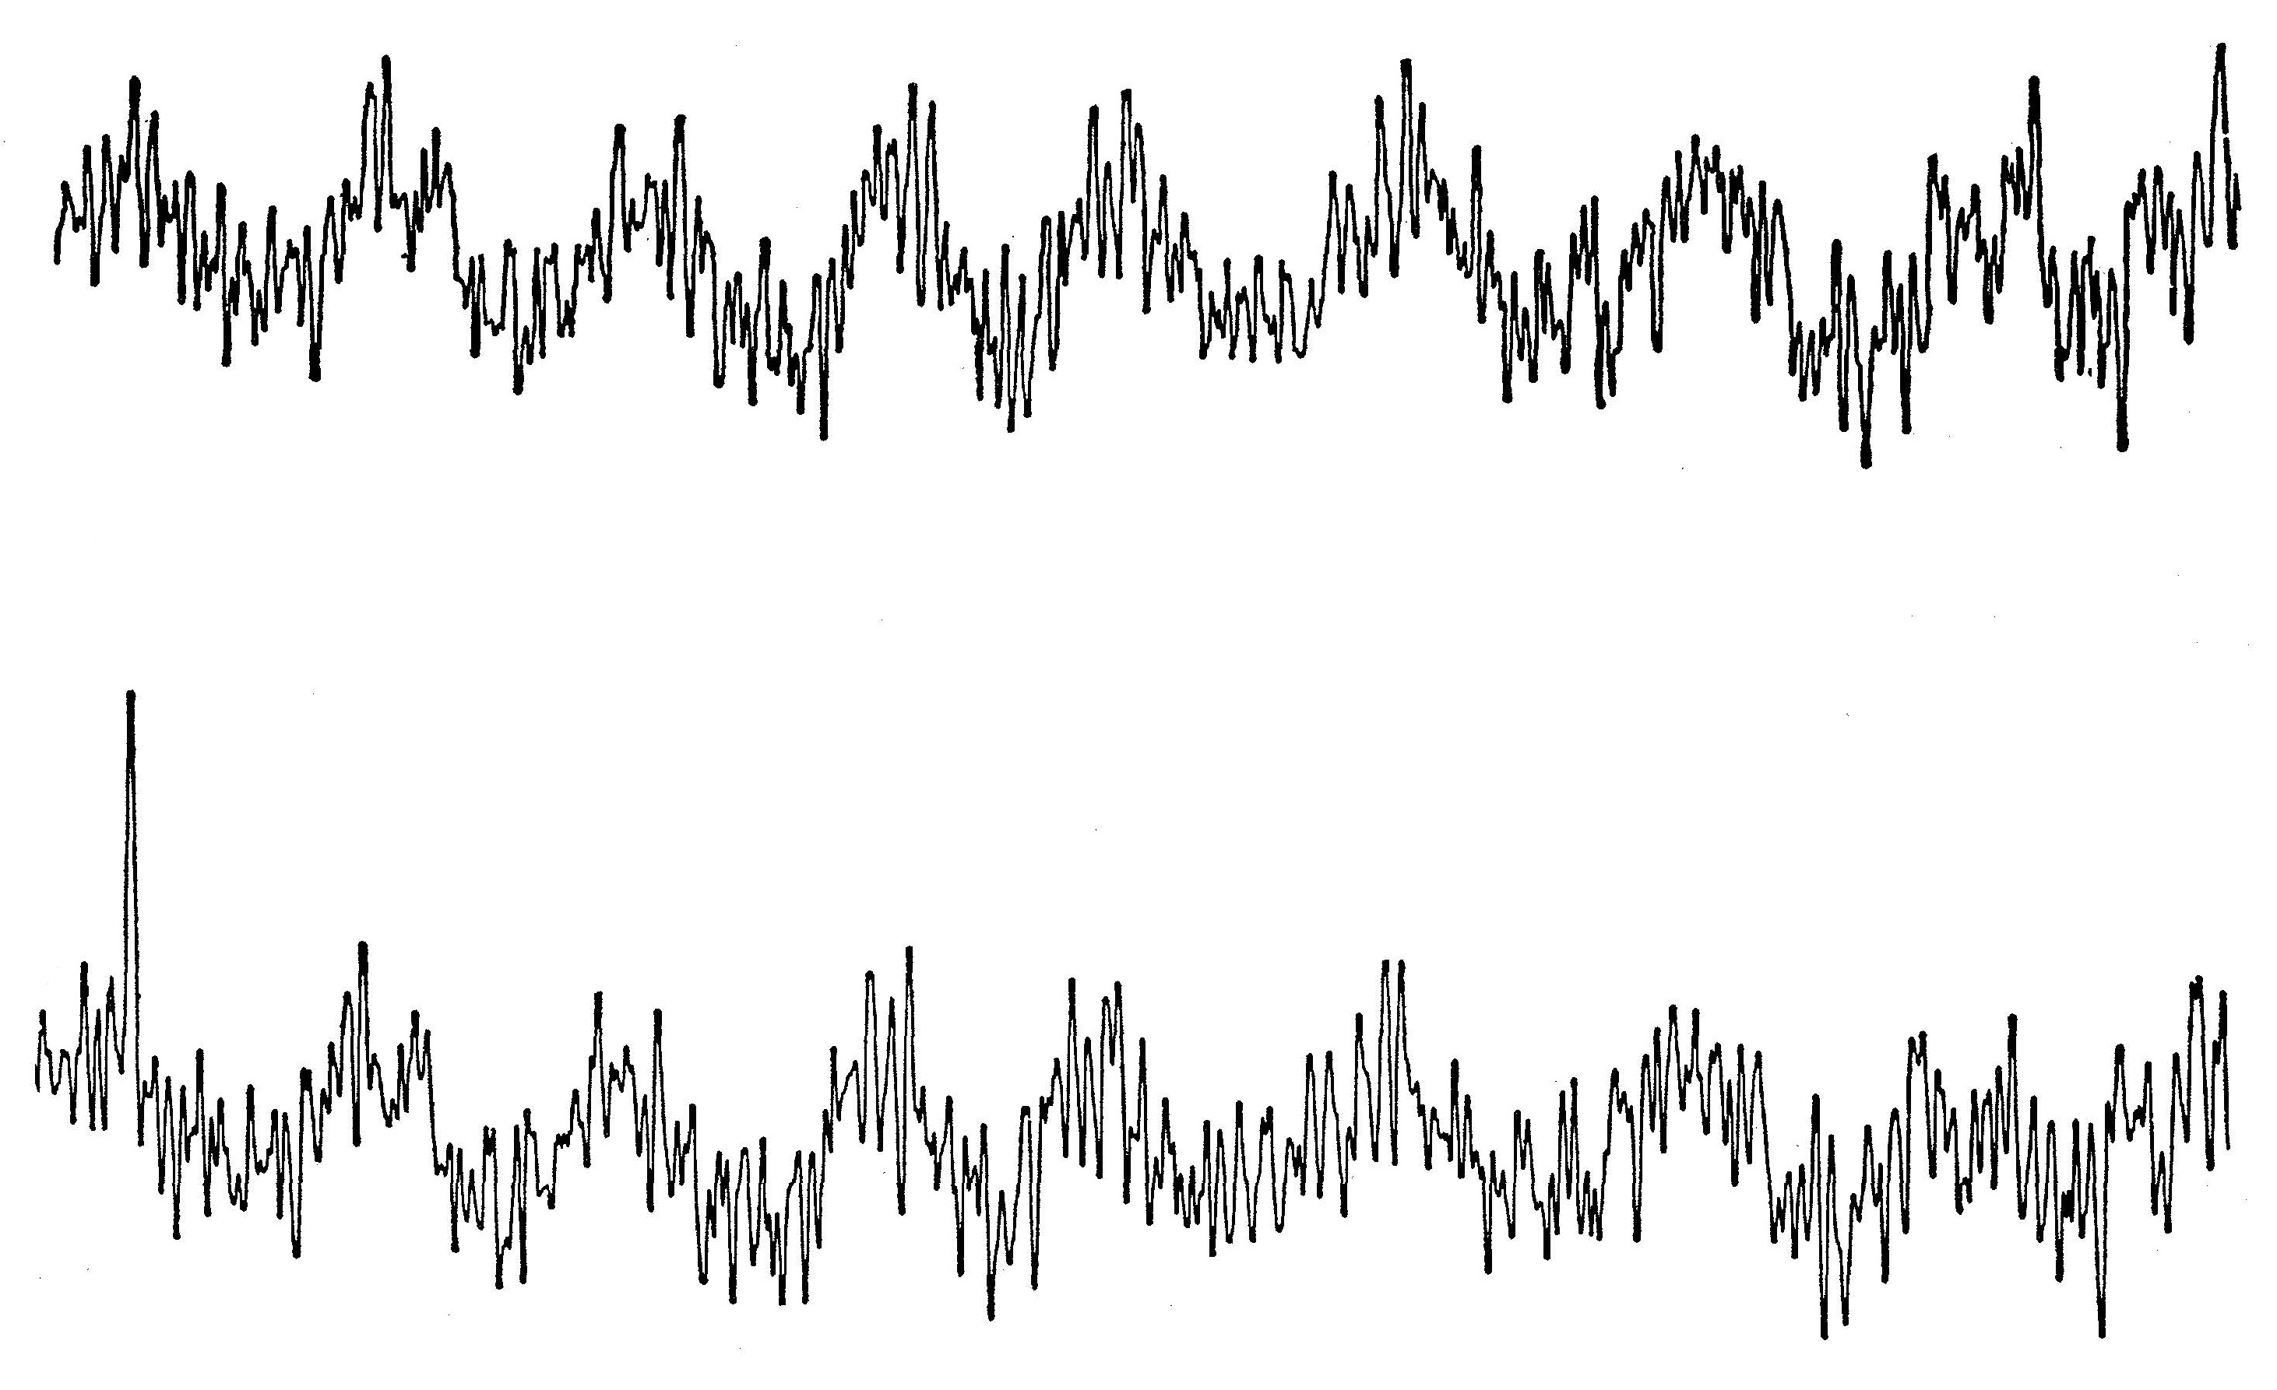
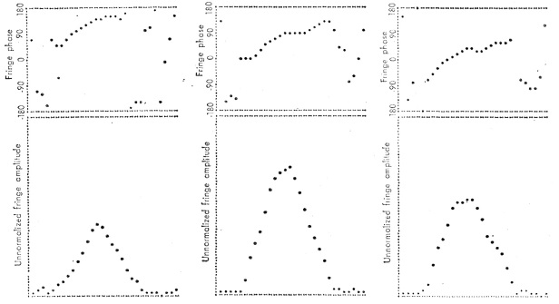
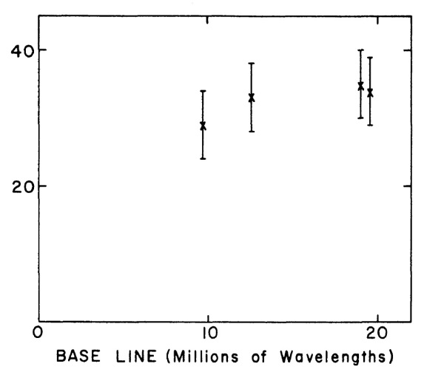
First VLBI Fringes
Broten et al., Nature, 1967
3C294
448 MHz
Moran et al., Science, 1967
W3(OH)
1665 MHz
Haystack–Green Bank
Clark et al., ApJ, 1967
3C273
1665 MHz
Haystack–Green Bank

Slide 10
Early Results
Quasar brightness approaching Compton limit ~10¹³K
Superluminal expansion in quasars
OH Masers resolved into compact “spots”
Contemporary plate motions

Slide 11
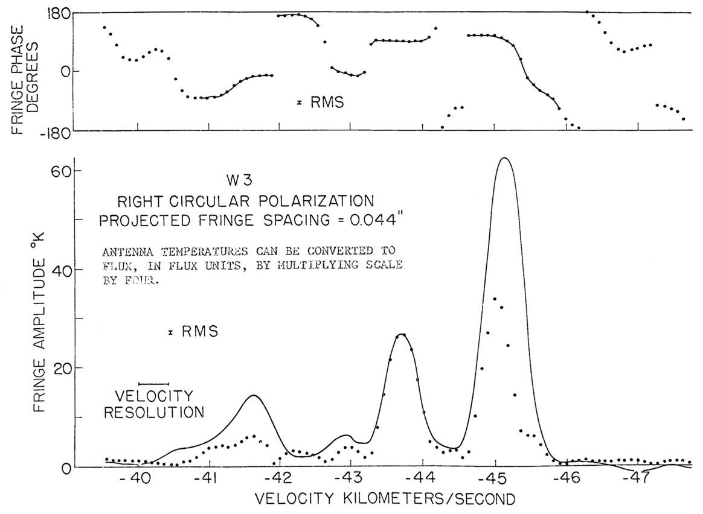
Interferometer Spectrum of W3 in 120 KHz Band (June 1967)
Cross power (solid)
Total power (dotted)

Slide 12
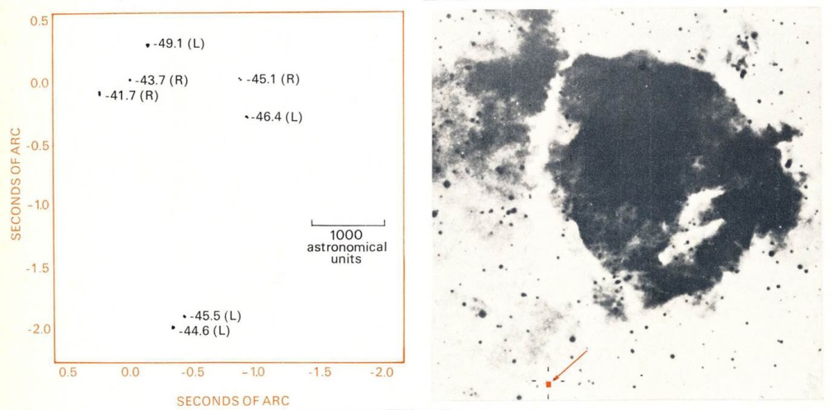
VLBI Image of W3 Maser
Palomar Sky Survey Image
of W3 HII Region
Moran et al., ApJ, 1967

Slide 13
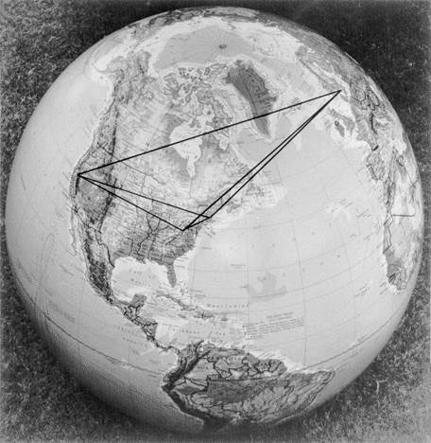
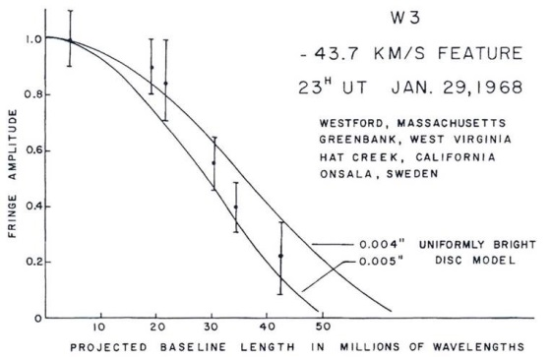
First Resolution of a Maser “Spot”

Slide 14
First VLBI Fringes
Canadian Group–(DRAO–Algonquin) 17 April 1967
NRAO/Cornell–(NRL–Green Bank) 8 May 1967
MIT–(Haystack–Green Bank) 5 June 1967
Canadian
Norm Broten (D)
Tom Legg (D)
Jack Locke (D) Charles McLeish (D)
Roger Richards (D)
Richard Chisholm (D)
Herb Gush (R)
Alan Yen (D)
John Galt (D)
NRAO
Claude Bare (D)
Barry Clark (R)
Ken Kellermann (A)
Marshall Cohen (R)
Dave Jauncey (A)
MIT
Jim Moran (A)
Al Barrett (D)
Bernie Burke (A)
Alan Rogers (A)
Joe Carter (R)
Patty Crowther (R)*
John Ball (R)
American Academy of Arts and Sciences Rumford Award, 1971
*sole woman
A = active, R = retired, D = deceased

Slide 15
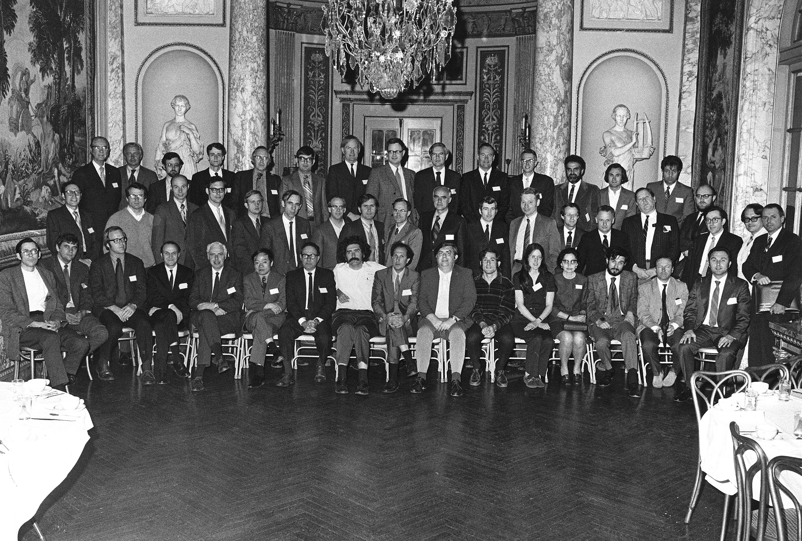
Rumford Prize Symposium, Boston, April 1971

Slide 16
Important Early Innovations in VLBI
Digital fringe rotation (Clark, 1968)
Bandwidth synthesis (Rogers, 1968)
Partially coherent interferometers (Clark, 1968)
Spectral line phase referencing (Moran, 1968)
Phase closure (Jennison, 1958; rediscovered by Rogers, 1974)
Hybrid mapping (Readhead and Wilkinson, 1978)

Slide 17
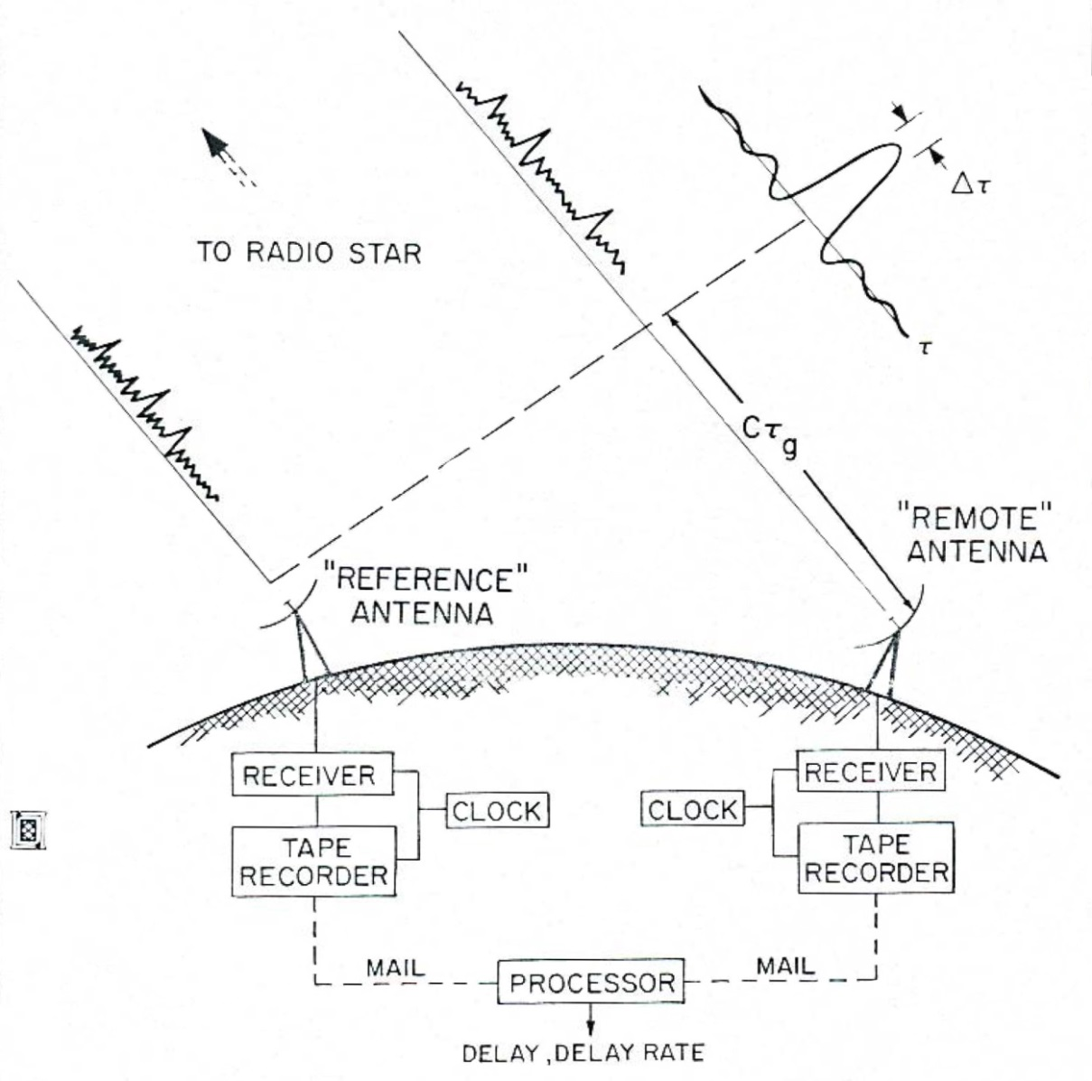
Delay Measurements via VLBI
Rogers, 1967

Slide 18
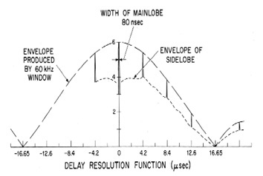
Bandwidth Synthesis Using “Arsac” Array of Frequencies

Slide 19
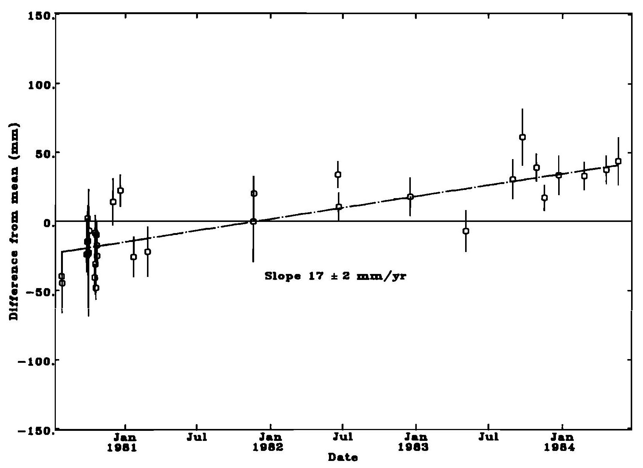
First Measurement of Contemporary Plate Tectonics Westford-Onsala Baseline length
Herring et al., JGR, 1986

Slide 20
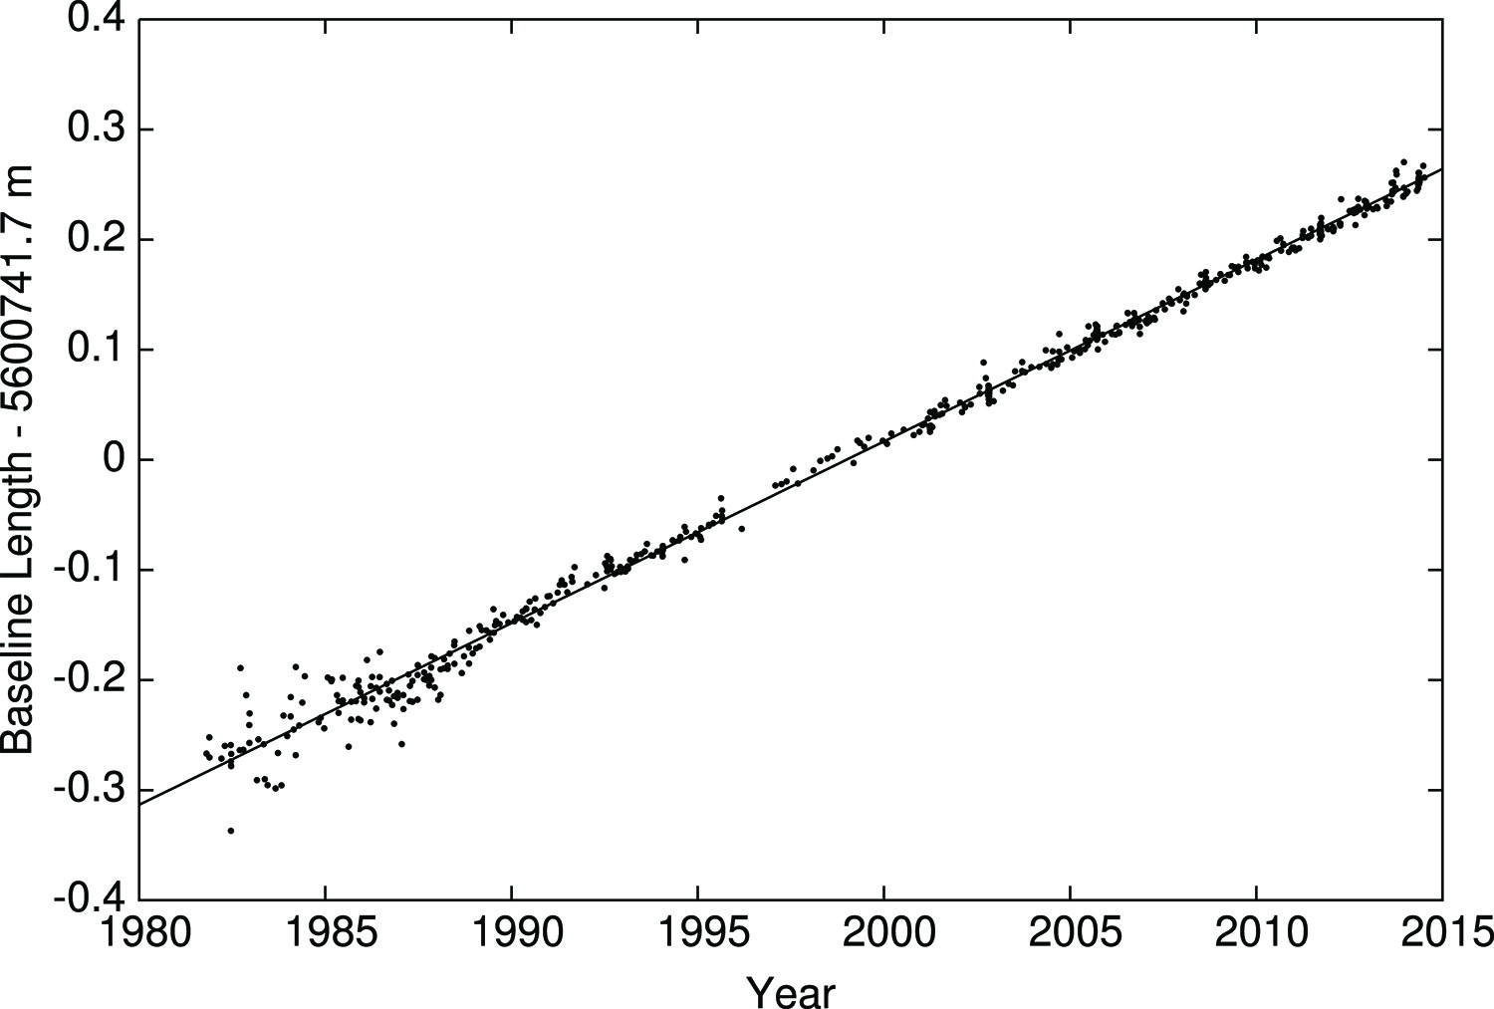
Westford–Onsala Baseline Length vs. Time Determined by VLBI
VLBI Service for Geodesy and Astrometry (see Thompson, Moran, and Swenson, 2017)

Slide 21
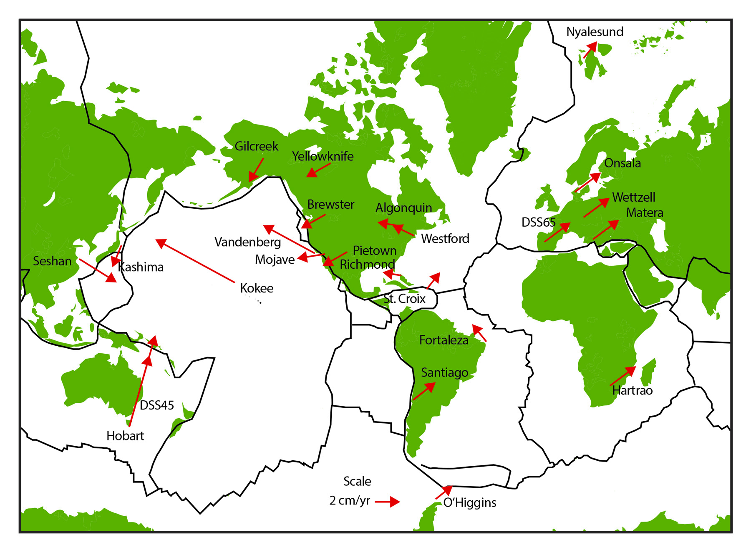
Tectonic Plate Motions Measured with VLBI

Slide 22
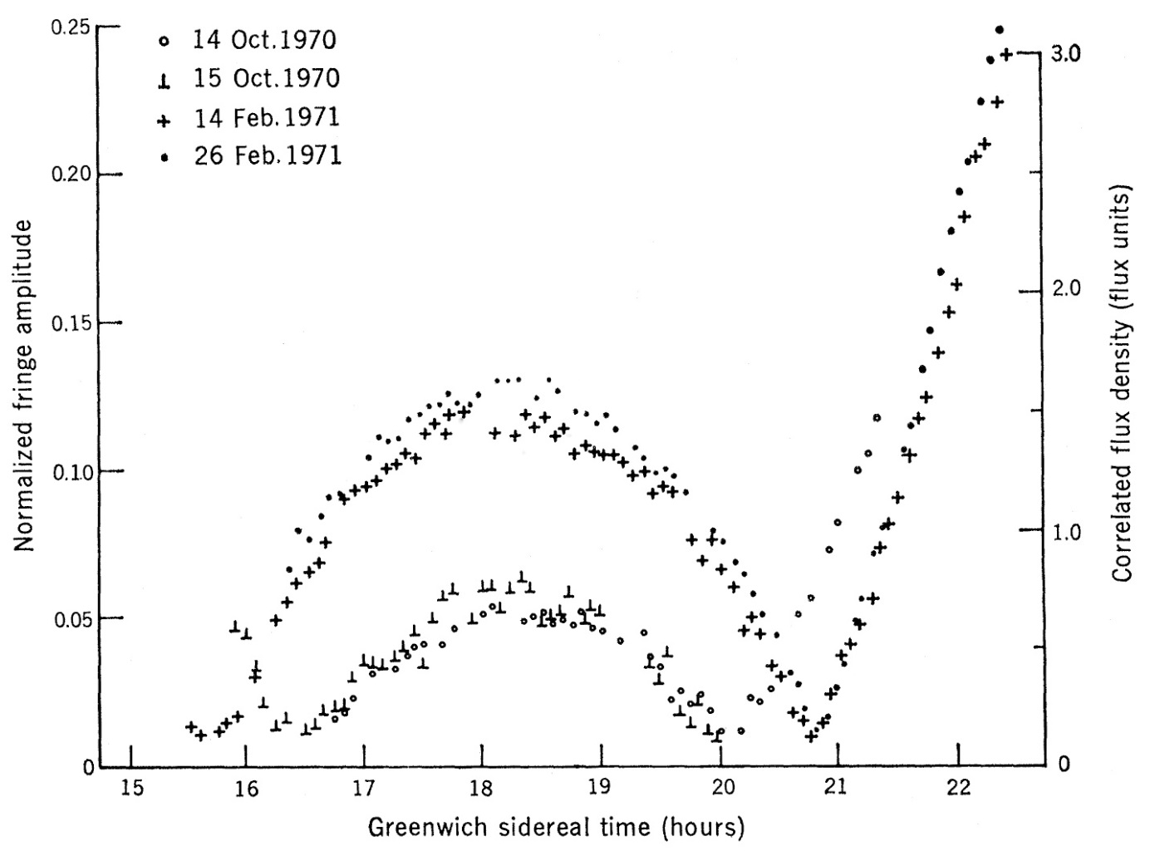
Discovery of Superluminal Motion: Fringe Visibility on 3C279 Haystack – Goldstone Baseline
Oct 1970
Feb 1971
Whitney et al., Science, 1971

Slide 23
Hybrid Mapping of 3C273 for Five Epochs at 10GHz
Pearson et al., ApJ, 1981

Slide 24
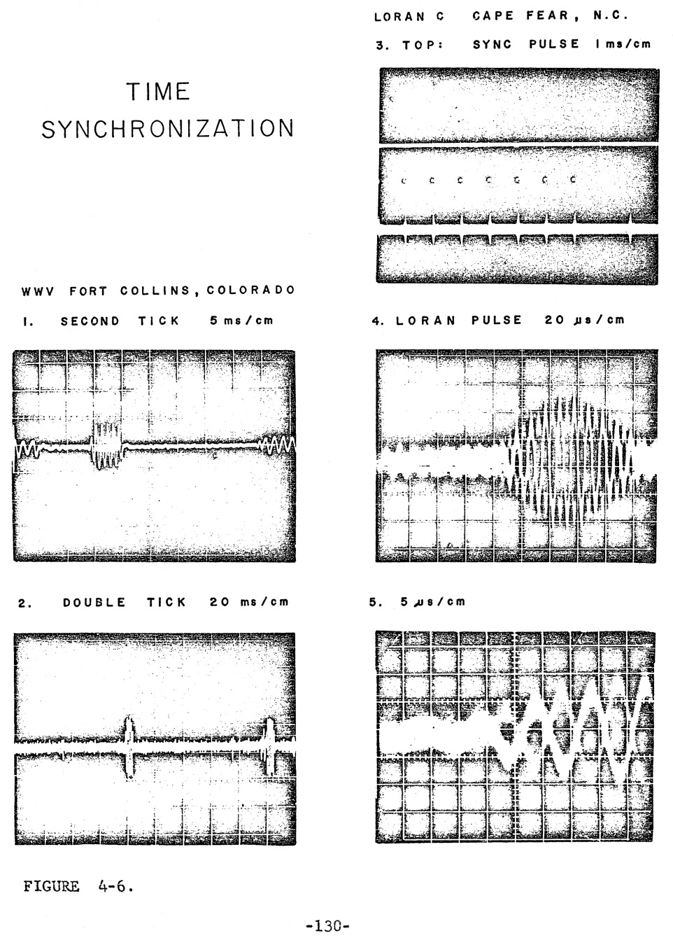
Station Timing via WWV and Loran C
Moran, PhD thesis, 1968

Slide 25
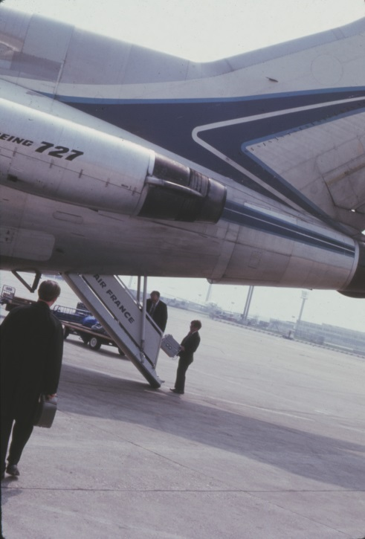
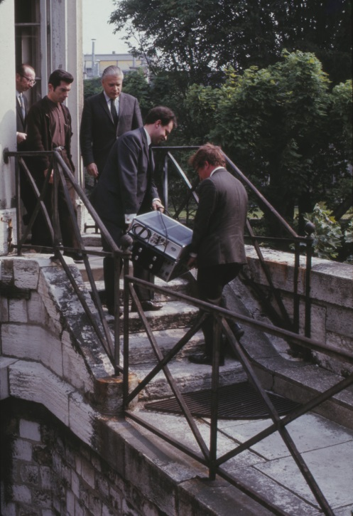
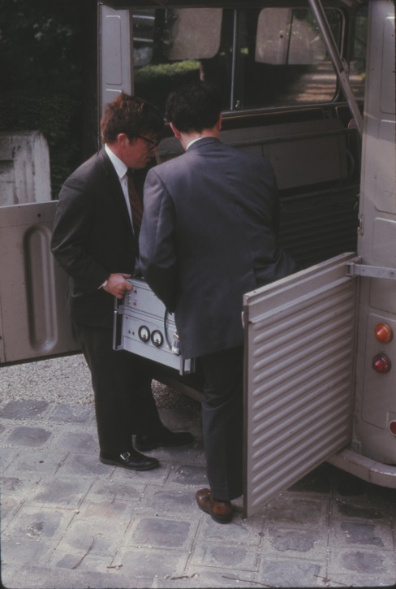
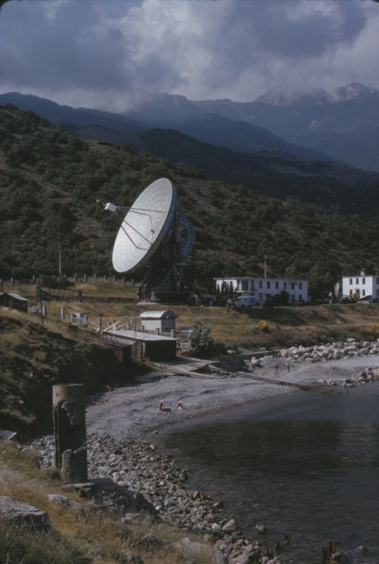
Station Time Synchronization
Paris Observatory
Emile Blum, Steve Knowles
Simeiz,
Crimea,
USSR

Slide 26
VLBI Equipment Used at Haystack for First Fringes 8 June 1967

Slide 27
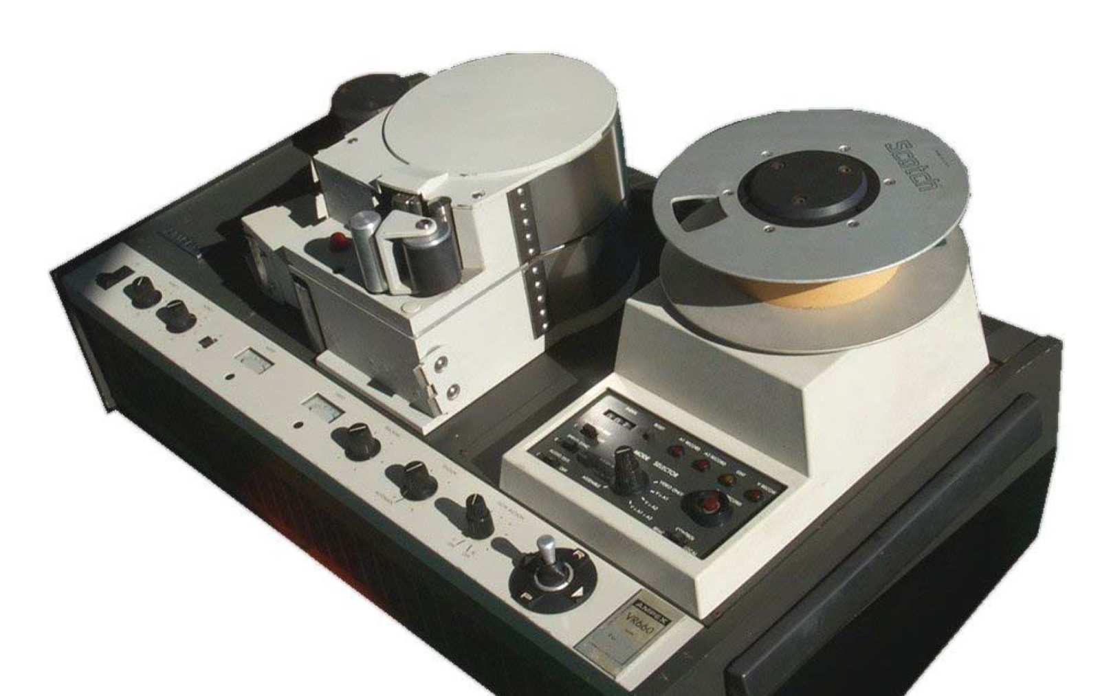
Canadian Analog and US Digital Mk II Systems Ampex VR660 Television Recorder (10^11 bits)

Slide 28
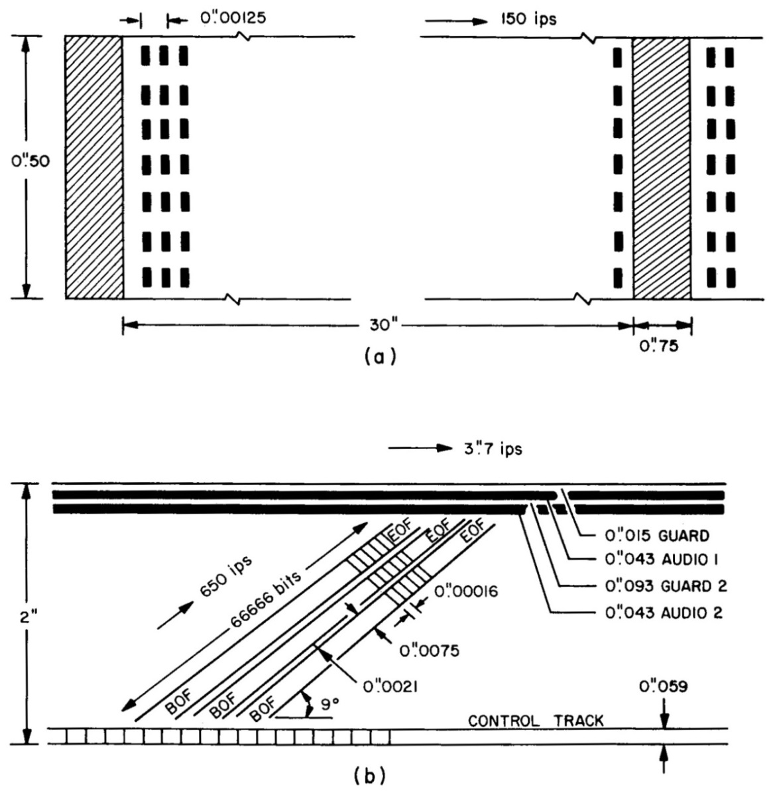
Tape Formats
NRAO
MK1
NRAO
MK2

Slide 29
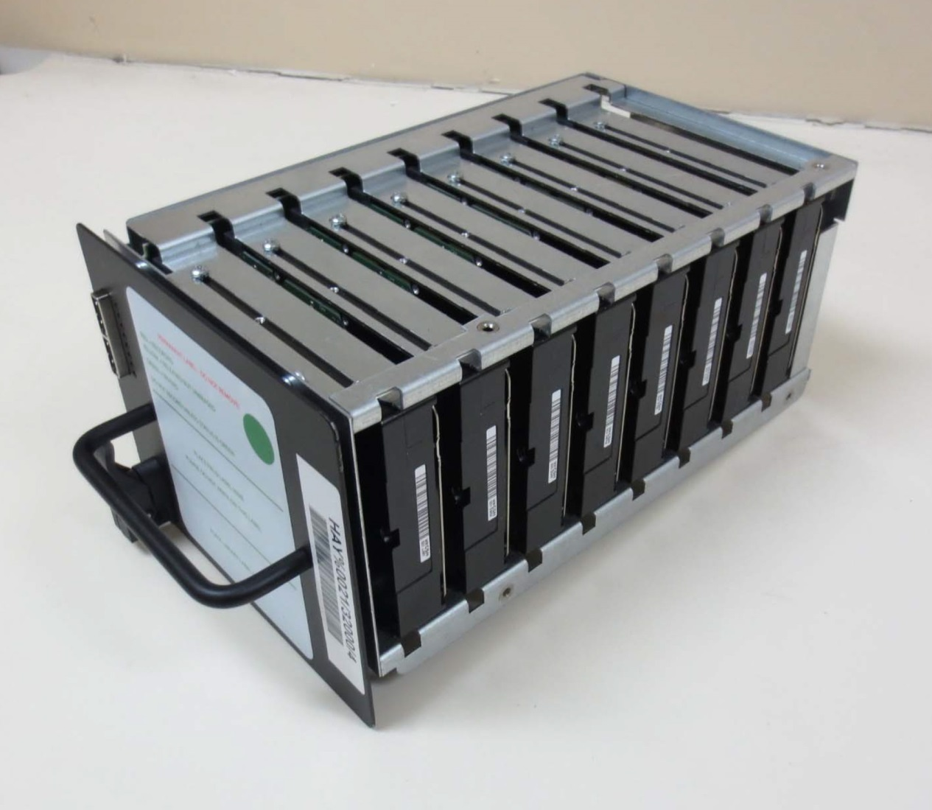
Mk 6 Module with 8 x 4 = 32 Terabytes of Disks (2 x 10^14 bits)

Slide 30
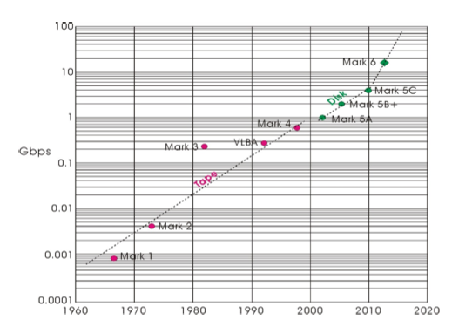
Data Rate vs. Time

Slide 31
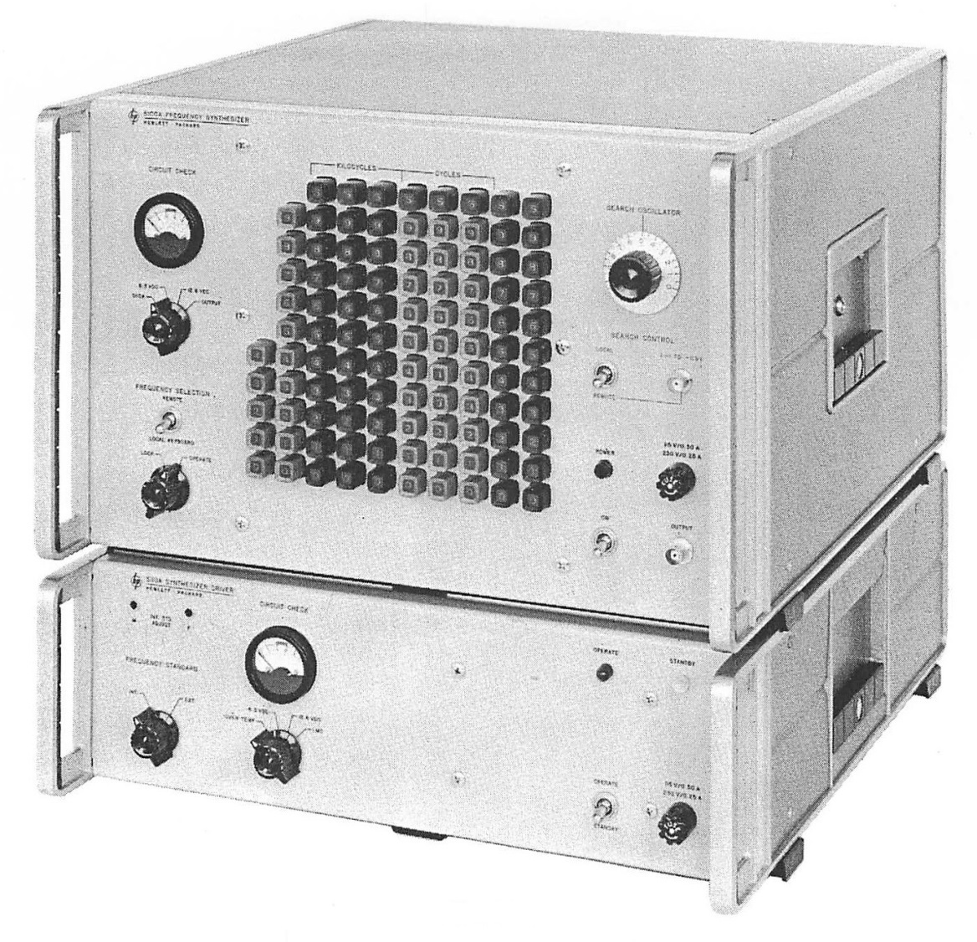
Hewlett-Packard HP-5100 Frequency Synthesizer (0–50 MHz)
From 1967 HP catalogue

Slide 32
Visibility of Cepheus A Water Maser on 3.5 Earth-Diameter Baseline (RadioAstron–Yebes)
Visibility model (c): Double source, 24 μas separation, 15 μas diameter
Sobolev et al., 2017, in preparation

Slide 33
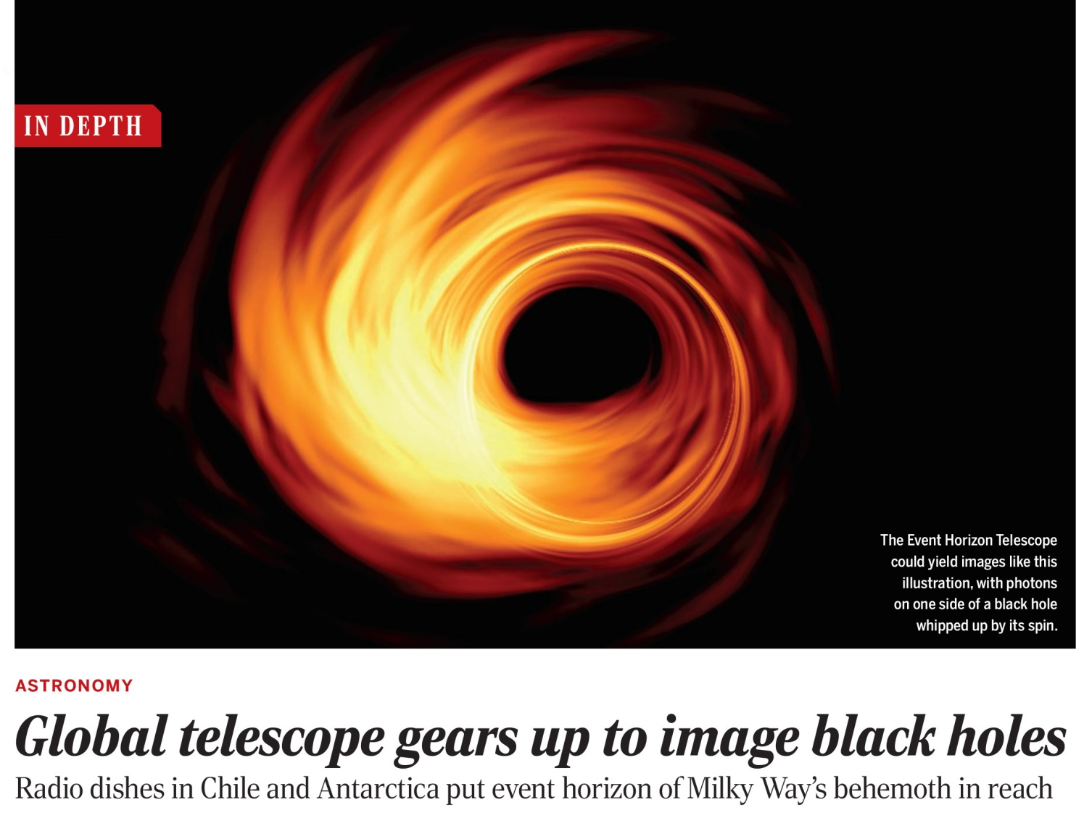
Hydrodynamic Simulation of Black Hole Accretion Disk
Science, 355, 893, March 21, 2017

Slide 34
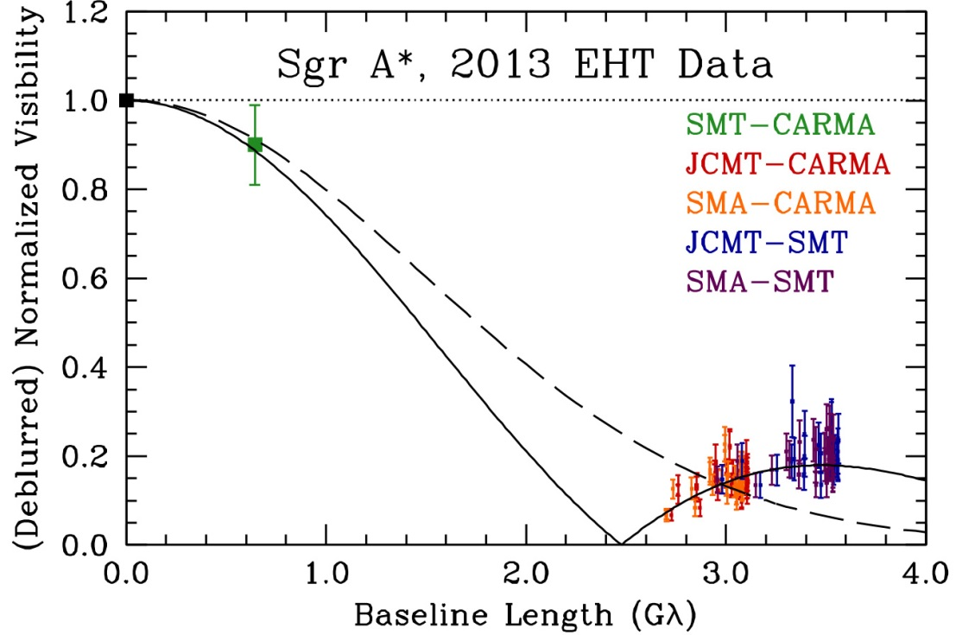
Pre-EHT (Maunakea–CARMA–SMT) Observations of SgrA* at 230 GHz
dashed line: circular Gaussian model (FWHM = 52 μas)
solid line: uniform annulus model
(inner diameter = 21 μas, outer diameter = 97 μas
Johnson … Inoue … et al., Science, 2015

