Slide 1
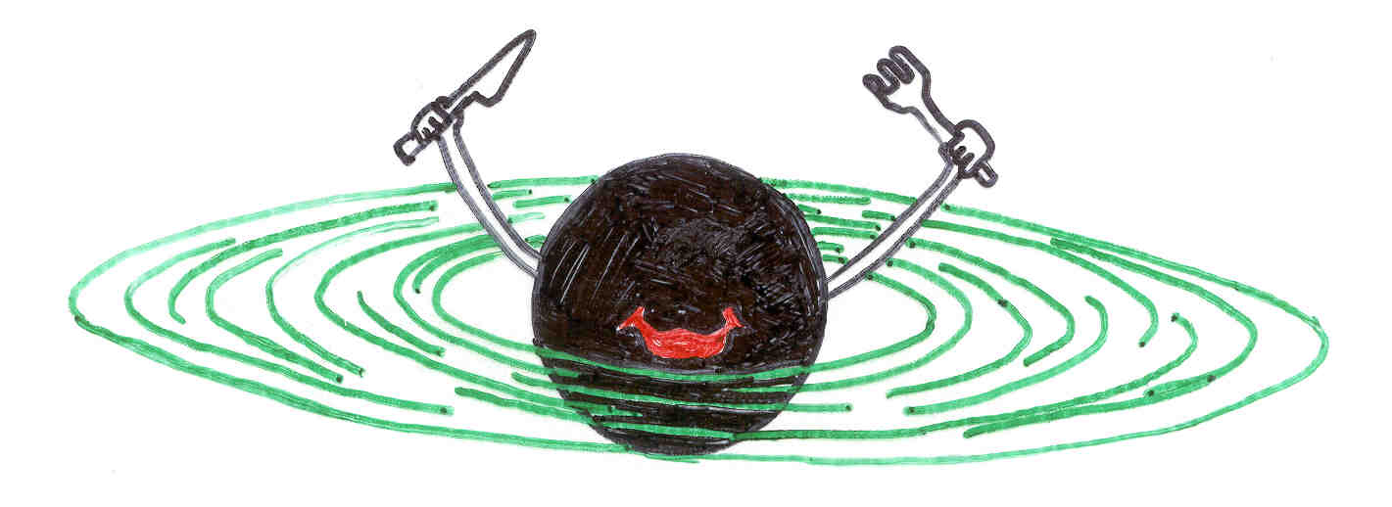
Probing the Black Hole in the Center of Our Galaxy at Radio through Submillimeter Wavelengths
by
James Moran
Harvard-Smithsonian Center for Astrophysics
Boston University Astrophysics Colloquium, October 6, 2014

Slide 2
Types of Cosmic Black Holes
1.
2.
“stellar” sized black holes found through the galaxy in binary stellar systems, M ∼ 10 M_{Sun}
“supermassive” black holes (SMBHs) found in the centers of most galaxies, M ∼ 10^{6–9} M_{Sun}

Slide 3
How to Detect Supermassive Black Holes?
1.
2.
3.
Explanation of massive radio jets emanating from galaxies
Track stars in orbit about unseen SMBH
Observe radio or X-ray emission from superheated gas in the inner accretion disk

Slide 4
Summary
The mass of the black hole in the Center of the Galaxy (Sgr A*) is about 4 x 10⁶ solar masses.
The accretion rate is about 10⁻⁸ solar masses per year.
The angular diameter of the radio emission from Sgr A* is about 37 microarcseconds at 1.3 mm wavelength.
The circular polarization is LCP at all wavelengths from 1 mm to 30 cm.
Linear polarization of compact structure is up to 80%, implying coherent structures.
The earth-mass object in orbit about the Galactic Center that has just passed perihelion has shown no effects at radio wavelengths (either increased accretion rate or bow shock).
EHT under development.

Slide 5
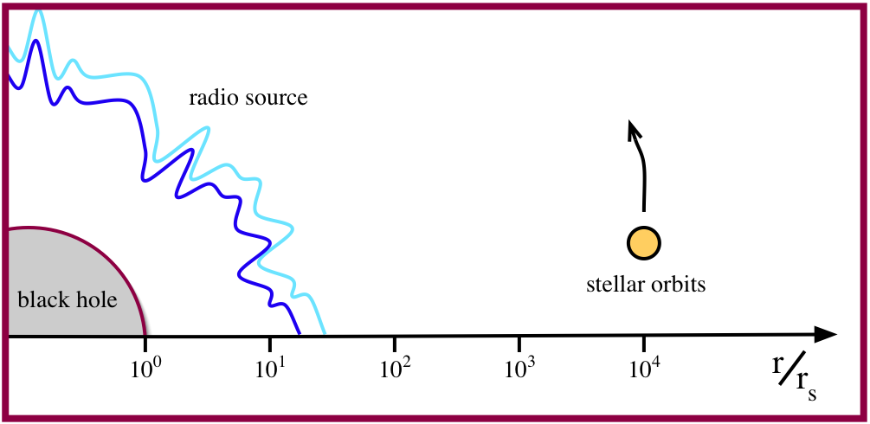
Some Scales in the Galactic Center
Luminosity ~ 300 L_{sun} or 10⁻⁹ Eddington

Slide 6
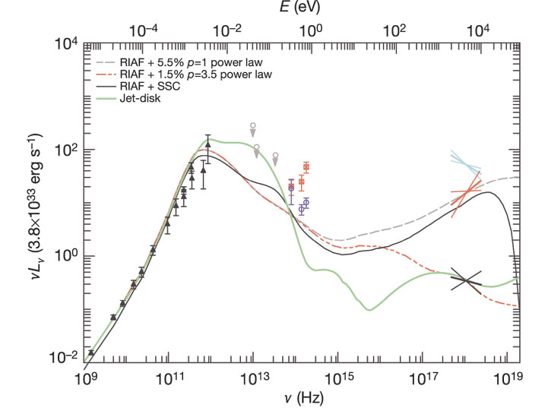
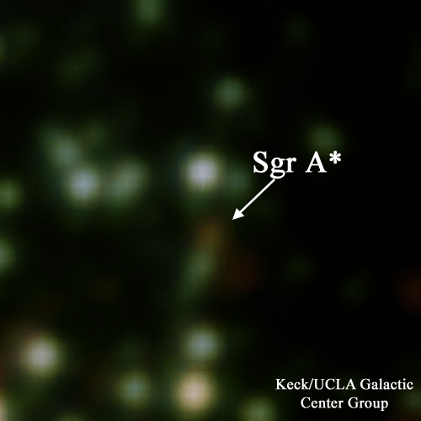
SgrA*: Spectral Energy Distribution
Very faint source still detectible at most astronomical observing bands
L_{SgrA*} ~ 300 L_{Sun} ~ 10^{–9} Eddington limit
Submm
Near IR
Radio
X-Ray
Genzel et al. 2004
IR flare (Hornstein et al. 2007)

Slide 7
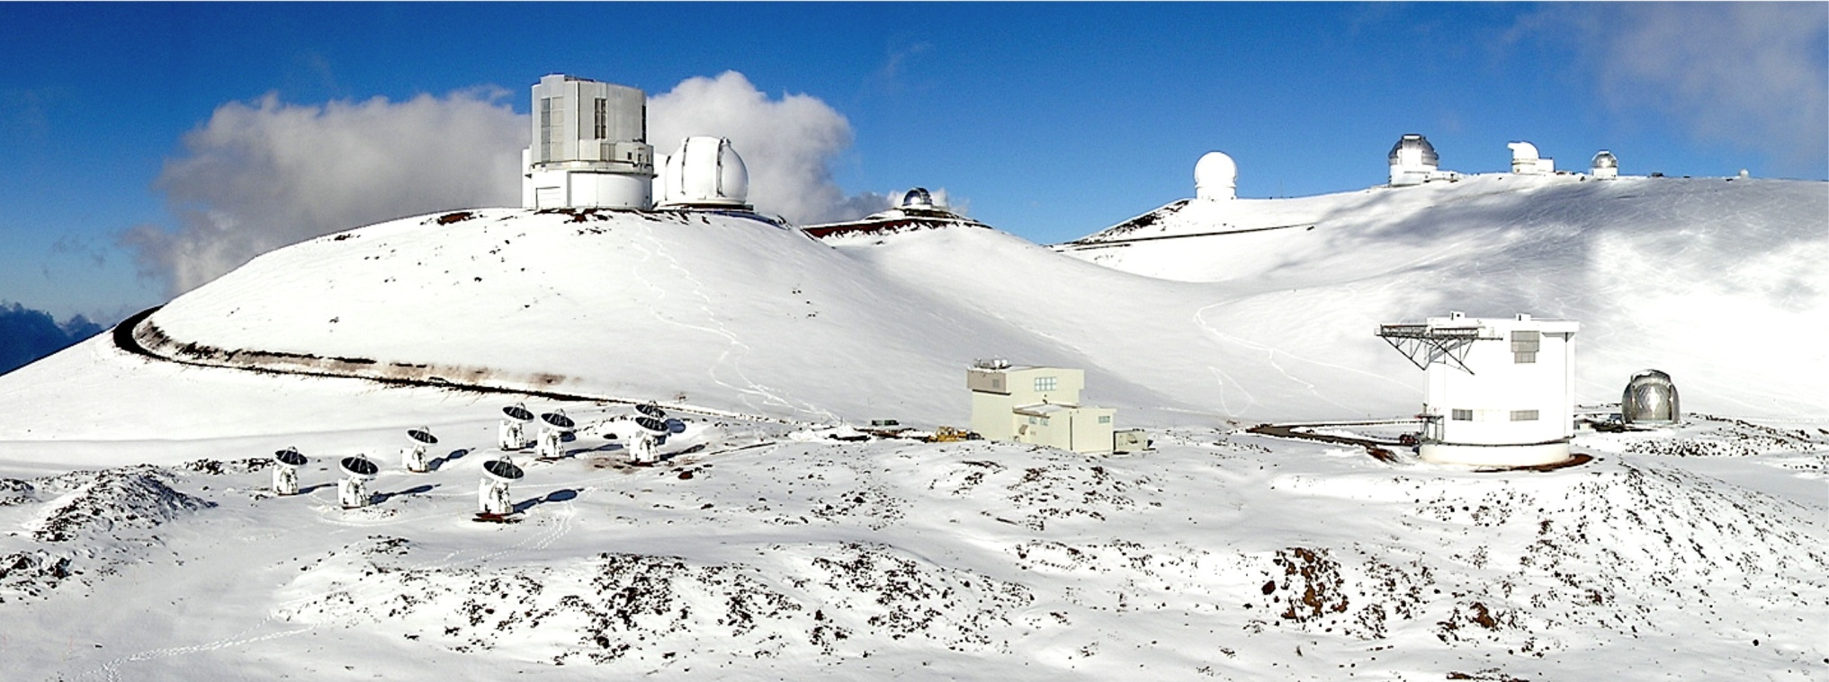
Mauna Kea Summit
Paul Yamaguchi, 2007
SMA
SMA control building
Frequency range: 200 – 900 GHz
Notes:
Summit view of the SMA in the compact configuration after a winter Pacific snow storm. The JCMT and CSO telescopes (middle right) are linked in to the SMA to form the eSMA.

Slide 8
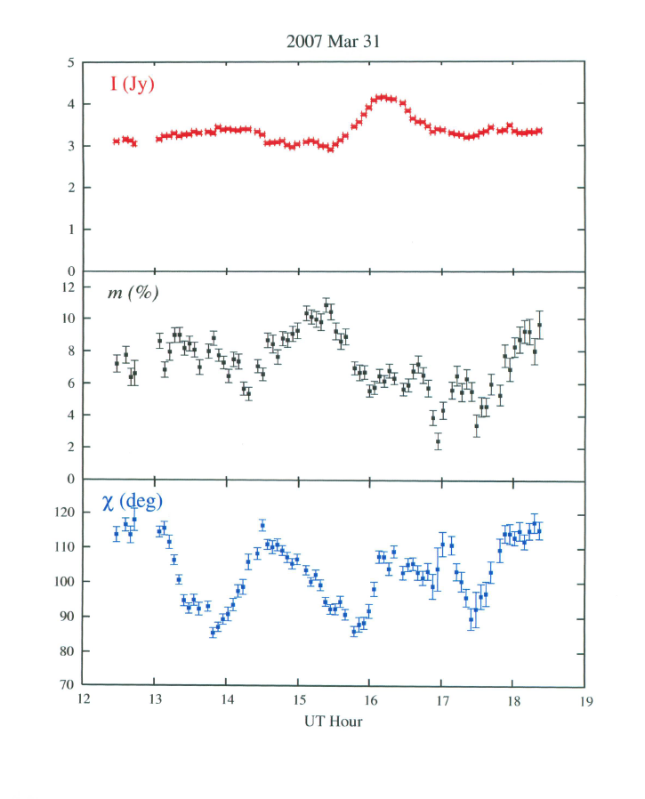
Polarization of Sgr A* at 230 GHz (1.3 mm) (SMA)
Marrone et al. 2007

Slide 9
Sgr A* Polarization Orientation at 230 GHz
Orbiting blob Model

Slide 10
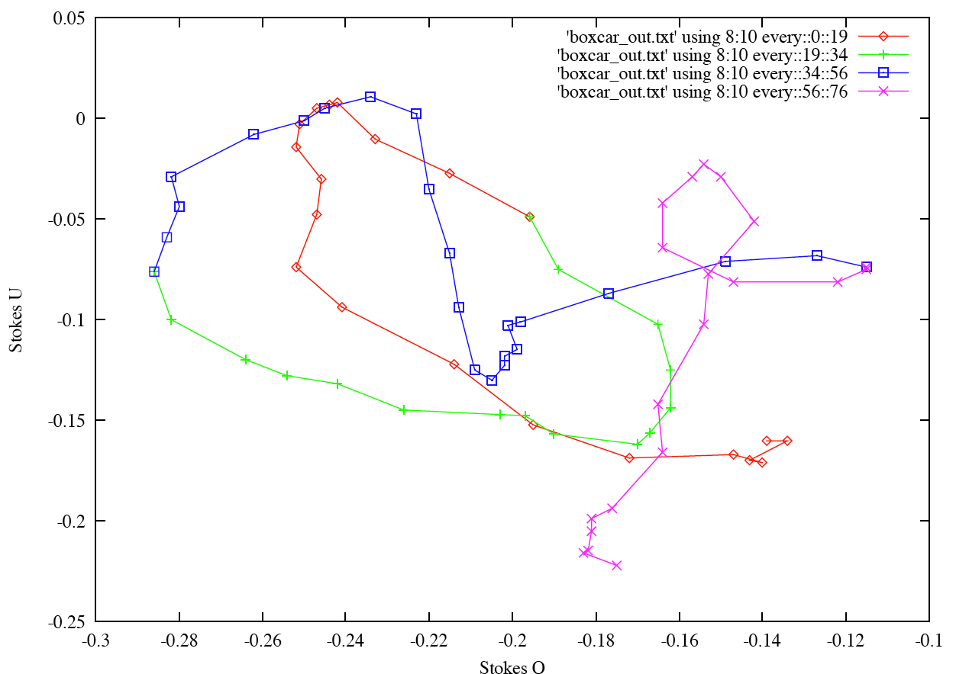
Polarization Track for 3/31/07 Observation of SgrA*
+
start
stop

Slide 11
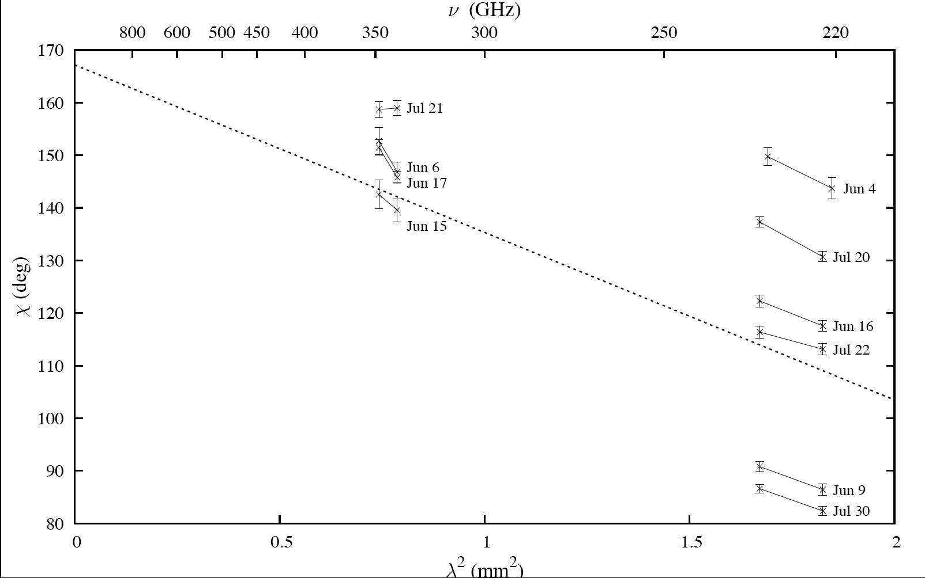
2005 SMA Measurements of
Faraday Rotation in Sgr A*
Important: SLOPE of polarization angle ~ constant in time at 230 GHz
Marrone et al. 2007

Slide 12
Accretion Rate and Faraday Rotation
χ
χ
(,t) = ₀(t) + ² RM(t)
⇩
RM = 8.1 x 10⁵  n_{e} B dl
×
RM = –5.1 x 10⁵ rad/m²
Assumptions
equipartition
density power law
inner radius cutoff of Faraday screen
Accretion rate = 10^{–9}–10^{–7} M_{Sun} /yr
Notes:
12

Slide 13
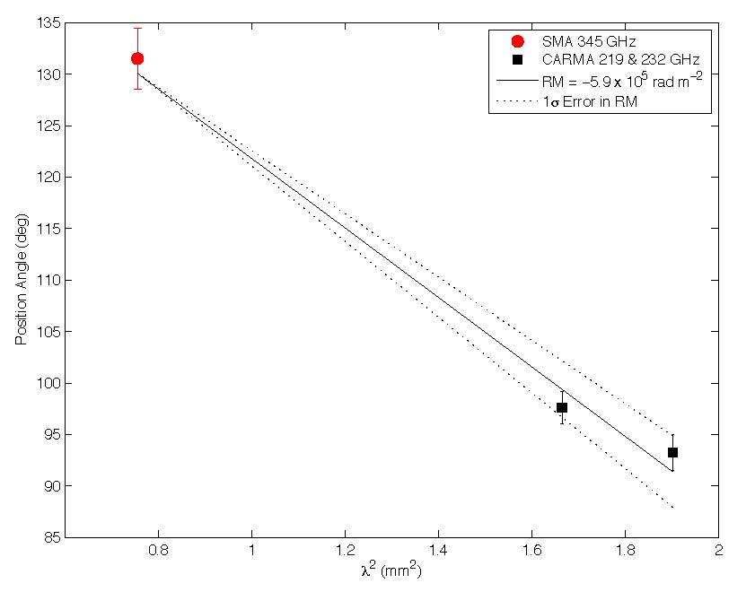
Polarization at Three Frequencies Simultaneously

Slide 14
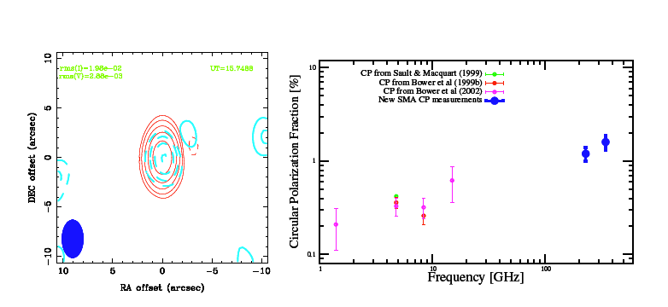
Circular Polarization of Sgr A*
Left handed CP at all frequencies measured!!
(red) Stokes I
(blue) Stokes V
Fractional Circular Polarization
vs. Frequency
Munoz, Marrone, Moran, and Rao 2012

Slide 15
Faraday Conversion in Sgr A*
τ = 1 surface
ν
GHz
230
22
1.4
θ_{τ =1}
R_{s}
6
80
1600
θ_{τ =1} (diameter)
mas
0.06
0.8
16
BH
Range of τ = 1 surface between 1.4 and 230 GHz: ~350
(based on R_{τ =1} ~ ν ^{-1.1})
Faraday conversion phase shift
input
signal
φ = 10⁹ L B⁴λ³ = π/2 (optimum)
B = magnetic field in Gauss
L = length in pc
λ = wavelength in m
mode direction
mode direction in
ultrarelativistic plasma

Slide 16
Animation of Accretion Object Discovered by Genzel Group, 2012

Slide 17
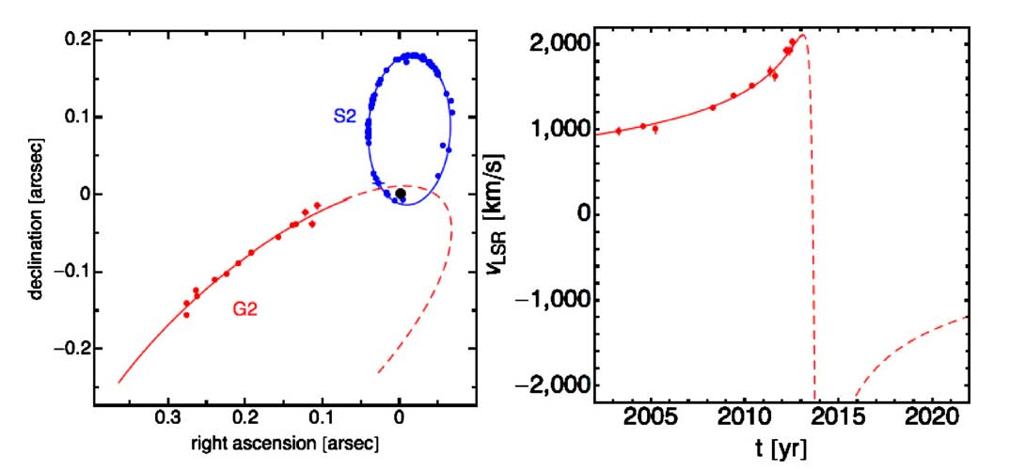
Predicted Orbit of G2 – earth mass cloud approaching Sgr A*
Gillessen et al., Ap.J. 767, 1, February 1, 2013

Slide 18
G2
Latest orbit information (Gillessen et al., ApJ., 763, 78, Feb. 1, 2013)
Closest approach 2013.7 at 3 x 10¹⁵ cm (2200 R_{s})
Velocity ~ 3,000 km/s (c/1,000)
Orbital period ~ 198 years
Mass ~ 1.7 x 10²⁸ grams = 10⁻⁵ M_{sun}
Could brighten by 100!
f = 100
f = flux density change
.
(
)
(
)
T
10 yrs
M
10⁻⁸ M_{sun}/yr

Slide 19
SMA Flux Monitoring June 1, 2013 – September 15, 2014

Slide 20
Flux Density at 230 GHz

Slide 21
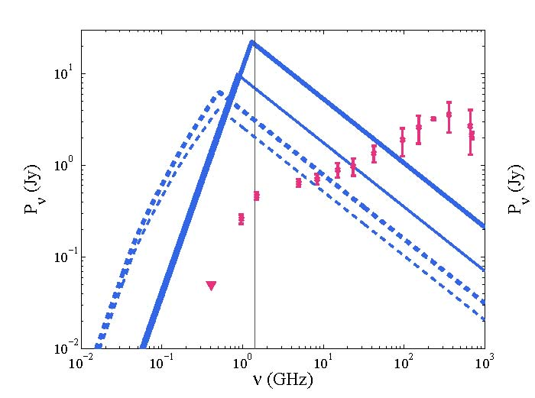
Bow Shock Emission Model for G2: August 2013
Sadowski, Sironi, Abarca, Guo, Ozel and Narayan, MNRAS, 432, 478, 2013
Also: Narayan, Ozel and Sironi, ApJ(L) , 757, L20, 2012

Slide 22
Flux Density of Sgr A* at 10.0 and 32.0 GHz

Slide 23
Black Hole “image” Dominated by GR
The black hole “shadow”
(Bardeen 1973; Falcke, Agol, Melia 2000; Johannsen and Psaltis 2010)
Measuring the shadow gives Mass.
(Johannsen, Psaltis et al. 2012)
Maximally spinning BH
Free fall envelope
D_{shadow} = 9/2 * R_{s}
Non-spinning BH
Rotating accretion envelope
D_{shadow} = sqrt(27) * R_{s}

Slide 24
Observing Strong GR Signatures
Innermost Stable Circular Orbit (ISCO) Size
Sky & Telescope
Max. Prograde
ISCO_D = 1 R_{s}
No Spin
ISCO_D = 6 R_{s}
Max Retrograde
ISCO_D = 9 R_{s}

Slide 26
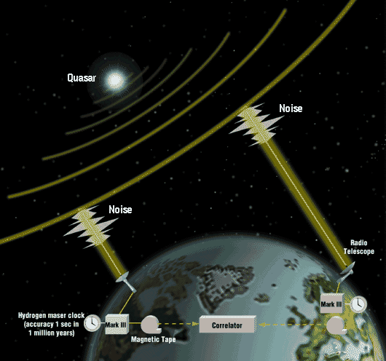
VLBI: An Earth Sized Telescope
Resolution:
λ/D (cm) ~ 0.5 mas
λ/D (1.3mm) ~ 30 μas
λ/D (0.8mm) ~ 20 μas
ISM Scattering:
Θscat ~ λ²

Slide 27
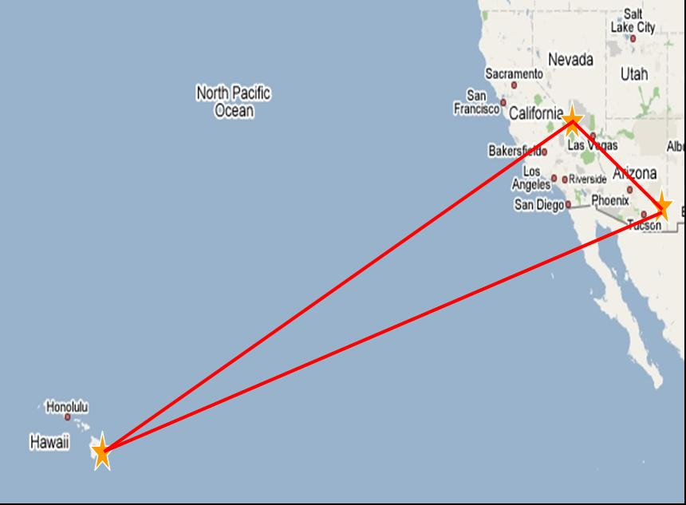
1.3 mmλ (230 GHz) Observations of Sgr A*
908km
4030km
4630km
VLBI program led by a large consortium led by Shep Doeleman, MIT/Haystack/CfA

Slide 28
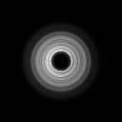
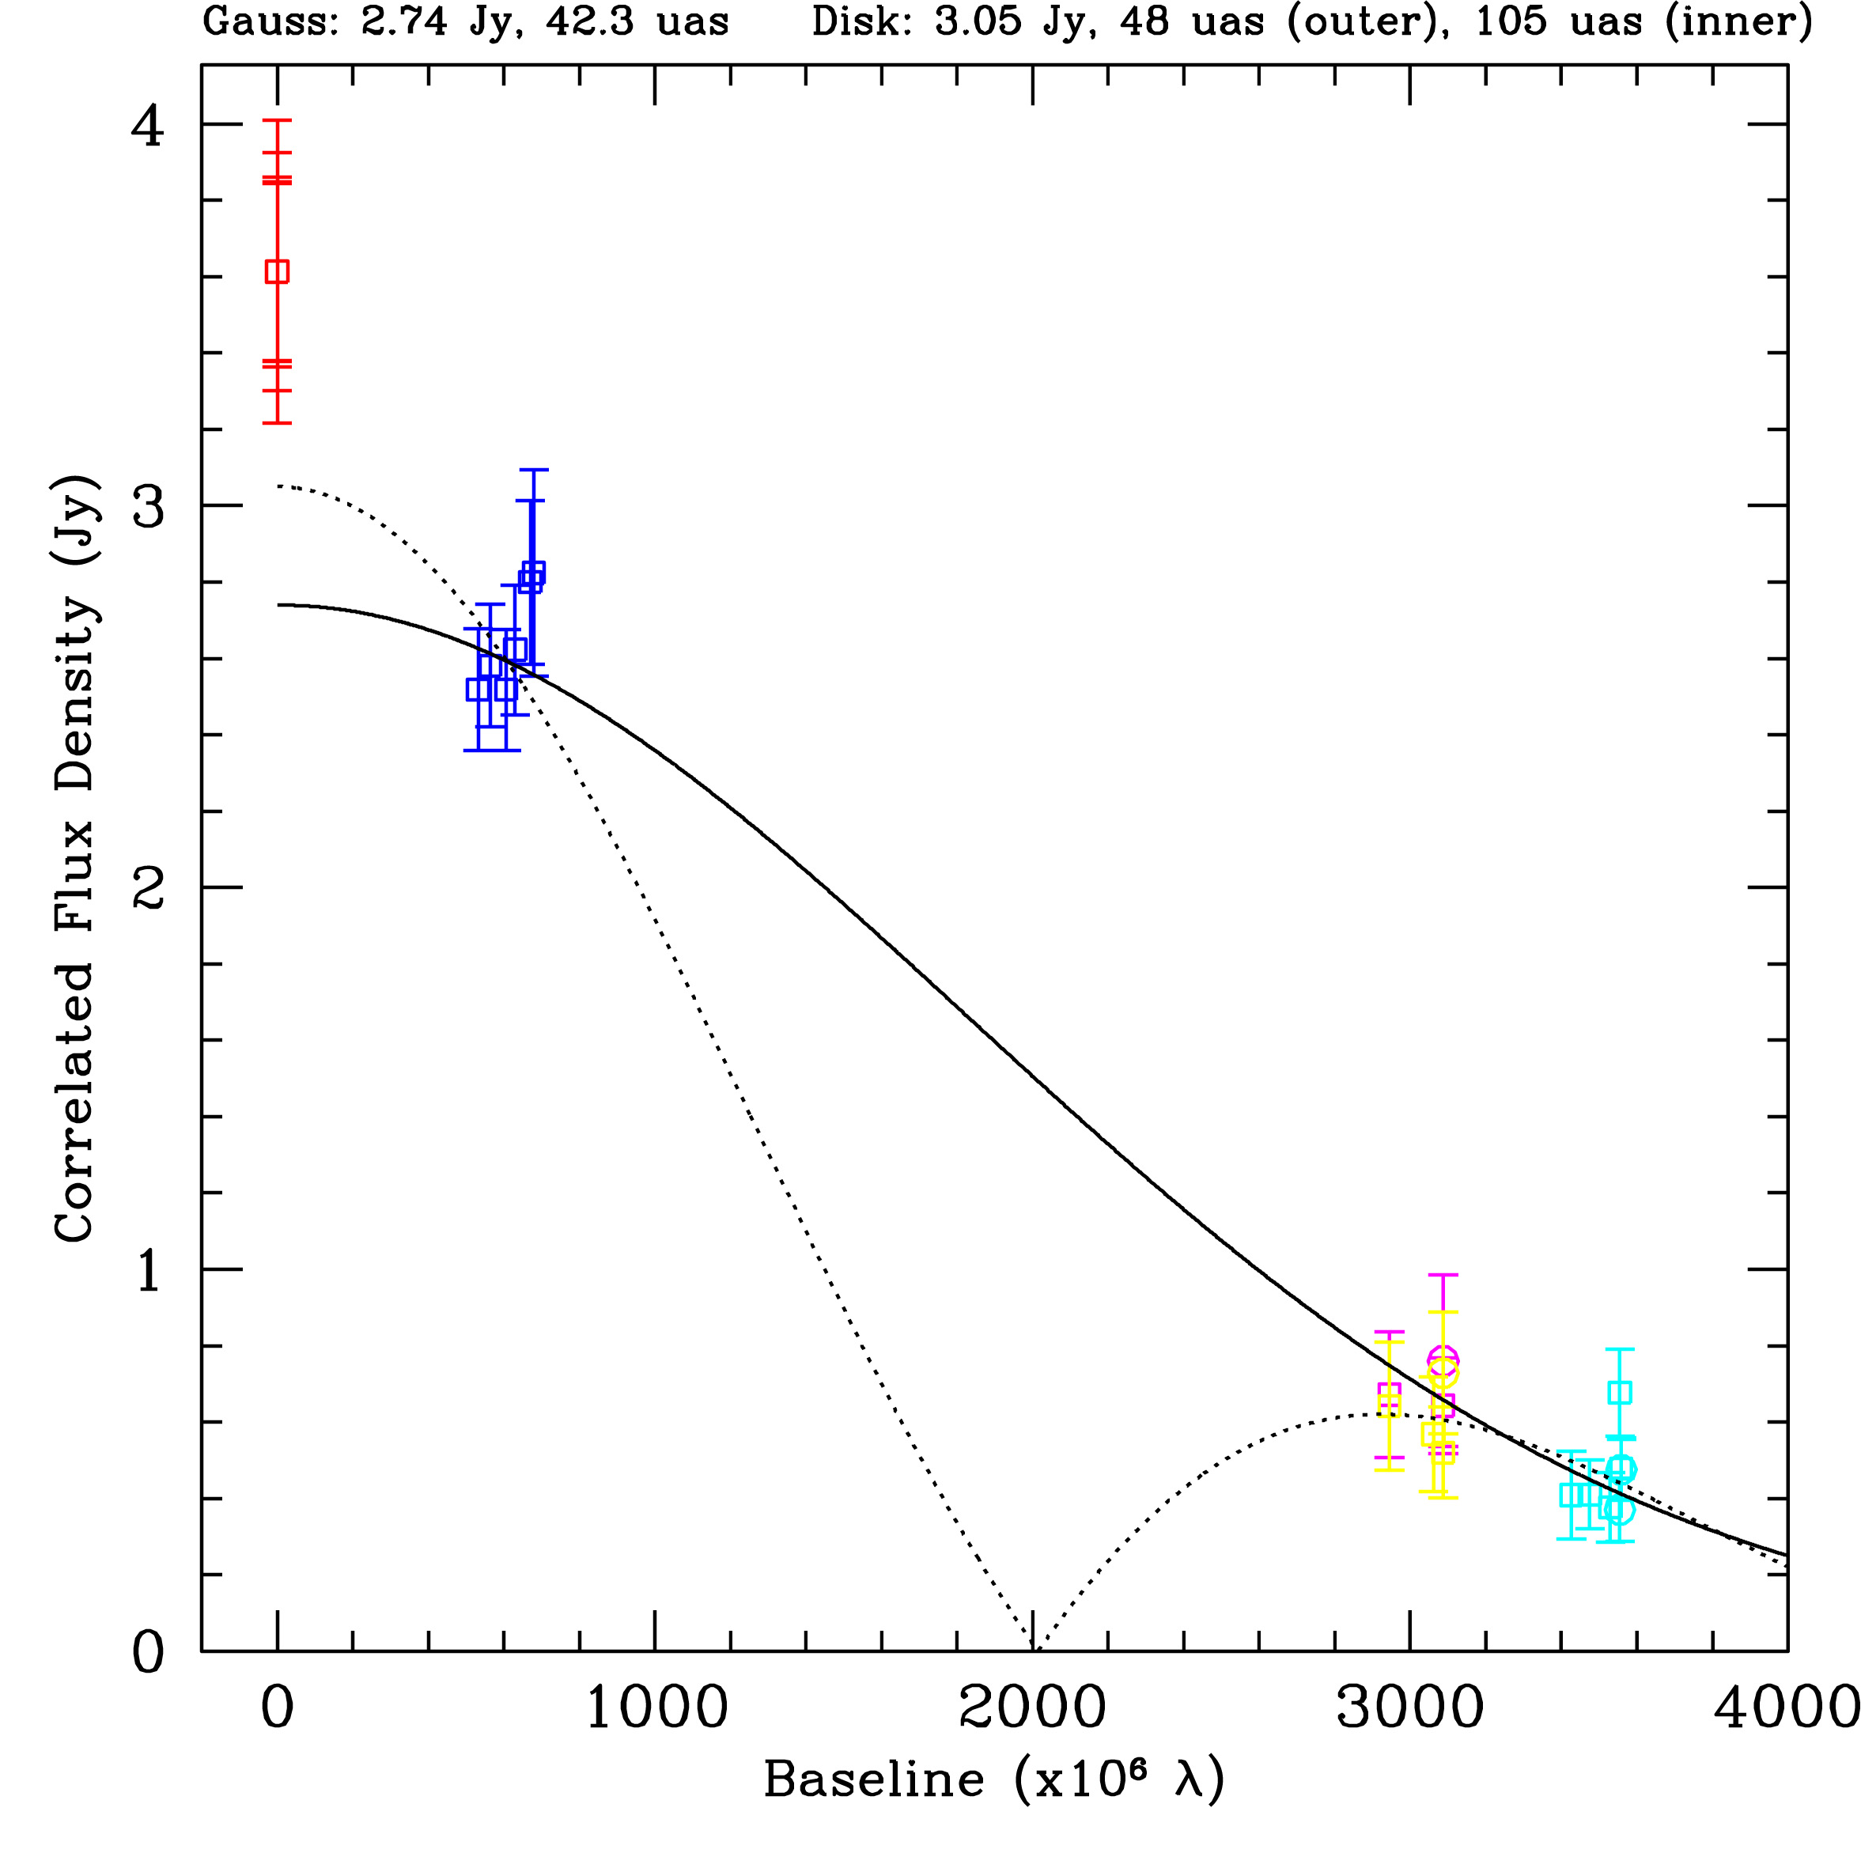
Gaussian and Torus Fit to Visibility Data
14 Rsch (140as) 
Gammie et al.
Doeleman et al. 2008; Fish et al. 2011

Slide 29
Seeing Through the Scattering
_{OBS} deviates
from scattering
for    cm
_{INT}  _{SCAT}
for    mm
_{INT}  

Slide 30
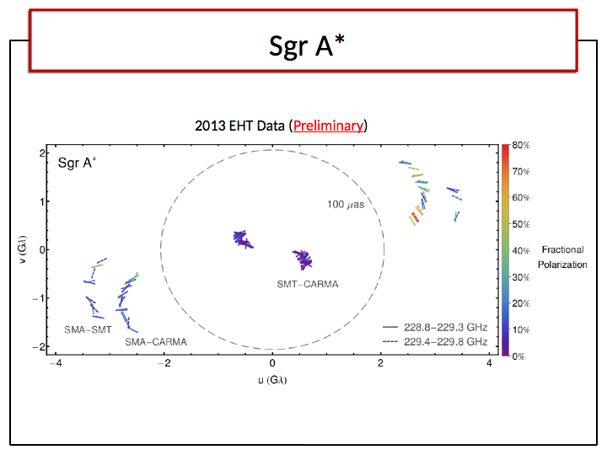
M. Johnson et al. (in prep)

Slide 31
Event Horizon Telescope Collaboration
MIT Haystack: Shep Doeleman, Alan Rogers, Vincent Fish, et al.
NAOJ: Mareki Honma, Tomoaki Oyama, Kazunori Akiyama
U. Arizona Steward Obs: Lucy Ziurys, Robert Freund, Dan Marrone
Harvard CfA: Jonathan Weintroub, Jim Moran, Ray Blundell, et al.
CARMA: Dick Plambeck, Mel Wright, David Woody, Geoff Bower
NRAO: John Webber, Ray Escoffier, Rich Lacasse
Caltech Submillimeter Observatory: Richard Chamberlin
UC Berkeley SSL: Dan Werthimer
MPIfR: Thomas Krichbaum, Anton Zensus, Alan Roy, et al.
IRAM: Michael Bremer, Karl Schuster
APEX: Karl Menten, Michael Lindqvist
James Clerk Maxwell Telescope: Remo Tilanus, Per Friberg
ASIAA: Paul Ho, Makoto Inoue, Keiichi Asada
U. Concepcion: Neil Nagar

Slide 32
Short-Term Goals of EHT
2014 LMT Checkout
2015 ALMA Phased Array Ready
2015 SPT Ready
2015 2 GHz Bandwidth

Slide 33
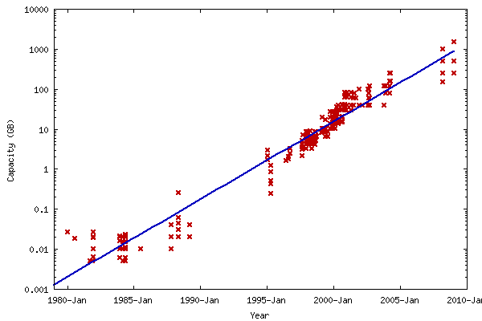
Disk Capacity vs. Year

Slide 34
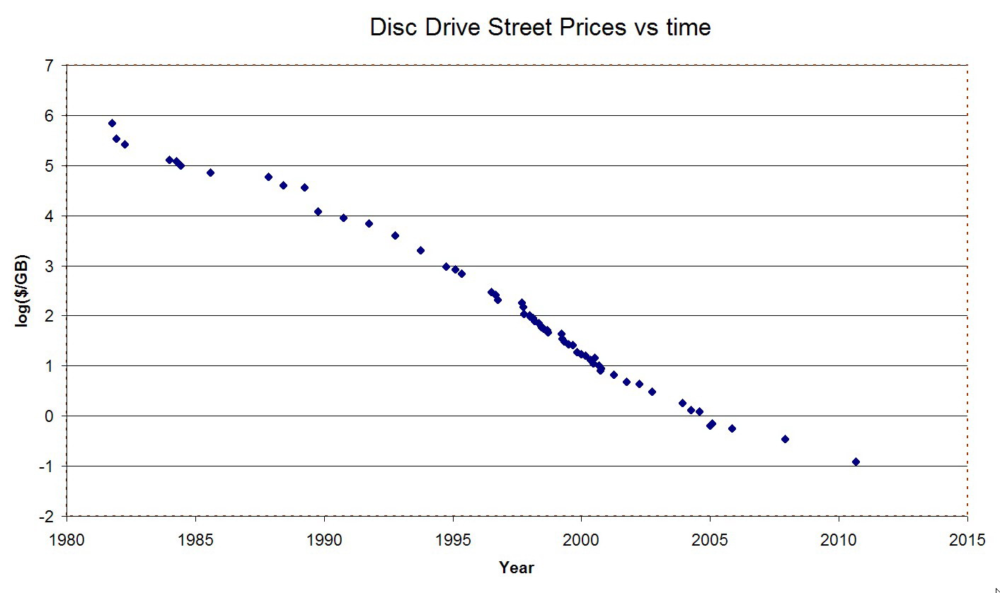

Slide 35
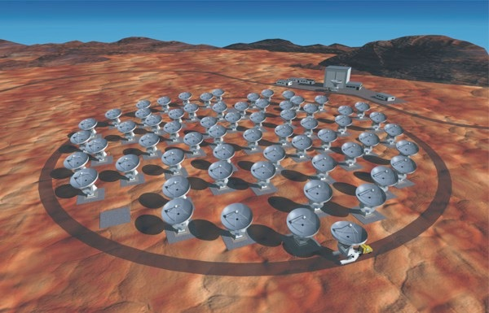
Phasing ALMA
Single most important objective for EHT.
Increases resolution by x2, sensitivity by x10.
First ALMA VLBI scheduled 2014/2015.

Slide 36
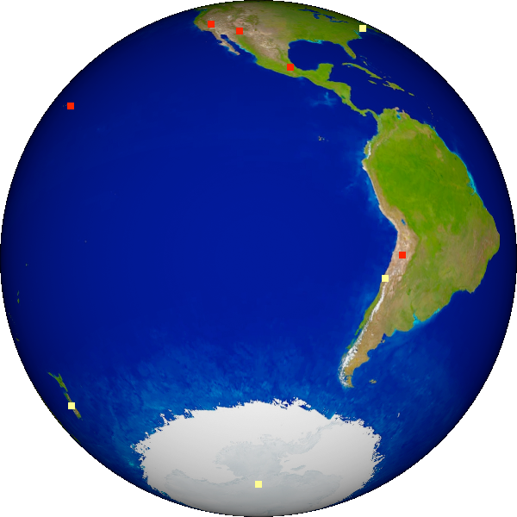
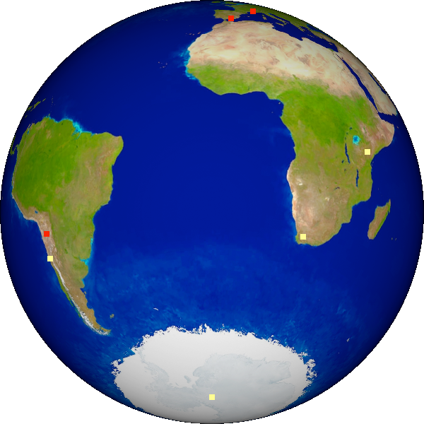
SgrA*’s view of the EHT
GLT - Greenland
CARMA
SMT
IRAM
SMA
JCMT
LMT
ALMA
APEX
SPole
SPole

Slide 37
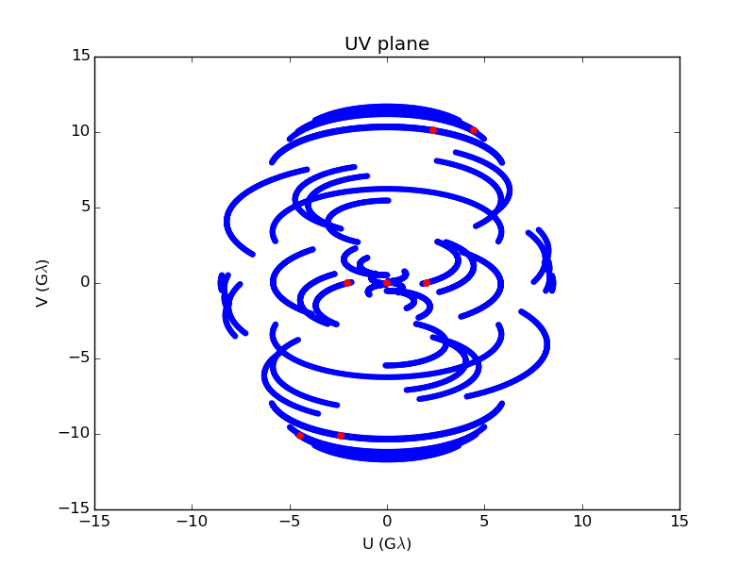
EHT, seen by Sgr A* near future
For 1 mm
Hawaii
Chile
California
Arizona
Spain
France
South Pole
Mexico
Courtesy of L. Vertatschitsch

Slide 38
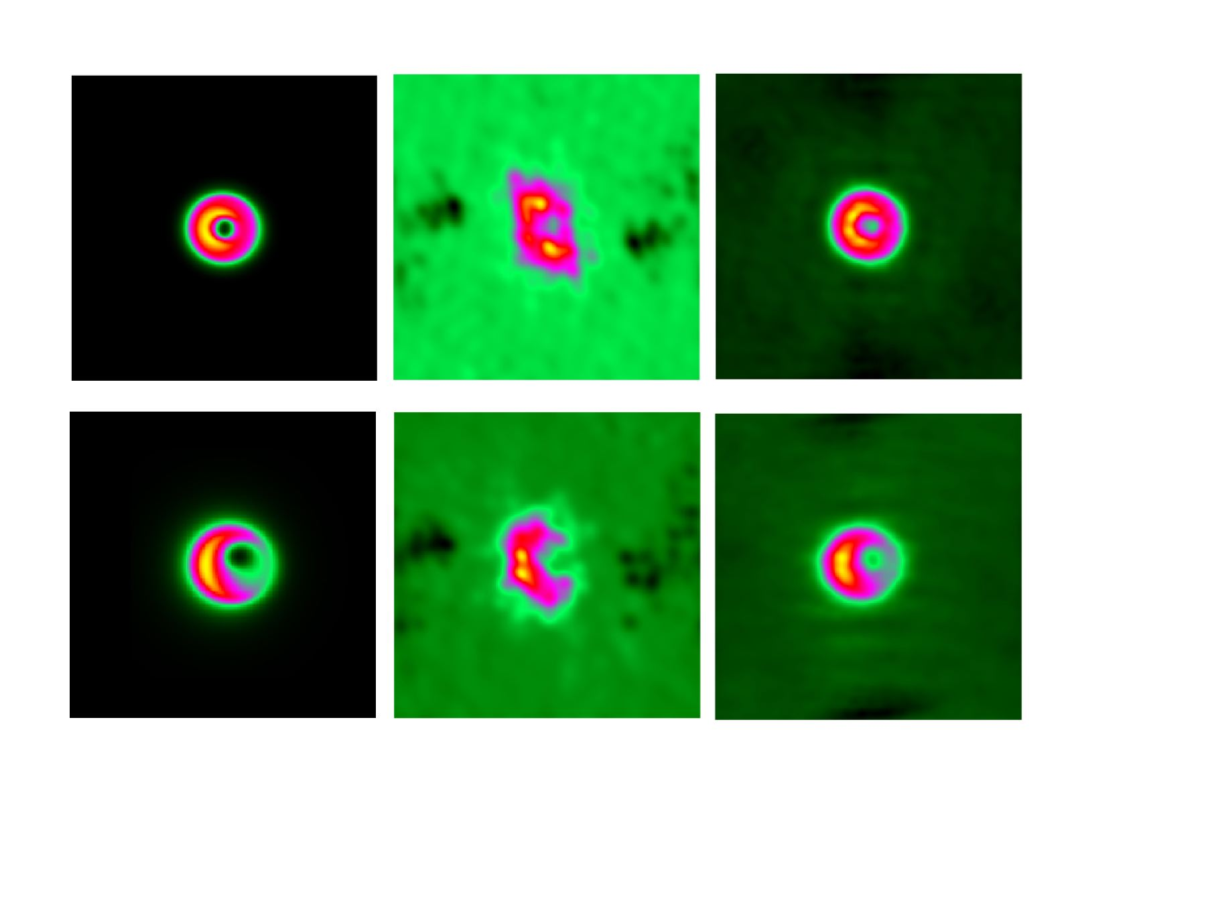
Progression to an Image
GR Model
7 station
13 station
Doeleman et al., “The Event Horizon Telescope,” Astro2010: The Astronomy and Astrophysics Decadal Survey, Science White Papers, no. 68

Slide 39
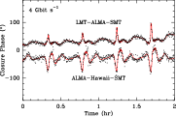
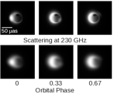
Time Resolving BH Orbits
Full EHT can measure closure phase on 10s intervals (25 times faster than smallest ISCO Period).

Slide 40
Summary
The mass of the black hole in the Center of the Galaxy (Sgr A*) is about 4 x 10⁶ solar masses.
The accretion rate is about 10⁻⁸ solar masses per year.
The angular diameter of the radio emission from Sgr A* is about 37 microarcseconds at 1.3 mm wavelength.
The circular polarization is LCP at all wavelengths from 1 mm to 30 cm.
Linear polarization of compact structure is up to 80%, implying coherent structures.
The earth-mass object in orbit about the Galactic Center that has just passed perihelion has shown no effects at radio wavelengths (either increased accretion rate or bow shock).
EHT under development.

