Slide 1
The Galactic Center: From the Black Hole to the Minispiral
Jim Moran
Harvard-Smithsonian Center for Astrophysics
Institut d’Astrophysique de Paris and Observatoire de Paris
October 8, 2010
Notes:
MBH – paradigm, useful but dangerous, need to really push techniques to make MBH case solid.

Slide 2
The Galactic Center on Three Size Scales
1. Circumnuclear (molecular) Disk (CND)
and Minispiral (ionized streamers)
120 arcs / 5 pc
Zhao, Blundell, Downes, Schuster, Marrone
2. Black hole accretion envelope (100 R_s)
1 mas / 0.3 micro pc
Marrone, Munoz, Rao
3. SgrA* radio source
37 microarcseconds / 0.01 microparsec
Doeleman et al.

Slide 3
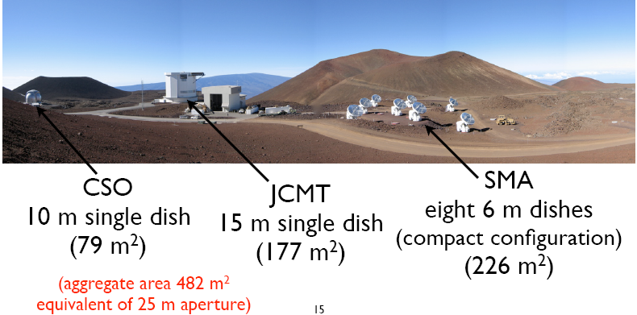
Submillimeter Valley, Mauna Kea, HI

Slide 4
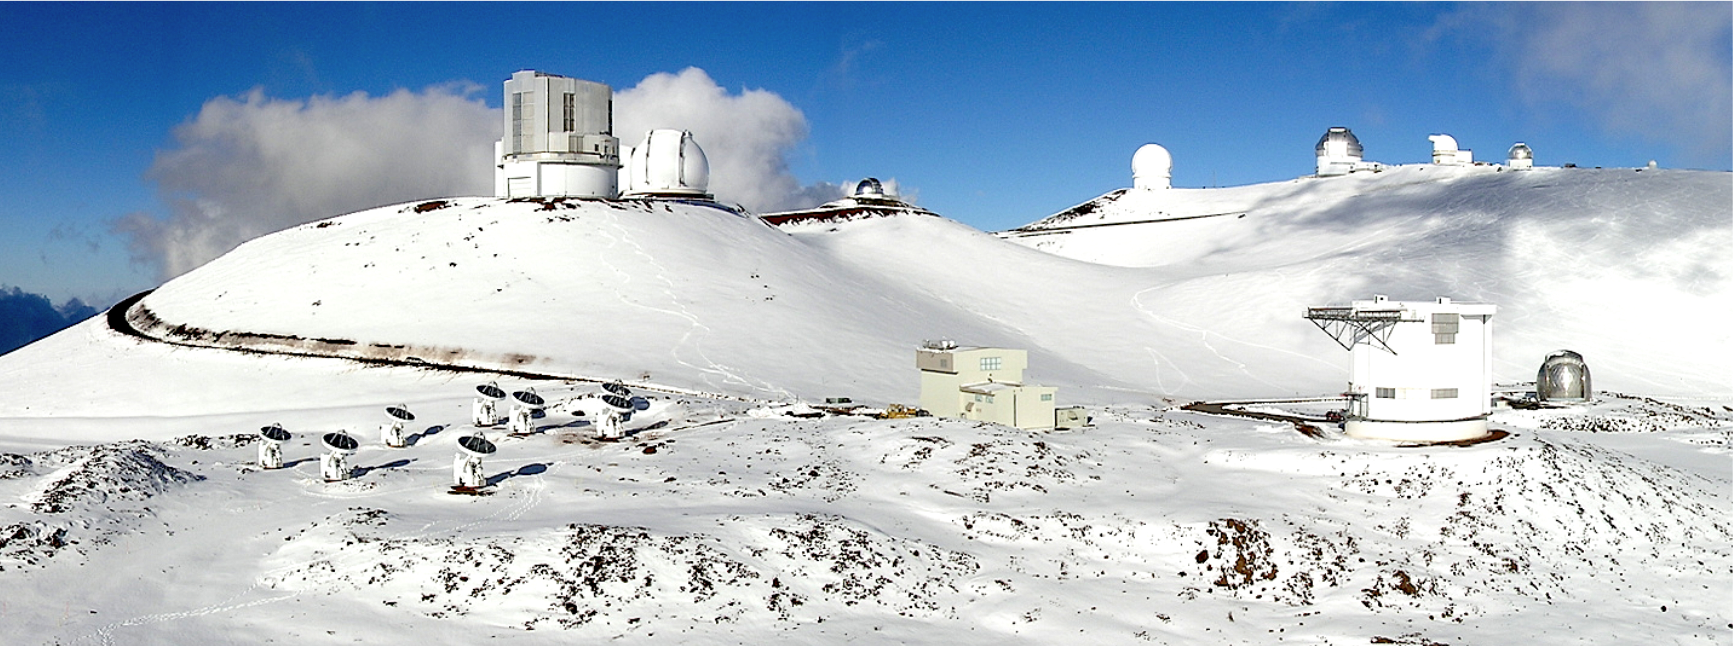

Slide 5
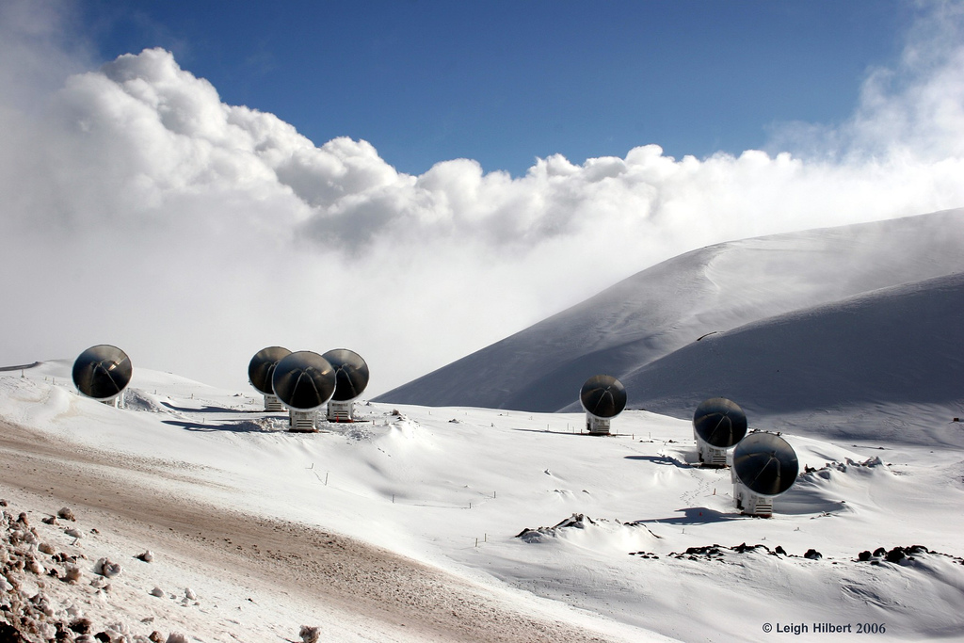

Slide 6
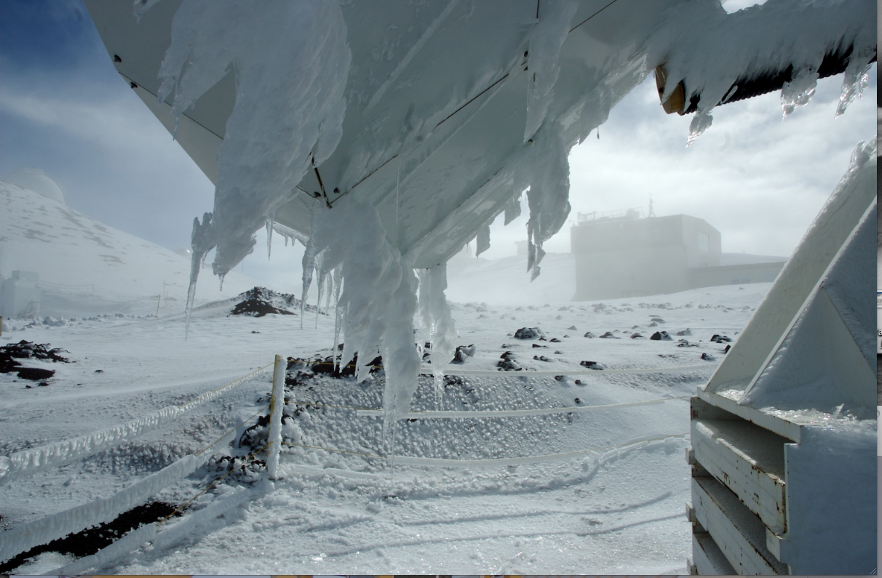

Slide 7
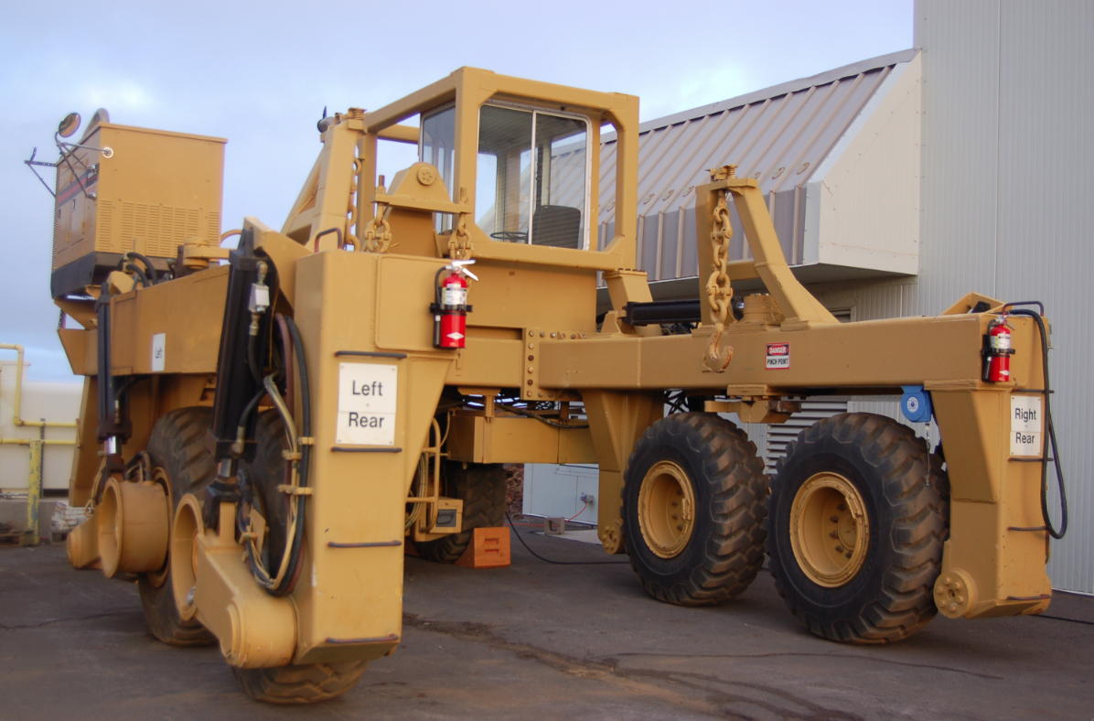

Slide 8
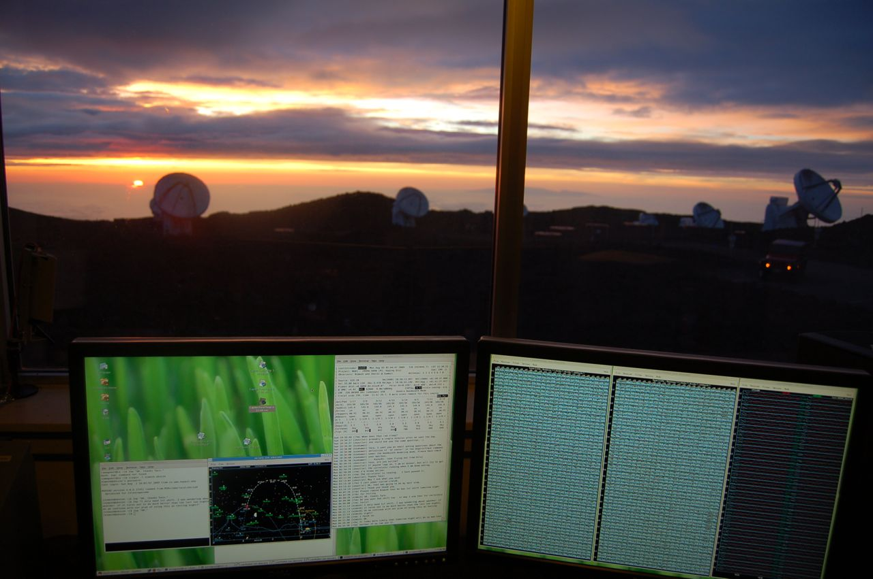

Slide 9
Nine-Field Mosaic Image of
Circumnuclear Disk in Galactic Center
CN
H₂CO
SiO
SMA Data
Sergio Martin Ruiz
5 arcmin field
3 arcs resolution
1.3 mm wavelength

Slide 10
Galactic Center CND with 230 GHz
Continuum from Ionized Minispiral

Slide 11
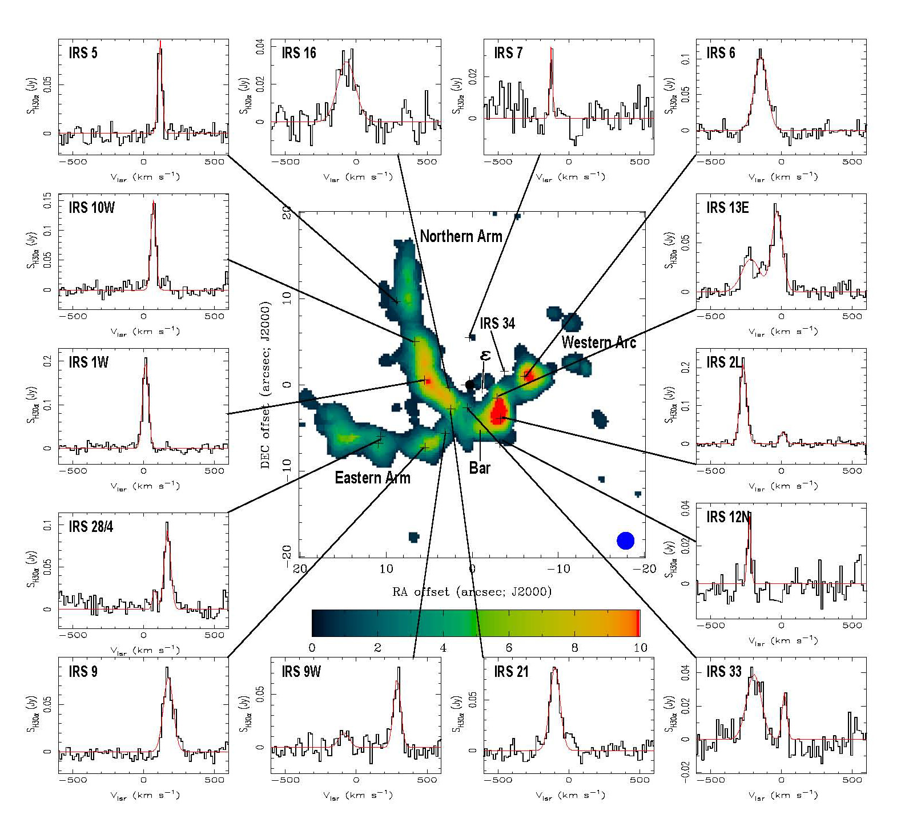
H30 Recombination Line at Prominent Locations

Slide 12
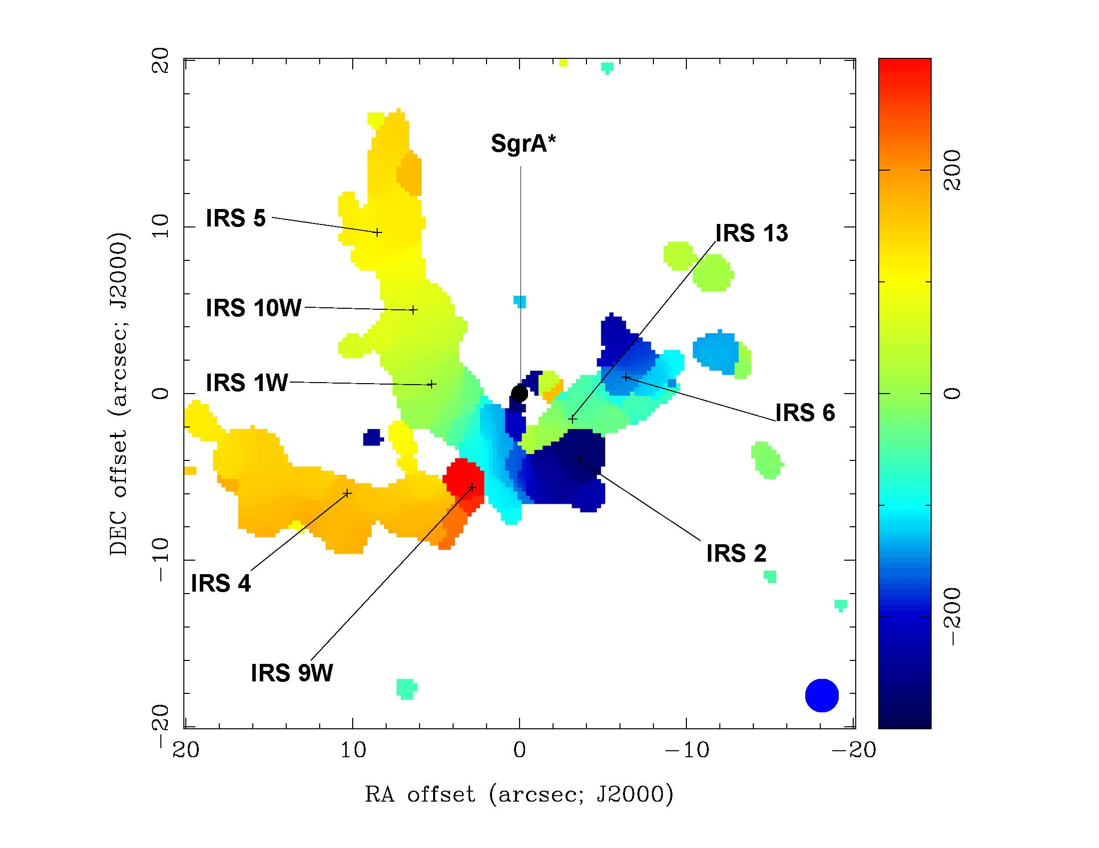
Velocity Distribution of Gas Traced by H30 Emission

Slide 13
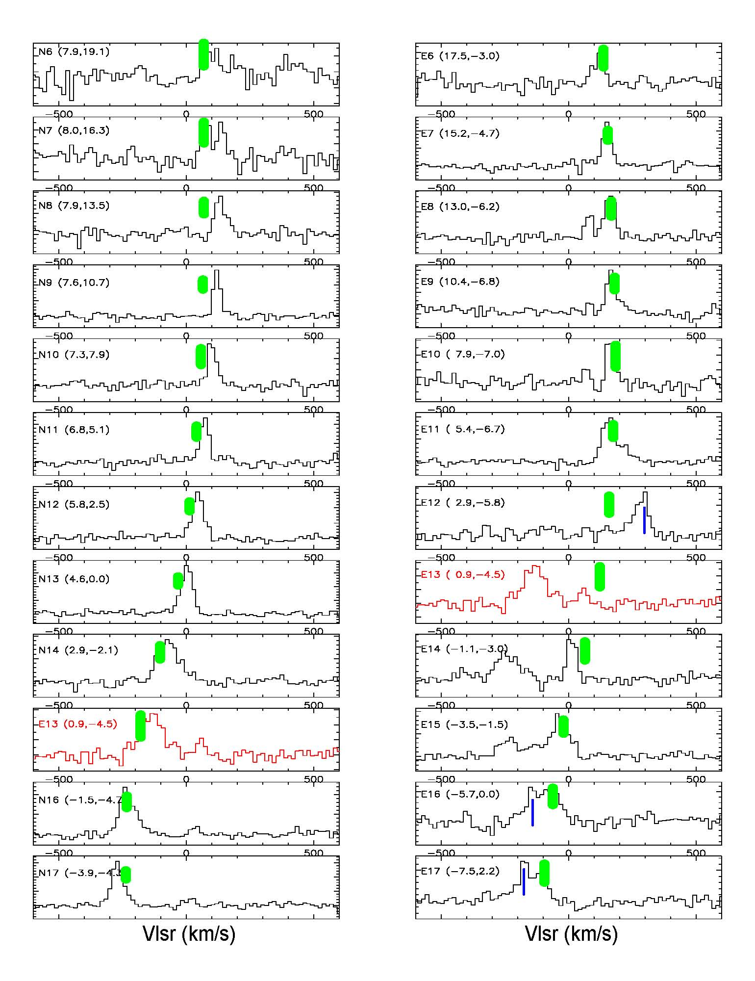
Keplerian Radial Velocity Model

Slide 14
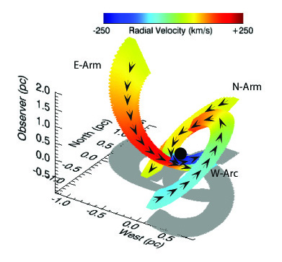
Three-Dimensional Geometry of Minispiral Arms
Observer above
Gray image is in the sky projection

Slide 15
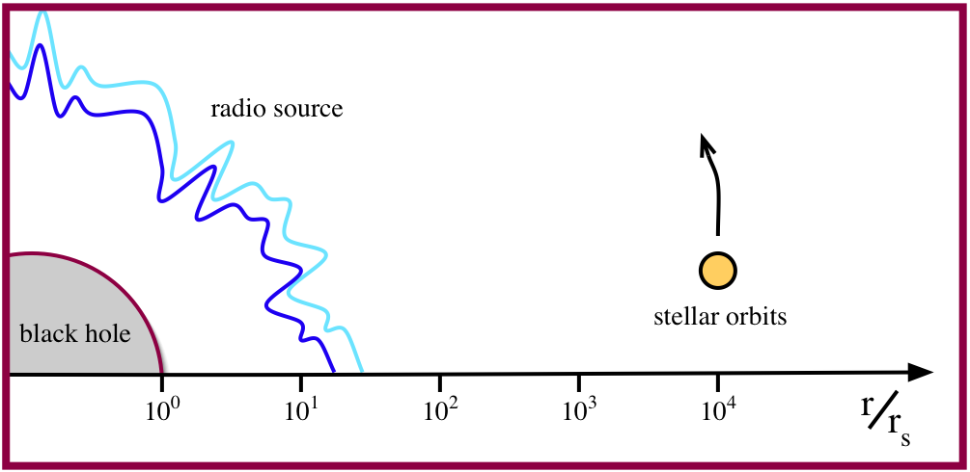
Some Scales in the Galactic Center
accretion flow

Slide 16
A Hungry Black Hole

Slide 17
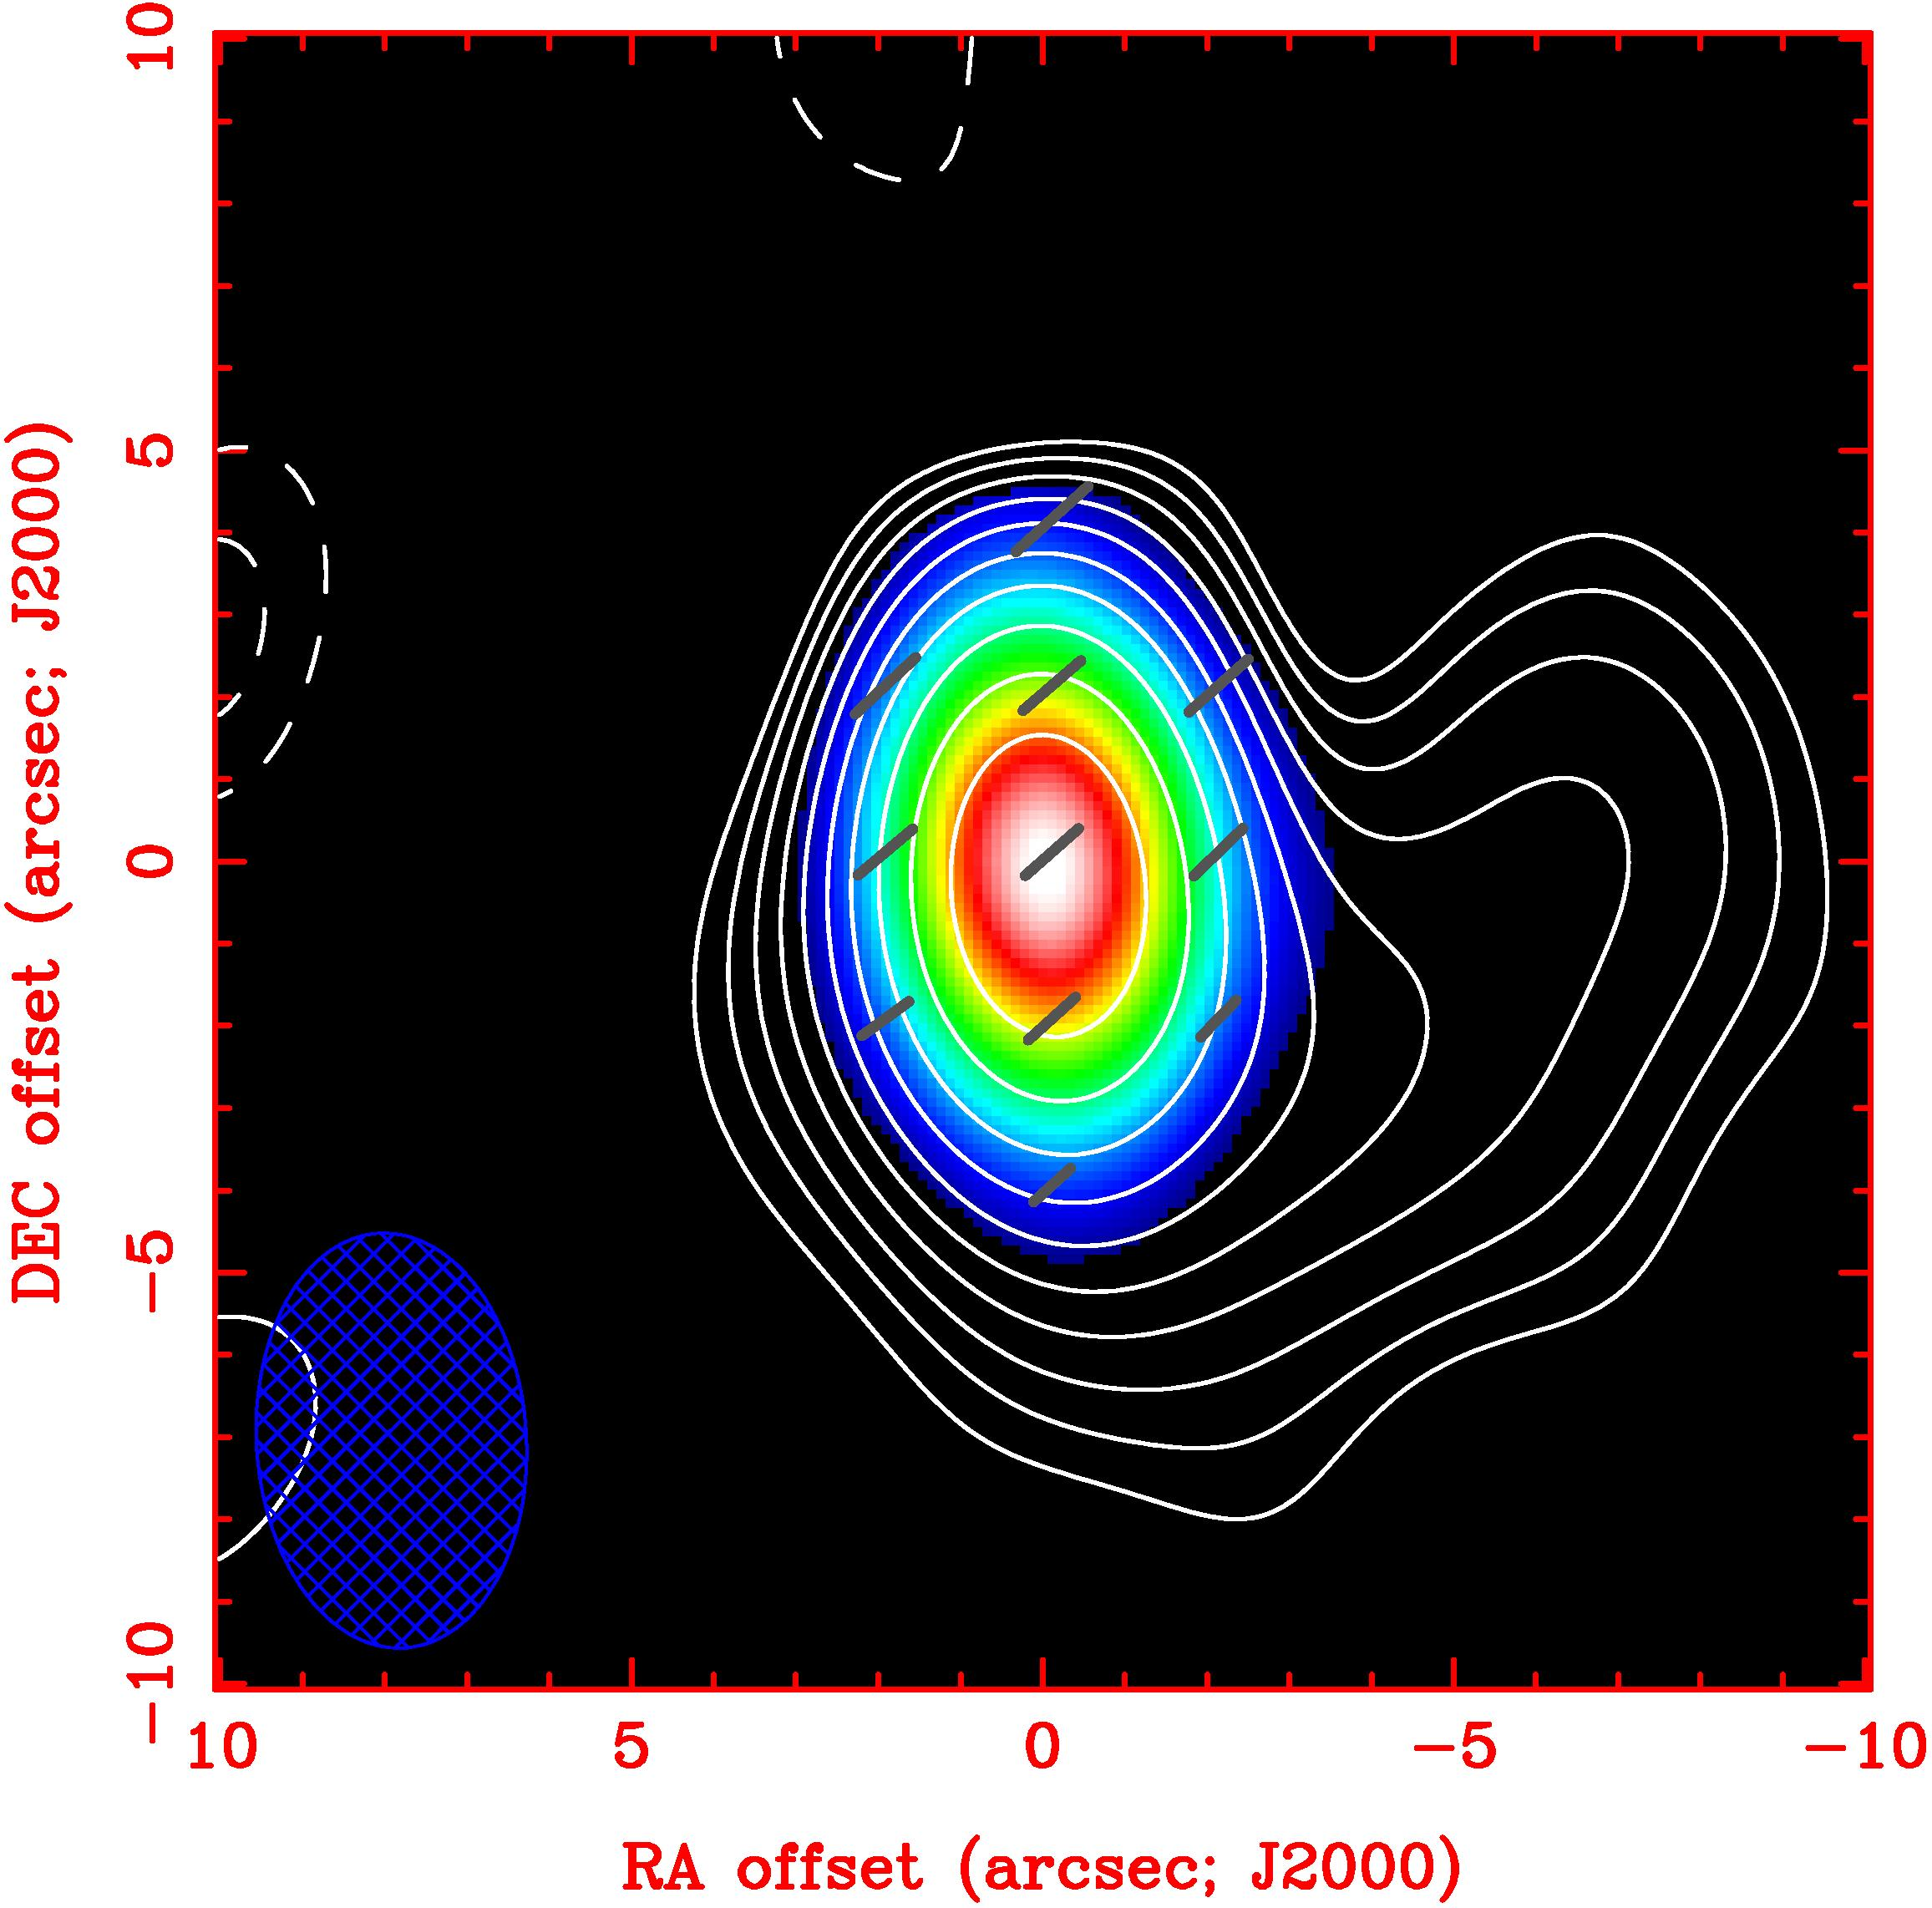
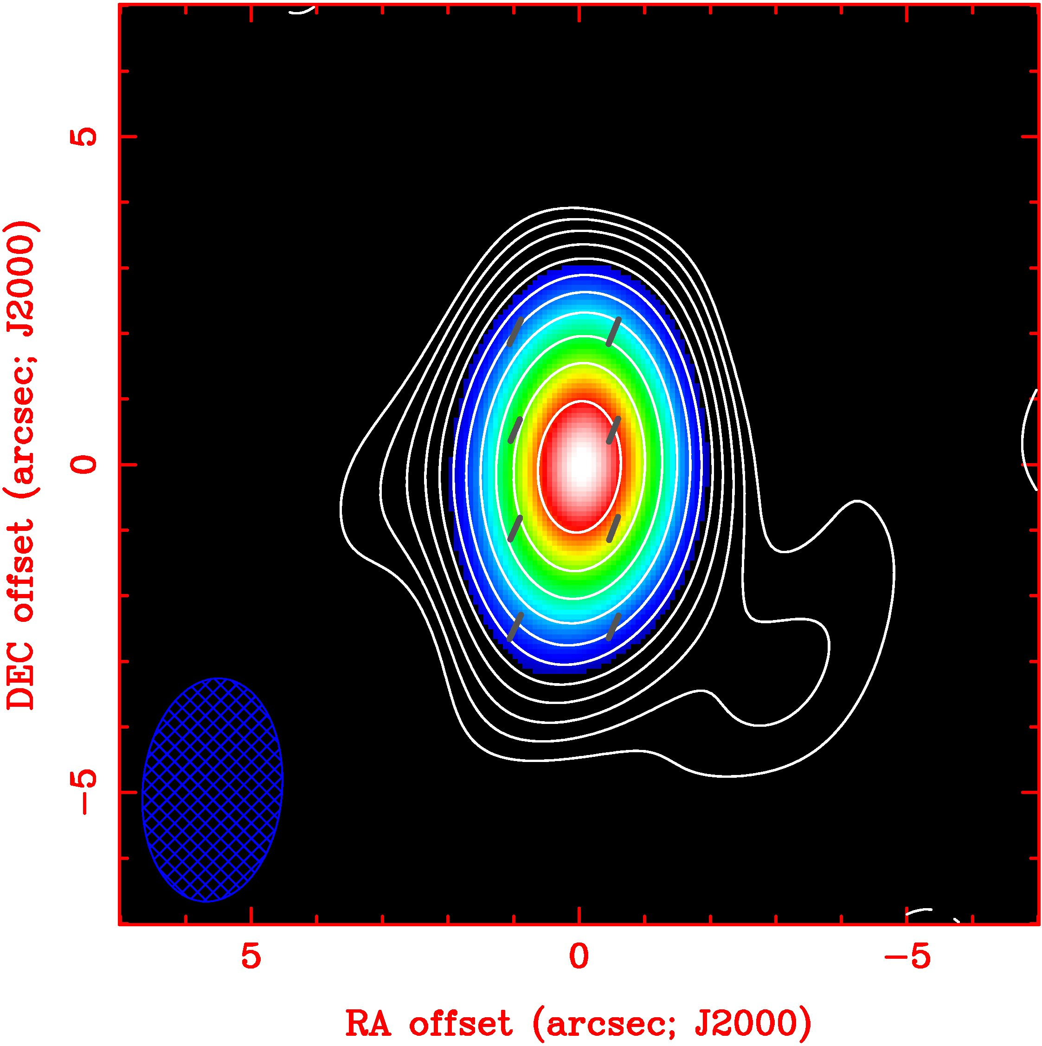
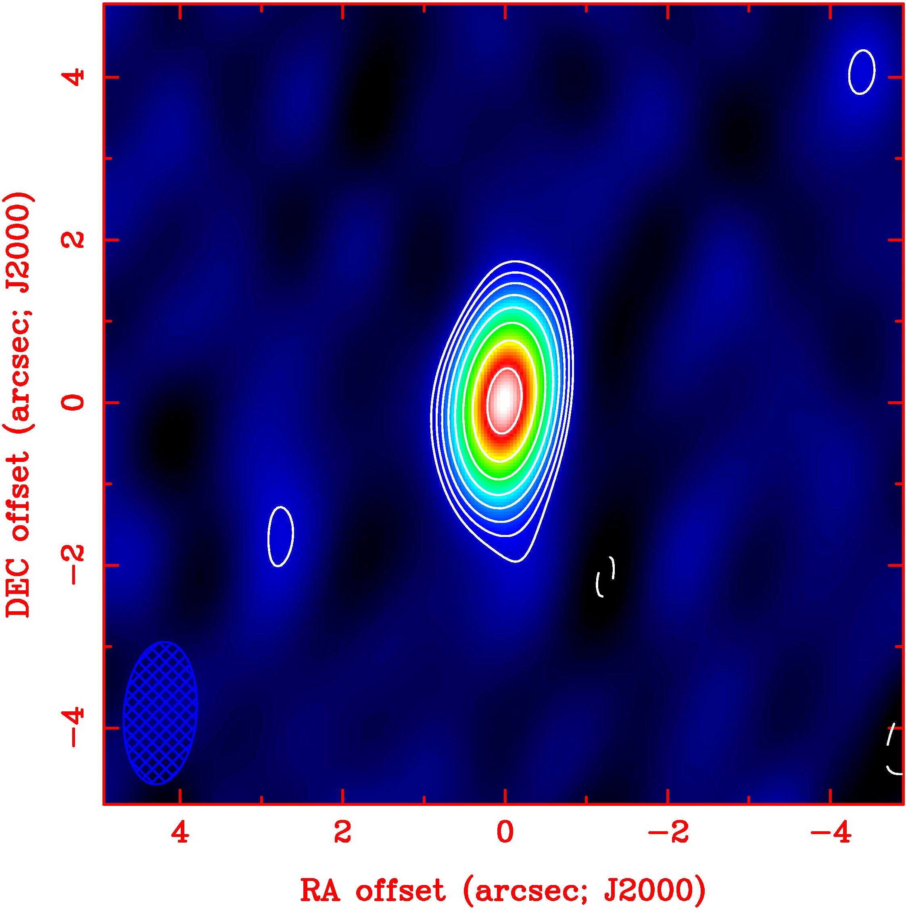
Polarization Images at Various Wavelengths from the SMA
230 GHz
345 GHz
690 GHz

Slide 18
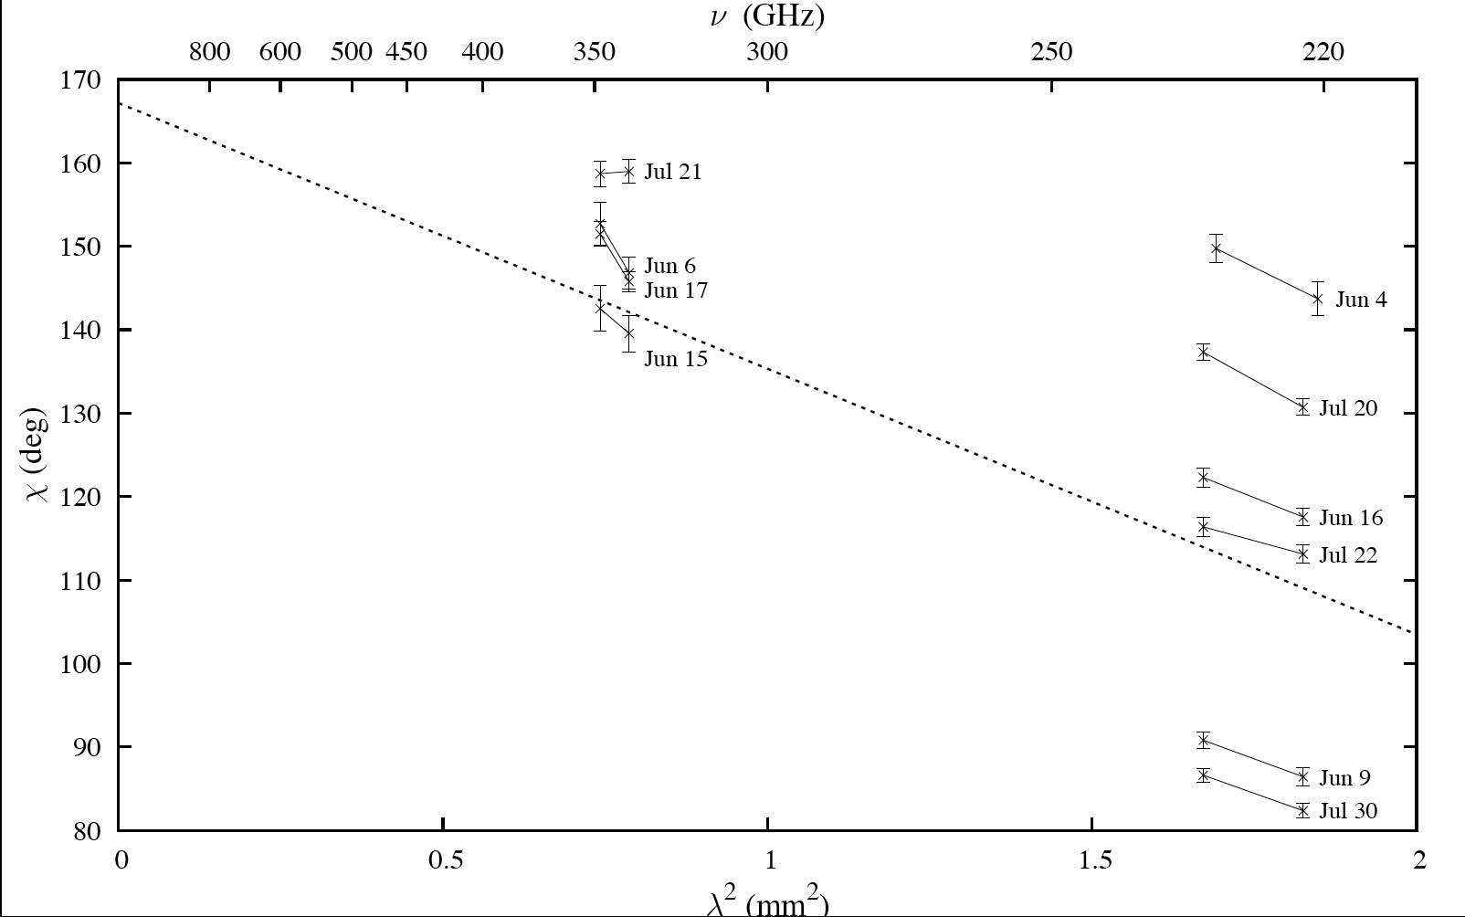
2005 SMA Measurements of Faraday Rotation in Sgr A*

Slide 19
Accretion Rate and Faraday Rotation
c(,t) = c₀(t) + ² RM(t)
⇩
RM = 8.1 x 10⁵  n_{e} B dl
×
RM = –5.1 x 10⁵ rad/m²
Assumptions
equipartition
density power law
inner radius cutoff of Faraday screen
Accretion rate = 10^{–9}–10^{–7} M_{Sun} /yr
Notes:
19

Slide 20
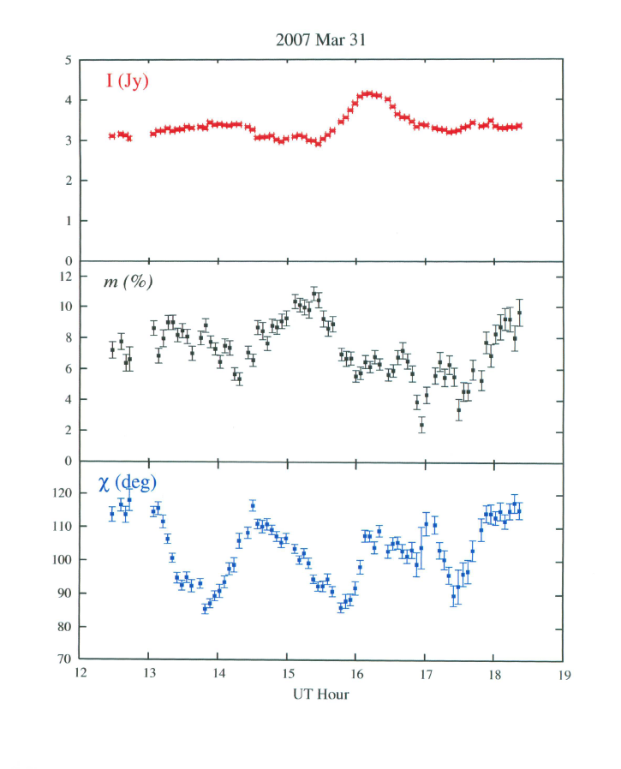
Polarization of Sgr A* at 230 GHz (1.3 mm) (SMA)

Slide 22
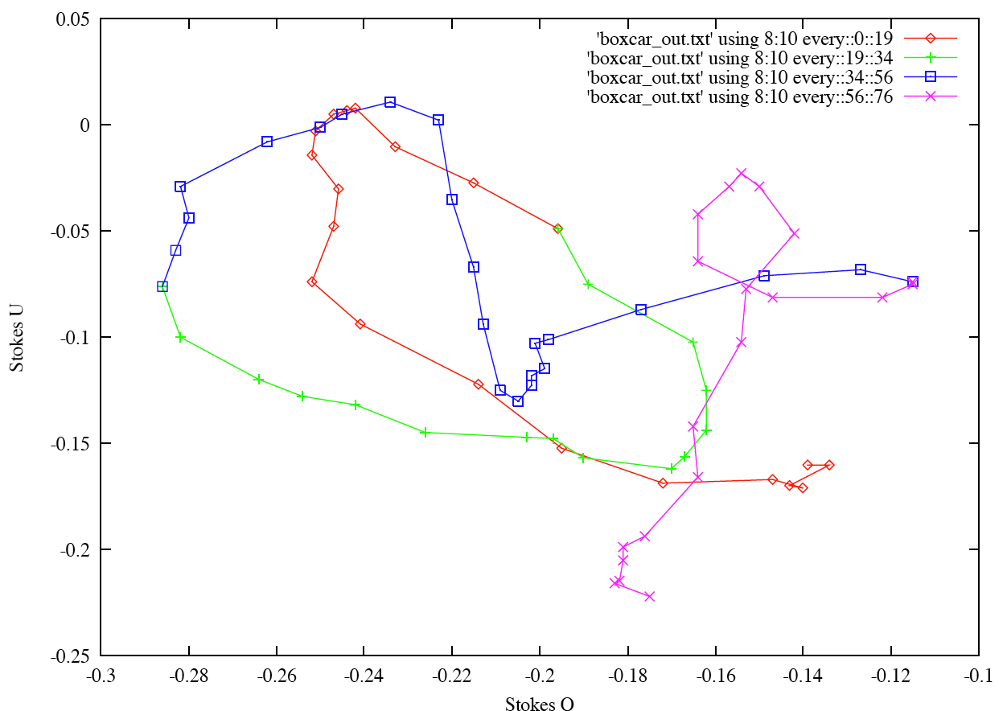
Polarization Track for 3/31/07 Observation of SgrA*
+
start
stop

Slide 23
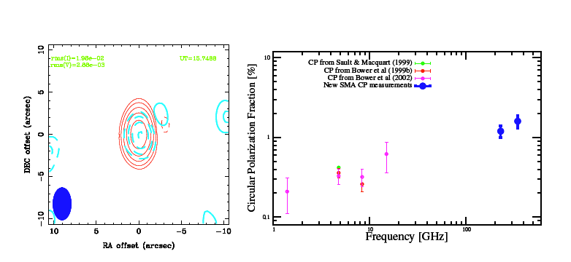
Circular Polarization of Sgr A*
(red) Stokes I
(blue) Stokes V
Fractional Circular Polarization
vs. Frequency

Slide 24
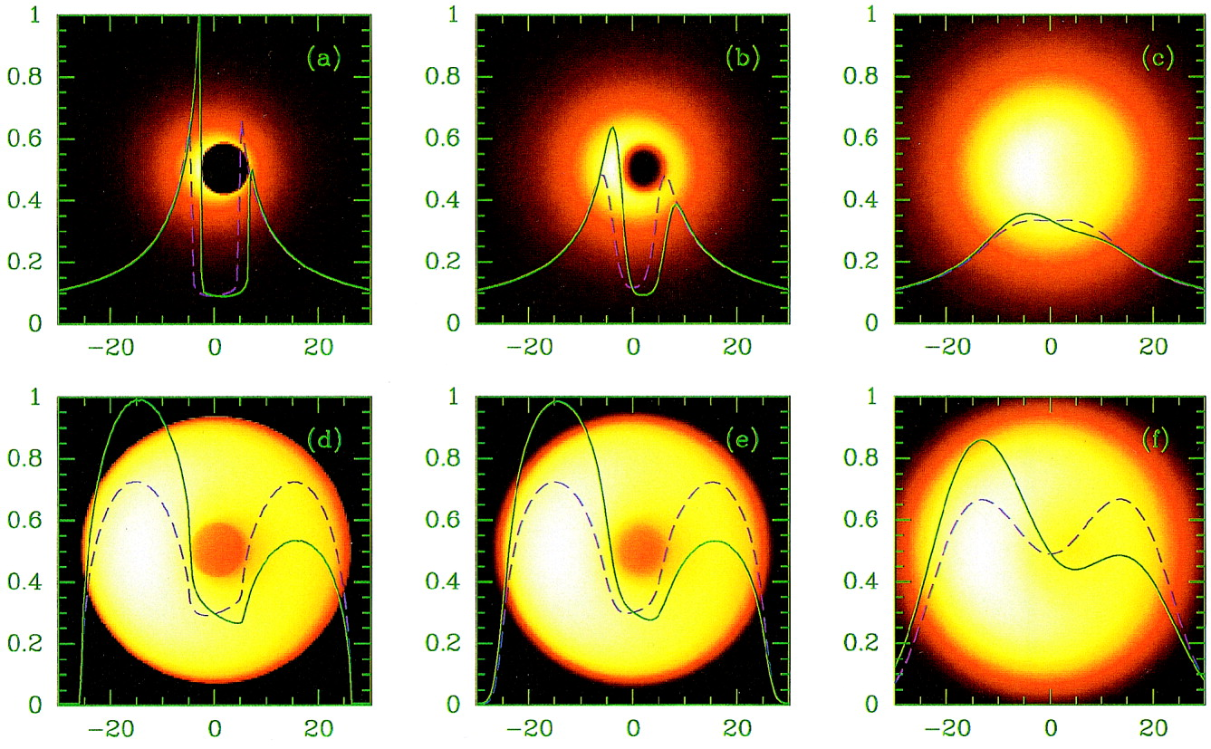
Emission Models for SgrA*
Free Fall
onto
Rotating BH
Orbiting
Gas and
Nonrotating
BH
GR Code
0.6mm VLBI
1.3mm VLBI
Falcke et al.

Slide 25
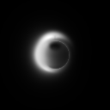
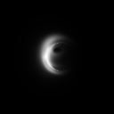
Hot Spot Models (P = 27 min)
230 GHz, ISM scattered
Models: Broderick & Loeb
Spin = 0, orbit = ISCO
Spin = 0.9, orbit = 2.5 x ISCO

Slide 26
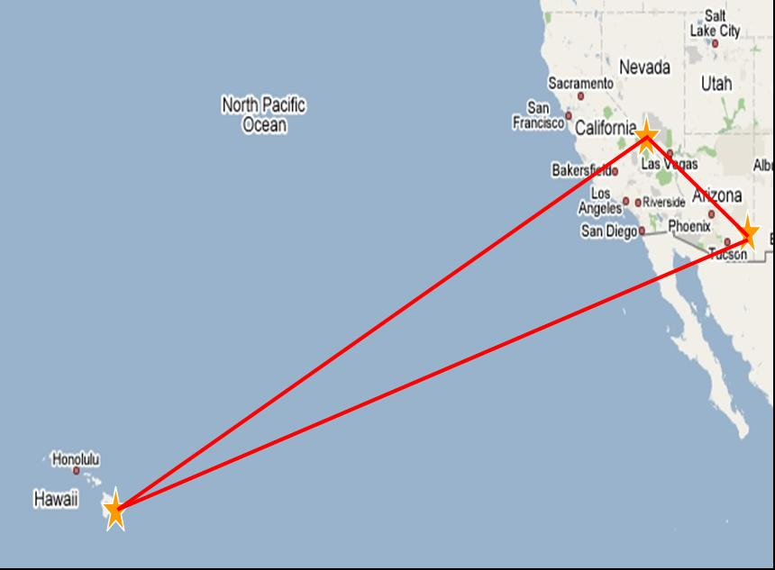
1.3mmλ Observations of SgrA*
908 km
4030 km
4630 km
VLBI program led by a large consortium led by Shep Doeleman, MIT/Haystack

Slide 27
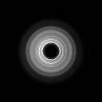
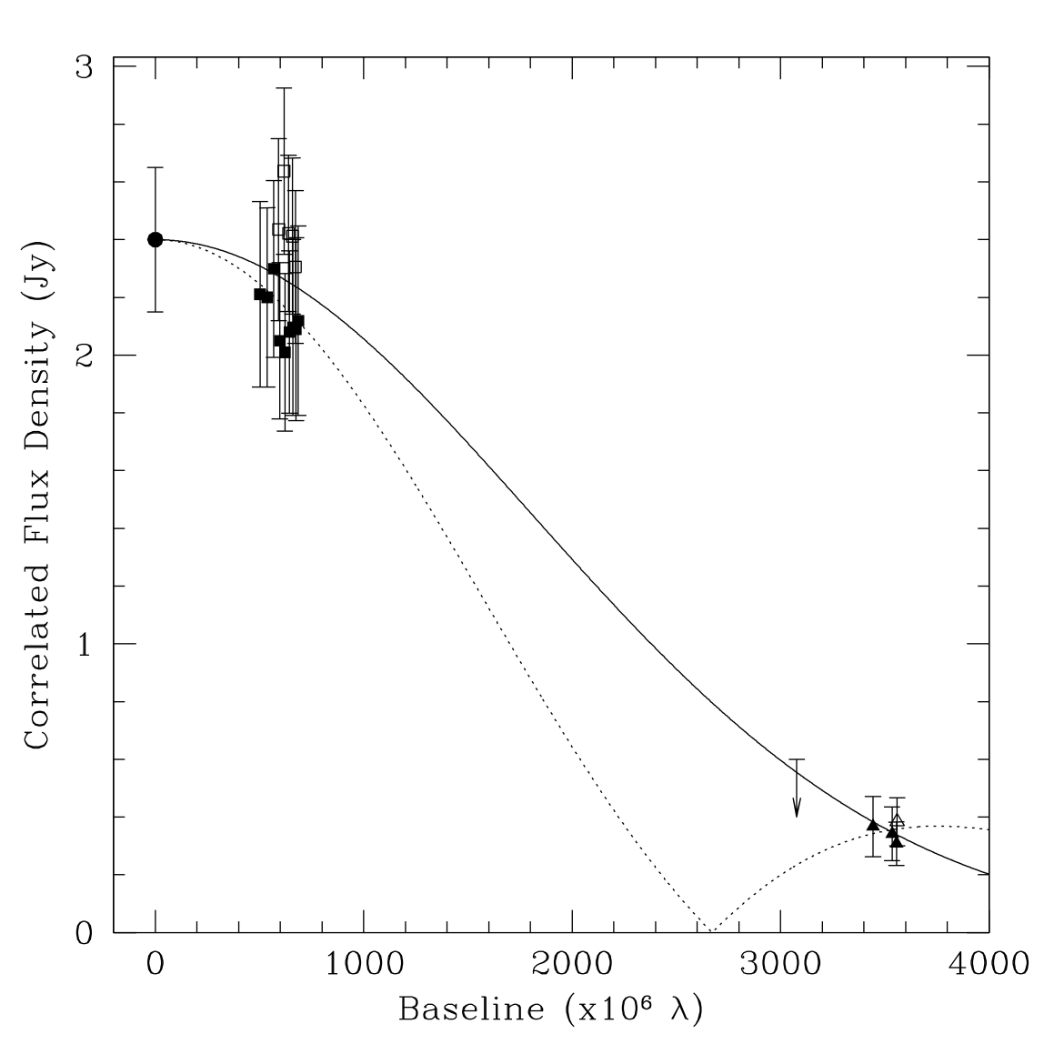
Fits to Visibility Data
14 Rsch (140as) 
Gaussian function
Torus
(Jinc functions)
Gammie et al.

Slide 28
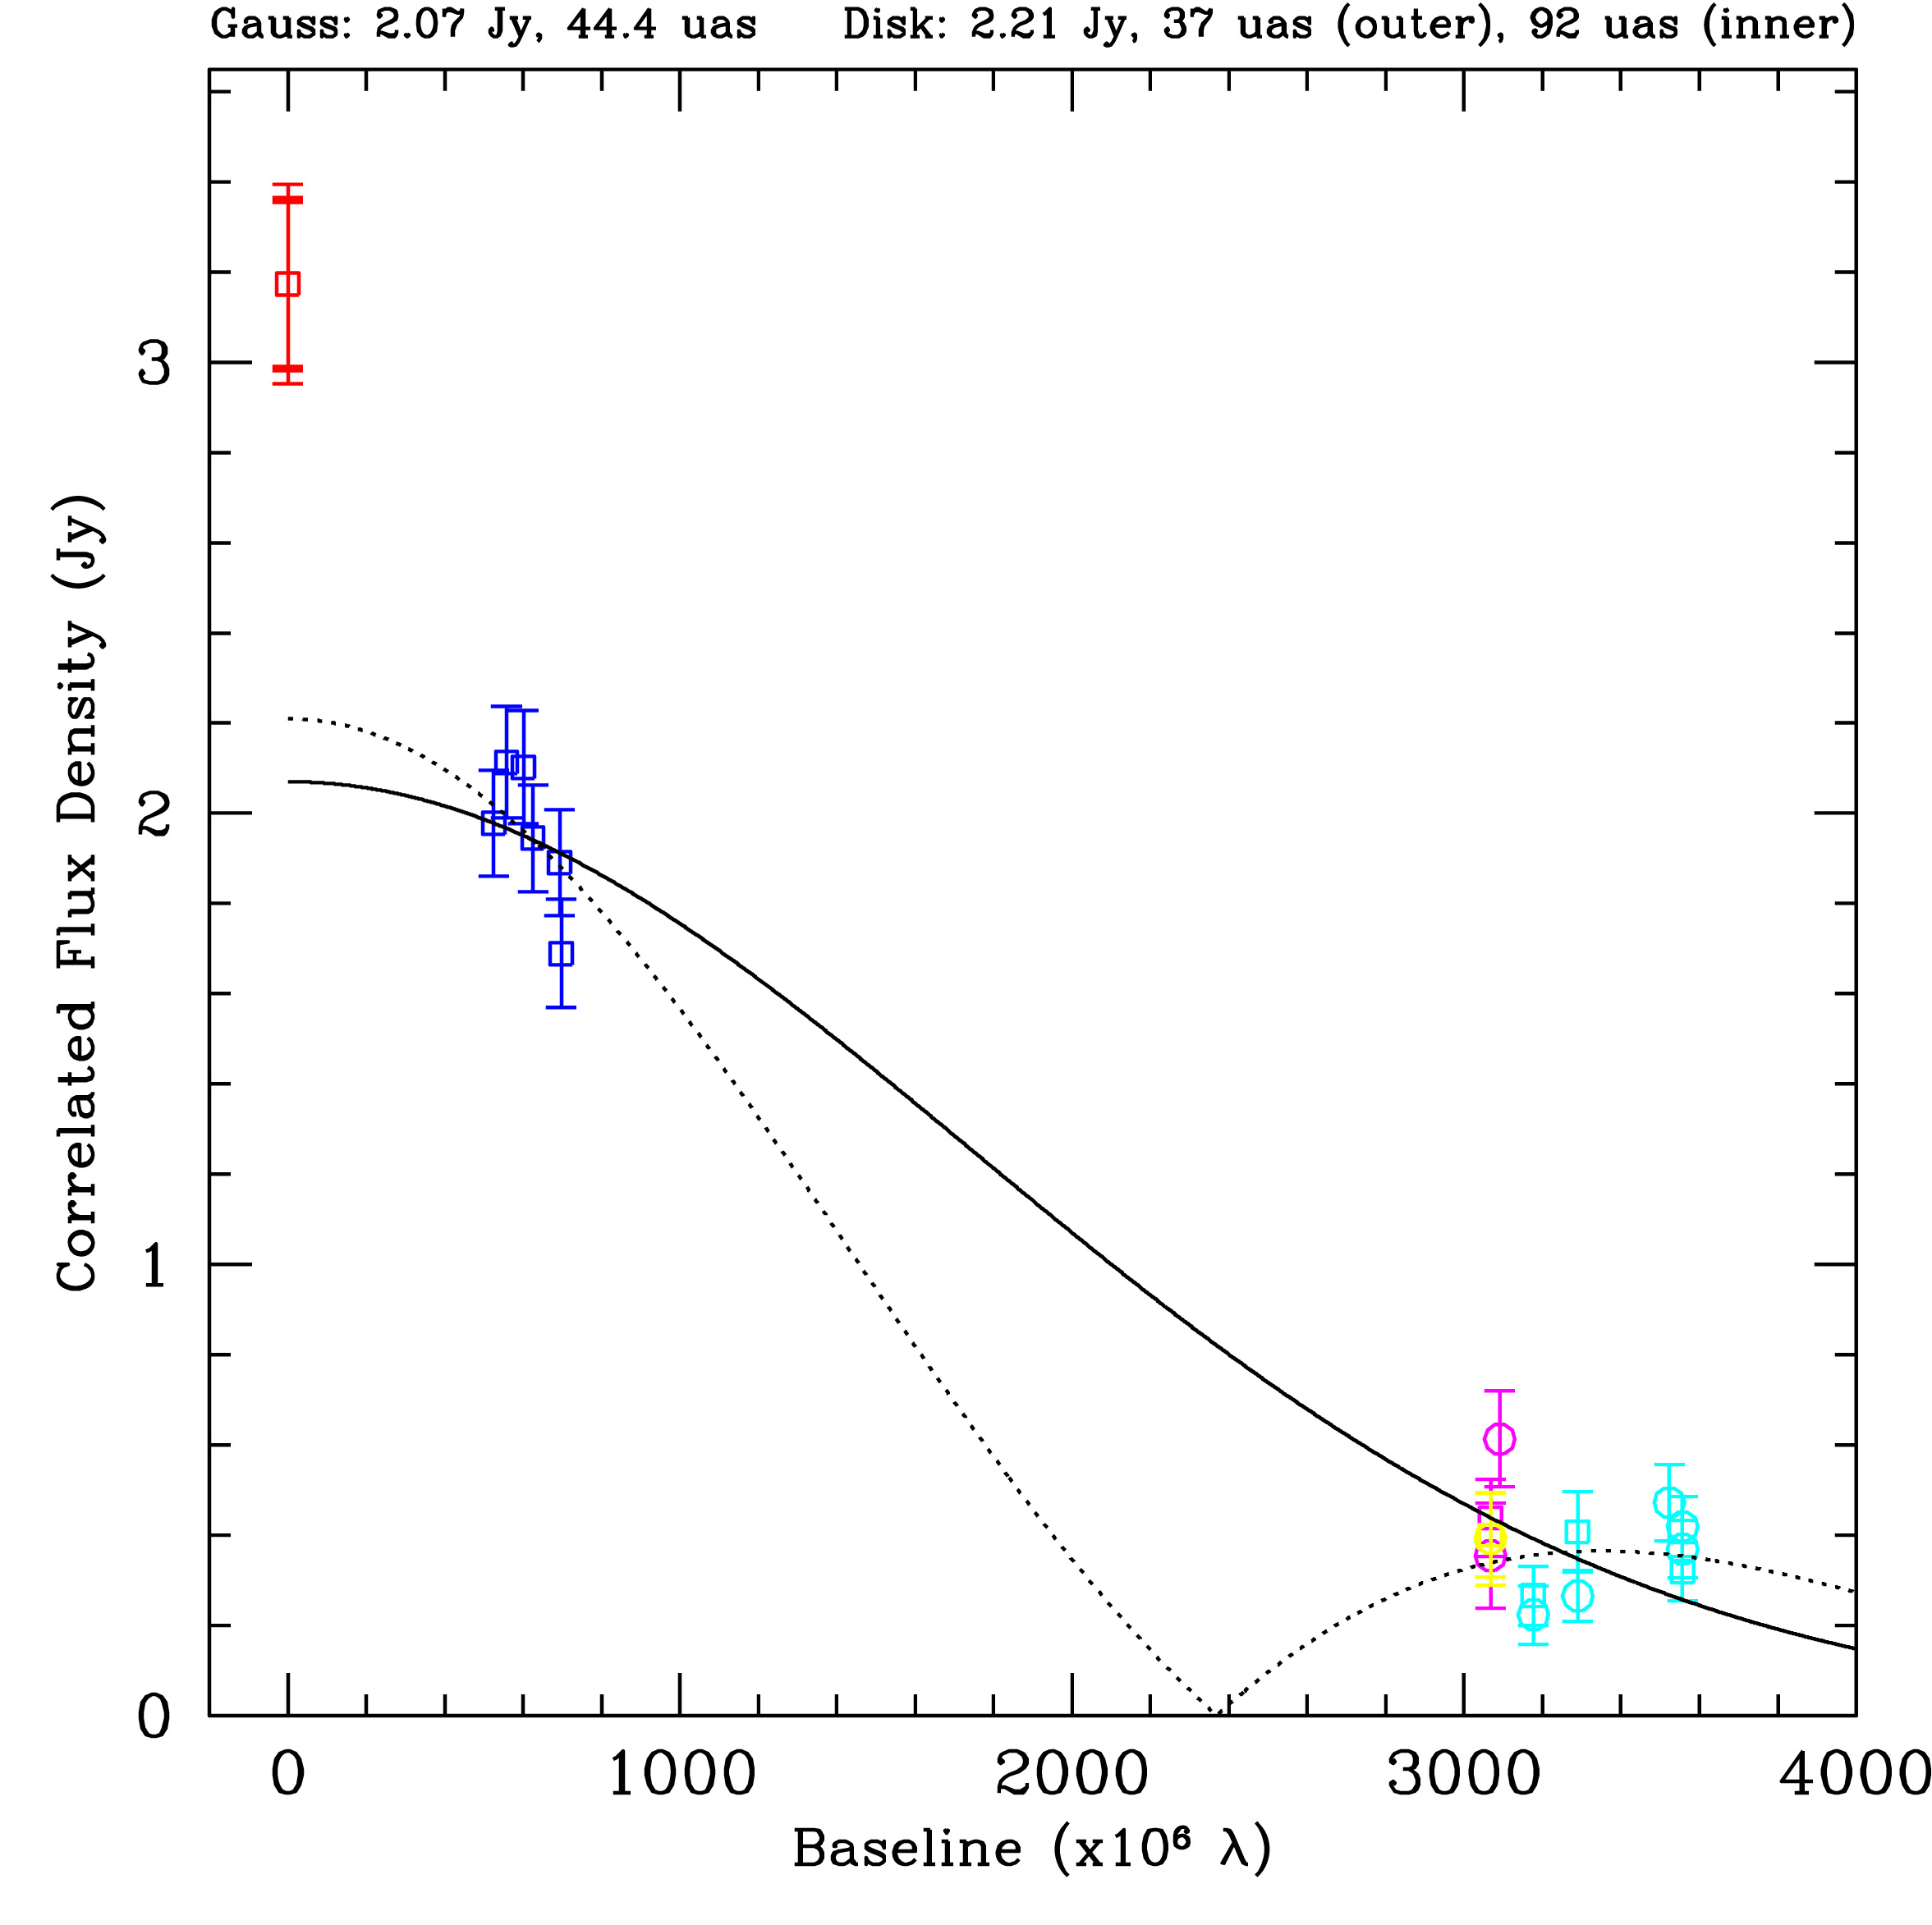
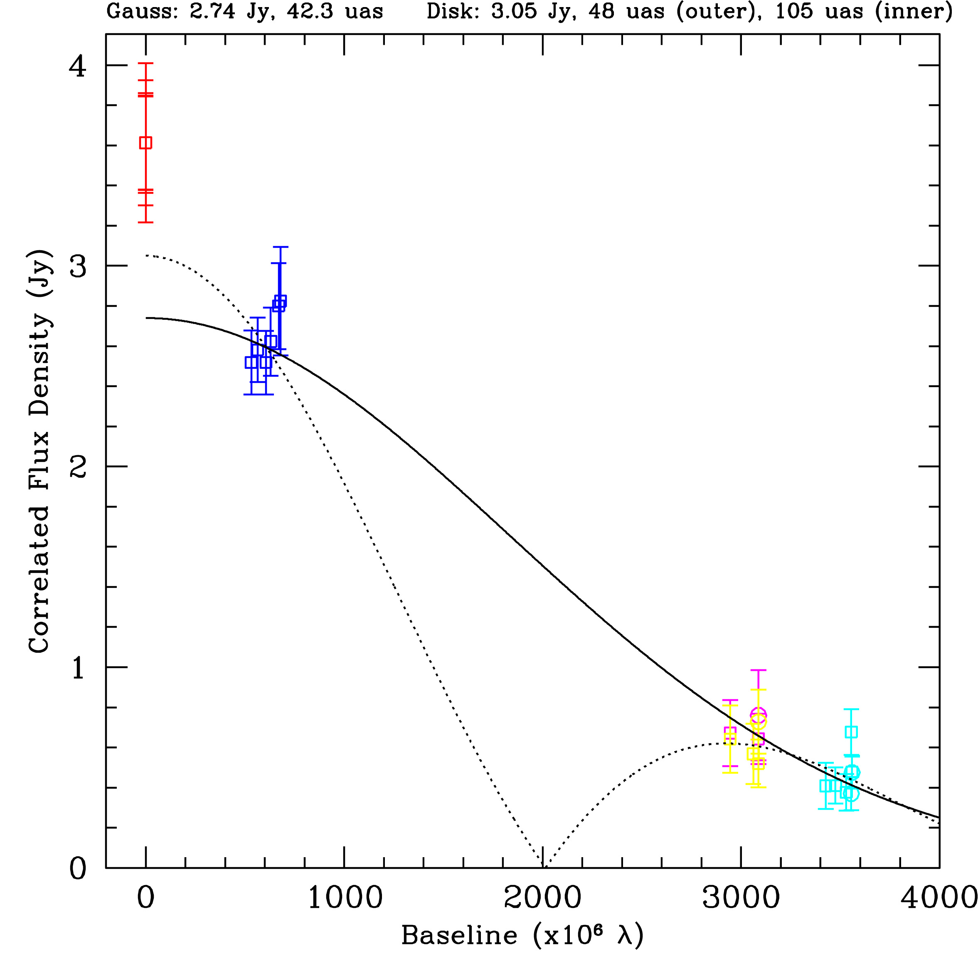
Days 96 and 97 (2009)

Slide 29
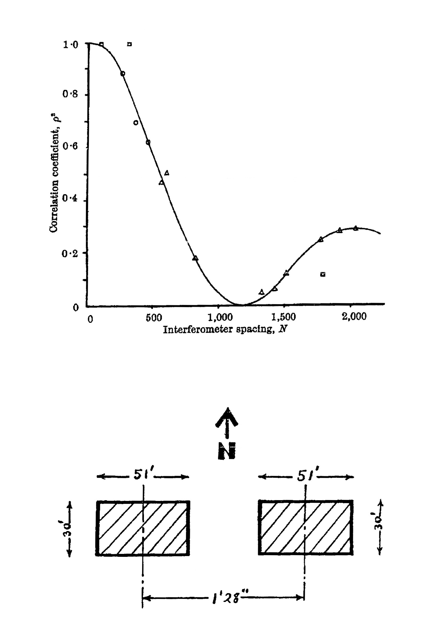
Observations of Cygnus A with the Jodrell Bank Intensity
Interferometer at 125 MHz before 1952 by Jennison and das Gupta
Preferred model!

Slide 30
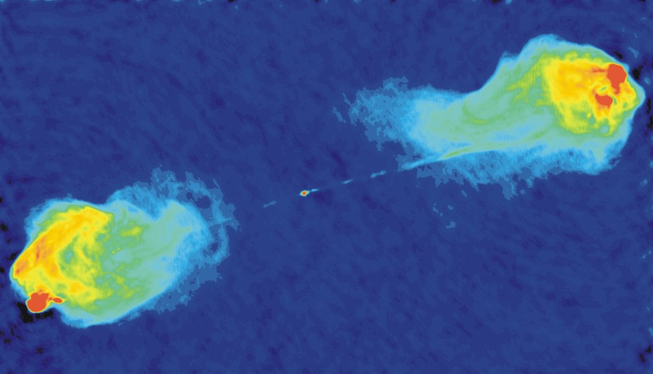
The Synchrotron Emission from Cygnus A
Imaged with the VLA at 6 cm Wavelength

Slide 31
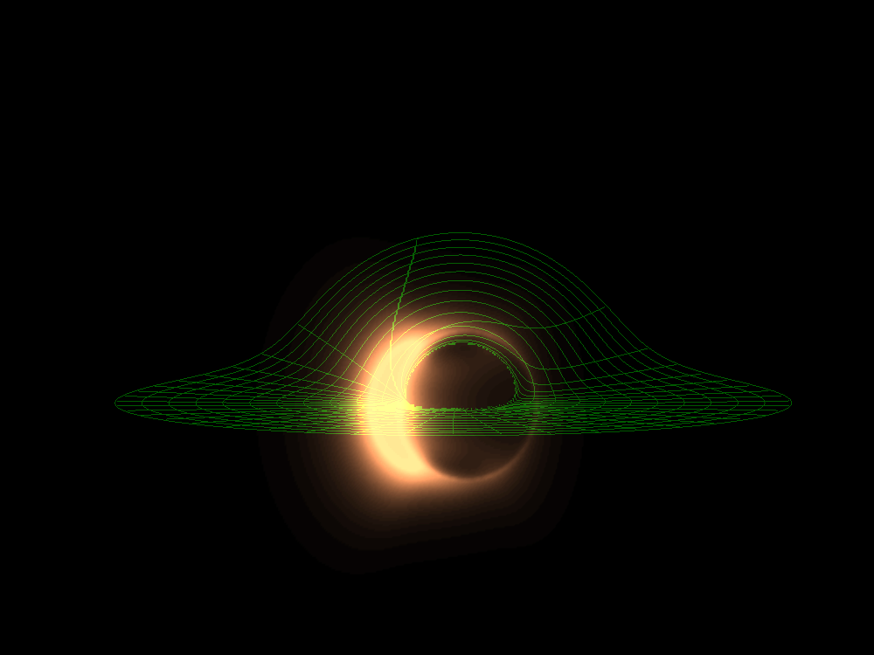
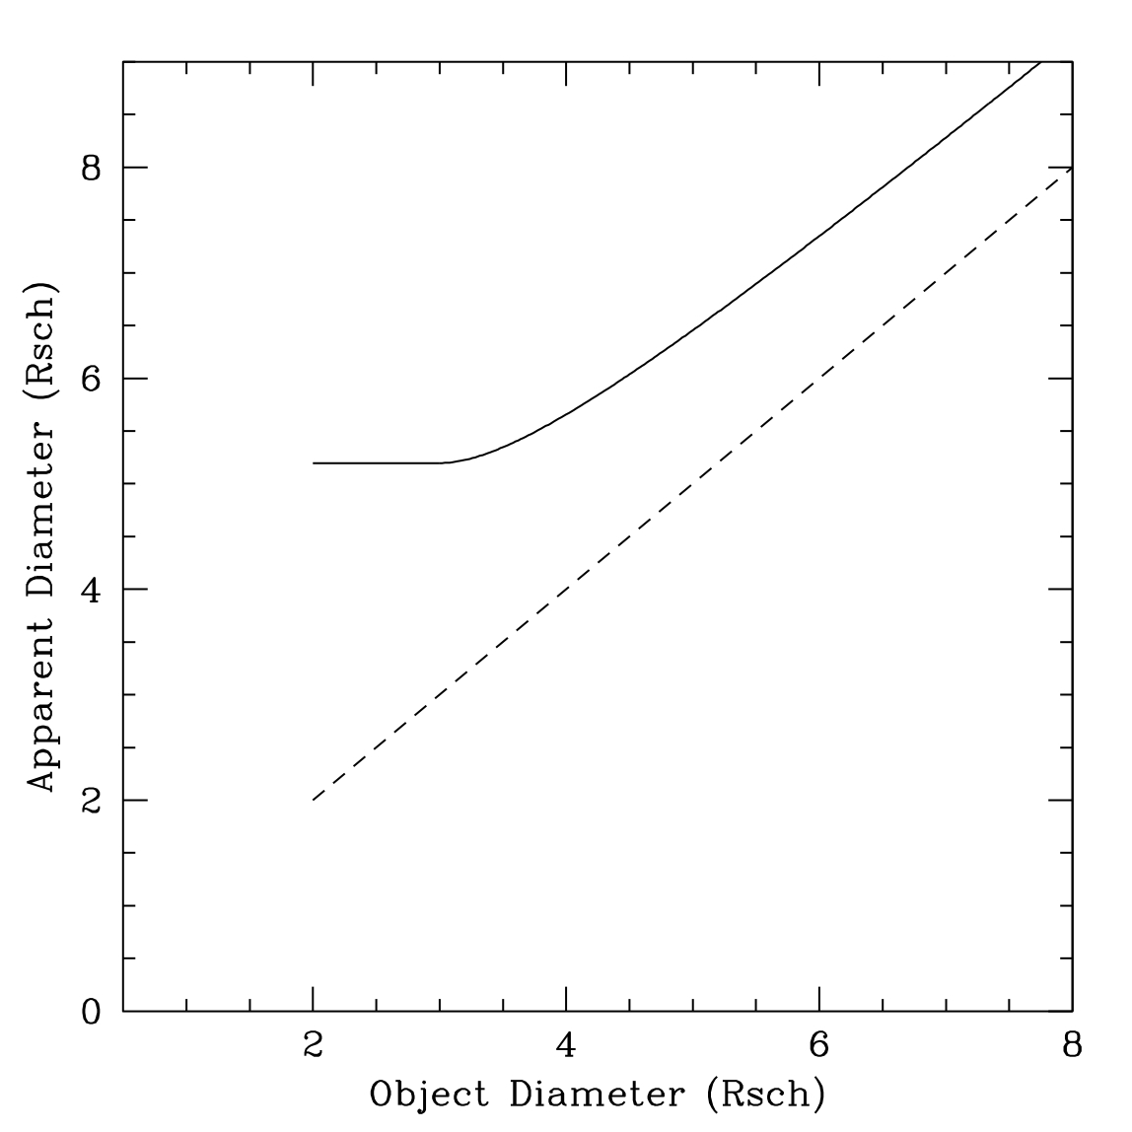
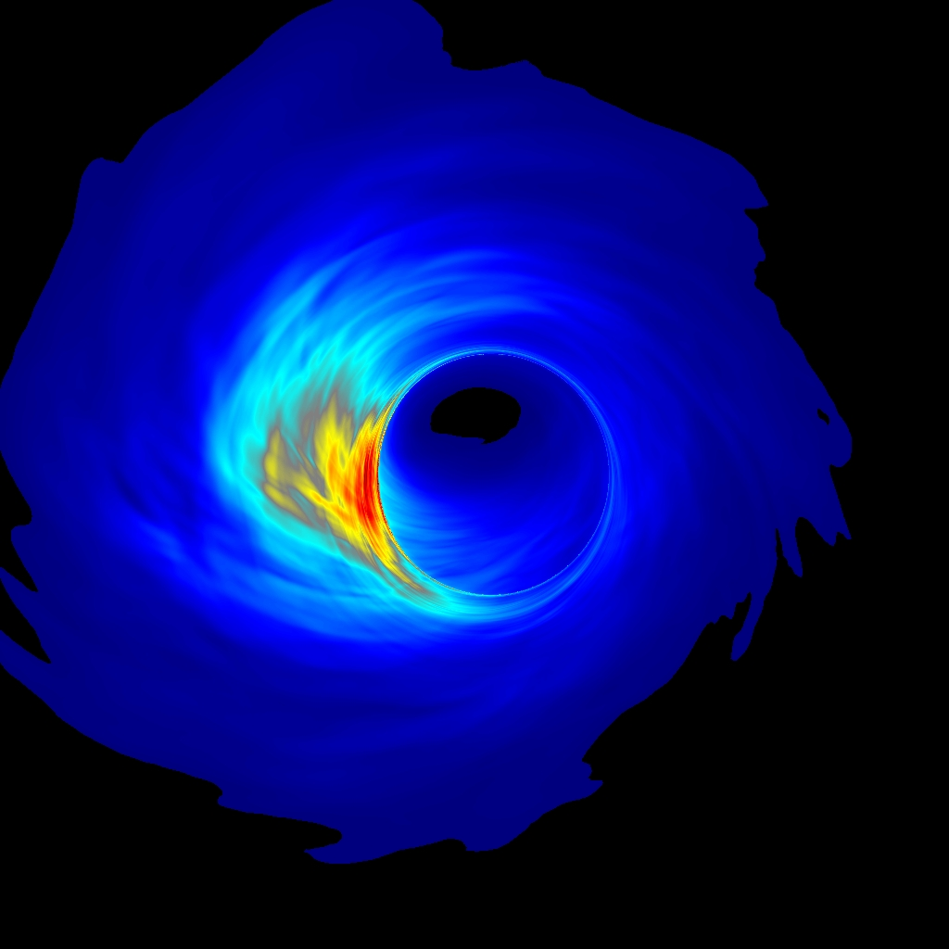
The Minimum Apparent Size
Broderick & Loeb
Event Horizon
Noble & Gammie

Slide 32
Seeing Through the Scattering
_{OBS} deviates
from scattering
for    cm
_{INT  }  _{SCAT}
for    mm
_{INT}  

Slide 33
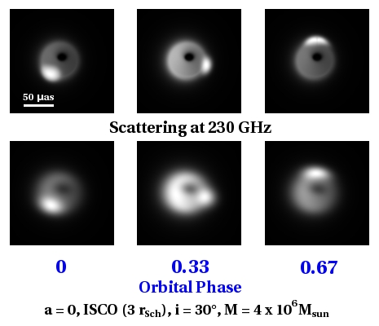
Hot Spot Model (a = 0, i = 30)

Slide 34
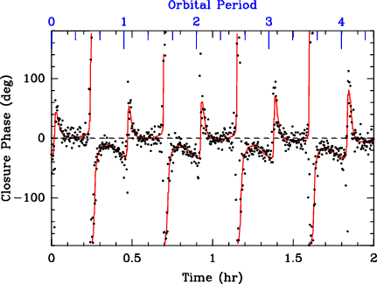
Simulation of Closure Phase for Hot Spot Model
SMTO–Hawaii–CARMA, 8 Gb/s, 230 GHz, 10 sec points
Notes:
34

Slide 35
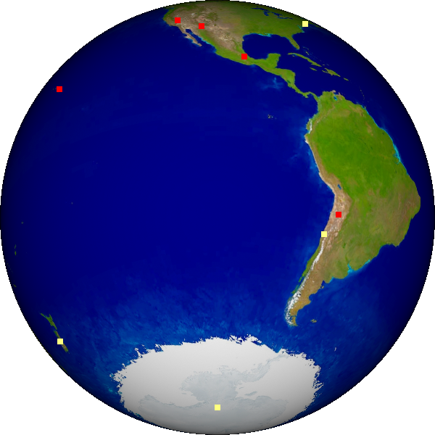
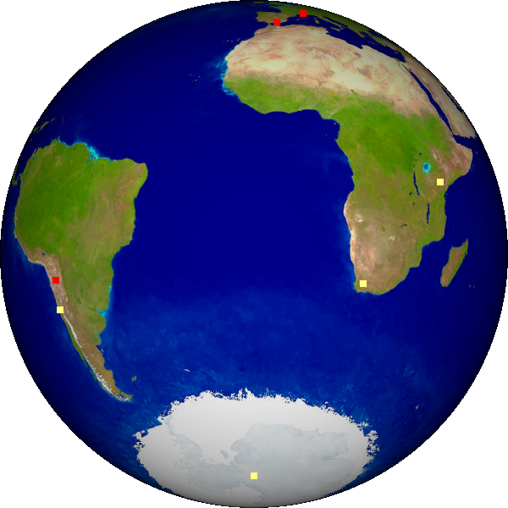
New (sub)mm VLBI Sites
Phase 1: 7 Telescopes (+ IRAM, PdB, LMT, Chile)
Phase 2: 10 Telescopes (+ Spole, SEST, Haystack)
Phase 3: 13 Telescopes (+ NZ, Africa)

Slide 36
EHT Phases
Phase I: 7-station 8Gb/s array
Phasing ALMA and CARMA
2010–2014
Phase II: 10-station 32Gb/s dual-pol array
Activate SEST, equip S.Pole
move to 0.8mm observations
2015–2018
Phase III: 12-station array up to 64Gb/s
New dishes for optimal baseline coverage
2019–2024

Slide 37
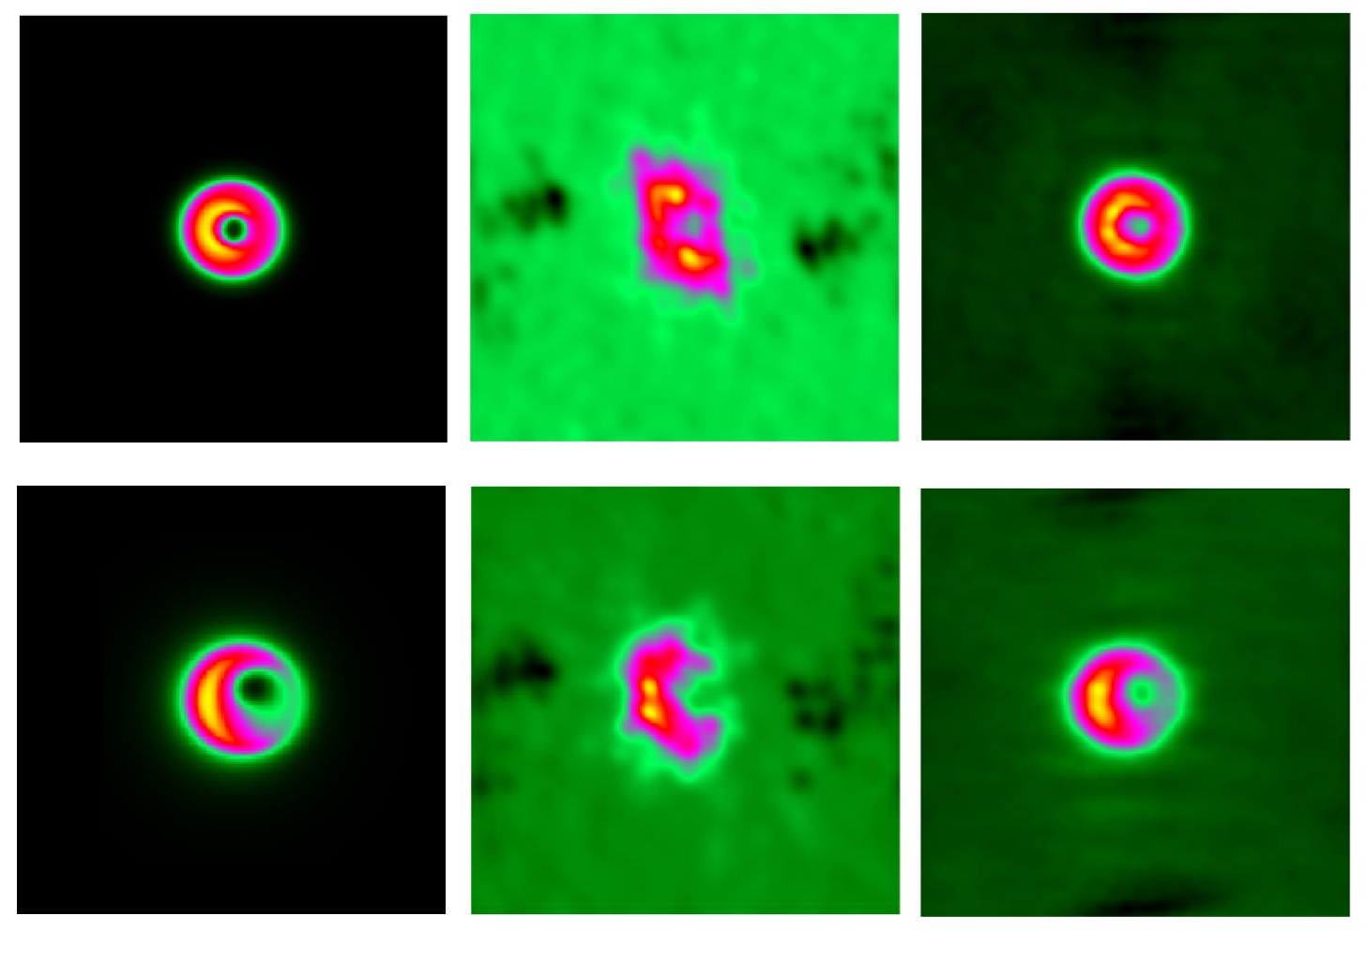
Progression to an Image
GR Model
7 Stations
13 Stations

