Slide 1
Before Phil Myers, dense cores were without form and void,
And darkness was upon the face of the deep.....

Slide 2
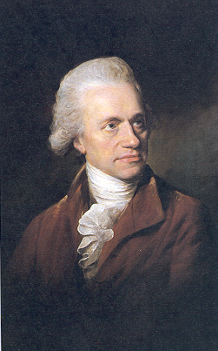
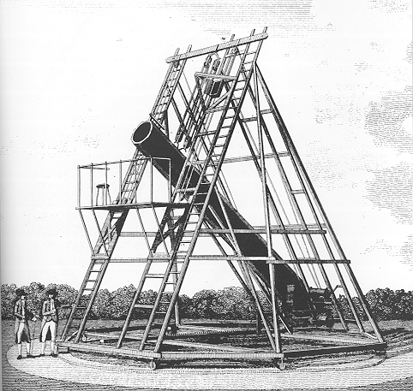
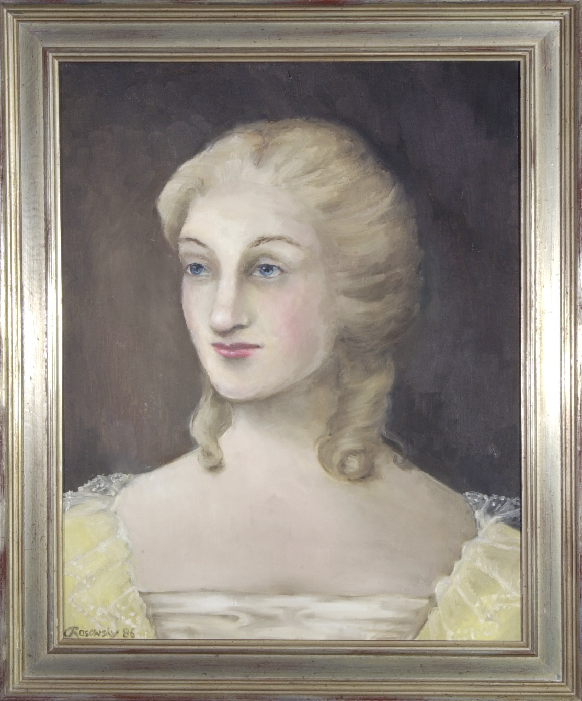
Vacancies in the Heavens: The Discovery of Dark Nebulae
William Herschel
1738-1822
Caroline Herschel
1750-1848

Slide 3
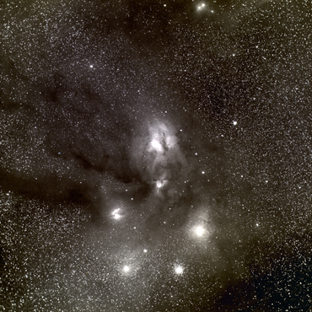
An Opening in the heavens
“...for instance, in the body of the
Scorpion is an opening, or hole,
...I found it while I was gauging in
parallel from 112 to 114 degrees
north of polar distance…As I
approached the Milky Way the
gauges were gradually running up
…when all of a sudden, they fell to
nothing!
http://www.library.gatech.edu/barnard
William Herschel
1785, Phil. Trans. LXXV, pp. 213-266

Slide 4
An Opening in the heavens
“...It is remarkable, that one of the
richest and most compressed
clusters of small stars I remember
to have seen, is situated on the
western border of it, and would
almost authorise a suspicion that
the stars, of which it is composed,
were collected from that place and
had left the vacancy.”
William Herschel
1785, Phil. Trans. LXXV, pp. 213-266

Slide 5
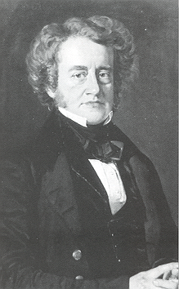
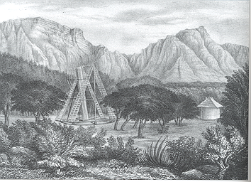
John Herschel
1792-1871
Feldhausen, South Africa:1834
“…for I remember your father returned several nights and years
to the same spot but could not satisfy himself about the
uncommon appearance of the heavens. It was something more than
a total absence of stars.”

Slide 6
Feldhausen, South Africa:1834
And “… remembering having once heard your father...
exclaim, ‘Hier ist wahrhaftig ein Loch im Himmel!’”

Slide 7
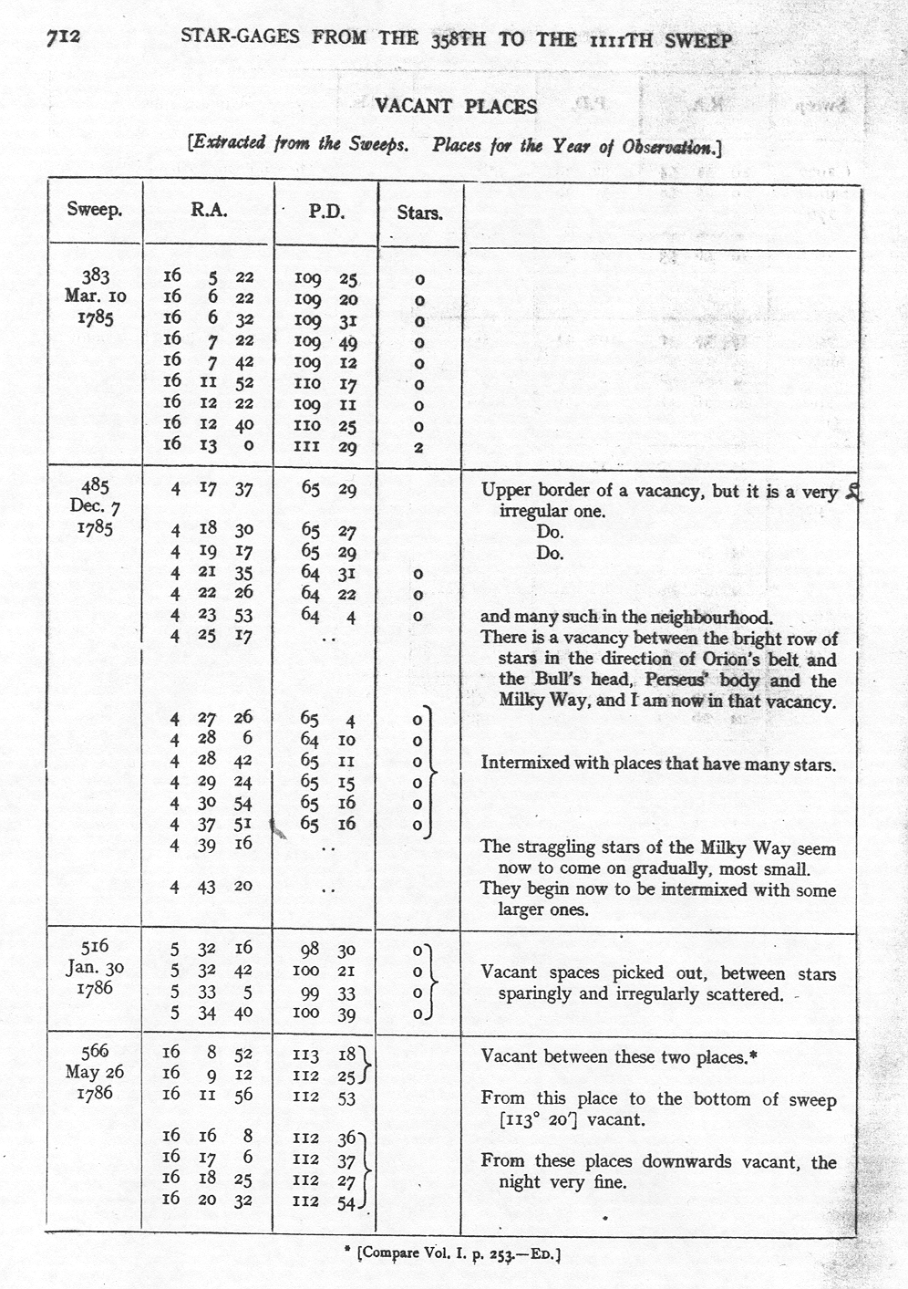
First Catalog of Dark Nebula
1912 The Scientific Papers of Sir William Herschel,
(London: The Royal Society & Royal Astronomical
Society), Vol II, pg 712.

Slide 8
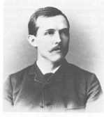
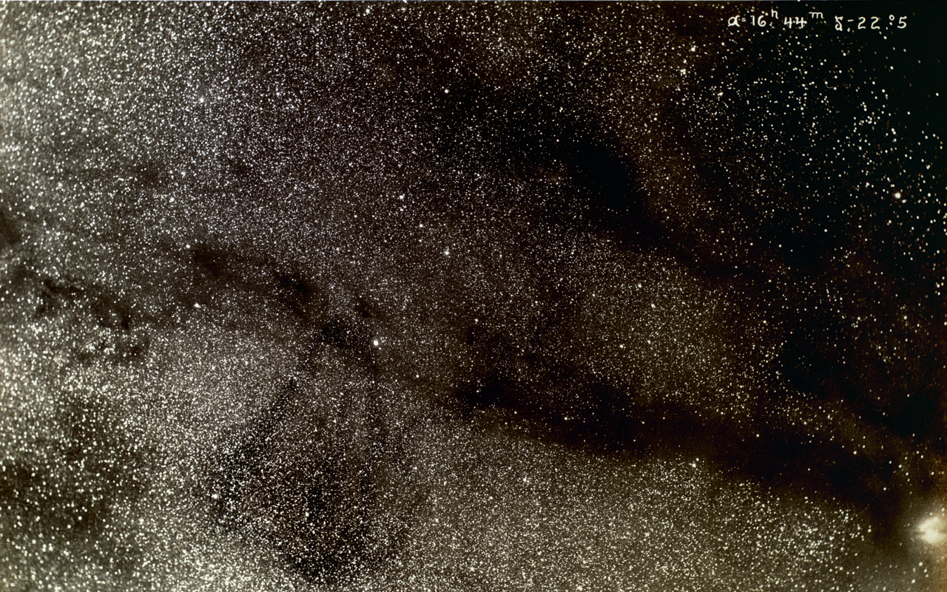
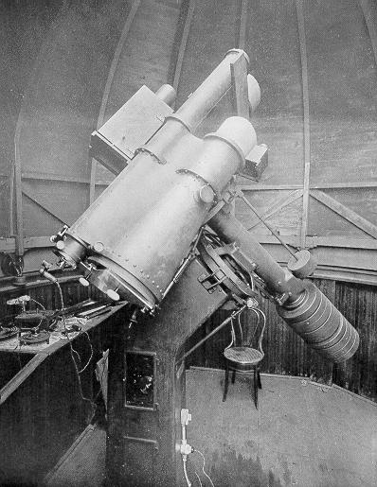
1919 Astrophysical Journal 49, 1.
“...my own photographs convinced me...that
many of these markings were not simply due
to an actual want of stars, but were really
obscuring bodies nearer to us than the stars.”
E. E. Barnard
1857-1923
“In a considerable number of cases no other explanation seems
possible, but (that) some of them are doubtless only vacancies.”

Slide 9
WOLF DIAGRAM
Max Wolf
1863-1932
“We must therefore conclude that no
reddening of the stars arises from the dark cloud…and it seems quite probable that the light-capturing cloud consists, for the most part, of a dust mass.”
1923 Astr. Nachr., 219, 109.

Slide 10
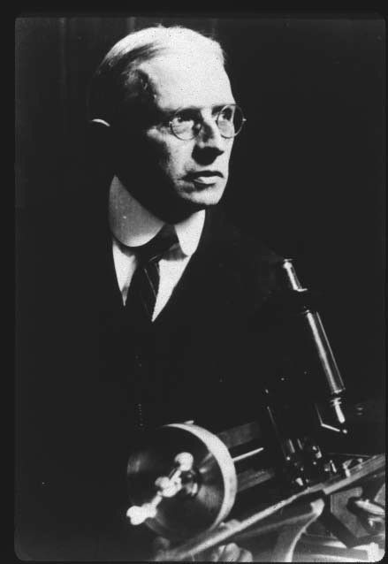
On The Nature of Dark Clouds
“The chief difficulty here is …how such (clouds) should have possessed so little angular momentum as the stars have at present.”
“…dark nebulae…may alone be permanent just because of their chaotic nature. As far back in time as our reasoning carries us, they may even then have been substantially the same as now—’without form and void’.”
Russell, Dugan and Stewart 1927
H.N. Russell

Slide 11
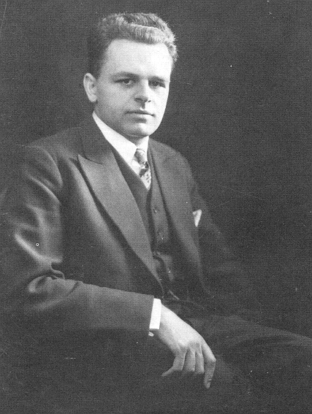
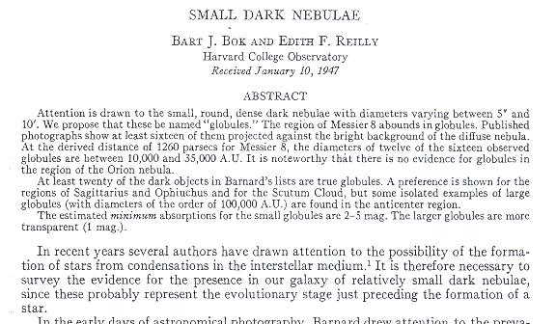
Bok Ties Star Formation to Dark Clouds!
Bart J. Bok 1906-1983
“…in some cosmic clouds we are now witnessing the operation of the process of star formation.” Bok 1948
1946: Harvard Observatory Centennial Symposium

Slide 12
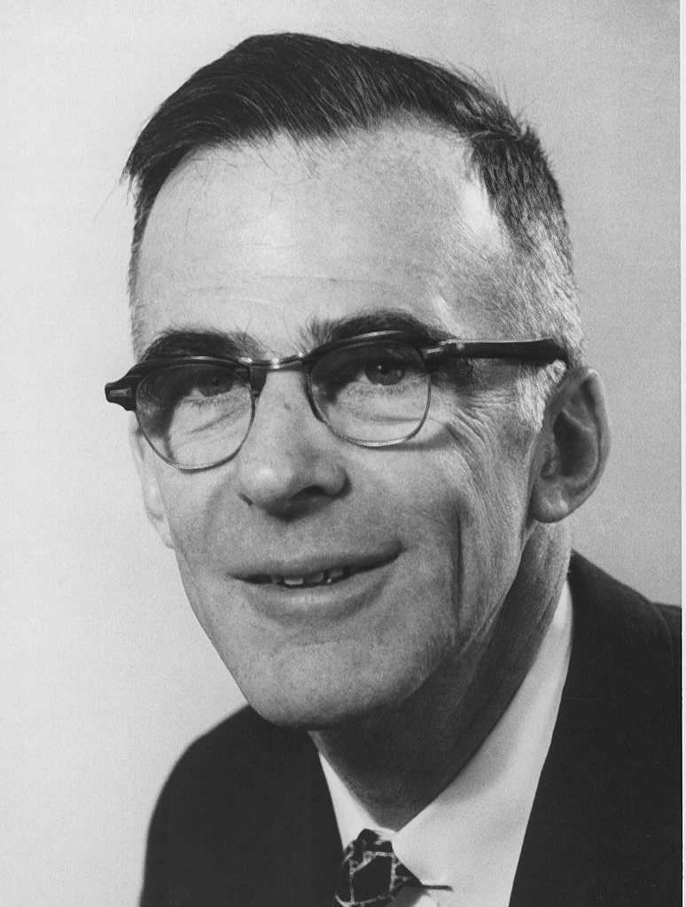
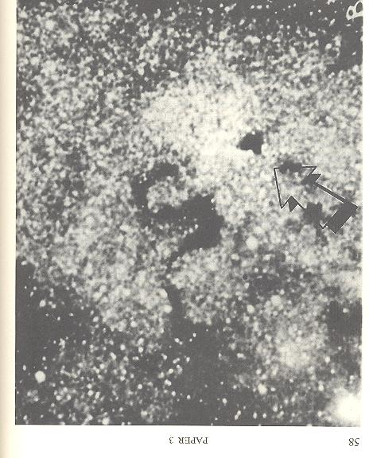
The Concept of a Protostar
During this stage of gravitational contraction
an aggregation of dust and atoms will be stable
against most disruptive influences’ it should no longer
Be regarded as a cloud, and will here be called a
“Protostar”.
Spitzer 1948
Physics Today, 1948 1, 6
Lyman Spitzer Jr. (1914-1997)
“...(although) the results presented here are therefore favorable to the hypothesis that stars…have originated recently from interstellar matter, this hypothesis remains extremely tentative at the present time.” Spitzer 1948
1946: Harvard Observatory Centennial Symposium

Slide 13
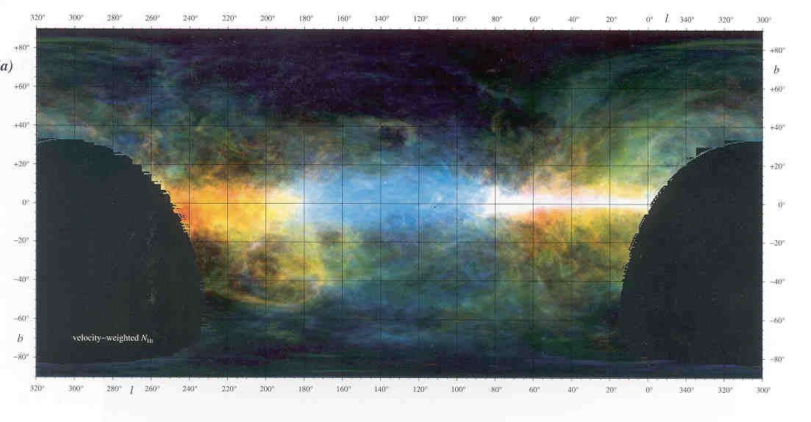
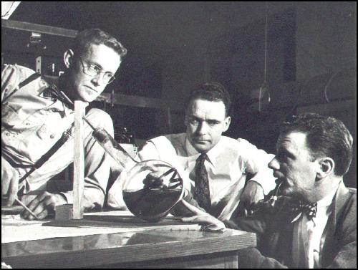
A Hydrogen-rich Interstellar Medium
The discovery of pervasive HI emission in the galaxy by Ewen and Purcell in 1951 convincingly demonstrated that the raw material for building stars existed in substantial concentrations between the stars.

Slide 14
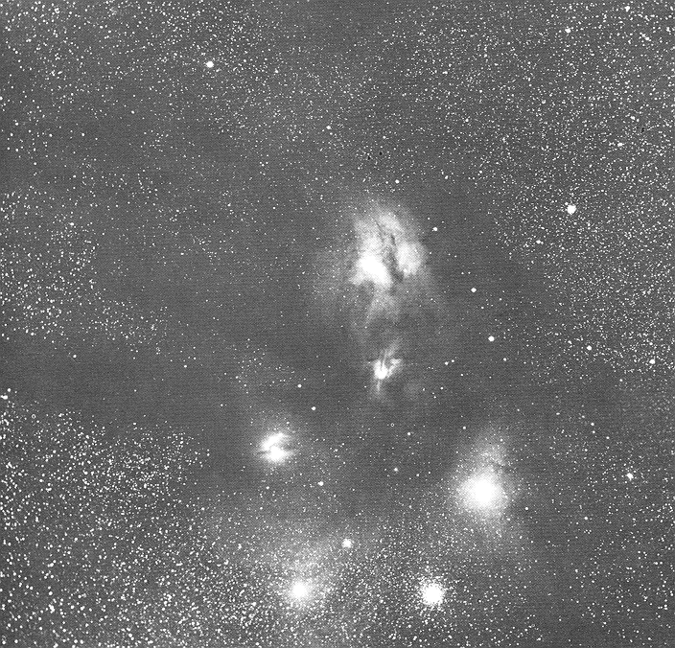
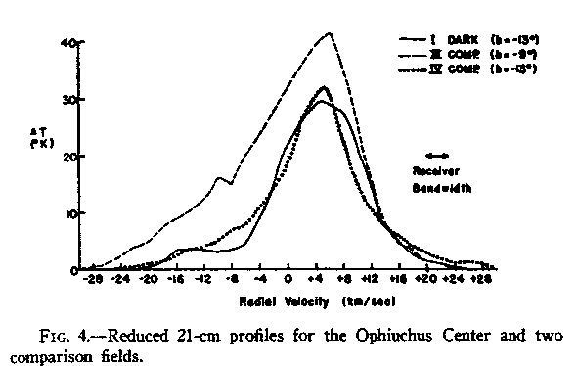
Bart J. Bok 1906-1983
“There remains the possibility that
the neutral hydrogen in the dark
clouds is mostly in molecular
form.....”
1956, PASP 67, 108.

Slide 15
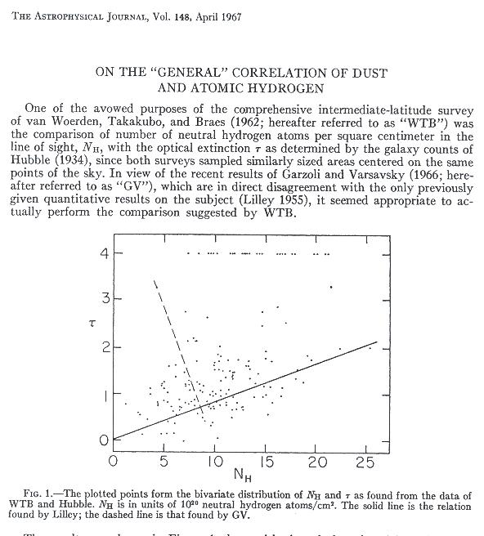
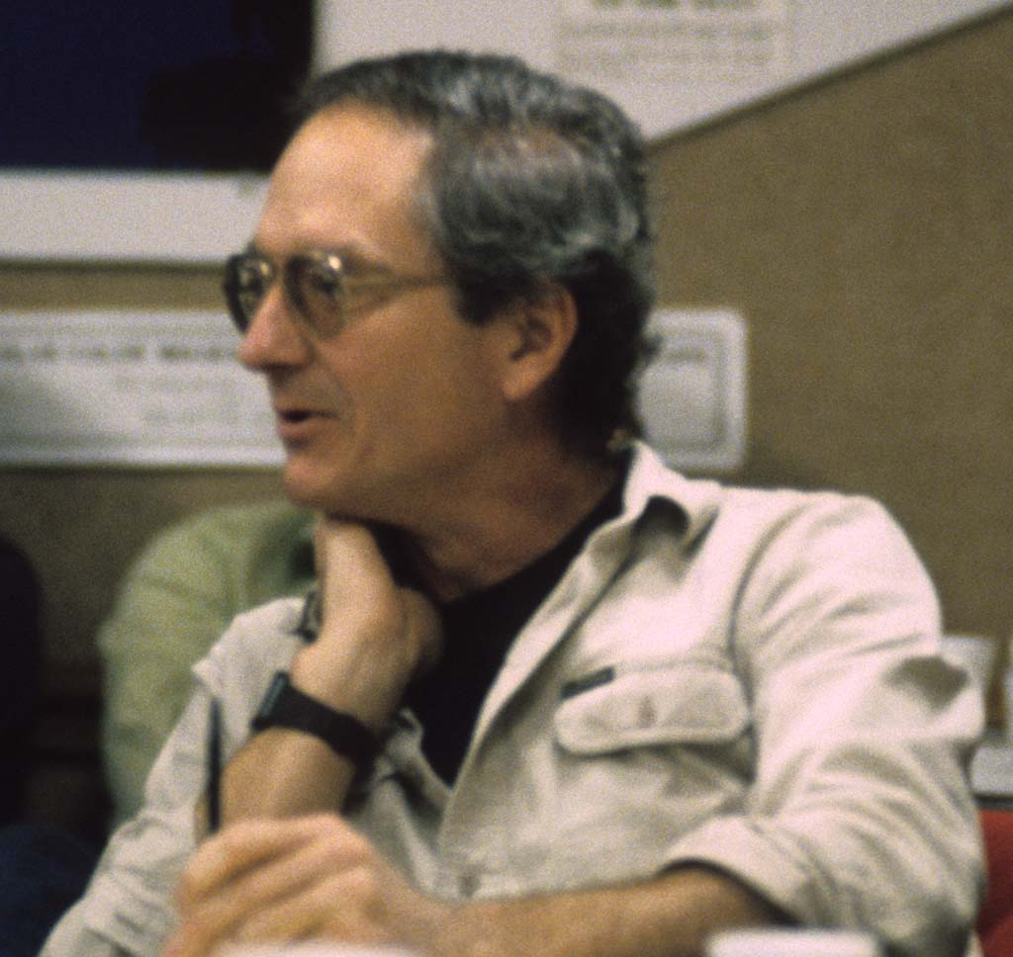
“...thus the reasonable conclusion to be drawn is that...the abundance of molecular hydrogen is several times that of atomic hydrogen”

Slide 16
Discovery of the Molecular Universe
1963: OH in absorption
1965: OH in emission
1968: NH₃ in emission
1969: H₂O in emission
1969 : H₂CO in absorption

Slide 17
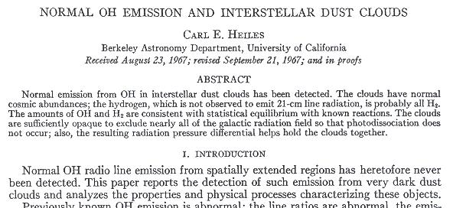
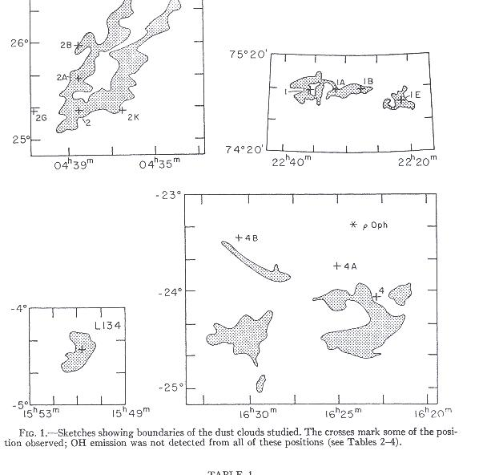

Slide 18
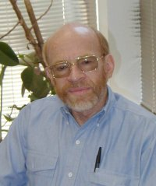
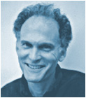
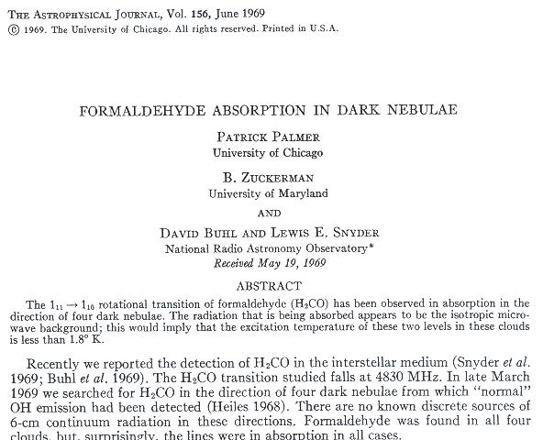
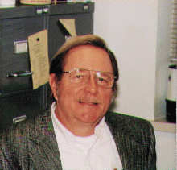

Slide 19
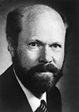
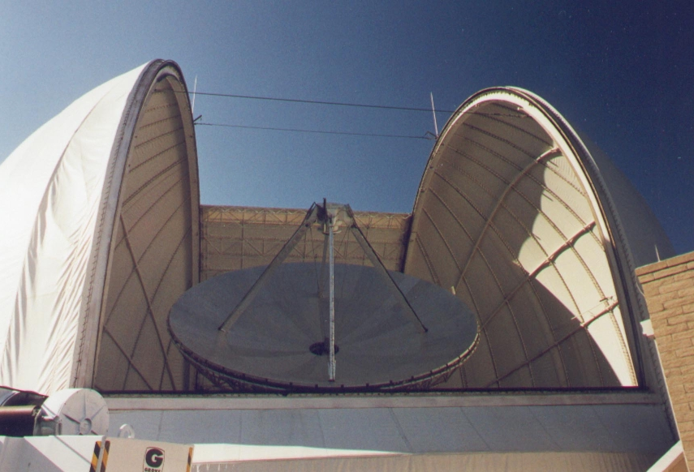
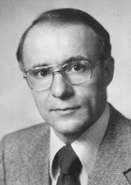
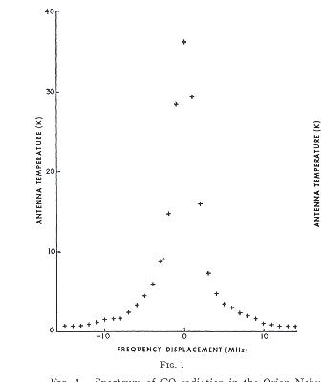
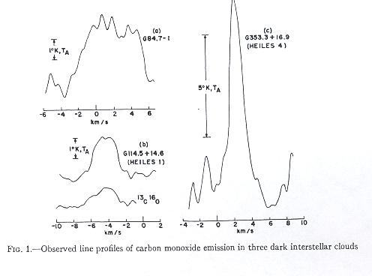
R. Wilson
A. Penzias
Detection of CO in 1970

Slide 20
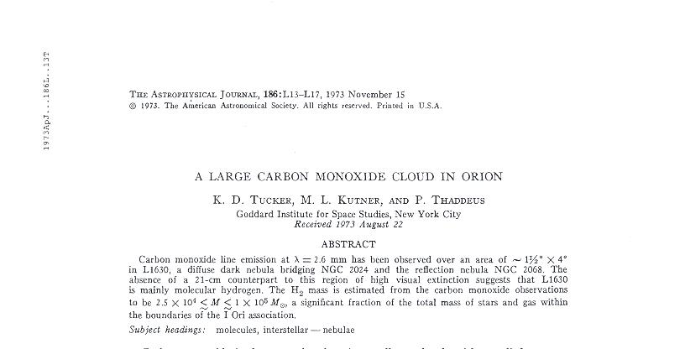
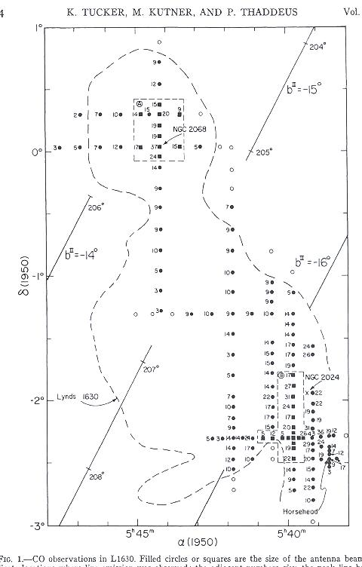
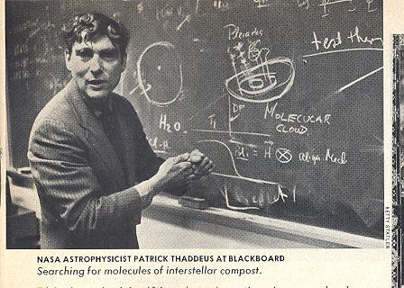

Slide 21
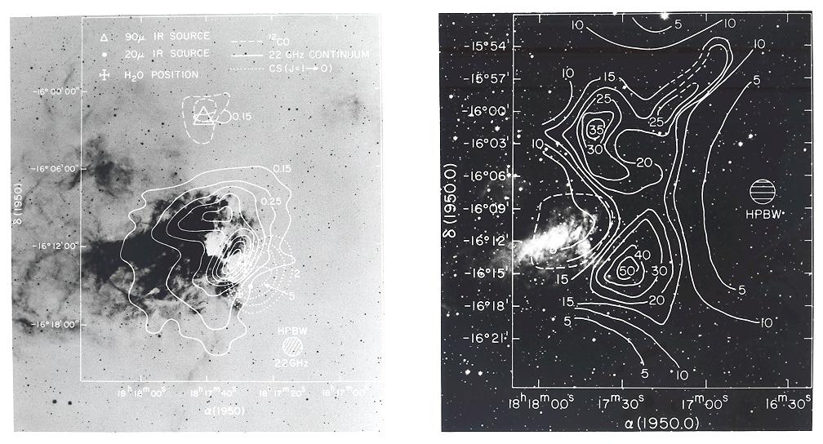
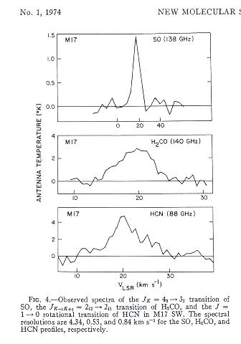

Slide 22
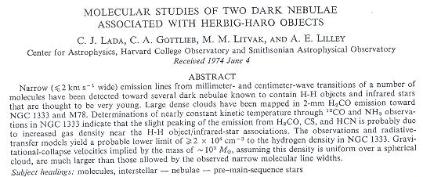
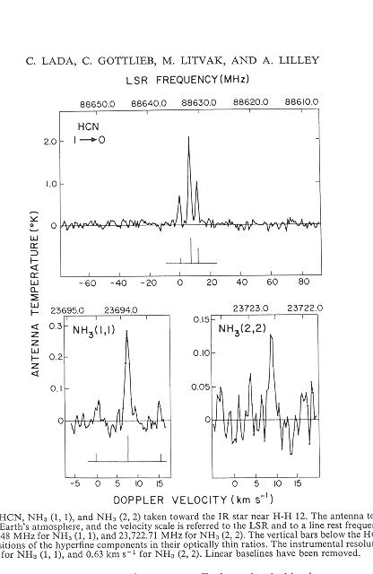
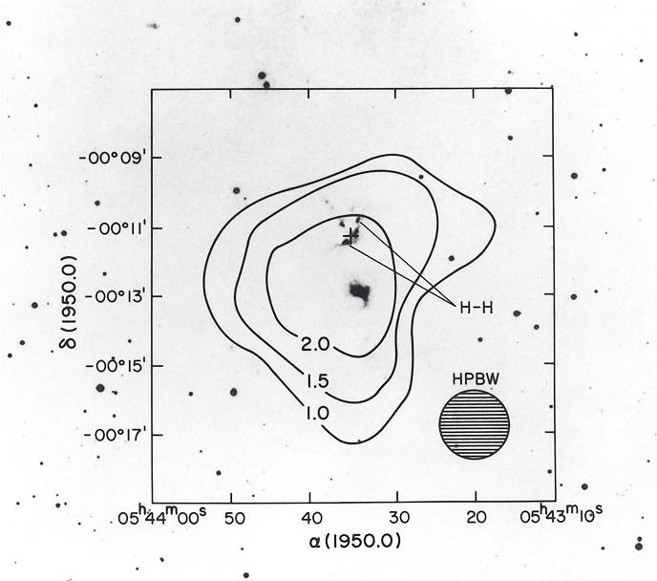

Slide 23
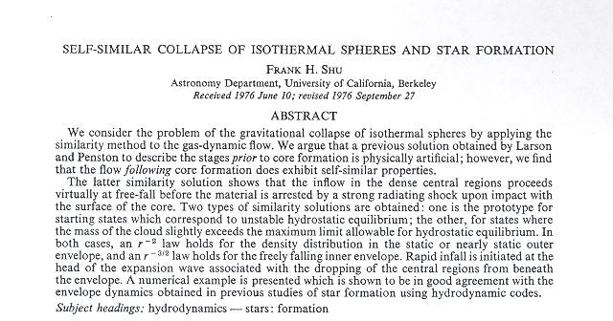
“ In conclusion, the results are consistent with the notion that globules are small, collapsing, and/or rotating dark nebulae which could be locations for future star formation.”

Slide 24
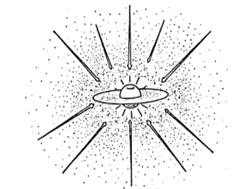

Slide 25
And then there was Phil & Priscilla
And all was light!!!

Slide 26
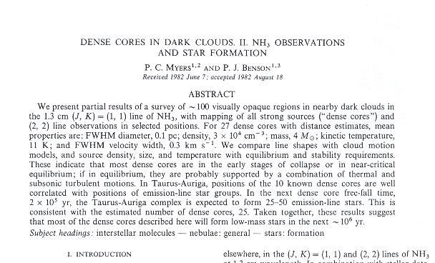
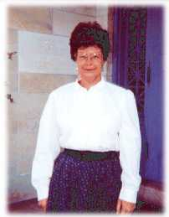
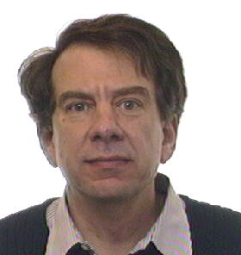
THE END!

