Slide 1
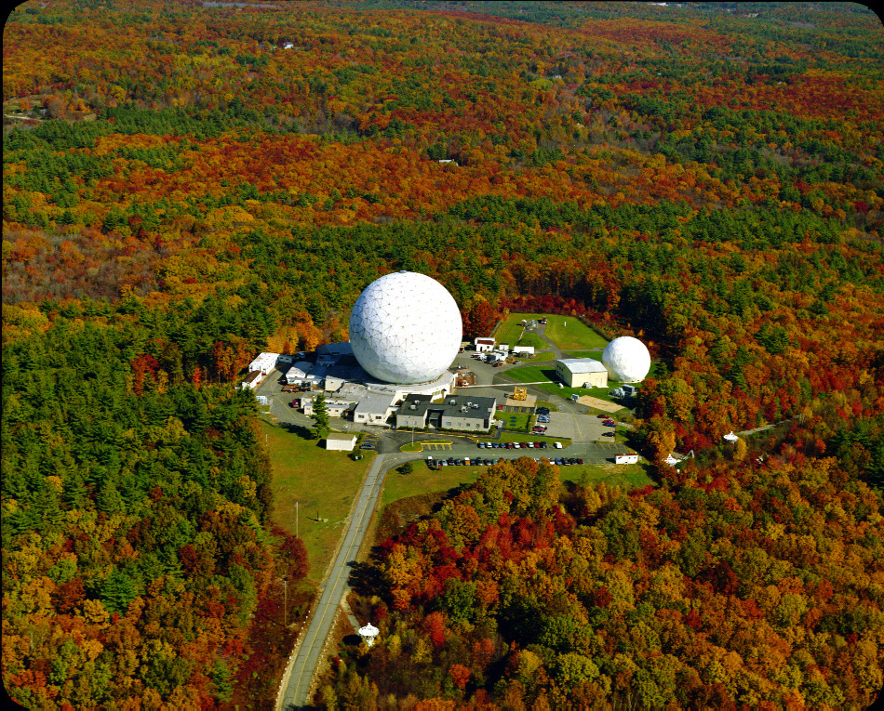
The Upgrade of the Haystack 37-m
Antenna
Lynn D. Matthews
MIT Haystack Observatory

Slide 3
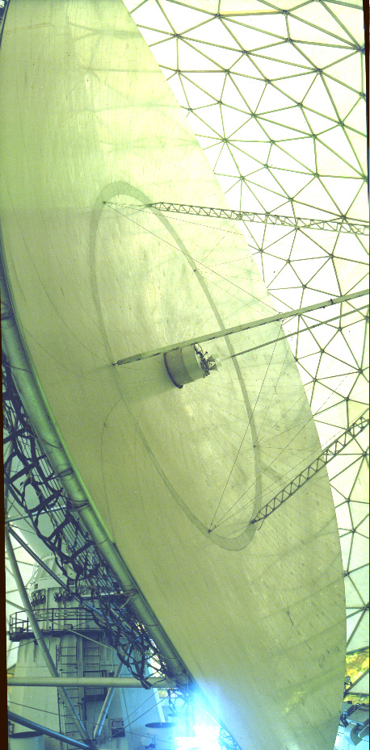
Two views of the 37-m Telescope

Slide 4
A Brief History of the Haystack 37-m Antenna
1964: “Haystack Microwave Research Facility” completed in
Tyngsborough, MA; supported by US Air Force
Characteristics: radome-enclosed 120-ft (36.6-m) parabola; alt-az mount;
Cassegrain focus; solid aluminum panel surface
Initial operating frequencies: 8-10 GHz ; 8 GHz radar
July 1970: Operations shifted to university consortium (NEROC)
HMRF ➔ Haystack Observatory
January 1971: Phil begins part of his PhD thesis work at Haystack
(“Microwave Observations of Molecular Spectral
Lines in Galactic Clouds’’)

Slide 5
Haystack Observatory c. 1968

Slide 6
Haystack Control Room, late 1960 s
Notes:
Stan Zisk (right); Arnold Kaminksy (left)
Univac 490 computer used for pointing; CDC3300 computer used for processing.

Slide 7
Phil and PhD thesis advisor, Al Barrett
MIT, June 1987

Slide 8
Examples of science done by Phil & collaborators using the Haystack 37-m Antenna
Search for 2²P_{3/2}−2²S_{1/2} fine structure
transition of H in HII regions
Myers & Barrett 1972

Slide 9
Examples of science done by Phil & collaborators using the
Haystack 37-m Antenna (cont.)
NH₃ surveys of dense
cores
Myers & Benson 1983;
Benson & Myers 1989

Slide 10
Examples of science done by Phil and collaborators using the
Haystack 37-m Antenna (cont.)
Discovery of infall signatures in
dense cores containing embedded
protostars through observations of
N₂H⁺, C₃H₂, H₂CO
Myers et al. 1995

Slide 11
Examples of science done by Phil & collaborators using the
Haystack 37-m Antenna (cont.)
First simultaneous survey of neutrals (C₃H₂, CCS) and ions (N₂H⁺) in
dense cores
Benson, Caselli, &
Myers 1998

Slide 12
Examples of science done by
Phil & collaborators using the
Haystack 37-m Antenna (cont.)
Survey of infall motions of 220
starless cores via CS &
N₂H⁺
Lee, Myers, & Tafalla 1999

Slide 13
Previous Upgrades of the Haystack 37-m Antenna
“λ7-mm upgrade’’ (1986-1989):
- replacement of radome membrane
- implementation of active thermal control of critical substructure elements
- adjustment of surface panels to 500 μm rms
“λ3-mm upgrade” (1991-1993):
installation of deformable subreflector
enhanced thermal control of surface
improved radome heating and circulation

Slide 14
Limitations of Existing 37-m Antenna:
Gravitational deformations of primary and differential thermal
expansion of telescope components limit high-frequency
performance:
Aperture efficiency @115 GHz only ~13%
- No operational capabilities at higher frequencies
Inability to rapidly switch between radar/radio astronomy boxes
limits scheduling flexibility
Moreover:
NSF support for Haystack as user facility ceased in May 1998
Control of telescope passed back to Air Force in June 2005
Radiometers were removed and 37-m education programs
ceased in January 2007

Slide 15
A New Life for the 37-m Antenna:
However...
Needs of Air Force (e.g., characterizing microsatellites) has motivated
development of new wideband 95 GHz radar system.
And...
The existing system cannot support such a capability
➔ A new Haystack 37-m upgrade program is currently underway
(funded jointly by Air Force and Defense Advanced Research
Projects Agency and executed by MIT Lincoln Lab).
And...
Funds to re-establish radio science capabilities on new 37-m now
committed by Lincoln Lab.

Slide 16
Ongoing Upgrade of Haystack 37-m Antenna
Plan: replacement of radome
membrane and entire elevation
structure supported by existing
yoke and tower:
- Reflector panels
- Subreflector
Reflector back structure
- Transition structure (drive arcs
and elevation bearings)
Drive and control systems
Equipment box (for radar
receivers and radiometers)
(Existing hydrostatic azimuth
bearing will be retained).
37-m tower and yoke, c. 1962

Slide 17
Specifications:
37-m diameter dish with aluminum panel
surface; improved thermal properties
100 micron rms surface accuracy (~ 3×
improvement)
~40-50% aperture efficiency at 100 GHz
(inclusive of radome losses)
New 3-ply radome membrane (improved
hydrophobicity; similar transmissivity)

Slide 18
37-m Upgrade Timeline:
April 2010: operations with current dish cease
March 2011: new dish in place; begin initial verifications
April 2011: acceptance tests; characterization of radiometer performance
Late 2011: possible early science opportunities?
September 2012: fully operation system
Some recent milestones:
- Back structure completed
- Cast aluminum subreflector complete
- Control system being tested
- Azimuth gear fabricated
- Panel manufacturing complete

Slide 19
Radio Astronomy with the Upgraded 37-m
Expected ~30% of telescope time will be available for science
Radio astronomy feeds will be offset from center axis and subreflector
tilted to provide alignment➔ rapid switching (~5 minutes) between
radar receivers and radiometers will be possible

Slide 20
Radio Astronomy with the Upgraded 37-m (cont.)
Initially 3 radio astronomy receivers available:
1.3 cm/36-49 GHz (Q-band): 1 GHz BW, T_{sys}~120 K (above atmos.)
7 mm/20-25 GHz (K-band): 1 GHz BW, T_{sys}~120-200 K
3mm/86-116 GHz (W-band): T_{sys}~200-500 K
(new W-band radiometer with HEMT amplifiers will replace old system
with SIS mixers)
New RF Box
for radar
and radio
astronomy
systems

Slide 21
Radio Astronomy with the Upgraded 37-m (cont.)
Existing digital autocorrelator will be re-installed:
- 4096 lags, 4 independent modules
Bandwidth: 0.65 to 160 MHz
Channel spacing Δν: 0.16 to 312 kHz
New wideband digital spectrometer being built (some details not yet
finalized):
up to 15 GHz bandwidth
(Very) large number of spectral channels
3 pairs of independent dual polarization hardware channels (providing
ability to observe multiple spectral lines simultaneously)

Slide 22
What capabilities would make the 37-m most useful to the science
community?
(Caveat: there is no funding yet!)
Additional frequency bands?
(Radome transparency window exists at 230 GHz freq.; ~10 nights/yr
with opacities ~0.3)
VLBI capabilities? Which bands? 22 GHz? 43 GHz? 230 GHz?
Focal plane array?
Unique scientific niches?—e.g.,
- Long-term monitoring programs?
- Rapid response science?
- Key project opportunities?
Student training opportunities?
Other??

Slide 23
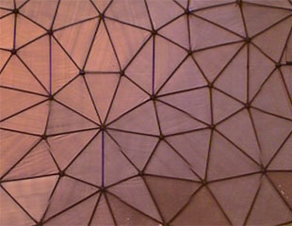
Additional thoughts or comments?
lmatthew@haystack.mit.edu

