Slide 1
Medición de contaminantes atmosféricos desde
plataformas satelitales
(principalmente TEMPO)
Kelly Chance
Smithsonian Astrophysical
Observatory
tempo.si.edu
29 de Junio de 2016

Slide 2


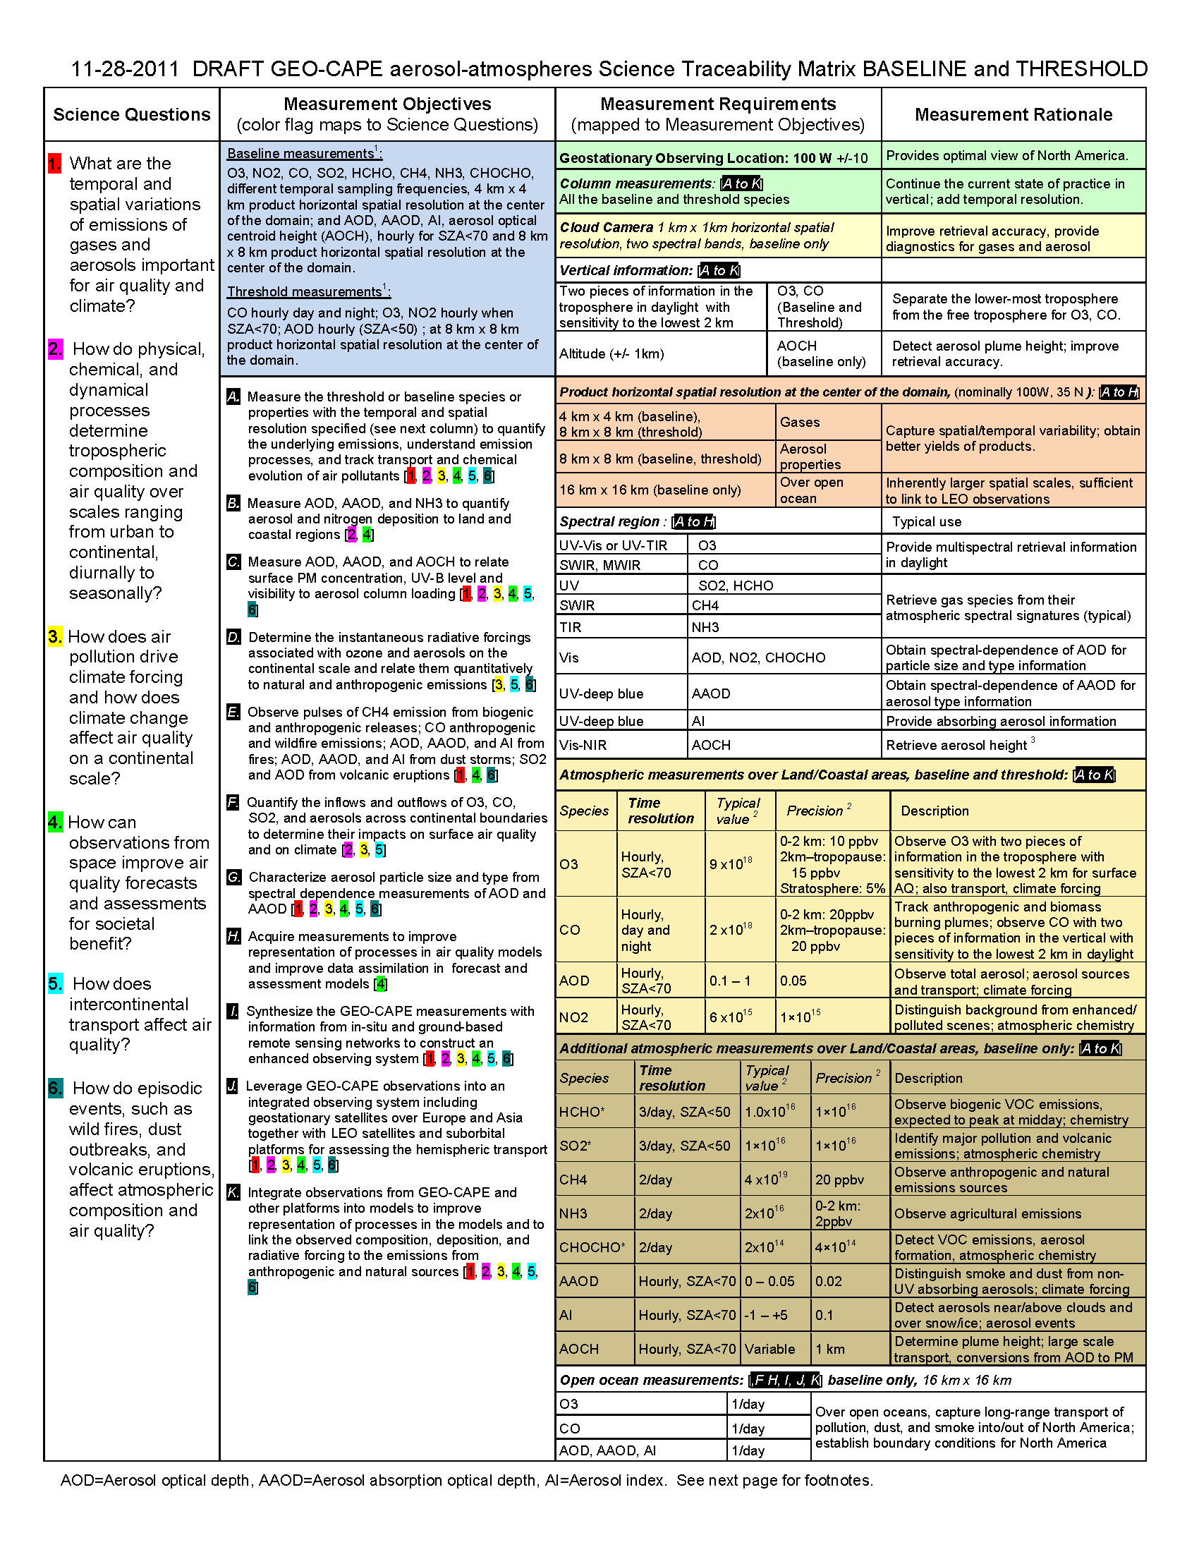

Air quality requirements from the GEO-CAPE Science Traceability Matrix

Slide 3
Infrared
species
Ultraviolet/
visible
species
(GOME,
TEMPO,
etc.)

Slide 4
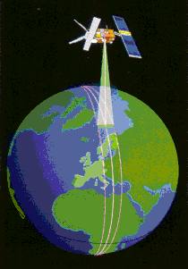
Our first: ESA Global Ozone Monitoring Experiment
Low Earth orbit (LEO)
  Sun synchronous
Nadir-viewing UV/vis/NIR
  240-400 nm @ 0.2 nm
  400-790 nm @ 0.4 nm
Launched April 1995, turned off July 2011
Footprint 320 × 40 km²
10:30 am cross-equator time, descending node
Global coverage in 3 days

Slide 5
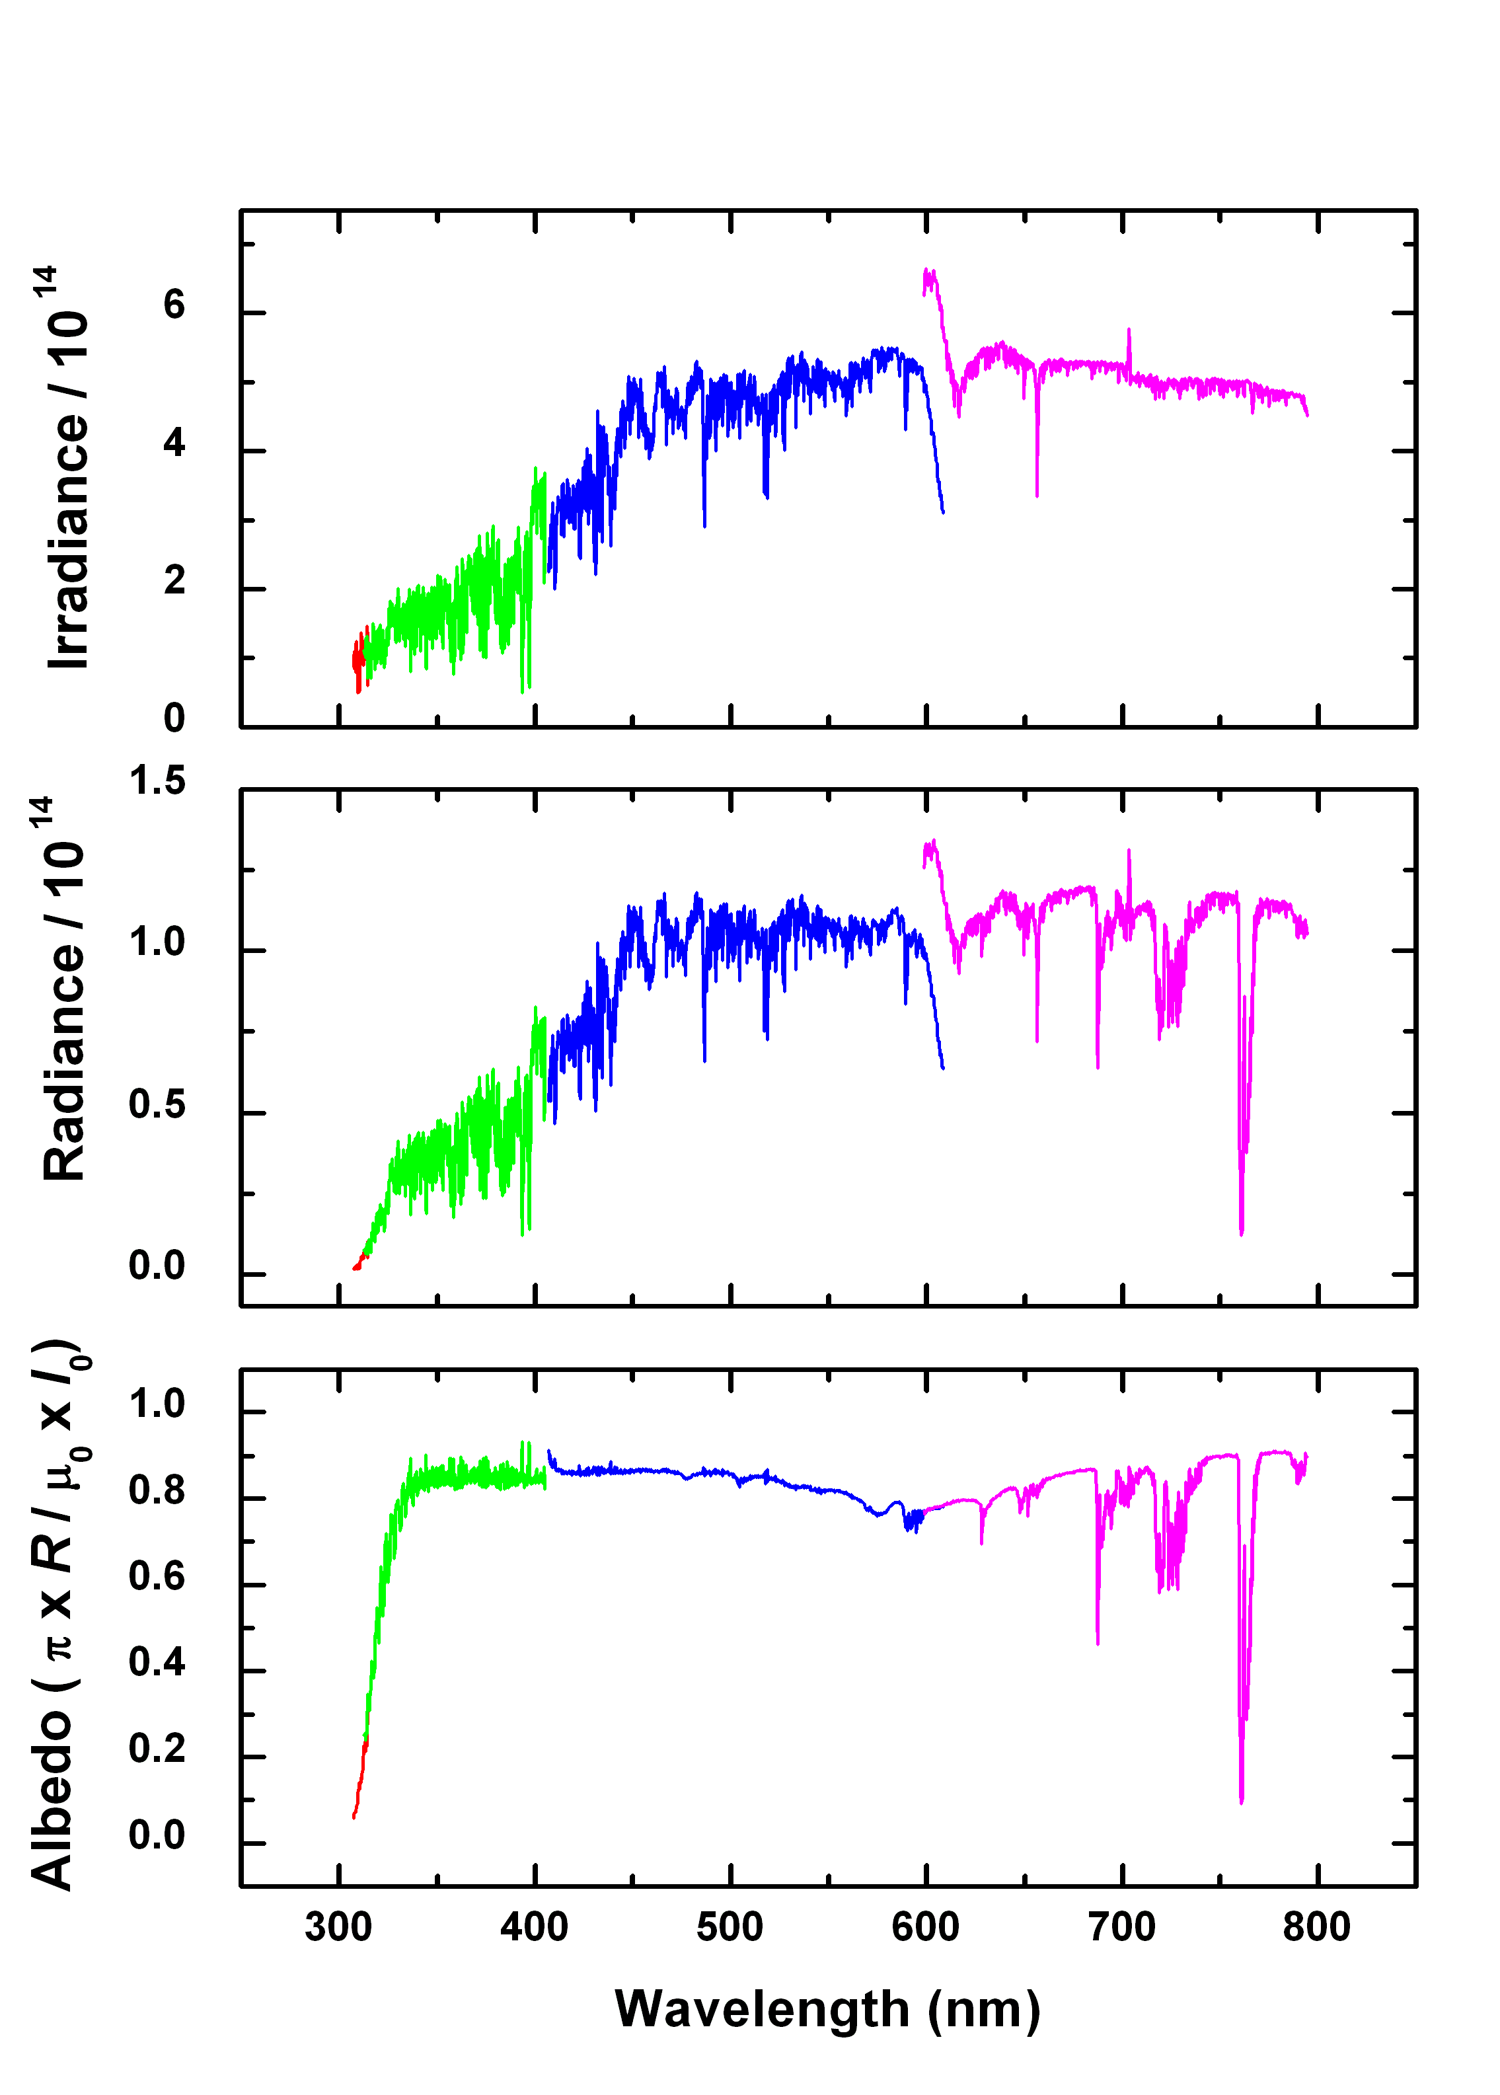
What do we measure?
GOME irradiance, radiance, and albedo spectrum for high-albedo (fully cloudy) ground pixel

Slide 6
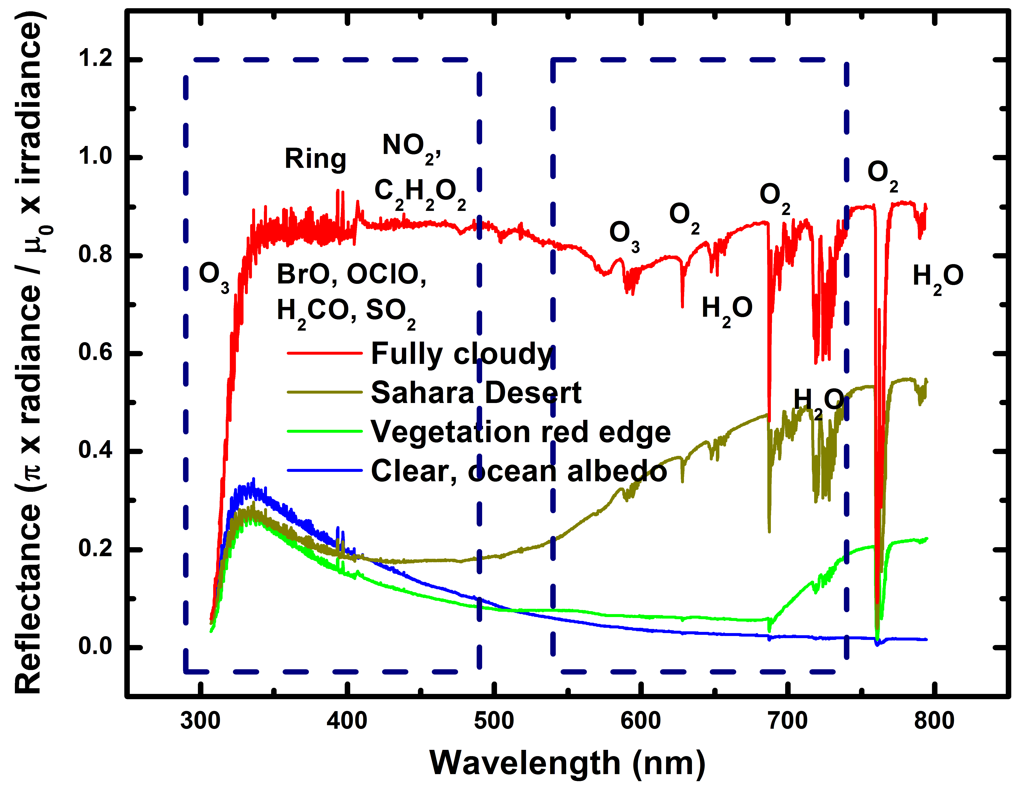
Typical TEMPO-range spectra (from ESA GOME-1)

Slide 7
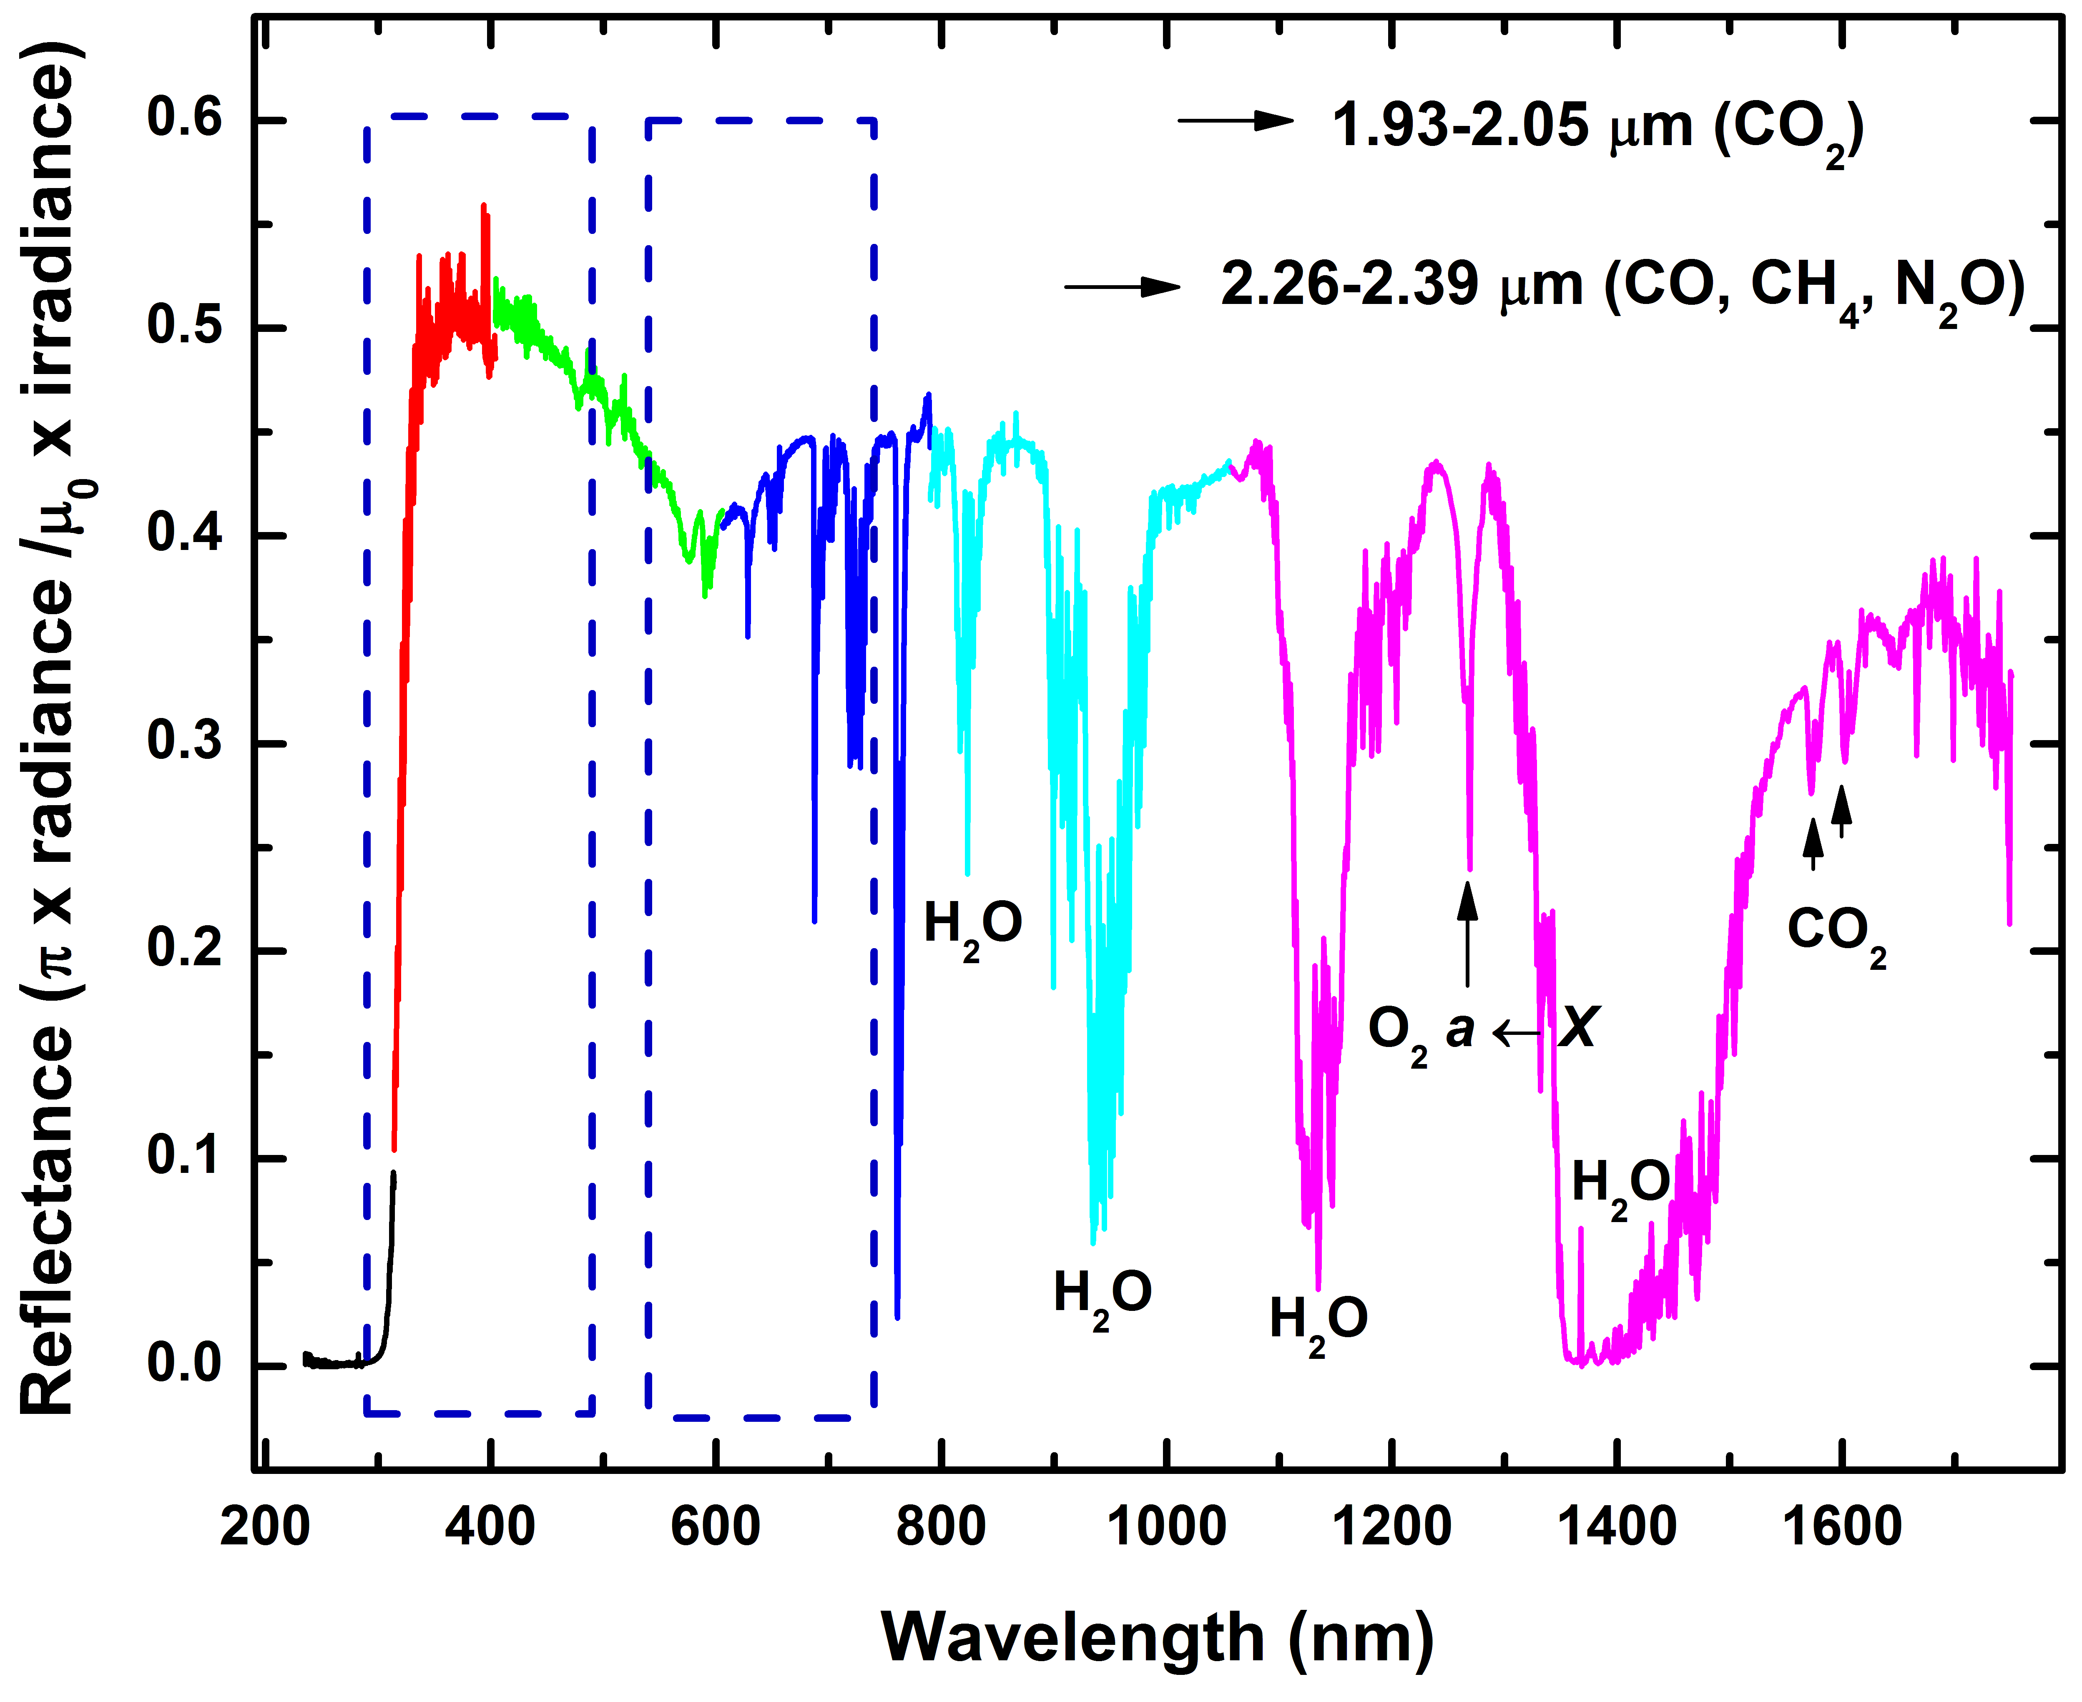
Typical TEMPO-range spectra (from SCIAMACHY, 2002-2012)

Slide 8
Low Earth orbit:
Sun-synchronous nadir heritage
Instrument | Detectors | Spectral Coverage [nm] | Spectral Res. [nm] | Ground Pixel Size [km²] | Global Coverage
GOME-1 (1995-2011)‏ | Linear Arrays | 240-790 | 0.2-0.4 | 40×320 (40×80 zoom) | 3 days
SCIAMACHY (2002-2012)‏ | Linear Arrays | 240-2380 | 0.2-1.5 | 30×30/60/90 30×120/240 | 6 days
OMI (2004)‏ | 2-D CCD | 270-500 | 0.42-0.63 | 13×24 - 42×162 | daily
GOME-2a,b (2006, 2012) | Linear Arrays | 240-790 | 0.24-0.53 | 40×80 (40×10 zoom) | near-daily
OMPS-1 (2011) | 2-D CCDs | 250-380 | 0.42-1.0 | 50×50 | daily
Previous experience (since 1985 at SAO and MPI)
Scientific and operational measurements of pollutants O₃, NO₂, SO₂, H₂CO, C₂H₂O₂ (& CO, CH₄, BrO, OClO, ClO, IO, H₂O, O₂-O₂, Raman, aerosol, ….)

Slide 9
LEO measurement capability
A full, minimally-redundant, set of polluting gases, plus aerosols and clouds is now measured to very high precision from satellites. Ultraviolet and visible spectroscopy of backscattered radiation provides O₃ (including profiles and tropospheric O₃), NO₂ (for NO_{x}), H₂CO and C₂H₂O₂ (for VOCs), SO₂, H₂O, O₂-O₂, N₂ and O₂ Raman scattering, and halogen oxides (BrO, ClO, IO, OClO). Satellite spectrometers we planned since 1985 began making these measurements in 1995.

Slide 10
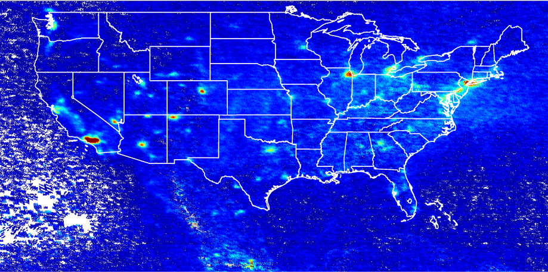
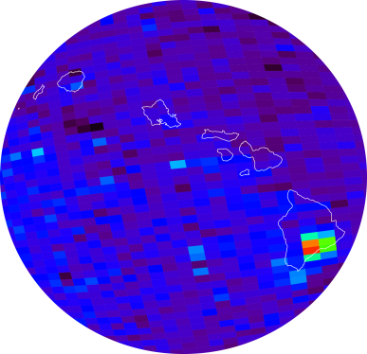
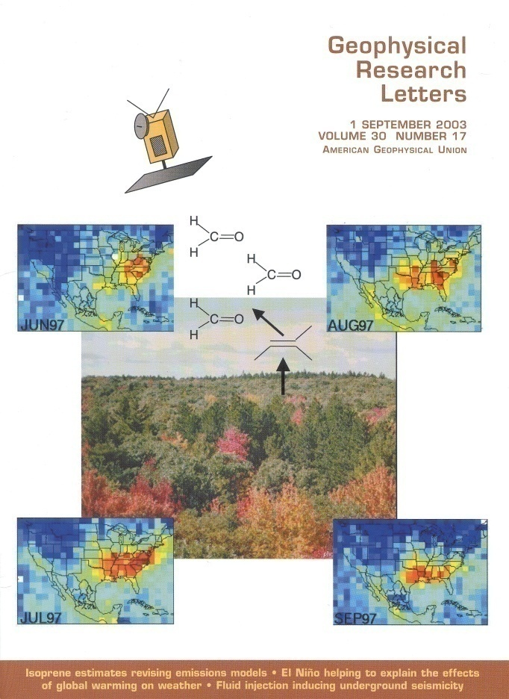
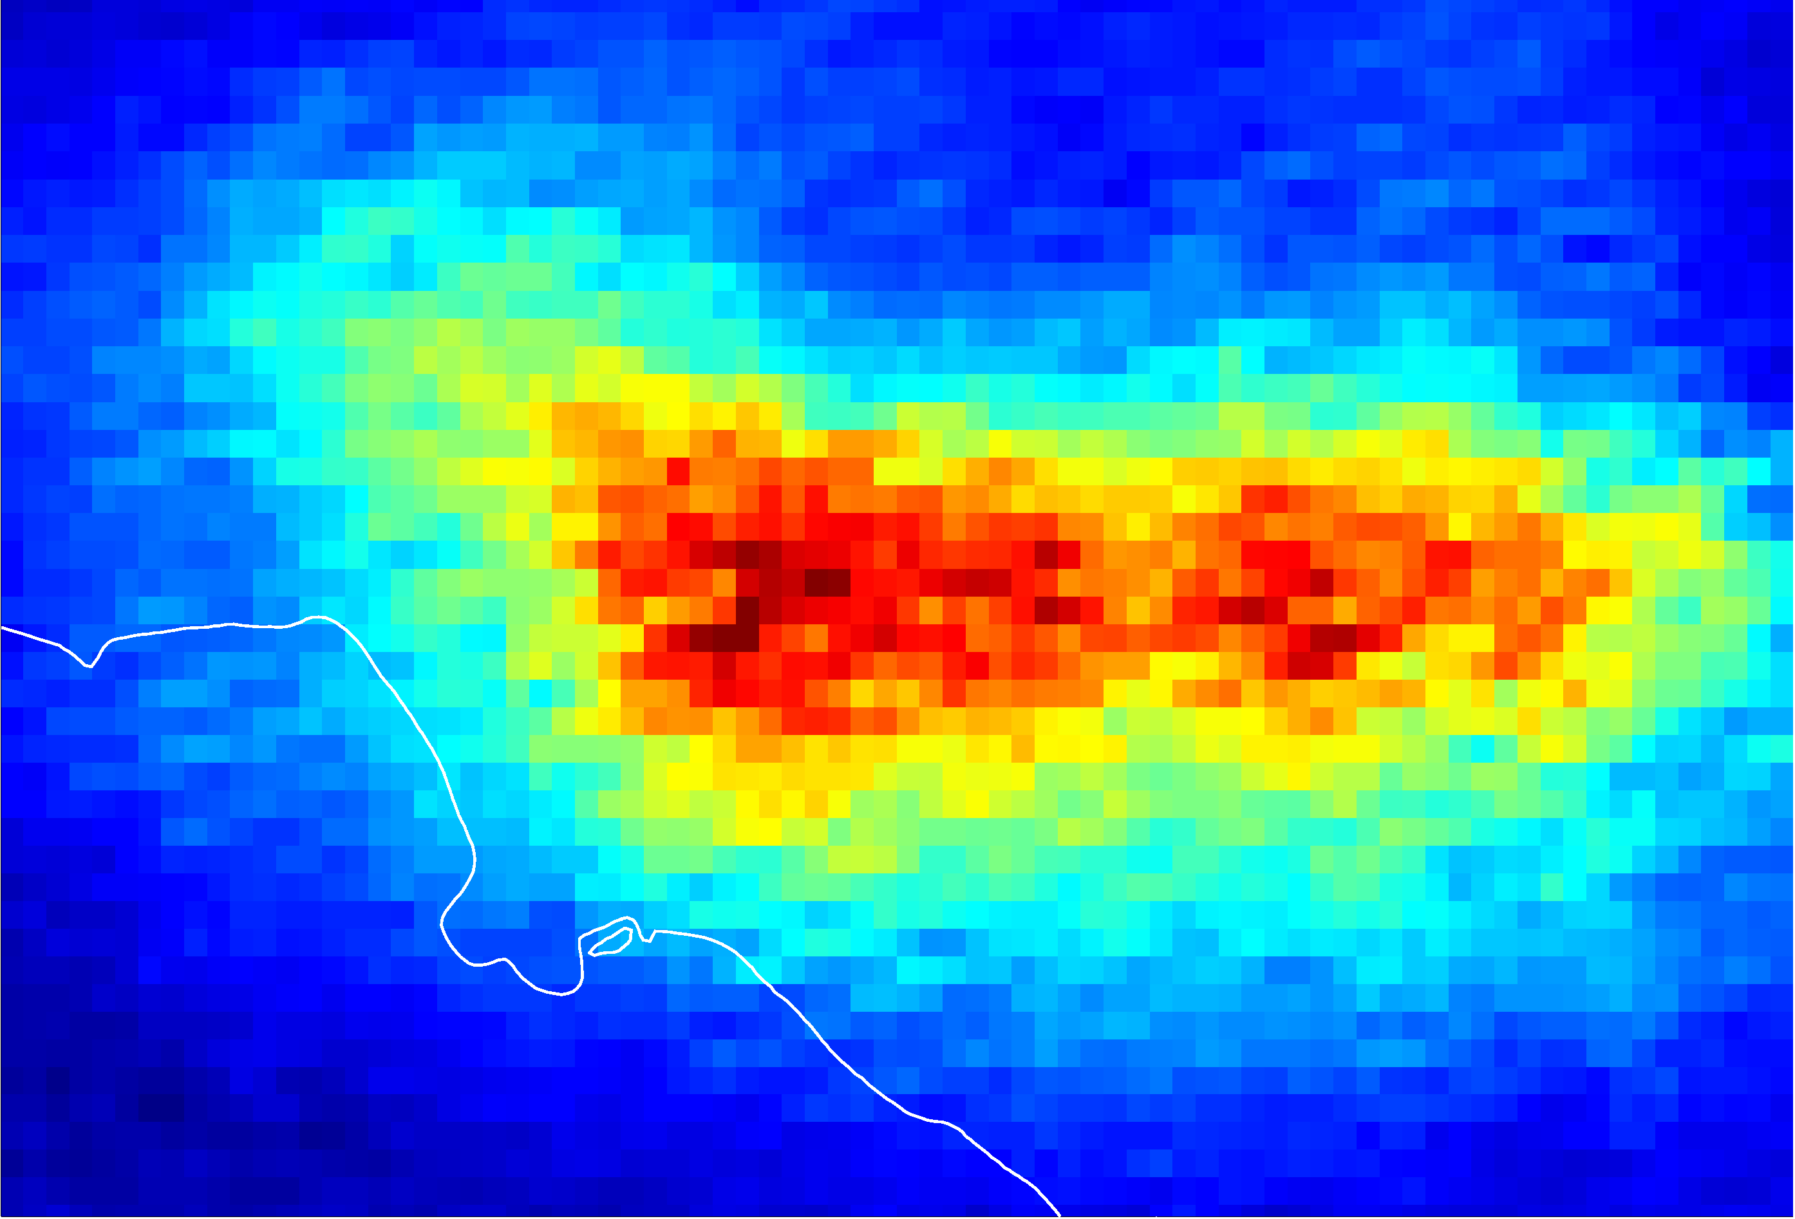
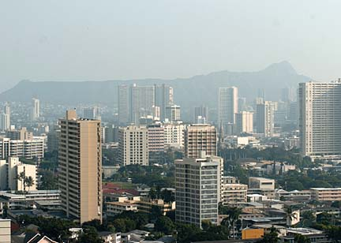
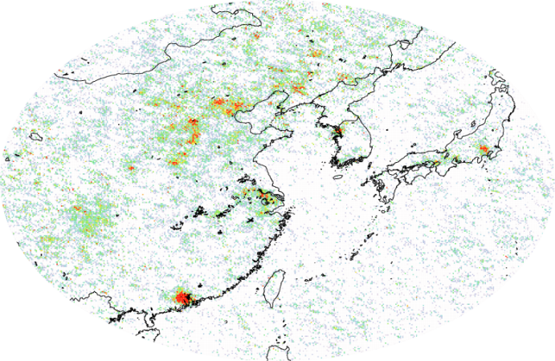
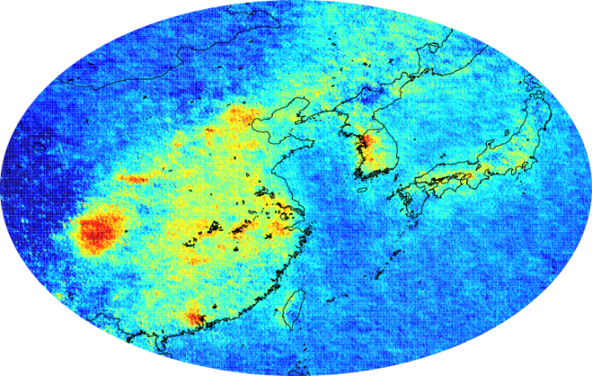
GOME, SCIAMACHY, and OMI measurement examples
NO₂
SO₂
Kilauea activity, source of the VOG event in Honolulu on 9 November 2004
O₃ strat
trop
HCHO
CHOCHO

Slide 11
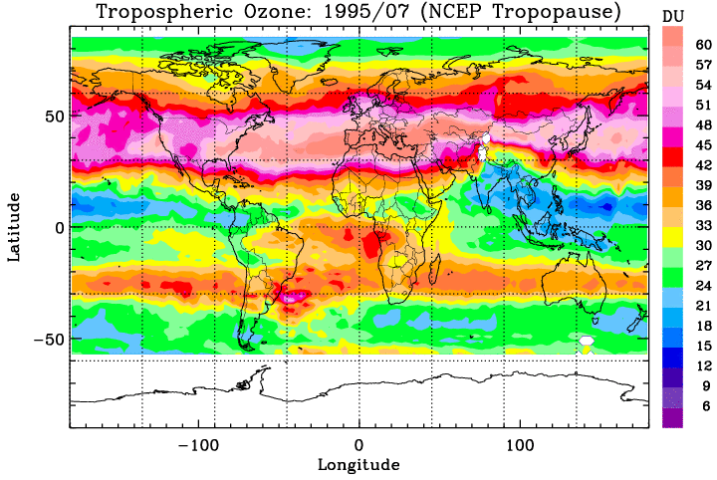

Slide 12
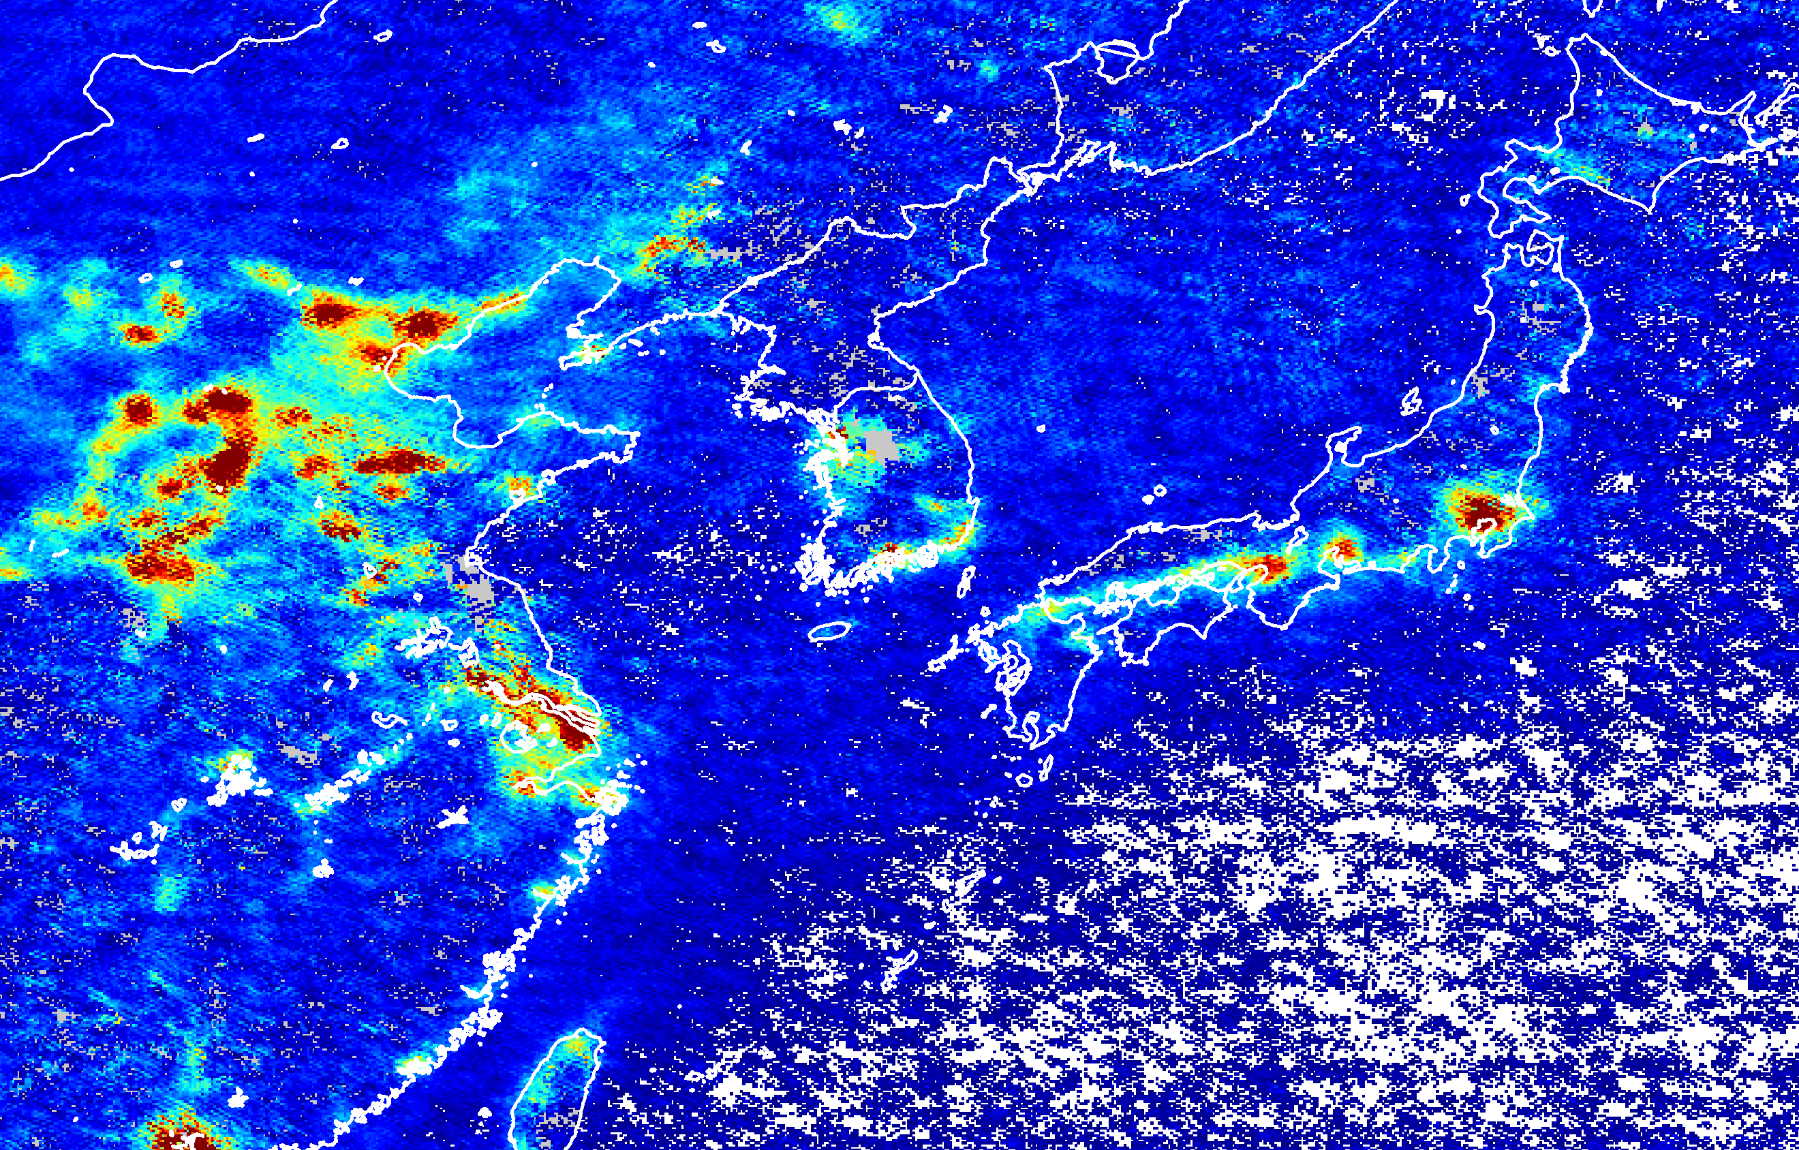

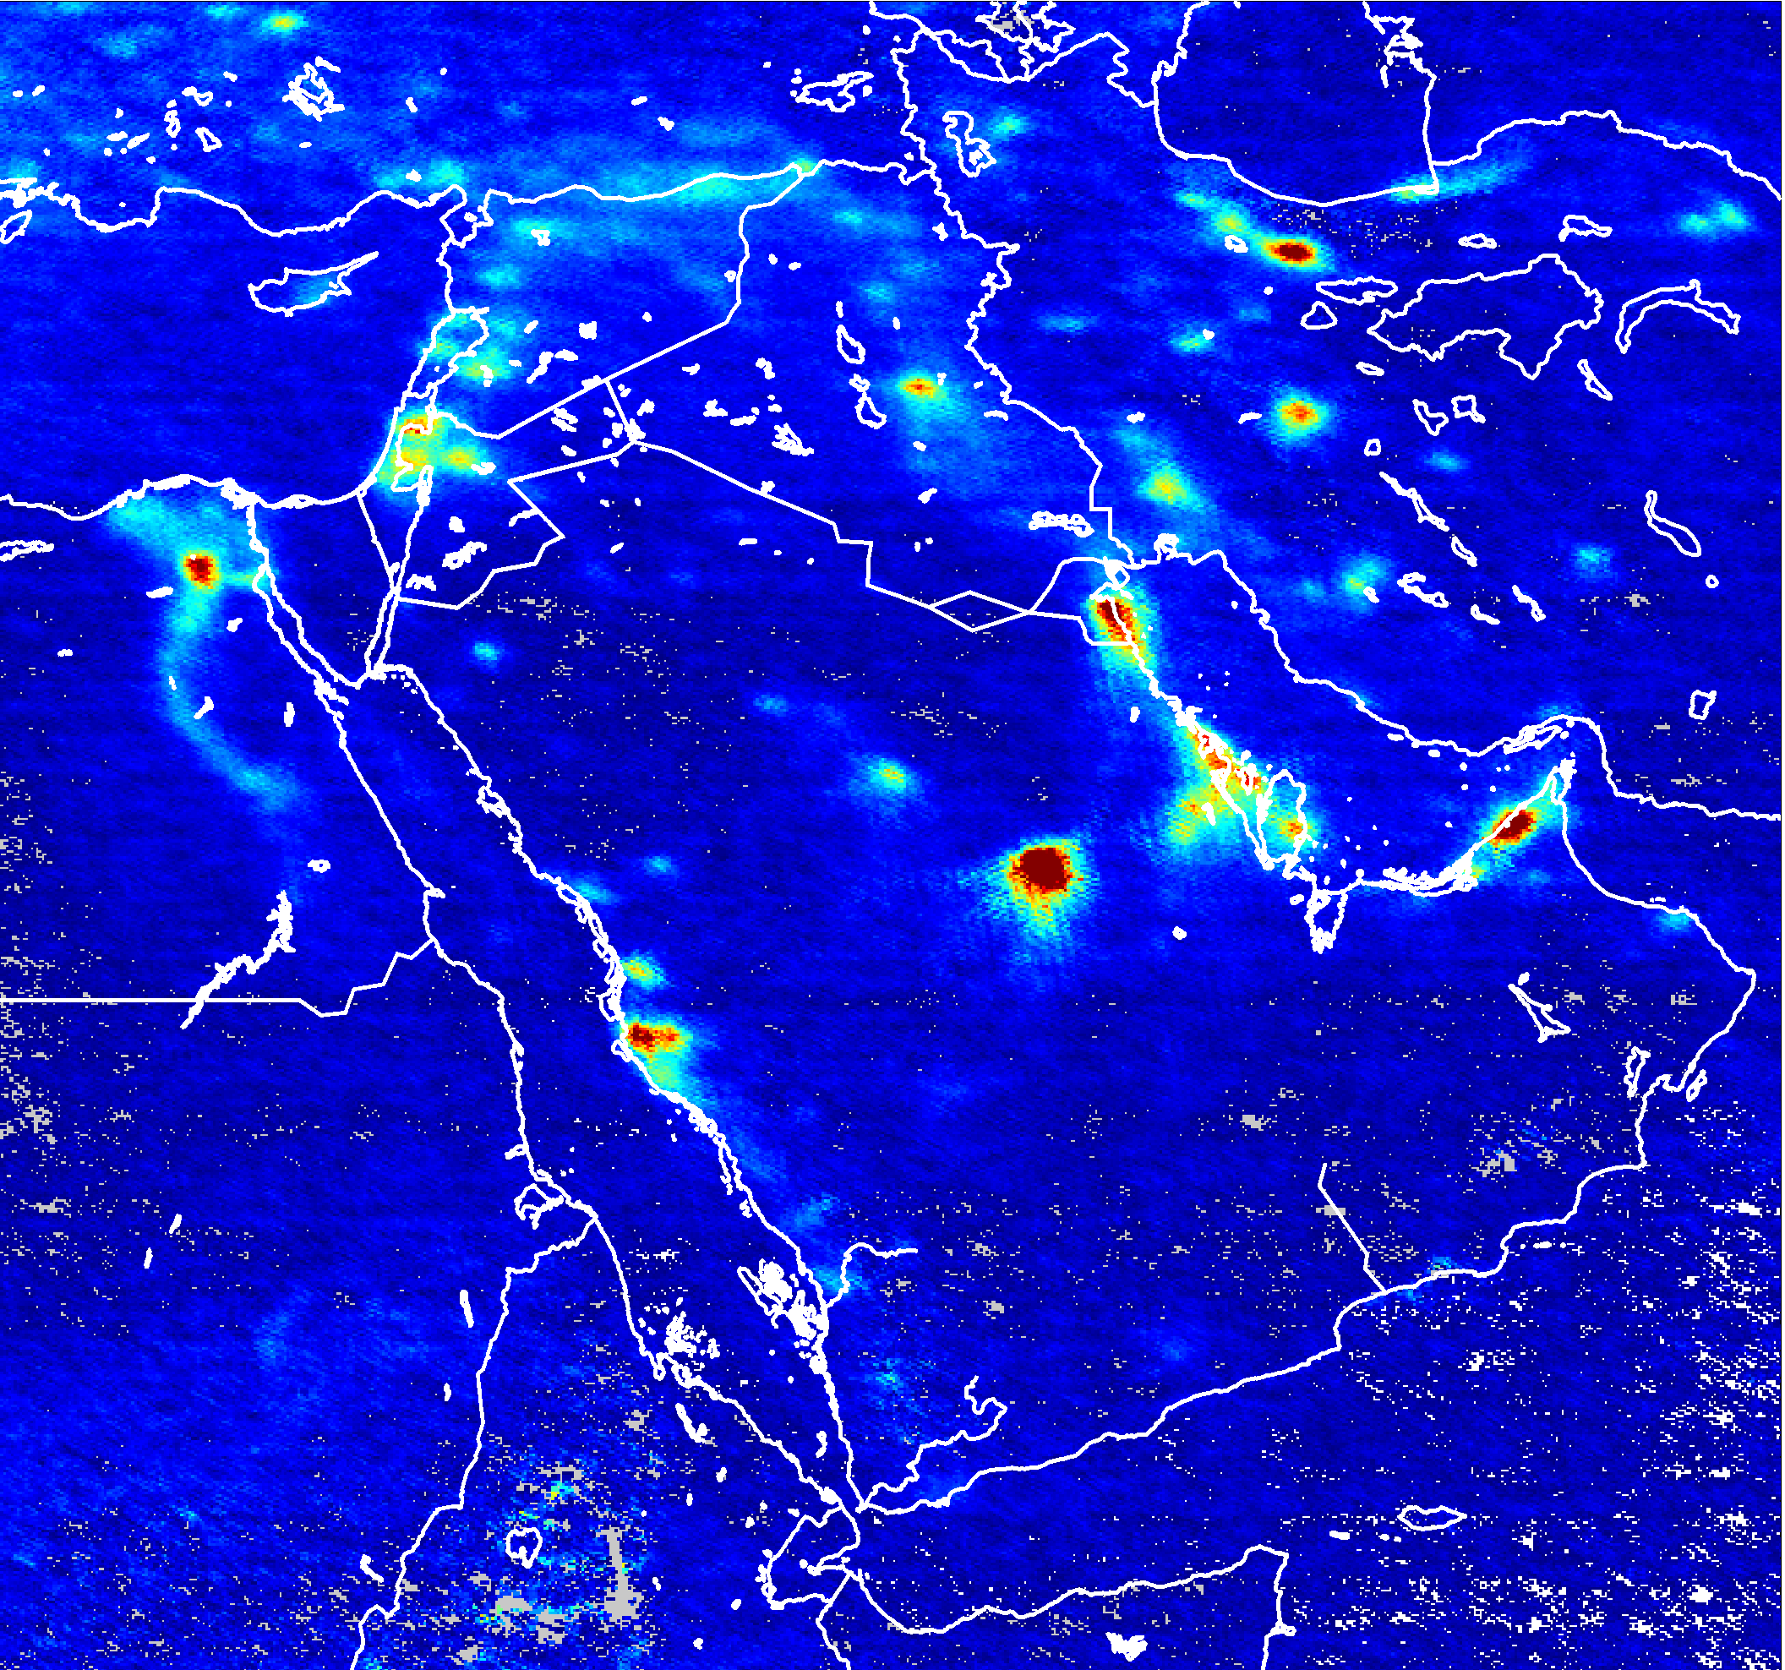
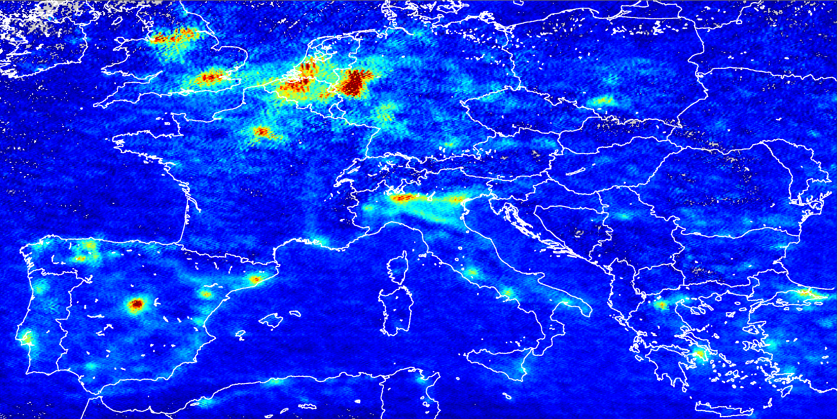
NO₂
Vancouver
Seattle
Minneapolis
Montreal
Portland
Detroit
Chicago
Boston
S.F.
Denver
N.Y.
L.A.
Las Vegas
power station
Phoenix
Atlanta
Dallas
Houston
Miami
Mexico City

Slide 13
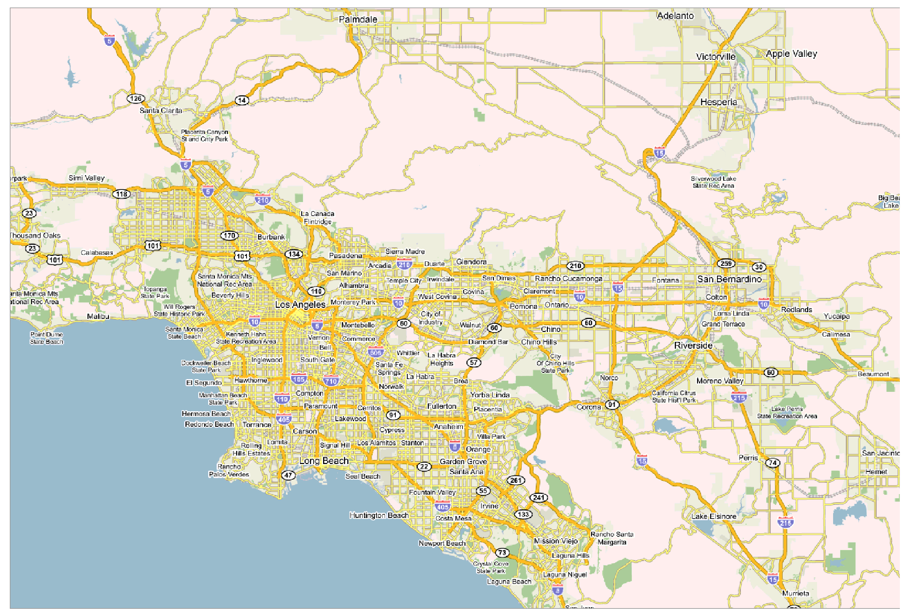
NO₂ - Los Angeles

Slide 14
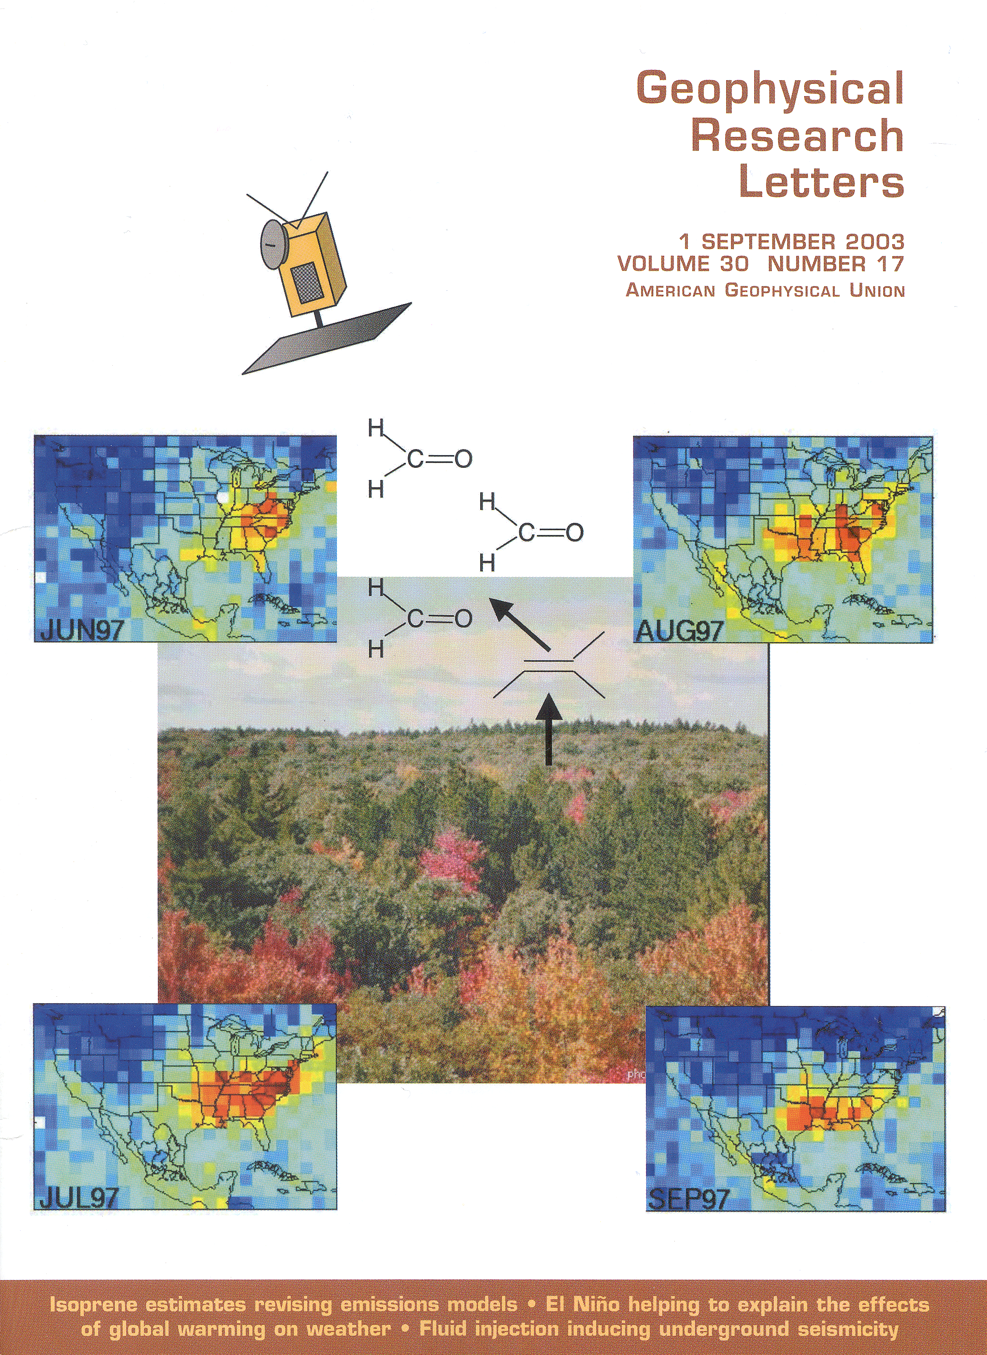
VOC emission inventories derived from H₂CO measurements
Volatile Organic Compound
Produced from Methane oxidation, isoprene emissions
Indicator for Air Quality
Average lifetime: ~1.5 h, against photolysis, OH

Slide 15
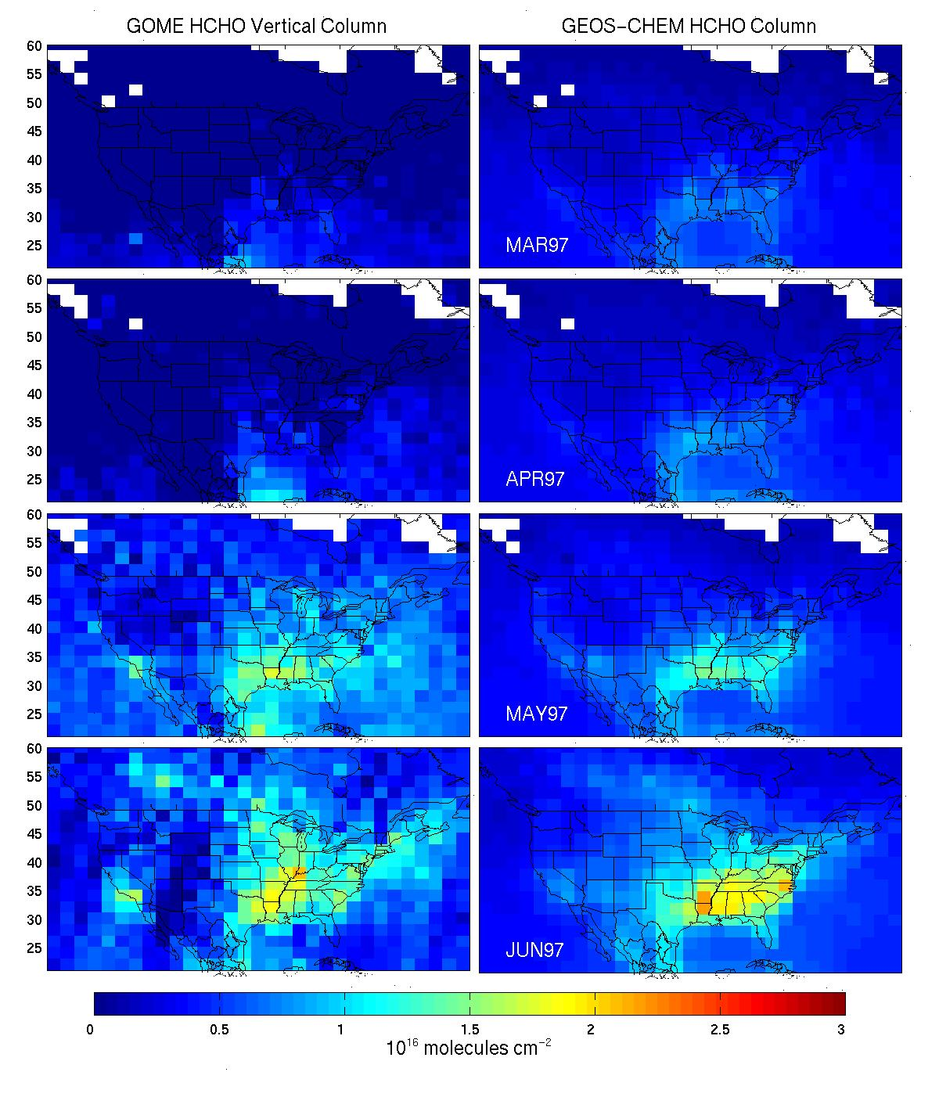
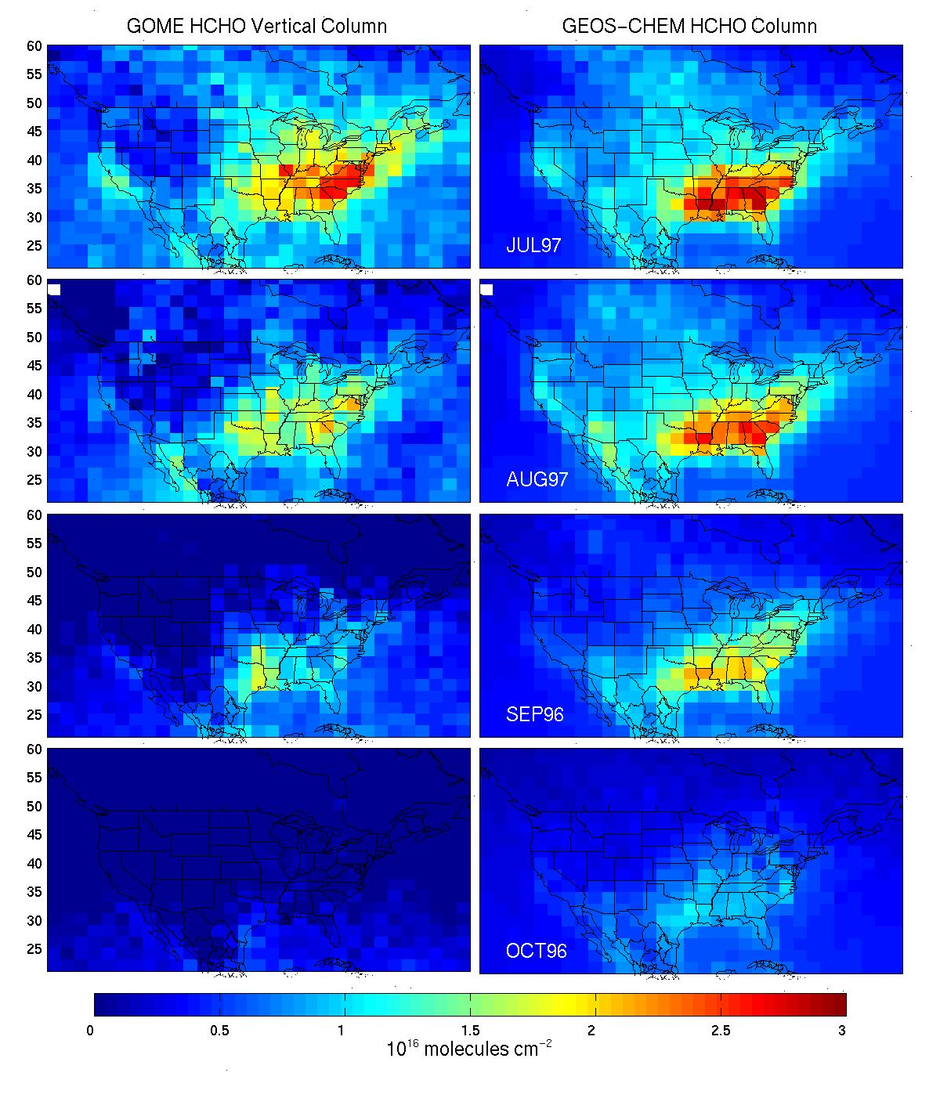
SEASONALITY OF GOME HCHO COLUMNS (9/96-8/97)
Largely reflects seasonality of isoprene emissions; general consistency with GEIA but also some notable differences
GOME GEOS-CHEM (GEIA) GOME GEOS-CHEM (GEIA)
MAR
JUL
APR
AUG
MAY
SEP
JUN
OCT

Slide 16
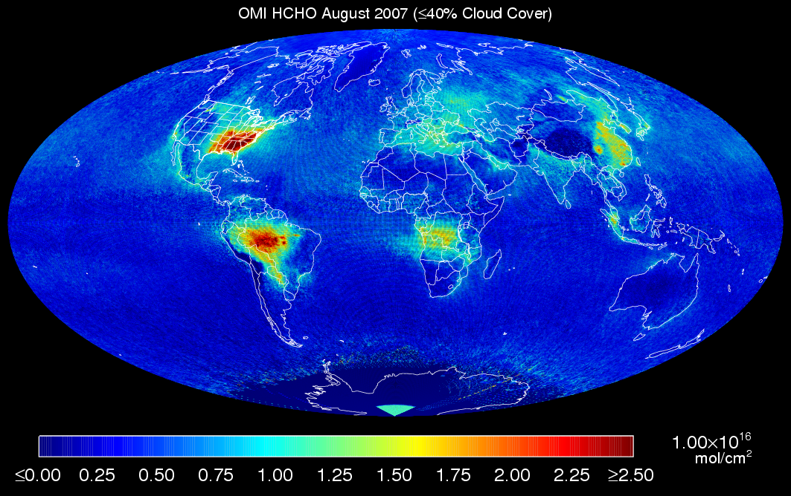

Slide 17
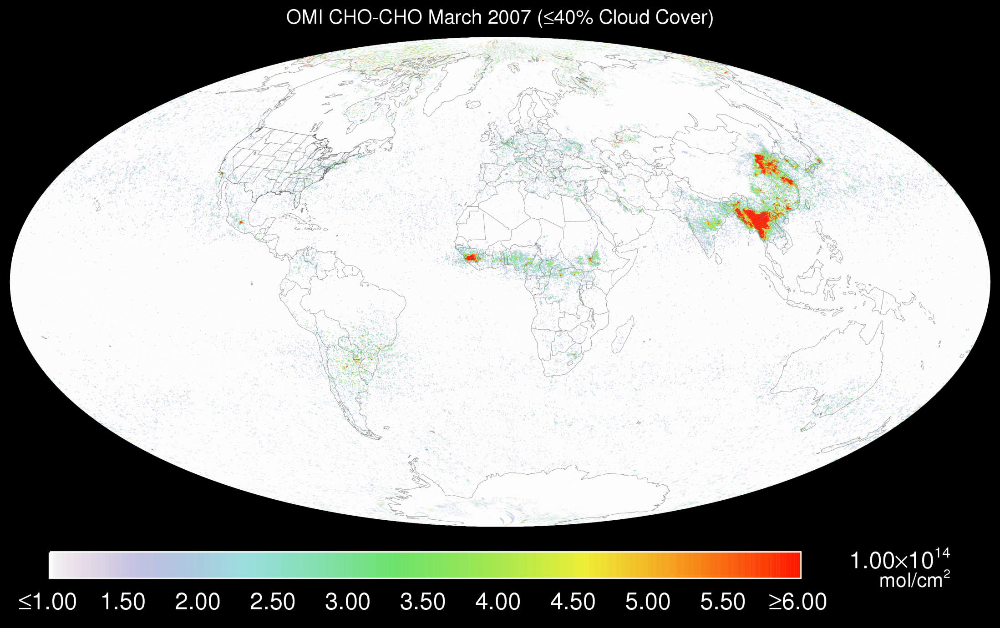
OMI C₂H₂O₂, March 2007 (<40% cloud cover)

Slide 18
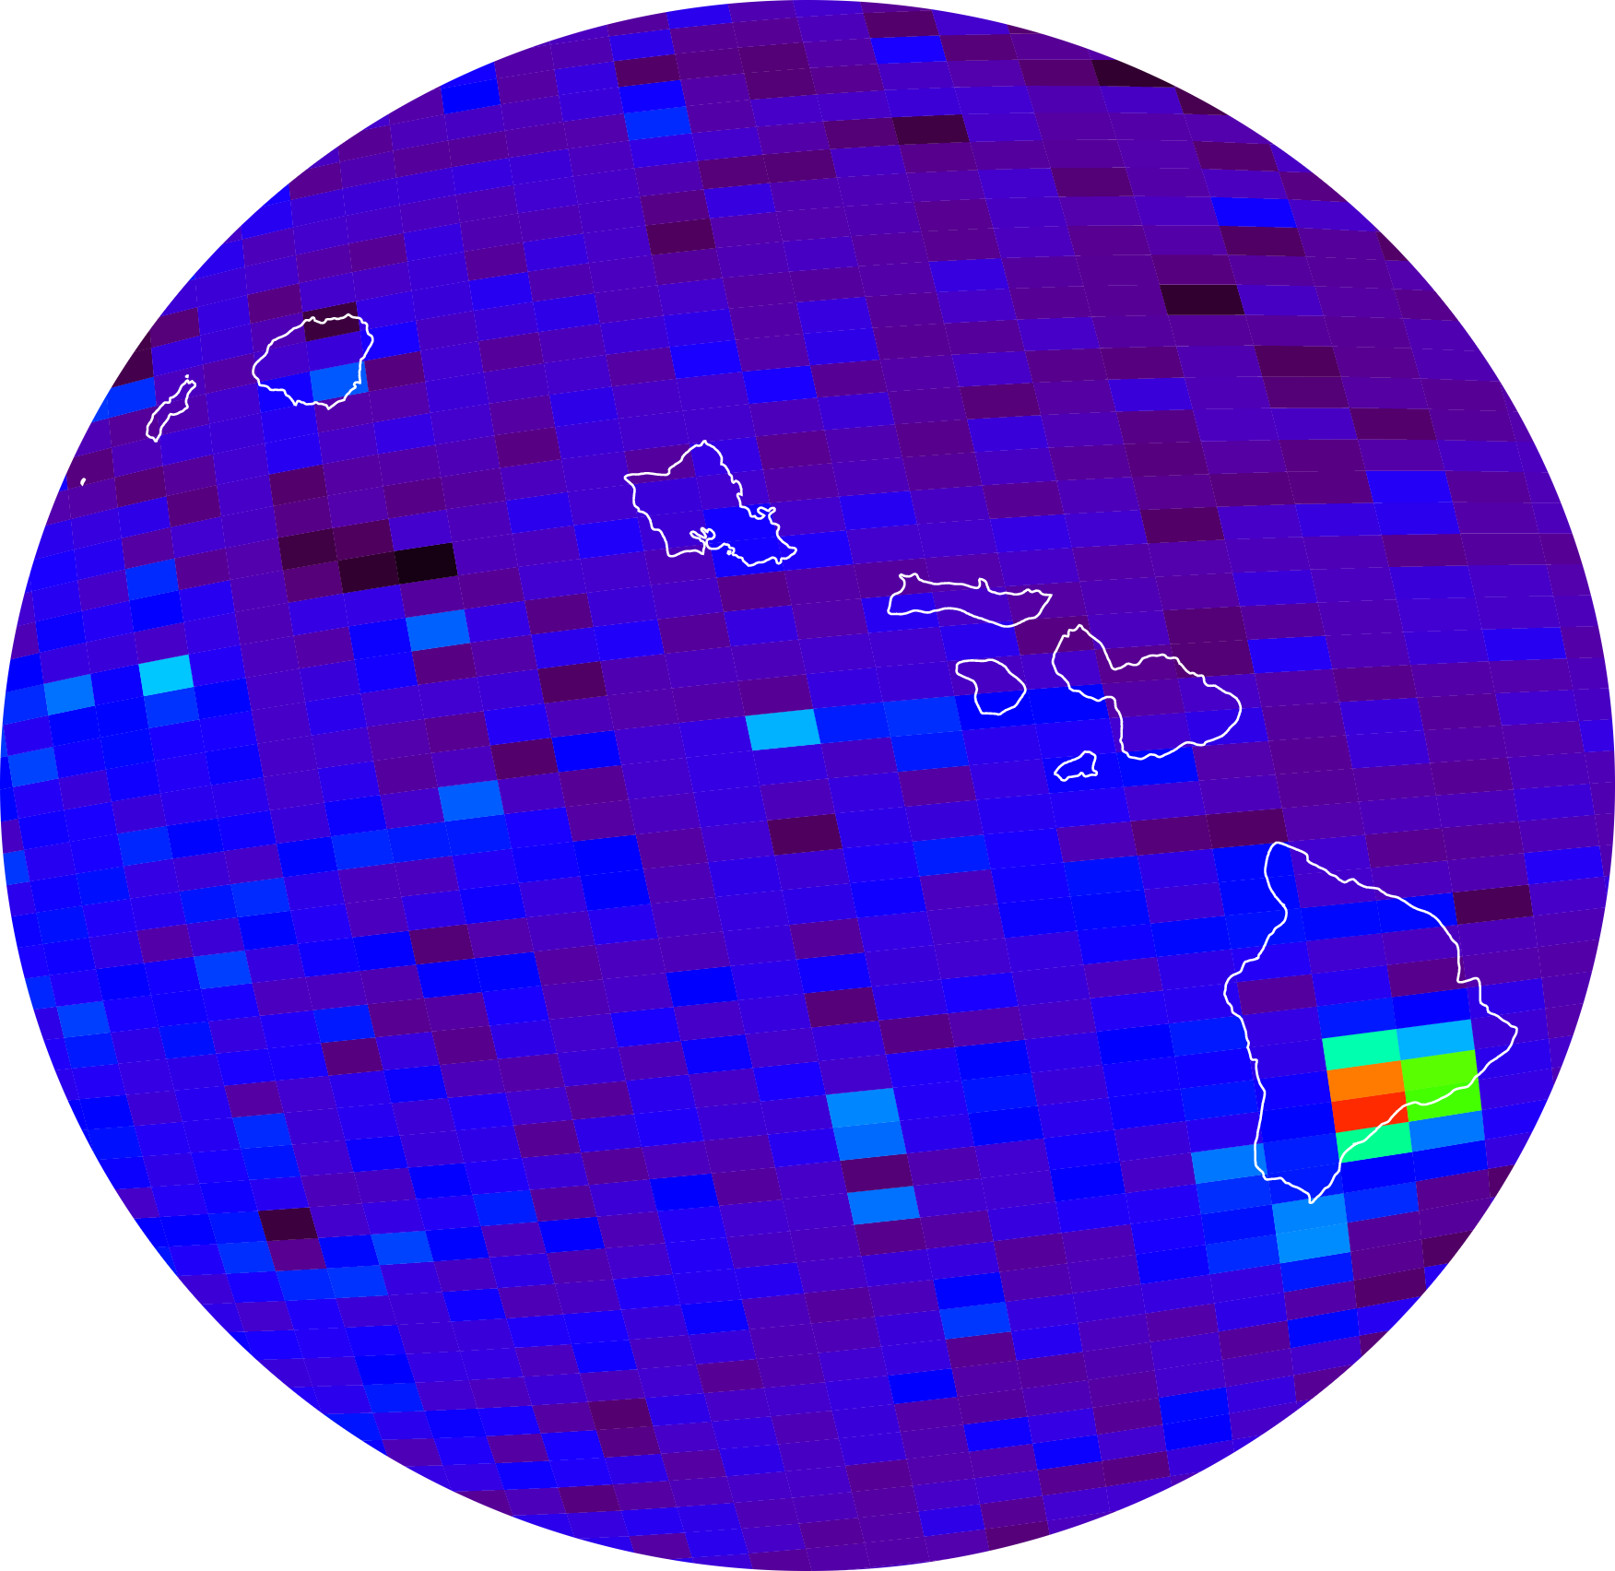
Volcanic (and anthropogenic) SO₂
Kilauea activity, source of the VOG event in Honolulu on 9 November 2004
Air quality forecasting

Slide 19
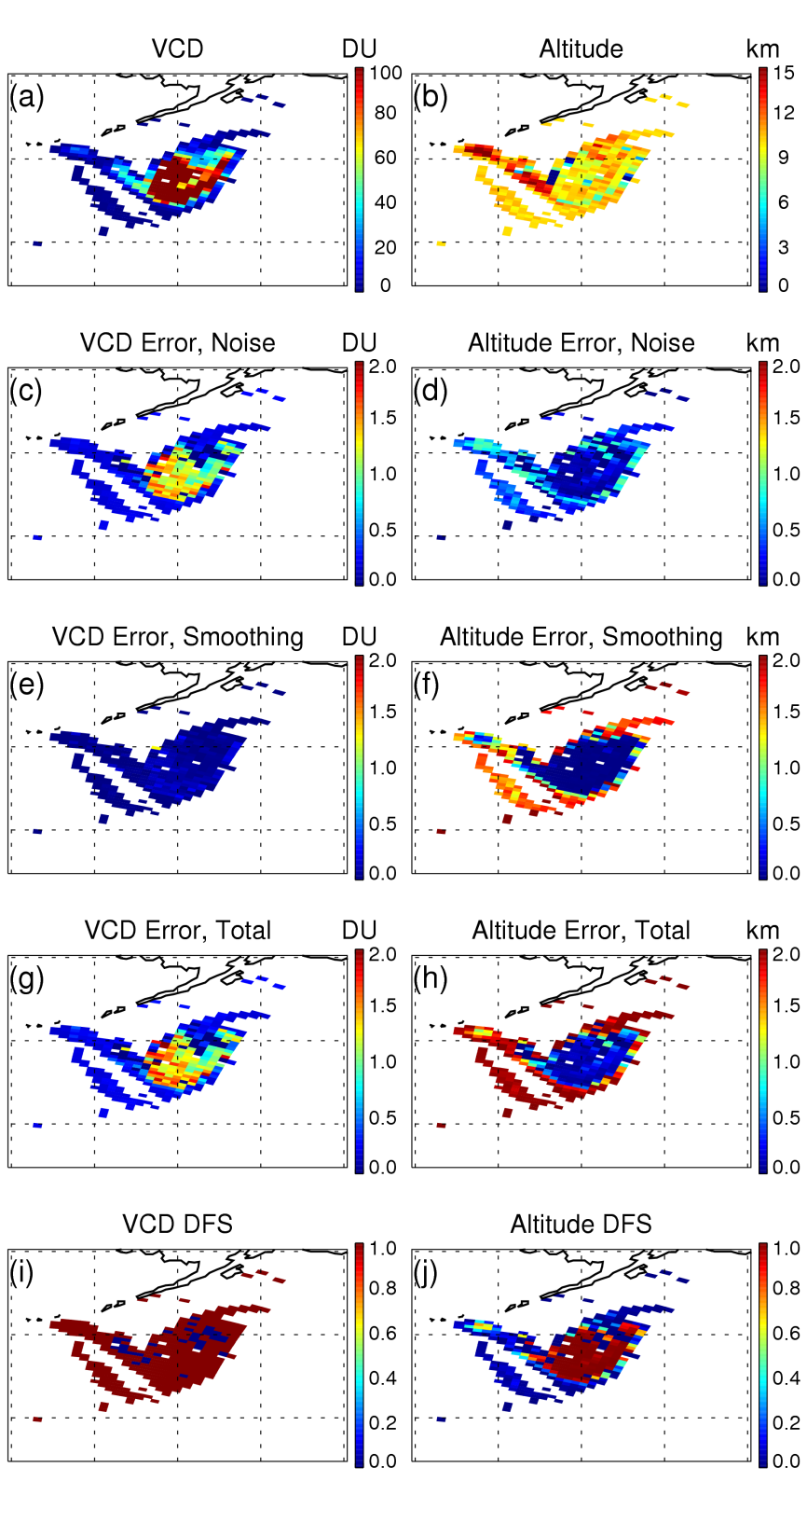
C. Nowlan et al., JGR 2011: GOME-2 SO₂ from optimal estimation
Figure 7. (a, b) SO₂ vertical column density and retrieved SO₂ plume altitude; and their (c, d) measurement noise error; (e, f) smoothing error, (g, h) total solution error; and (i, j) the retrieval degrees-of-freedom for signal (DFS) for the Mt. Kasatochi SO₂ plume on 9 August 2008 for SO2 VCD greater than 1 DU, using z_{ap}=10 km and ε_{zap}=2 km.

Slide 20
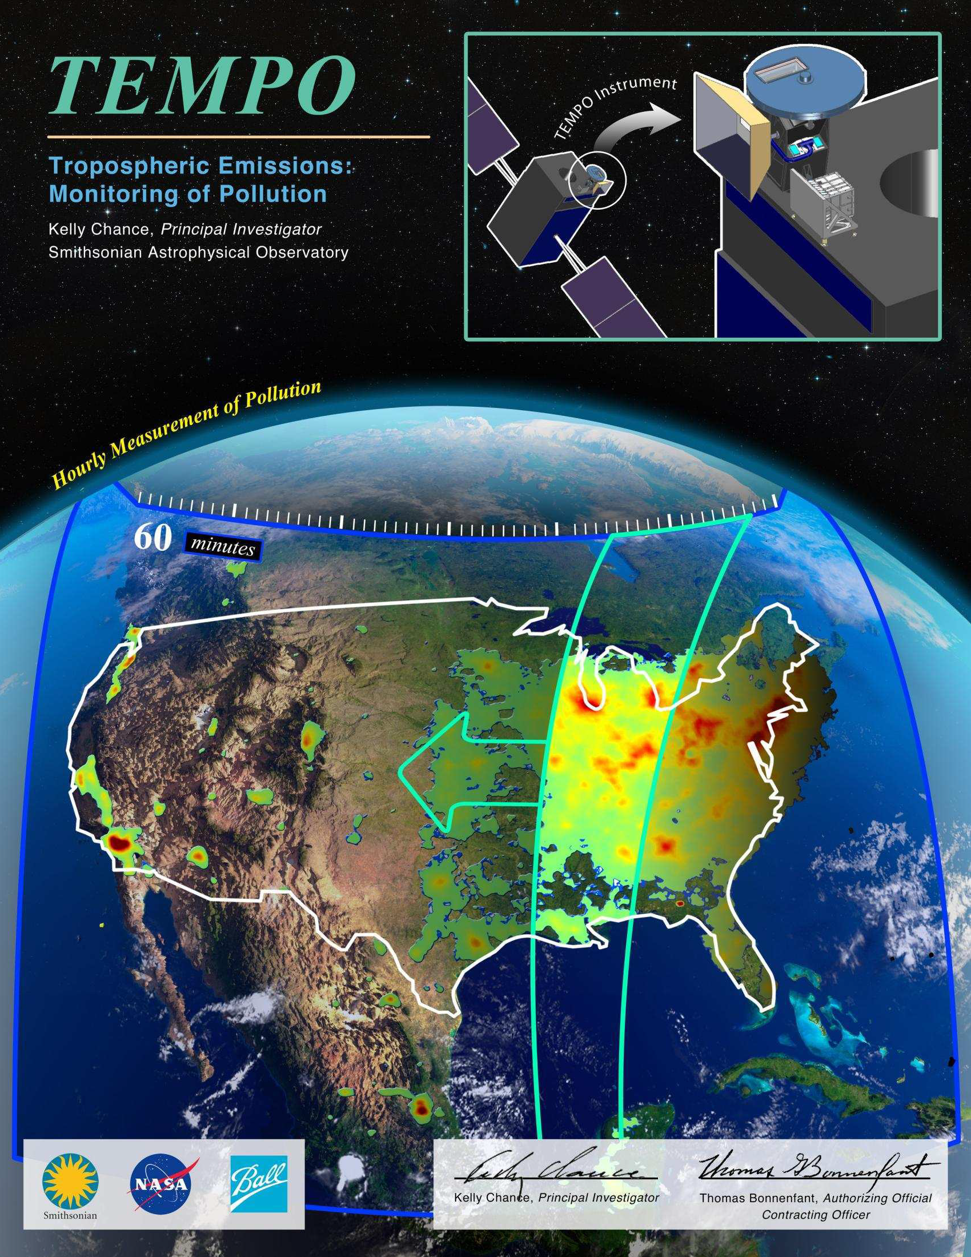
¡On to TEMPO!

Slide 21
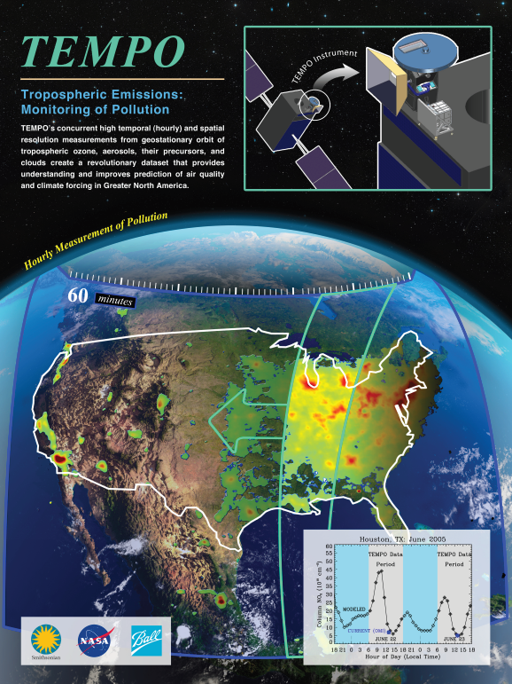
Hourly atmospheric pollution from geostationary Earth orbit
PI: Kelly Chance, Smithsonian Astrophysical Observatory
Instrument Development: Ball Aerospace
Project Management: NASA LaRC
Other Institutions: NASA GSFC, NOAA, EPA, NCAR, Harvard, UC Berkeley, St. Louis U, U Alabama Huntsville, U Nebraska, RT Solutions, Carr Astronautics
International collaboration: Mexico, Canada, Cuba, Korea, U.K.,
ESA, Spain
Selected Nov. 2012 as NASA’s first Earth Venture Instrument
  Instrument delivery May 2017
  NASA will arrange hosting on commercial geostationary communications satellite with launch expected NET 11/2018
Provides hourly daylight observations to capture rapidly varying emissions & chemistry important for air quality
  UV/visible grating spectrometer to measure key elements in tropospheric ozone and aerosol pollution
  Distinguishes boundary layer from free tropospheric & stratospheric ozone
Aligned with Earth Science Decadal Survey recommendations
  Makes many of the GEO-CAPE atmosphere measurements
  Responds to the phased implementation recommendation of GEO-CAPE mission design team
  North American component of an international constellation for air quality observations

Slide 22
TEMPO Science Team, U.S.
Team Member | Institution | Role | Responsibility
K. Chance | SAO | PI | Overall science development; Level 1b, H₂CO, C₂H₂O₂
X. Liu | SAO | Deputy PI | Science development, data processing; O₃ profile, tropospheric O₃
J. Al-Saadi | LaRC | Deputy PS | Project science development
J. Carr | Carr Astronautics | Co-I | INR Modeling and algorithm
M. Chin | GSFC | Co-I | Aerosol science
R. Cohen | U.C. Berkeley | Co-I | NO₂ validation, atmospheric chemistry modeling, process studies
D. Edwards | NCAR | Co-I | VOC science, synergy with carbon monoxide measurements
J. Fishman | St. Louis U. | Co-I | AQ impact on agriculture and the biosphere
D. Flittner | LaRC | Project Scientist | Overall project development; STM; instrument cal./char.
J. Herman | UMBC | Co-I | Validation (PANDORA measurements)
D. Jacob | Harvard | Co-I | Science requirements, atmospheric modeling, process studies
S. Janz | GSFC | Co-I | Instrument calibration and characterization
J. Joiner | GSFC | Co-I | Cloud, total O₃, TOA shortwave flux research product
N. Krotkov | GSFC | Co-I | NO₂, SO₂, UVB
M. Newchurch | U. Alabama Huntsville | Co-I | Validation (O₃ sondes, O₃ lidar)
R.B. Pierce | NOAA/NESDIS | Co-I | AQ modeling, data assimilation
R. Spurr | RT Solutions, Inc. | Co-I | Radiative transfer modeling for algorithm development
R. Suleiman | SAO | Co-I, Data Mgr. | Managing science data processing, BrO, H₂O, and L3 products
J. Szykman | EPA | Co-I | AIRNow AQI development, validation (PANDORA measurements)
O. Torres | GSFC | Co-I | UV aerosol product, AI
J. Wang | U. Nebraska | Co-I | Synergy w/GOES-R ABI, aerosol research products
J. Leitch | Ball Aerospace | Collaborator | Aircraft validation, instrument calibration and characterization
D. Neil | LaRC | Collaborator | GEO-CAPE mission design team member

Slide 23
TEMPO Science Team, non-U.S.
Team Member | Institution | Role | Responsibility
Randall Martin | Dalhousie U. | Collaborator | Atmospheric modeling, air mass factors, AQI development
Chris McLinden | Environment Canada | Collaborator | Canadian air quality coordination
Michel Grutter de la Mora | UNAM, Mexico | Collaborator | Mexican air quality coordination
Gabriel Vazquez | UNAM, Mexico | Collaborator | Mexican air quality, algorithm physics
Amparo Martinez | INECC, Mexico | Collaborator | Mexican environmental pollution and health
J. Victor Hugo Paramo Figeuroa | INECC, Mexico | Collaborator | Mexican environmental pollution and health
Brian Kerridge | Rutherford Appleton Laboratory, UK | Collaborator | Ozone profiling studies, algorithm development
Paul Palmer | Edinburgh U., UK | Collaborator | Atmospheric modeling, process studies
Alfonso Saiz-Lopez | CSIC, Spain | Collaborator | Atmospheric modeling, process studies
Juan Carlos Antuña Marrero | GOAC, Cuba | Collaborator | Cuban Science team lead, Cuban air quality
Osvaldo Cuesta | GOAC, Cuba | Collaborator | TEMPO validation, Cuban air quality
René Estevan Arredondo | GOAC, Cuba | Collaborator | TEMPO validation, Cuban air quality
J. Kim | Yonsei U. | Collaborators, Science Advisory Panel | Korean GEMS, CEOS constellation of GEO pollution monitoring
C.T. McElroy | York U. Canada |  | CSA PHEOS, CEOS constellation of GEO pollution monitoring
B. Veihelmann | ESA |  | ESA Sentinel-4, CEOS constellation of GEO pollution monitoring
J.P. Veefkind | KNMI |  | ESA Sentinel-5P (TROPOMI)

Slide 24
TEMPO instrument concept
Measurement technique
  Imaging grating spectrometer measuring solar backscattered Earth radiance
  Spectral band & resolution: 290-490 + 540-740 nm @ 0.6 nm FWHM, 0.2 nm sampling
  2 2-D, 2k×1k, detectors image the full spectral range for each geospatial scene
Field of Regard (FOR) and duty cycle
  Mexico City/Yucatan, Cuba to the Canadian oil sands, Atlantic to Pacific
  Instrument slit aligned N/S and swept across the FOR in the E/W direction, producing a radiance map of Greater North America in one hour
Spatial resolution
  2.1 km N/S × 4.7 km E/W native pixel resolution (9.8 km²)
  Co-add/cloud clear as needed for specific data products
Standard data products and sampling rates
  Most sampled hourly, including eXceL O₃ (troposphere, PBL)
  NO₂, H₂CO, C₂H₂O₂, SO₂ sampled hourly (average results for ≥ 3/day if needed)
  Nominal spatial resolution 8.4 km N/S × 4.7 km E/W at center of domain (can often measure 2.1 km N/S × 4.7 km E/W)
  Measurement requirements met up to 50º for SO₂, 70º SZA for other products

Slide 25
Baseline and threshold data products
Species/Products | Required Precision | Temporal Revisit
0-2 km O₃ (Selected Scenes) Baseline only | 10 ppbv | 2 hour
Tropospheric O₃ | 10 ppbv | 1 hour
Total O₃ | 3% | 1 hour
Tropospheric NO₂ | 1.0 × 10¹⁵ molecules cm⁻² | 1 hour
Tropospheric H₂CO | 1.0 × 10¹⁶ molecules cm⁻² | 3 hour
Tropospheric SO₂ | 1.0 × 10¹⁶ molecules cm⁻² | 3 hour
Tropospheric C₂H₂O₂ | 4.0 × 10¹⁴ molecules cm⁻² | 3 hour
Aerosol Optical Depth | 0.10 | 1 hour
Minimal set of products sufficient for constraining air quality
Across Greater North America (GNA): 18°N to 58°N near 100°W, 67°W to 125°W near 42°N
Data products at urban-regional spatial scales
  Baseline ≤ 60 km² at center of Field Of Regard (FOR)
  Threshold ≤ 300 km² at center of FOR
Temporal scales to resolve diurnal changes in pollutant distributions
Collected in cloud-free scenes
Geolocation uncertainty of less than 4 km
Mission duration, subject to instrument availability
  Baseline 20 months
  Threshold 12 months

Slide 26
TEMPO mission concept
Geostationary orbit, operating on a commercial telecom satellite
  NASA will arrange launch and hosting services (per Earth Venture Instrument scope)
    80-115º W acceptable latitude
    Specifying satellite environment, accommodation
  Hourly measurement and telemetry duty cycle for at least ≤70º SZA
TEMPO is low risk with significant space heritage
  We proposed SCIAMACHY in 1985, as suggested by the late Dr. Dieter Perner
  All proposed TEMPO measurements have been made from low Earth orbit satellite instruments to the required precisions by SAO and Science Team members
  All TEMPO launch algorithms are implementations of currently operational algorithms
    NASA TOMS-type O₃
    SO₂, NO₂, H₂CO, C₂H₂O₂ from fitting with AMF-weighted cross sections
    Absorbing Aerosol Index, UV aerosol, Rotational Raman scattering cloud
    SAO eXceL profile/tropospheric/PBL O₃ for selected geographic targets
Example higher-level products: Near-real-time pollution/AQ indices, UV index
TEMPO research products will greatly extend science and applications
  Example research products: BrO and IO from AMF-normalized cross sections; height-resolved SO₂; additional cloud/aerosol products; vegetation products; additional gases

Slide 27
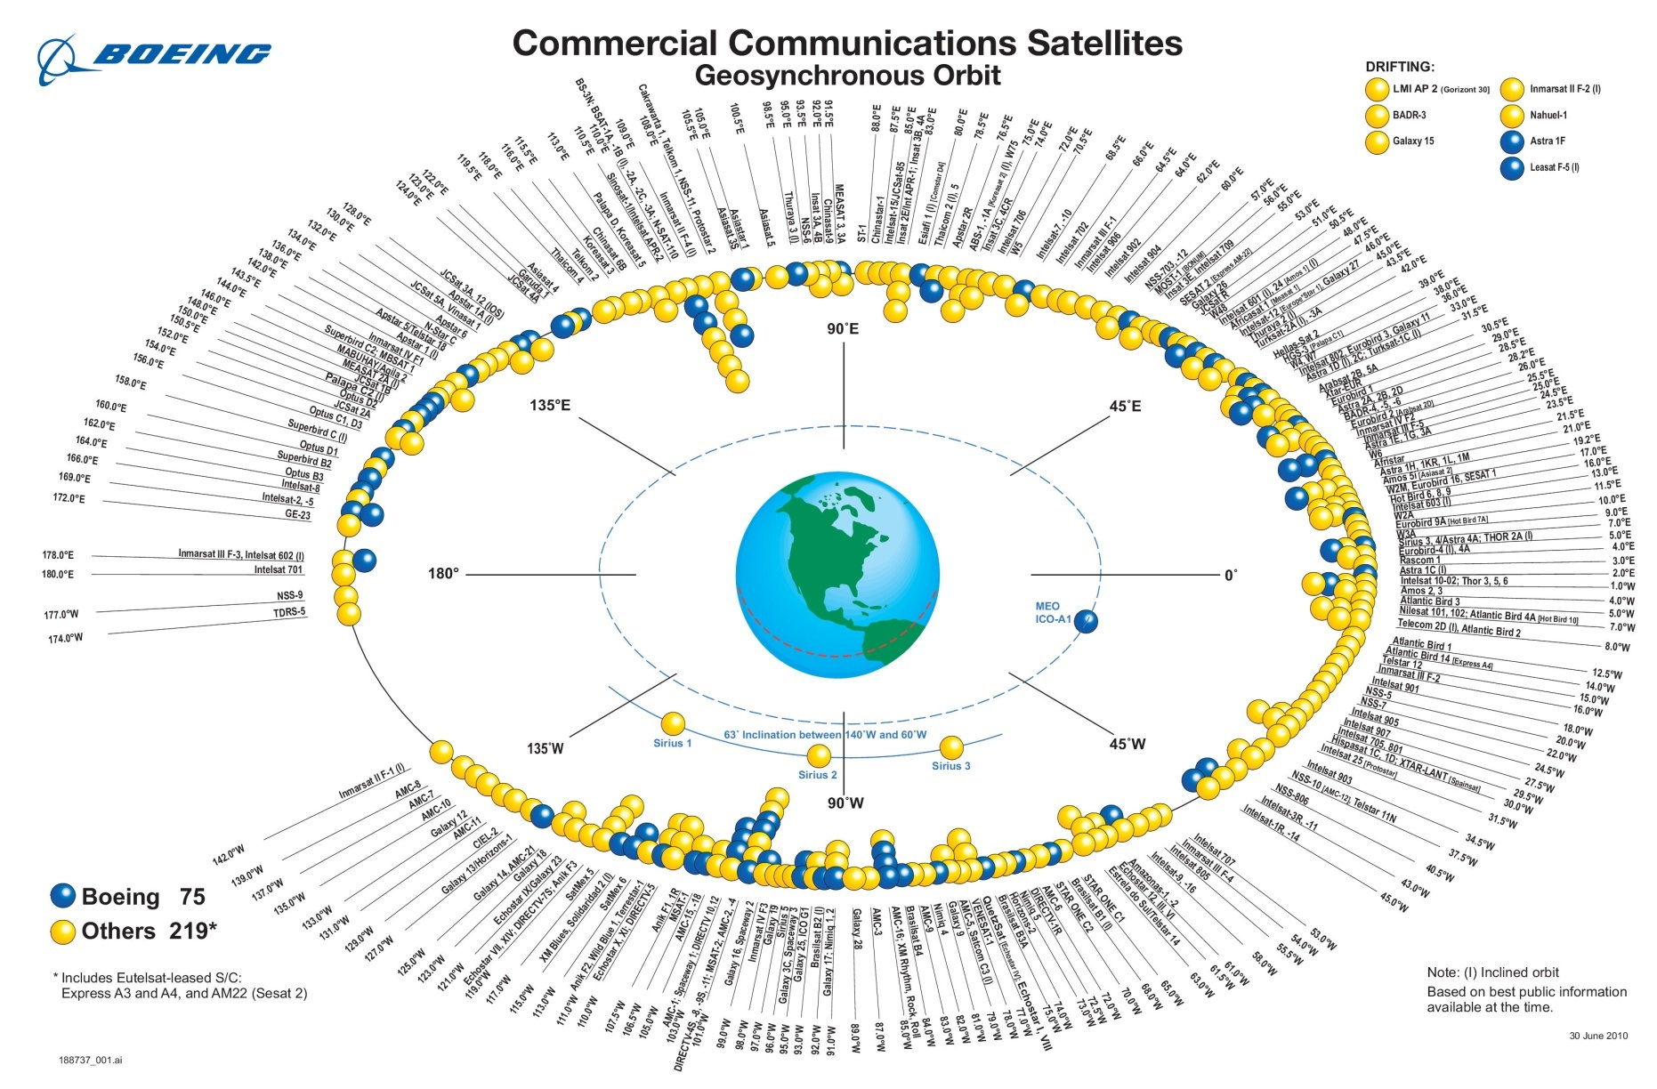
Geostationary orbit opportunities of interest
(typical)
Between 90 W and 110 W, there are nine owner operators of 30 satellites including older models still used in this location:
  Direct TV Group (7)
  AGS (5)
  Intelsat (5)
  Telesat (4)
  Hughes Network Systems (3)
  Echostar (2)
  SkyTerra (2)
  Inmarsat (1)
  ICO Global Communications (1)
TEMPO
TEMPO can be located between 80 – 120 West
Notes:
The atmospheric instruments can accomplish their science objectives in orbit locations from around 110 W to 90 W
The ocean science instrument needs to be in an orbit location between 85 W to 95 W to accomplish its science objectives

Slide 28
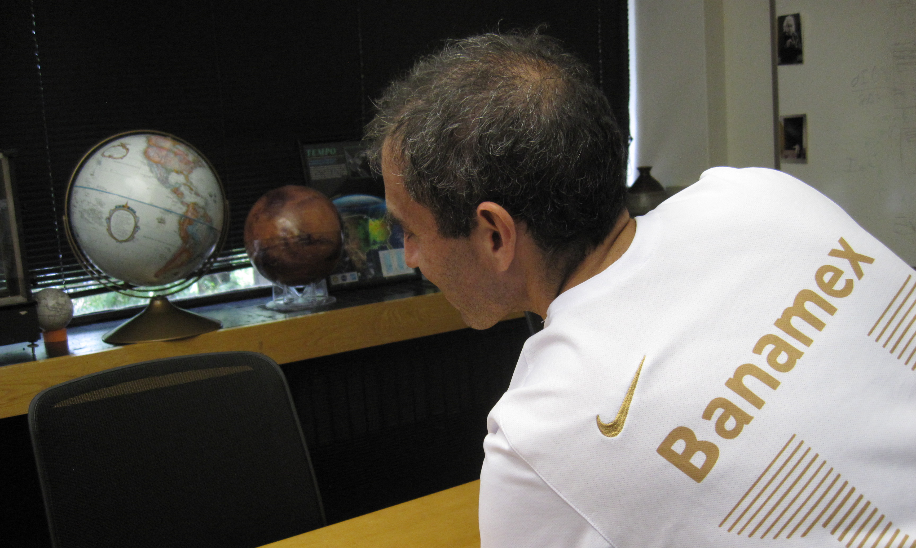
The view from GEO

Slide 29
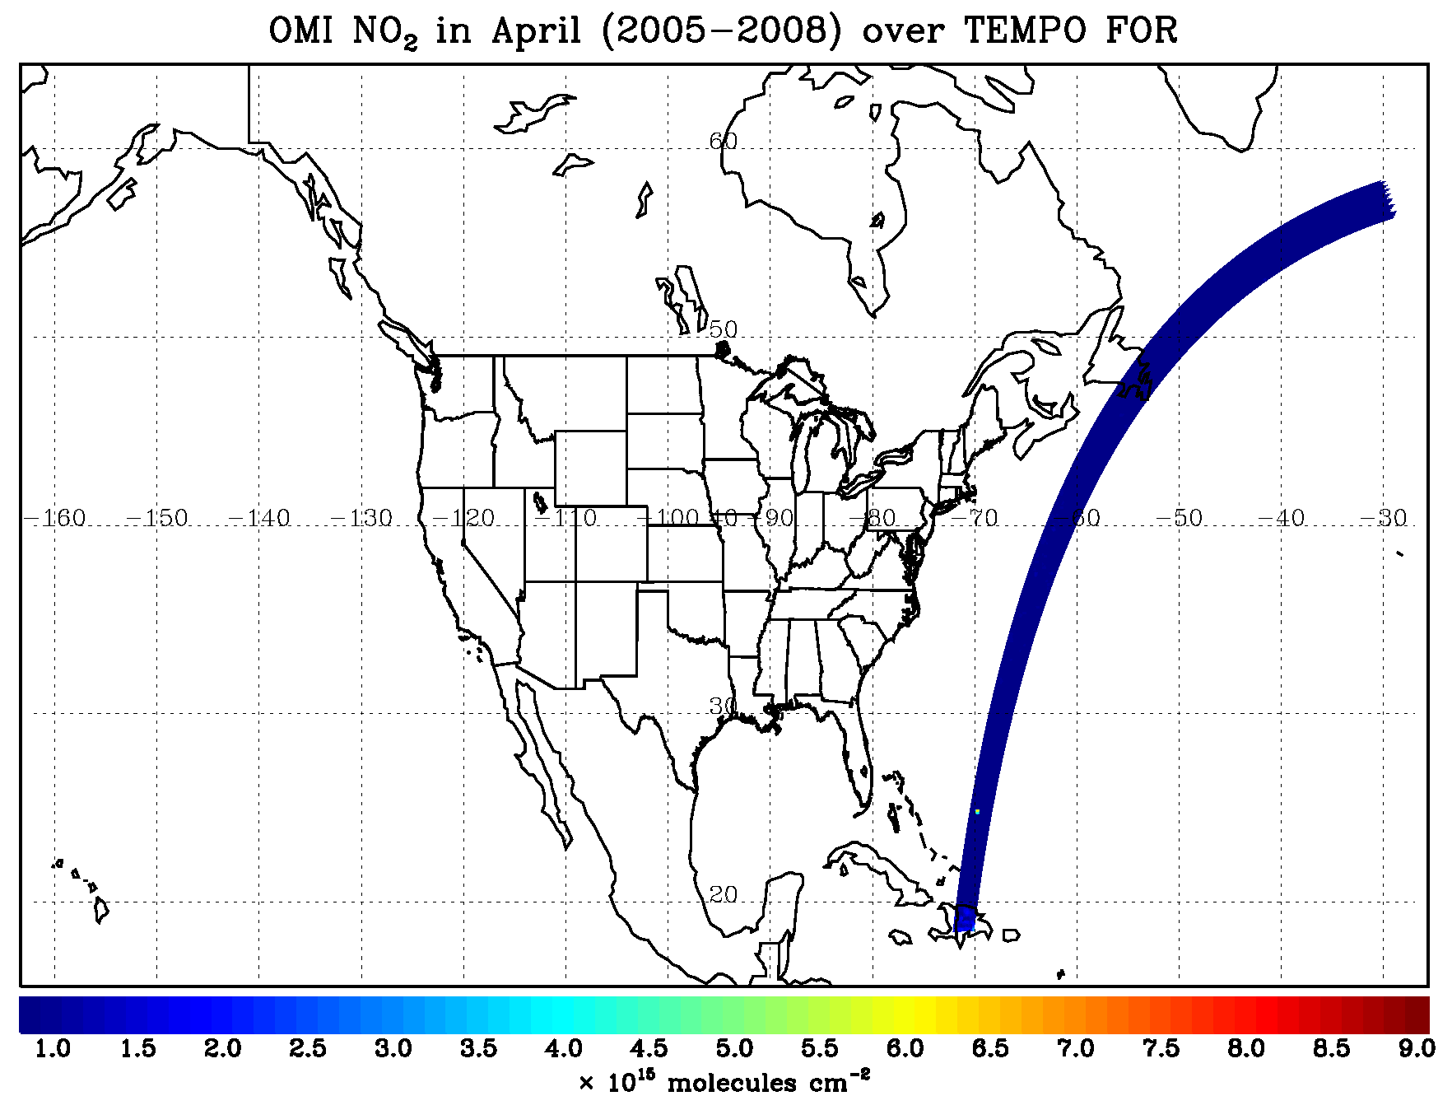
TEMPO hourly NO₂ sweep
N.B. special operations
give 10-minute resolution
for selected longitude
regions

Slide 30
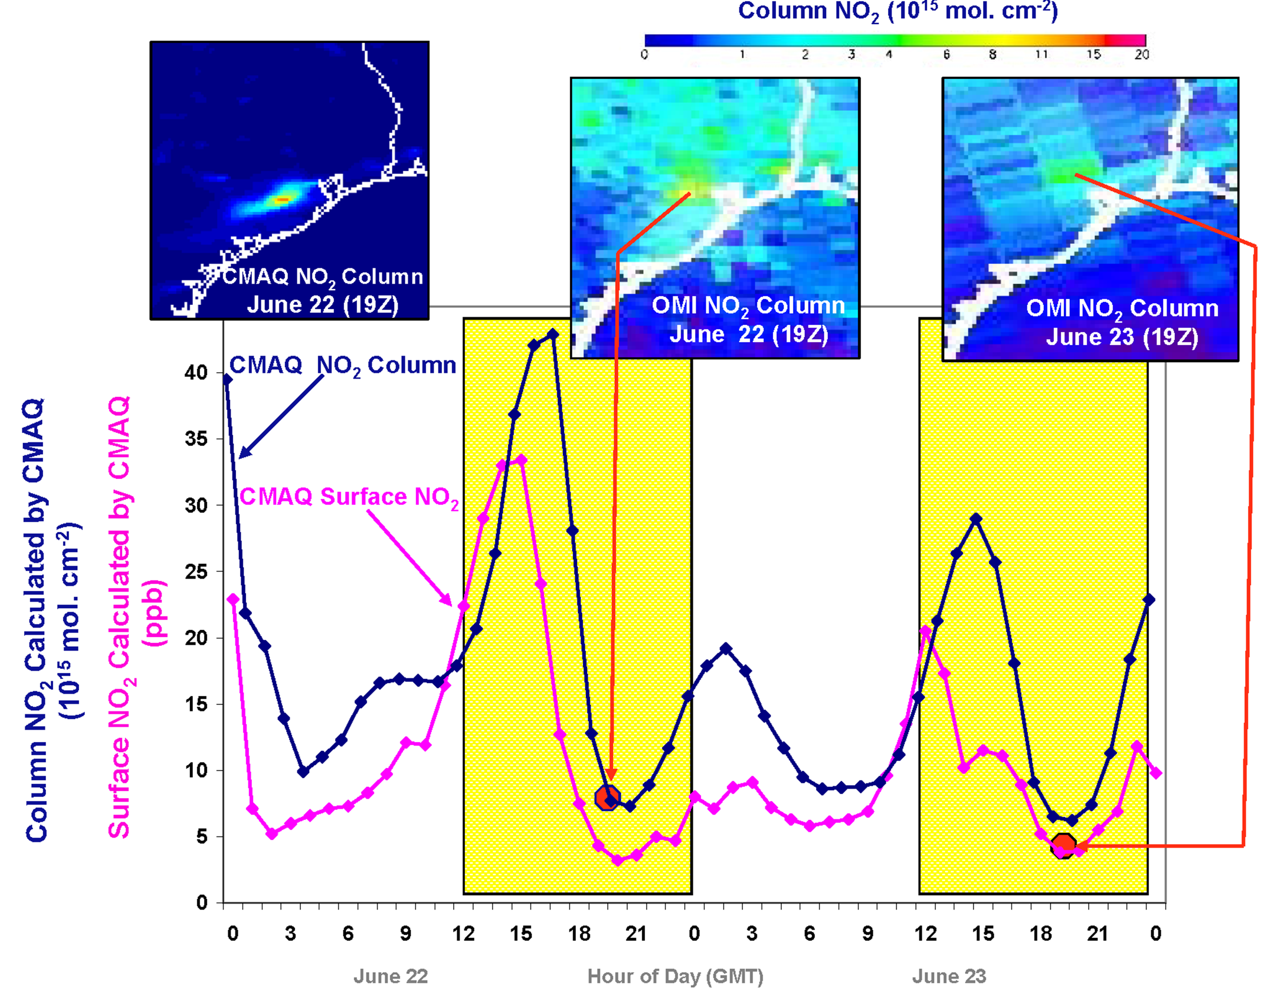
Why geostationary? High temporal and spatial resolution
Hourly NO₂ surface concentration and integrated column calculated by CMAQ air quality model: Houston, TX, June 22-23, 2005
June 22
Hour of Day (UTC)
June 23
LEO observations provide limited information on rapidly varying emissions, chemistry, & transport
GEO will provide observations at temporal and spatial scales highly relevant to air quality processes

Slide 31
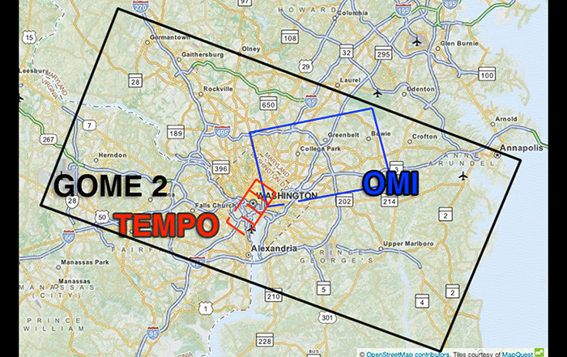
Science studies
  Spatial resolution: allow tracking pollution at sub-urban scale
    GEO at 100°W: 2.1 km N/S × 4.7 km E/W = 9.8 km² (native) at center of FOR (36.5°N, 100°W)
    Full resolution for NO₂, HCHO, total O₃ products
    Co-add 4 N/S pixels for O₃ profile product: 8.4 km N/S × 4.7 km E/W
~ 1/300 of GOME-2
~ 1/30 of OMI

Slide 32
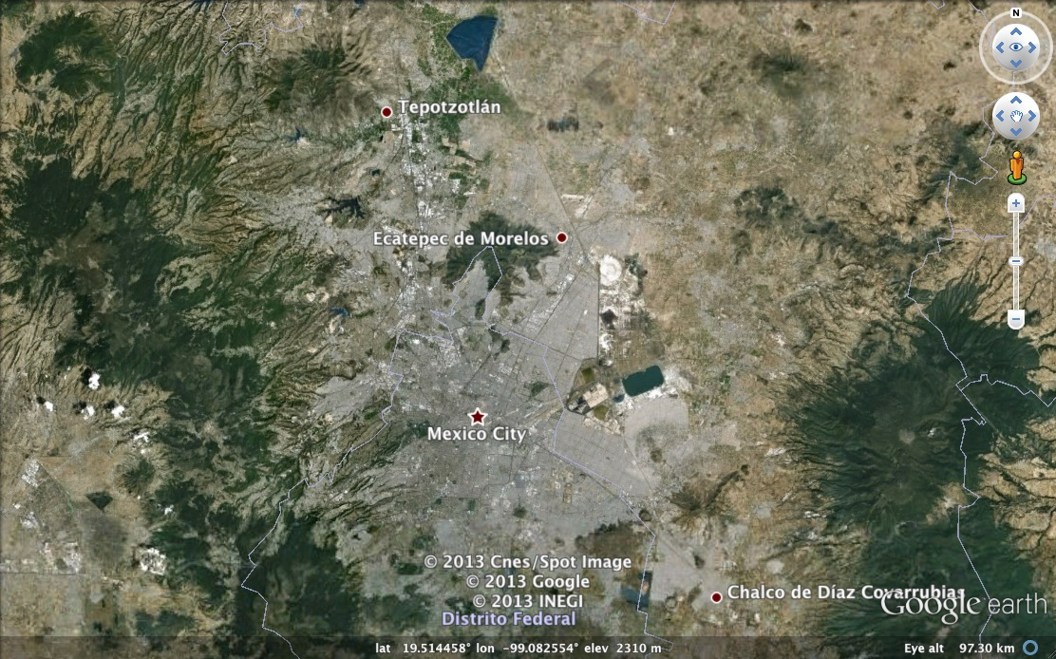

Mexico City coverage
¡Cada hora!

Slide 33
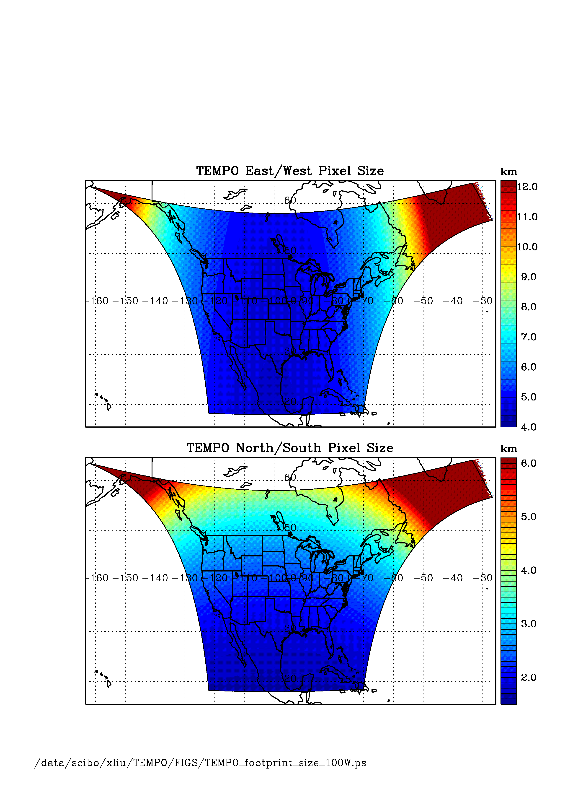
TEMPO footprint (GEO at 100º W)
Location | N/S (km) | E/W (km) | GSA (km²)
36.5ºN, 100ºW | 2.11 | 4.65 | 9.8
Washington, DC | 2.37 | 5.36 | 11.9
Seattle | 2.99 | 5.46 | 14.9
Los Angeles | 2.09 | 5.04 | 10.2
Boston | 2.71 | 5.90 | 14.1
Miami | 1.83 | 5.04 | 9.0
Mexico City | 1.65 | 4.54 | 7.5
Canadian oil sands | 3.94 | 5.05 | 19.2
Assumes 2000 N/S pixels
For GEO at 80ºW, pixel size at 36.5ºN, 100ºW is 2.2 km × 5.2 km.

Slide 34
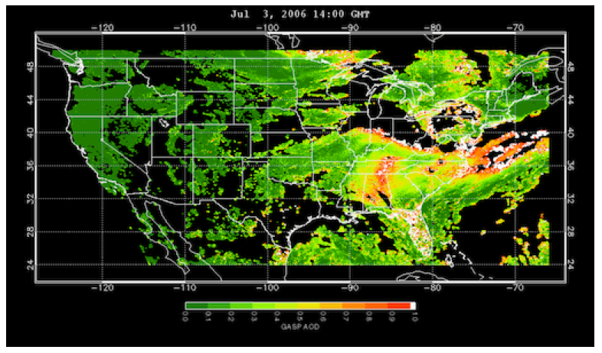
www.epa.gov/rsig
TEMPO will use the EPA’s Remote Sensing Information Gateway (RSIG) for subsetting, visualization, and product distribution – to make TEMPO YOUR instrument

Slide 35
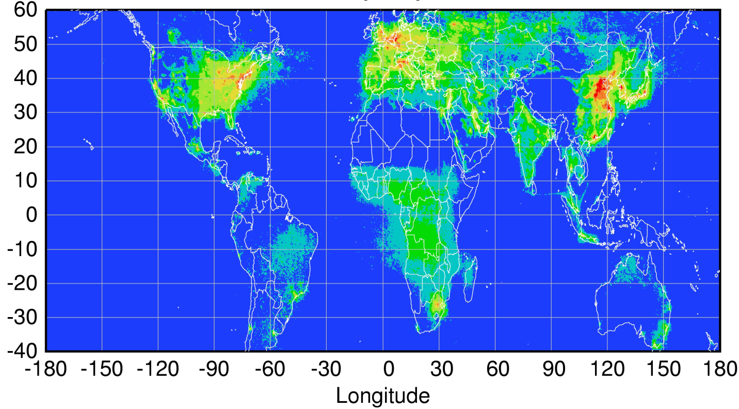
Global pollution monitoring constellation
Sentinel-4
(hourly)
TEMPO
(hourly)
GEMS
(hourly)
80-115°W
0°
2021+ launch
128.2°E
2019 launch
Sentinel-5P
(once per day)
Courtesy Jhoon Kim,
Andreas Richter
Policy-relevant science and environmental services enabled by common observations
Improved emissions, at common confidence levels, over industrialized Northern Hemisphere
Improved air quality forecasts and assimilation systems
Improved assessment, e.g., observations to support United Nations Convention on Long Range Transboundary Air Pollution

Slide 36
Data products, science studies (the Green Paper), special operations
Volcanic SO₂ (column amount and plume altitude is a potential research product.
Diurnal out-going shortwave radiation and cloud forcing is a potential research product.
Nighttime “city lights” products, which represent anthropogenic activities at the same spatial resolution as air quality products, may be produced twice per day (late evening and early morning) as a research product. Meeting TEMPO measurement requirements for NO₂ (visible) implies the sensitivity for city lights products over the CONUS within a 2-hour period at 2×4.5 km² to 1.1×10⁻⁸ W cm⁻² sr⁻¹ μm⁻¹.
Several additional first-measurement molecules are being studied.
H₂O will be produced at launch from the 7ν vibrational polyad at 445 nm. Water vapor retrieved from the visible spectrum has good sensitivity to the planetary boundary layer, since the absorption is optically thin, and is available over both the land and ocean. The hourly coverage of TEMPO will greatly improve the knowledge of water vapor’s diurnal cycle and make rapid variations in time readily observed.

Slide 37
Clouds and aerosols
Clouds The launch cloud algorithm is be based on the rotational Raman scattering (RRS) cloud algorithm that was developed for OMI by GSFC. Retrieved cloud pressures from OMCLDRR are not at the geometrical center of the cloud, but rather at the optical centroid pressure (OCP) of the cloud. Additional cloud products are possible using the O₂-O₂ collision complex and/or the O₂ B band.
Aerosols TEMPO’s launch algorithm for retrieving aerosols will be based upon the OMI aerosol algorithm that uses the sensitivity of near-UV observations to particle absorption to retrieve Absorbing Aerosol Index (AAI), aerosol optical depth (AOD) and single scattering albedo (SSA). TEMPO may be used together with the advanced baseline imager (ABI) instruments on the NOAA GOES-R and GOES-S satellites for aerosol retrievals, reducing AOD and fine mode AOD uncertainties from 30% to 10% and from 40% to 20%.

Slide 38
NO_{x} studies
Lightning NO_{x} Interpretation of satellite measurements of tropospheric NO₂ and O₃, and upper tropospheric HNO₃ lead to an overall estimate of 6 ± 2 Tg N y-1 from lightning [Martin et al., 2007]. TEMPO measurements, including tropospheric NO₂ and O₃, can be made for time periods and longitudinal bands selected to coincide with large thunderstorm activity, including outflow regions, with fairly short notice.
Soil NO_{x} Jaeglé et al. [2005] estimate 2.5 - 4.5 TgN y⁻¹ are emitted globally from nitrogen-fertilized soils, still highly uncertain. The US a posteriori estimate for 2000 is 0.86 ± 1.7 TgN y⁻¹. For Central America it is 1.5 ± 1.6 TgN y⁻¹. They note an underestimate of NO release by nitrogen-fertilized croplands as well as an underestimate of rain-induced emissions from semiarid soils.
TEMPO is able to follow the temporal evolution of emissions from croplands after fertilizer application and from rain-induced emissions from semi-arid soils. Higher than hourly time resolution over selected regions may be accomplished by special observations. Improved constraints on soil NO_{x} emissions may also improve estimated of lightning NO_{x} emissions [Martin et al. 2000].

Slide 39
Halogens
BrO will be produced at launch, assuming stratospheric AMFs. Scientific studies will correct retrievals for tropospheric content. IO was first measured from by SAO space using SCIAMACHY spectra [Saiz-Lopez et al., 2007]. It will be produced as a scientific product, particularly for coastal studies, assuming AMFs appropriate to lower tropospheric loading.
The atmospheric chemistry of halogen oxides over the ocean, and in particular in coastal regions, can play important roles in ozone destruction, oxidizing capacity, and dimethylsulfide oxidation to form cloud-condensation nuclei [Saiz-Lopez and von Glasow, 2012]. The budgets and distribution of reactive halogens along the coastal areas of North America are poorly known. Therefore, providing a measure of the budgets and diurnal evolution of coastal halogen oxides is necessary to understand their role in atmospheric photochemistry of coastal regions. Previous ground-based observations have shown enhanced levels (at a few pptv) of halogen oxides over coastal locations with respect to their background concentrations over the remote marine boundary layer [Simpson et al., 2015]. Previous global satellite instruments lacked the sensitivity and spatial resolution to detect the presence of active halogen chemistry over mid-latitude coastal areas. TEMPO observations together with atmospheric models will allow examination of the processes linking ocean halogen emissions and their potential impact on the oxidizing capacity of coastal environments of North America.
TEMPO also performs hourly measurements one of the world’s largest salt lakes: the Great Salt Lake in Utah. Measurements over Salt Lake City show the highest concentrations of BrO over the globe. Hourly measurement at a high spatial resolution can improve understanding of BrO production in salt lakes.

Slide 40
Spectral indicators
Fluorescence and other spectral indicators Solar-induced fluorescence (SIF) from chlorophyll over both land and ocean will be measured. In terrestrial vegetation, chlorophyll fluorescence is emitted at red to far-red wavelengths (~650-800 nm) with two broad peaks near 685 and 740 nm, known as the red and far-red emission features. Oceanic SIF is emitted exclusively in the red feature. SIF measurements have been used for studies of tropical dynamics, primary productivity, the length of carbon uptake period, and drought responses, while ocean measurements have been used to detect red tides and to conduct studies on the physiology, phenology, and productivity of phytoplankton. TEMPO can retrieve both red and far-red SIF by utilizing the property that SIF fills in solar Fraunhofer and atmospheric absorption lines in backscattered spectra normalized by a reference (e.g., the solar spectrum) that does not contain SIF.
TEMPO will also be capable of measuring spectral indices developed for estimating foliage pigment contents and concentrations. Spectral approaches for estimating pigment contents apply generally to leaves and not the full canopy. A single spectrally invariant parameter, the Directional Area Scattering Factor (DASF), relates canopy-measured spectral indices to pigment concentrations at the leaf scale.
UVB TEMPO measurements of daily UV exposures build upon heritage from OMI and TROPOMI measurements. Hourly cloud measurements from TEMPO allow taking into account diurnal cloud variability, which has not been previously possible. The OMI UV algorithm is based on the TOMS UV algorithm. The specific product is the downward spectral irradiance at the ground (in W m⁻² nm⁻¹) and the erythemally weighted irradiance (in W m⁻²).

Slide 41
Traffic, biomass burning
Morning and evening higher-frequency scans The optimized data collection scan pattern during mornings and evenings provides multiple advantages for addressing TEMPO science questions. The increased frequency of scans coincides with peaks in vehicle miles traveled on each coast.
Biomass burning The unexplained variability in ozone production from fires is of particular interest. The suite of NO₂, H₂CO, C₂H₂O₂, O₃, and aerosol measurements from TEMPO is well suited to investigating how the chemical processing of primary fire emissions effects the secondary formation of VOCs and ozone. For particularly important fires it is possible to command special TEMPO observations at even shorter than hourly revisit time, probably as short as 10 minutes.

Slide 42
City lights
SNRs of various artificial lighting types normalized to a common VIIRS-DNB response with a 10s dwell, no co-addition, and no spatial binning, assuming a dark current of 2800 e⁻ s⁻¹. City lights over all of greater North America can either be observed piecemeal over several days or in a single scan near the winter solstice.

Slide 43
Air quality and health
TEMPO’s hourly measurements allow better understanding of the complex chemistry and dynamics that drive air quality on short timescales. The density of TEMPO data is ideally suited for data assimilation into chemical models for both air quality forecasting and for better constraints on emissions that lead to air quality exceedances. Planning is underway to combine TEMPO with regional air quality models to improve EPA air quality indices and to directly supply the public with near real time pollution reports and forecasts through website and mobile applications. As a case study, an OSSE for the Intermountain West was performed to explore the potential of geostationary ozone measurements from TEMPO to improve monitoring of ozone exceedances and the role of background ozone in causing these exceedances (Zoogman et al. 2014).

Slide 44






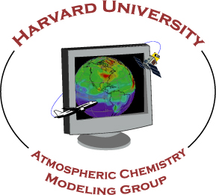



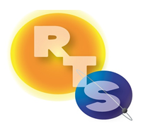

The end!
Thanks to NASA, ESA, Ball Aerospace &
Technologies Corp., The Boeing Company

Slide 45
Backups

Slide 46
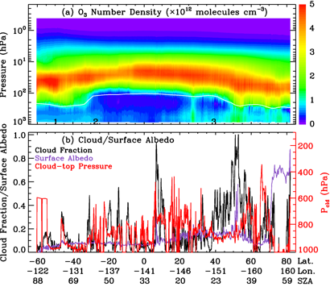
An orbit of retrievals at OMI across-track position 16 (in the UV-1 channel) for July 11, 2006 as a function of latitude, longitude, and solar zenith angle. (a) Ozone profiles in number density, and (b) the effective cloud fraction (black), fitted surface albedo (purple) for the UV-2 channel, and effective cloud-top pressure (red) used in the retrievals. The white line in (a) indicates the NCEP thermal tropopause.

Slide 47
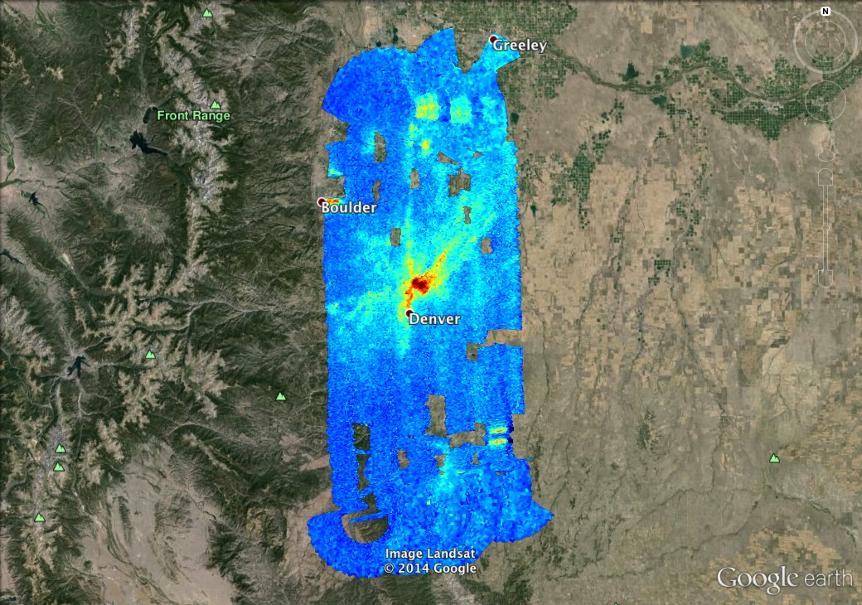

TEMPO measurements will capture the diurnal cycle of pollutant emissions
GeoTASO NO₂ Slant Column, 02 August 2014 Morning
Co-added to approx.
500m x 450m
Morning vs. Afternoon
Preliminary data,
C. Nowlan, SAO

Slide 48
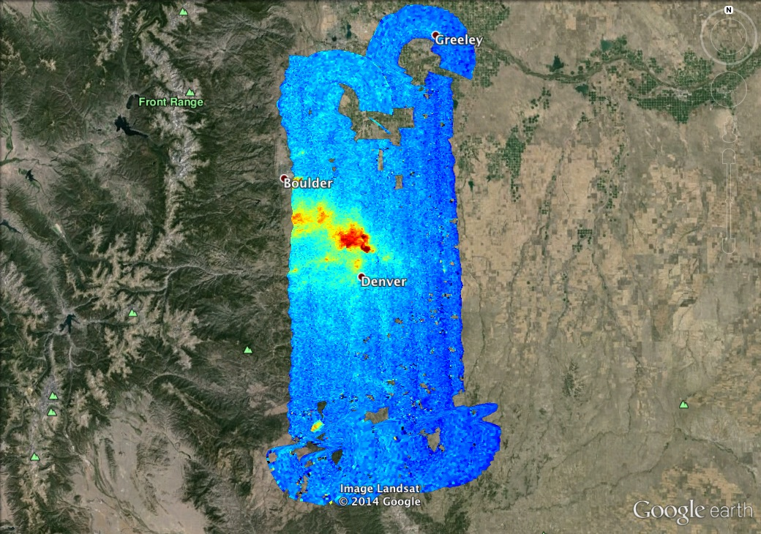
TEMPO measurements will capture the diurnal cycle of pollutant emissions
GeoTASO NO₂ Slant Column, 02 August 2014 Afternoon
Co-added to approx.
500m x 450m
Morning vs. Afternoon
Preliminary data,
C. Nowlan, SAO

Slide 49
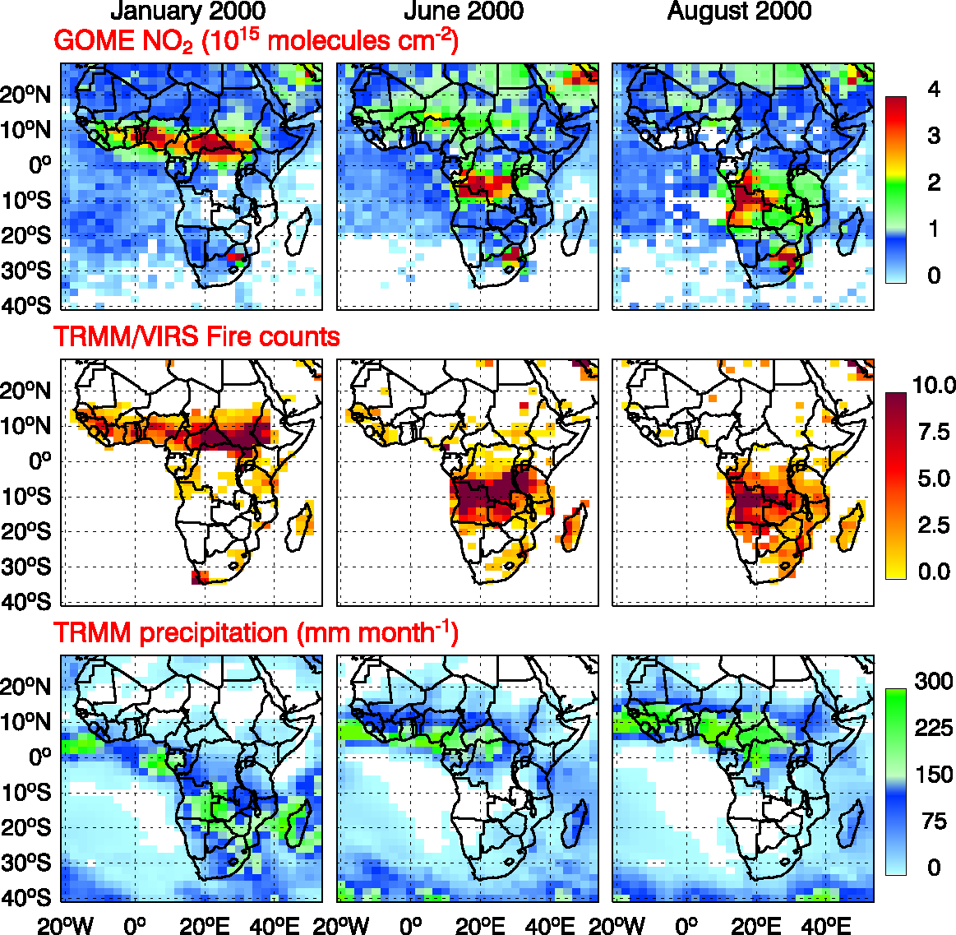
Soil NO_{x} (Lyatt Jaeglé et al.)

Slide 50
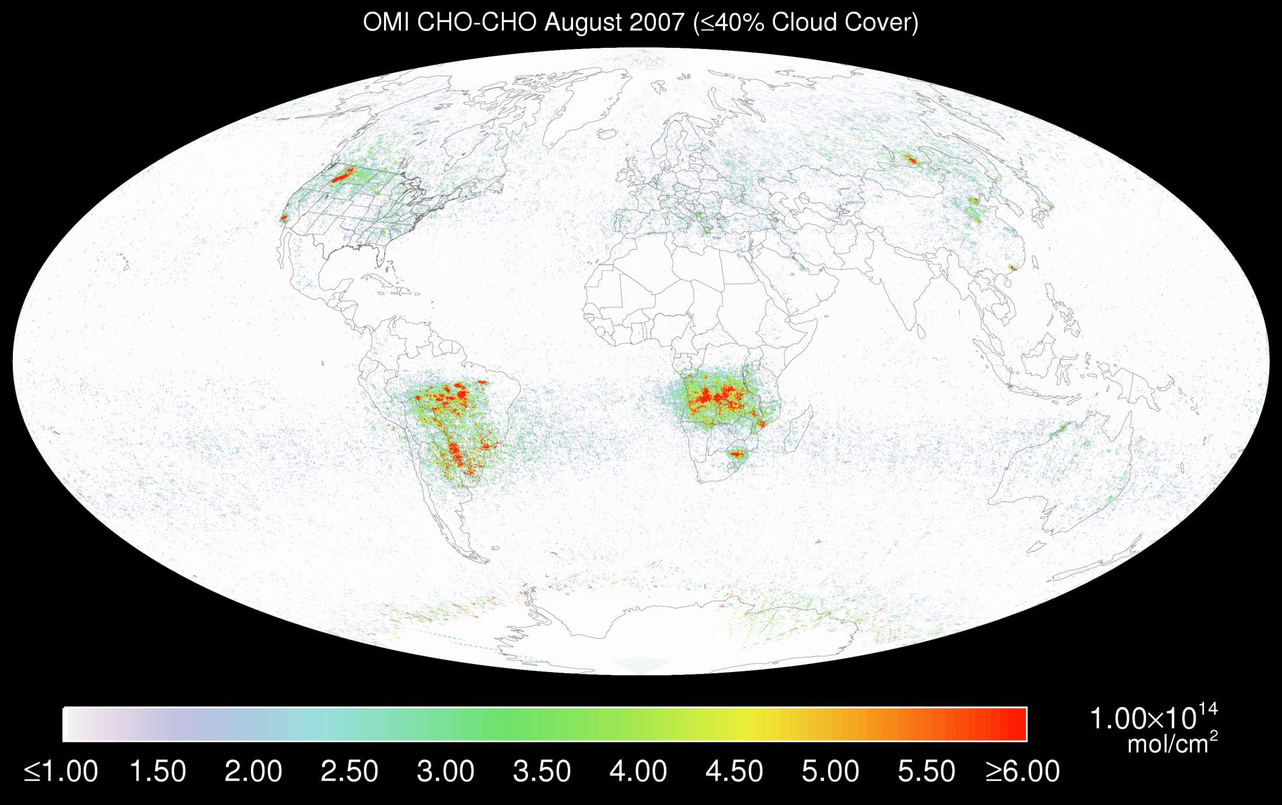
OMI C₂H₂O₂, August 2007 (<40% cloud cover)

Slide 51
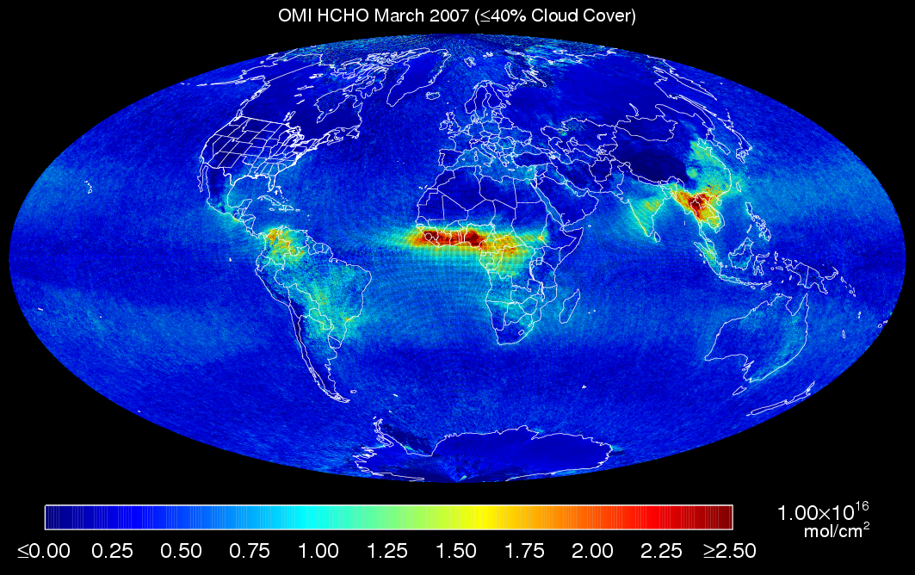

Slide 52
TEMPO summary
Currently on-schedule and on-budget
  Passed System Requirements Review and Mission Definition Review in November 2013
  Passed KDP-B April 2014
  Most technical issues solved at the preliminary design level, following technical interchange meeting at Ball, April 2014
  Passed PDR on July 31, 2014
  Now in Phase C: KDP-C April 10, 2015
  Instrument CDR June 2015
  Ground Systems CDR May 2016
Select satellite host 2017+
  TEMPO operating longitude and launch date are not known until after host selection
Instrument delivery 05/2017 for launch 11/2018 or later

Slide 53
Review of the questions
What enables us to make measurements to 2-5×10⁻⁴?
Careful algorithm physics, spectroscopy, calibration
What is the state of the art (SOTA)?
SNR of 3000-5000 @ 0.2-0.4 nm FWHM resolution
Next UV gas (on Earth)? Maybe nitrous acid (HONO)
What does the SOTA imply for near-term monitoring from space?
Enough for UV/visible geostationary monitoring. See below.
Where are the limitations?
In the PBL, ~40% artifacts from instrumentation (not SNR)
20-40% AMF effects, requires improved distributions from CTMs, validation
N.B. O₃ can be better than H₂CO or NO₂ because no assumptions on height distribution are necessary
Overcome differences among instruments and algorithms by looking in detail at spectra to rationalize them (e.g., SCIAMACHY versus OMI C₂H₂O₂)
How might the SOTA be improved?
Bigger light bucket (photon noise limited) followed by better radiance modeling (e.g., detector nonlinearity)
Add visible O₃ intentionally

Slide 54
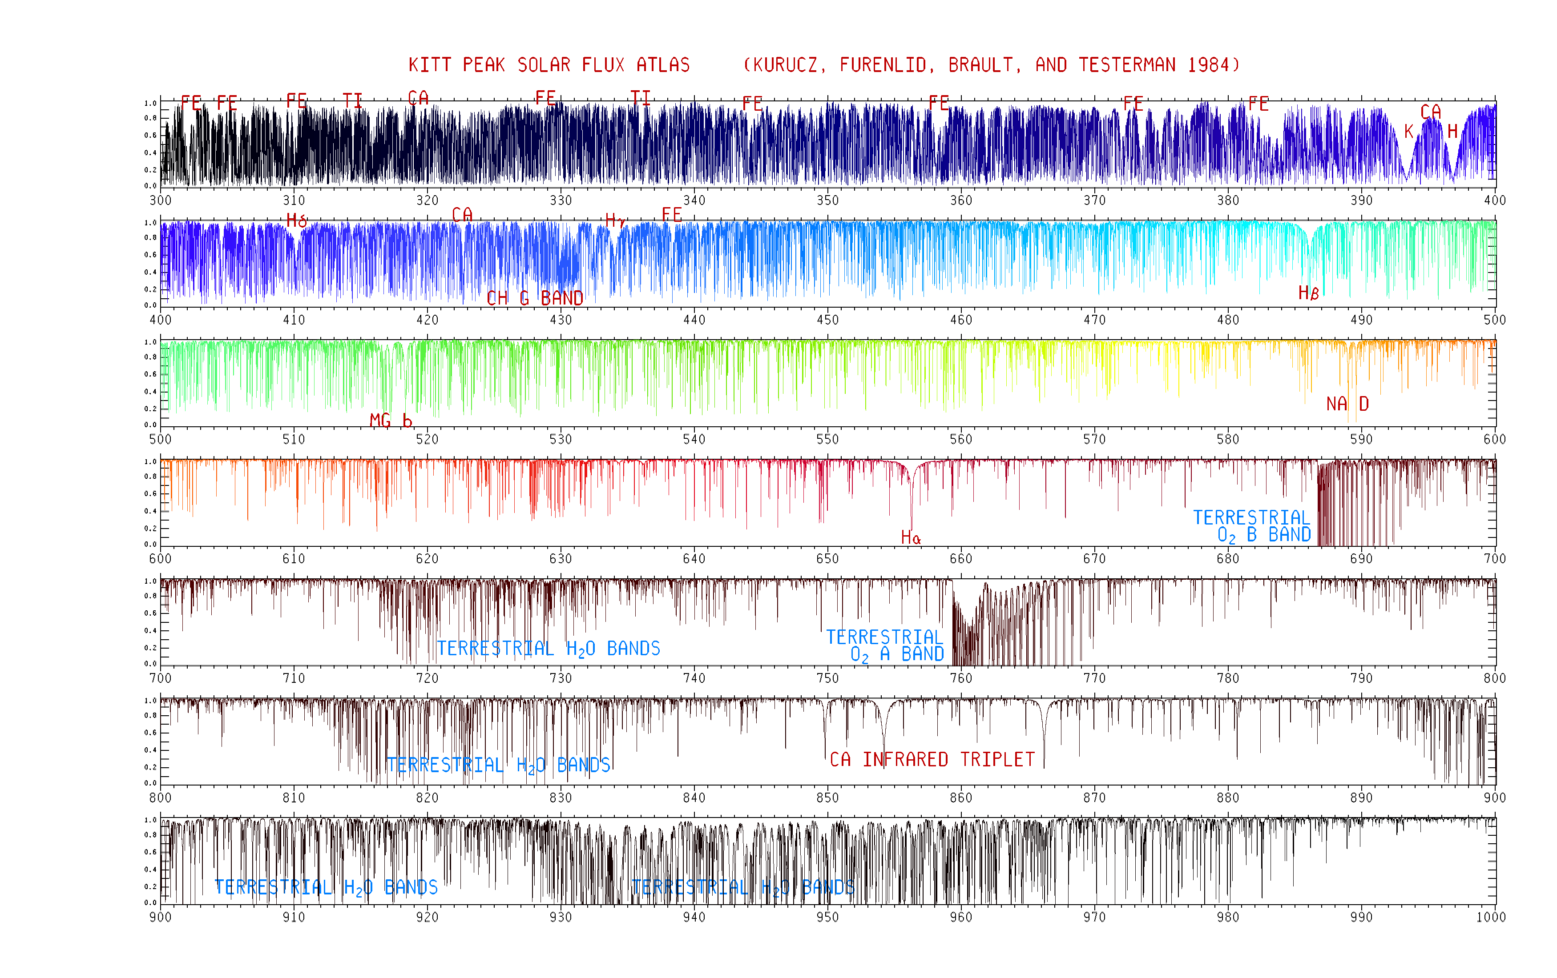
High resolution solar reference spectrum

Slide 55
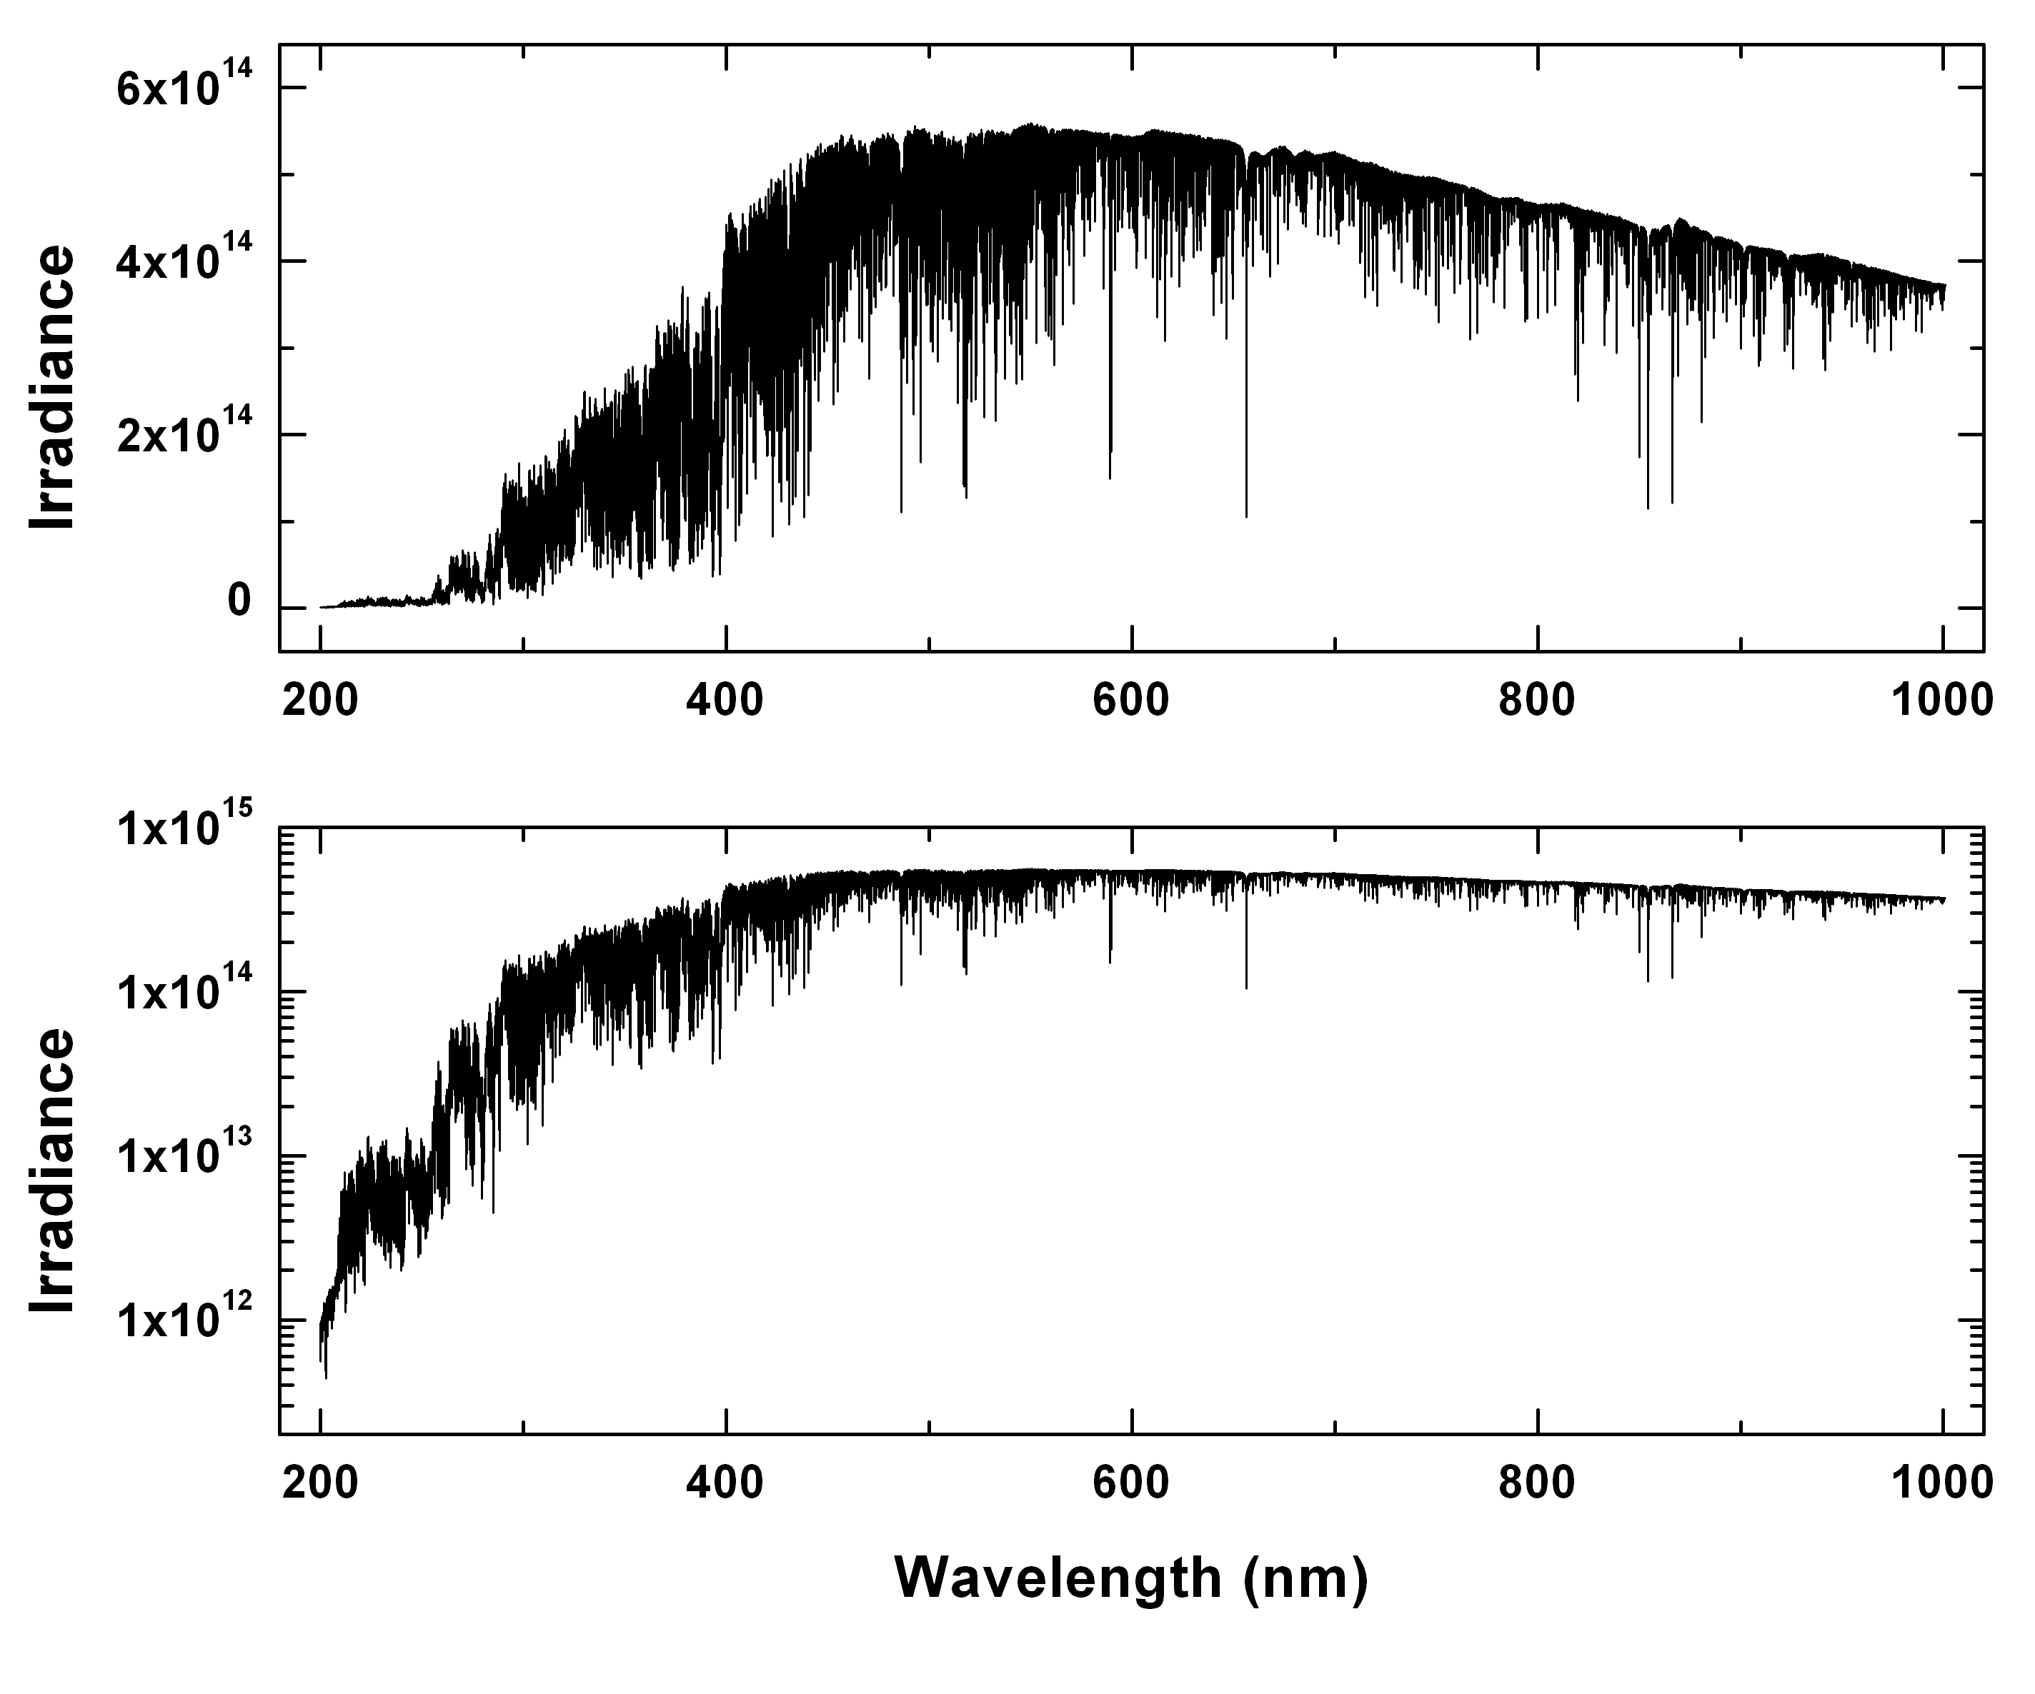
Upper panel: The SAO2010 irradiance reference spectrum (photons s⁻¹ cm⁻² nm^{‑1}). Lower panel: Irradiance on a logarithmic scale.
An improved high-resolution solar reference spectrum for Earth's atmosphere measurements in the ultraviolet, visible, and near infrared, K. Chance and R.L. Kurucz, JQSRT, 2010, http://www.cfa.harvard.edu/atmosphere/publications.html

Slide 56
Top-of-atmosphere solar spectral irradiance
The high resolution solar spectral irradiance is critical in analyzing atmospheric trace gases:
Solar lines are source of accurate wavelength calibration (±0.0003-0.0004 nm for GOME!) – Our method now used operationally on GOME, SCIAMACHY, OMI, and OMPS – Adapted from CfA galactic redshift survey
Determination of the Ring effect (Inelastic part of Rayleigh, mostly RR)
Improved knowledge of instrument slit functions
Correction for spectral undersampling
Photochemistry of Schumann-Runge system
A space-based determination would be an ideal support mission for 12+ international atmospheric missions!
Range: 240-1000+ nm
FWHM: 0.01 nm or better
Ideal FTS Space Shuttle Canadian European Asian experiment

Slide 57
GEOS-CHEM global 3D tropospheric chemistry and transport model
Driven by NASA GMAO met data
≤2×2.5º resolution/26 vertical levels
O₃-NO_{x}-VOC-halogen chemistry
VOC NO_{x}, SO₂ emissions
Aerosol scattering

Slide 58
LIDORT multiple-scattering radiative transfer code (R. Spurr)
Discrete ordinate radiative transfer code
Full analytical perturbation analysis of intensity field:
  Yields radiances and Jacobians (weighting functions) in one pass (no finite-differencing)
Pseudo-spherical and quasi-spherical versions available
Surface BRDF
Vector (polarization) version (VLIDORT) now used

Slide 59
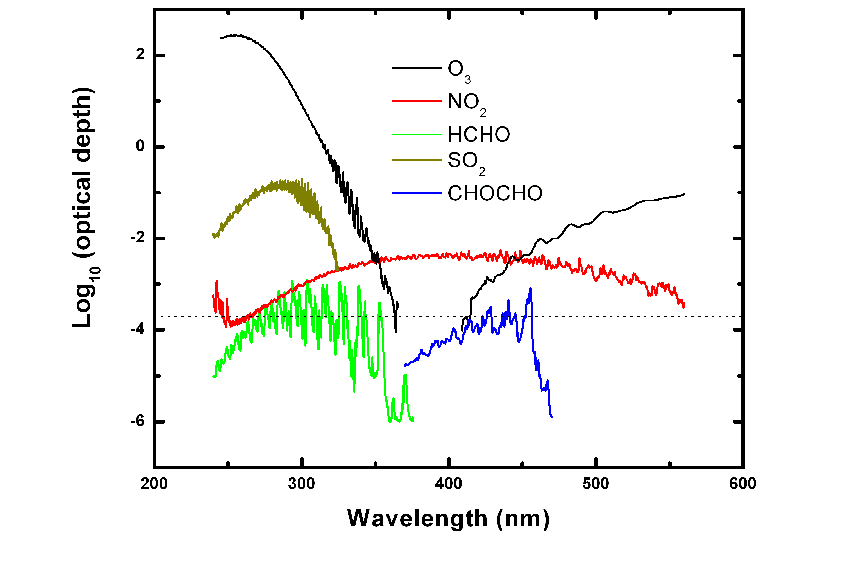
Optical depths for typical GEO measurement geometry
Important!
Best fitting to date:
2.0×10⁻⁴ full-scale radiance
(Instrument vs. algorithm: Tied! S/N drives instrument if meas. requirements can be met

Slide 60
XL ozone profile retrievals
Retrieval averaging kernels based on iterative nonlinear retrievals from synthetic TEMPO radiances with the signal to noise ratio (SNR) estimated using the TEMPO SNR model at instrument critical design review in June 2015 for (a) UV (290-345 nm) retrievals and (b) UV/Visible (290-345 nm, 540-650 nm) retrievals for clear-sky condition and vegetation surface with solar zenith angle 25°, viewing zenith angle 45° and relative azimuthal angle 86°. DFS is degrees of freedom for signal, the trace of the averaging kernel matrix, which is an indicator of the number of pieces of independent information in the solution.

Slide 61
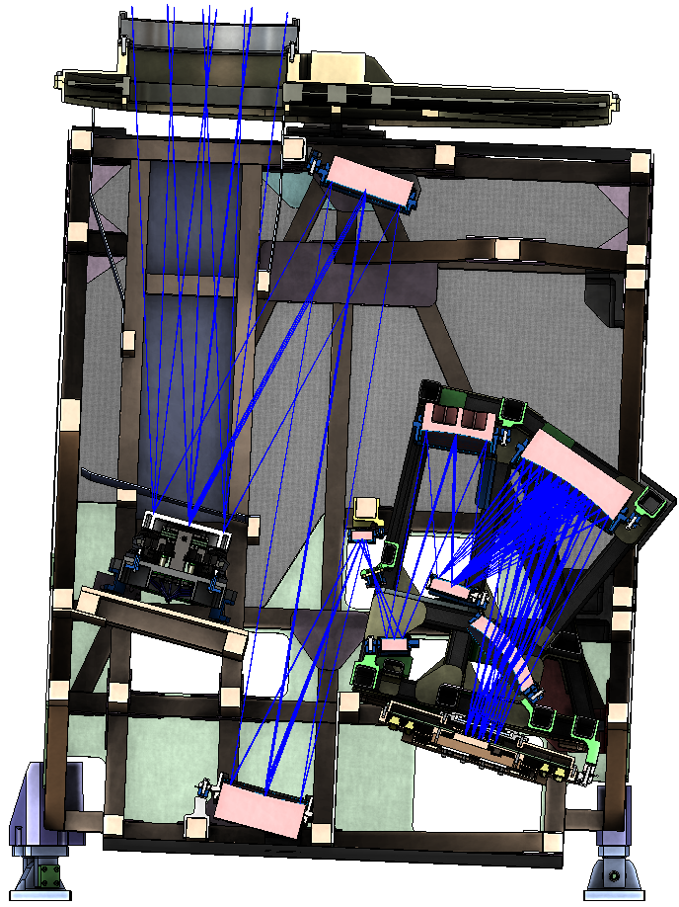
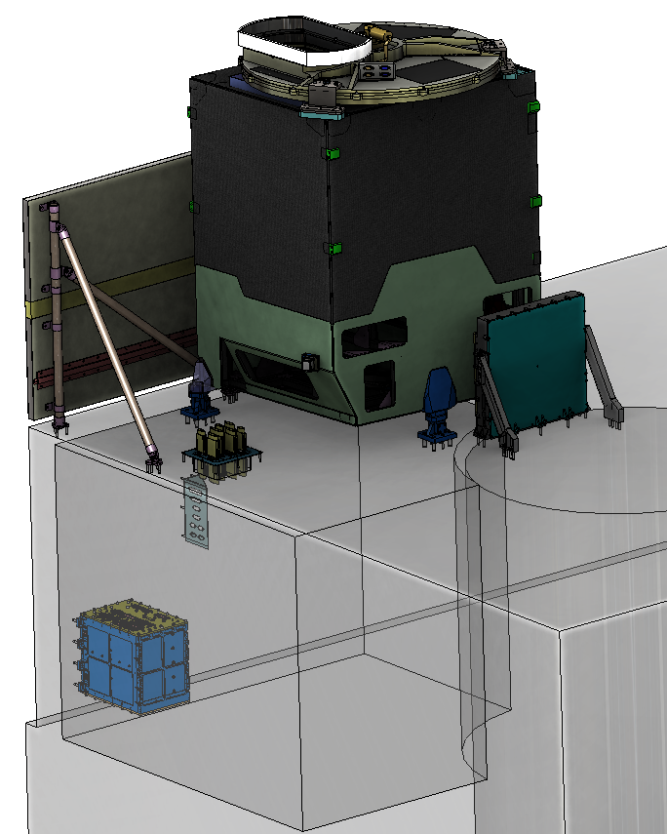
Instrument layout
Calibration Mechanism Assembly
Telescope Assembly
Scan Mechanism Assembly
Spectrometer Assembly
Radiator Assembly
Focal Plane Electronics
Focal Plane
Assembly
Instrument
Control Electronics
Instrument Support
Assembly
Notes:
Most of final drawings done; detectors in-house; grating ordered; optical bench ordered

Slide 62
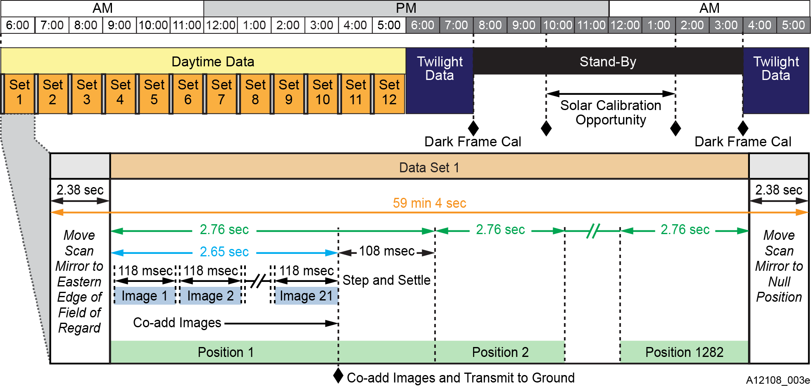
A day in the life
Figure 7. Nominal daily operations for TEMPO instrument.

Slide 63
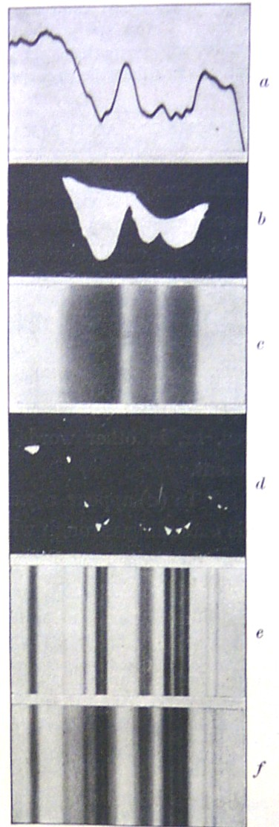
Why the Smithsonian?
Langley, S.P., and C.G. Abbot, Annals of the Astrophysical Observatory of the Smithsonian Institution, Volume 1 (1900).
Langley’s recently invented bolometer was used to make measurements from the infrared through the near ultraviolet in order to determine the mean value of the solar constant and its variation. Langley and Abbot also developed substantial new experimental techniques (such as an early chart recorder) and various analysis techniques (e.g., the “Langley plot”), including photographic techniques for high and low pass filtering to produce line spectra from “bolographs” (spectra), illustrated, foreshadowing the high pass filtering used today by researchers employing the DOAS technique for analyzing atmospheric spectra.

Slide 64
TEMPO science questions
What are the temporal and spatial variations of emissions of gases and aerosols important for air quality and climate?
How do physical, chemical, and dynamical processes determine tropospheric composition and air quality over scales ranging from urban to continental, diurnally to seasonally?
How does air pollution drive climate forcing and how does climate change affect air quality on a continental scale?
How can observations from space improve air quality forecasts and assessments for societal benefit?
How does intercontinental transport affect air quality?
How do episodic events, such as wild fires, dust outbreaks, and volcanic eruptions, affect atmospheric composition and air quality?

Slide 65
TEMPO launch algorithms
NO₂, SO₂, H₂CO, C₂H₂O₂ vertical columns
  Direct fitting to TEMPO radiances
    AMF-corrected reference spectra, Ring effect, etc.
    DOAS option available to trade more speed for less accuracy, if necessary
    Research products could include H₂O, BrO, OClO, IO
O₃ profiles, tropospheric O₃
eXceL optimal-estimation method developed @ SAO for GOME, OMI
May be extended to SO₂, especially volcanic SO₂
TOMS-type ozone retrieval included for heritage
Aerosol products from OMI heritage: AOD, AAOD, Aerosol Index
Advanced/improved products likely developed @ GSFC, U. Nebraska
Cloud Products from OMI heritage: CF, CTP
Advanced/improved products likely developed @ GSFC
UVB research product based on OMI heritage
Nighttime research products include city lights

Slide 66


Slide 67

TEMPO Baseline Products¹

Slide 68
Default Launch Data Products
Product | Algorithm | Hourly Coverage @ ≤ 4.5×8 km²
O₃ | TOMS-Vn | 15 - 50.25ºN, 60 - 130ºW
O₃ | XL optimal estimation | Selected urban areas and burning regions
NO₂ | Direct fitting, AMF (λ) | 15 - 50.25ºN, 60 - 130ºW
SO₂ | Direct fitting, AMF (λ) | 15 - 50.25ºN, 60 - 130ºW
H₂CO | Direct fitting, AMF (λ) | 15 - 50.25ºN, 60 - 130ºW
C₂H₂O₂ | Direct fitting, AMF (λ) | 15 - 50.25ºN, 60 - 130ºW
Aerosol OD and SSA | AERUV | 15 - 50.25ºN, 60 - 130ºW
Cloud pressure and fraction | CLDRR | 15 - 50.25ºN, 60 - 130ºW
UBV and Eryth. dose | UVB (?) | 15 - 50.25ºN, 60 - 130ºW
AQ indices | L3-L4 based | 15 - 50.25ºN, 60 - 130ºW

Slide 69
Secondary and Improved Data Products
Product | Algorithm | Hourly Coverage @ ≤ 4.5×8 km²
O₃ | XL optimal estimation | 15 - 50.25ºN, 60 - 130ºW (or, extended regions)
BrO | Direct fitting, AMF (λ) | 15 - 50.25ºN, 60 - 130ºW
H₂O | Direct fitting, AMF (λ) | 15 - 50.25ºN, 60 - 130ºW
C₂H₂O₂ | Direct fitting, AMF (λ) | 15 - 50.25ºN, 60 - 130ºW
Aerosols | AERUV | 15 - 50.25ºN, 60 - 130ºW
Clouds | CLDRR | 15 - 50.25ºN, 60 - 130ºW
SO₂ | Height-resolved | 15 - 50.25ºN, 60 - 130ºW
NO₂ | Improved | 15 - 50.25ºN, 60 - 130ºW

Slide 70
Alignment with 2007 Decadal Survey
The NRC 2007 Decadal Survey “Earth Science and Applications from Space: National Imperatives for the Next Decade and Beyond” recommended missions including Geostationary Coastal and Air Pollution Events (GEO-CAPE). The atmosphere part of GEO-CAPE is recommended to include the measurements proposed here.
TEMPO makes all the requisite GEO-CAPE UV/visible measurements, including O₃, NO₂, H₂CO, and aerosols (plus several additional species including SO₂). Together with the proposed IR instrument for CO measurements, all GEO-CAPE atmospheric requirements for North America are fulfilled.

Slide 71
TEMPO template

