Slide 1
Tropospheric Emissions: Monitoring of Pollution (TEMPO)
Kelly Chance & the TEMPO Team
April 6, 2013

Slide 2
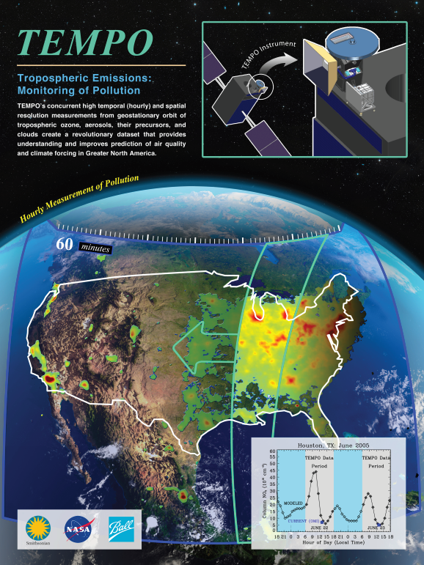
Hourly atmospheric pollution from geostationary Earth orbit
PI: Kelly Chance, Smithsonian Astrophysical Observatory
Instrument Development: Ball Aerospace
Project Management: NASA LaRC
Other Institutions: NASA GSFC, NOAA, EPA, NCAR, Harvard, UC Berkeley, St. Louis U, U Alabama Huntsville, U Nebraska
International collaboration: Korea, ESA, Canada
Selected Nov. 2012 through NASA’s first Earth Venture Instrument solicitation
Instrument delivery September 2017
NASA will arrange hosting on commercial geostationary communications satellite with expected ~2018 launch
Provides hourly daylight observations to capture rapidly varying emissions & chemistry important for air quality
  UV/visible grating spectrometer to measure key elements in tropospheric ozone and aerosol pollution
  Exploits extensive measurement heritage from LEO missions
  Distinguishes boundary layer from free tropospheric & stratospheric ozone
Aligned with Earth Science Decadal Survey recommendations
  Makes most of the GEO-CAPE atmosphere measurements
  Responds to the phased implementation recommendation of GEO-CAPE mission design team
  The North American geostationary component of an international constellation for air quality monitoring

Slide 3
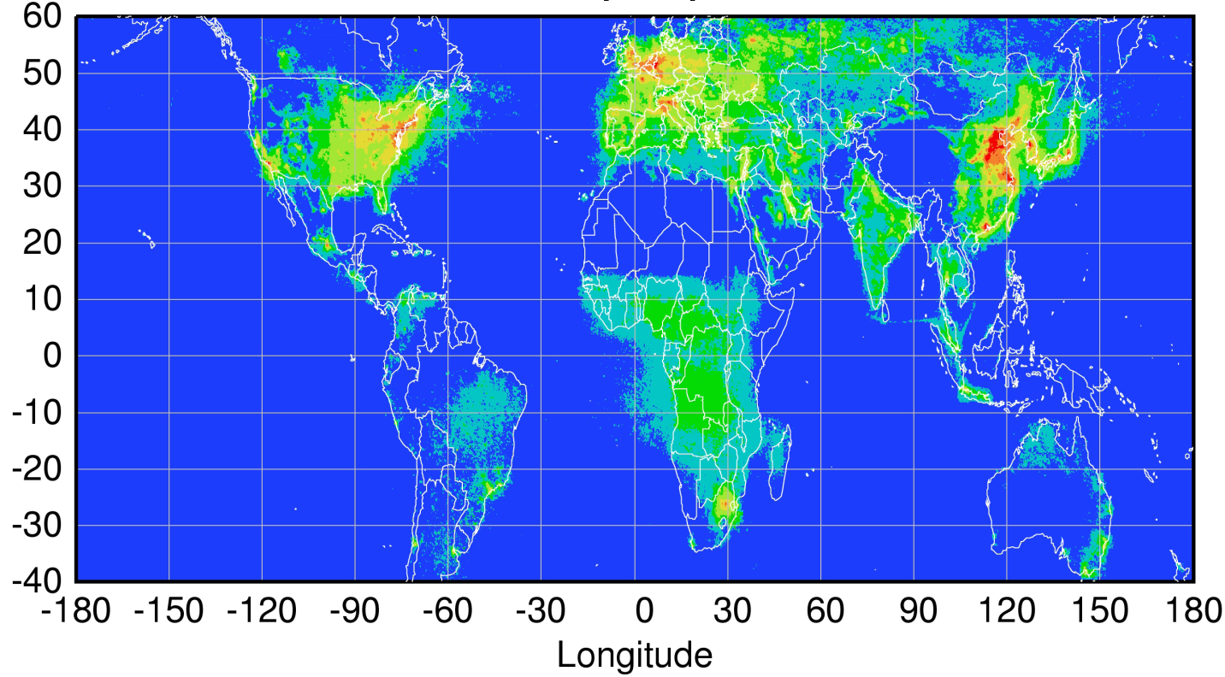
Geostationary constellation coverage
Sentinel-4
TEMPO
GEMS
Courtesy Jhoon Kim,
Andreas Richter
Policy-relevant science and environmental services enabled by common observations
Improved emissions, at common confidence levels, over industrialized Northern Hemisphere
Improved air quality forecasts and assimilation systems
Improved assessment, e.g., observations to support United Nations Convention on Long Range Transboundary Air Pollution

Slide 4
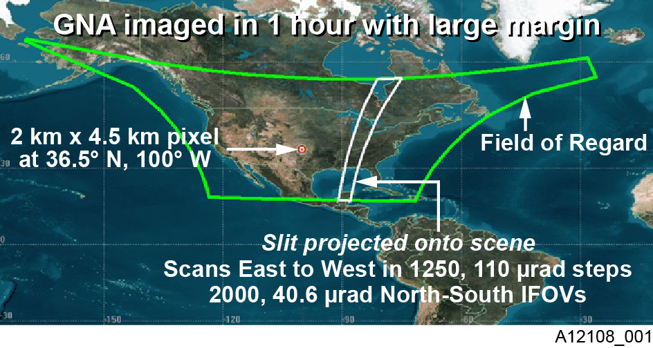
TEMPO footprint, ground sample distance and field of regard
Each 2 km × 4.5 km pixel is a 2K element spectrum from 290-690 nm
GEO platform selected by NASA for viewing Greater North America

Slide 5
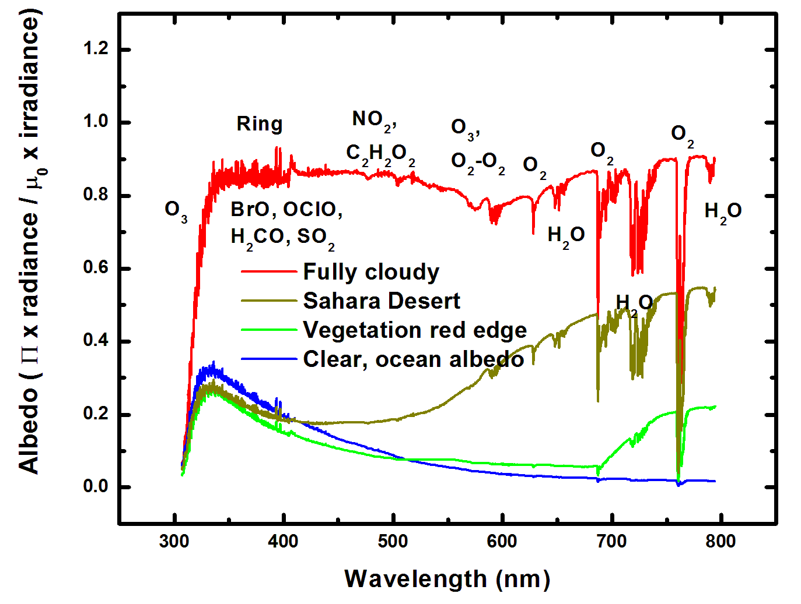
Typical spectra (from GOME-1)

Slide 6
TEMPO science questions
What are the temporal and spatial variations of emissions of gases and aerosols important for air quality and climate?
How do physical, chemical, and dynamical processes determine tropospheric composition and air quality over scales ranging from urban to continental, diurnally to seasonally?
How does air pollution drive climate forcing and how does climate change affect air quality on a continental scale?
How can observations from space improve air quality forecasts and assessments for societal benefit?
How does intercontinental transport affect air quality?
How do episodic events, such as wild fires, dust outbreaks, and volcanic eruptions, affect atmospheric composition and air quality?

Slide 7
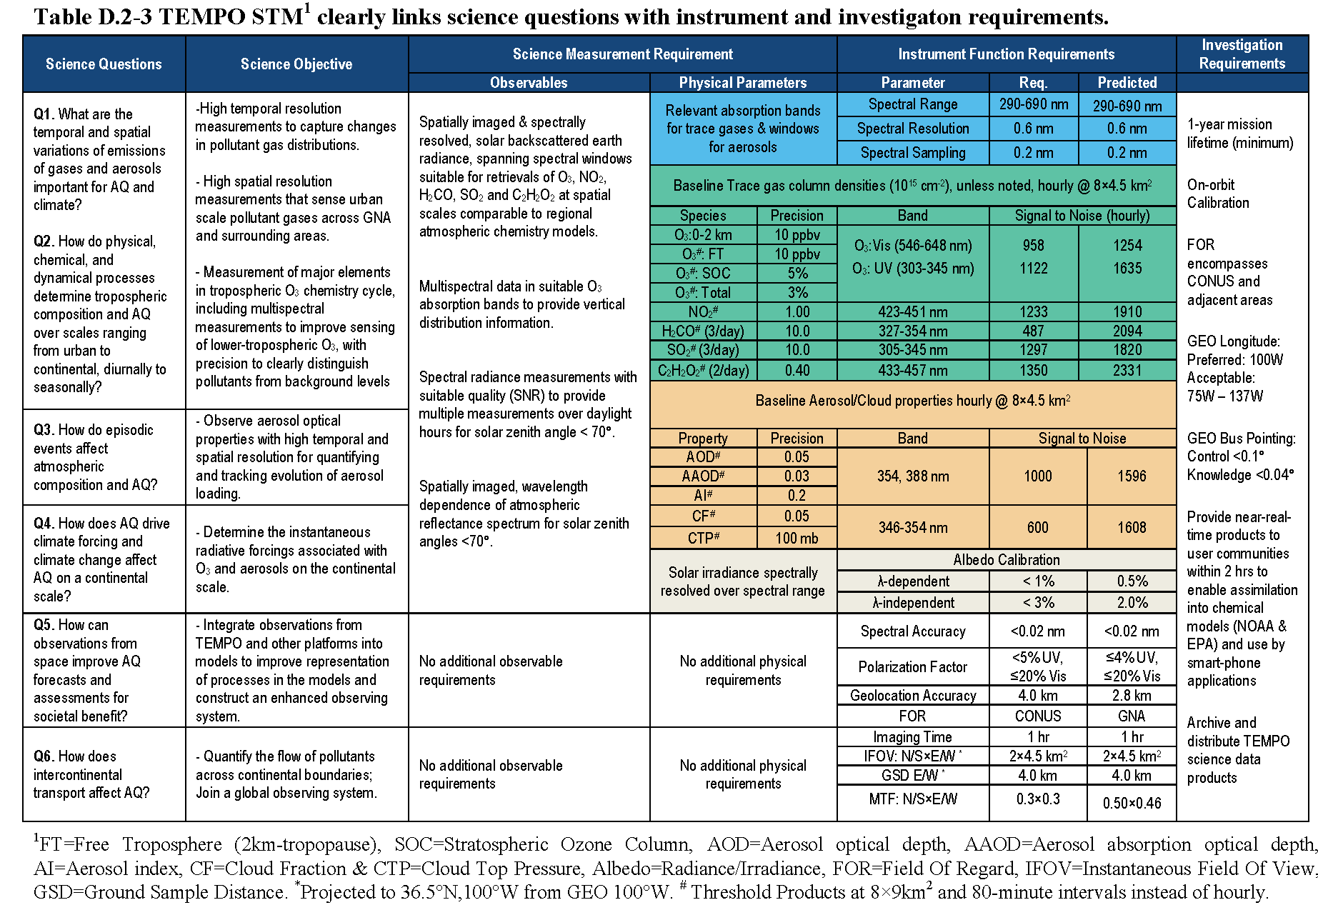
TEMPO Science Traceability Matrix

Slide 8
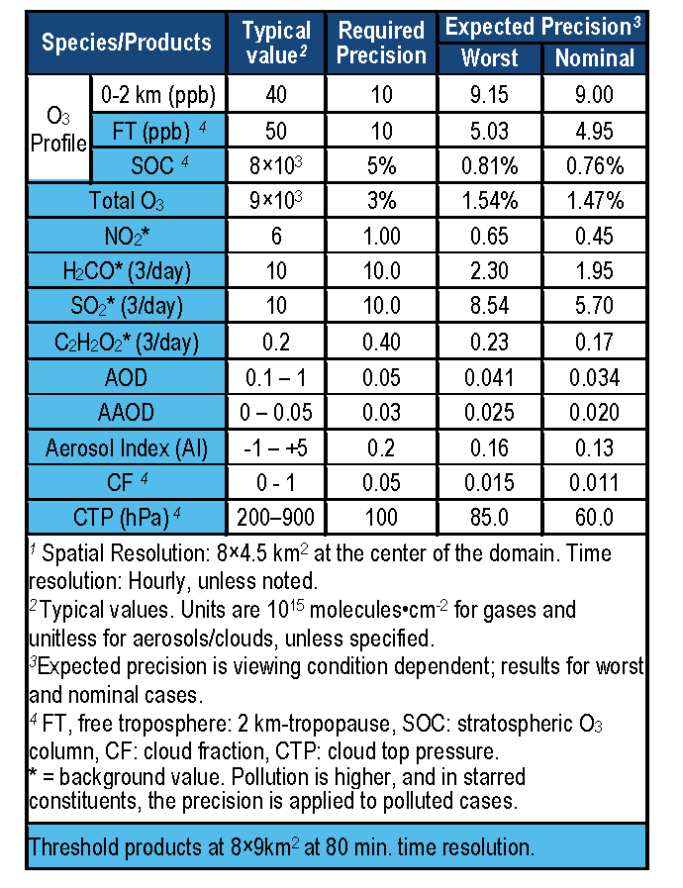
TEMPO baseline products

Slide 9
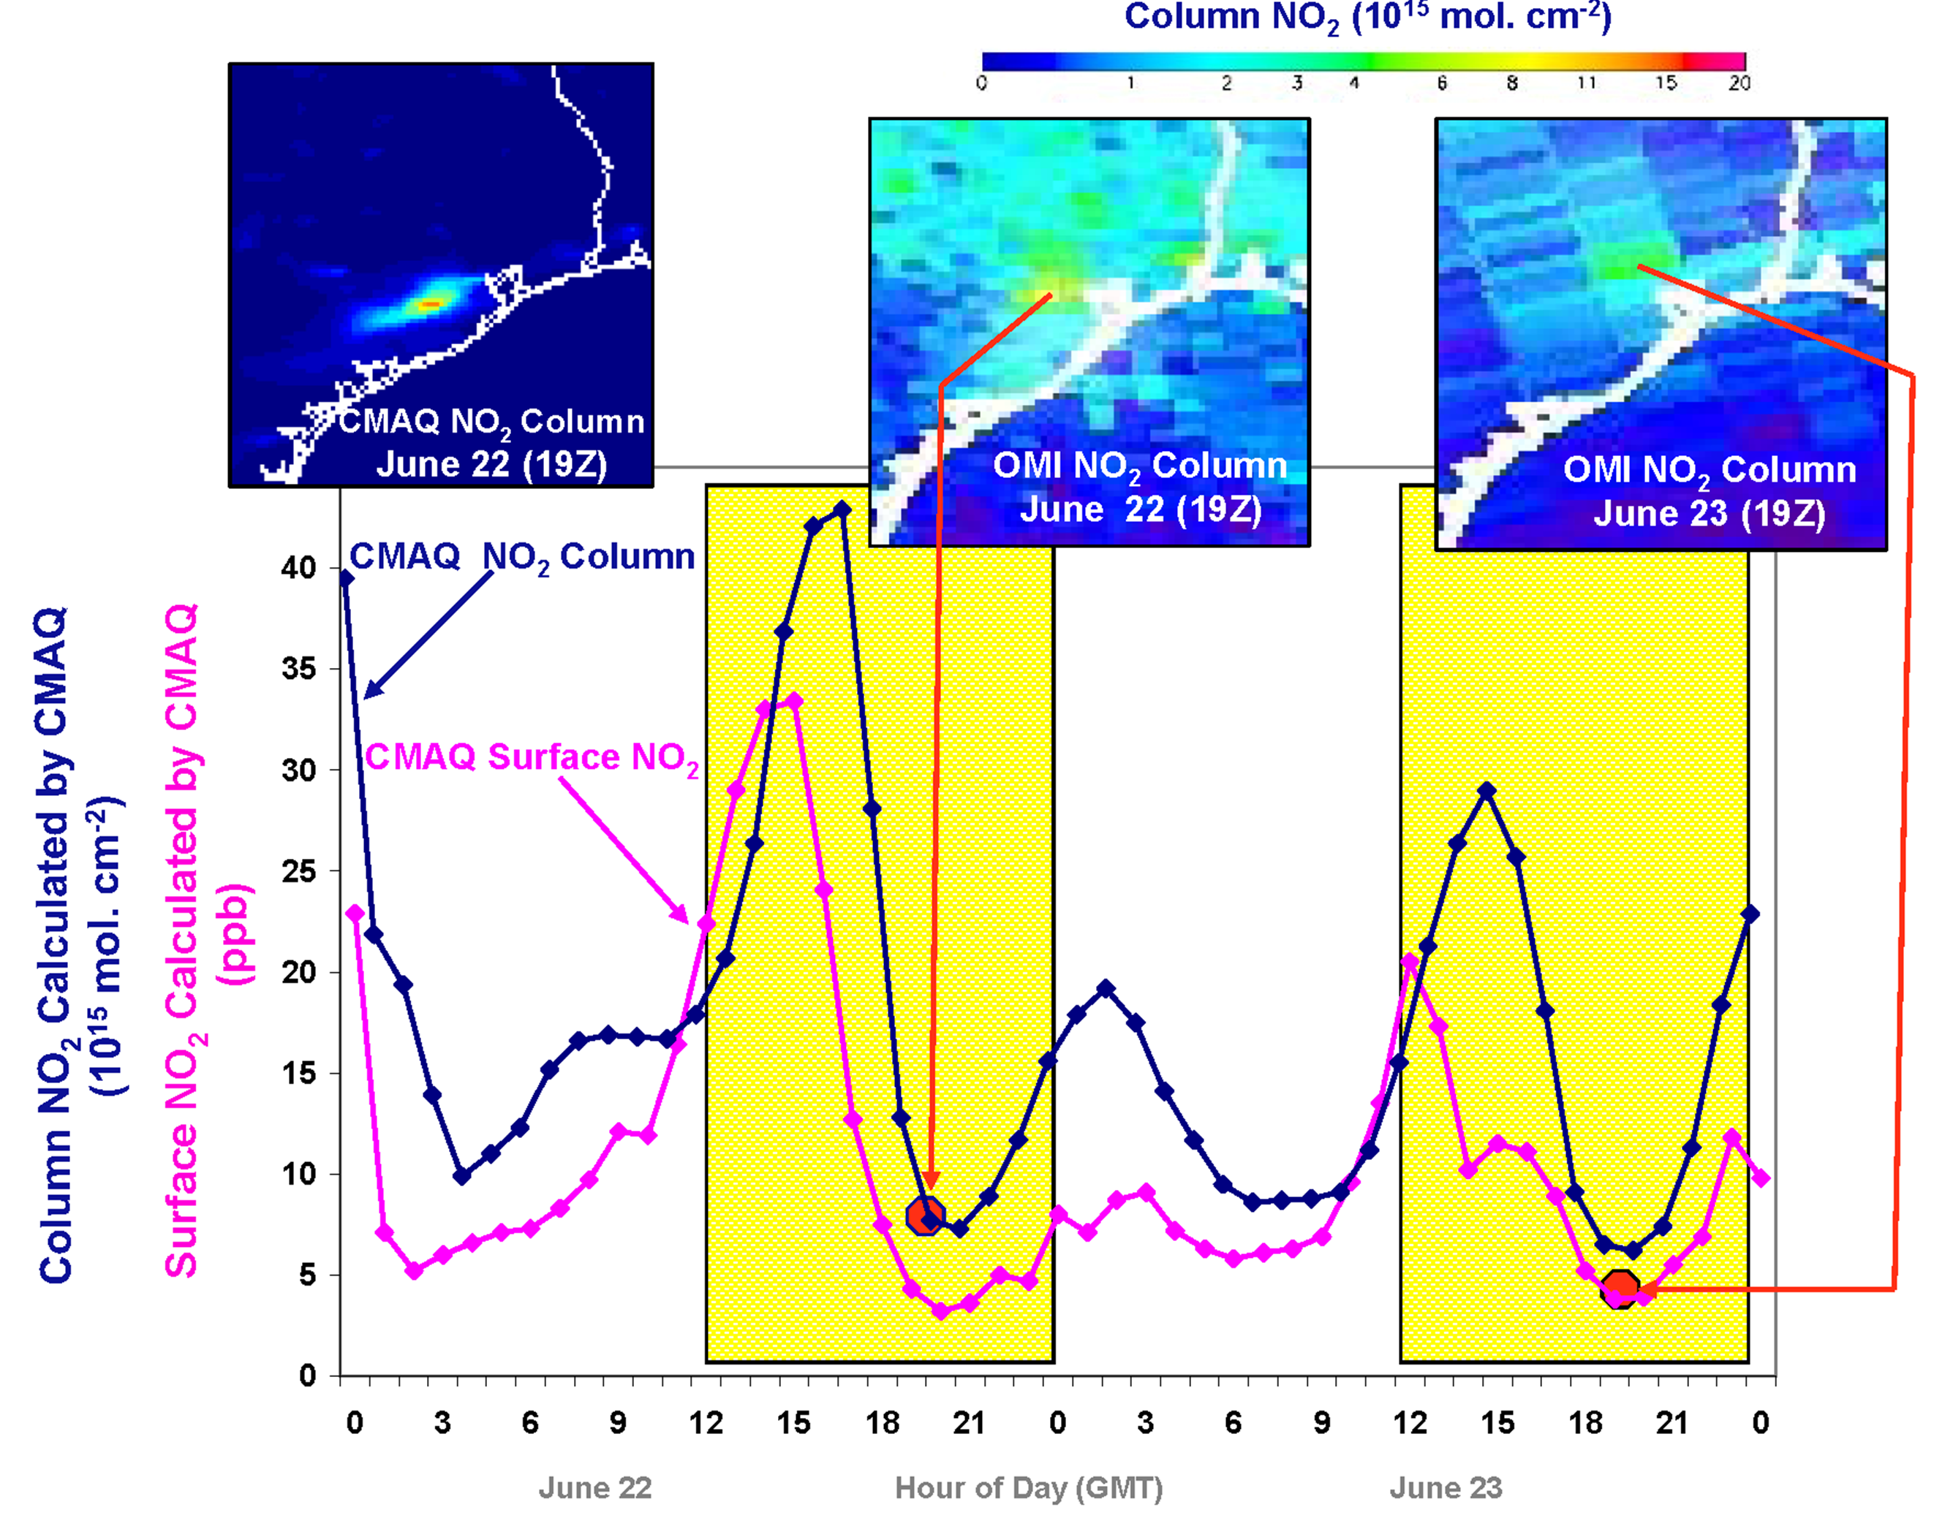
Why geostationary? High temporal and spatial resolution
Hourly NO₂ surface concentration and integrated column calculated by CMAQ air quality model: Houston, TX, June 22-23, 2005
June 22
Hour of Day (UTC)
June 23
LEO observations provide limited information on rapidly varying emissions, chemistry, & transport
GEO will provide observations at temporal and spatial scales highly relevant to air quality processes

Slide 10
TEMPO instrument concept
Measurement technique
  Imaging grating spectrometer measuring solar backscattered Earth radiance
  Spectral band & resolution: 290-690 nm @ 0.6 nm FWHM, 0.2 nm sampling
  2-D, 2k×2k, detector images the full spectral range for each geospatial scene
Field of Regard (FOR) and duty cycle
  Mexico City to the Canadian tar/oil sands, Atlantic to Pacific
  Instrument slit aligned N/S and swept across the FOR in the E/W direction, producing a radiance map of Greater North America in one hour
Spatial resolution
  2 km N/S × 4.5 km E/W native pixel resolution (9 km²)
  Co-add/cloud clear as needed for specific data products
Standard data products and sampling rates
  NO₂, O₃, aerosol, and cloud products sampled hourly, including eXceL O₃ for selected target areas
  H₂CO, C₂H₂O₂, SO₂ sampled 3 times/day (hourly samples averaged to get S/N)
  Product spatial resolution ≤ 8 km N/S × 4.5 km E/W at center of domain
  Measurement requirements met up to 70º SZA for NO₂, 50º for other standard products

Slide 11
TEMPO mission concept
Geostationary orbit, operating on a commercial telecom satellite
  NASA will arrange launch and hosting services (per Earth Venture Instrument scope)
    90-110º W preferred, 80-120º W acceptable
    Surveying COMSAT companies for specifications on satellite environment and launch manifests
  Hourly measurement and telemetry duty cycle for ≤70º SZA
    Hope to measure 20 hours/day
TEMPO is low risk with significant space heritage
  All proposed TEMPO measurements have been made from low Earth orbit satellite instruments to the required precisions
  All TEMPO launch algorithms are implementations of currently operational algorithms
    NASA TOMS-type O₃
    SO₂, NO₂, H₂CO, C₂H₂O₂ from AMF-normalized cross sections
    Absorbing Aerosol Index, UV aerosol, Rotational Raman scattering cloud, UV index
    eXceL profile O₃ for selected geographic targets
  Near-real-time products will be produced
TEMPO research products will greatly extend science and applications
  Example research products: profile O₃ for broad regions; BrO from AMF-normalized cross sections; height-resolved SO₂; additional cloud/aerosol products; vegetation products
  Example higher-level products: pollution/AQ indices from standard products, city light maps

Slide 12
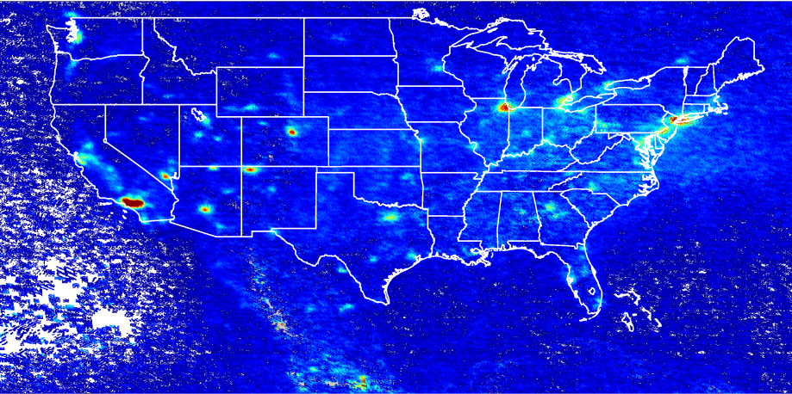
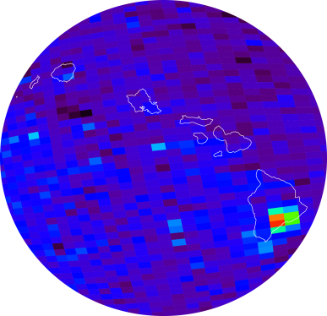
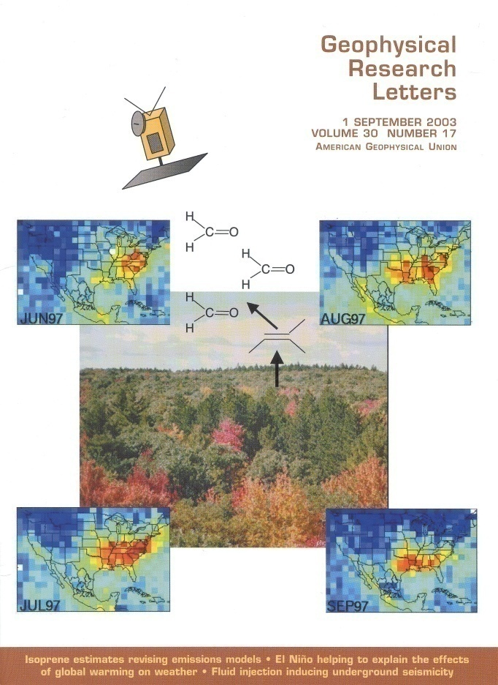
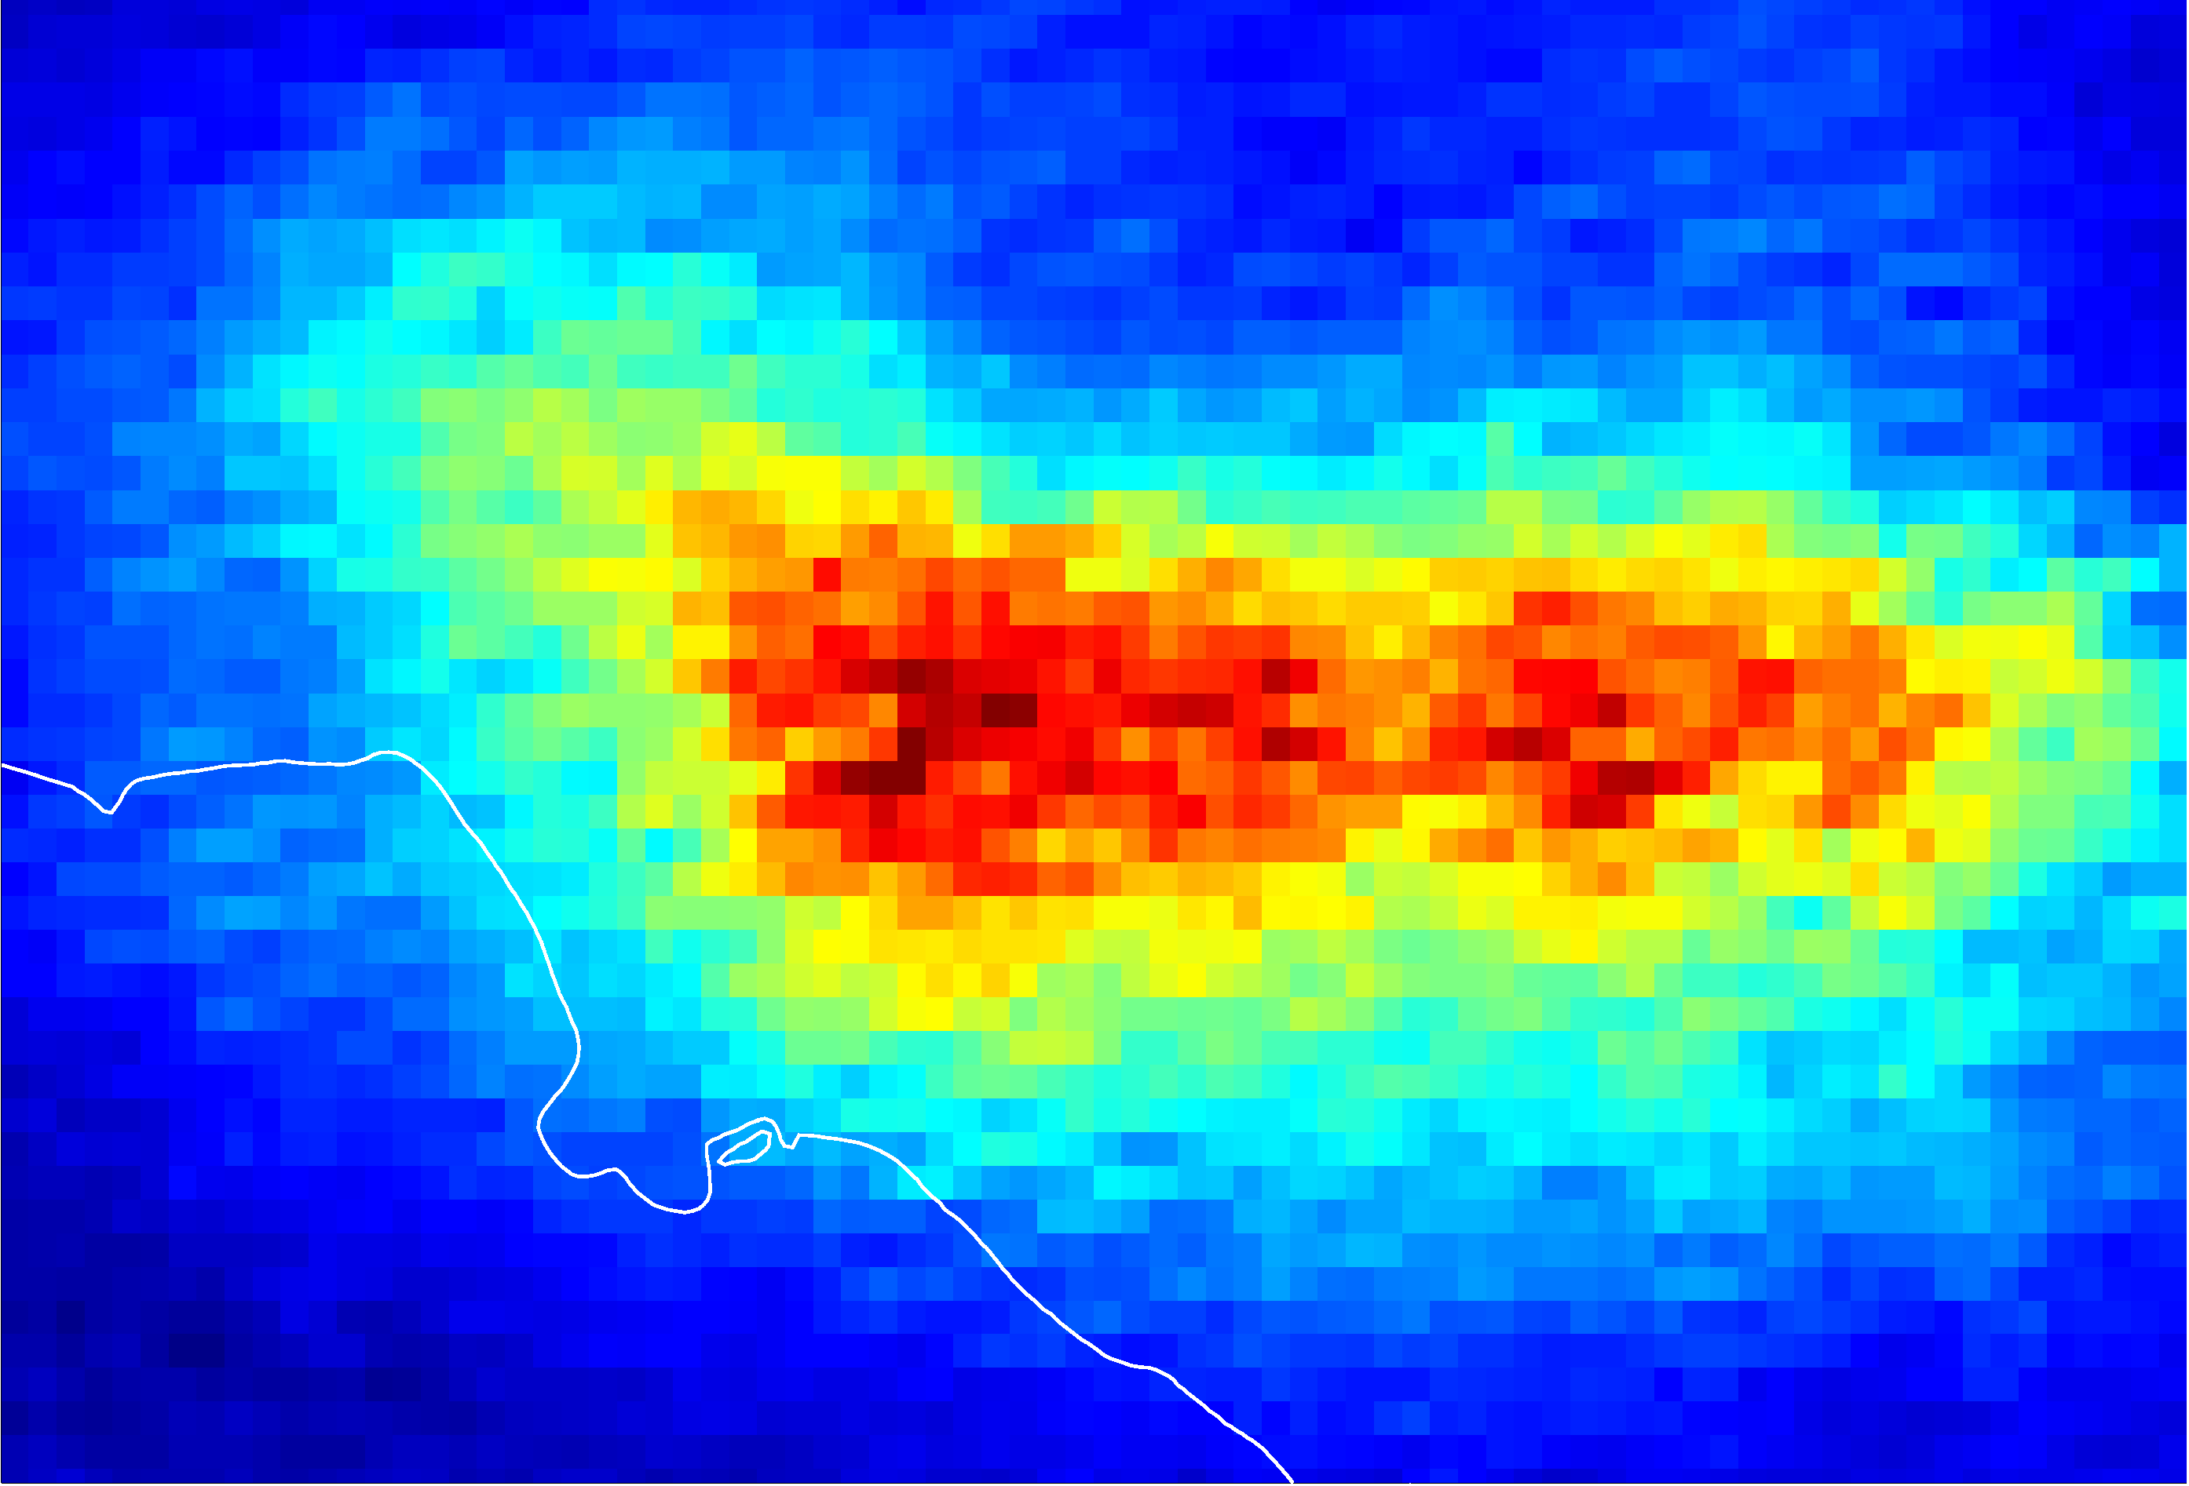
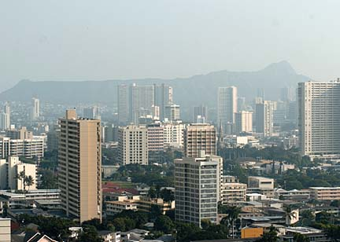
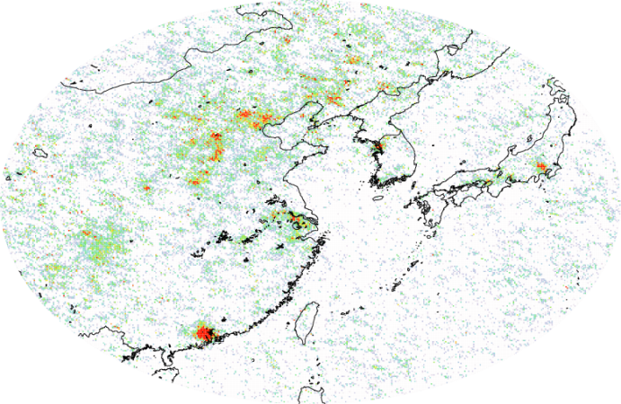
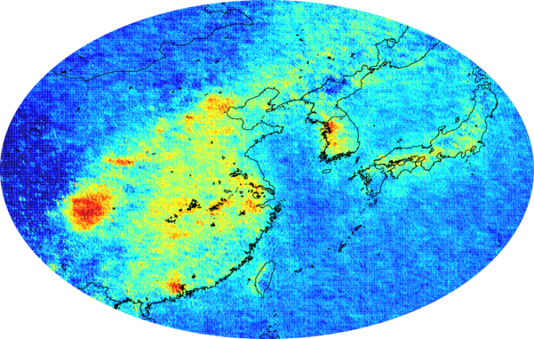
GOME, SCIA, OMI examples
NO₂
SO₂
Kilauea activity, source of the VOG event in Honolulu on 9 November 2004
O₃ strat
trop
HCHO
CHOCHO

Slide 13
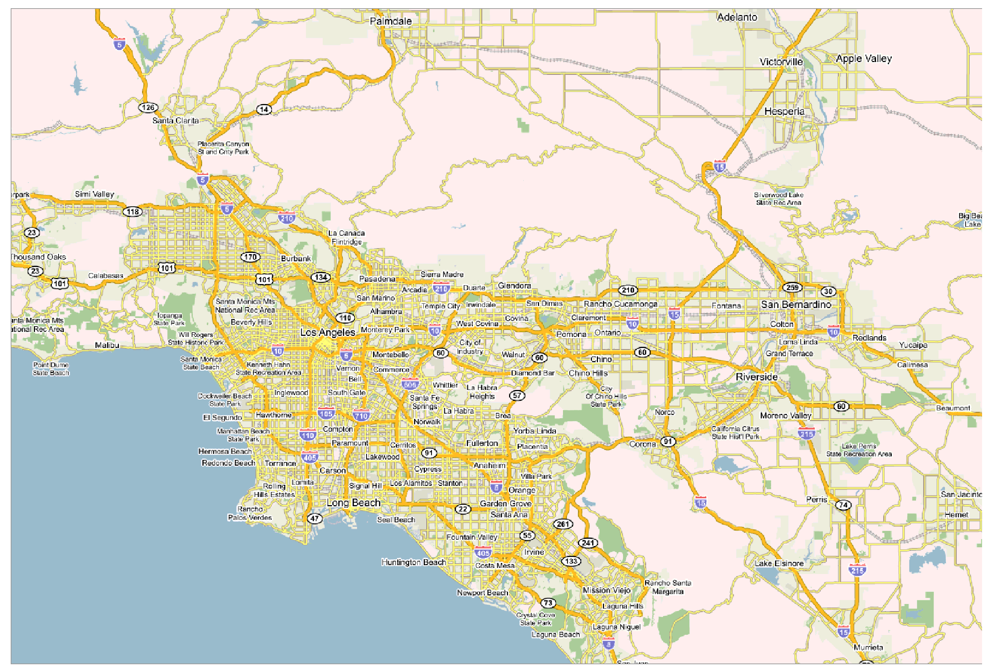
NO₂ over Los Angeles

Slide 14

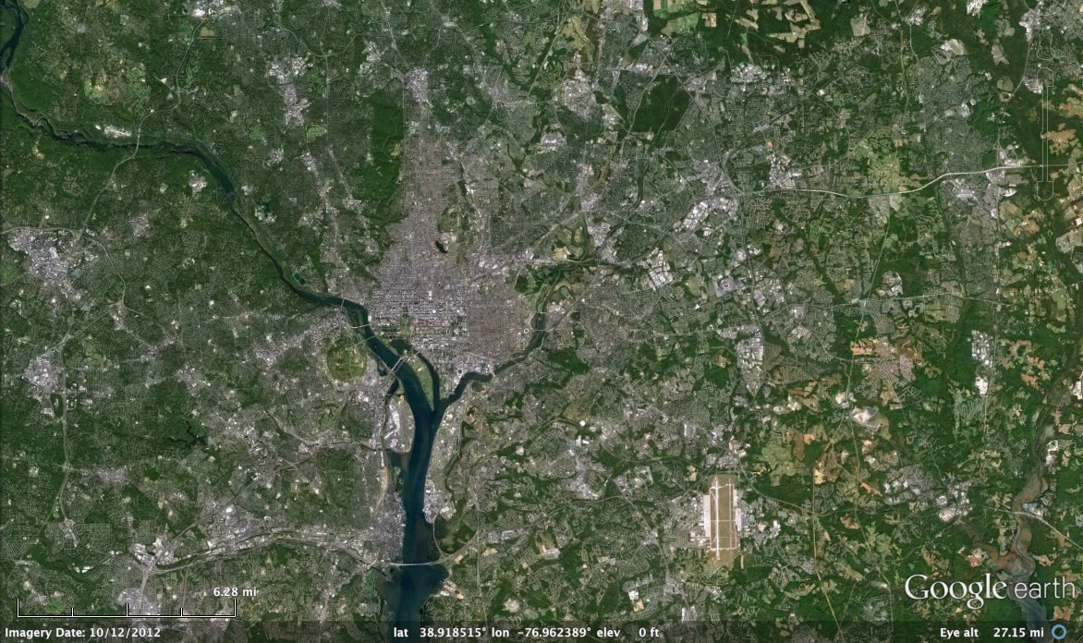
Washington, DC coverage
Hourly!

Slide 15

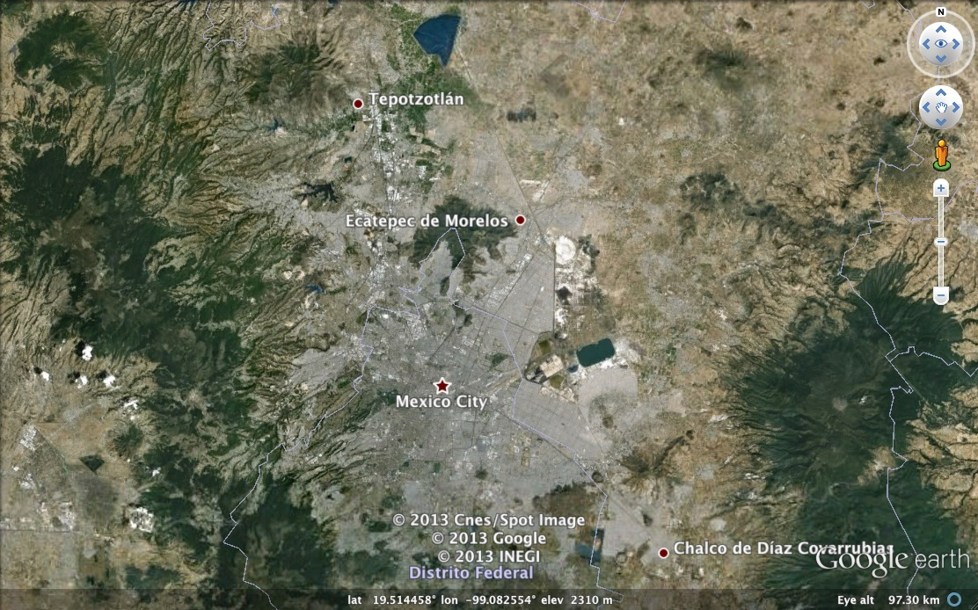
Mexico City coverage
¡Cada hora!

Slide 16




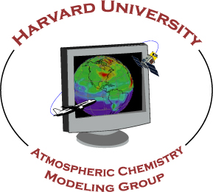


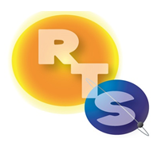


The End!

