Slide 1
Why So Few? Women in Science, Technology,
Engineering, and Mathematics
Joan Schmelz
Physics Prof, Univ of Memphis
Program Officer, NSF
Chair, CSWA

Slide 2
Girls’ achievements & interests in STEM are shaped by social & environmental factors.
Growth Mindset
Stereotype Threat
Spatial Relations

Slide 3
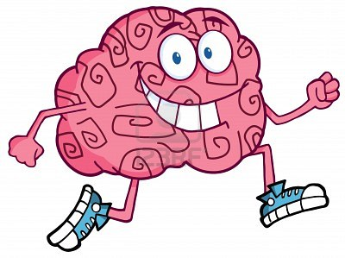
1. Growth Mindset
Believing in the potential for intellectual growth, in and of itself, improves outcomes.
Dweck & Leggett (1988) Psychological Review, 95(2), 256

Slide 4
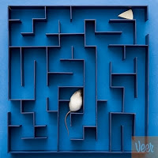
Fixed Mindset
You can lose confidence when you encounter challenges
If you are “smart,” things will come easily to you
If you have to work hard, you question your abilities and lose confidence
If you are “not good” at the task, you will never be good at it
So you are likely to give up

Slide 5
Growth Mindset
You show a far greater belief in the power of effort
Your confidence actually grows in the face of difficulty
You believe you are learning and getting smarter as a result of challenging yourself

Slide 6
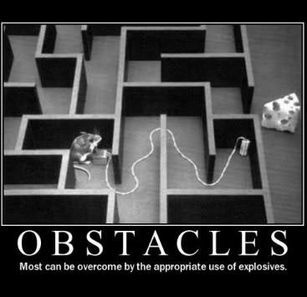
Important for women in STEM - encountering obstacles and challenging problems is the essence of scientific work.
If you believe you have a fixed amount of intelligence, you are more likely to lose confidence and disengage from STEM when you (inevitably) encounter difficulties in your course work.

Slide 7
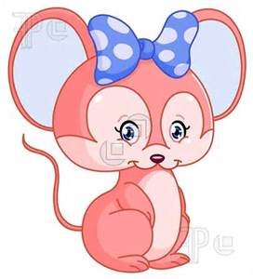
This is true for all students, but it is particularly relevant for girls in math and science, where negative stereotypes persist about their abilities.

Slide 8
In math and science, a growth mindset benefits girls.
Fixed Mindset | Growth Mindset
Intelligence is static. | Intelligence can be developed.
Leads to a desire to look smart and therefore a tendency to | Leads to a desire to learn and therefore a tendency to
avoid challenges | embrace challenges
give up easily due to obstacles | persist despite obstacles
see effort as fruitless | see effort as path to mastery
ignore useful feedback | learn from criticism
be threatened by others’ success | be inspired by others’ success

Slide 9
In math and science, a growth mindset benefits girls.
Fixed Mindset | Growth Mindset
Intelligence is static. | Intelligence can be developed.
Leads to a desire to look smart and therefore a tendency to | Leads to a desire to learn and therefore a tendency to
avoid challenges | embrace challenges
give up easily due to obstacles | persist despite obstacles
see effort as fruitless | see effort as path to mastery
ignore useful feedback | learn from criticism
be threatened by others’ success | be inspired by others’ success

Slide 10
In math and science, a growth mindset benefits girls.
Fixed Mindset | Growth Mindset
Intelligence is static. | Intelligence can be developed.
Leads to a desire to look smart and therefore a tendency to | Leads to a desire to learn and therefore a tendency to
avoid challenges | embrace challenges
give up easily due to obstacles | persist despite obstacles
see effort as fruitless | see effort as path to mastery
ignore useful feedback | learn from criticism
be threatened by others’ success | be inspired by others’ success

Slide 11
In math and science, a growth mindset benefits girls.
Fixed Mindset | Growth Mindset
Intelligence is static. | Intelligence can be developed.
Leads to a desire to look smart and therefore a tendency to | Leads to a desire to learn and therefore a tendency to
avoid challenges | embrace challenges
give up easily due to obstacles | persist despite obstacles
see effort as fruitless | see effort as path to mastery
ignore useful feedback | learn from criticism
be threatened by others’ success | be inspired by others’ success

Slide 12
In math and science, a growth mindset benefits girls.
Fixed Mindset | Growth Mindset
Intelligence is static. | Intelligence can be developed.
Leads to a desire to look smart and therefore a tendency to | Leads to a desire to learn and therefore a tendency to
avoid challenges | embrace challenges
give up easily due to obstacles | persist despite obstacles
see effort as fruitless | see effort as path to mastery
ignore useful feedback | learn from criticism
be threatened by others’ success | be inspired by others’ success

Slide 13
In math and science, a growth mindset benefits girls.
Fixed Mindset | Growth Mindset
Intelligence is static. | Intelligence can be developed.
Leads to a desire to look smart and therefore a tendency to | Leads to a desire to learn and therefore a tendency to
avoid challenges | embrace challenges
give up easily due to obstacles | persist despite obstacles
see effort as fruitless | see effort as path to mastery
ignore useful feedback | learn from criticism
be threatened by others’ success | be inspired by others’ success

Slide 14
In math and science, a growth mindset benefits girls.
Fixed Mindset | Growth Mindset
Intelligence is static. | Intelligence can be developed.
Leads to a desire to look smart and therefore a tendency to | Leads to a desire to learn and therefore a tendency to
avoid challenges | embrace challenges
give up easily due to obstacles | persist despite obstacles
see effort as fruitless | see effort as path to mastery
ignore useful feedback | learn from criticism
be threatened by others’ success | be inspired by others’ success
Teach kids that intellectual skills can be acquired.
Praise kids for effort.
Highlight the struggle.
Gifted and talented programs should send the message that you value growth and learning.

Slide 15
Parents and Teachers Should:
Teach kids that intellectual skills can be acquired.
When girls are taught that their intelligence can expand with experience and learning, they do better on math tests and are more likely to want to continue to study math in the future.

Slide 16
Parents and Teachers Should:
Praise kids for effort.
Don’t say, “You’re so smart!” when kids do well; say “You worked hard! You did it!”
It is especially important to praise the smartest kids for their effort. They often coast, get good grades, and get praised for their intelligence. They may be the very students who opt out when the work gets tough.

Slide 17
Parents and Teachers Should:
Highlight the struggle.
Tell kids that we value hard work and admire effort.
This will teach kids the values that are at the heart of STEM success:
-love the challenge;
-embrace hard work;
-learn from our (inevitable) mistakes.

Slide 18
Parents and Teachers Should:
Gifted and talented programs should send the message that they value growth and learning.
It is not just being “gifted” that is important

Slide 19
Growth Mindset
This research has so much potential
Work has expanded to address
Girls in engineering
1st generation college students
People of color in calculus classes
NYT article focused on retention – how to make people from underrepresented groups feel like they belong

Slide 20
2. Stereotype Threat
Negative stereotypes about women’s and girls’ abilities in STEM persist despite considerable gains in the last few decades.
The anxiety women face in a situation where they have the potential to confirm a negative stereotype about women as a group.

Slide 21
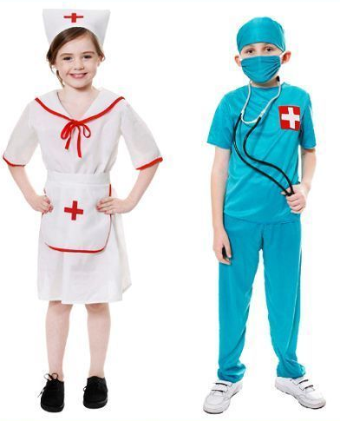
Two stereotypes are prevalent:
girls are not as good as boys in math, &
scientific work is better suited to boys and men.
As early as elementary school, kids are aware of these stereotypes and can express stereotypical beliefs about which STEM courses are suitable for girls and boys
Farenga & Joyce (1999) Science Education, 83(1), 55–76;
Ambady et al. (2001) Psychological Science, 12(5), 385–90.

Slide 22
Girls and young women are
aware of, and
negatively affected by,
the stereotypical image of a scientist as a man.
Although largely unspoken, negative stereotypes about women and girls in STEM are very much alive.
Buck et al. (2008) Science Education, 92(4), 688–707.

Slide 23
A large body of experimental research has found that negative stereotypes affect women’s and girls’ performance and aspirations in STEM
Even female students who strongly identify with math—who think that they are good at math and being good in math is important to them—are susceptible to effects
Nguyen & Ryan (2008) Journal of Applied Psychology, 93(6), 1314–34

Slide 24
Stereotype threat may help explain this discrepancy: girls get
higher grades in STEM classes
lower scores on high-stakes tests (math SAT and AP calculus).

Slide 25
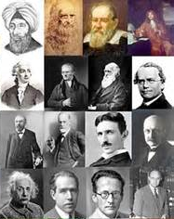
May also help explain why fewer girls express interest in careers in mathematically demanding fields.
Girls may be trying to reduce the likelihood that they will be judged through the lens of negative stereotypes by avoiding these fields all together.

Slide 26
Stereotype threat can be felt as both psychological and physiological responses that result in impaired performance.

Slide 27
African Americans taking an IQ test under stereotype threat had higher blood pressure levels than whites.
No difference in blood pressure occurred in the nonthreat situation.
Blascovich et al. (2001) Psychological Science, 12(3), 225–29.

Slide 28
Stereotyped individuals
made more of an effort
attempted more items
reread items more often
worked slower
worked with less accuracy
Steele & Aronson (1995) Jour of Personality & Social Psych, 69(5), 797–811

Slide 29
Stereotype Threat: Example 1
Researchers gave a math test to two groups of female and male college students with similar math abilities
Group 1: told that men perform better than women do on the test
(stereotype-threat group)
Group 2: told specifically that this test was designed to be gender neutral
(no-stereotype-threat group)

Slide 30
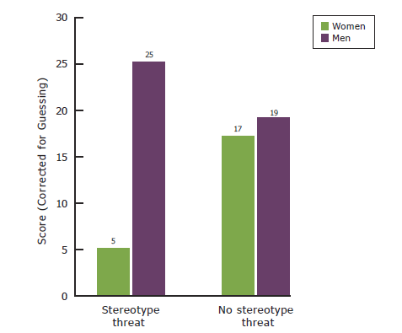
Negative stereotypes about girls’ and women’s abilities in math and science adversely affect their performance in these fields.
Performance on a Challenging Math Test, by Stereotype Threat Condition and Gender
Expose girls to successful female role models in math and science.
Teach students about stereotype threat.
Spencer et al. (1999), Journal of Experimental Social Psychology, 35(1), 13
Notes:
[This slide contains “fly ins.” When you first view the slide, only the heading and graph are visible. Simply click the mouse like you would to advance to the next slide to cue the fly ins.]
Stereotype threat arises in situations where a person fears that her or his performance will be evaluated based on a negative stereotype.
For example, a female student taking a difficult math test might experience an extra cognitive and emotional burden of worry that if she performed poorly, her performance would reinforce and confirm the stereotype that women are not good at math. This added burden of worry can have a negative effect on her performance.
For example, in one experiment, researchers gave a math test to two groups of female and male college students with similar math abilities .
One group was told that men perform better than women do on the test (the “stereotype threat” group), and the other group was told that there were no gender differences (the “no stereotype threat” group).
[Please refer to the graph shown]
The results are shown in the graph here. The researchers found that women did significantly worse than men did in the “stereotype threat” group. Women scored 5 on average and men scored 25 on average. But in the “no stereotype threat” group, women and men performed equally well. [Please note that although there is a small difference in scores in the no stereotype threat group, this is not a statistically significant difference.]
The researchers concluded that because women’s performance improved when there was no “threat,” it must have been something about the testing situation rather than women’s ability that accounted for the difference in their performance in the threat group compared to the no threat group.
This result has been shown again and again in other experiments.
But this finding also points to some good news, which is that “stereotype threat” is largely situational, and when the threat is removed girls’ performance improves. Researchers recommend some simple suggestions that have been shown to lessen the impact of stereotype threat and improve girls’ performance. They recommend:
[Click mouse to cue first fly-in]
Exposing girls to successful role models in math and science to combat the negative stereotypes about women in these fields, and
[Click mouse for second fly in]
Explicitly talking to students about stereotype threat, which has resulted in improved performance.
[OPTIONAL]
We chose to highlight this research because (1) it gets at a puzzling discrepancy between girls’ grades, which are generally higher than boys’ even in high school math and science, and their performance on high-stakes exams such as the SAT math or Advanced Placement calculus exams, where their performance still lags behind that of male students. And (2) the research also demonstrates the continuing power of gender stereotypes.

Slide 31
Stereotype Threat: Example 2
Students are selected based on their excellent math SAT scores and divided randomly into two groups
Both groups are given a math test of GRE level problems
Group 1: test given under normal “GRE-type” conditions
Group 2: told specifically that this test was designed to be gender neutral

Slide 32
Stereotype Threat: Results
Results for Group 1: men and women got the same average score
Results for Group 2: women did significantly better than men. Why?
On the SAT test, they got scores equal to the men, but with stereotype threat
On the GRE test, there was no stereotype threat, so they performed at their “real” level
Good et al. (2003) Applied Developmental Psychology, 24, 645–62.
Notes:
Good news: situational, so can be removed by changing the situation.

Slide 33
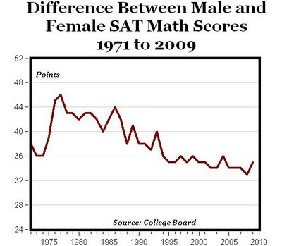
20 of these 30+ points could be the result of Stereotype Threat

Slide 34
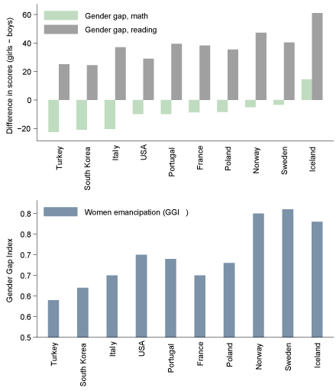

Slide 36
Stereotype Threat
adversely affects women’s math performance to a modest degree
may account for as much as 20 points on the math SAT
20 points on a test with a total possible score of 800 may seem small, in 2008 the average male score on the SAT math exam was 30 points higher than the average female score
so eliminating stereotype threat could eliminate two-thirds of the gender gap on the math SAT

Slide 37
3. Spatial Skills
A cognitive skill with one of the largest and most persistent gender gaps, where boys consistently outperform girls.

Slide 38
Mental Rotation Question on a Spatial Skills Test
Notes:
spatial skills are not fixed and can improve dramatically in a short time with training.
To give you an idea of what we mean by spatial skills, this slide shows a sample question on mental rotation, which is just one example of spatial skills.

Slide 39
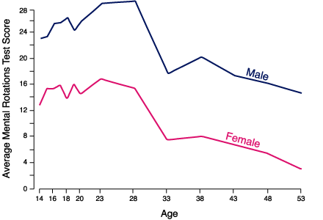

Slide 40
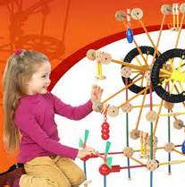
Spatial skills are important for success in fields like engineering
The wrong theory:
-If you think that these skills are innate
-Then the gender gap in spatial skills explains why there are so few women in engineering

Slide 41
Research shows that spatial skills
-Are not innate!
-Can improve dramatically in a short time with training.

Slide 42
College engineering students
-fail a spatial visualization test;
-take a 10-week training course;
-improve their scores from an average of 52% before the course to 82%
Sorby (2009) International Journal of Science Education, 31(3), 459

Slide 43
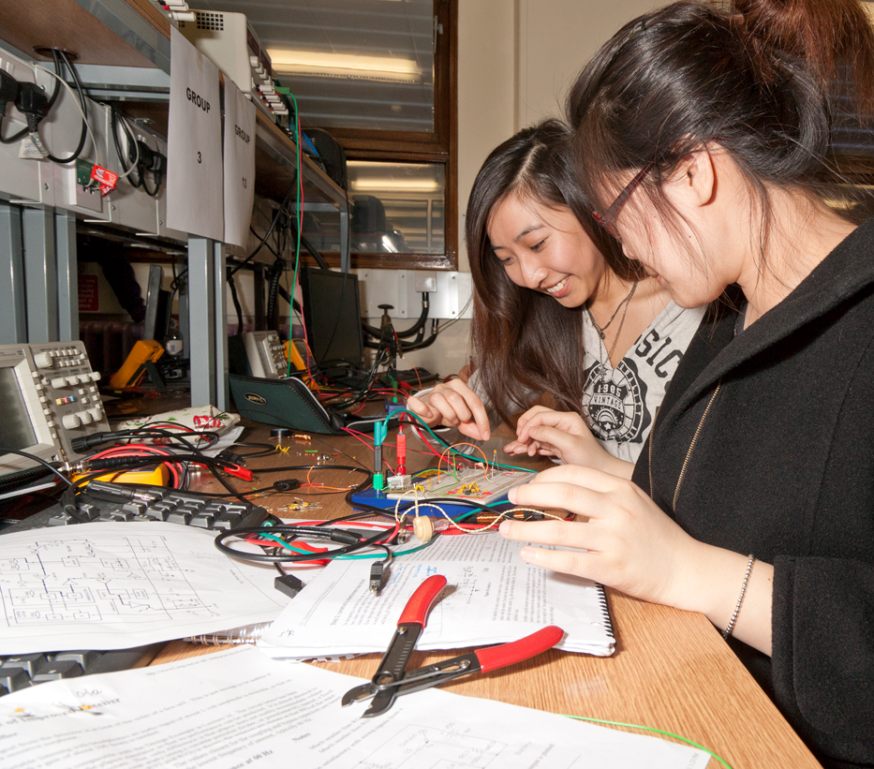
Having good spatial skills can help
-encourage girls to pursue their interest in science and math;
-keep women in engineering
Why? we use spatial skills to interpret diagrams & drawings in math and science textbooks as early as elementary school.

Slide 44
So what can be done to help children, especially girls, develop their spatial skills, which can increase their interest in studying STEM subjects?

Slide 45
Play with building toys - Legos or blocks - where kids take things apart and put them together again.
Draw - kids turn the 3D world into a 2D picture.

Slide 46
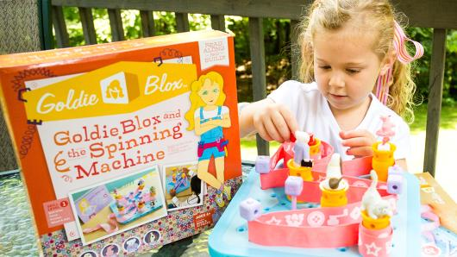

Slide 49
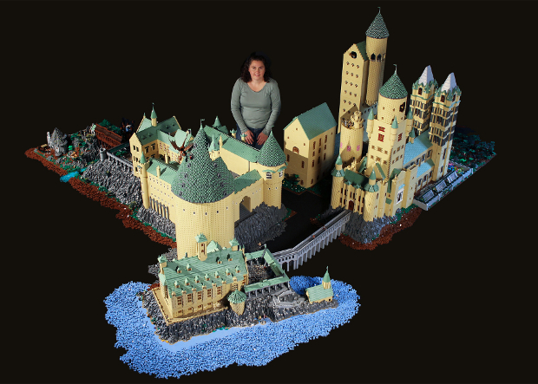
Alice Finch used over 400,000 LEGO bricks to build this massive replica of Hogwarts

Slide 50
Why So Few? Women in Science, Technology, Engineering, and Mathematics
To download the report
www.aauw.org
To contact the researchers
aauw-research@aauw.org
Notes:
So Why So Few? The answer is all around us.
The research we profiled provides evidence that social and environmental factors at work in the home, at school, and in the workplace act as barriers to girls’ and women’s performance and participation in science, technology, engineering, and math fields.
The report also provides concrete recommendations for what each of us can do in our roles as parents, educators, employers, decision-makers, and leaders to effect positive change and more fully open opportunities for girls and women in science and engineering fields.
Like all AAUW research reports, this report will be influential only if we all help spread the word.
Please share these findings with
The report can be downloaded for free from our website; the address is shown here.
You can also contact our research department at the e-mail address shown here if you have questions or comments.

