Slide 1

Molecular Databases:
Evolution and Revolution
Laurence S. Rothman
Iouli E. Gordon
Harvard-Smithsonian
Center for Astrophysics
Atomic and Molecular
Physics Division
Cambridge MA 02138, USA
HITRAN/ASA Conference
16-18 June
SAO, Cambridge MA, USA

Slide 2
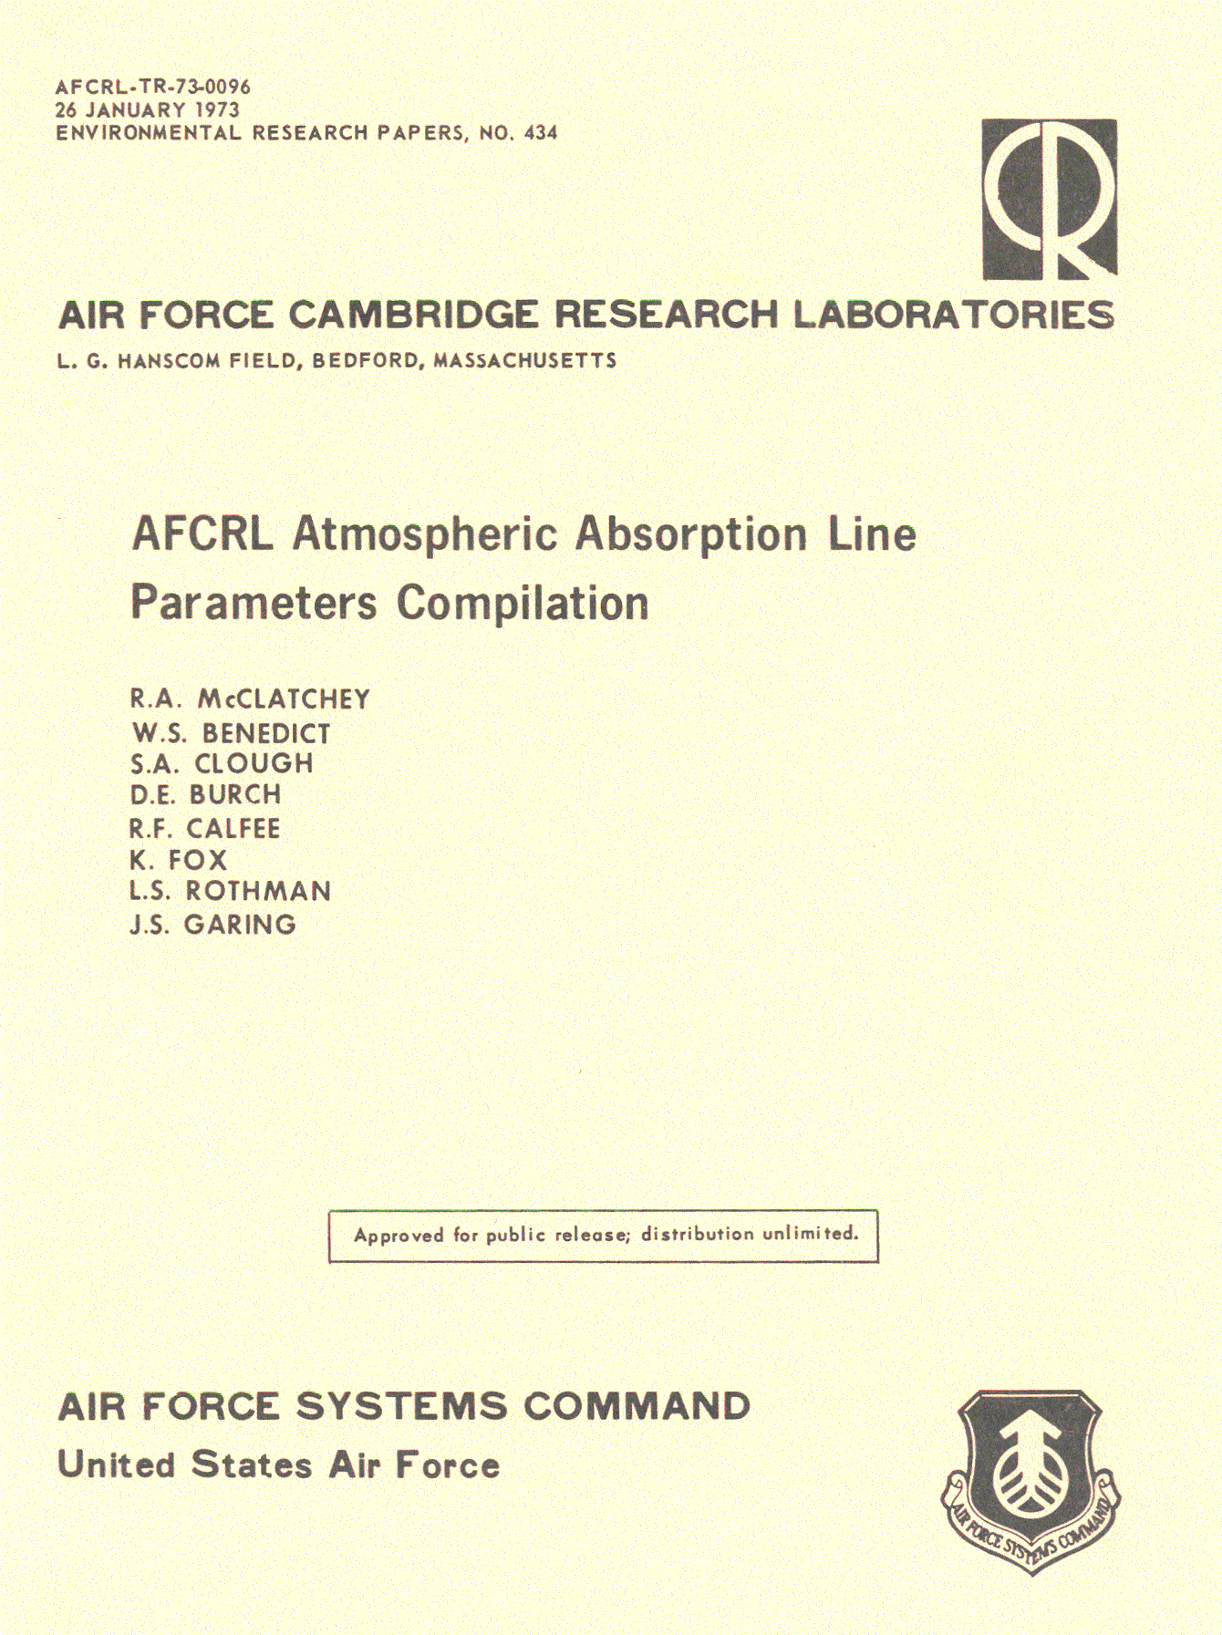
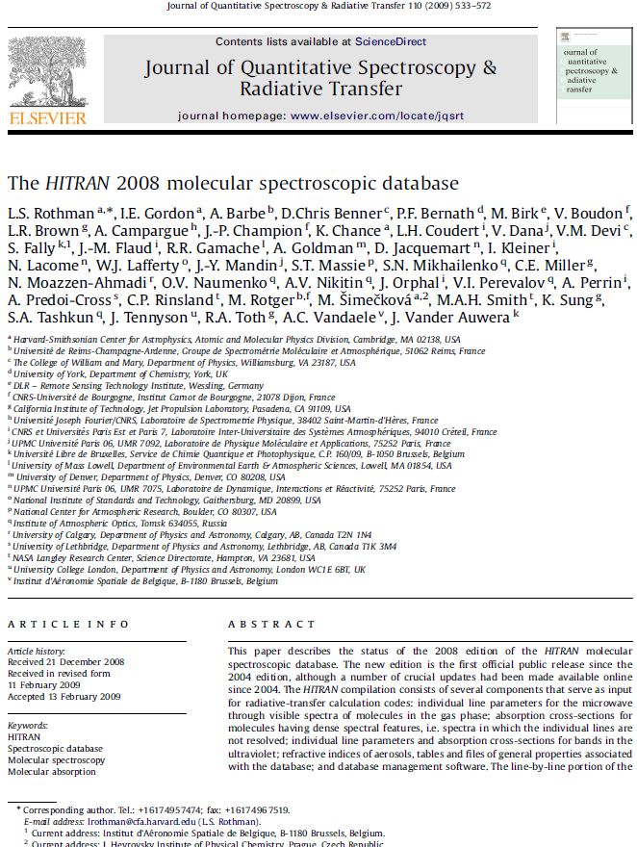
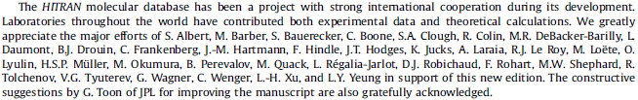

Slide 3
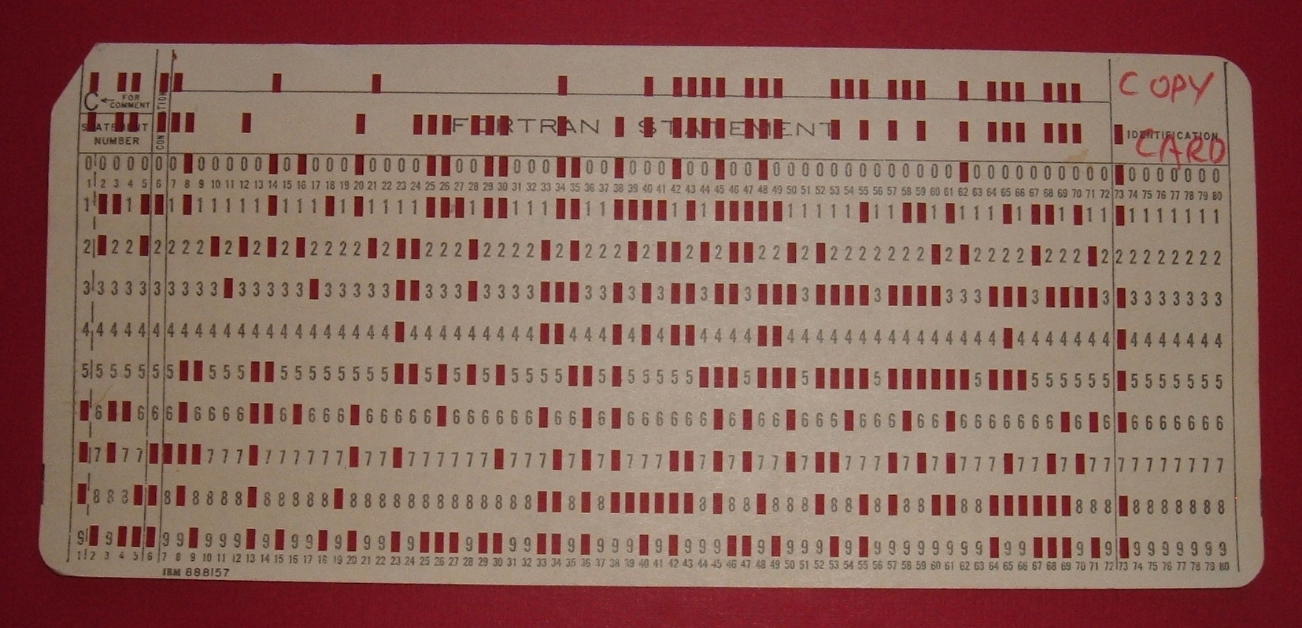
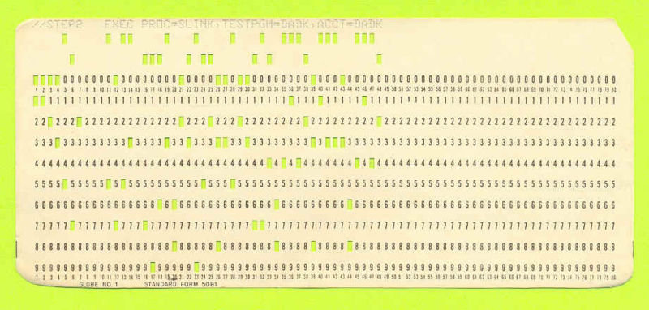
Notes:
Babbage once contacted the poet Alfred Tennyson in response to his poem "The Vision of Sin". Babbage wrote, "In your otherwise beautiful poem, one verse reads,
Every moment dies a man,
Every moment one is born.
... If this were true, the population of the world would be at a standstill. In truth, the rate of birth is slightly in excess of that of death. I would suggest [that the next version of your poem should read]:
Every moment dies a man,
Every moment 1 1/16 is born.
Strictly speaking, the actual figure is so long I cannot get it into a line, but I believe the figure 1 1/16 will be sufficiently accurate for poetry."

Slide 4
File Structure of HITRAN Compilation
Level 1
JavaHAWKS Software Installers and Documentation
HITRAN
(line-transition parameters)
IR
Cross-sections
UV
Aerosol
Refractive Indices
Line
Coupling
CO₂ data
Level 2
Global Data Files, Tables, and References
Line-by-line
Cross-sections
Supplemental
Supplemental
Alternate
Molecule-
by-molecule
Level 3

Slide 5
HITRAN Line-by-line Parameters
Parameter | Field size | Definition
Mol | I2 | Molecule number
Iso | I1 | Isotopologue no.(1 = most abundant, 2 = second most abundant, …)
ν_{if} | F12.6 | Transition wavenumber in vacuum [cm⁻¹]
S_{if} | E10.3 | Intensity [cm⁻¹/(molecule∙cm⁻²) @ 296K]
A_{if} | E10.3 | Einstein A-coefficient [s⁻¹]
γ_{air} | F5.4 | Air-broadened half-width (HWHM) [cm⁻¹/atm @ 296K]
γ_{self} | F5.3 | Self-broadened half-width (HWHM) [cm⁻¹/atm @ 296K]
E″ | F10.4 | Lower-state energy [cm⁻¹]
n_{air} | F4.2 | Temperature-dependence coefficient of γ_{air}
δ_{air} | F8.6 | Air pressure-induced shift [cm⁻¹/atm @ 296K]
v′, v″ | 2A15 | Upper and Lower “global” quanta
q′, q″ | 2A15 | Upper and Lower “local” quanta
ierr | 6I1 | Uncertainty indices for ν_{if} , S_{if} , γ_{air} , γ_{self} , n_{air} , δ_{air}
iref | 6I2 | Reference pointers for ν_{if} , S_{if} , γ_{air} , γ_{self} , n_{air} , δ_{air}
* | A1 | Flag for line-coupling algorithm
g′, g″ | 2F7.1 | Upper and Lower statistical weights
160-character total

Slide 6
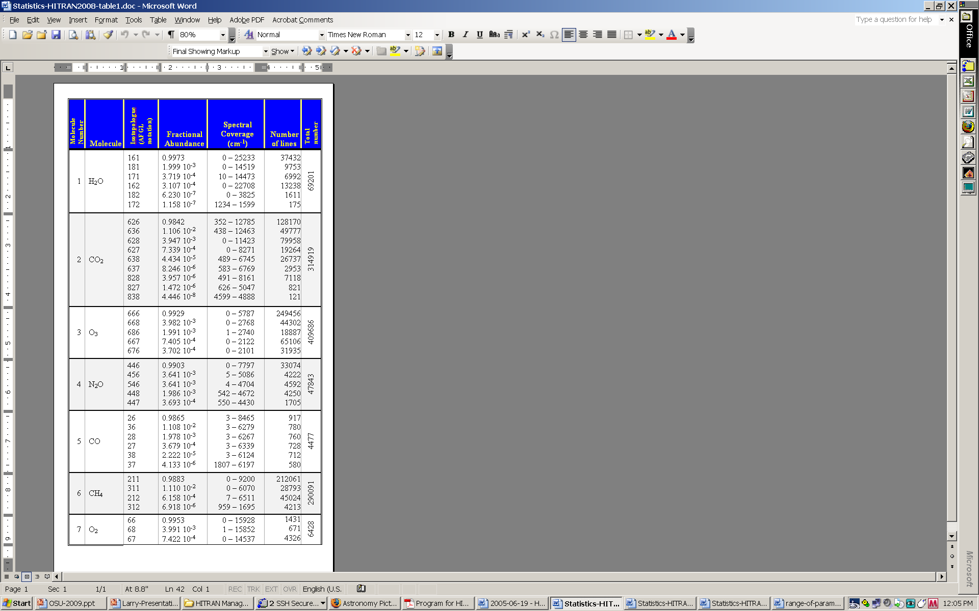
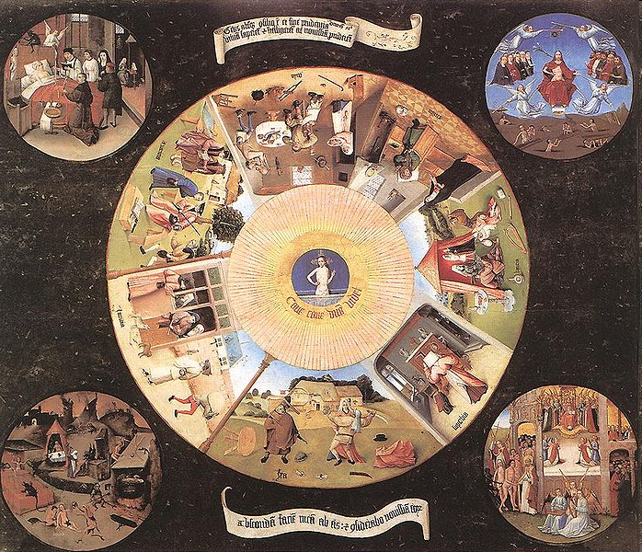
HITRAN2004
63226
62913
311481
47835
4477
251440
6428

Slide 7
MkIV balloon spectra provided by Geoffrey Toon, JPL
Note different
scales
Most of the improve-ments in residuals are due to improved and extended lines of HCl (SAO) and O₃ (Reims & Tomsk).
MkIV balloon spectra provided by Geoffrey Toon, JPL
Note different
scales
Most of the improvements in residuals are due to improved and extended lines of HCl and O₃.

Slide 8
Comparison of the experimental spectrum of H₂CO measured with an OPO-based CRDS technique (black line) with HITRAN2004 (blue dashed line) and HITRAN2008 (red line).
Taken from Persijn et al, Appl Phys B DOI 10.1007/s00340-009-3875-3
H₂CO parameters in HITRAN2008 based
on the work of Perrin et al,
JQSRT HITRAN Special Issue (2009).

Slide 9
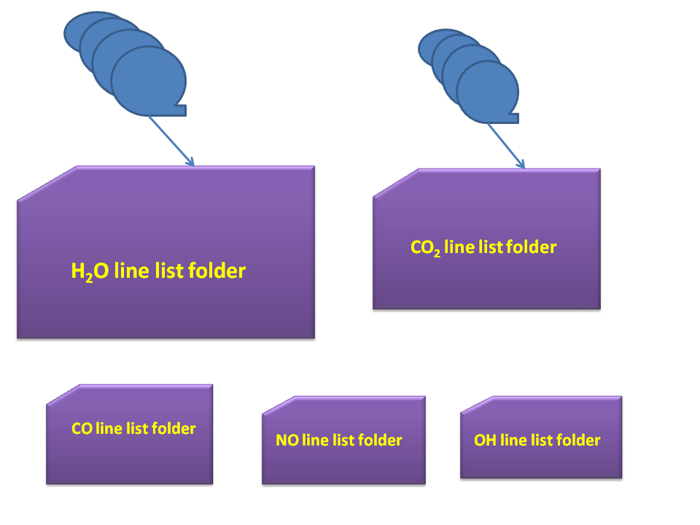
Files contained in new HITEMP database
Mol_v1-v2_HITEMP2010.zip

Slide 10
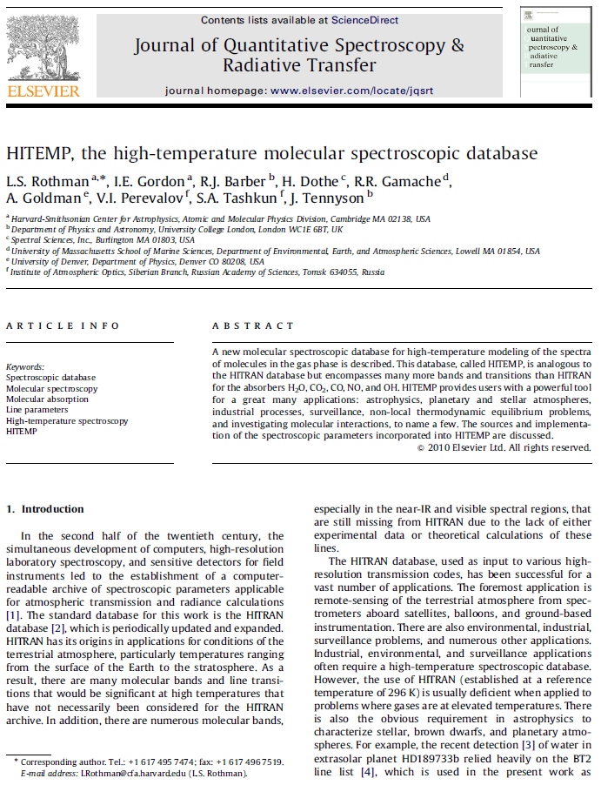

Slide 11
Comparison of line lists
Molecule | Spectral coverage (cm⁻¹) | Number of isotopologues (HITEMP2010) | Number of transitions (HITEMP2010) | Number of transitions (HITEMP1995) | Number of transitions (HITRAN)* | Dissociation Energy (cm⁻¹)
H₂O | 0 – 30 000 | 6 | 111 377 777 | 1 283 486 | 69 201 | 41 146
CO₂ | 258 – 9 648 | 7 | 11 167 618 | 1 032 269 | 312 479 | 44 360
CO | 0 – 8 465 | 6 | 115 218 | 113 022 | 4 477 | 90 674
NO | 0 – 9 274 | 3 | 105 633 | - - - | 105 079 | 52 265
OH | 0 – 19 268 | 3 | 40 055 | 40 055 | 31 976 | 35 593
* The number of transitions listed in this column are for the equivalent number of isotopologues and spectral range consistent with HITEMP2010

Slide 12

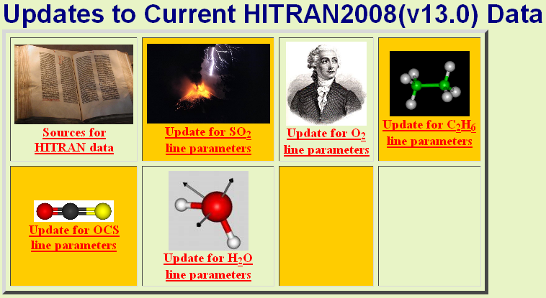

Slide 13
Line-shape fits on
oxygen line at 14546 cm⁻¹
courtesy, Joe Hodges, NIST
Voigt profile
Gallatry profile
Rautian profile
Speed-dependent w/Rautian
Speed-dependent w/Voigt
Voigt

Slide 14
“Wish” list
► Planetary applications:
propane (C₃H₈), diacetylene (C₄H₂), cyclopropene (C₃H₄), cyanoacetylene (HC₃N)
cyanogen (C₂N₂), sulfur monoxide (SO), CS and CS₂ molecules, H₃⁺,
molecular hydrogen (H₂), C₂HD isotopologue of acetylene, methyl radical (CH₃),..
....
More collision partners
► Collision-induced parameters:
O₂, CO₂, ...
► Line-shape parameters
► Absorption cross-sections:
More species, greater coverage, more temperatures and pressures
► Database structure
► High-temperature and weak lines
► Reliable error criteria

