Slide 1
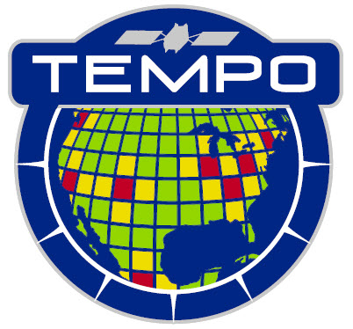



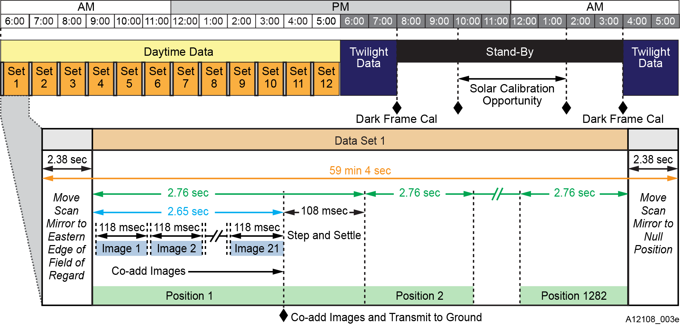
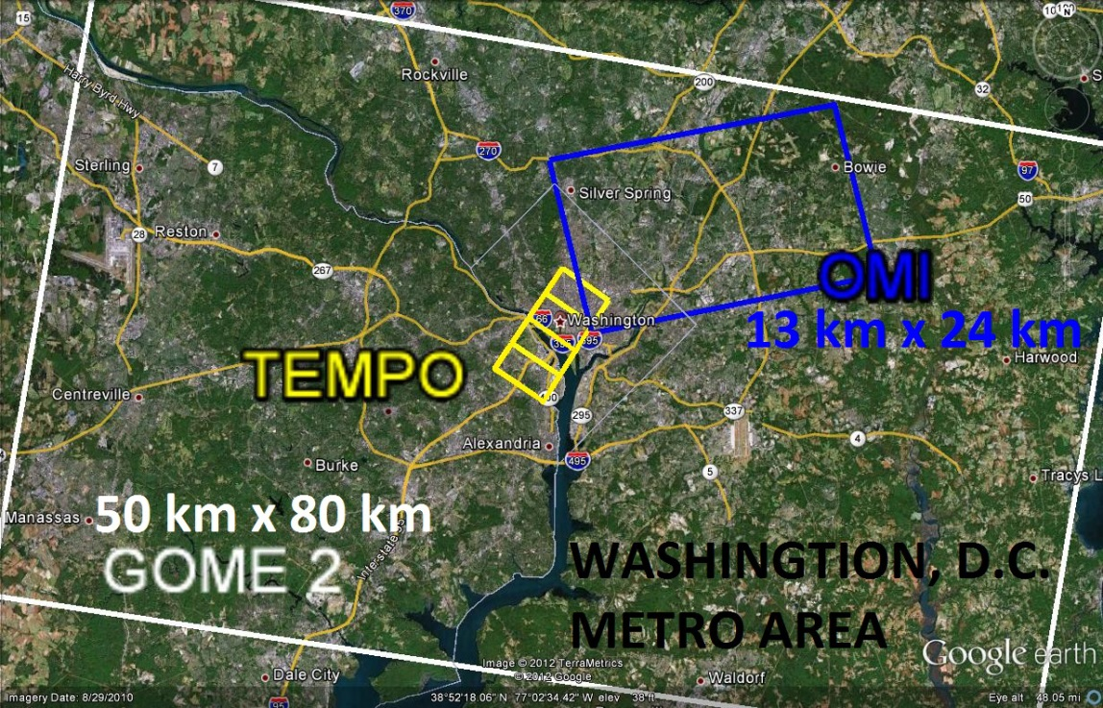
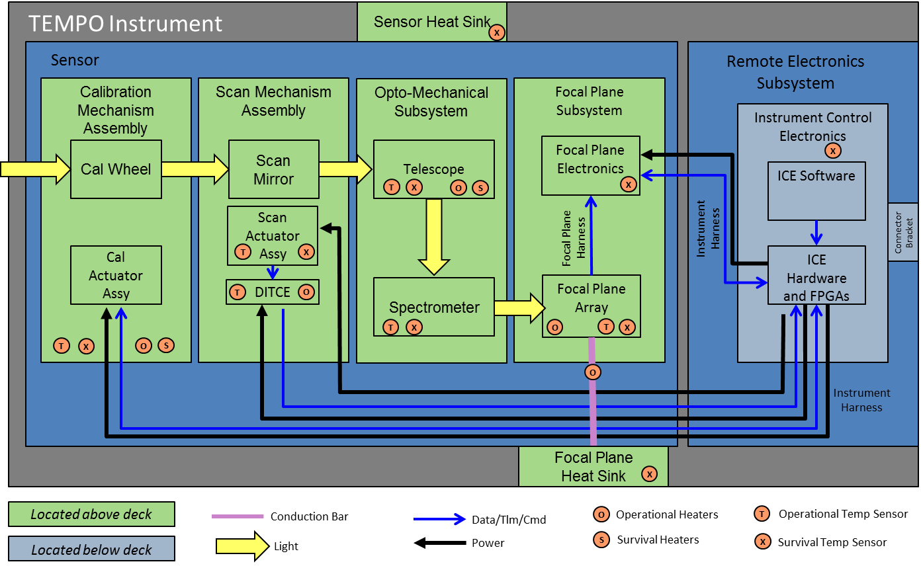
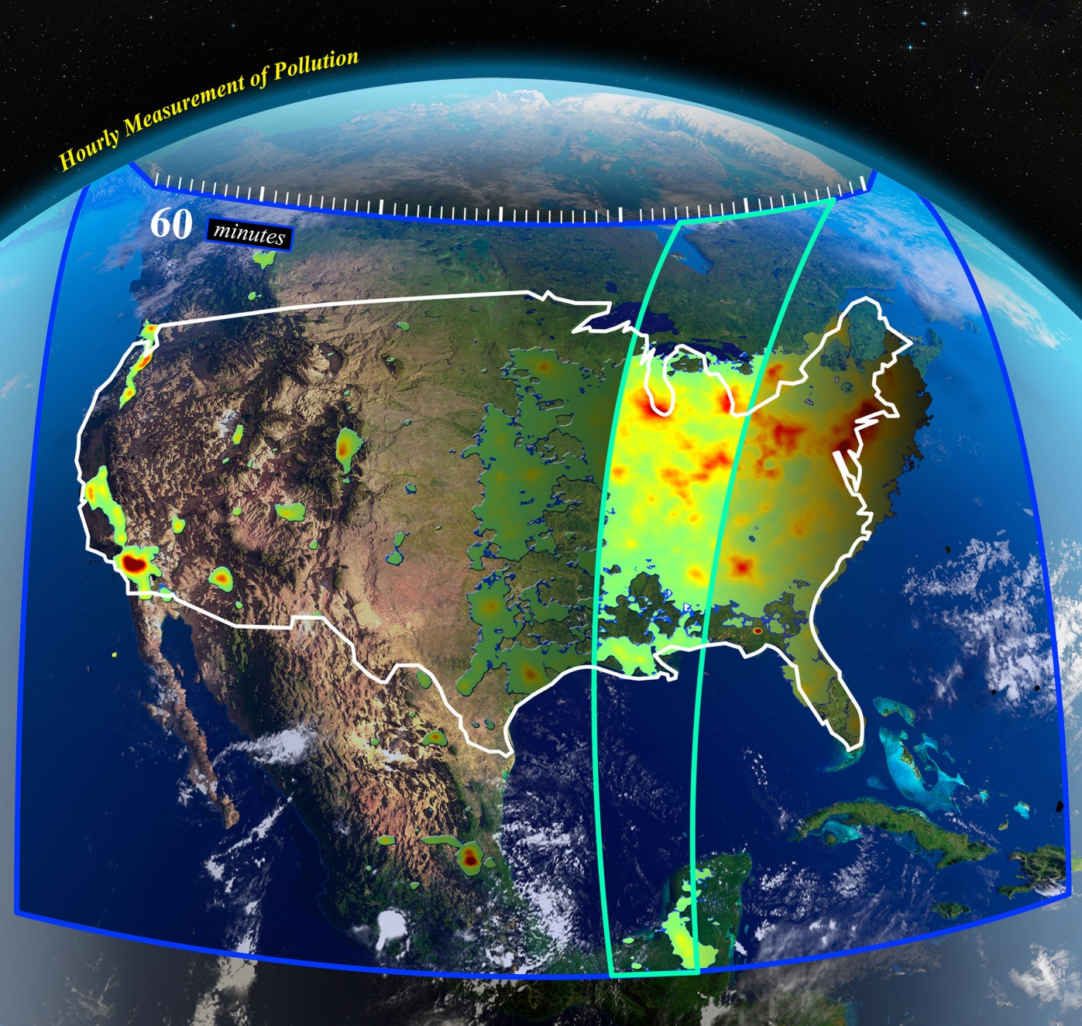
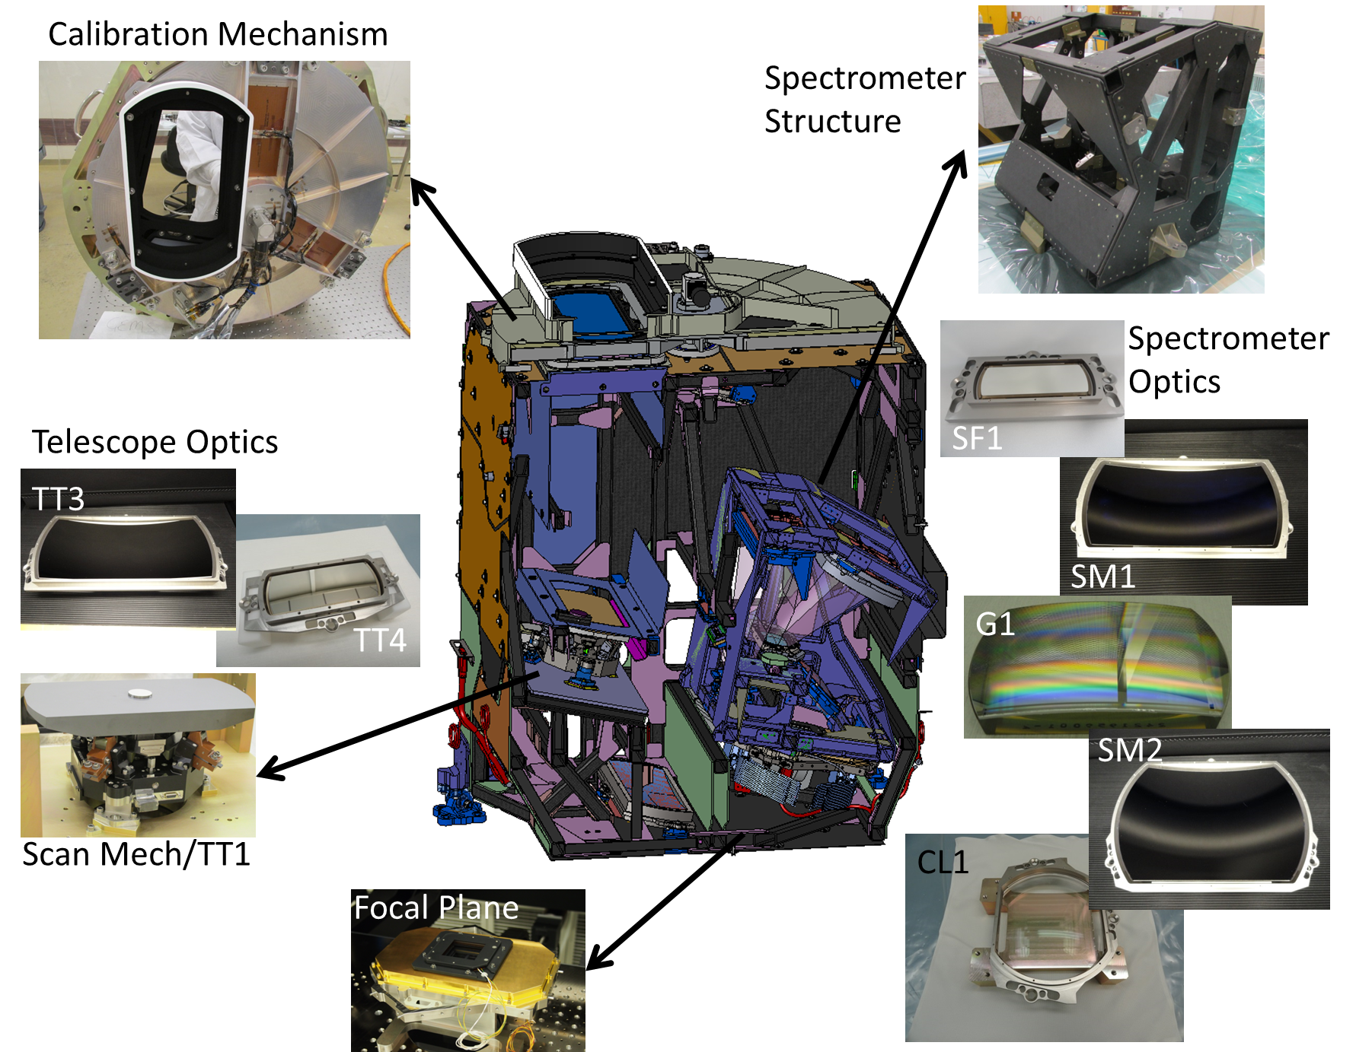
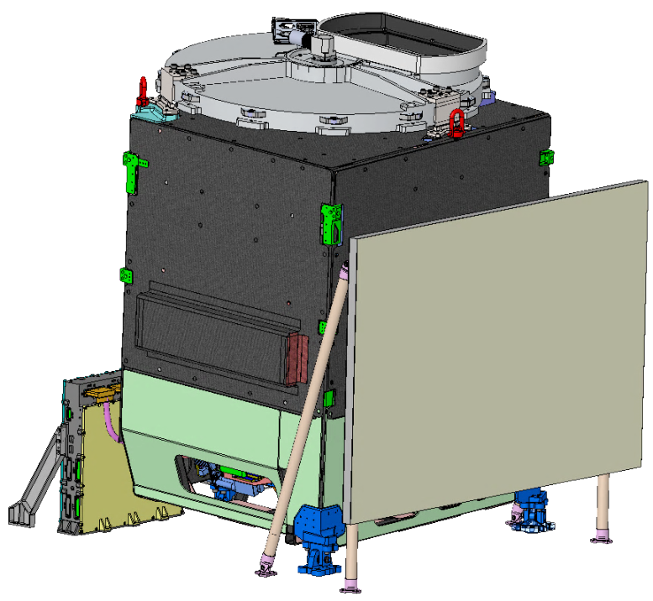
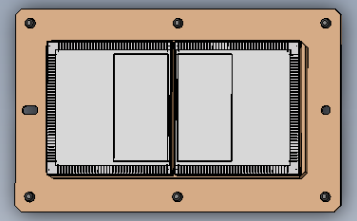
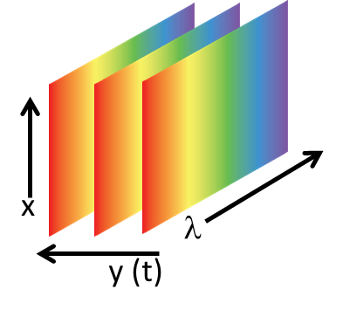
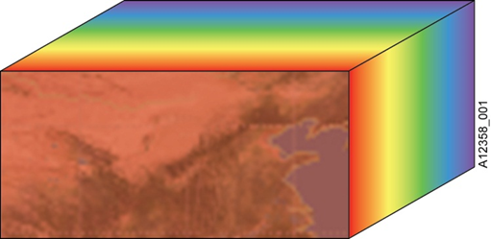
Converting Paper into Hardware: A Status of the TEMPO Instrument Design and Manufacturing
A11G-0126
D. Nicks¹, B. Baker¹, B. Canova¹, J. Lasnik¹, K. Chance², X. Liu², R. Suleiman², D. Flittner³, J. Al-Saadi³, D. Rosenbaum³, W. Pennington³
¹Ball Aerospace & Technologies Corp, ²Smithsonian Astrophysical Observatory, ³NASA Langley Research Center
The Tropospheric Emissions, Monitoring of Pollution (TEMPO) program was selected by NASA for the Earth Venture Instruments 2012 Announcement of Opportunity. TEMPO is an innovative use of a well-proven remote sensing technique for air quality measurements. The science team is lead by Kelly Chance and Xiong Liu from Smithsonian Astrophysical Observatory, NASA Langley Research Center is the management center and Ball Aerospace is the instrument developer.
Low Earth Orbit (LEO) remote sensing techniques have made measurements of photochemical species, precursors and oxidation products relative to air quality. These include NO₂, O₃, SO₂, C₂H₂O₂, CH₂O and atmospheric aerosol. The TEMPO instrument combines a
Instrument Key Technical Parameters
TEMPO Day-in-the-Life Operations
Parameter | Value | Note
Mass | 137 kg (CBE) / 148kg (mature) | Mature mass = CBE + 15%
Volume | 1.4 x 1.1 x 1.2m (x, y, z)
Average Operational Power | 148 W (CBE) / 163 W (mature) | Mature power = CBE + 10%
Field of Regard (FOR) | 4.76° N/S x 8.95° E/W | Greater North America
Ground Sample Distance (GSD) | 2.21 x 4.97 km (vertical x horizontal) | At Geodetic 36.5° N, 100° W
Spectral Range | 290 – 490nm, 540-740 nm
Spectral Bandwidth | 0.6 nm
The TEMPO instrument executes stored commands for nominal operations and calibration activities. The timing diagram below represents a day. The schedule activities are shown on the top of the diagram and the detailed activities for an hourly measurement are shown on the bottom. Daily calibration activities are planned during a window around midnight local satellite time.
The TEMPO Instrument will be hosted on a commercial spacecraft. NASA is exercising the US Air Force Hosted Payload Solutions (HoPS) contract to award a host contract. Host selection is expected in 2017.
high spatial resolution spectrometer with a geostationary orbit to achieve unprecedented spatial and temporal measurement resolution. These new measurements will allow for hourly observations of air quality of Greater North America with urban-regional spatial scales (<60 km²). Hourly daytime observations will allow for measurements of the complex diurnal cycle of pollution driven by photochemistry. These measurements will contribute to better understanding of regional air quality and improved air quality forecasts.
TEMPO Instrument Design
The TEMPO Instrument consists of an off-axis reflective Schmidt telescope and an Offner spectrometer. The yellow arrows through the block diagram below represent the optical path through the instrument. A graphic of the instrument cross section is shown along with images of actual flight hardware produced to date.
Program Status
The TEMPO program successfully completed the instrument Critical Design Review (CDR) in June 2015. Subsystems are completing integration and test in preparation for delivery to the TEMPO Assembly, Integration and Test (AI&T) Team. Flight software was completed in October 2015 and flight electronics are in final production. Telescope and spectrometer characterization is planned for mid-2016. Final assembly and environmental testing is planned for late 2016 with delivery to NASA LaRC in May 2017.
Traceability of instrument performance to science objectives are tracked using the science traceability matrix below. The TEMPO instrument is on-track to meet the science objectives documented in the Program Level Requirements Agreement (PLRA).
From Fishman, et al., 2008
TEMPO Measurement Concept
Notional TEMPO Field of Regard over Greater North America (GNA).
Scan mirror projects slit field of view onto GNA. Multiple images are taken at each scan mirror position. Mirror scans from East to West, imaging GNA on a hourly basis.
Short λ
Long λ
Images from each scan mirror position are co-added on-board
Ground processing spatially bins and geo-locates image
Transmit co-added images to ground
x
λ
FT=Free Troposphere (2km-tropopause), SOC=Stratospheric Ozone Column, AOD=Aerosol optical depth, AAOD=Aerosol absorption optical depth, AI=Aerosol index, CF=Cloud Fraction, COCP=Cloud Optical Centroid Pressure, Albedo=Radiance/Irradiance, FOR=Field Of Regard, CONUS=Continental US, GNA=Greater North America, IFOV=Instantaneous Field Of View, MTF=Modulation Transfer Function. *Projected to 36.5°N,100°W from orbit location 100°W.
y(t)

