Slide 1
From Water Vapor on Venus
to Neutron Stars
in the Crab Nebula
Jim Moran
Harvard-Smithsonian Center for Astrophysics
StaelinFest 2011
July 18, 2011
Figure 1

Slide 2
Dave Staelin
Radio Astronomy Pioneer
1963-1966
1968*
1968-1972
1979-1990
1988*
Venus and other planets
(+1980s Jupiter) (Barrett)
CMB (Burke)
Pulsars (Reifenstein)
Optical interferometry (Shao)
Uranus (Eikenberry)
*minor but interesting activities
Figure 2

Slide 3
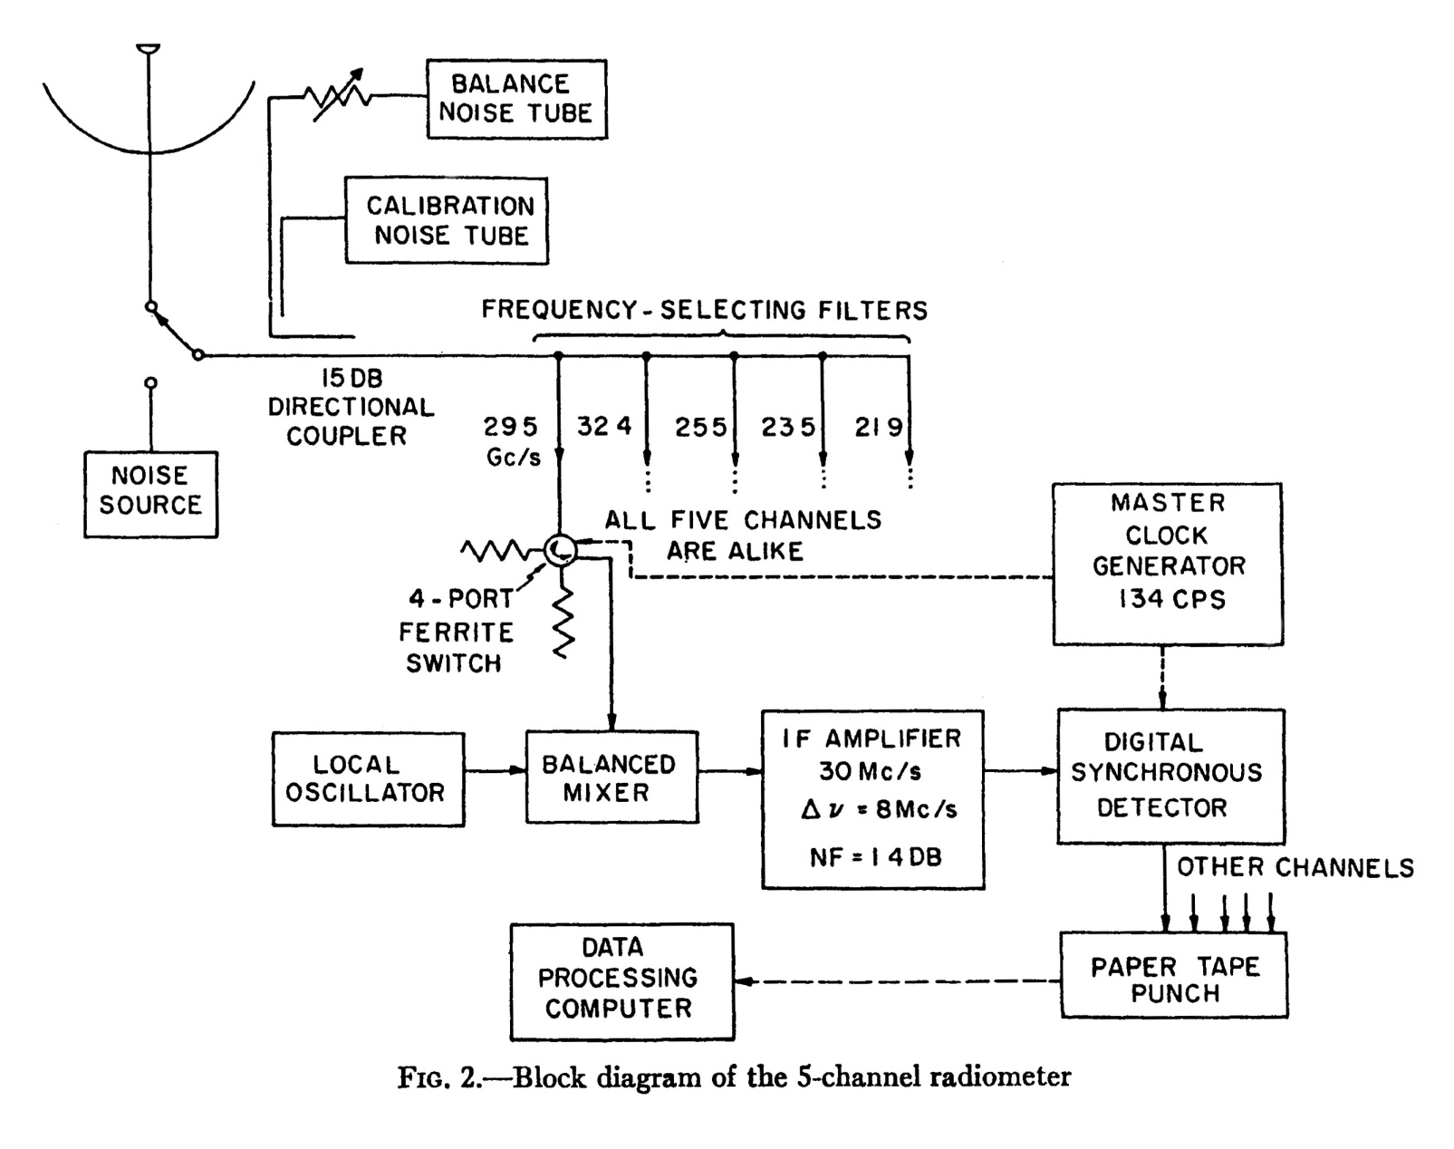
Venus Water Vapor Radiometer
Staelin and Barrett, ApJ, 144, 352 (1966)
Figure 3

Slide 4
Could Dave’s instrument have detected water vapor masers?
(They were discovered by Townes in 1968 toward the Orion star-forming region.)
I. Sensitivity okay
ν = 22.235 GHz
T_{B} ∼ 10¹⁵ K
S up to 10⁶ Jy (10⁻²⁰ w m⁻² hz⁻¹)
B ∼ 100 KHz
Staelin’s system
T_{s} = 22,000 K (ΔT = 4 K in 4 s)
B = 8 MHz
τ = 4 s
A = 30 m²
ΔS = 2kT_{s} /A√Bτ = 360 Jy
S_{maser} = 10⁶ (0.1/8) = 12,000 Jy
SNR = 35 in 4 seconds
II. Where to point?
With a beam of 6’ resolution, the sky has 4 x 10⁶ pixels.
Figure 4

Slide 5
Technical Progress in Radio Astronomy
at 22 GHz
D
T_{s}
1964
8.5 m (28 ft.)
(MIT LL)
22,000 K
2004
100 m
(GBT at NRAO)
22 K
factor
14
10⁻³
Ratio of sensitivities ∼ D²/T_{s}
∼ 1.4 x 10⁵ = 2¹⁷ in 40 years
“Doubling time” (aka “Moore’s law”) = 2.3 years
Figure 5

Slide 6
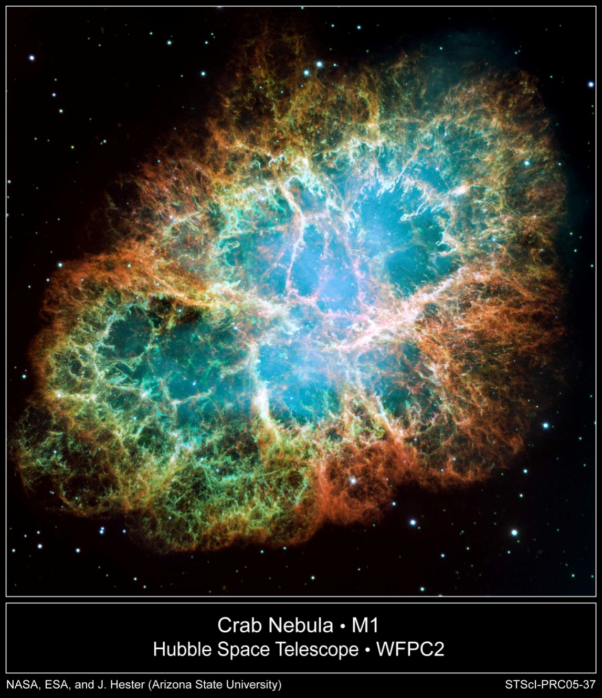
Crab Nebula
(Supernovae of 1054 AD)
Scale 3’ or 2 parsecs
Figure 6

Slide 7
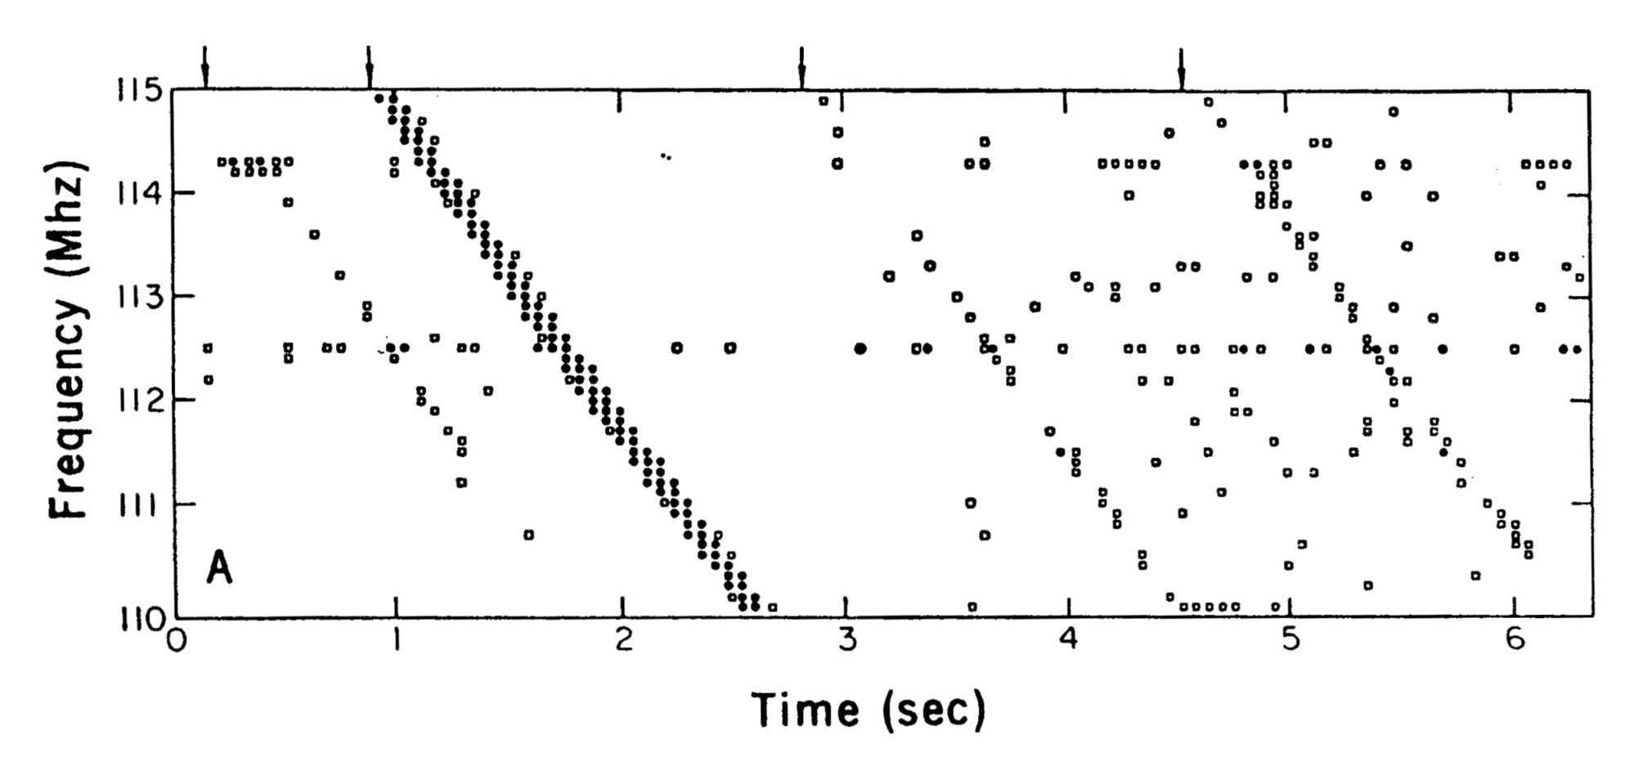
Discovery of Crab Pulsar
GB 300-ft. Telescope, October 1968
Staelin and Reifenstein, “Pulsating Radio Sources Near the Crab Nebula,” Science, 62, 1481 (Dec. 27, 1968)
Figure 7

Slide 8
Pulsars
A Review by F. Graham-Smith
Reports on Progress in Physics, 35, 399 (1972)
“The most significant discovery since the original Cambridge work then came from the National Radio Astronomy Observatory (NRAO) in USA. Staelin and Reifenstein (1968) found two pulsars close to the Crab nebula, the best known supernova remnant in the whole sky. They could not, however, measure the periods, and it was left to Comella et al. (1969) working with the 1,000-ft. telescope at Arecibo to show that one of these two had a period of only 33 ms and that it appeared to be within the nebula. This pulsar is also slowing down, but so much faster than the Vela pulsar that its age is of the order of only 1,000 years. This is in very good agreement with the known age of the Crab nebula itself, and the association is completely established.”
Figure 8

