Slide 1
The Past and Future of Our Universe
Professor Avi Loeb
Harvard University

Slide 3
Our Cosmic Roots:
The Scientific Story of Genesis
we are here
But there was a time when stars like the Sun and galaxies like the Milky Way did not exist. When and how did the first stars form?

Slide 4

Growth of Structure through Gravity
Early times
Density perturbation
Mean Density
Intermediate times
Late times
Bound Object
Void

Slide 5
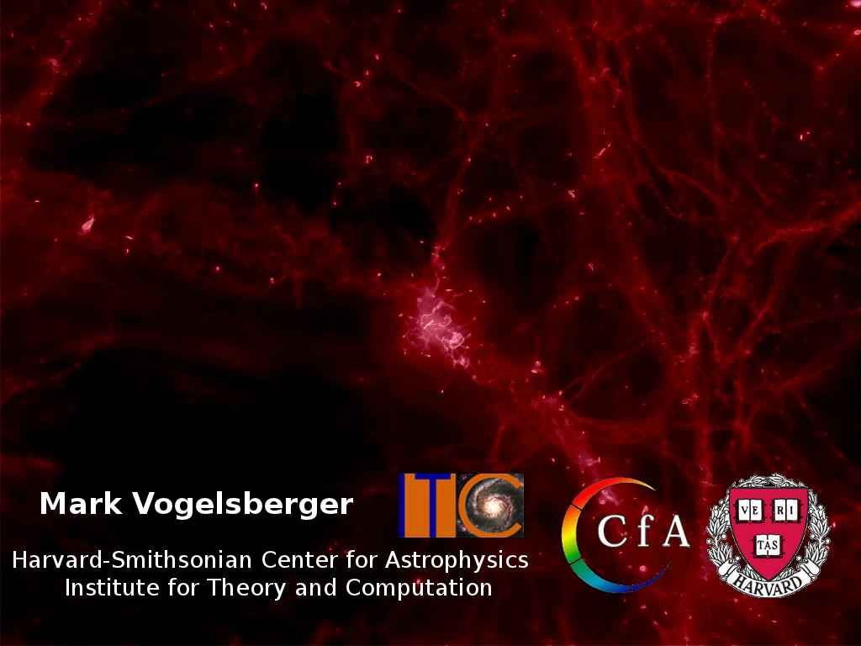
Thinking Inside the Simulation Box

Slide 6
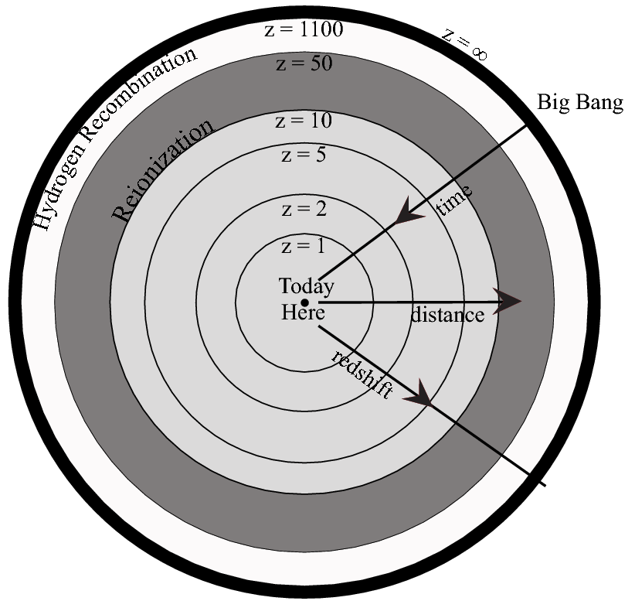
Our Archaeological Dig

Slide 7
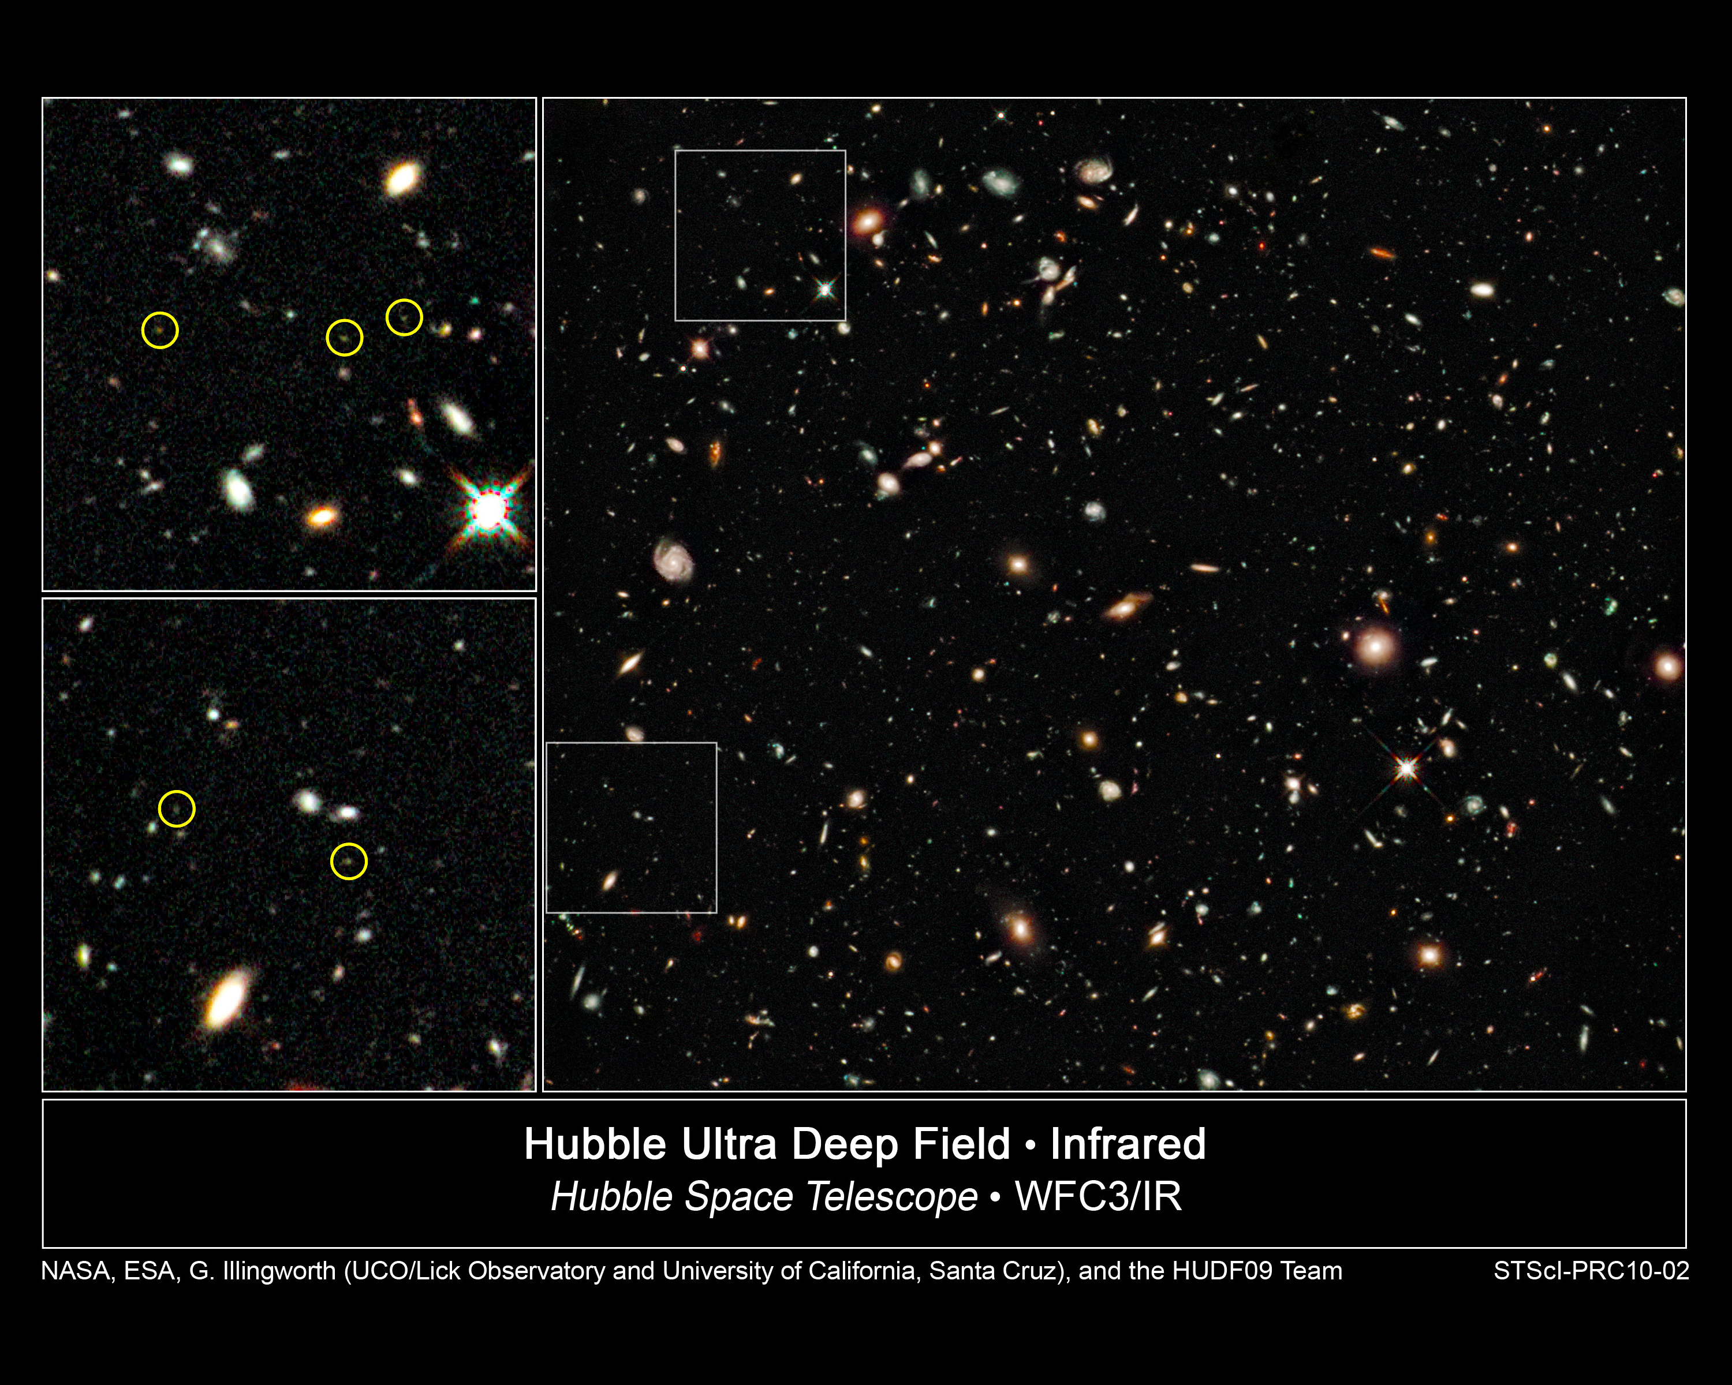
t~0.6-0.8 Gyr
z~7-8

Slide 8
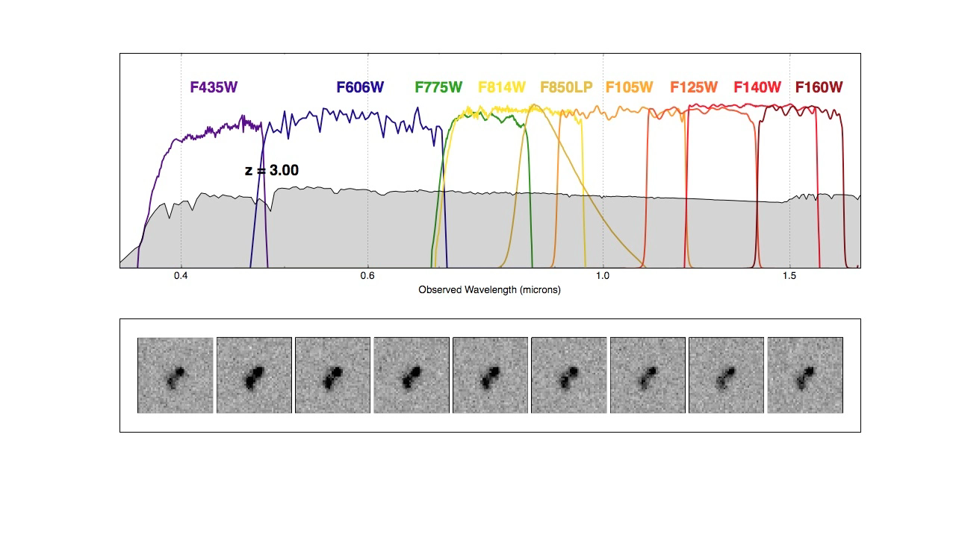
Finding the Redshift of Galaxies

Slide 9
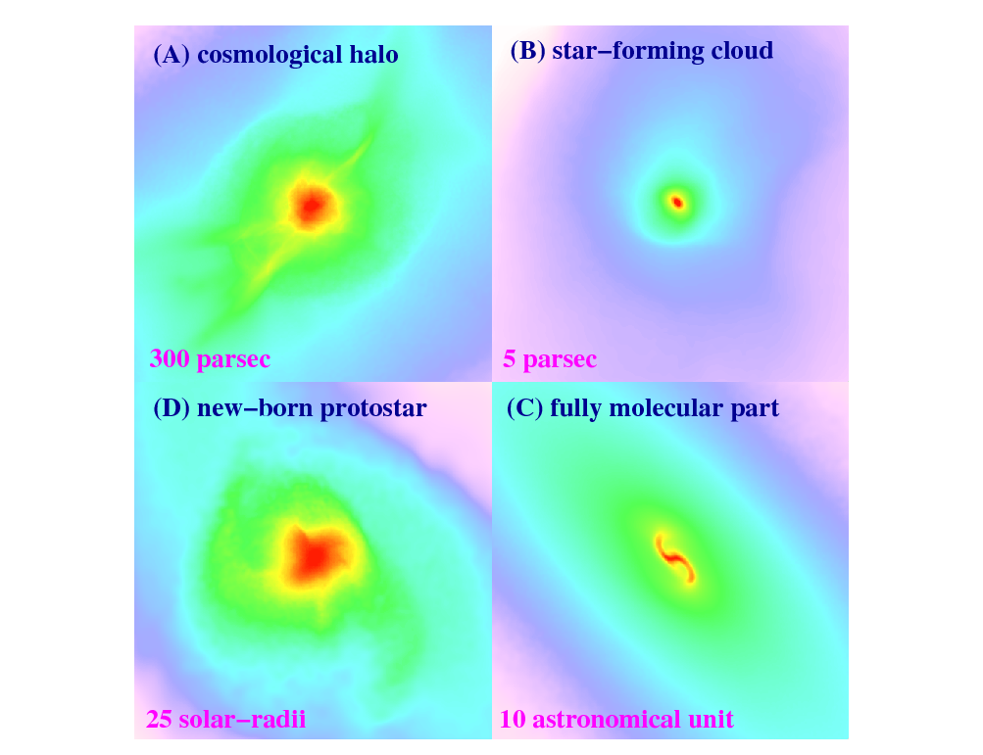



The First Stars Are Predicted to Have Formed ~100 Million Years After the Big Bang
1000 light-years
15 light-years
Bromm et al. (2009)

Slide 10
Mapping Hydrogen in Three Dimensions Through Cosmic Time

Slide 11
The Universe May be Full of Life When Did Life Begin?
10-100 Myr: first stars formed
~15 Myr: Cosmic Microwave Background had a temperature of ~300K=27C and could have served as an incubator for the chemistry of life if rocky planets existed with liquid water on their surface
~14 Gyr (now): we exist

Slide 12
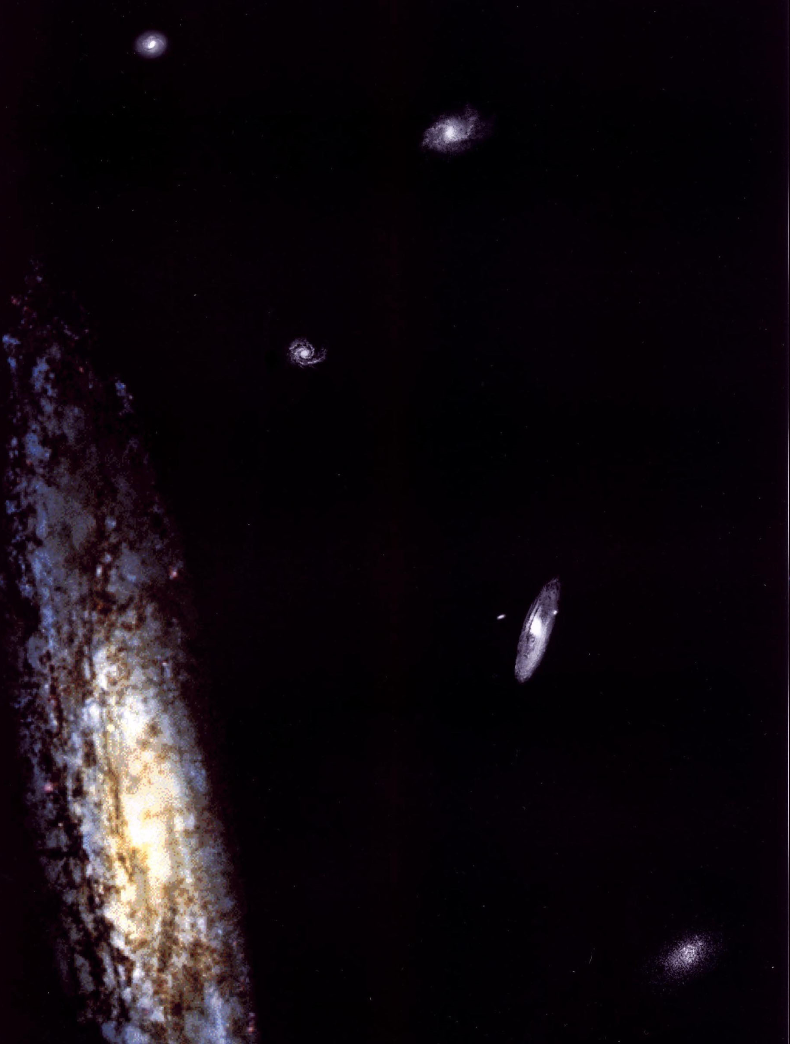
So much about the past, but what does the future hold?

Slide 13
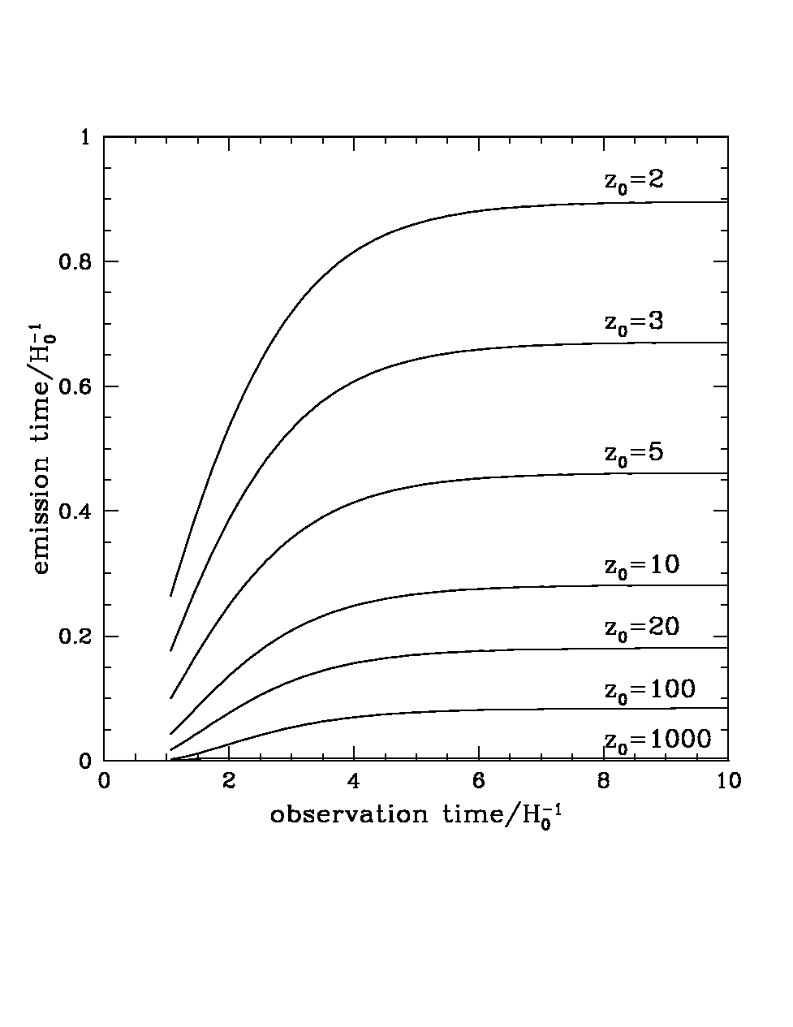
The Long Term Future of Extragalactic Astronomy
Accelerating
source
c
us
today
All galaxies beyond a redshift of z=1.8 are already outside our horizon (no cell phone communication to z>1.8!). (Loeb 2001)

Slide 14
Analogy
Ants = Photons Balloon=Expanding Space

Slide 15
Analogy
Ants = Photons Balloon=Expanding Space
visited area (horizon) since blowing started (Big Bang)

Slide 16
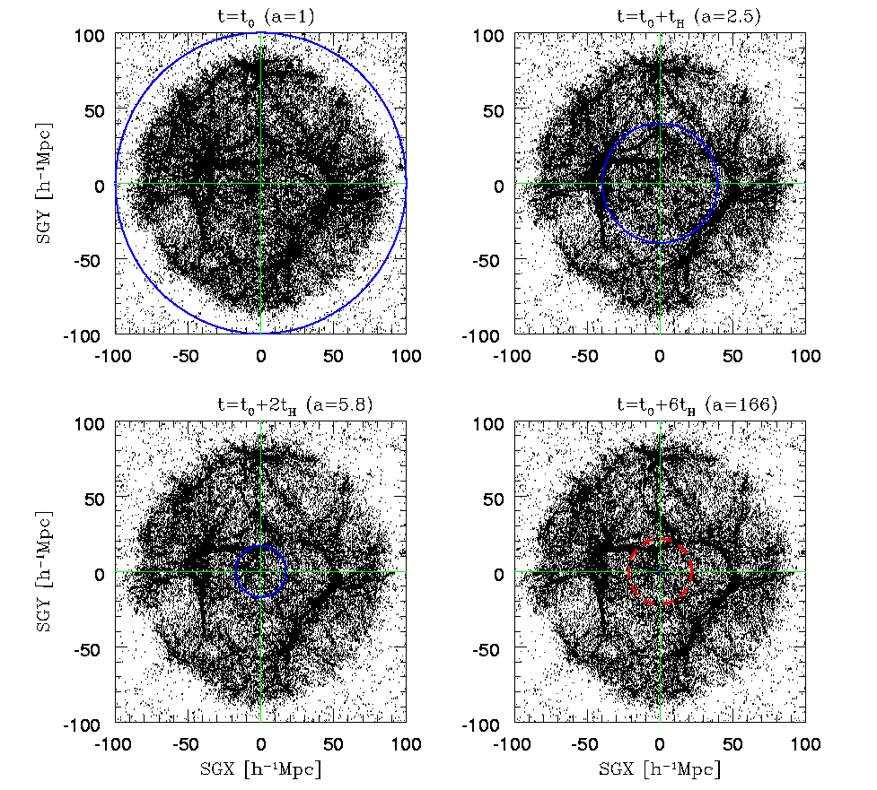
Future Evolution of Nearby Large-Scale Structure
Coma
Great Attractor
Perseus Pisces
us
100 cMpc
100 cMpc
horizon
100 cMpc
Nagamine & Loeb 2002,2003

Slide 17
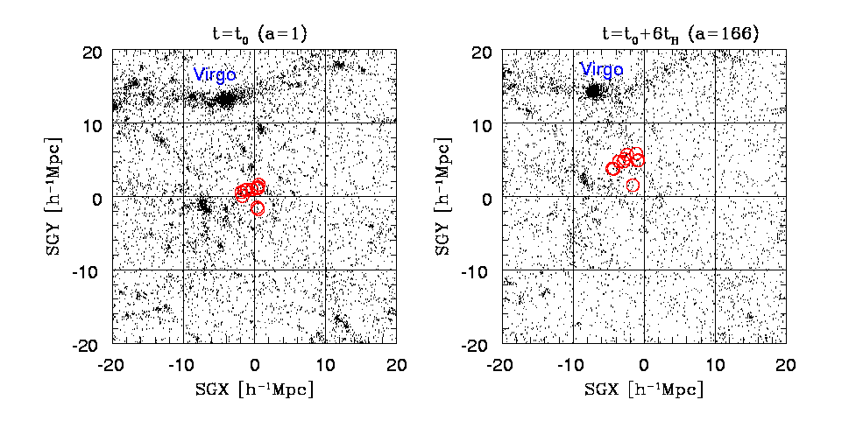
How many galaxies will reside within our event horizon in 100 billion years?
Answer: one surrounded by vacuum
The merger product of the Andromeda and Milky-Way galaxies!

Slide 18
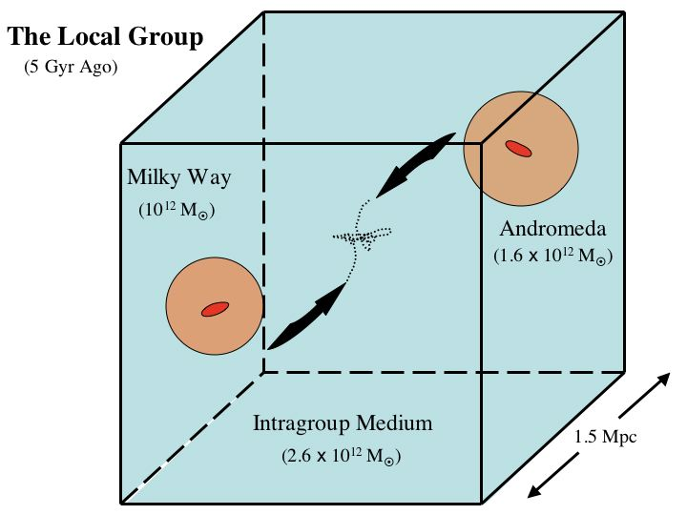
Cox & Loeb (2007): The only paper of mine that has a chance of being cited in 5 billion years…

Slide 19
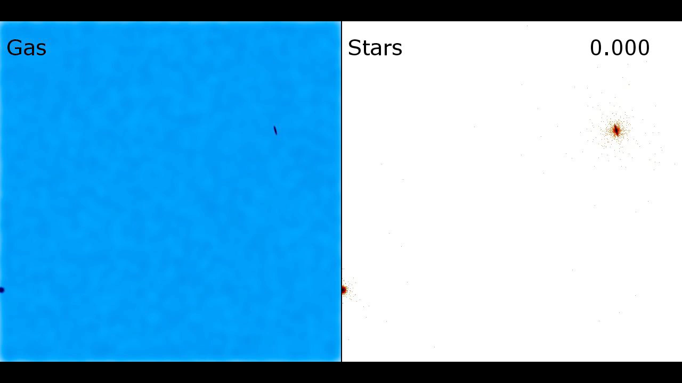
The Future Collision between the Milky Way and Andromeda Galaxies

Slide 20
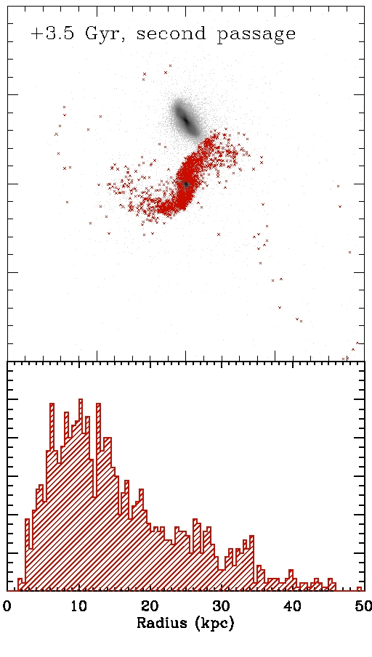
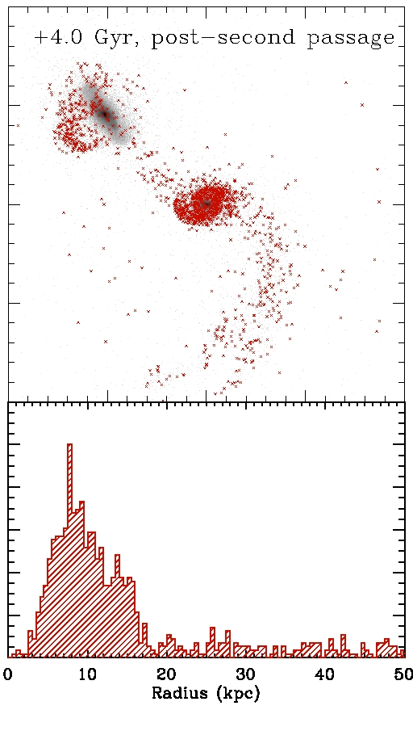
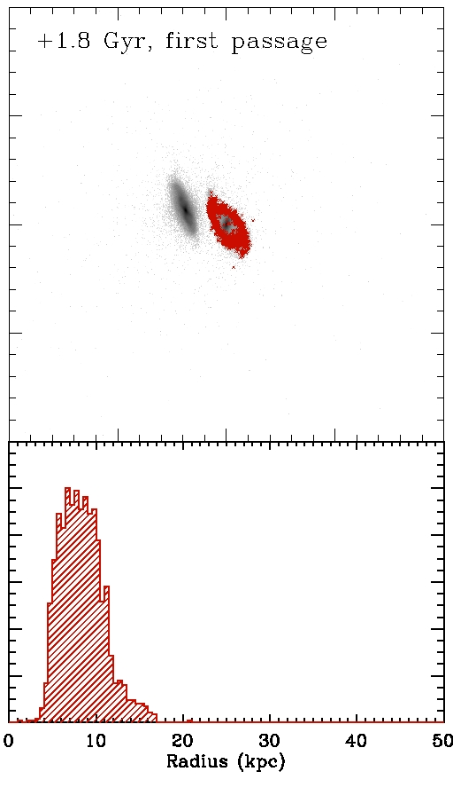
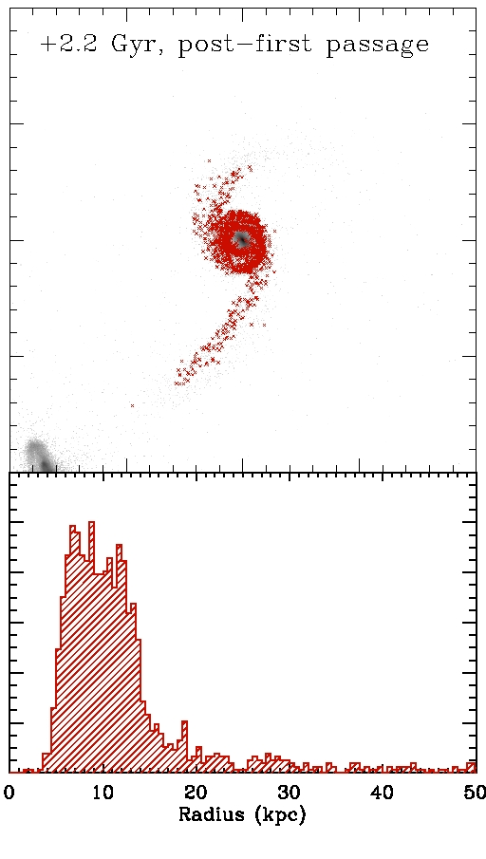
Fate of the Sun

Slide 21
State of the Unionverse
Cosmologists are currently exploring the scientific version of the story of genesis (“let there be light”). Future observations will utilize large-aperture infrared telescopes (for imaging the first galaxies) and low-frequency radio arrays (for imaging cosmic hydrogen in between the galaxies).
Religious ideas about genesis are modified by science.
The merger product of the Milky-Way and Andromeda (Milkomeda ) is the only galaxy that will remain visible to us once the Universe will age by a factor of ten (a hundred billion years from now). Subsequent generations of observers will not be able to find evidence for the big bang.
Will cosmology turn into religion at that time?

Slide 22
Once the Universe will age by a factor of ~100 (a trillion years from now), the wavelength of the cosmic microwave background (which is ~0.2 cm) will exceed the scale of our cosmic horizon, 10,000,000,000,000,000,000,000,000,000 cm
At that time, there will be no trace of the Big Bang …

Slide 23
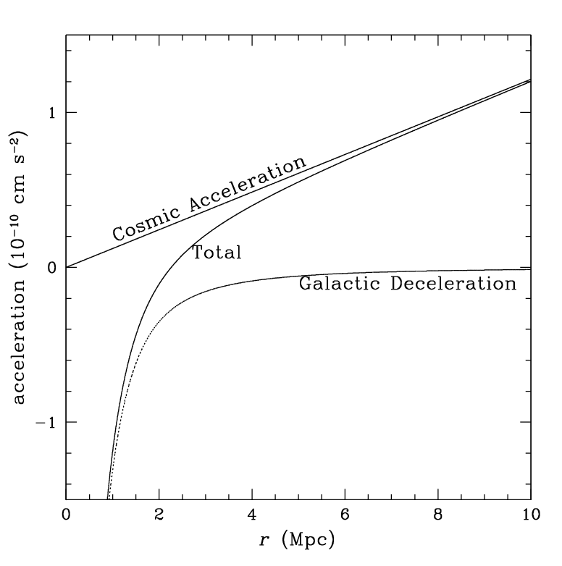
But our galaxy ejects hypervelocity stars!
SgrA*
Measure the vacuum mass density from the acceleration of hypervelocity stars that escape from Milkomeda
Estimate matter density when Milkomeda formed from the mean density of Milkomeda
Calculate time from the Big Bang based on the measured ages of Milkomeda’s stars
Infer microwave background temperature from light element abundances
VALIDATE ancient cosmology textbooks
(Loeb 2011, arXiv:1102.0007)

Slide 24
The End

Slide 26
