Slide 1
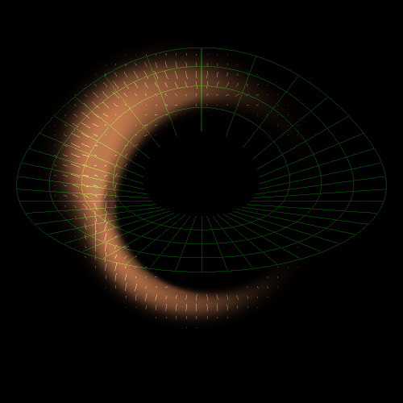
A Closer Look at Black Holes
Imaging black hole silhouettes
Gravitational waves from black hole binaries
Recoil of black holes
Tidal disruption of stars by black holes

Slide 2
How does a black hole look like?

Slide 3
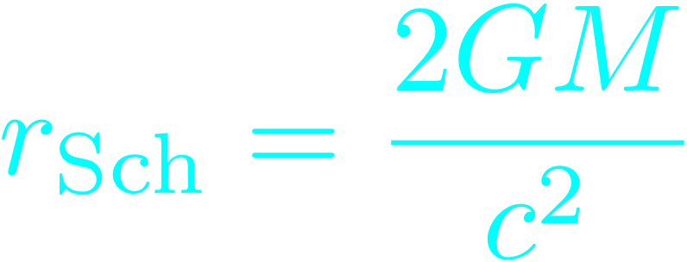
Image of a black hole in vacuum
For a non-spinning black hole: Schwarzschild radius:
singularity
event horizon

Slide 4
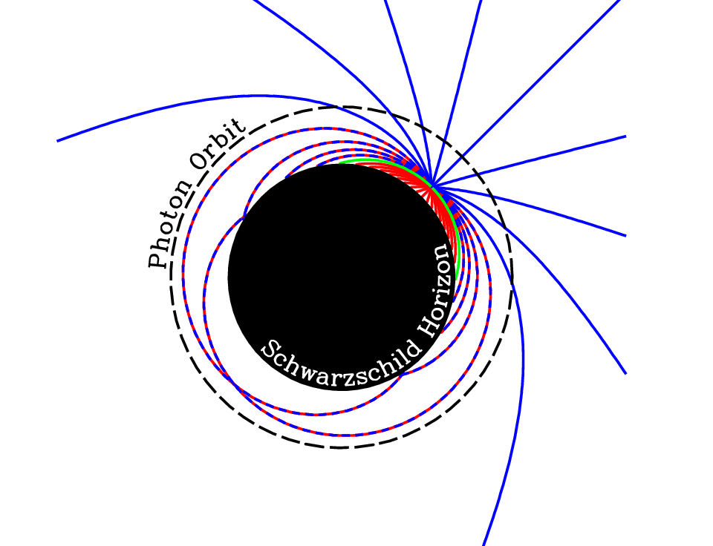
Broderick, Loeb, & Narayan 2008

Slide 5
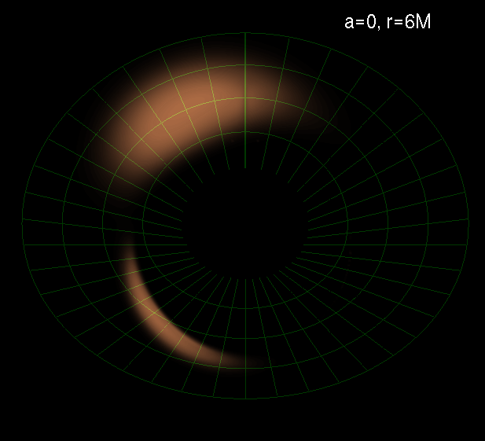
Imaging Black Holes
Testing theory of gas accretion: disks, jets
Testing General Relativity: strong field gravity

Slide 6
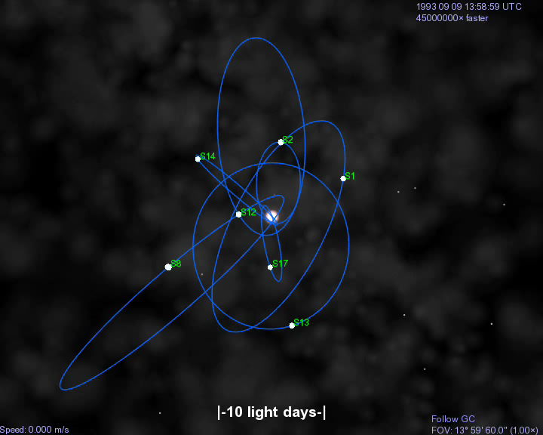


Stellar Orbits Around SgrA*
(BH at rest in GC)
Ghez et al. 2008; Genzel et al. 2008

Slide 7
SgrA* is the largest black hole on the sky

Slide 8
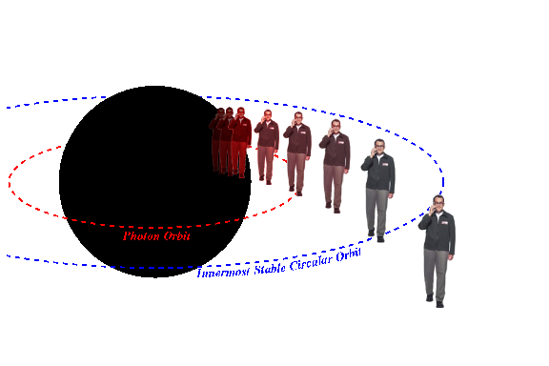
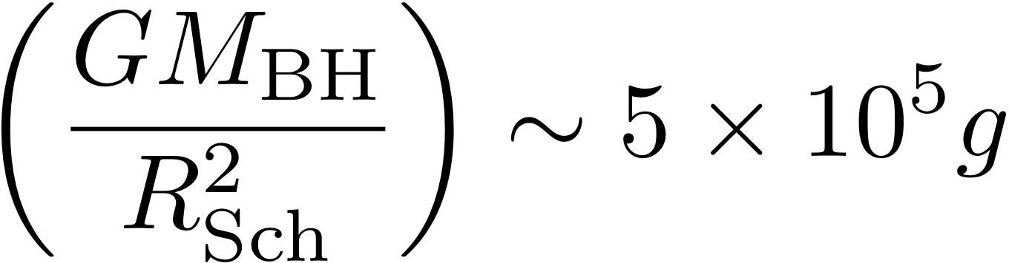
Can you hear me now?
10 million km
No, but no worries - you will be able to hear us for ~10 minutes until you reach the singularity…

Slide 9
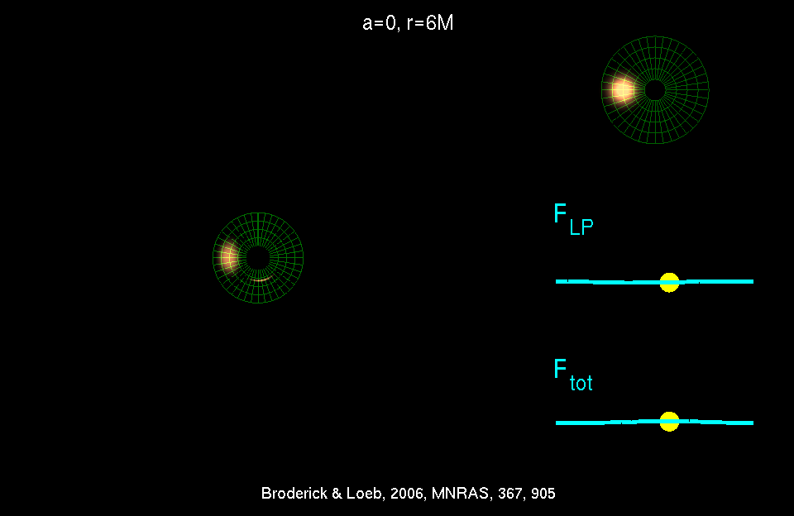
Physics + Astrophysics: Imaging Black Holes
Broderick & Loeb 2005

Slide 12
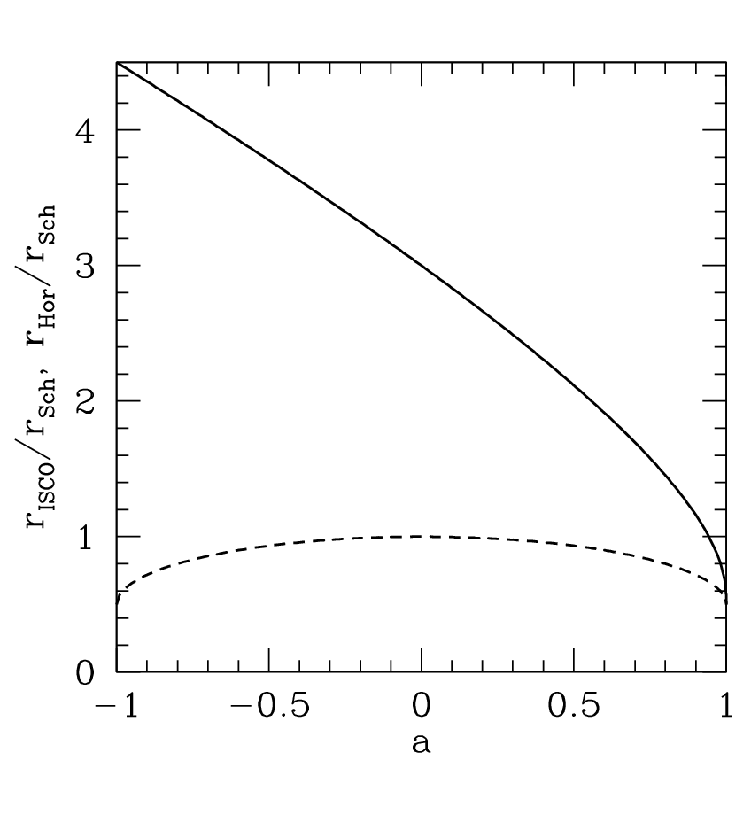
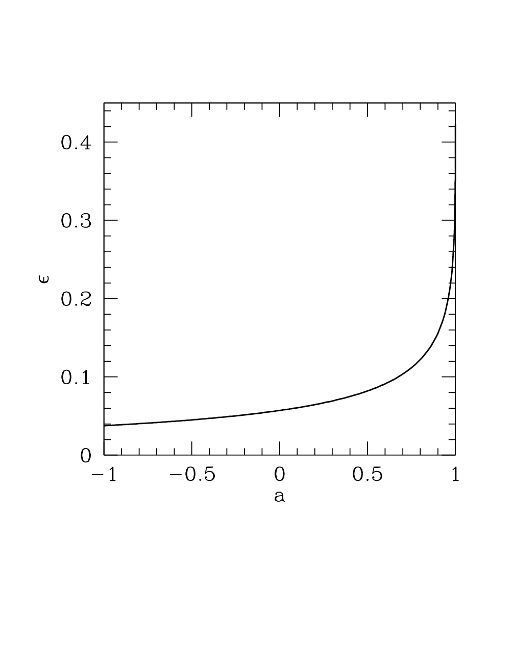
spin matters!
Innermost Stable Circular Orbit (ISCO)
radiative efficiency (binding energy at ISCO)
horizon

Slide 13
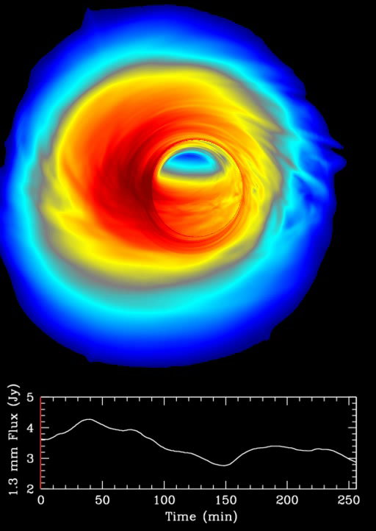
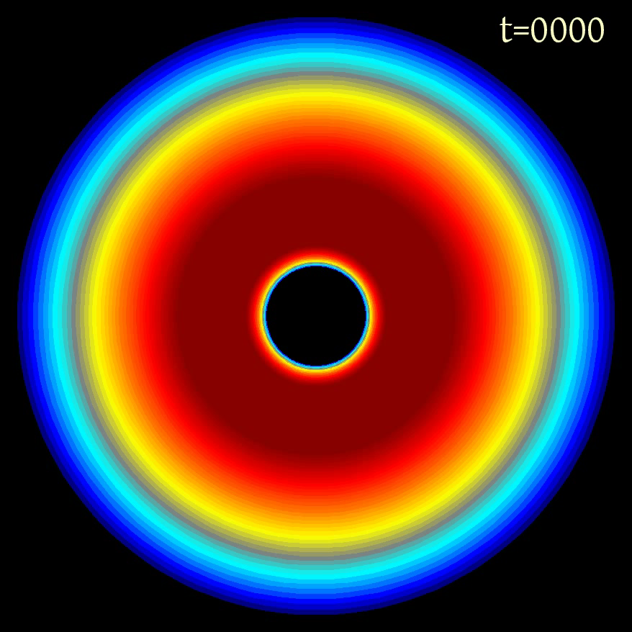
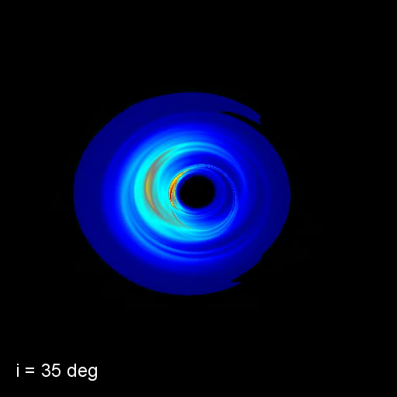
Numerical Simulations (GRMHD)
inclination
image
setup
C. Gammie, J. Dolence, M. Moscibrodzka, H. Shiokawa, P. Leung (2009)

Slide 14
Three Fortunate Coincidences
The accretion flow of SgrA* becomes transparent to synchrotron self-absorption at wavelengths shorter than 1 millimeter
Interstellar scattering ceases to blur the image of SgrA* on horizon scales at wavelengths shorter than 1 millimeter
The horizon scale of SgrA* and M87 (tens of micro-arcseconds) can be resolved by a Very Large Baseline Array across the Earth at wavelengths shorter than 1 millimeter

Slide 15
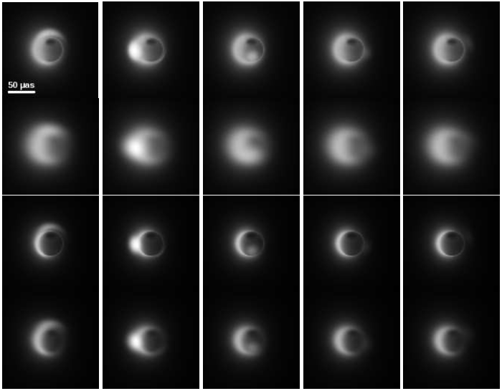
SgrA*
230 GHz
with interstellar scattering
345 GHz
with interstellar scattering
Different orbital phases of the hot spot →

Slide 16
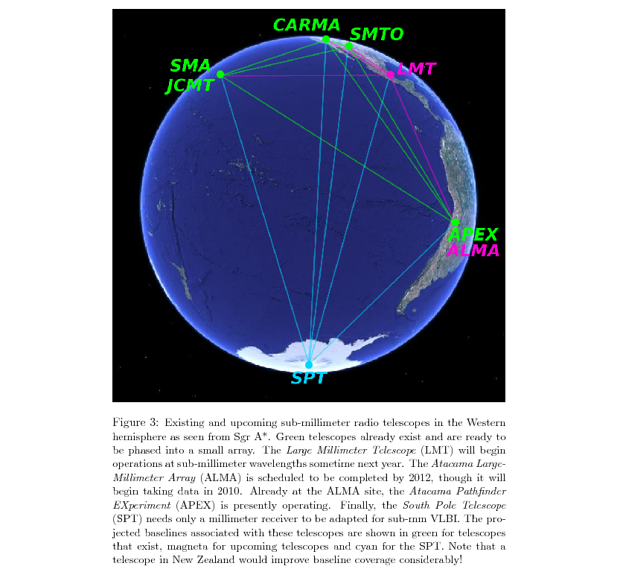
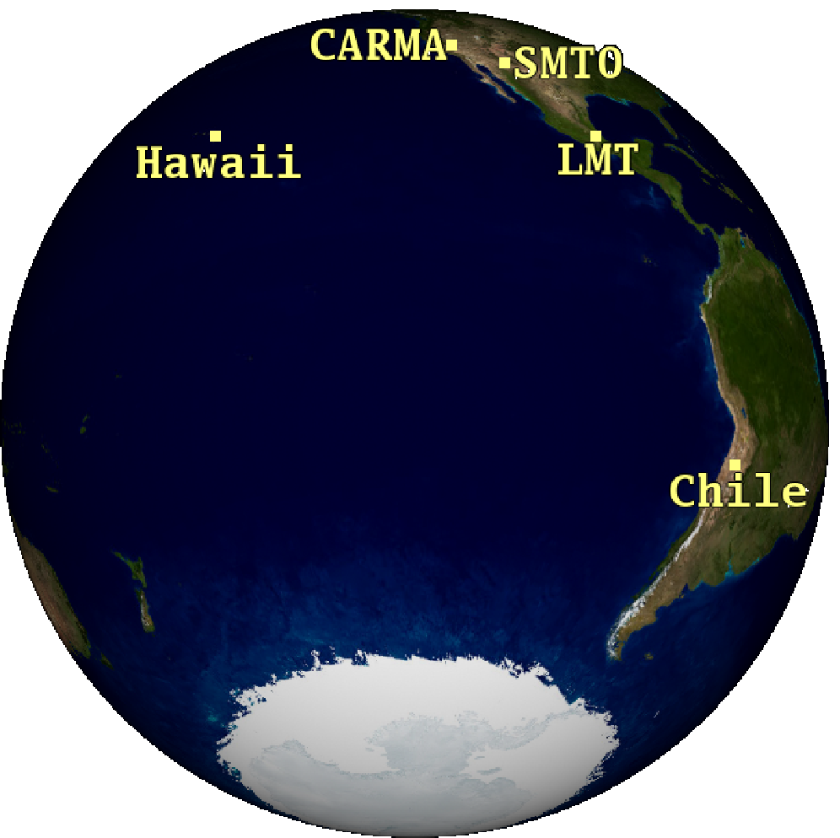

Very Long Baseline Interferometry (VLBI) at sub-millimeter wavelengths

Slide 17
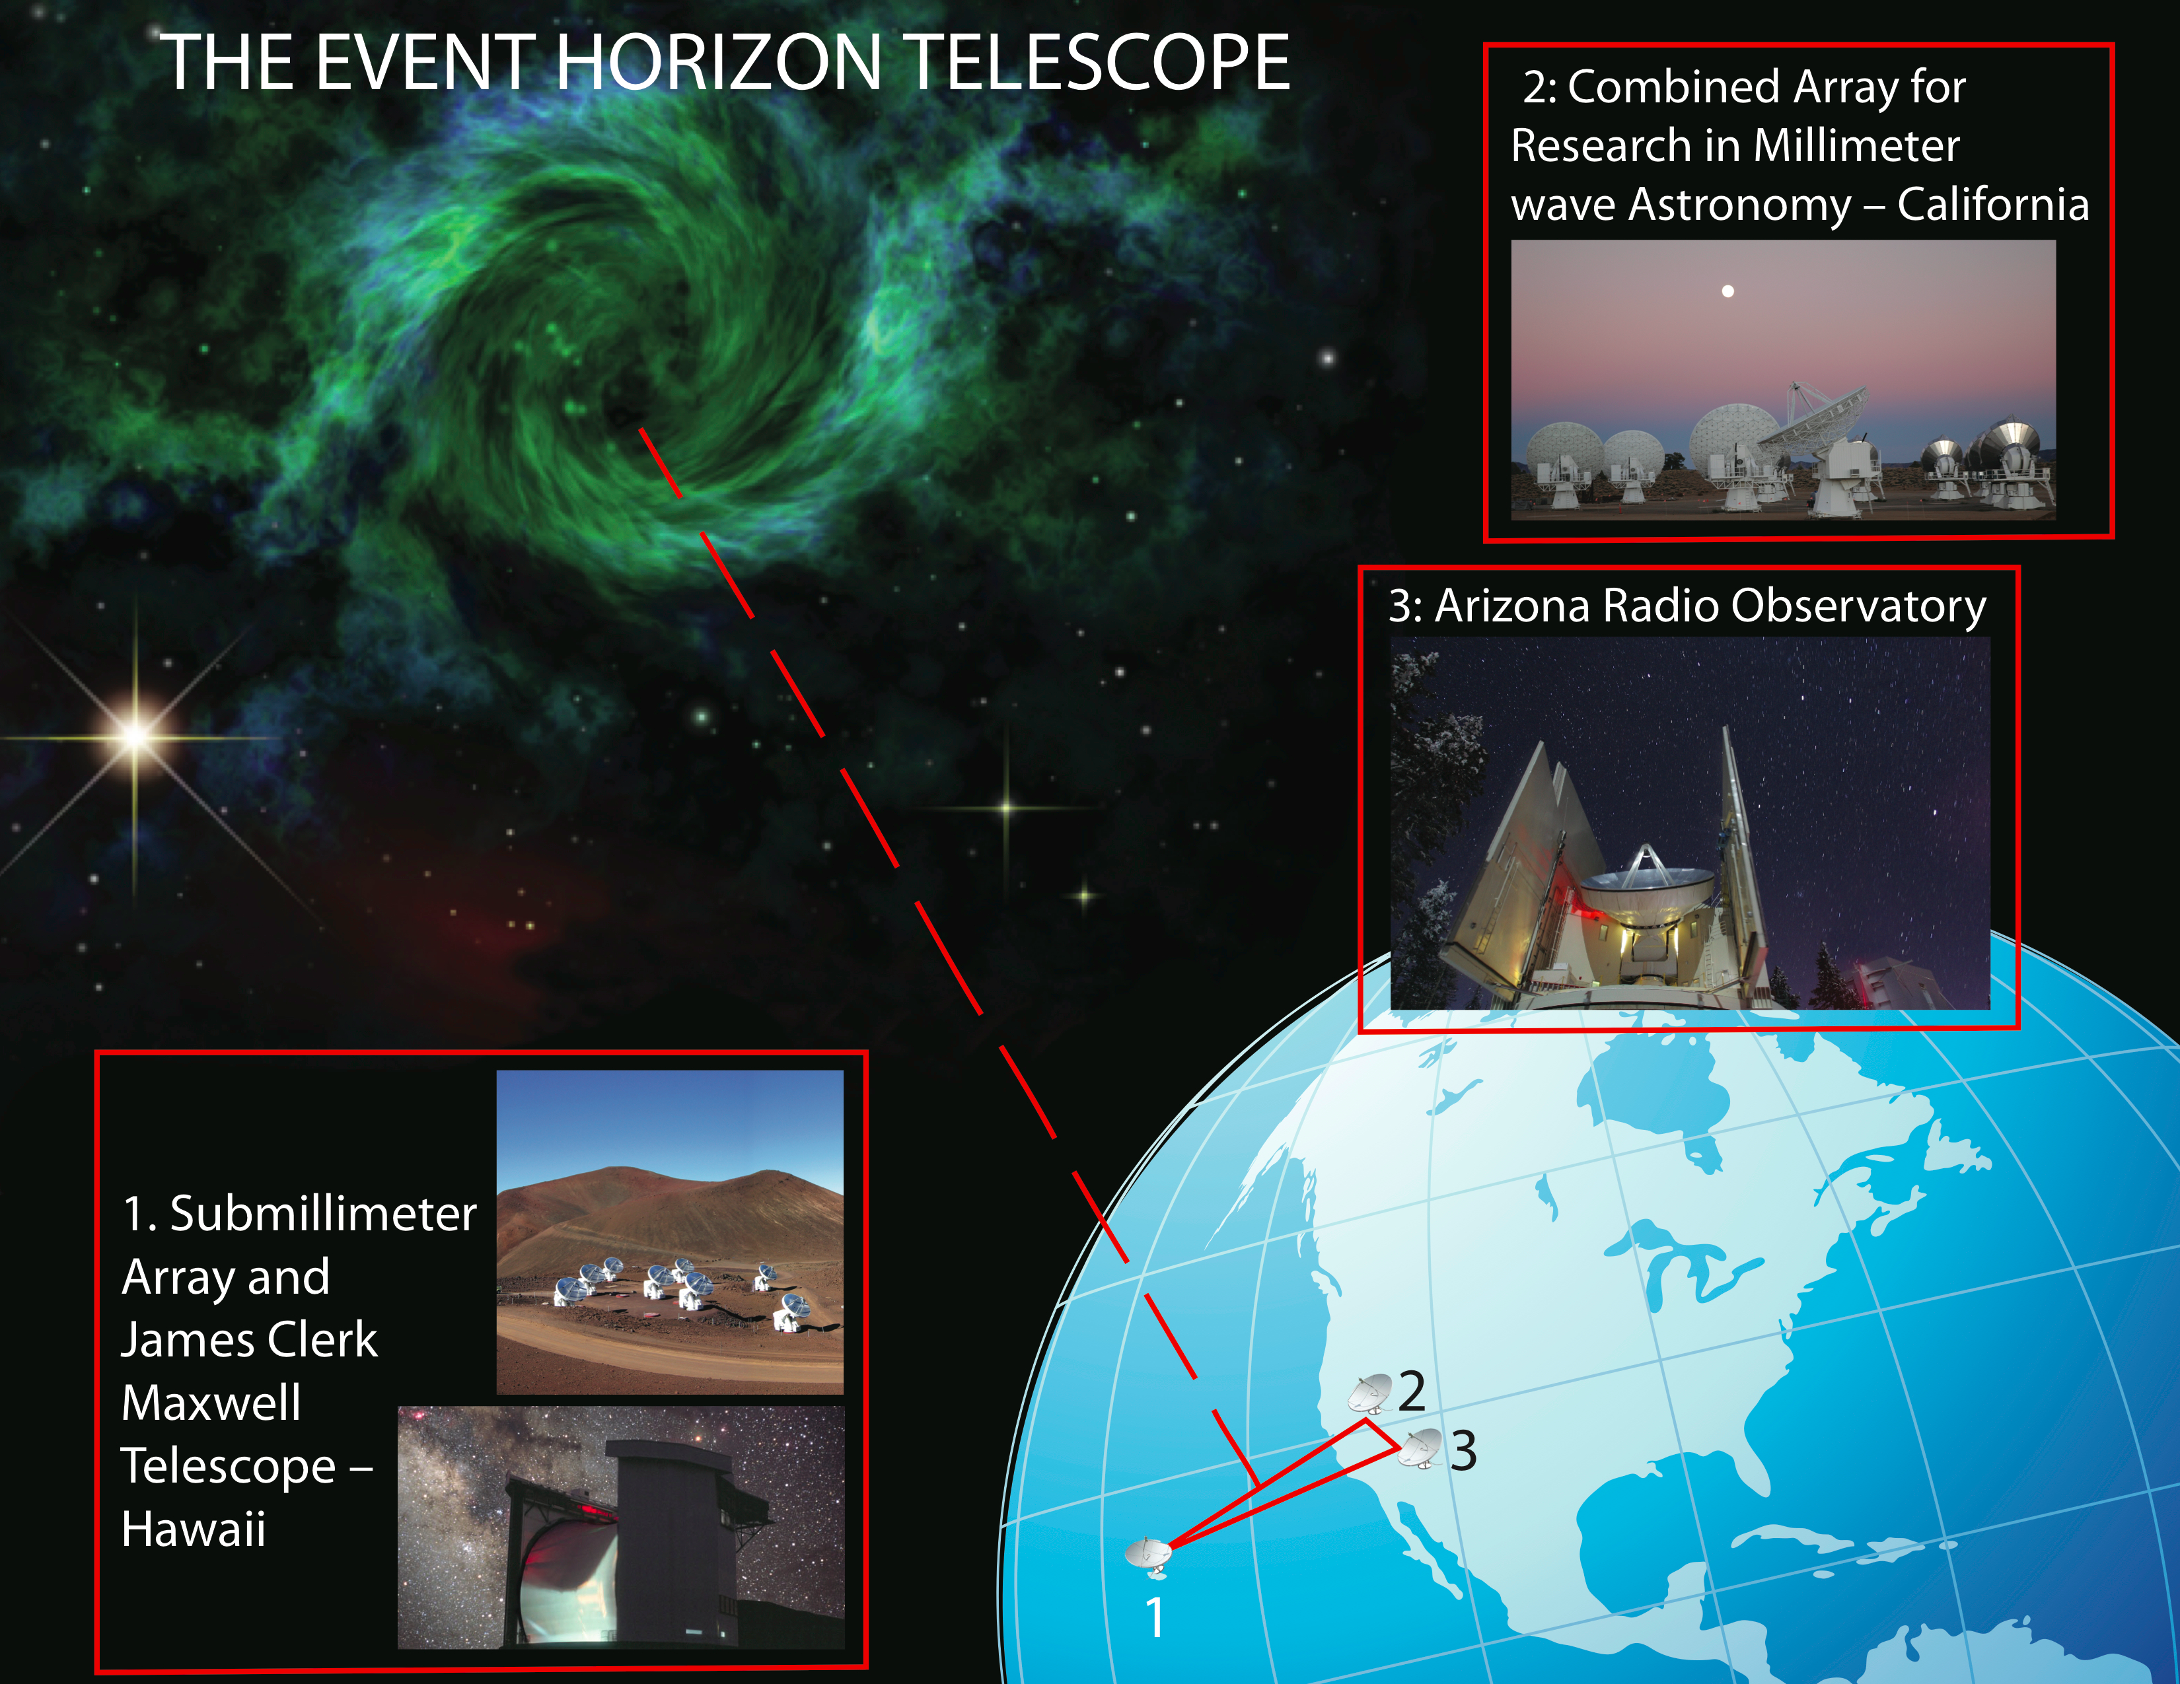
Event Horizon Telescope

Slide 18
Evidence for a Low-Spin BH in SgrA*
Broderick, Fish, Doeleman & Loeb 2010

Slide 19
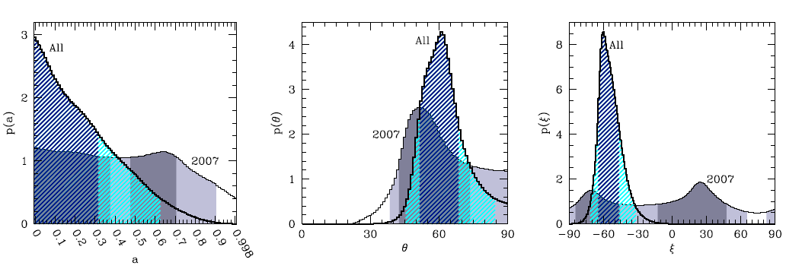

Slide 20

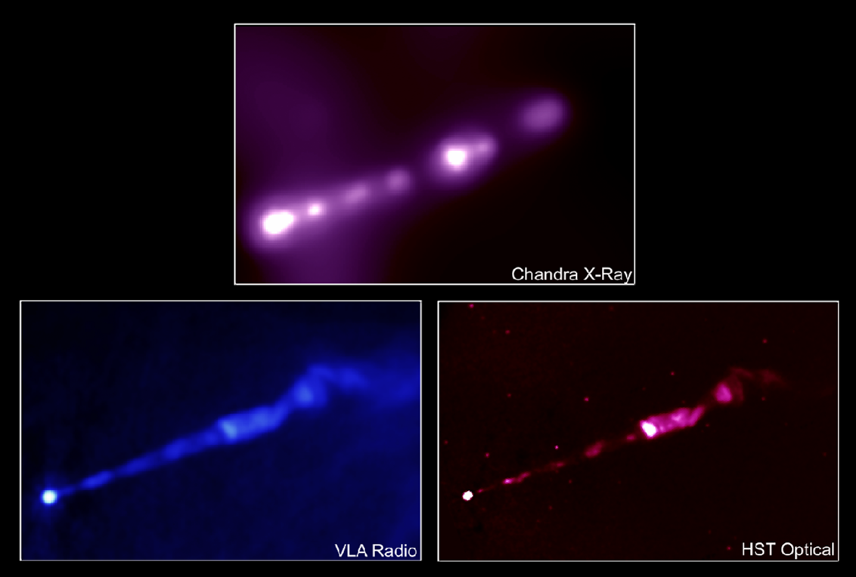

M87
(1400 times more massive than SgrA*)
(~2000 times farther than SgrA*)

Slide 21
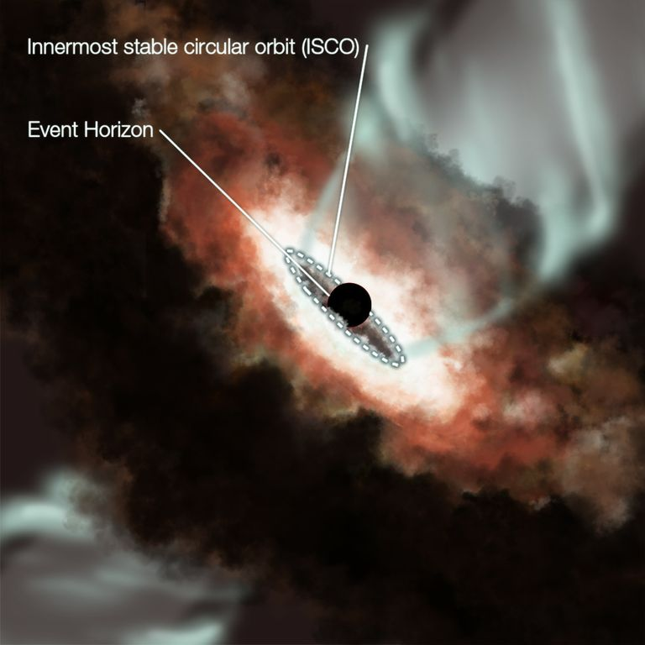
M87

Slide 22
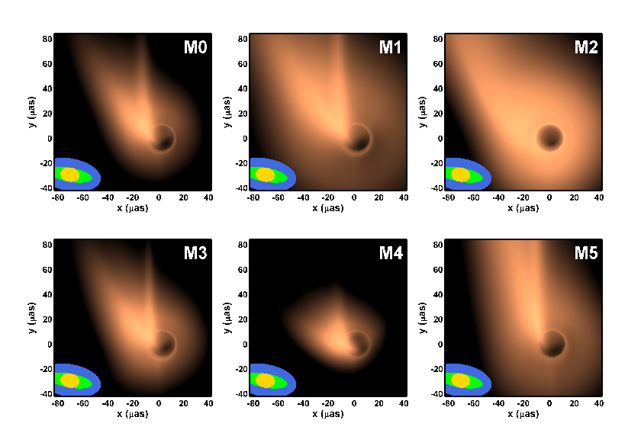
0.87 mm Images
US
+EU
+LMT

Slide 23
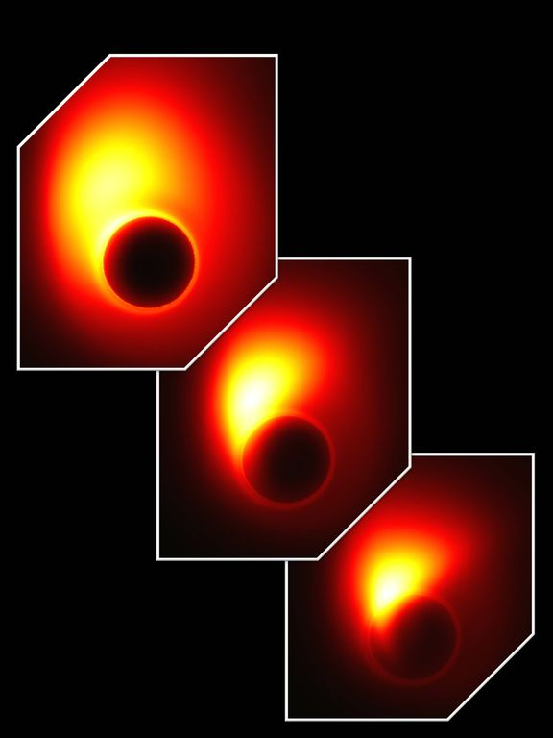
Different choices for the location of the jet base and black hole spin

Slide 24
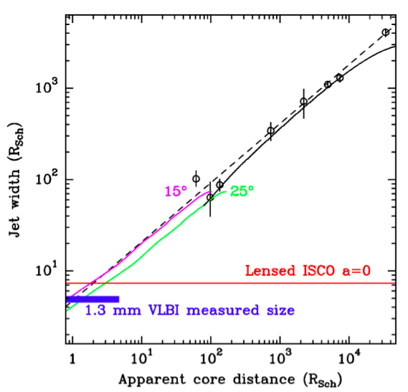
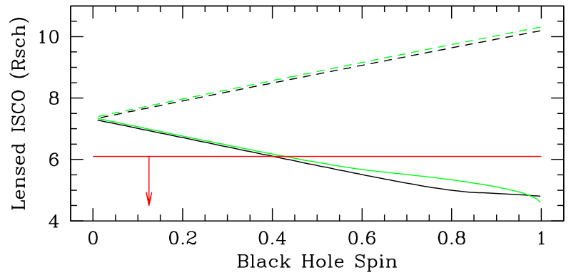
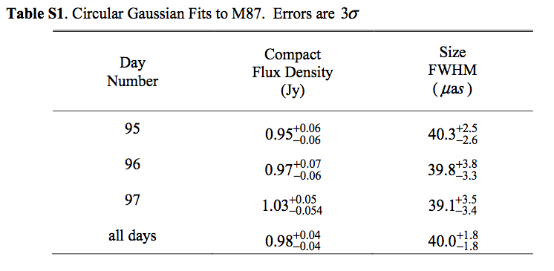
Detection of Jet Launching Structure in M87
a<0
a>0
Doeleman et al. (2012)

Slide 25
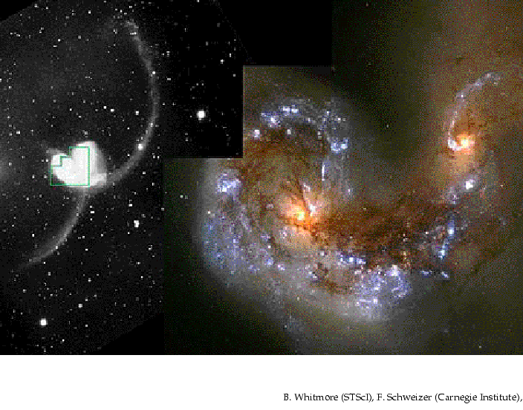
Black Hole Binaries due to Galaxy Mergers

Slide 26
Binary AGN with 1-10kpc separation at z<0.3
Shen et al. (2011)

Slide 27
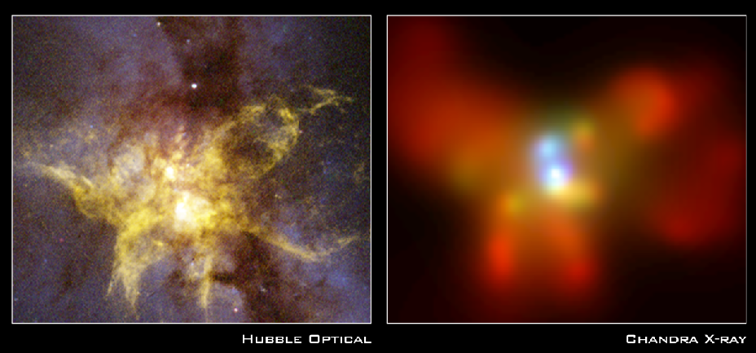
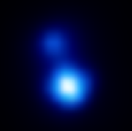
X-ray Image of a binary black hole system in NGC 6240
10kpc
z=0.025
Komossa et al. 2002

Slide 28
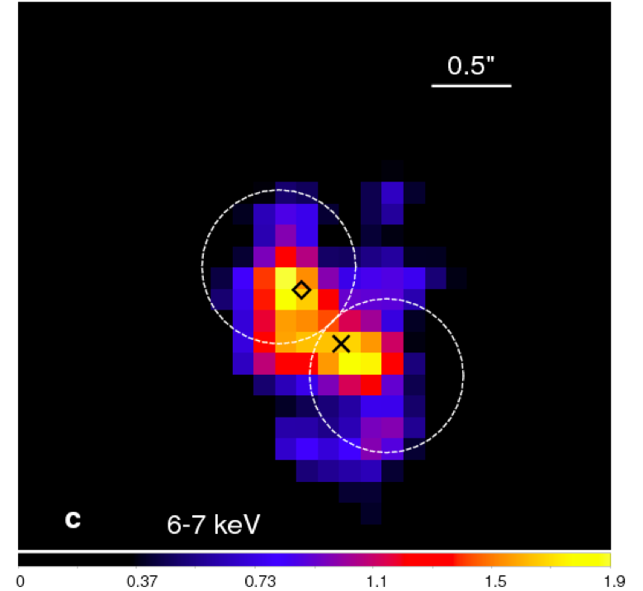
NGC 3393
Fabbiano et al. (2011)

Slide 29
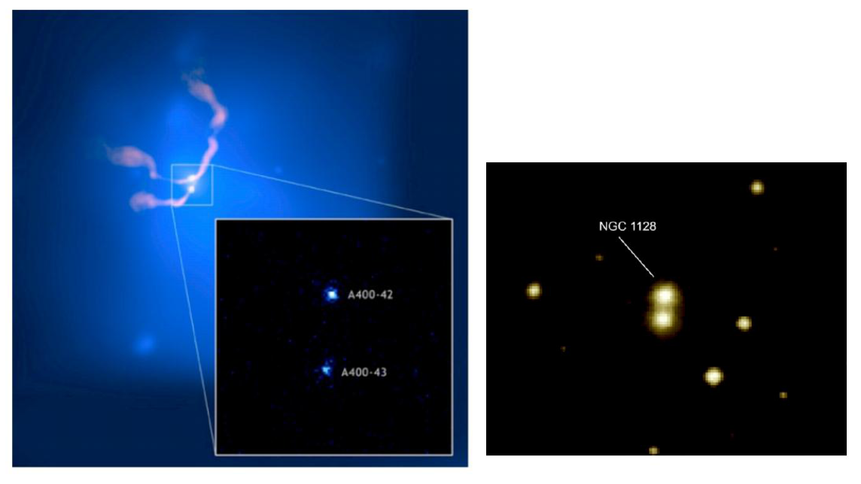
X-ray Cluster Abell 400
3C 75
NGC 1128

Slide 30
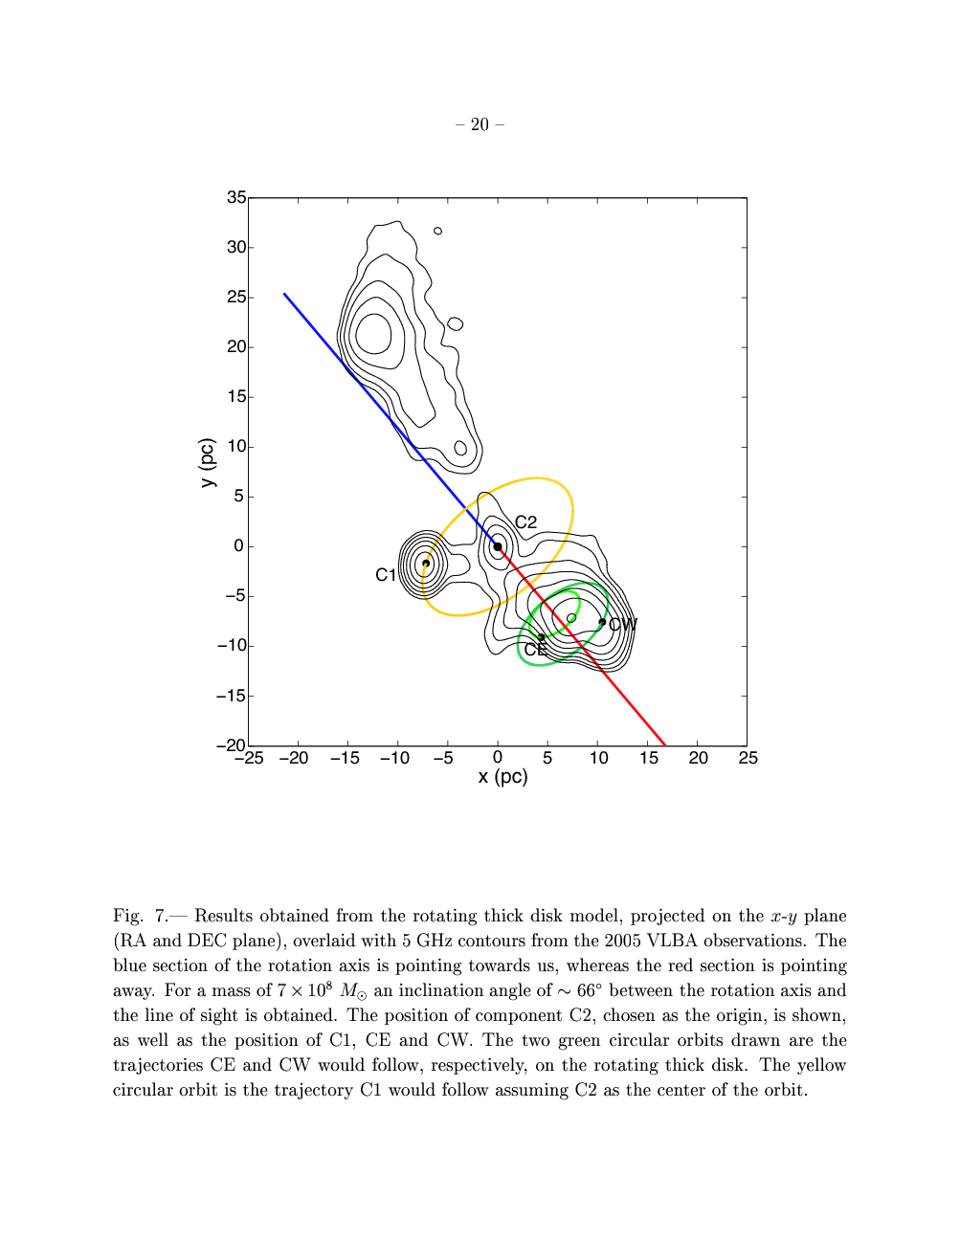
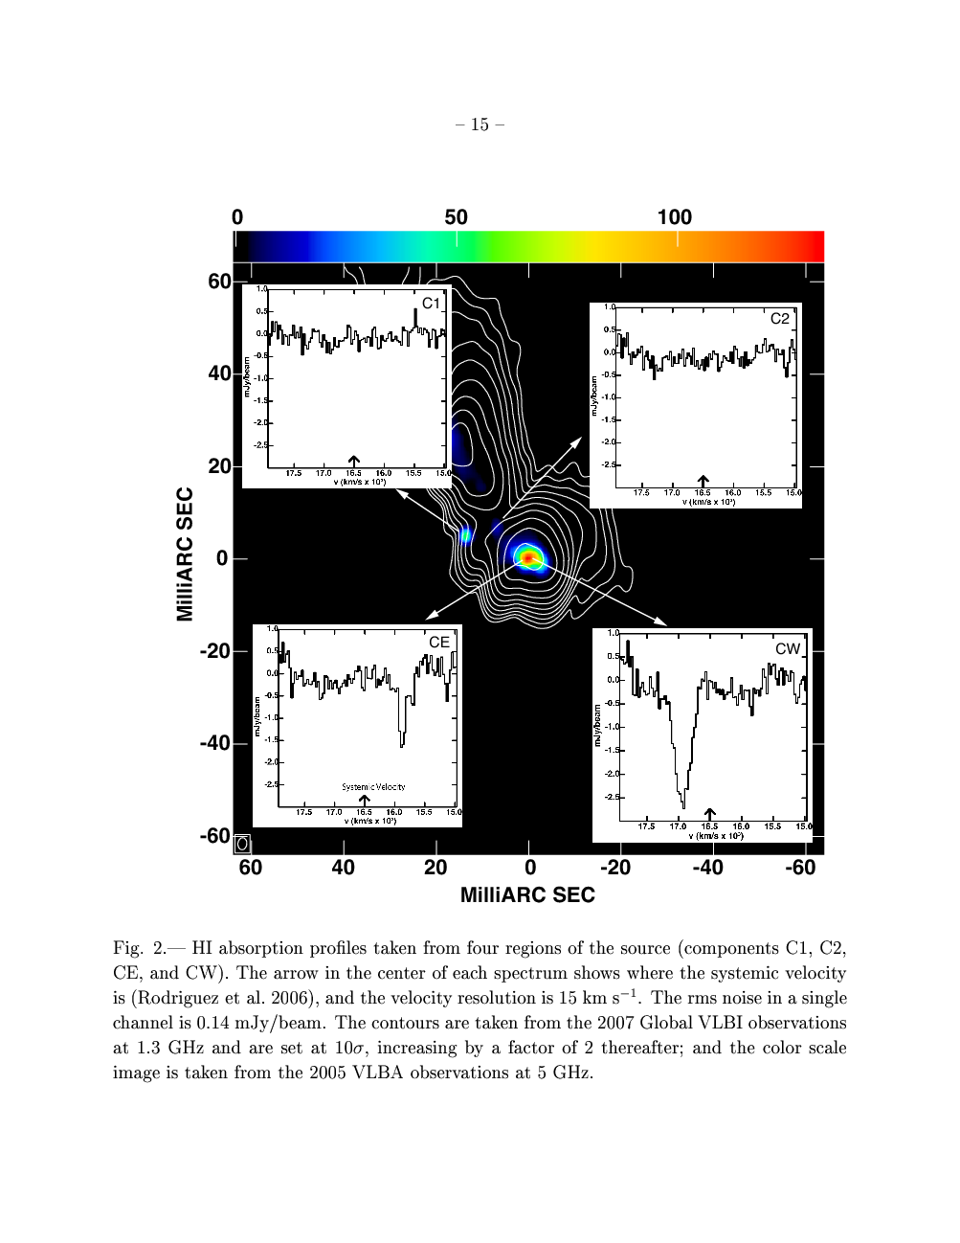

0402+379 (Rodriguez et al. 2006-9)
VLBI at 1.35 GHz
Projected separation: 7.3 pc,
Estimated total mass:

Slide 31
stars
stars
broad-line clouds
broad-line clouds
narrow-line clouds
narrow-line clouds

Slide 32
stars
broad-line clouds
broad-line clouds
narrow-line clouds

Slide 33
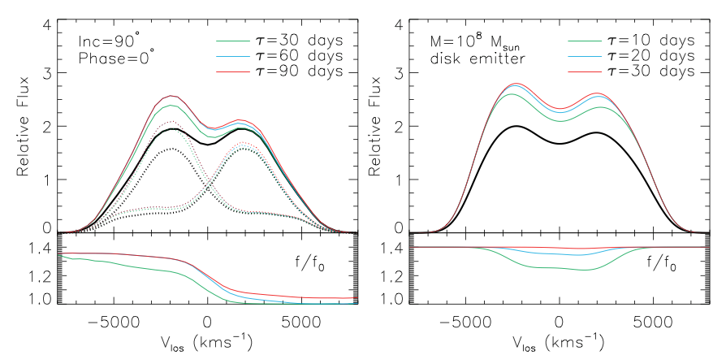
Double Broad Lines: Reverberation
Shen & Loeb (2010)

Slide 34
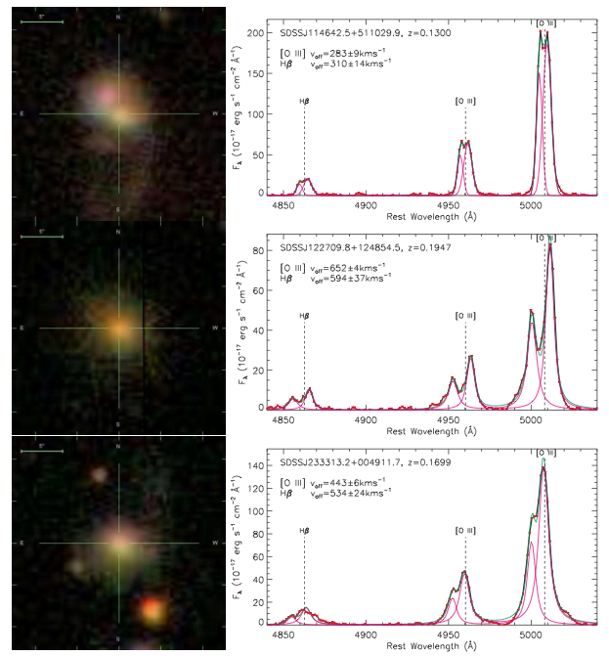
SDSS images & spectra of selected double narrow -line quasars
(Liu et al. 2009)

Slide 35
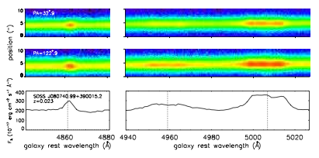
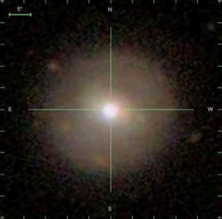
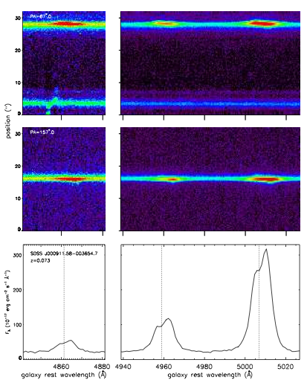
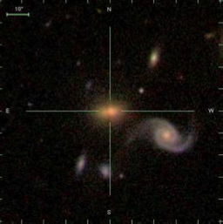
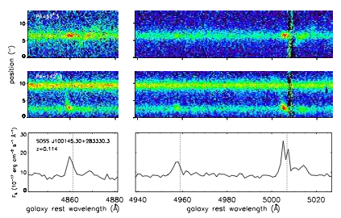
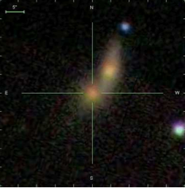
Comerford et al. (2012)

Slide 36
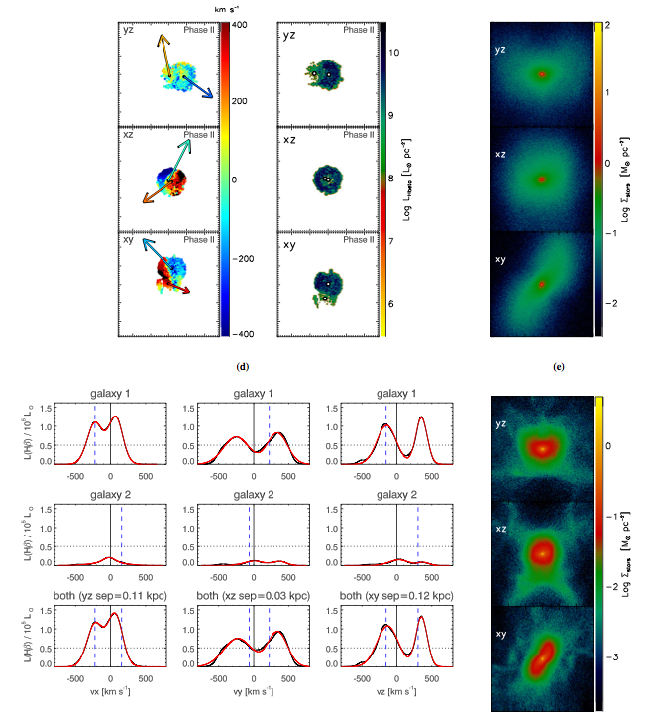
Double-peaked Narrow-Line Signatures of Dual Supermassive Black Holes in Galaxy Merger Simulations
Blecha, Loeb, & Narayan (2012)

Slide 37
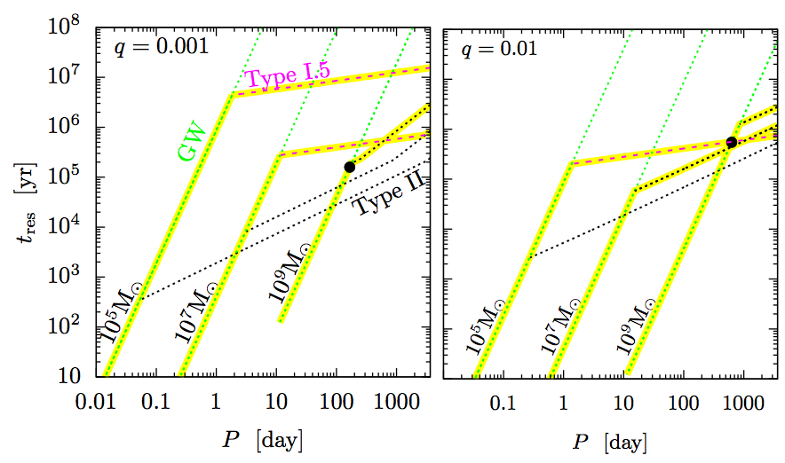
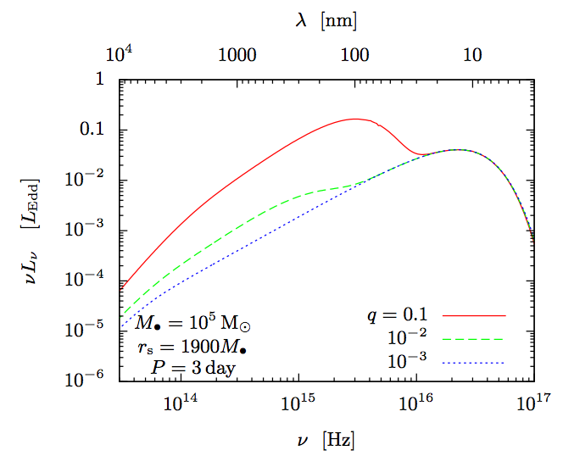
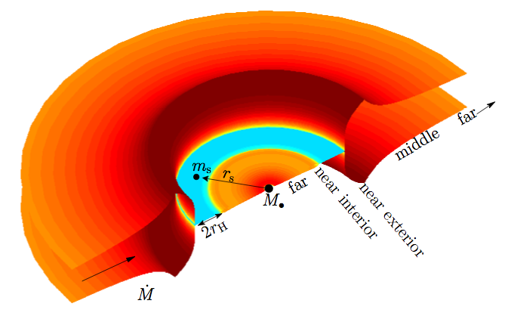
Gas Accretion and Electromagnetic Emission from BH Binaries
Kocsis, Haiman, & Loeb ArXiv:1205.5268 (2012)

Slide 38
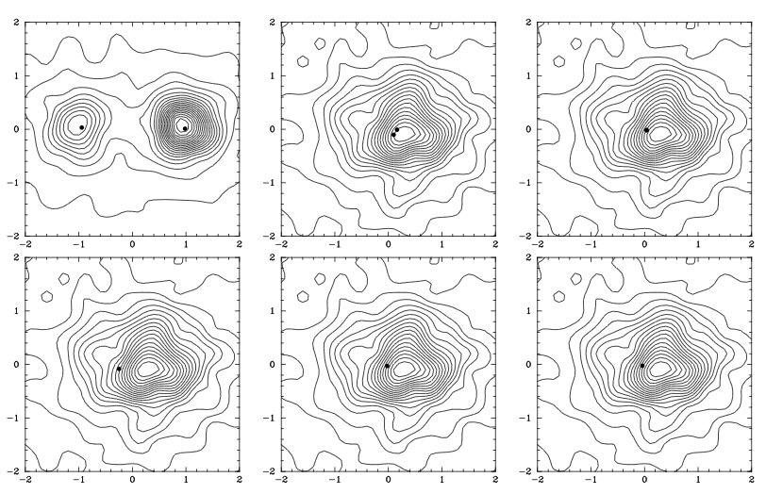
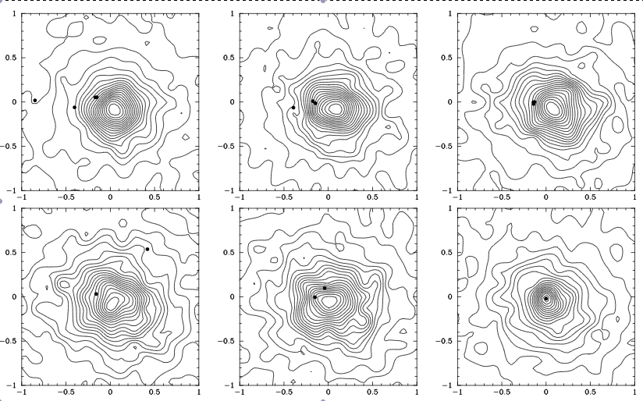
Multiple Black Holes
>2000 km/s
Kulkarni & Loeb 2011; Hoffman & Loeb 2007

Slide 39
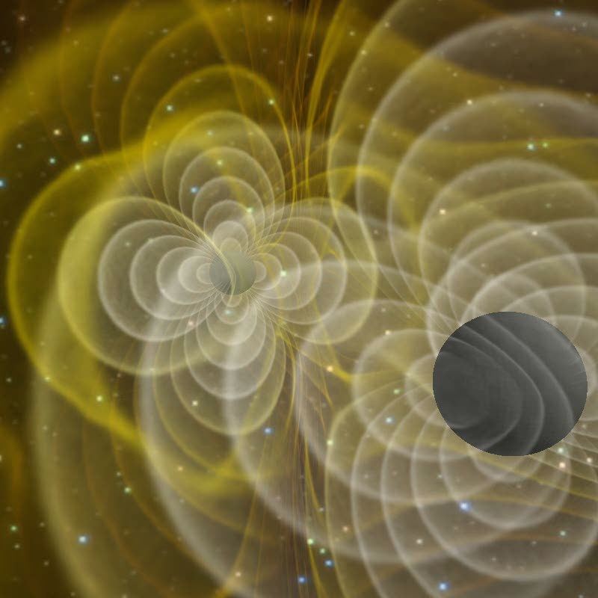
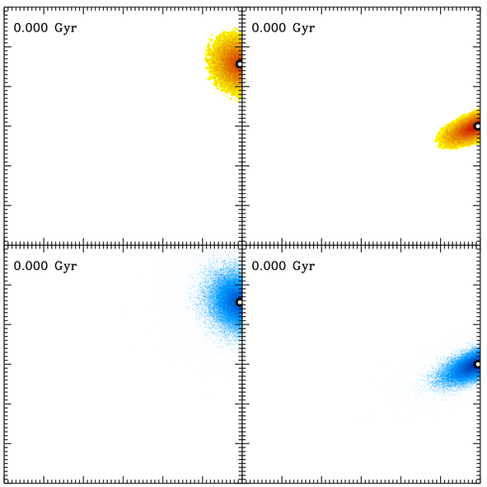
Black Hole Recoil
Physics
Astrophysics
(Centrella et al. 2007)
(Blecha & Loeb 2009)

Slide 40
A recoil candidate: CID-42
*spatial offset: ~2.5 kpc *velocity offset in NLR/BLR of H-beta: ~1,200 km/s *z=0.36
Civano et al. (2010)

Slide 41
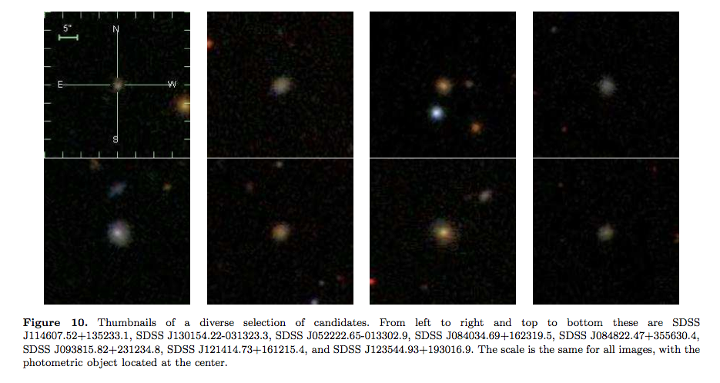
Star Clusters Around Recoiled Black Holes in the Milky Way Halo
~100 BHs ejected during assembly of MW halo
Carry star clusters from cusp of host dwarf galaxy
Clusters characterized by compact size (~1pc) and high velocity dispersion (~10-100 km/s)
escape (dwarf) ~ 10 km/s << GW recoil~hundreds of km/s < escape(MW) ~ 500 km/s
O’Leary & Loeb 2008, 2010 arXiv:0809.4262 ; arXiv:1102.3695

Slide 42

Tidal Disruption of a Star by a Supermassive Black Hole

Slide 43



Tidal Disruption of Stars
Single BH rate per MW galaxy due to empty loss cone
BHs with swallow the star whole
Super-Eddington initial feeding rate:

Slide 44
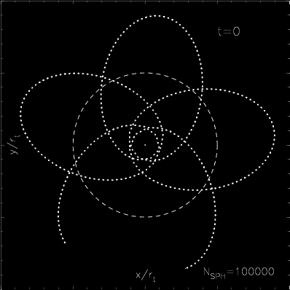
Bound Star in a Pseudo-Newtonian Potential (e=0.8,beta=5)
Hayasaki, Stone, and Loeb 2012

Slide 45



EM Counterpart of LISA Sources: Tidal Disruption of Stars
“loss cone” filled by GW recoil
(Stone & Loeb 2010)

Slide 46

A Relativistic Jet from a TDE: Swift 164449.3+573451 (GRB110328A)
Bloom et al. 2011
Zauderer et al. 2011
*Synchrotron and X-ray peaks are emitted from different regions; bulk Lorentz factor~2-3

Slide 47



Observing Lense-Thirring Precession in Tidal Disruption Flares
days
log(spin)
a
Stone & Loeb (2011)

Slide 48


Pulsations in Short GRBs from Black Hole-Neutron Star Mergers
Jet precession period 0.01-0.1 s.
Spin misalignment ~10 degrees
Stone, Loeb, & Berger 2012

Slide 49


Gillessen et al., Nature (2012)

Slide 50

Tidal Disruption of a Proto-Planetary Disk by SgrA*
*Planets form near SgrA*
*Flags low-mass stars
Murray-Clay & Loeb (2012)

Slide 51

Schartmann et al. (2012)

Slide 52
Summary:
1. Direct imaging of the largest silhouettes of black holes (SgrA*, M87) will be achievable with upcoming radio telescopes within the next decade.

Slide 53
Summary:
2. Black hole binaries form in galaxy mergers and produce detectable gravitational waves
3. Coalescence of black hole binaries results in recoils and consequently: offset quasars, floating star clusters in the Milky-Way halo, enhanced rate for tidal disruption of stars

Slide 55



Why are there galaxies and not just black holes in the Universe?
Spherical Collapse of dark matter and gas
Tidal torque from neighboring objects near turnaround: angular momentum

Slide 56
Is general relativity a valid description of strong gravity?
*Infrared variability of flux (Genzel et al.) and polarization (Eckart et al.) of SgrA*: hot spots.
*Innermost Stable Circular Orbit: radius of 30 (10) micro-arcsecond and orbital time of 30 (8) minutes for a non-rotating (maximally-rotating) black hole at the Galactic center
*A hot spot would result in infrared centroid motion (GRAVITY-VLT) and could be imaged by a Very Large Baseline Array of (existing) sub-millimeter observatories. Targets: SgrA* and M87
Broderick & Loeb 2005

Slide 57



Gravitational Waves
source: BH/NS binaries
detector: laser interferometer (such as LIGO or eLISA)
Precision: one thousandth the diameter of a proton

Slide 58
Extreme Mass Ratio Inspirals (EMRIs)
Stellar mass BH or NS in an orbits around SMBH
Many orbital times in the eLISA/NGO band, allowing a precise determination of GR or astrophysical perturbations
The compact object may have formed or been trapped inside the accretion disk.

Slide 59


Effect of Recoil on Black Hole Growth
Blecha, Cox , Loeb, & Hernquist 2010

Slide 60



Hypervelocity Planets
Ginsburg, Loeb, & Wegner (2012)

Slide 61


Slide 62



