Slide 1
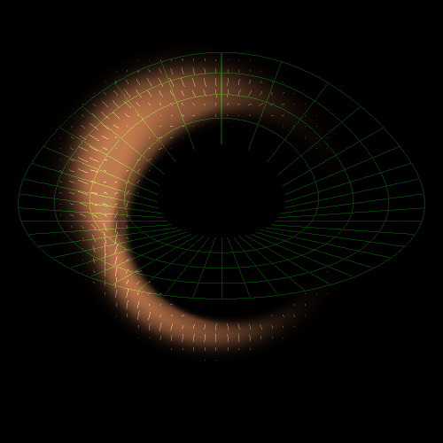
Observational Signatures of Planets Around the Black Hole at theMilky Way Center (SgrA*)
Proto-Planetary Disk as the Source of the G2 Gas Cloud
Hypervelocity planets and planets around hypervelocity stars

Slide 2
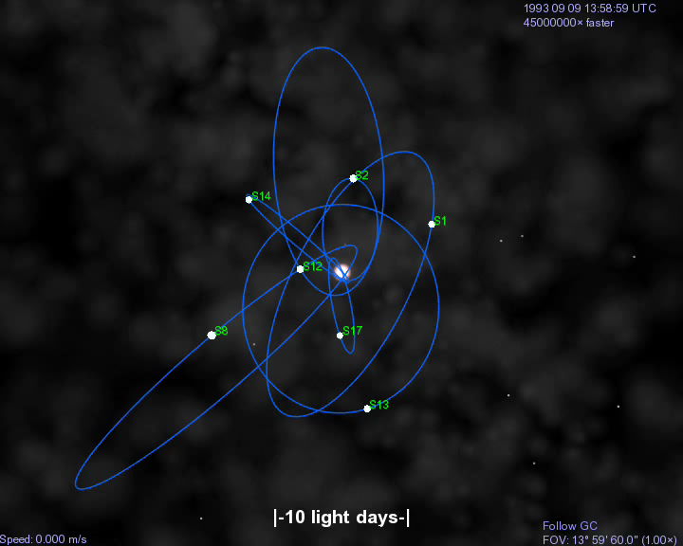


Stellar Orbits Around SgrA*
(BH at rest in GC)
Ghez et al. 2008; Genzel et al. 2008

Slide 3
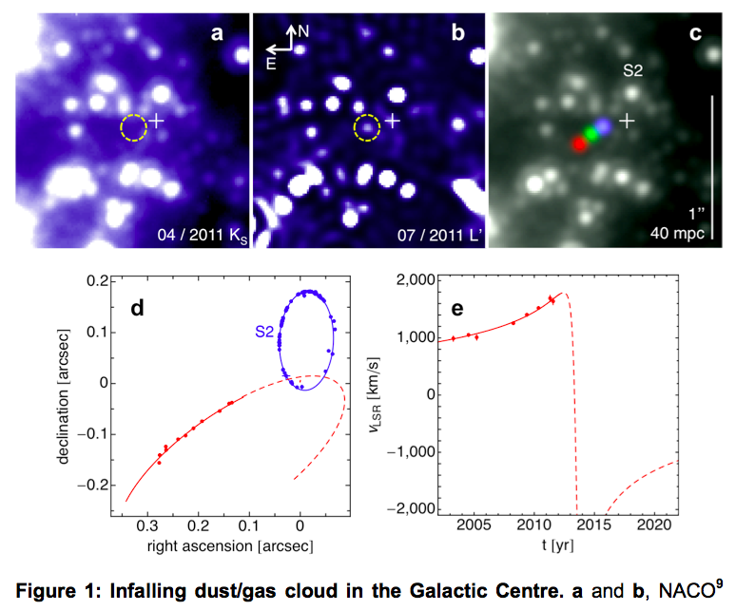
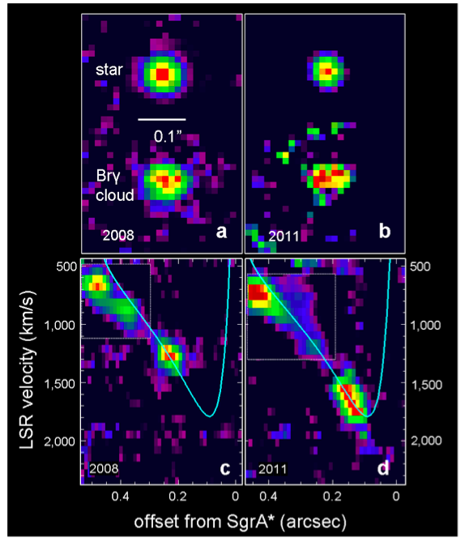
*Ionized cloud, ~3x10^5 cm^{-3}, ~100AU, electrons at 10^4K, dust at 550K, 3 Earth masses
Gillessen et al., Nature (2012)

Slide 4
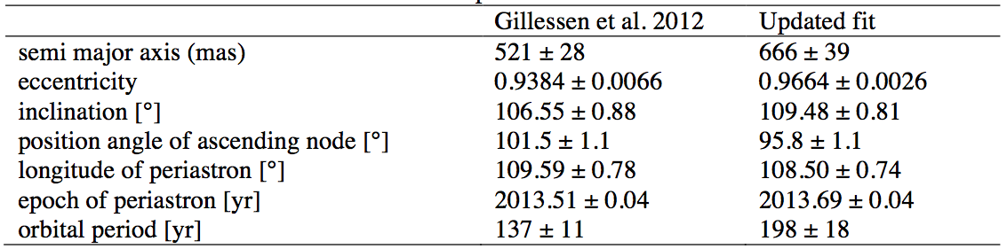
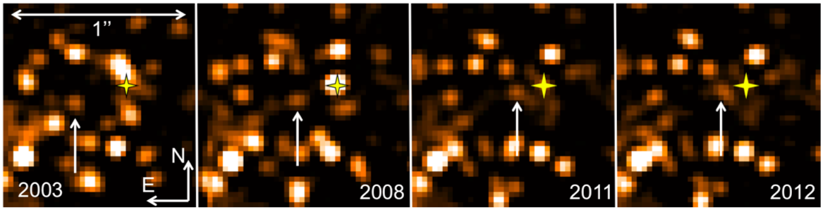
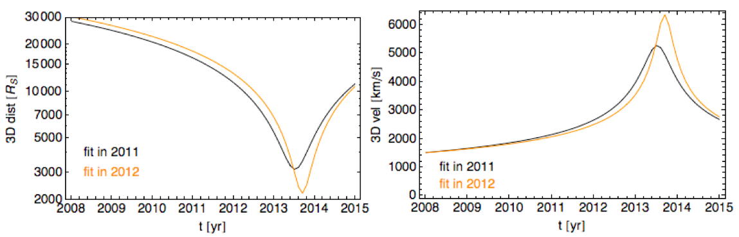
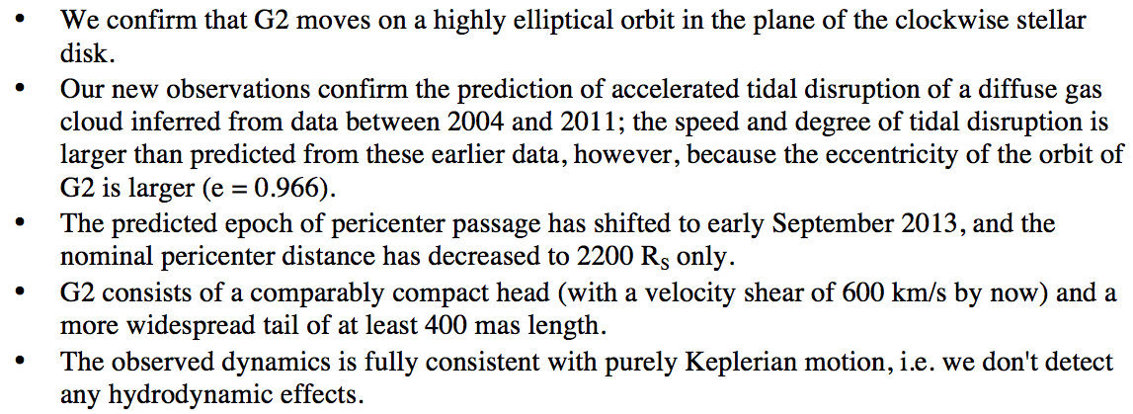
Latest Data
Gillessen et al. , submitted (2012)

Slide 5
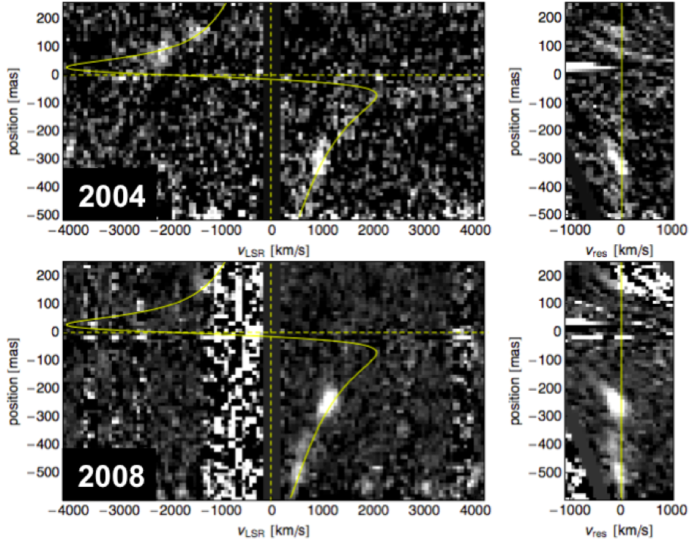
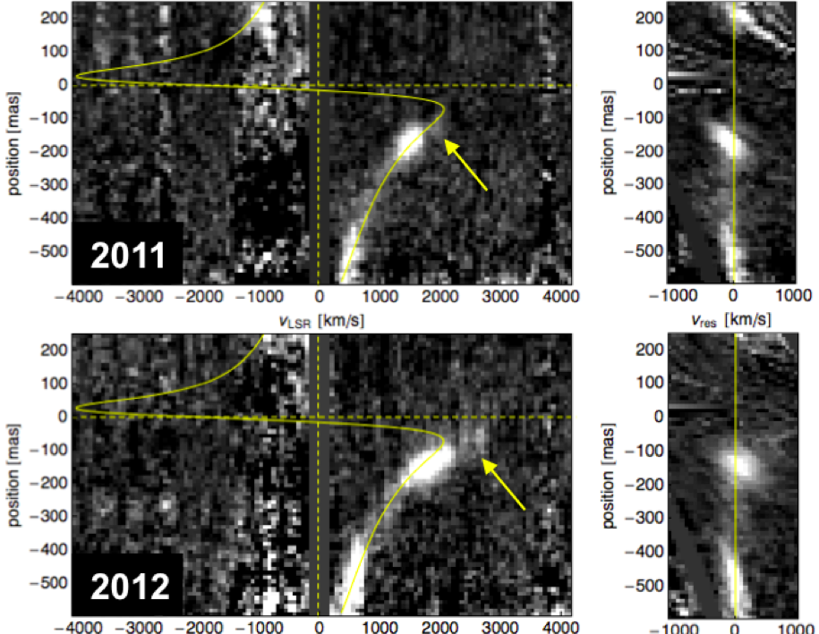

Slide 6
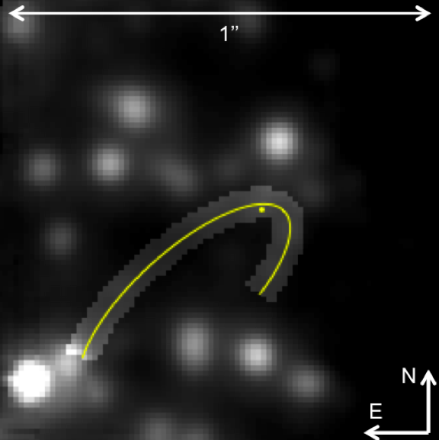
SgrA*
Br-gamma slit

Slide 7
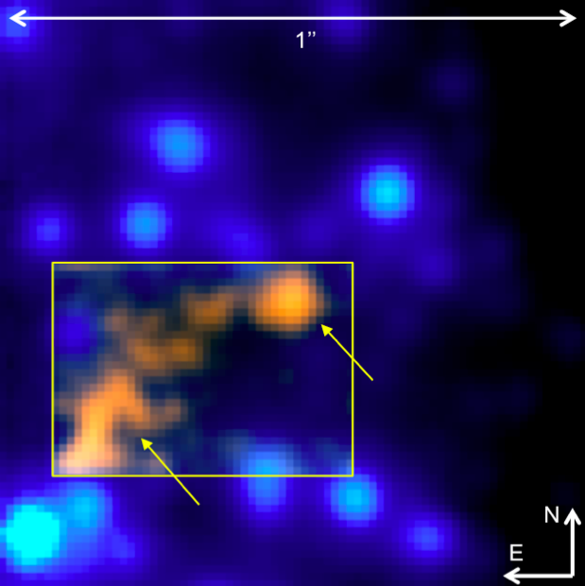
Br-gamma

Slide 8
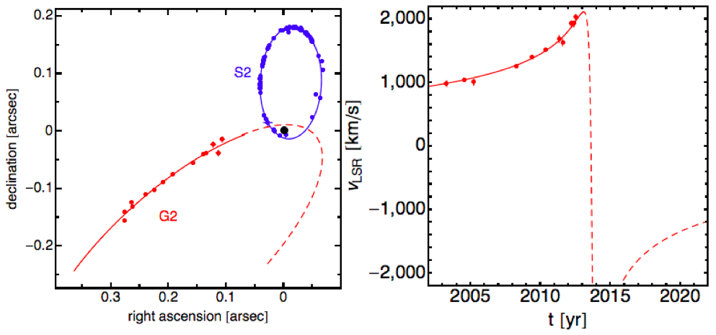

Slide 9

Burkert et al. (2012)

Slide 10
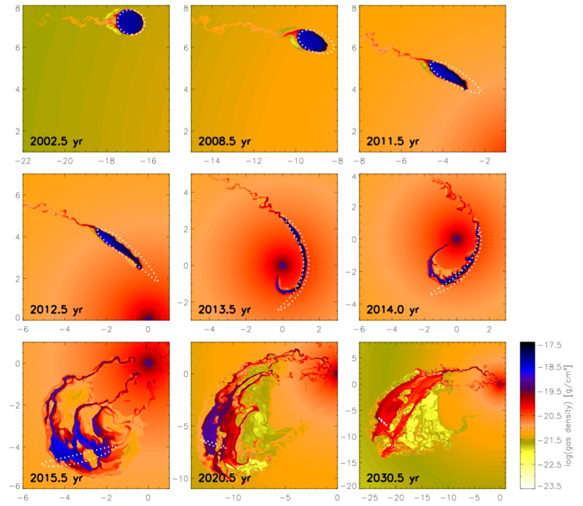
“Pressure-Confined Cloud” Model
Schartmann et al. (2012)

Slide 11
Problem: why is the head moving on a ballistic orbit with no evidence for ambient ram-pressure?

Slide 12
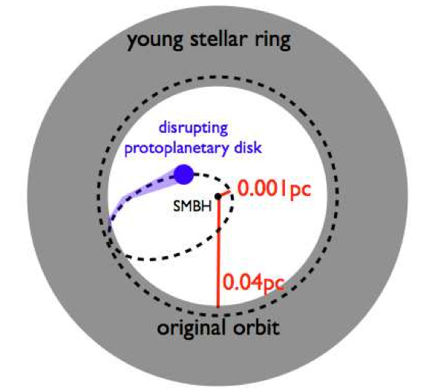
Tidal Disruption of a Proto-Planetary Disk Around a Low-Mass Star
*Planets form near SgrA*
*Flags low-mass stars
Murray-Clay & Loeb (2012)

Slide 13
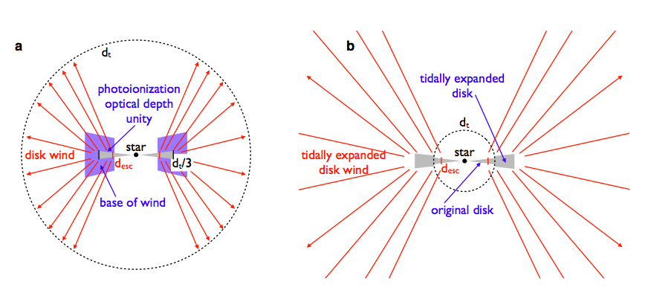
Physical Parameters
Low-mass star, born in circum-nuclear ring at ~0.04pc, and scattered into orbit a few Myrs ago.
Original
Current

Slide 14

Low probability for scattering if this represents the first passage, but high probability for multiple passages in which the gas cloud is rejuvinated every pericenter passage (from ~1AU).
Ionizing background from surrounding O-stars generates a ~10 km/s outflow from tidally-truncated disk of 1-10AU around M-dwarf (too faint to be observable).
Photoevaporation yields a wind mass loss rate:

Slide 15
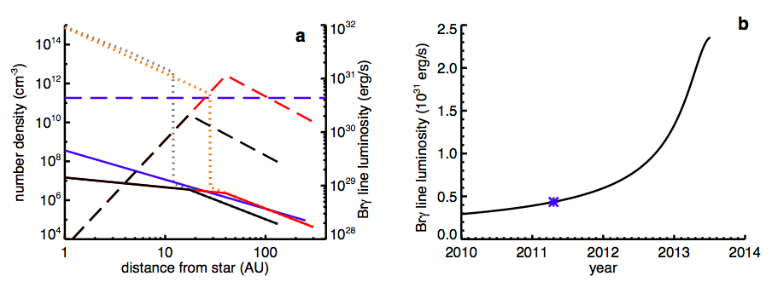
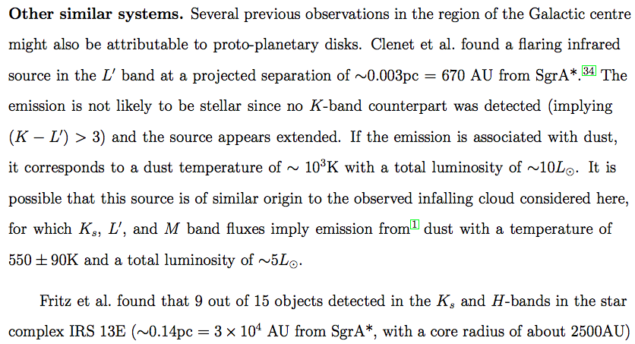
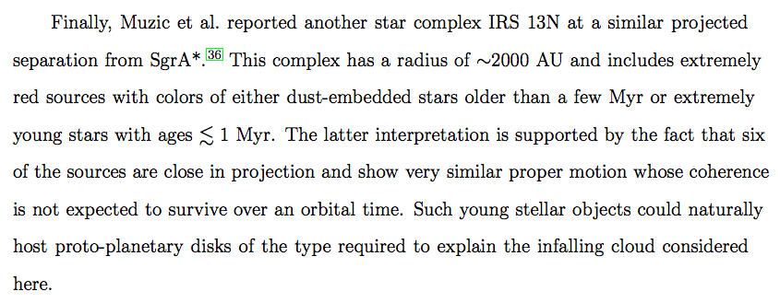
HI
Br-pericenter
observed
observed
now
ionized

Slide 16
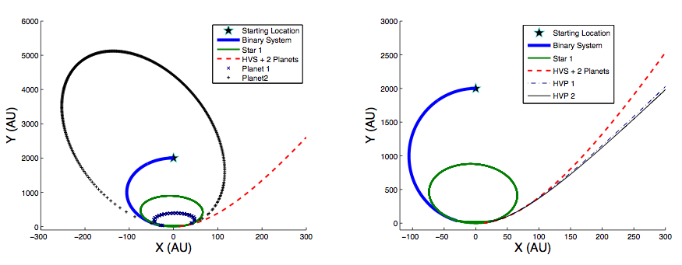
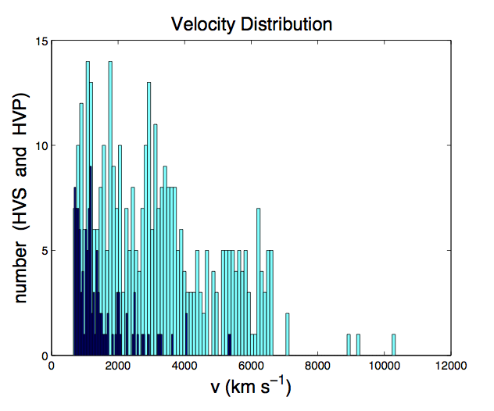
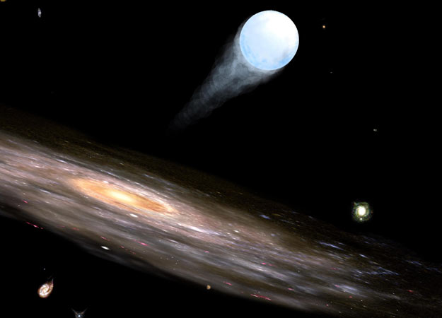
Hypervelocity Planets from Tidal Disruption of Stellar Binaries by SgrA*
Ginsburg, Loeb, & Wegner (2012)

Slide 17
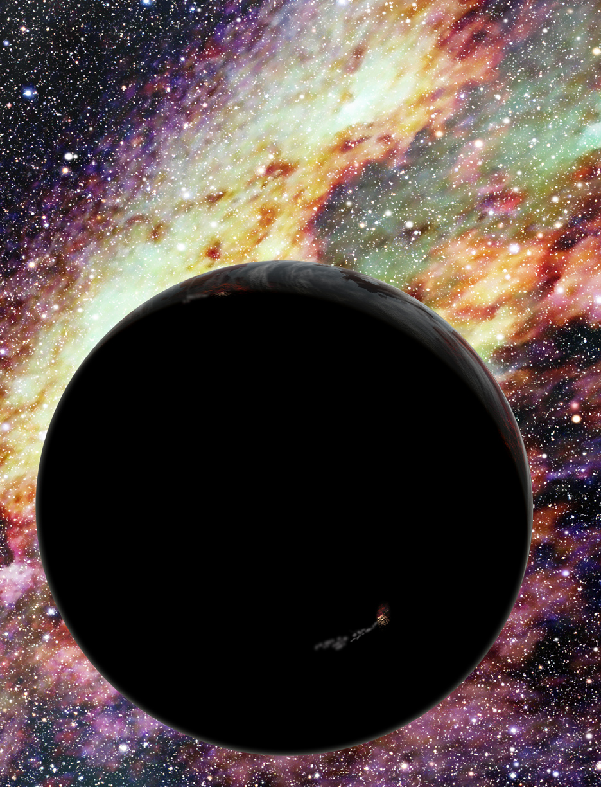
Possible Outcome: Free Hypervelocity Planets

Slide 18
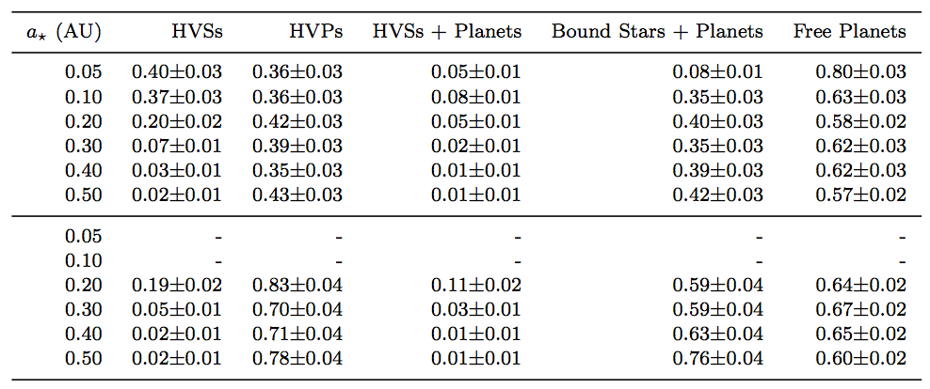
Probabilities of Outcomes
2 planets
0.02 AU
4 planets
0.02 AU 0.03AU

Slide 19
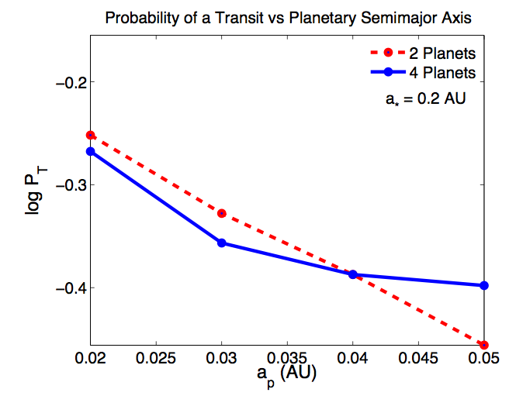
Transits of Hypervelocity Stars

Slide 20

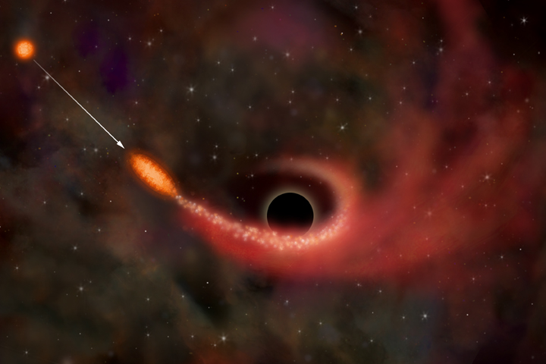
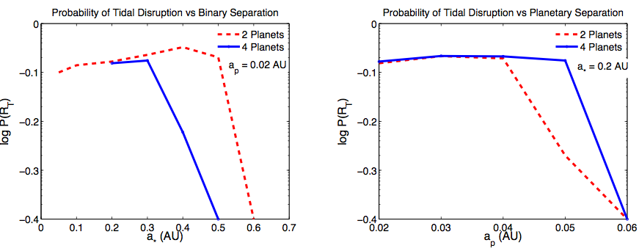
Tidal Flares from Disrupted Planets or Asteroids
Waste dump: source of clean energy for galacto-centeric civilizations

Slide 21
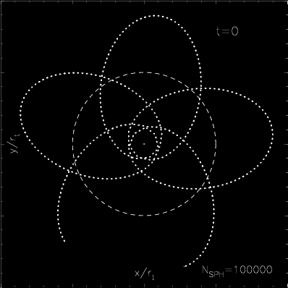
Tidal Distruption of a Bound Object (e=0.8,beta=5)
Hayasaki, Stone, and Loeb 2012

Slide 22
Summary:
1. Evaporation of proto-planetary disks may flag low-mass stars at the Galactic Center.
2. Close-in planets around hypervelocity stars may cause detectable transit signatures.

Slide 24
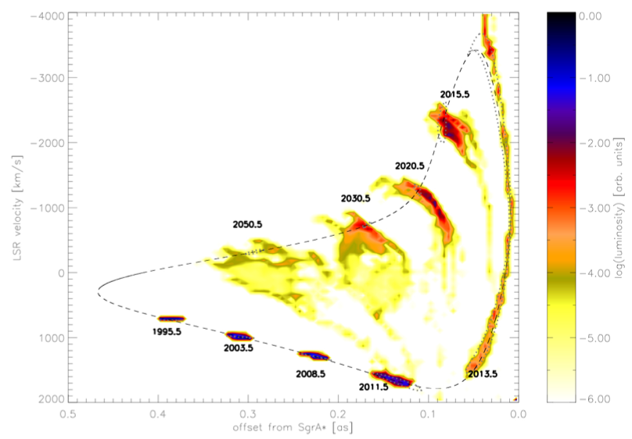
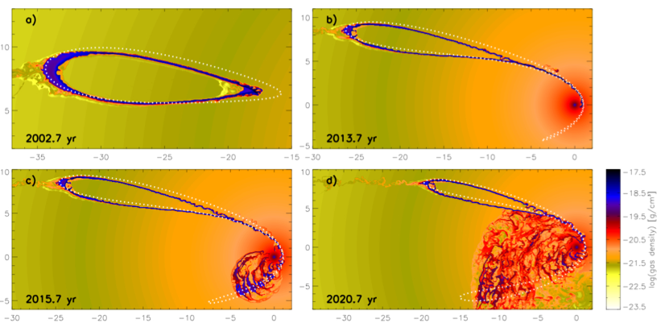
Initial Ring Results in Two Bright Spots

Slide 25
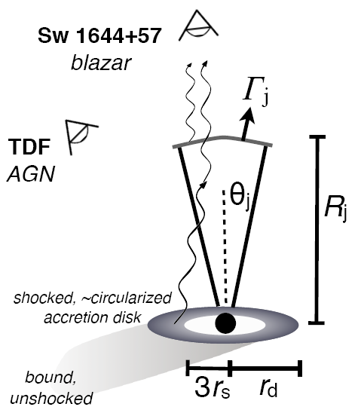
A Relativistic Jet from a TDE: Swift 164449.3+573451 (GRB110328A)
Bloom et al. 2011
Zauderer et al. 2011
*Synchrotron and X-ray peaks are emitted from different regions; bulk Lorentz factor~2-3

