Slide 1
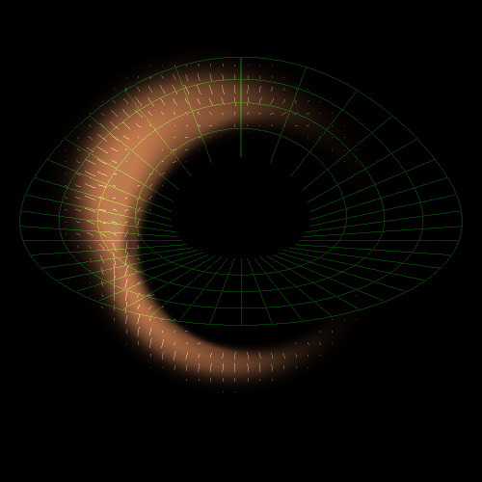
Lecture III: A Closer Look at Black Holes
Imaging black hole silhouettes
Gravitational waves from black hole binaries
Recoil of black holes
Tidal disruption of stars by black holes

Slide 2



Why are there galaxies and not just black holes in the Universe?
Spherical Collapse of dark matter and gas
Tidal torque from neighboring objects near turnaround: angular momentum

Slide 3
What is a black hole?
The ultimate prison. Even light cannot escape from its gravitational pull!

Slide 4
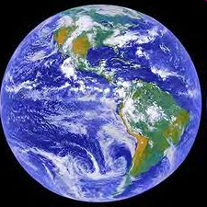
escape speed = 11 km/s
Compress the Earth to ~1cm
escape speed = 300,000 km/s = speed of light

Slide 5


space-time
c=const
x = c t
Equivalence Principle (Galileo, Pisa)
General relativity: matter curves spacetime Einstein’s equations: [Matter] = [Curvature]
Time-dependent quadrupole -> ripples in spacetime . ( (gravitational waves)
Black hole: Schwarzschild’s letter in WWI

Slide 7
How does a black hole look like?

Slide 8
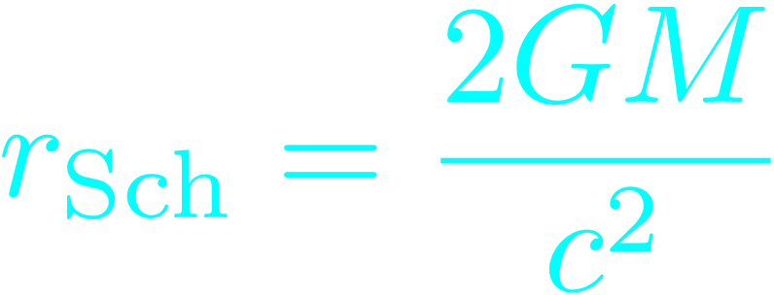
Image of a black hole in vacuum
For a non-spinning black hole: Schwarzschild radius:
singularity
event horizon

Slide 9
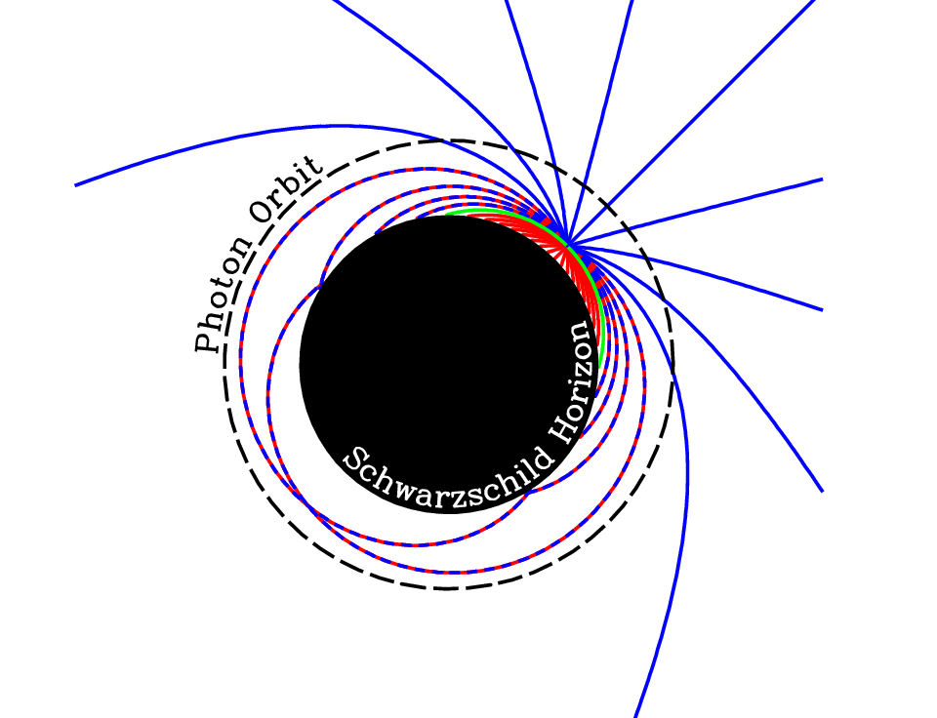
Broderick, Loeb, & Narayan 2008

Slide 10
No hair Theorem: a black hole is characterized by three numbers: its mass, spin, and charge (N/A)
Cosmic censorship: every singularity is surrounded by an event horizon (which protects the outside world from its influence)

Slide 11
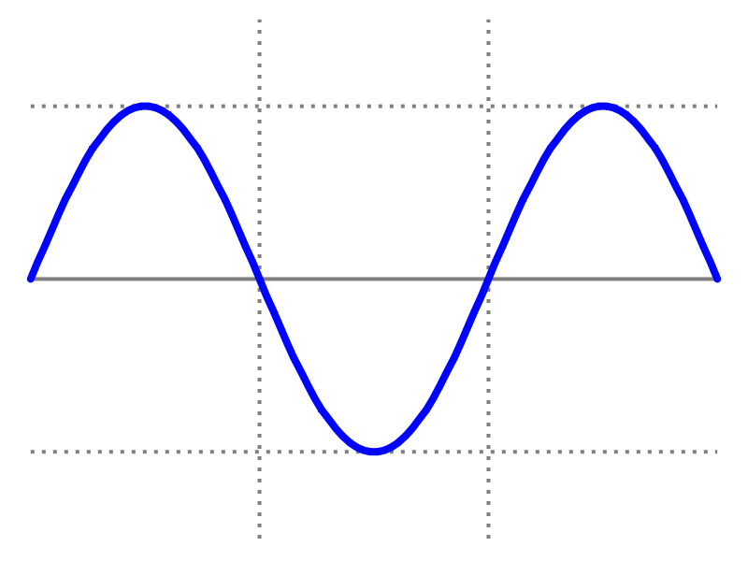
Quantum Mechanics
Important only for wavelengths comparable to horizon size (Hawking radiation)
Negligible importance outside the horizon of astrophysical black holes

Slide 13
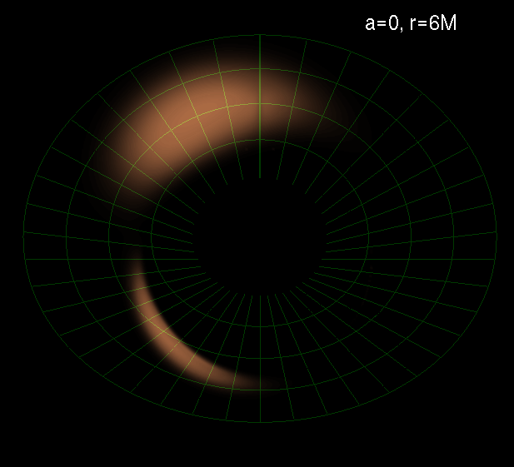
Imaging Black Holes
Testing theory of gas accretion: disks, jets
Testing General Relativity: strong field gravity

Slide 14
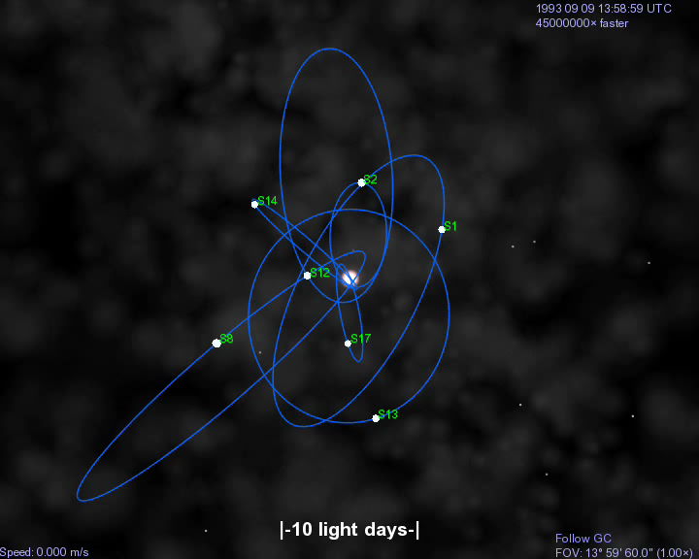


Stellar Orbits Around SgrA*
(BH at rest in GC)
Ghez et al. 2008; Genzel et al. 2008

Slide 15
SgrA* is the largest black hole on the sky

Slide 16
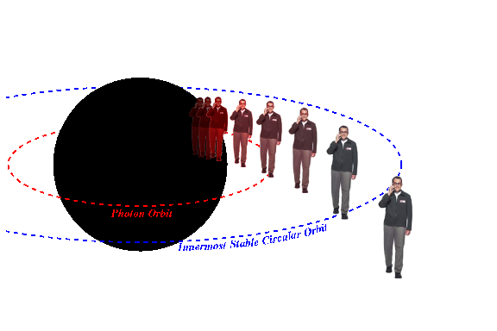
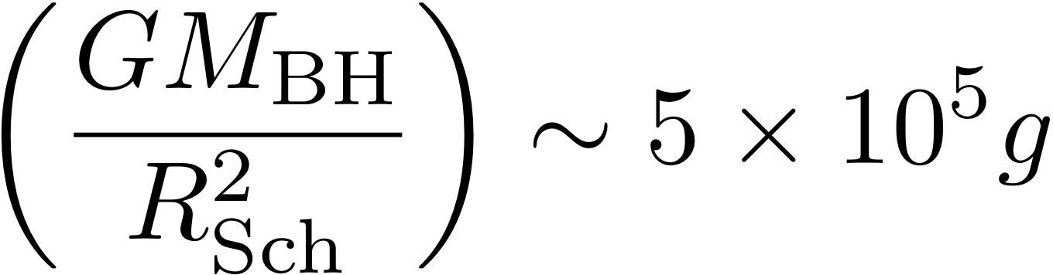
Can you hear me now?
10 million km
No, but no worries - you will be able to hear us for ~10 minutes until you reach the singularity…

Slide 17
Is general relativity a valid description of strong gravity?
*Infrared variability of flux (Genzel et al.) and polarization (Eckart et al.) of SgrA*: hot spots.
*Innermost Stable Circular Orbit: radius of 30 (10) micro-arcsecond and orbital time of 30 (8) minutes for a non-rotating (maximally-rotating) black hole at the Galactic center
*A hot spot would result in infrared centroid motion (GRAVITY-VLT) and could be imaged by a Very Large Baseline Array of (existing) sub-millimeter observatories. Targets: SgrA* and M87
Broderick & Loeb 2005

Slide 18
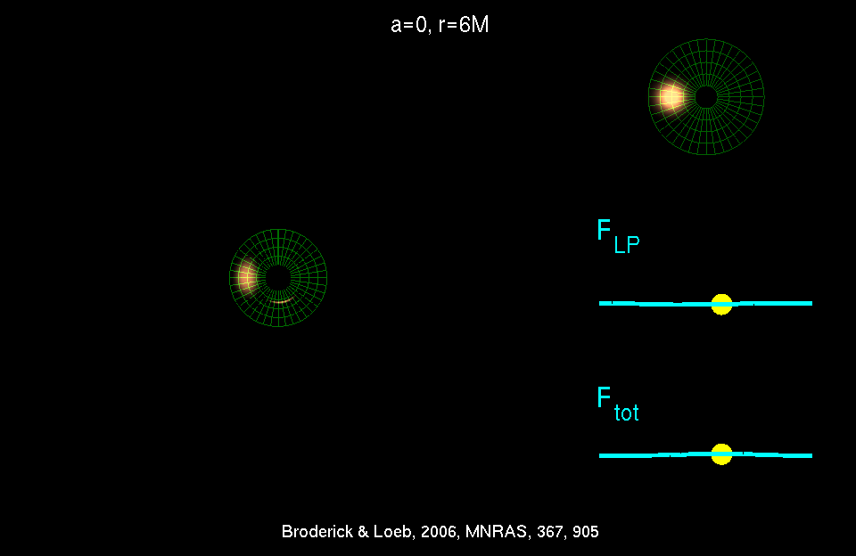
Physics + Astrophysics: Imaging Black Holes
Broderick & Loeb 2005

Slide 21
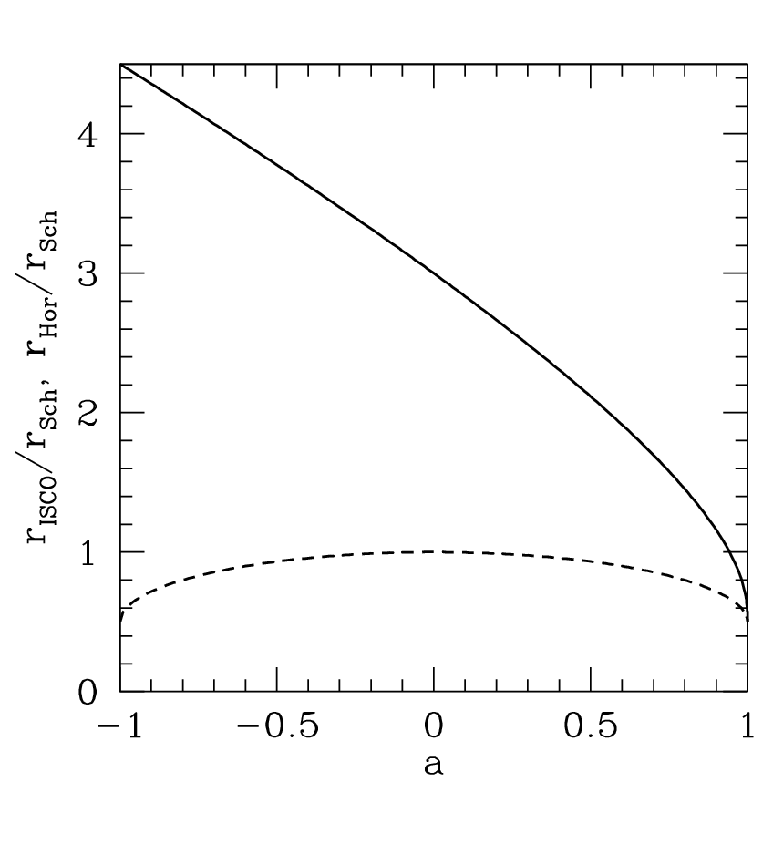
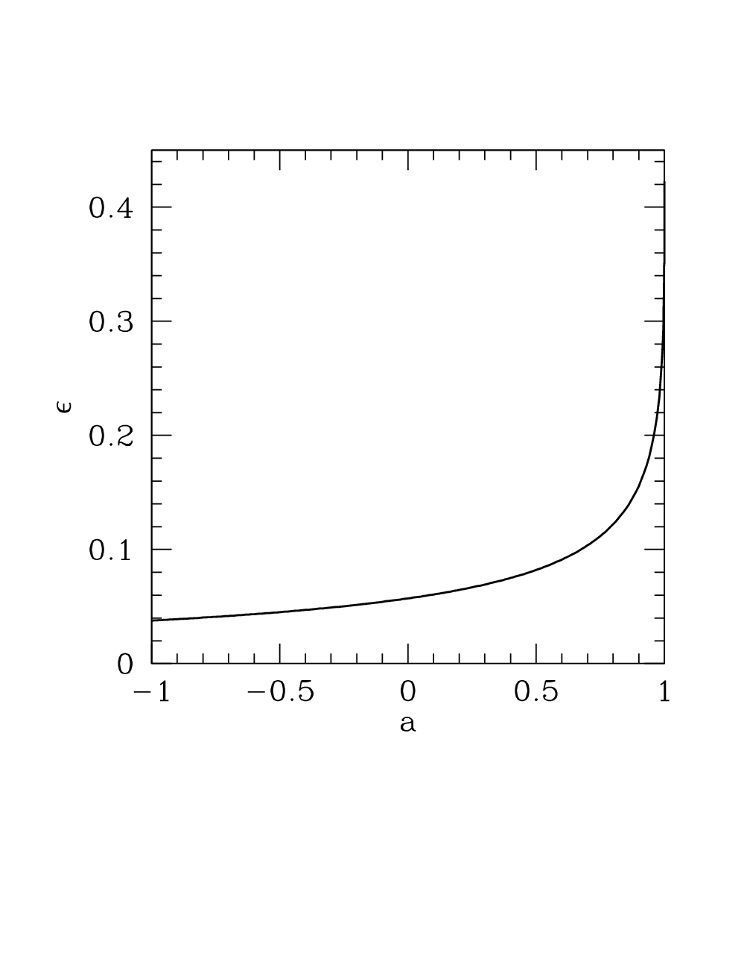
spin matters!
Innermost Stable Circular Orbit (ISCO)
radiative efficiency (binding energy at ISCO)
horizon

Slide 22
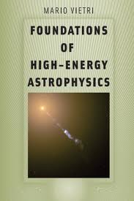
Recommended Further Reading

Slide 23
Three Fortunate Coincidences
The accretion flow of SgrA* becomes transparent to synchrotron self-absorption at wavelengths shorter than 1 millimeter
Interstellar scattering ceases to blur the image of SgrA* on horizon scales at wavelengths shorter than 1 millimeter
The horizon scale of SgrA* and M87 (tens of micro-arcseconds) can be resolved by a Very Large Baseline Array across the Earth at wavelengths shorter than 1 millimeter

Slide 24
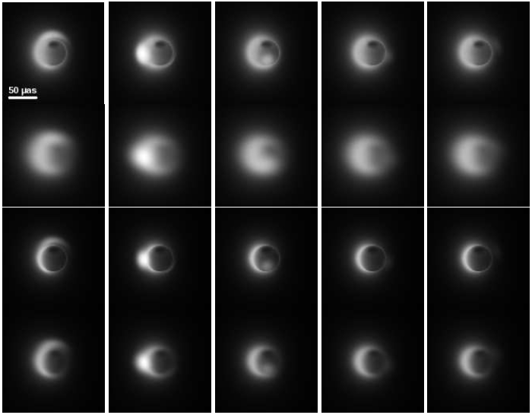
SgrA*
230 GHz
with interstellar scattering
345 GHz
with interstellar scattering
Different orbital phases of the hot spot →

Slide 26
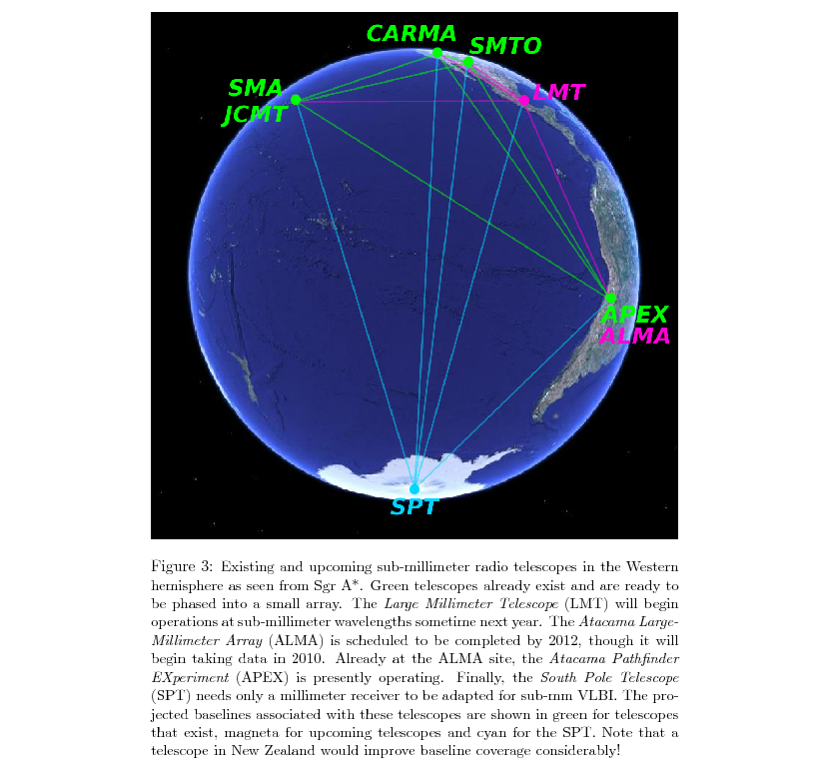
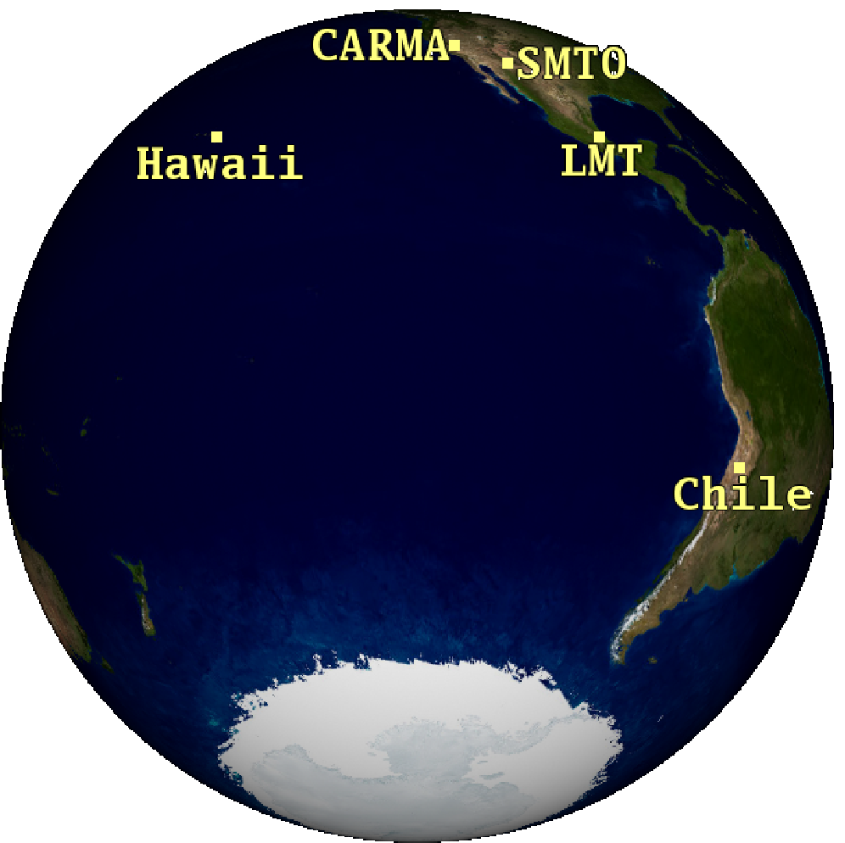
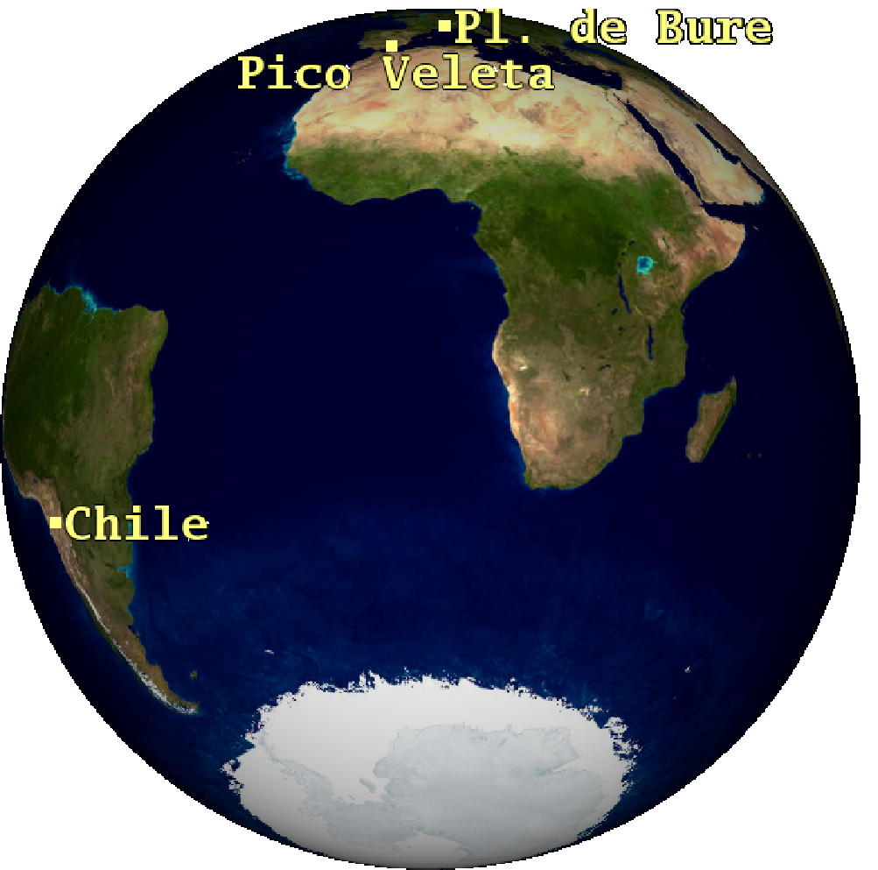
Very Long Baseline Interferometry (VLBI) at sub-millimeter wavelengths

Slide 27
Evidence for a Low-Spin BH in SgrA*
Broderick, Fish, Doeleman & Loeb 2010

Slide 28
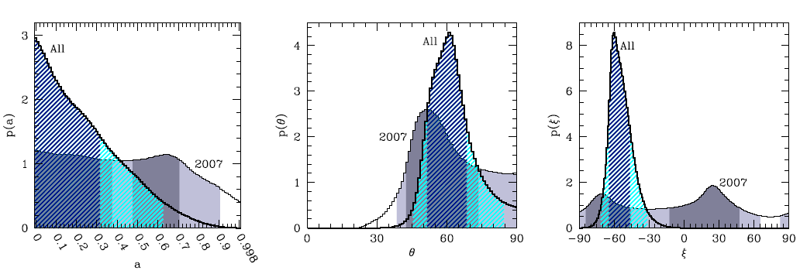

Slide 29


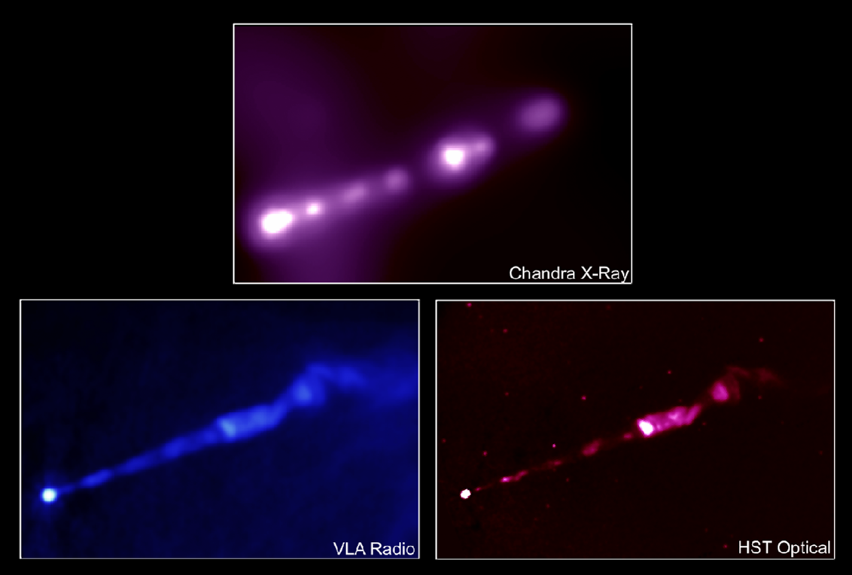

M87
(~700 times more massive than SgrA*)
(~2000 times farther than SgrA*)
But Gebhardt & Thomas (2009) argue for a mass twice as large, . If true, this would make M87’s apparent size as large as SgrA*!

Slide 30
(Broderick & Loeb 2008)
44GHz, (7 mm) VLBA Junor, Biretta, & Livio (1999)
Walker 2008

Slide 31
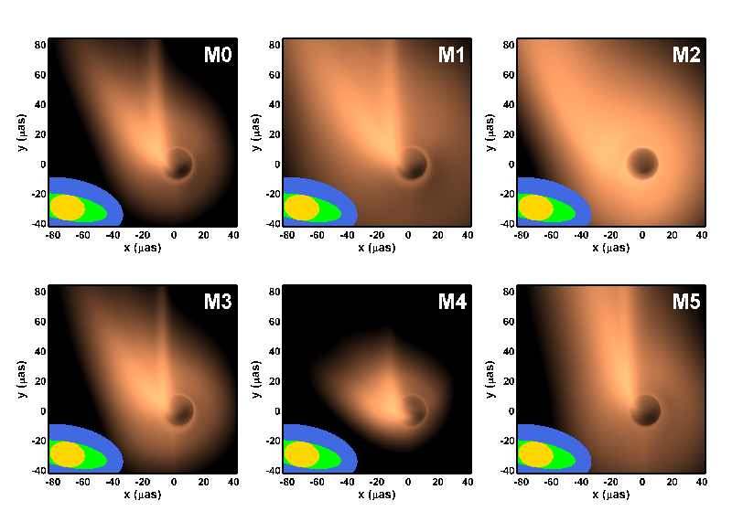
1.3 mm Images
US
+EU
+LMT

Slide 32

0.87 mm Images
US
+EU
+LMT

Slide 33
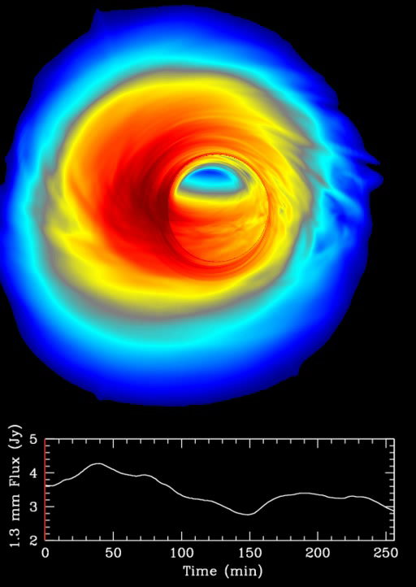
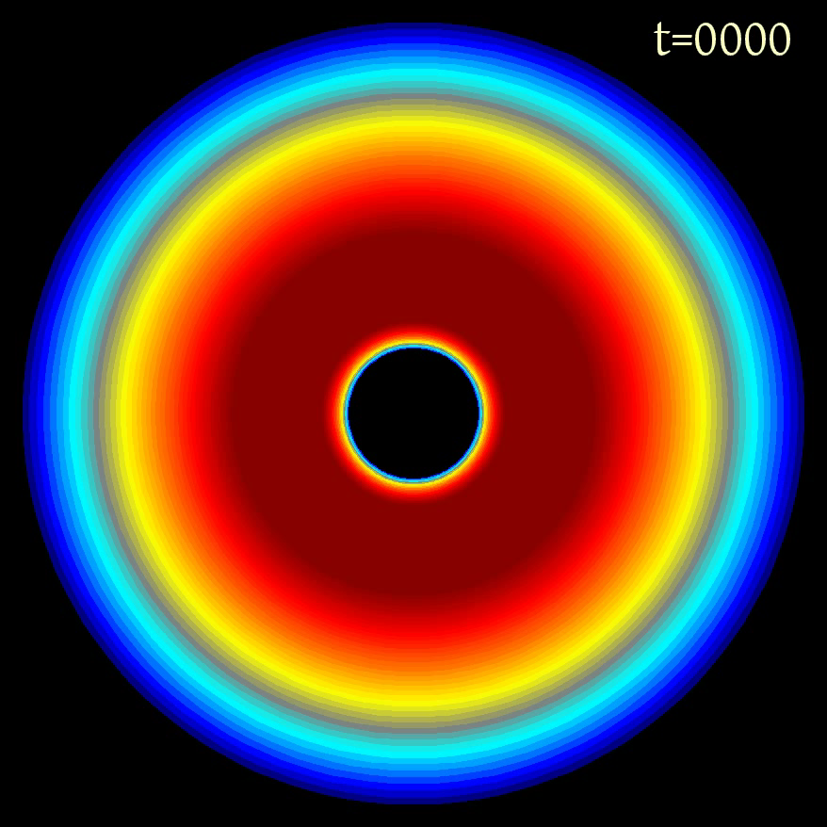
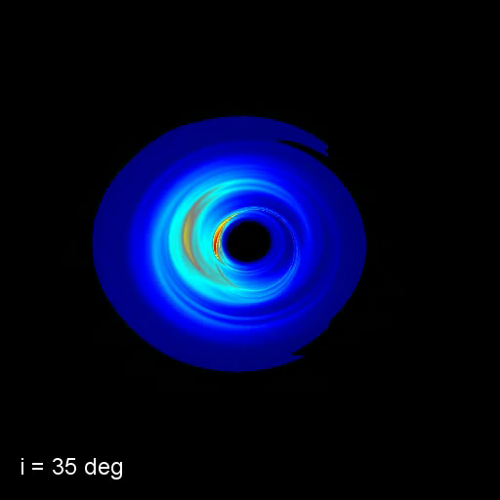
Numerical Simulations (GRMHD)
inclination
image
setup
C. Gammie, J. Dolence, M. Moscibrodzka, H. Shiokawa, P. Leung (2009)

Slide 34
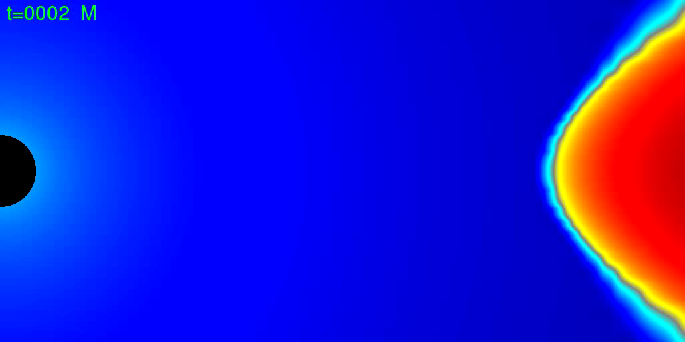
How do black holes accrete gas?
Penna et al. (2011)

Slide 35
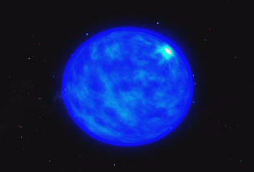
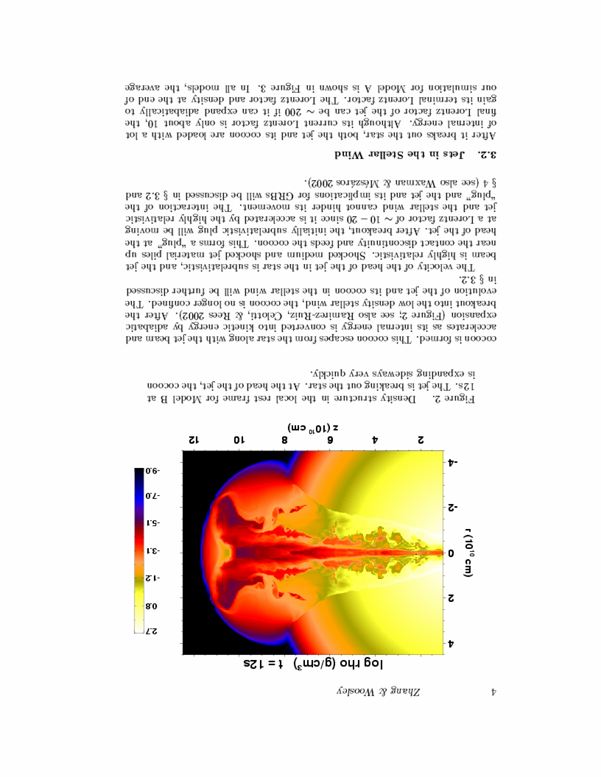
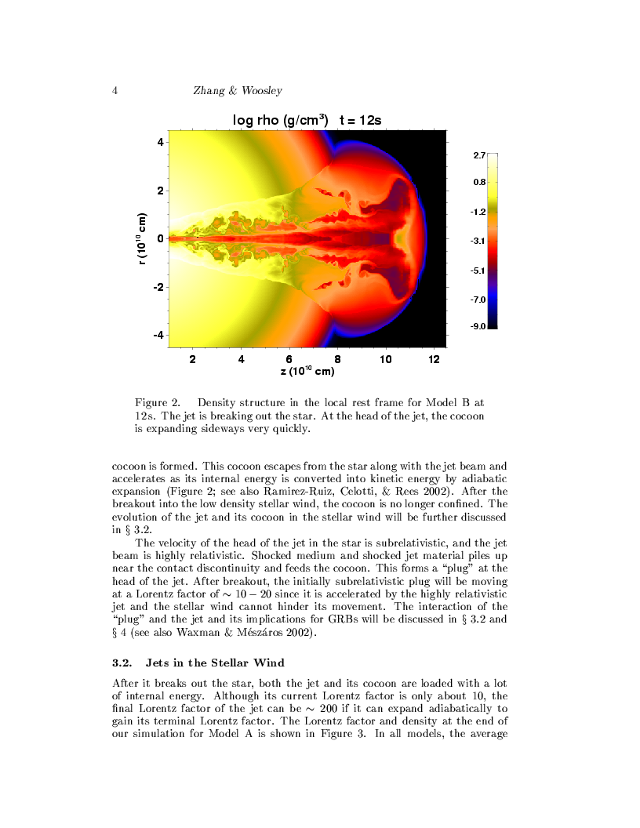
Gamma-Ray Bursts: Observing the birth of a black hole
Collapse of a Massive Star (accompanied by a supernova )
Existing finder: Swift; Proposed: JANUS, EXIST (high-z GRBs)

Slide 36
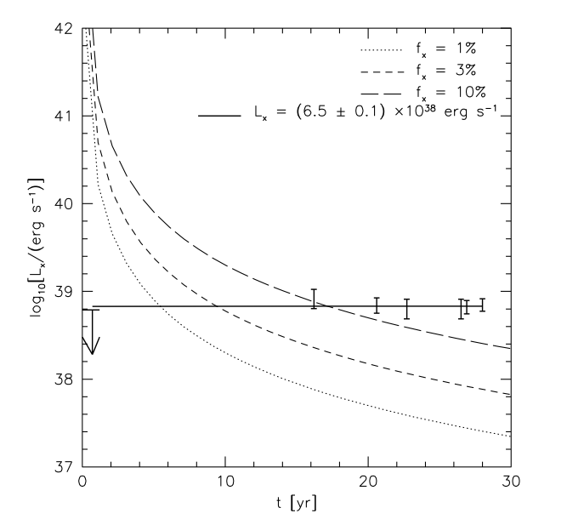

EVIDENCE FOR BLACK HOLE BIRTH:
persistent X-ray emission in SN1979C
Patnaude, Loeb, Jones (2010)

Slide 37
…but bigger black holes form at the centers of galaxies

Slide 38
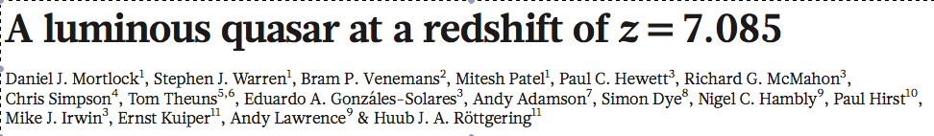
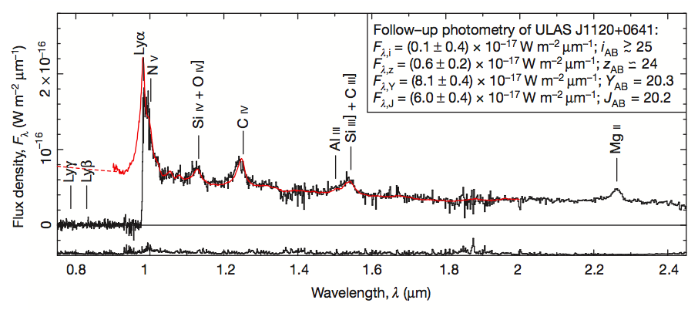
Black Hole Mass = 2 billion solar masses
Only 0.77 billion years after the Big Bang
Nature (2011)

Slide 39
What is a quasar?
A supermassive black hole which accretes gas and shines brightly. Typically found in the central region of a galaxy.

Slide 40
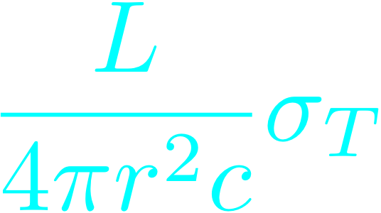
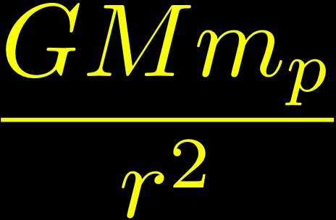

The Eddington Limit
Black Hole
Outward force
Inward force

Slide 41



Black Hole Growth
Starting from a stellar mass, there is barely enough time to grow the observed quasar black hole during the age of the Universe at z=7.1 for e=10%… but the radiative efficiency may be small due to trapping of radiation:

Slide 42
Correlation between black hole mass and velocity dispersion of their host spheroids

Slide 43
Why Are Quasars Short Lived?
Because they are suicidal!
Principle of Self Regulation: supermassive black holes grow until they release sufficient energy/momentum to unbind the gas that feeds them from their host galaxy
→Implies a correlation between black hole mass and the depth of the gravitational potential well of its host galaxy

Slide 44
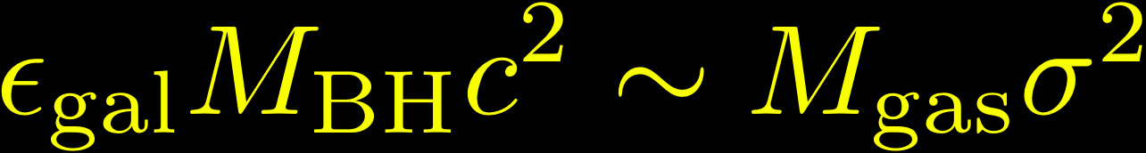
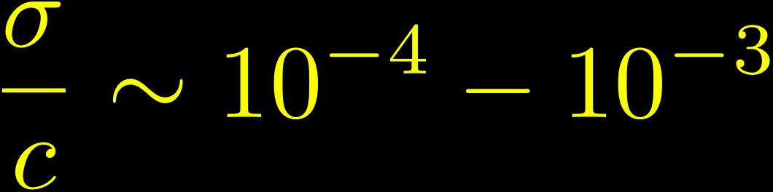
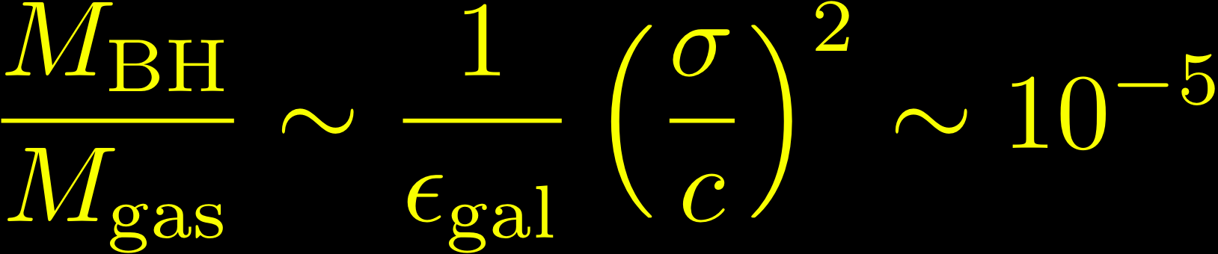
Unbinding the gas in a galaxy:

Slide 45
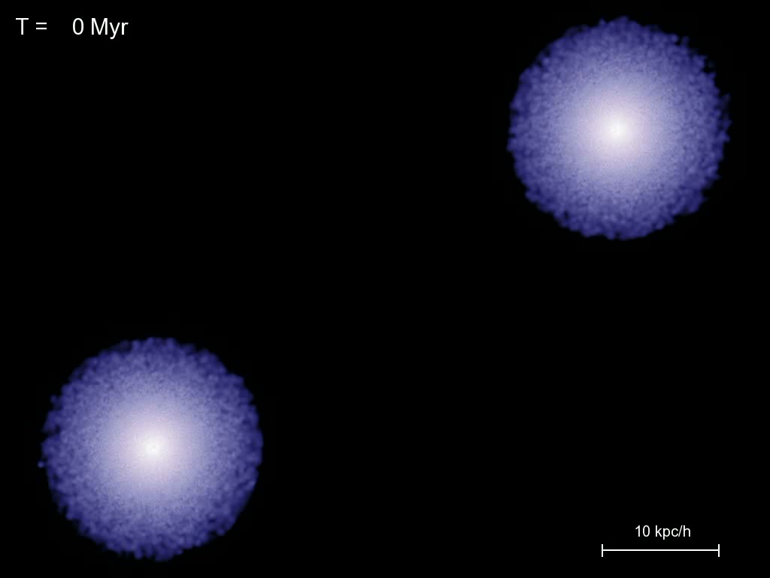
Computer Simulations of Quasar Feedback
Springel, Hernquist, Di Matteo et al. 2005

Slide 46
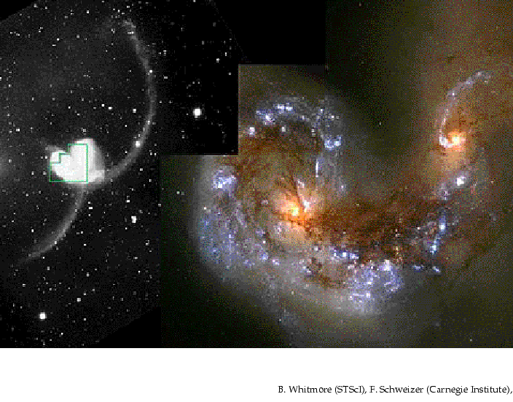
Black Hole Binaries due to Galaxy Mergers

Slide 47
Binary AGN with 1-10kpc separation at z<0.3
Shen et al. (2011)

Slide 48
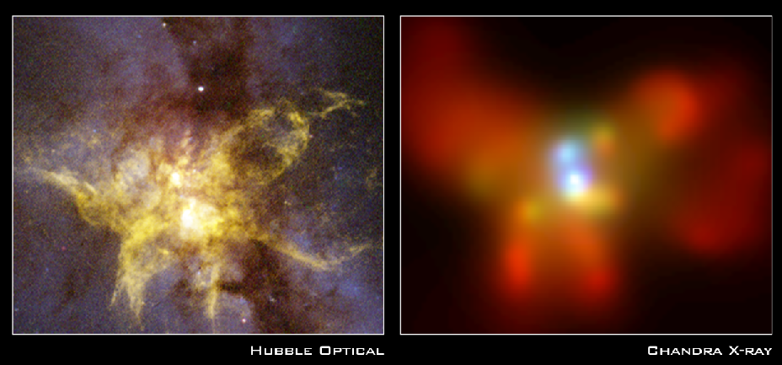
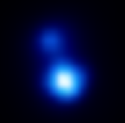
X-ray Image of a binary black hole system in NGC 6240
10kpc
z=0.025
Komossa et al. 2002

Slide 49
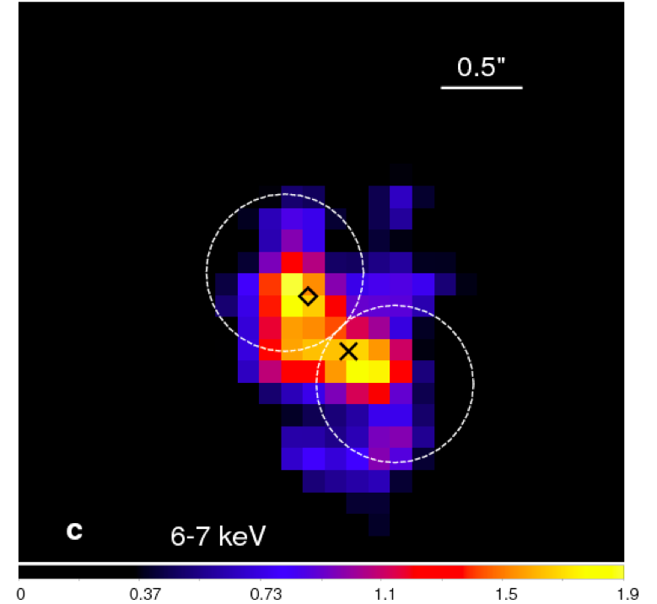
NGC 3393
Fabbiano et al. (2011)

Slide 50
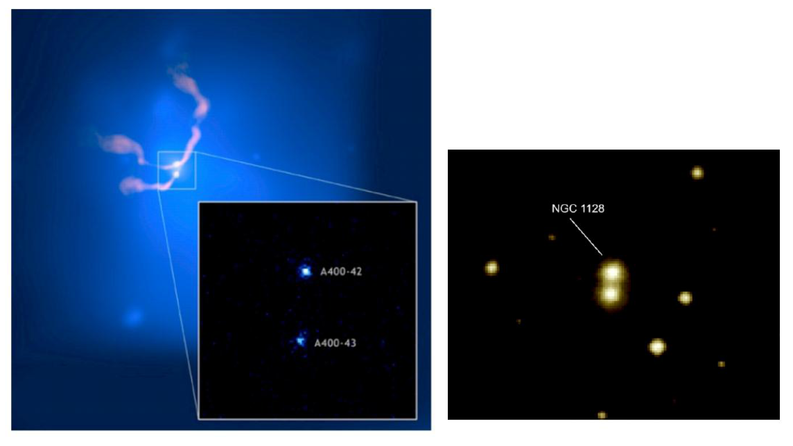
X-ray Cluster Abell 400
3C 75
NGC 1128

Slide 51
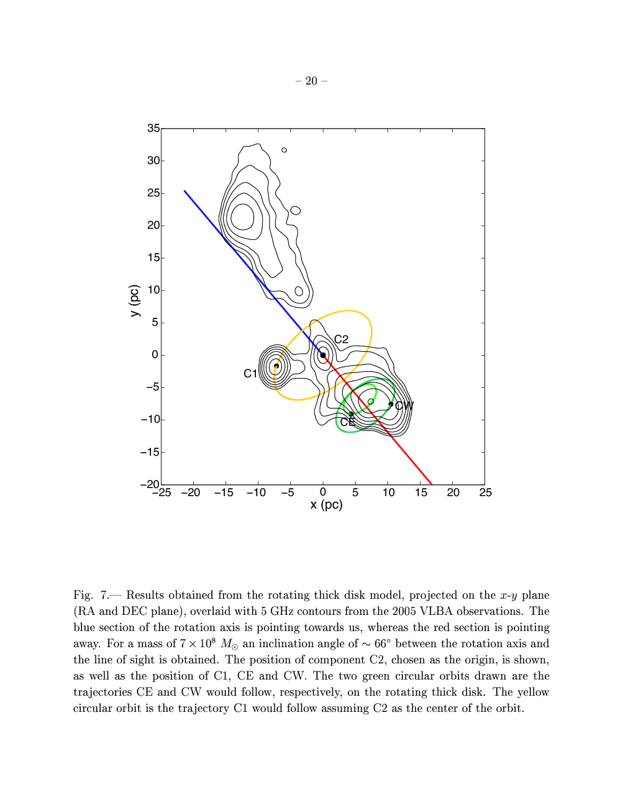
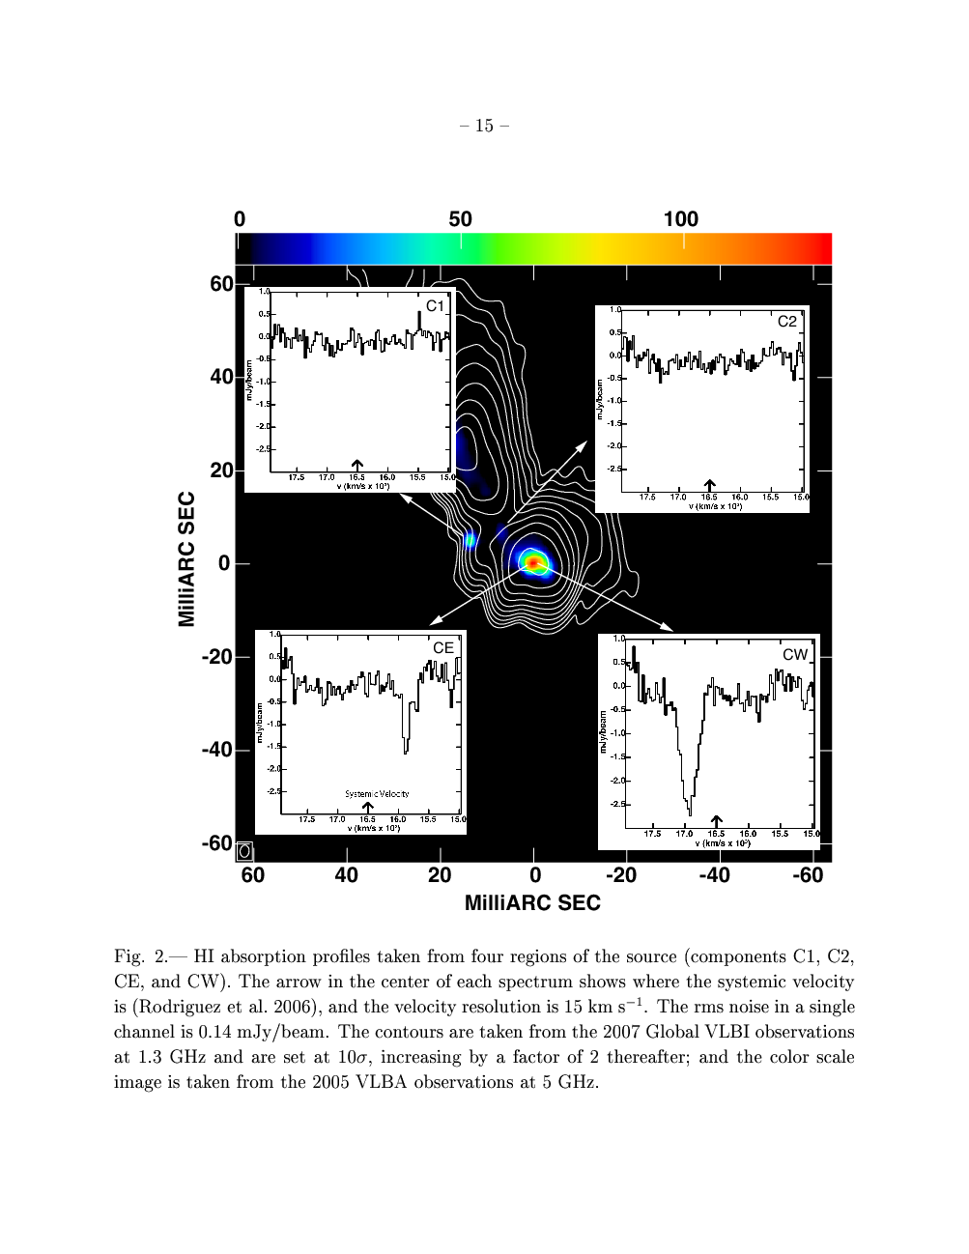

0402+379 (Rodriguez et al. 2006-9)
VLBI at 1.35 GHz
Projected separation: 7.3 pc,
Estimated total mass:

Slide 52
stars
stars
broad-line clouds
broad-line clouds
narrow-line clouds
narrow-line clouds

Slide 53
stars
broad-line clouds
broad-line clouds
narrow-line clouds

Slide 54
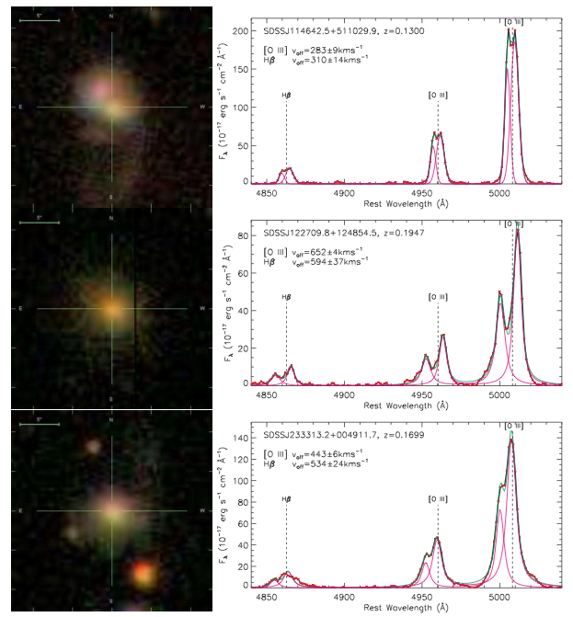
SDSS images & spectra of selected double narrow -line quasars
(Liu et al. 2009)

Slide 55
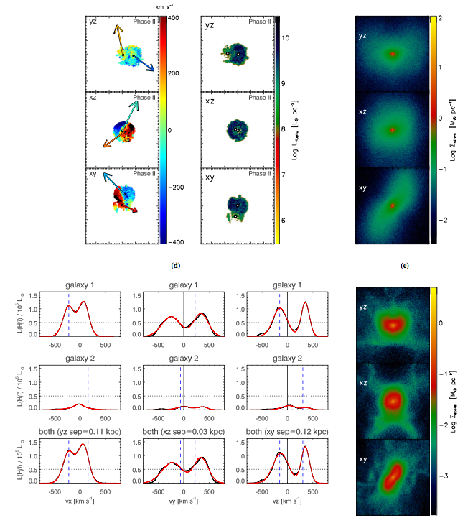
Double-peaked Narrow-Line Signatures of Dual Supermassive Black Holes in Galaxy Merger Simulations
Blecha, Loeb, & Narayan (2012)

Slide 56
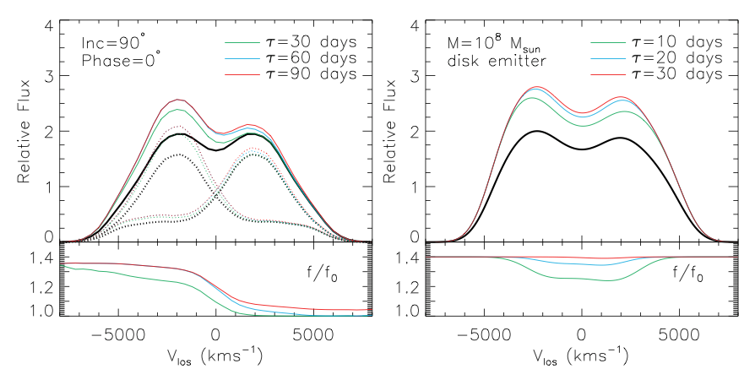
Double Broad Lines: Reverberation
Shen & Loeb (2010)

Slide 57
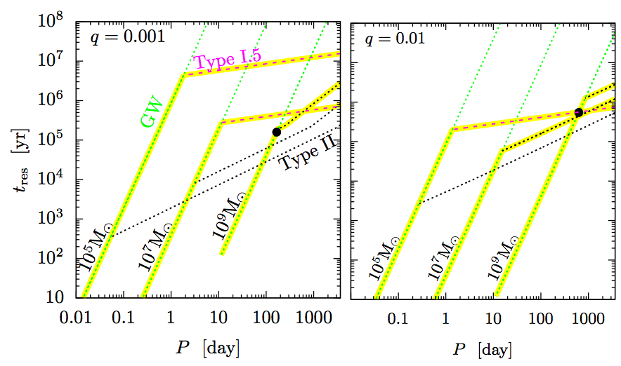
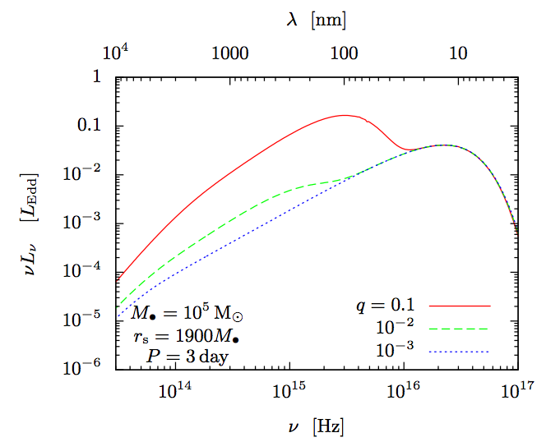
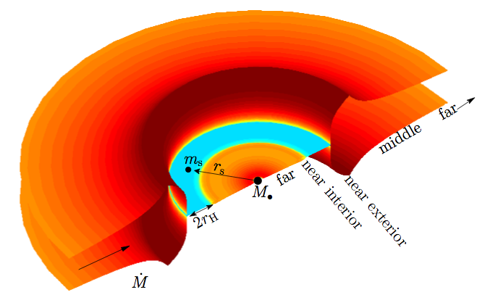
Gas Accretion and Electromagnetic Emission from BH Binaries
Kocsis, Haiman, & Loeb ArXiv:1205.5268 (2012)

Slide 58
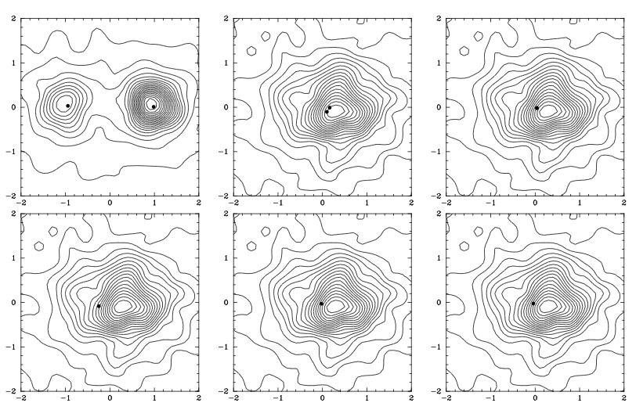

Multiple Black Holes
>2000 km/s
Kulkarni & Loeb 2011

Slide 59
Extreme Mass Ratio Inspirals (EMRIs)
Stellar mass BH or NS in an orbits around SMBH
Many orbital times in the eLISA/NGO band, allowing a precise determination of GR or astrophysical perturbations
The compact object may have formed or been trapped inside the accretion disk.

Slide 60



Gravitational Waves
source: BH/NS binaries
detector: laser interferometer (such as LIGO or eLISA)
Precision: one thousandth the diameter of a proton

Slide 61


Black Hole Recoil
Physics
Astrophysics
(Centrella et al. 2007)
(Blecha & Loeb 2009)

Slide 62
Gravitational Wave Recoil

Slide 63
Gravitational Wave Recoil
GWs
Anisotropic emission of gravitational waves → recoil

Slide 64
Gravitational Wave Recoil

Slide 65
A recoil candidate: CID-42
*spatial offset: ~2.5 kpc *velocity offset in NLR/BLR of H-beta: ~1,200 km/s *z=0.36
Civano et al. (2010)

Slide 66


Effect of Recoil on Black Hole Growth
Blecha, Cox , Loeb, & Hernquist 2010

Slide 67

Star Clusters Around Recoiled Black Holes in the Milky Way Halo
~100 BHs ejected during assembly of MW halo
Carry star clusters from cusp of host dwarf galaxy
Clusters characterized by compact size (~1pc) and high velocity dispersion (~10-100 km/s)
escape (dwarf) ~ 10 km/s << GW recoil~hundreds of km/s < escape(MW) ~ 500 km/s
O’Leary & Loeb 2008, 2010 arXiv:0809.4262 ; arXiv:1102.3695

Slide 68

Tidal Disruption of a Star by a Supermassive Black Hole

Slide 69



Tidal Disruption of Stars
Single BH rate per MW galaxy due to empty loss cone
BHs with swallow the star whole
Super-Eddington initial feeding rate:

Slide 70



EM Counterpart of LISA Sources: Tidal Disruption of Stars
“loss cone” filled by GW recoil
(Stone & Loeb 2010)

Slide 71

A Relativistic Jet from a TDE: Swift 164449.3+573451 (GRB110328A)
Bloom et al. 2011
Zauderer et al. 2011
*Synchrotron and X-ray peaks are emitted from different regions; bulk Lorentz factor~2-3

Slide 72



Observing Lense-Thirring Precession in Tidal Disruption Flares
days
log(spin)
a
Stone & Loeb (2011)

Slide 73


Gillessen et al., Nature (2012)

Slide 74

Tidal Disruption of a Proto-Planetary Disk by SgrA*
*Planets form near SgrA*
*Flags low-mass stars
Murray-Clay & Loeb (2012)

Slide 75

Schartmann et al. (2012)

Slide 76



Hypervelocity Planets
Ginsburg, Loeb, & Wegner (2012)

Slide 77


Slide 78
Summary:
1. Direct imaging of the largest silhouettes of black holes (SgrA*, M87) will be achievable with upcoming radio telescopes within the next decade.

Slide 79
Summary:
2. Black hole binaries form in galaxy mergers and produce detectable gravitational waves
3. Coalescence of black hole binaries results in recoils and consequently: offset quasars, floating star clusters in the Milky-Way halo, enhanced rate for tidal disruption of stars

