Slide 1
Let there be Light (and darkness) …
The Beginning and the End of Cosmology
Professor Avi Loeb
Harvard University

Slide 5
we are here

Slide 6
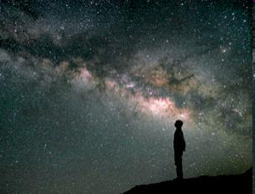
The Big Picture: Our largest environment is the Universe

Slide 7
Cosmic-Archaeology
Early time
redshift
today
distance
Earth
The farther a source is, the longer it takes for its light to reach us. Hence, the light must have been emitted when the universe was younger.
By looking at distant sources we can trace the history of the universe.

Slide 8
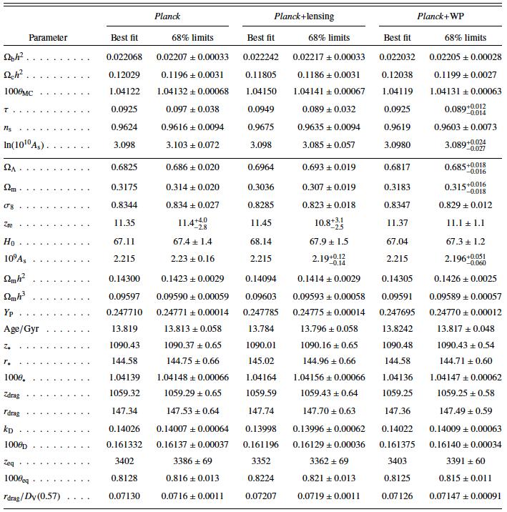
The initial conditions of the Universe can be summarized on a single sheet of paper, yet thousands of books cannot fully describe the complex structures we see today…

Slide 9
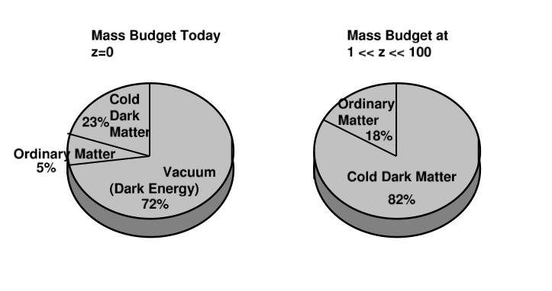
Standard Cosmological Model
13.8 billion years 50 million - 5 billion years
(1+z)=1/a is the stretching factor due to cosmic expansion z is the redshift of the source

Slide 10
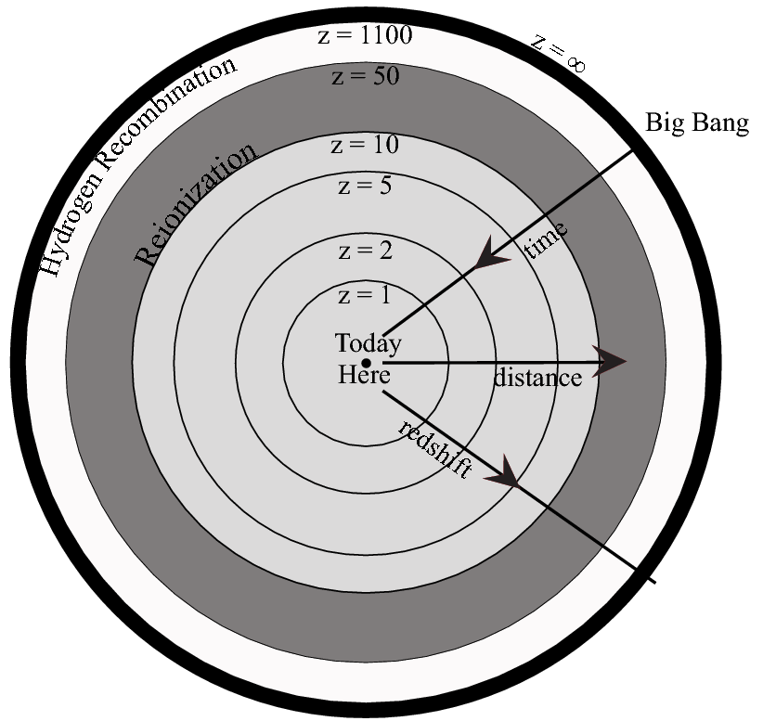
The Visible Universe
z>5: most comoving volume (best statistical constraints on high k-modes)

Slide 11
Gravitational Instability
The evolution of the universe is characterized by a persistent transition from simplicity to complexity
Why?
We can feed the initial conditions to a computer and solve for the evolution of cosmic structure.
Everthing else (including our own daily actions as human beings) was dictated by these initial conditions…

Slide 12

On small scales the universe is clumpy
Early times
Density perturbation
Mean Density
Intermediate times
Late times
Bound Object
Void

Slide 13
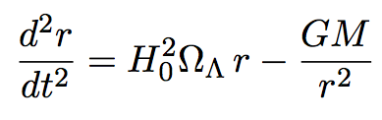
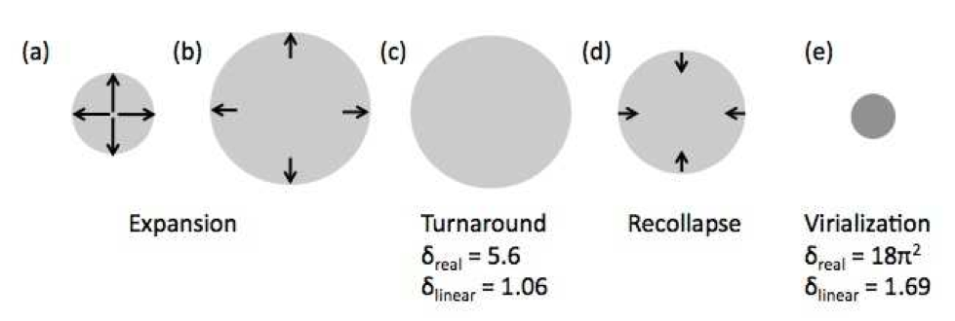
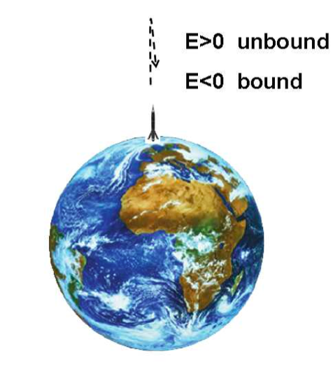
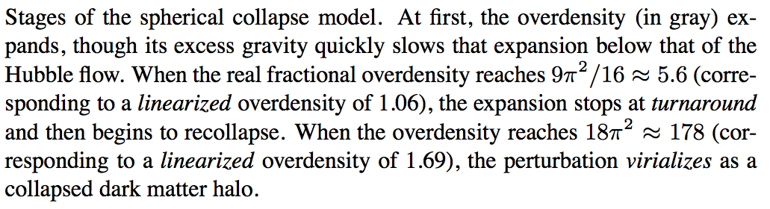
Nonlinear Spherical Collapse

Slide 14
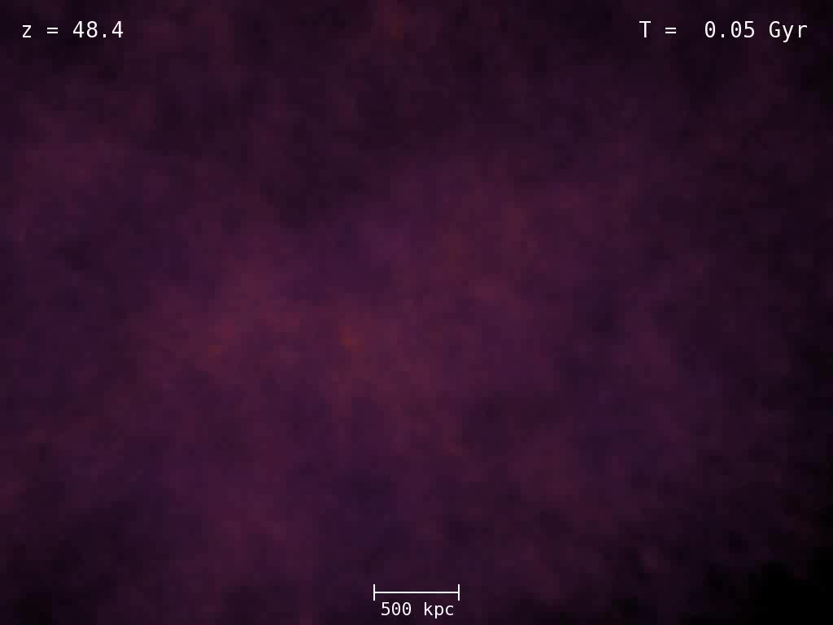
Aquarius N-body Simulation
(Springel et al. 2011)

Slide 15
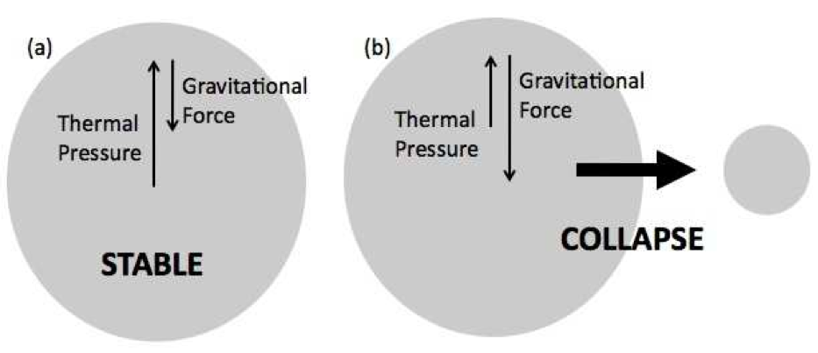
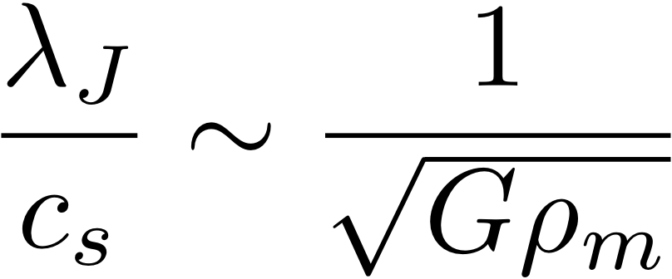
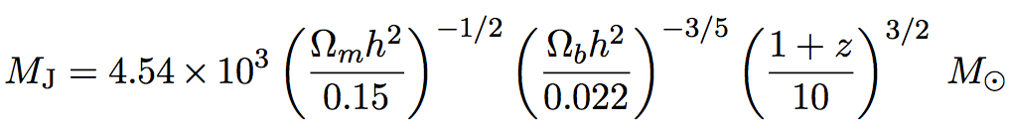
Gas Pressure
Jeans mass

Slide 16
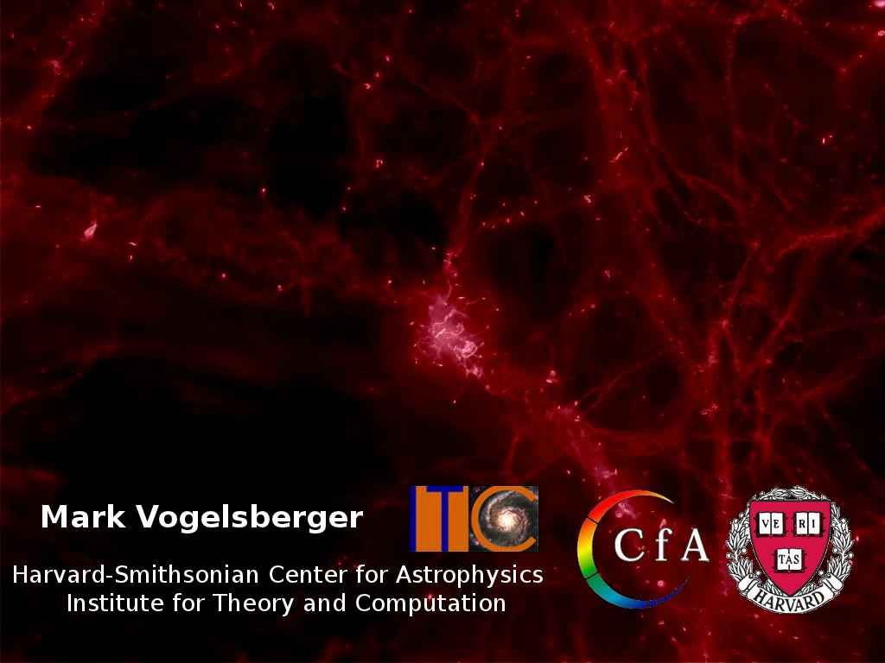
Hydrodynamic Simulation (AREPO, Vogelsberger et al. 2011)

Slide 17
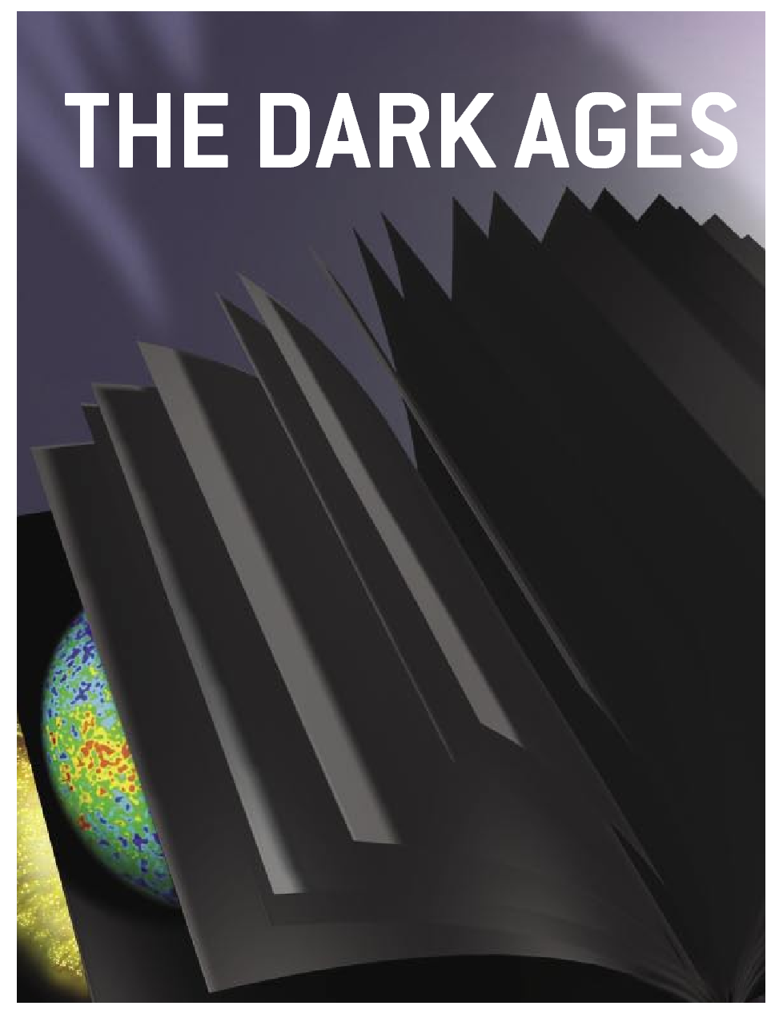
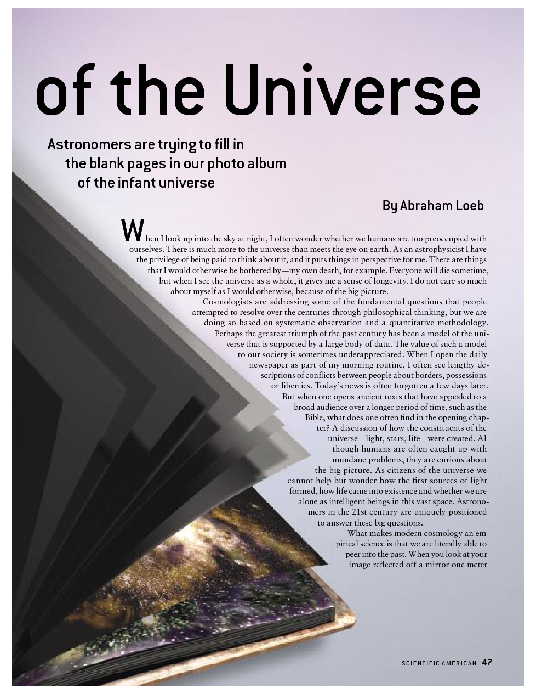

Slide 18
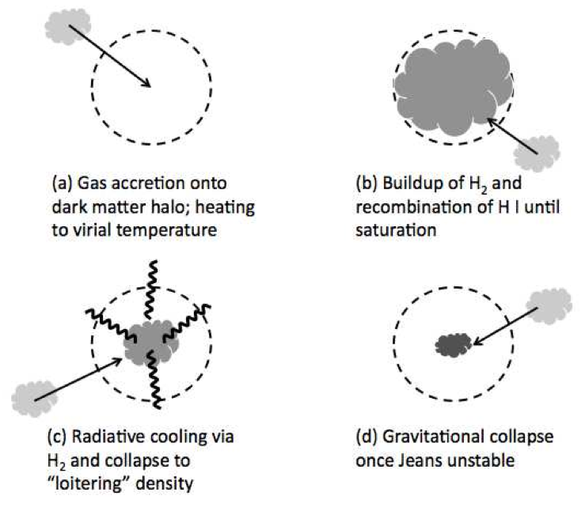
Population III.1

Slide 19
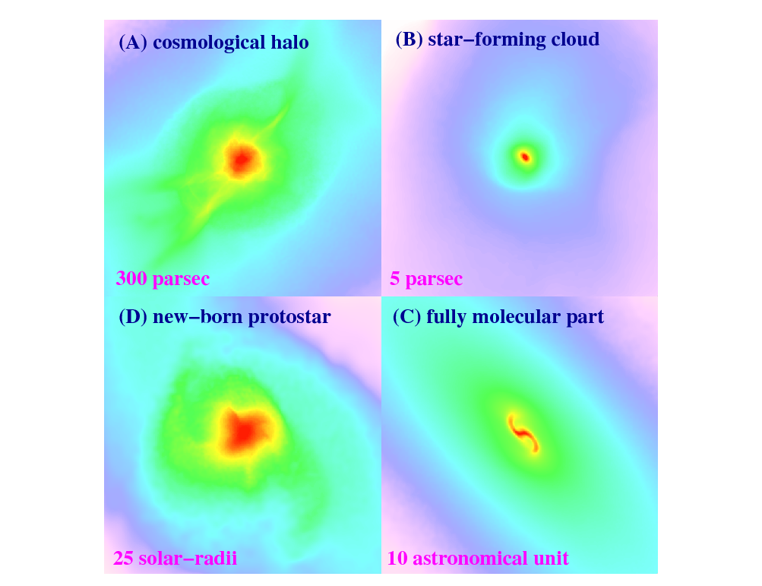



The First Stars Are Predicted to Have Formed ~100 Million Years After the Big Bang
1000 light-years
15 light-years
Bromm et al. (2009)

Slide 20
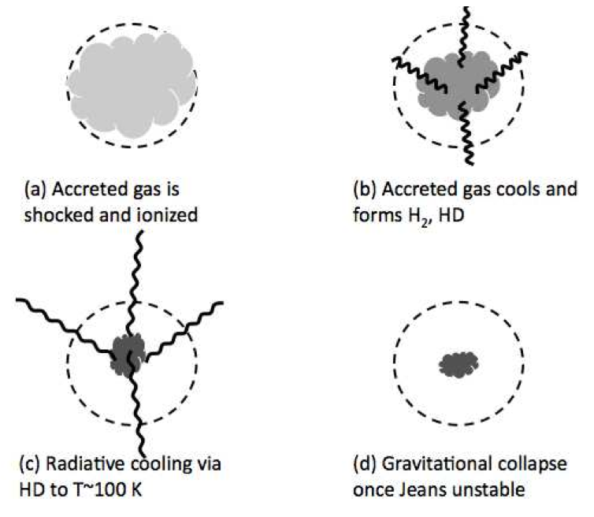
Population III.2

Slide 21
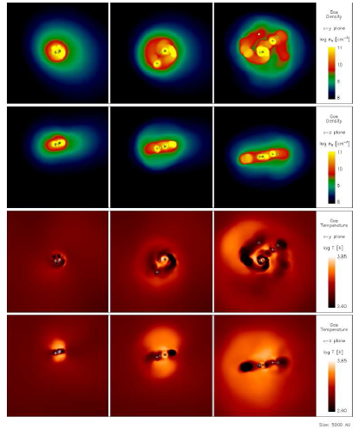
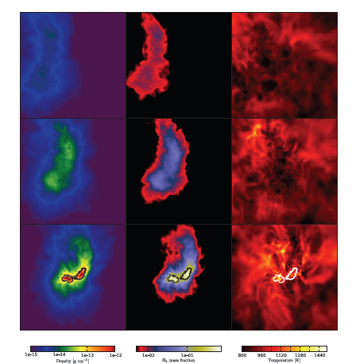
Population III Binaries and Multiples
Turk, Abel, & O’Shea 2009
Stacy, Greif, & Bromm 2009

Slide 22
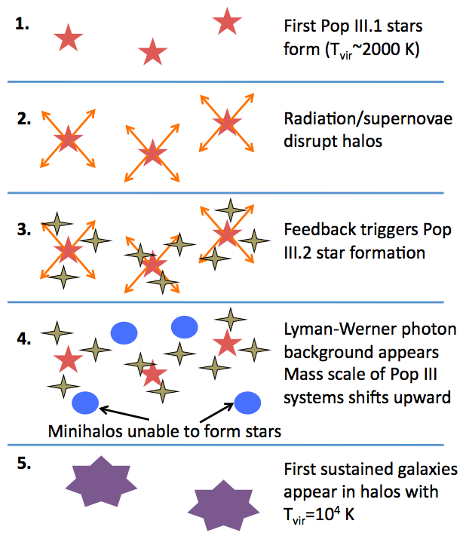

Slide 23
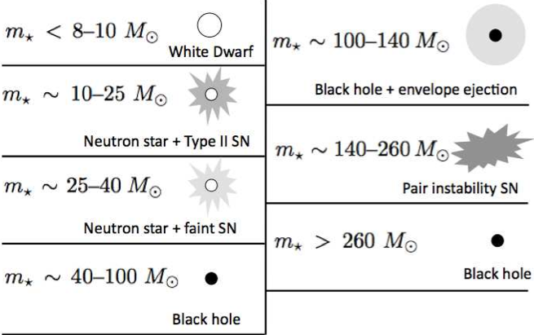
Stellar Remnants
Enrichment by >0.001 of solar metallicity: C+/O cooling is more effective than H_2 cooling: Pop III → Pop II

Slide 24
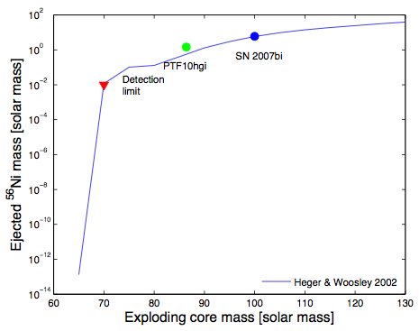

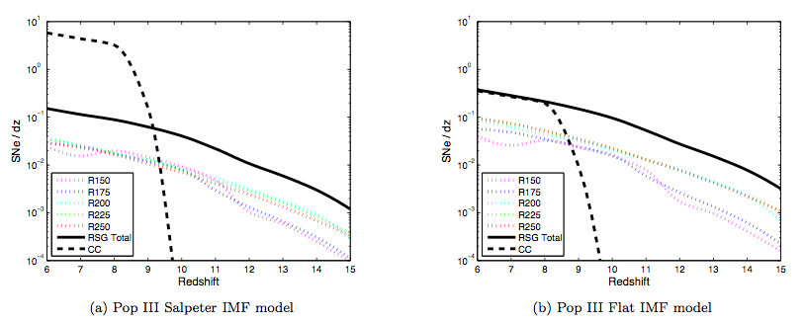
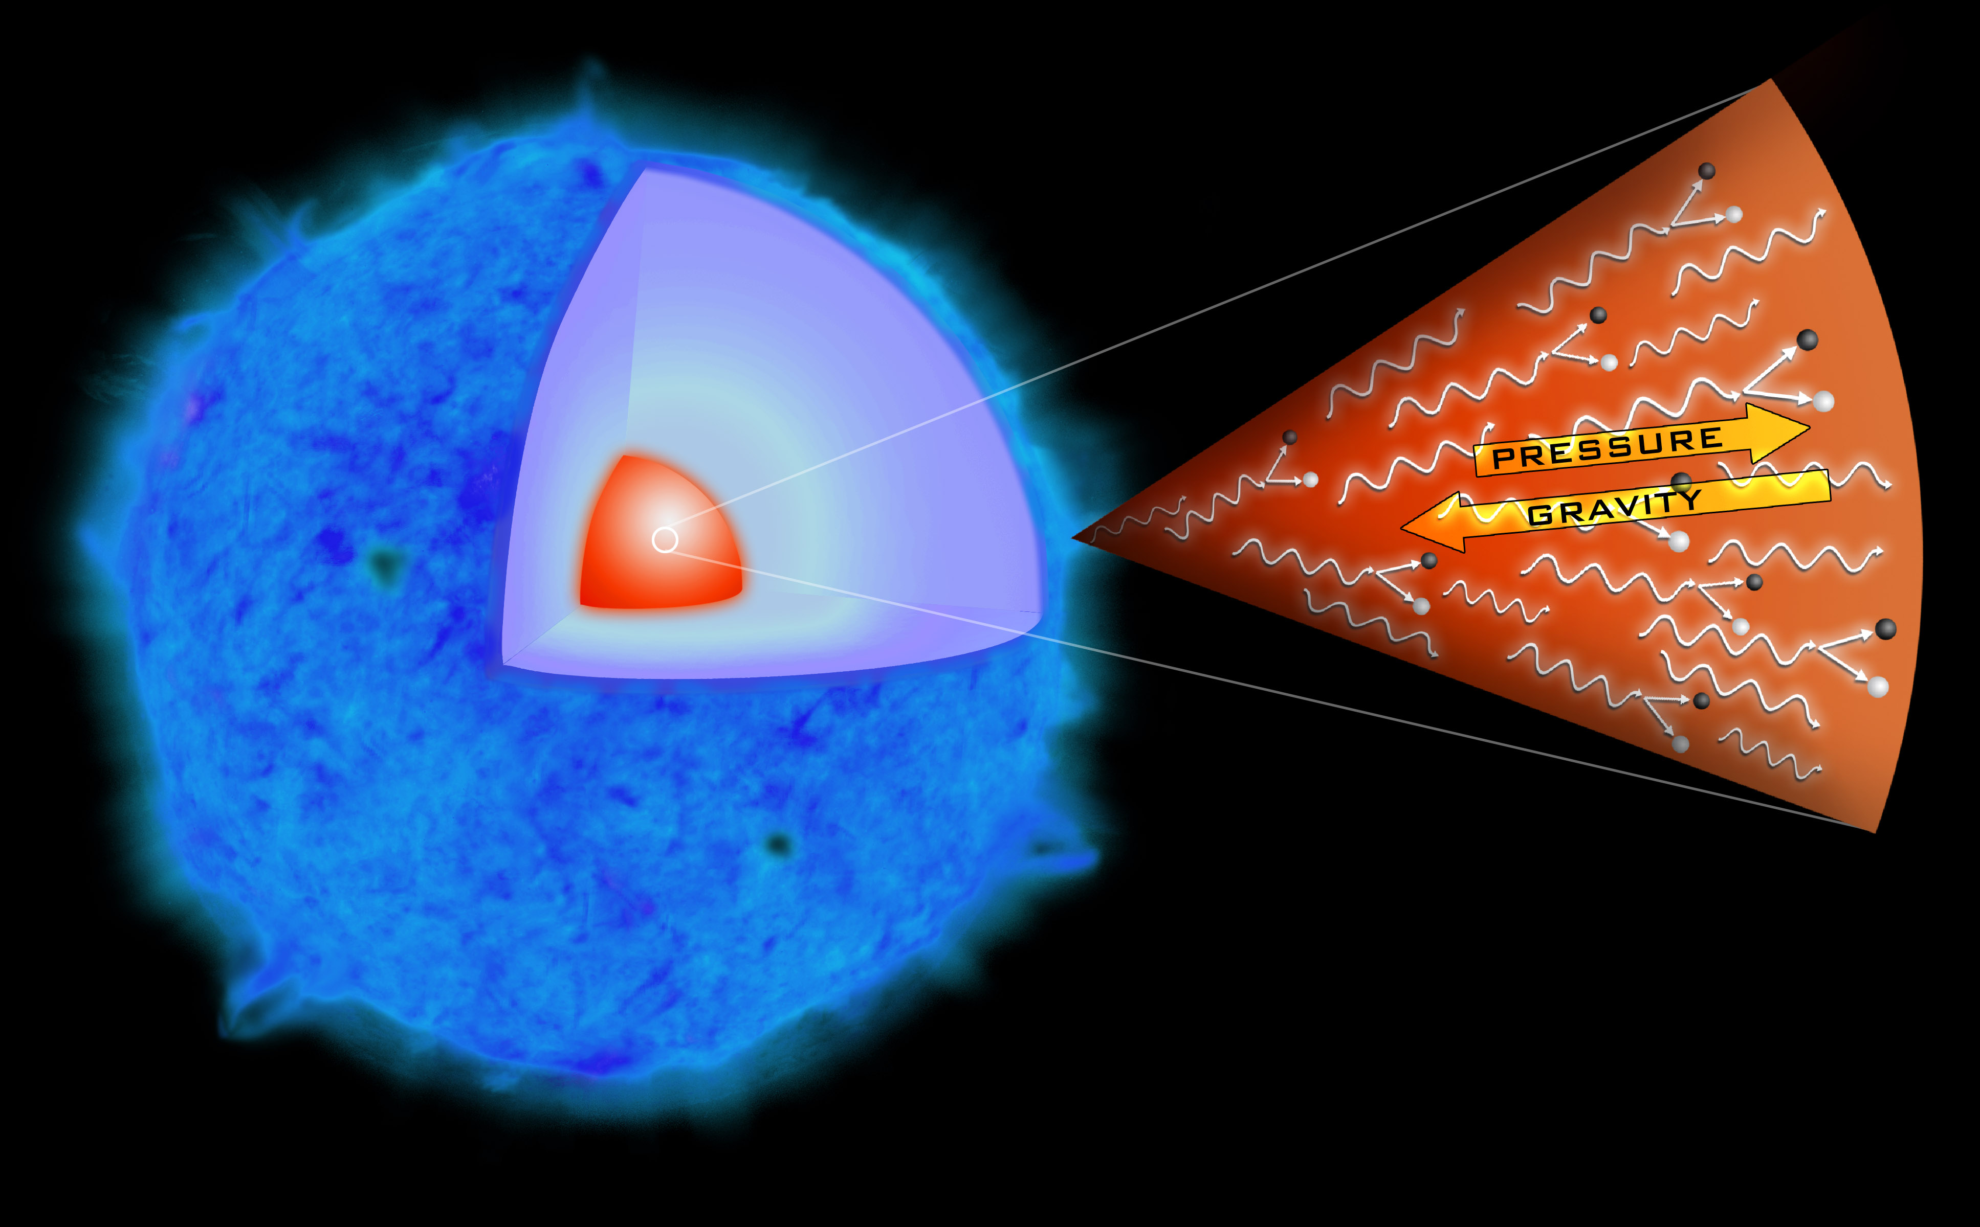
Pair Instability Supernovae
*Best understood SNe
*Examples are known up to z~4 (Cooke et al. 2012)
Gal-Yam 2012
JWST NIRCam, 10 arcsec^2, 8 hours (2nJy)
Pan, Kasen, & Loeb 2012
Pan, Kasen, & Loeb 2012

Slide 25
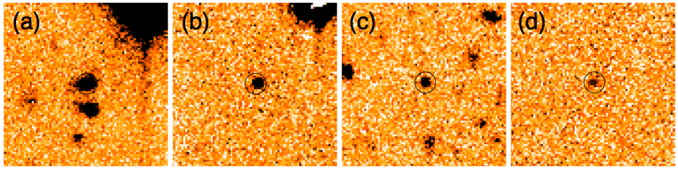
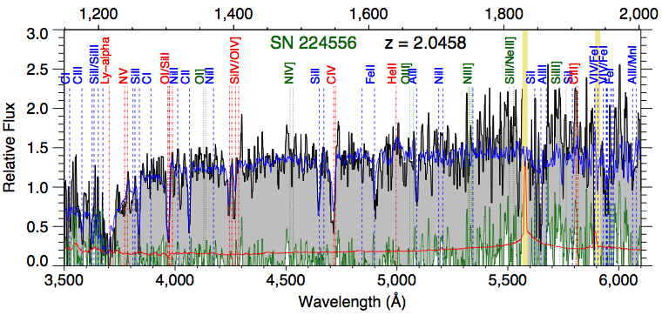
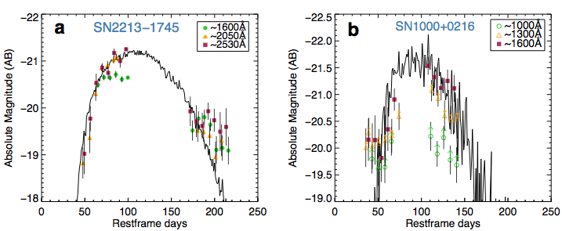


Farthest Superluminous Supernova
SN2213-1745 at z=2.05
SN1000-0216 at z=3.9=
Not Pop-III !
Cooke et al. , Nature (2012)

Slide 26
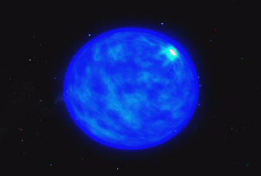
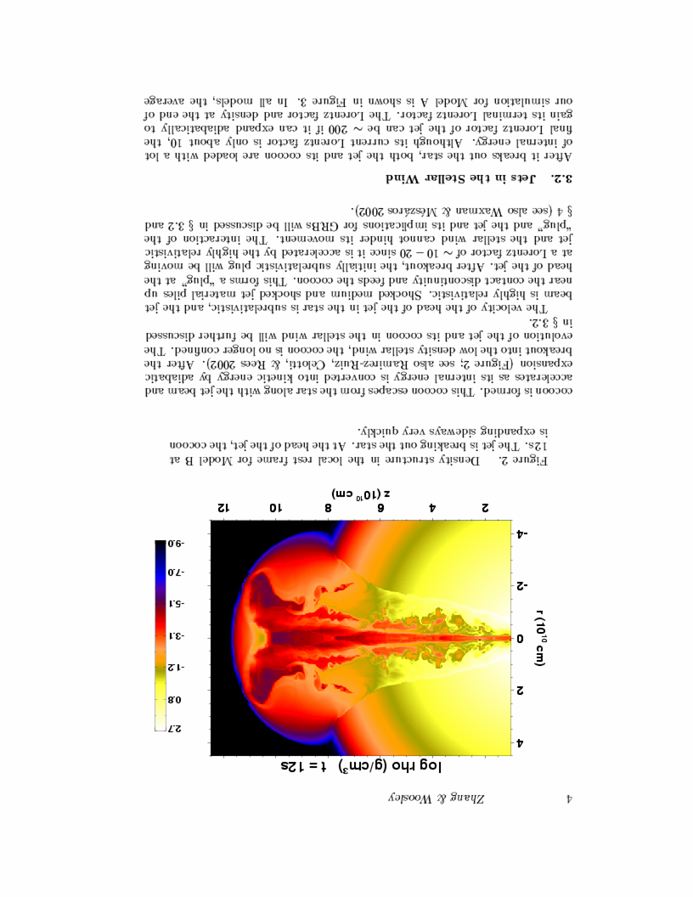
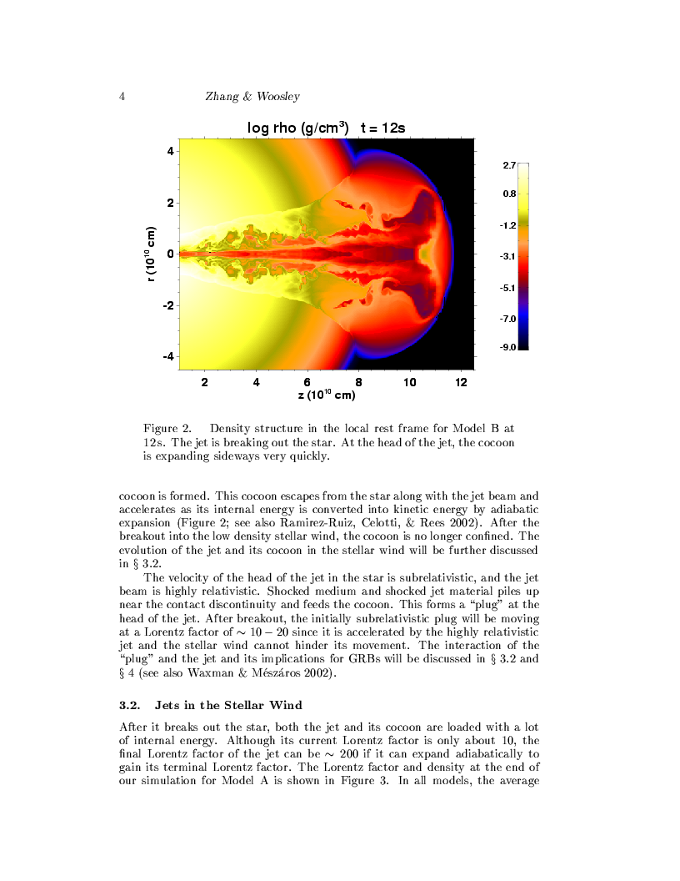
Long Gamma-Ray Bursts: Observing One Star at a Time
Collapse of a Massive Star (accompanied by a supernova )
Existing finder: Swift; Proposed: JANUS, EXIST (high-z GRBs)

Slide 27
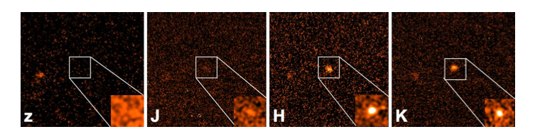
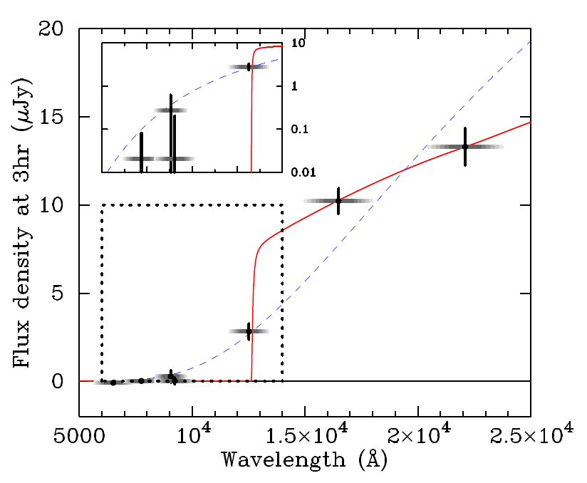
GRB 090429B at t=520 million years (z~9.4)
Cucchiara et al. (2011)

Slide 28
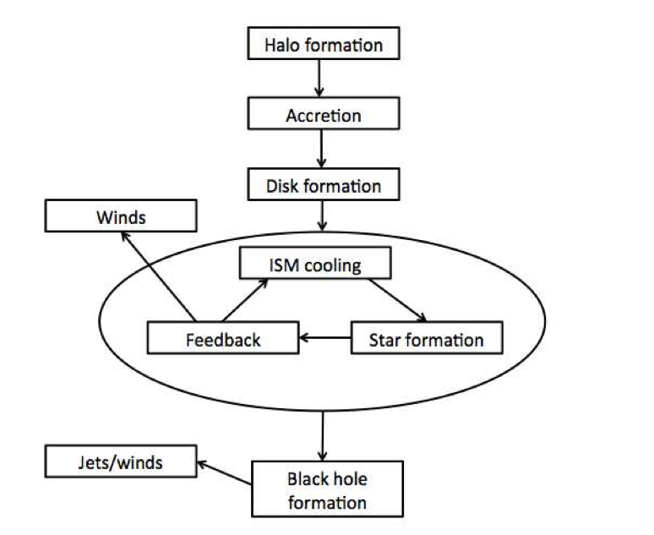
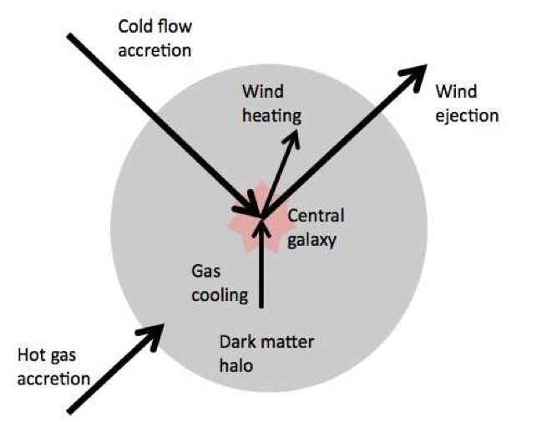

Slide 29
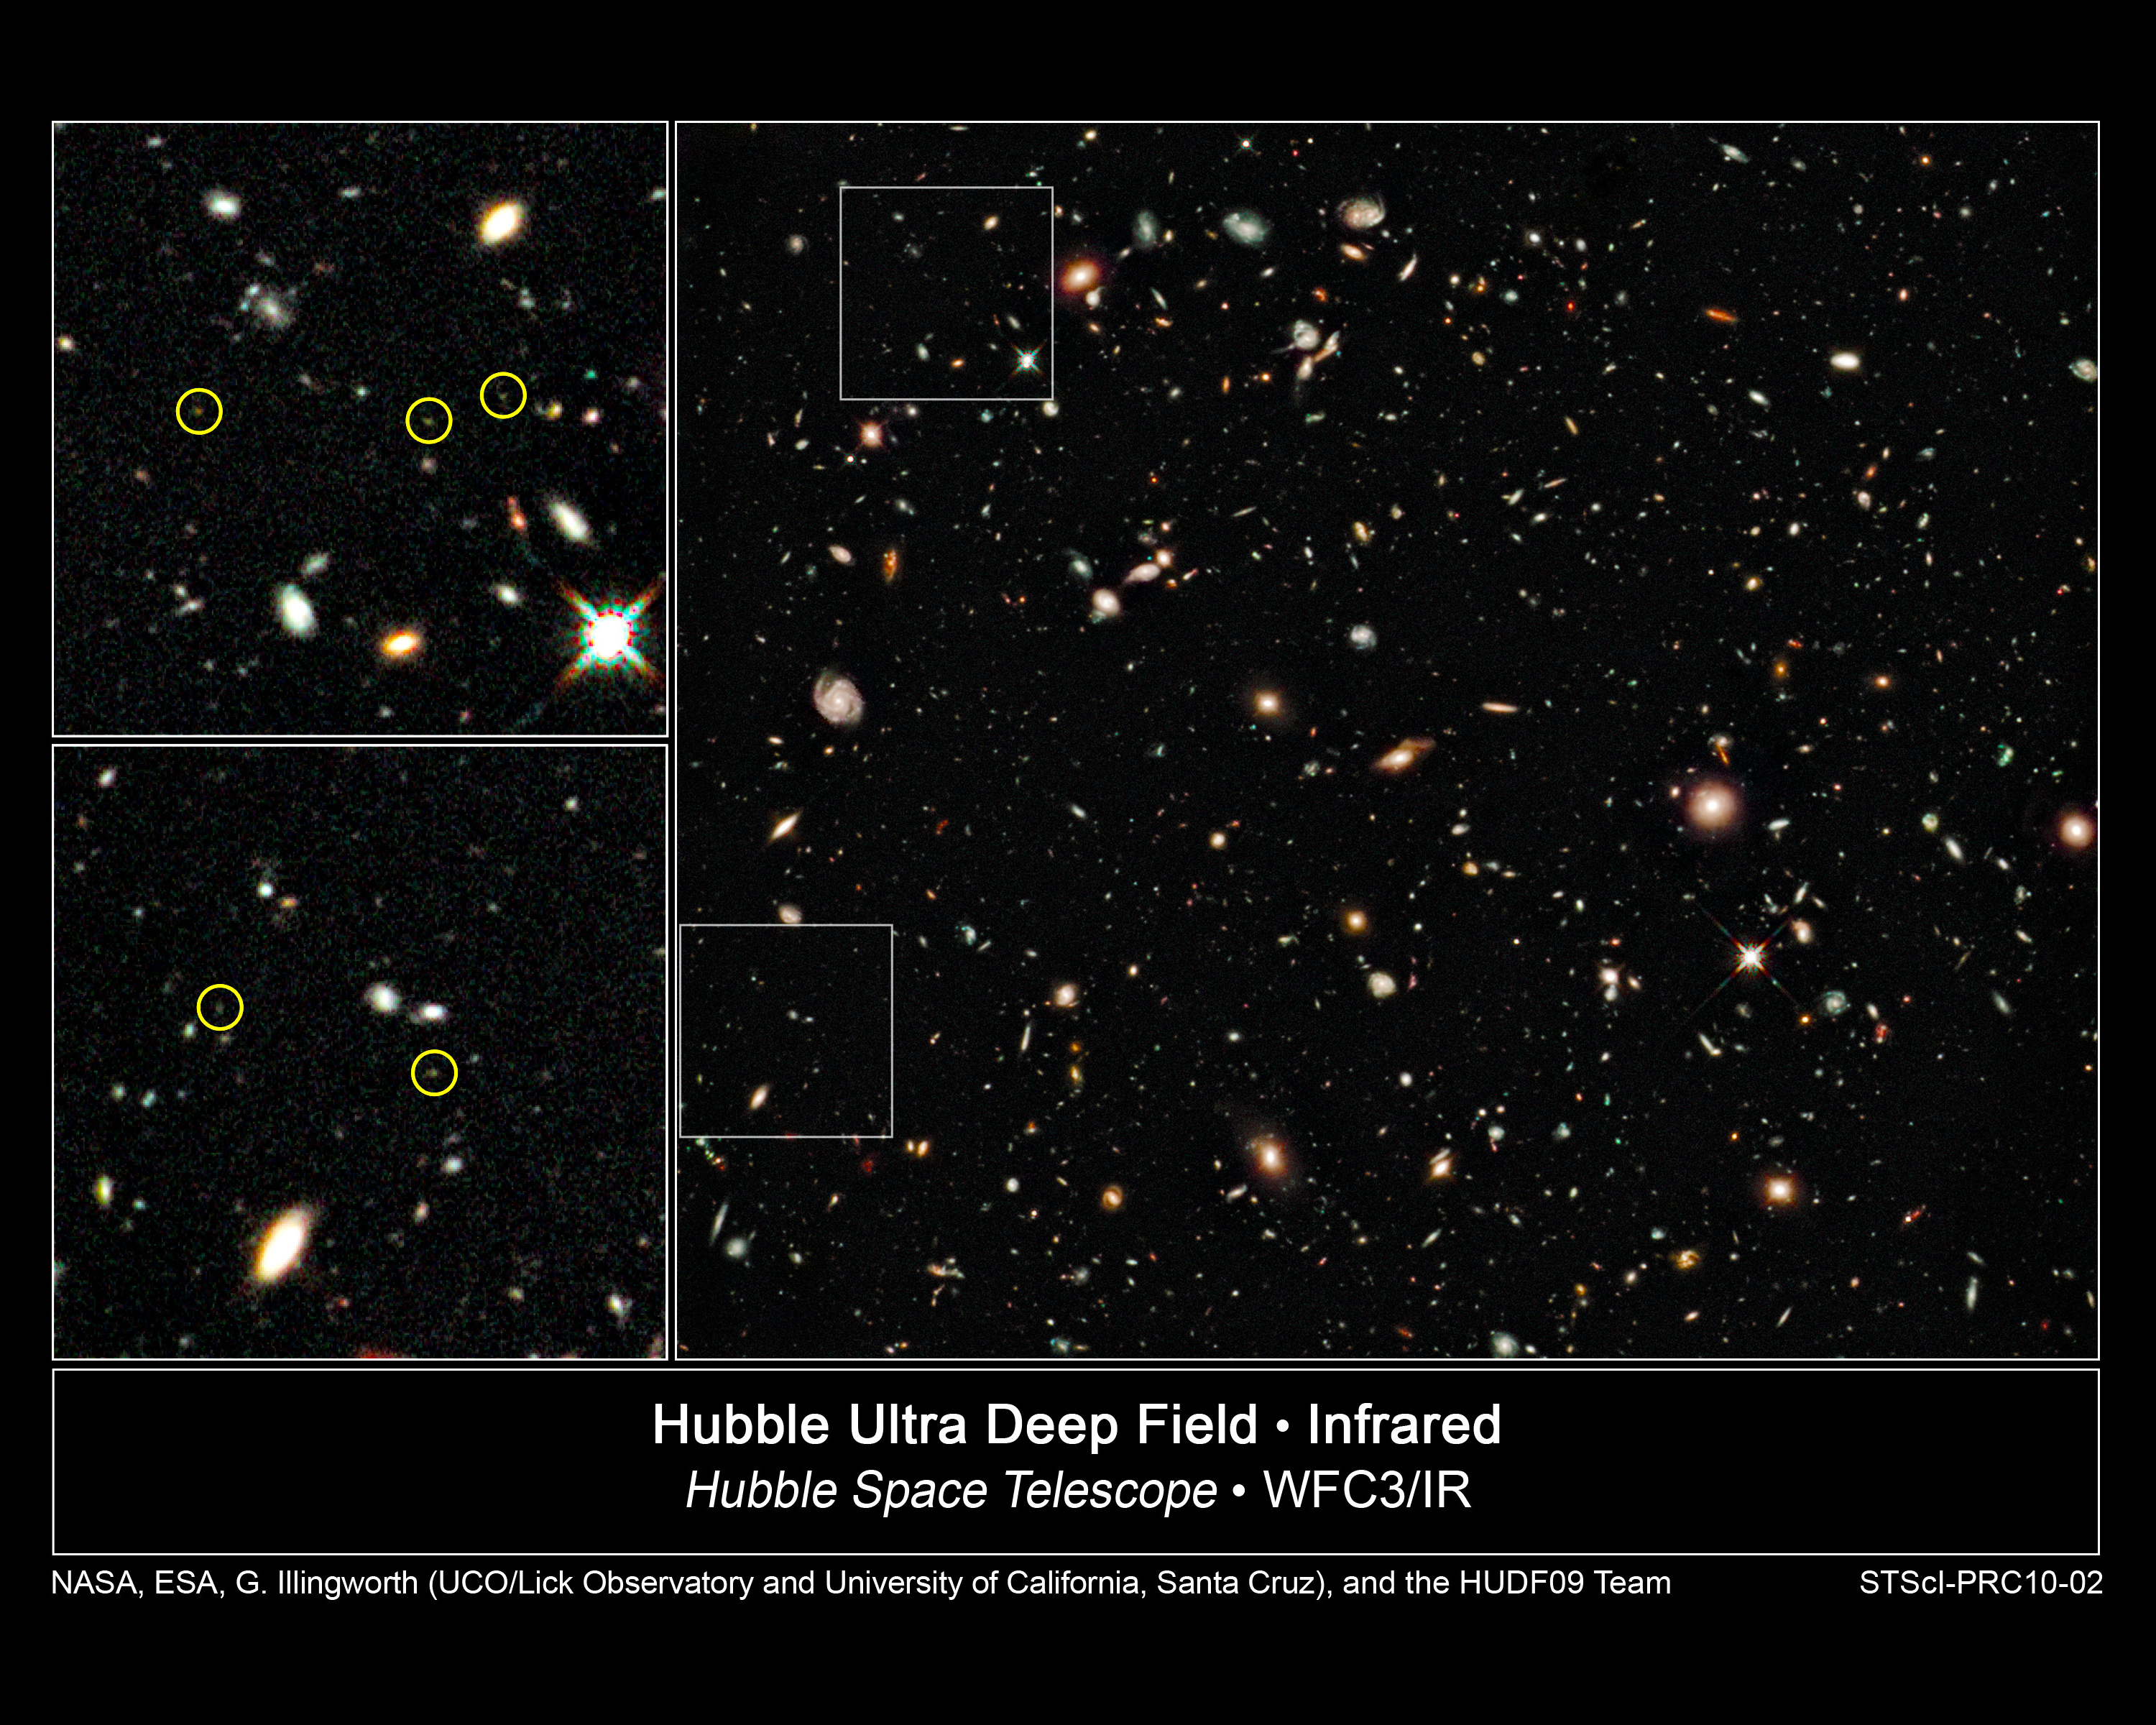
t~0.6-0.8 Gyr
z~7-8

Slide 30
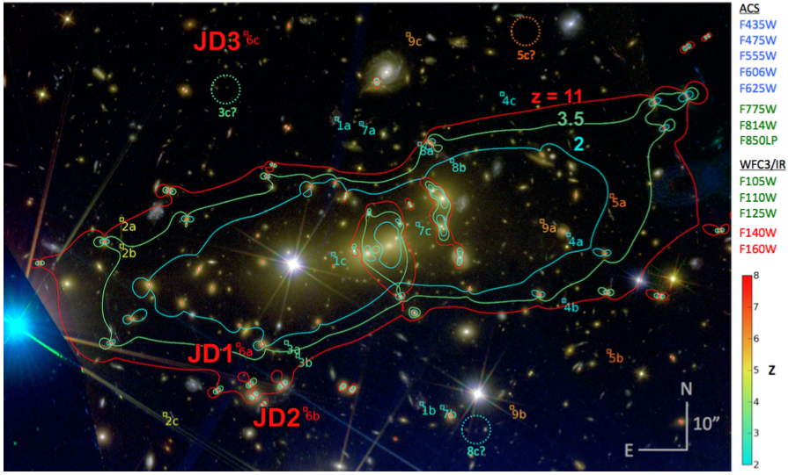
Galaxy at z~11
Coe et al. (2012)

Slide 31
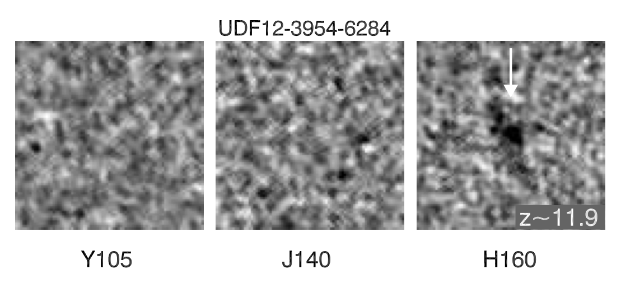
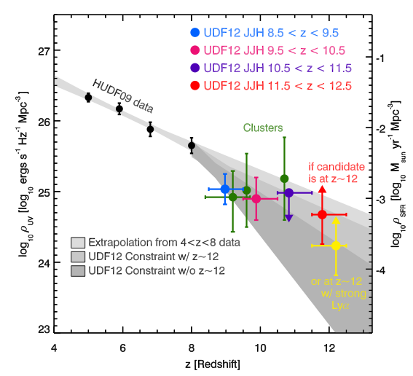
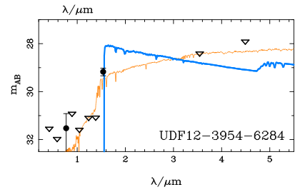
Candidate Galaxy at z~11.9
Ellis et al. (2012)

Slide 32
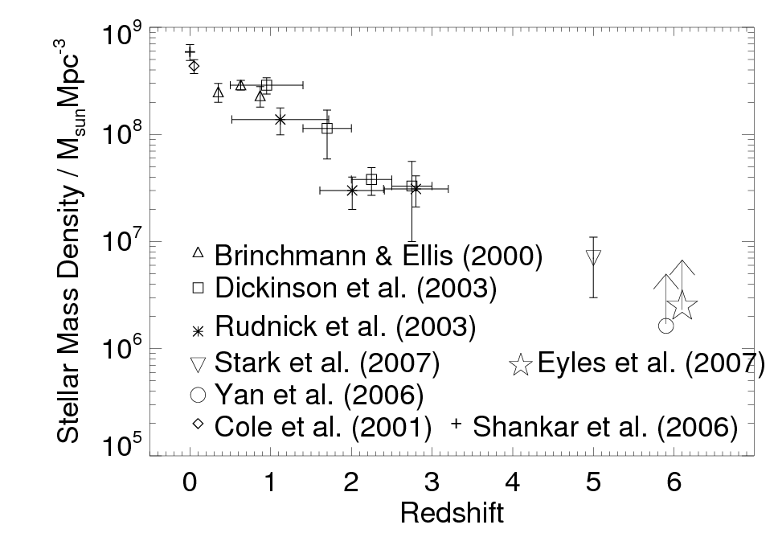
Observed Growth of Mass in Stars
← Time
13.8 billion years
~1% after 1 billion years
one ionizing photon per atom

Slide 33
James Webb Space Telescope: Searching for the First Light (successor to Hubble Space Telescope)
Mirror diameter: 6.5 meter
Material: beryllium
18 segments
Wavelength coverage: 0.6-28 micron
L2 orbit
Launch expected in 2018

Slide 34
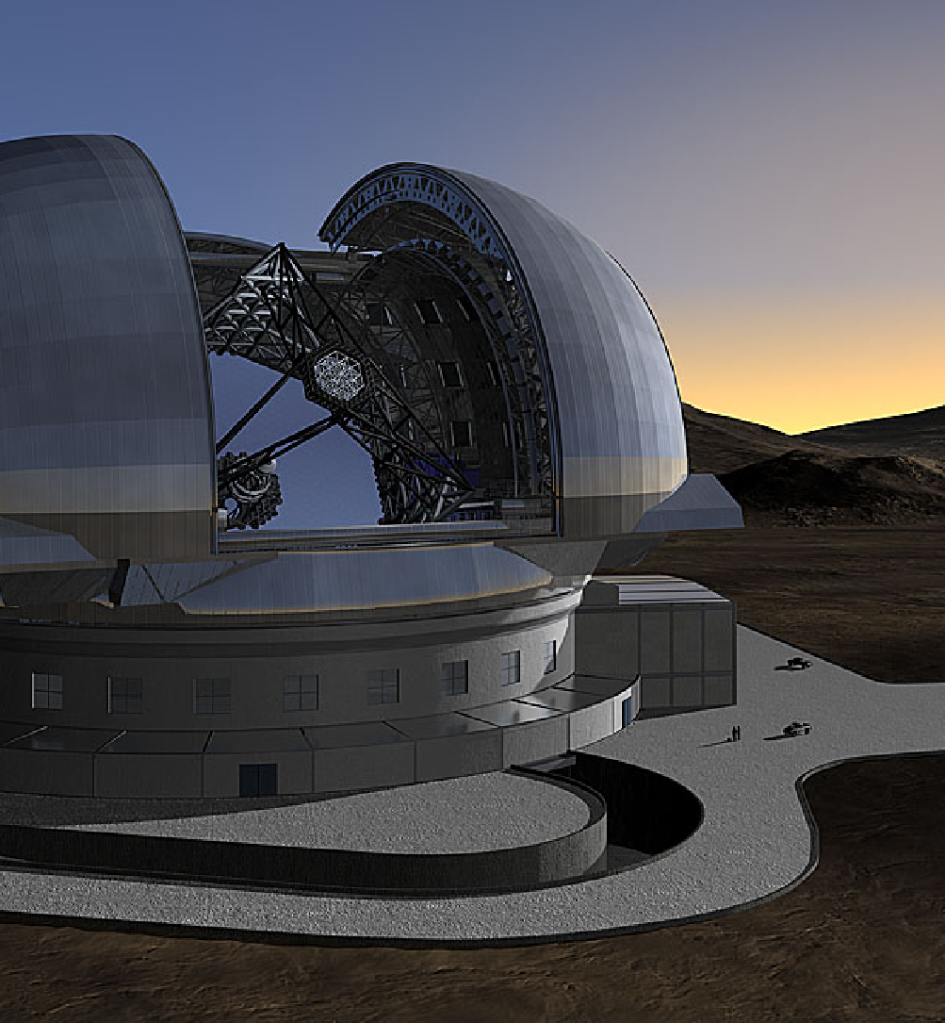
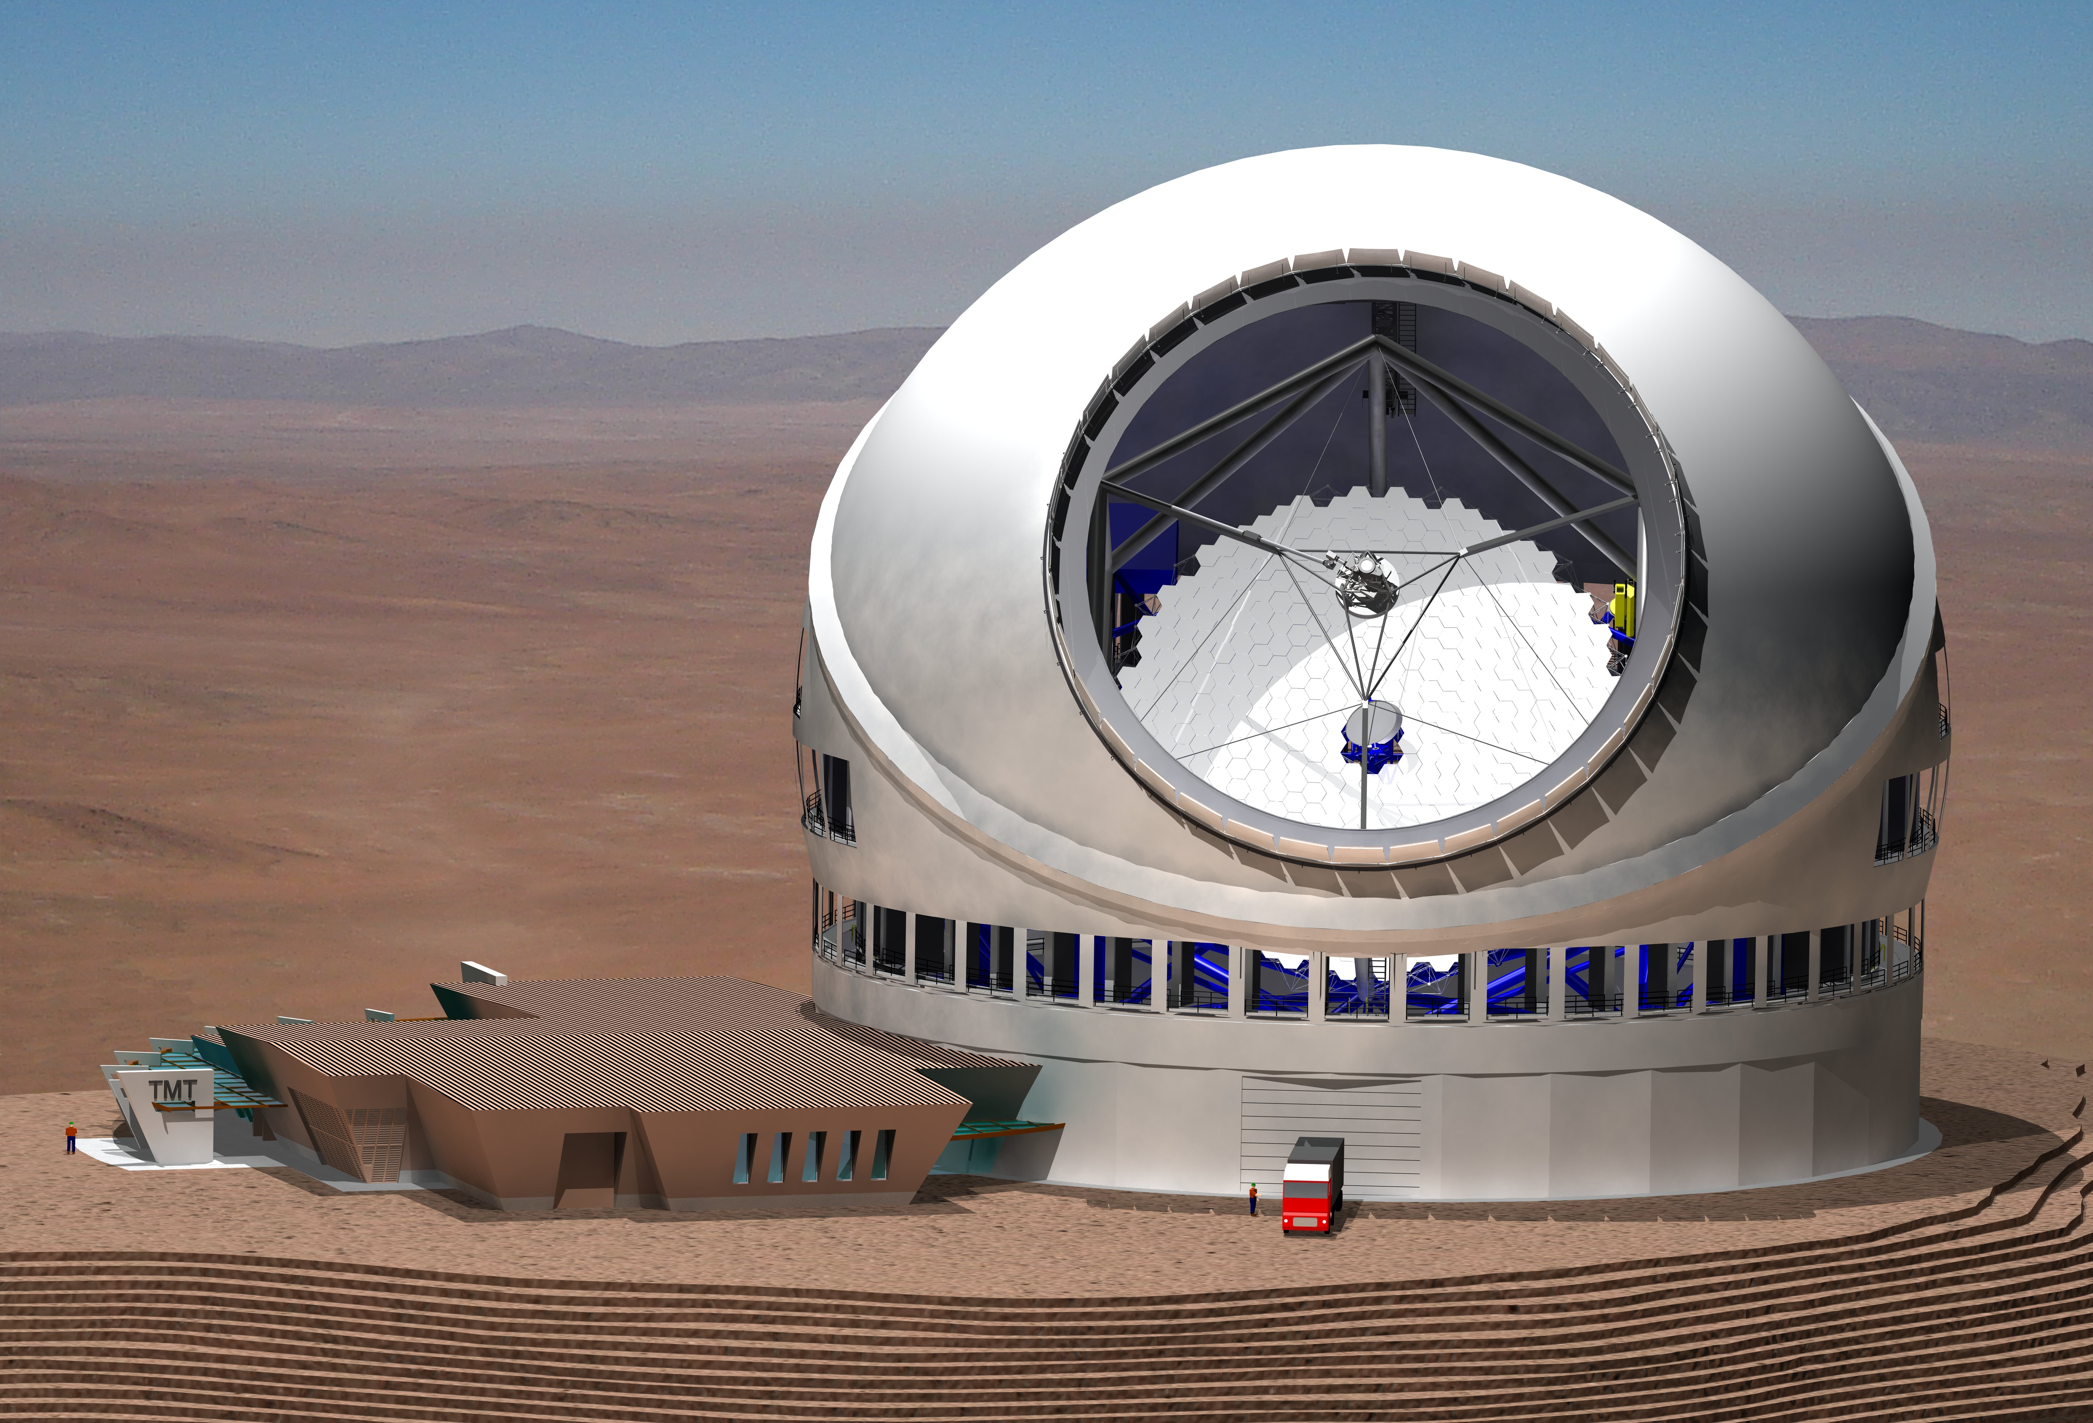
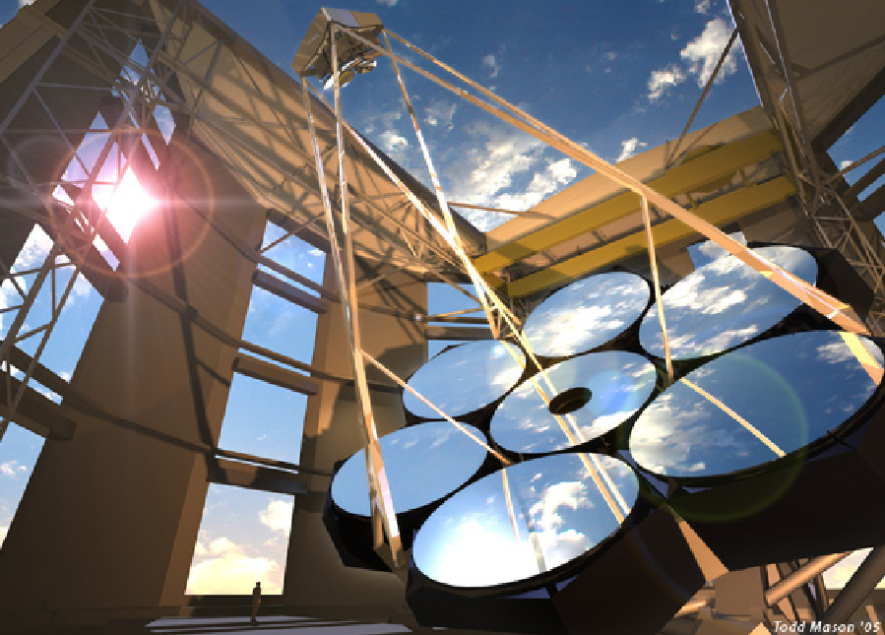
Extremely Large Telescopes (24-39 meters)
GMT=Seven mirrors, each 8.4m in diameter
TMT, EELT – segmented 30-39m aperture

Slide 35
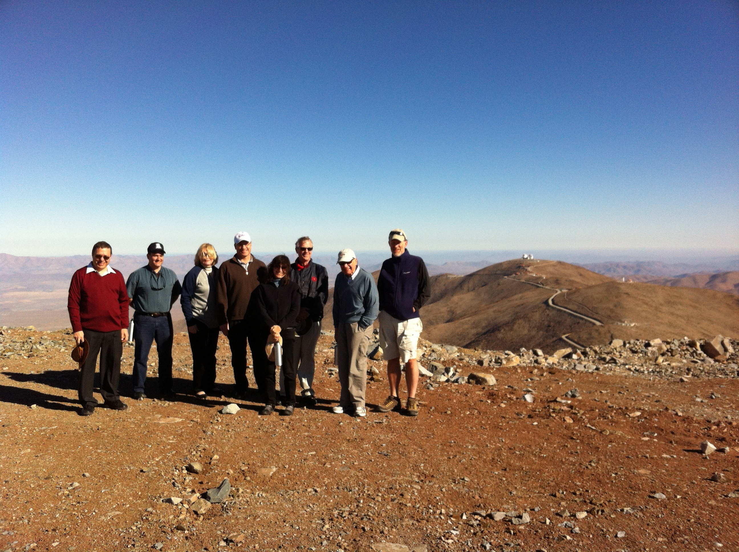
GMT site, Las Campanas, Chile January 2013

Slide 36
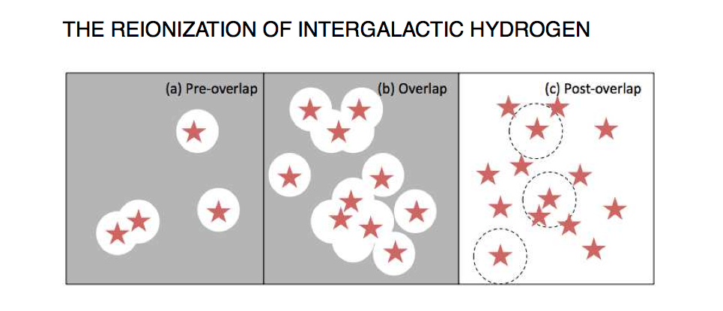
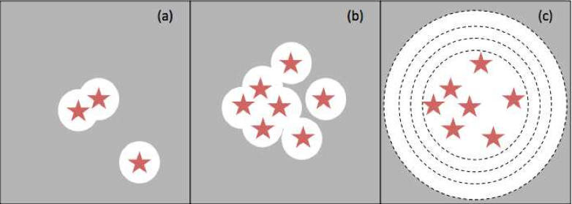
# ionizing photons = # H atoms

Slide 37
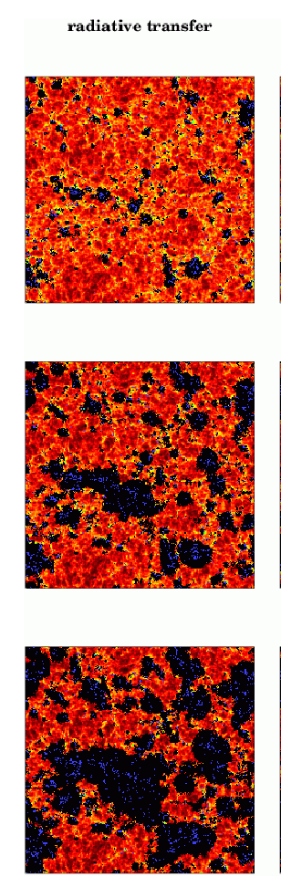
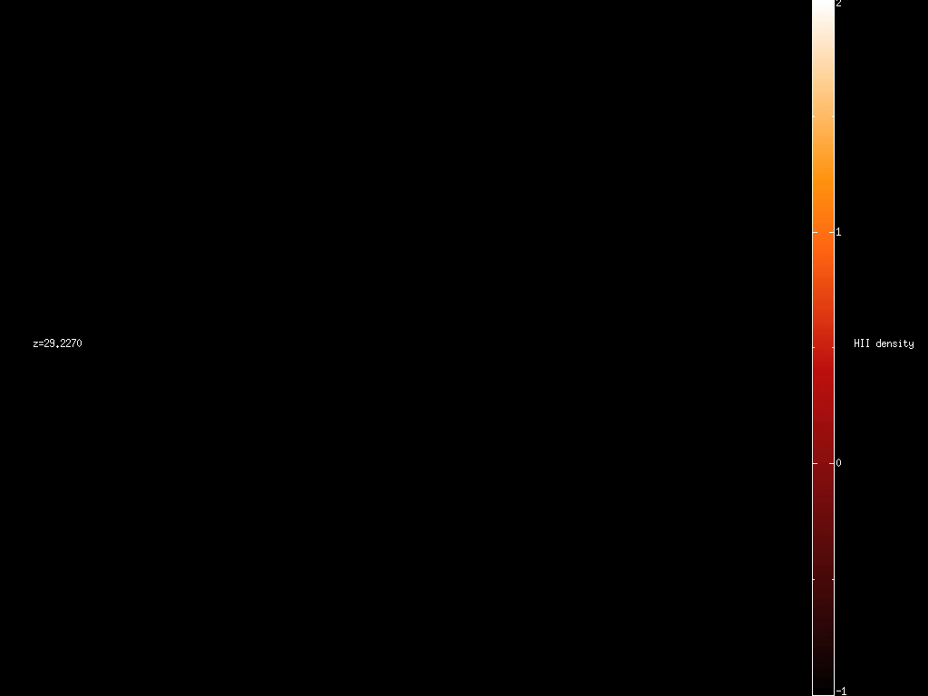
Reionization
HI Density
Z=8.16
x_HI(z)
Z=7.68
PopII/Pop III
T(z)
Z=6.89
Zahn et al. 2006
Trac, Cen, & Loeb 2008

Slide 38
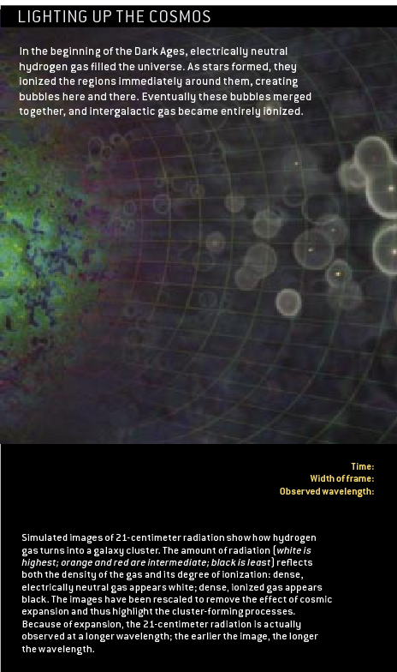

21-cm Mapping of Cosmic History in the 21st Century

Slide 39

wavelength: 21 cm
Harvard connection: Theodore Lyman, Cecilia Payne-Gaposchkin, Edward Purcell , George Field …

Slide 40
21cm Tomography of Ionized Bubbles During Reionization is like Slicing Swiss Cheese
H II
H I
Observed wavelength⬄ distance

Slide 41





Dipole Arrays: LOFAR,MWA,PAPER 21cm emission from diffuse hydrogen at z=6.5-15
MWA: 4mx4m tiles of 16 dipole antennae, 80-300MHz
128 antenna tiles with total collecting area 2000 sq.m. at 150MHz across a 1.5km area; few arcmin resolution

Slide 42

Pritchard & Loeb 2012

Slide 43
The EDGES Experiment

Slide 44

Galaxy surveys, Intensity Mapping and 21-cm Mapping

Slide 45

So much about the past, but what does the future hold?

Slide 46

The Long Term Future of Extragalactic Astronomy
Accelerating
source
c
us
today
All galaxies beyond a redshift of z=1.8 are already outside our horizon (no cell phone communication to z>1.8!). (Loeb 2001)

Slide 47
Analogy
Ants = Photons Balloon=Expanding Space

Slide 48
Analogy
Ants = Photons Balloon=Expanding Space
visited area (horizon) since blowing started (Big Bang)

Slide 49

Future Evolution of Nearby Large-Scale Structure
Coma
Great Attractor
Perseus Pisces
us
100 cMpc
100 cMpc
horizon
100 cMpc
Nagamine & Loeb 2002,2003

Slide 50

How many galaxies will reside within our event horizon in 100 billion years?
Answer: one surrounded by vacuum
The merger product of the Andromeda and Milky-Way galaxies!

Slide 52
The Forthcoming Merger Between the Milky-Way and Andromeda: Milkomeda
The merger product is the only cosmological object that will be observable to future astronomers in 100 billion years
Collision will occur during the lifetime of the Sun
The night sky will change
Simulated with an N-body/hydrodynamic code (Cox & Loeb 2007)
The only paper of mine that has a chance of being cited in five billion years…

Slide 53


Slide 54

The Future Collision between the Milky Way and Andromeda Galaxies

Slide 55


Slide 56




Fate of the Sun

Slide 57
Highlights
Cosmologists are currently exploring the scientific version of the story of genesis (“let there be light”). Future observations will utilize large-aperture infrared telescopes (for imaging the first galaxies) and low-frequency radio arrays (for imaging cosmic hydrogen in between the galaxies).
Religious ideas about genesis are modified by science.
The merger product of the Milky-Way and Andromeda (Milkomeda ) is the only galaxy that will remain visible to us as the Universe ages by a factor of ten (a hundred billion years from now). Subsequent generations of observers will not be able to find direct evidence for the big bang.
Will cosmology turn into religion at that time?

Slide 58
Once the Universe will age by a factor of ~100 (a trillion years from now), the wavelength of the microwave background will exceed the scale of our horizon…
At that time, all extragalactic atoms will be pushed out of the horizon and be unavailable for tracing the cosmic expansion…

Slide 59

But our galaxy ejects hypervelocity stars!
SgrA*
Measure the vacuum mass density from the acceleration of hypervelocity stars that escape from Milkomeda
Estimate matter density when Milkomeda formed from the mean density of Milkomeda
Calculate time from the Big Bang based on the the measured ages of Milkomeda’s stars
Infer microwave background temperature from light element abundances
VALIDATE ancient cosmology textbooks
(Loeb 2011, arXiv:1102.0007)

Slide 61


Slide 63


Slide 64


Slide 65




The Older We Get the Less We Know (Cosmologically)
The best constraints on the cosmological initial conditions can be obtained during the epoch of reionization, at z~10

Slide 66

Finkelstein et al. (2012)

Slide 67

Cosmological Evolution of the 21-cm Signal
Mesinger et al. (2012)

Slide 68
Excerpt 1:

Slide 69
Excerpt 2:

Slide 70

Excerpt 3:

Slide 71

Webcasting of four lectures between 6/26-7/4/12 at http://tv.sns.it/quicktime

