Slide 1
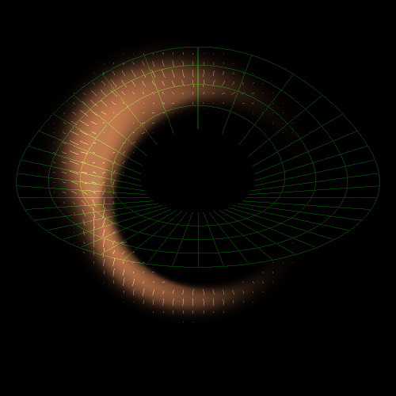
Lecture III: A Closer Look at Black Holes
Imaging black hole silhouettes
Gravitational waves from black hole binaries
Recoil of black holes
Tidal disruption of stars by black holes

Slide 2



Why are there galaxies and not just black holes in the Universe?
Spherical Collapse of dark matter and gas
Tidal torque from neighboring objects near turnaround: angular momentum

Slide 3
What is a black hole?
The ultimate prison. Even light cannot escape from its gravitational pull!

Slide 4
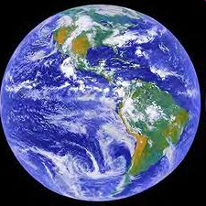
escape speed = 11 km/s
Compress the Earth to ~1cm
escape speed = 300,000 km/s = speed of light

Slide 5


space-time
c=const
x = c t
Equivalence Principle (Galileo, Pisa)
General relativity: matter curves spacetime Einstein’s equations: [Matter] = [Curvature]
Time-dependent quadrupole -> ripples in spacetime . ( (gravitational waves)
Black hole: Schwarzschild’s letter in WWI

Slide 7
How does a black hole look like?

Slide 8
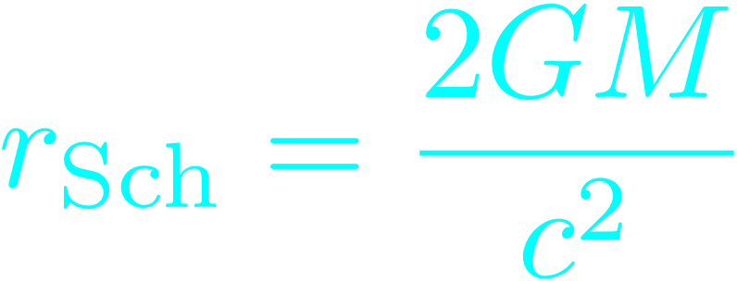
Image of a black hole in vacuum
For a non-spinning black hole: Schwarzschild radius:
singularity
event horizon

Slide 9
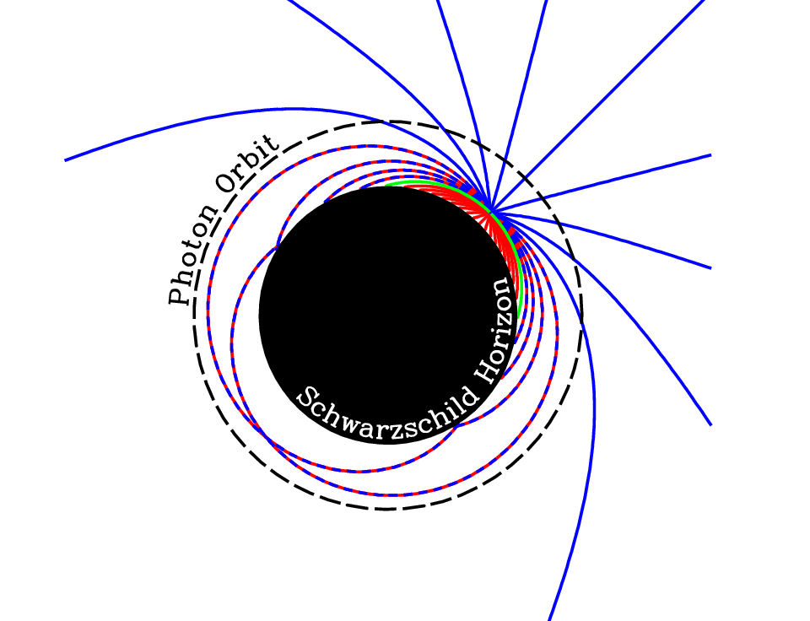
Broderick, Loeb, & Narayan 2008

Slide 10
No hair Theorem: a black hole is characterized by three numbers: its mass, spin, and charge (N/A)
Cosmic censorship: every singularity is surrounded by an event horizon (which protects the outside world from its influence)

Slide 11
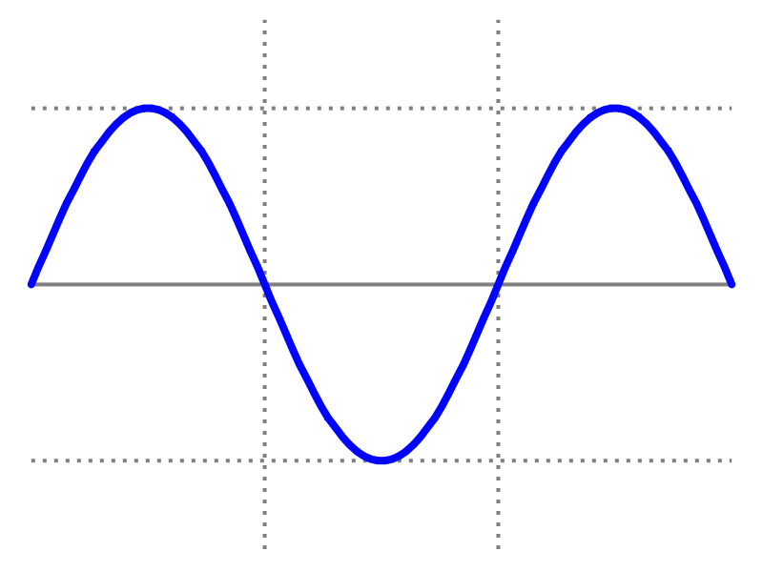
Quantum Mechanics
Important only for wavelengths comparable to horizon size (Hawking radiation)
Negligible importance outside the horizon of astrophysical black holes

Slide 13
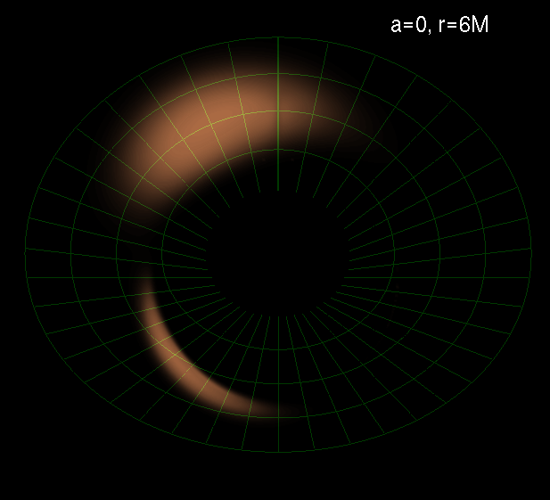
Imaging Black Holes
Testing theory of gas accretion: disks, jets
Testing General Relativity: strong field gravity

Slide 14
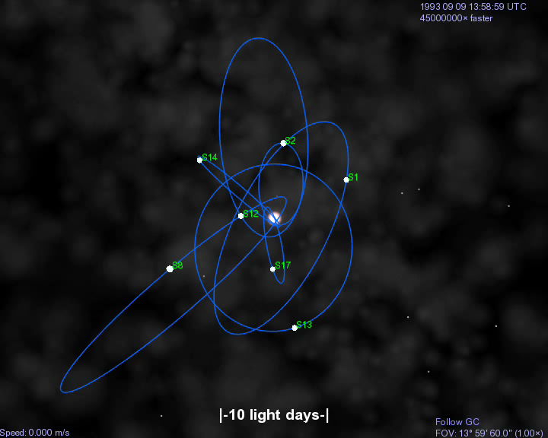


Stellar Orbits Around SgrA*
(BH at rest in GC)
Ghez et al. 2008; Genzel et al. 2008

Slide 15
SgrA* is the largest black hole on the sky

Slide 16
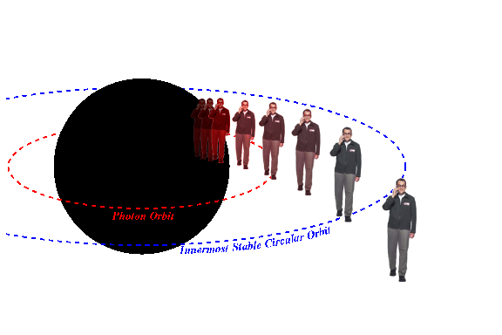
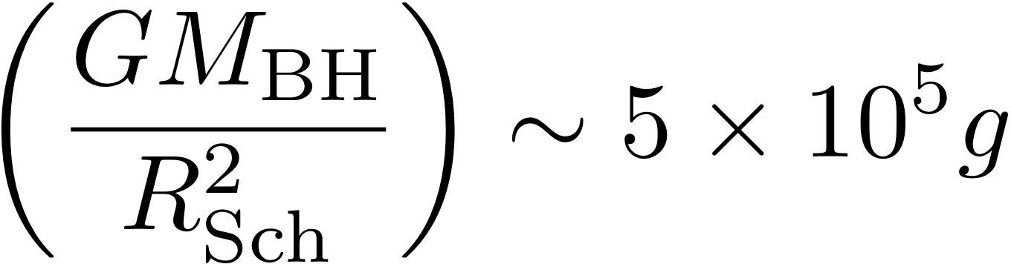
Can you hear me now?
10 million km
No, but no worries - you will be able to hear us for ~10 minutes until you reach the singularity…

Slide 17
Is general relativity a valid description of strong gravity?
*Infrared variability of flux (Genzel et al.) and polarization (Eckart et al.) of SgrA*: hot spots.
*Innermost Stable Circular Orbit: radius of 30 (10) micro-arcsecond and orbital time of 30 (8) minutes for a non-rotating (maximally-rotating) black hole at the Galactic center
*A hot spot would result in infrared centroid motion (GRAVITY-VLT) and could be imaged by a Very Large Baseline Array of (existing) sub-millimeter observatories. Targets: SgrA* and M87
Broderick & Loeb 2005

Slide 18
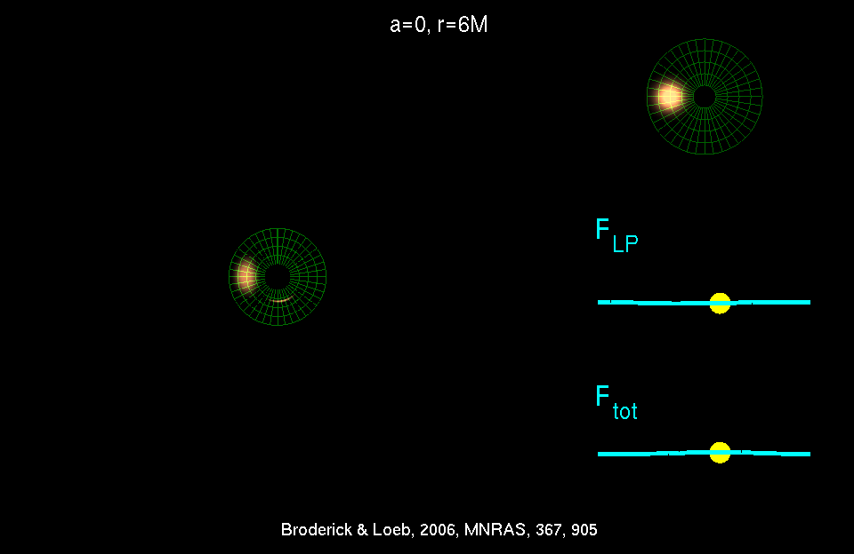
Physics + Astrophysics: Imaging Black Holes
Broderick & Loeb 2005

Slide 21
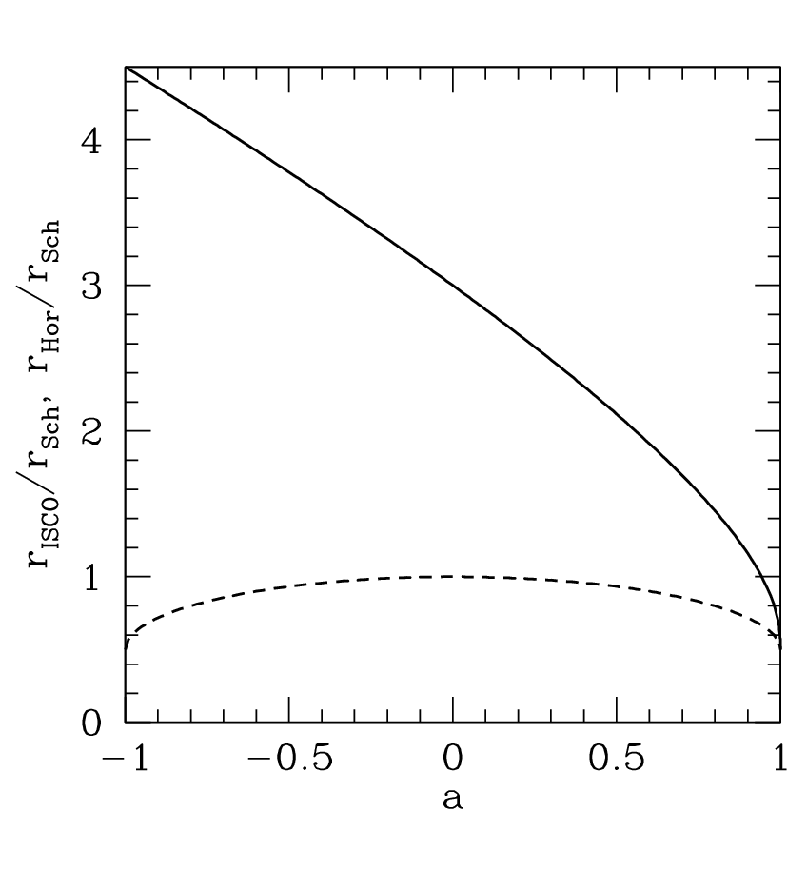
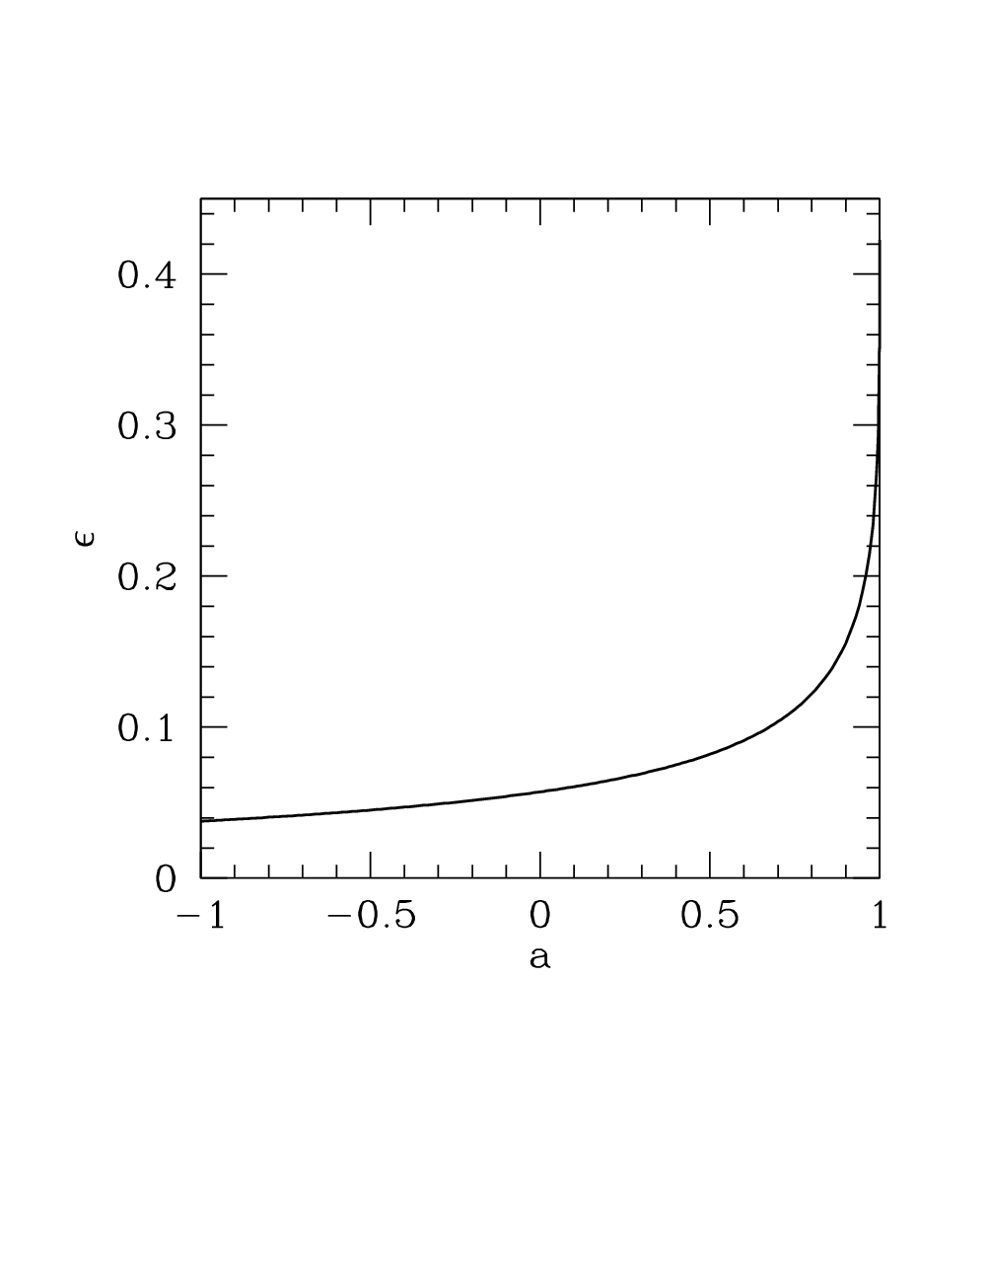
spin matters!
Innermost Stable Circular Orbit (ISCO)
radiative efficiency (binding energy at ISCO)
horizon

Slide 22
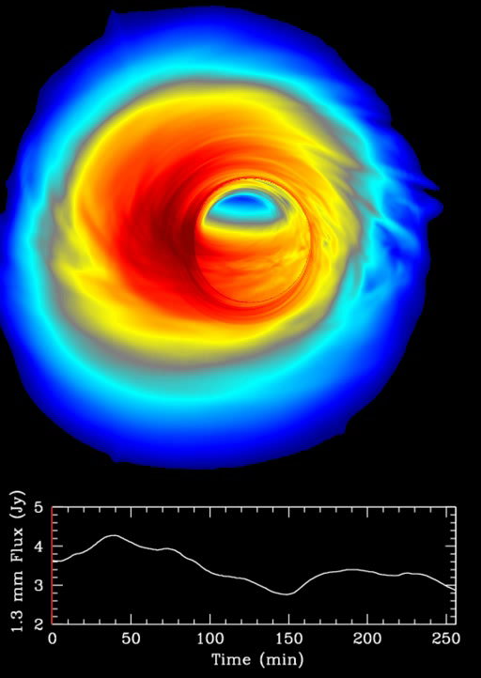
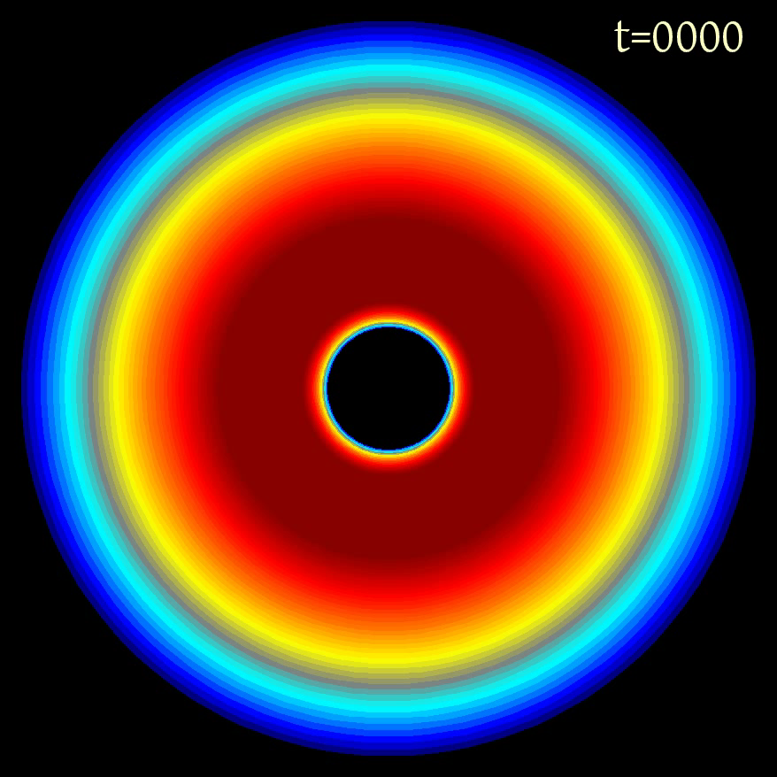
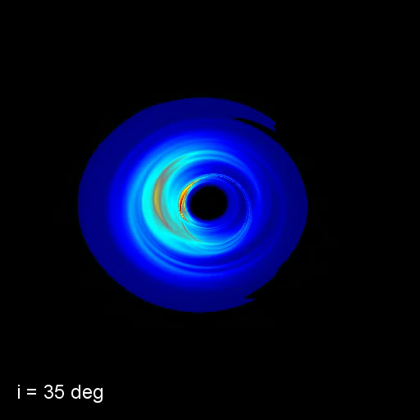
Numerical Simulations (GRMHD)
inclination
image
setup
C. Gammie, J. Dolence, M. Moscibrodzka, H. Shiokawa, P. Leung (2009)

Slide 23
Three Fortunate Coincidences
The accretion flow of SgrA* becomes transparent to synchrotron self-absorption at wavelengths shorter than 1 millimeter
Interstellar scattering ceases to blur the image of SgrA* on horizon scales at wavelengths shorter than 1 millimeter
The horizon scale of SgrA* and M87 (tens of micro-arcseconds) can be resolved by a Very Large Baseline Array across the Earth at wavelengths shorter than 1 millimeter

Slide 24
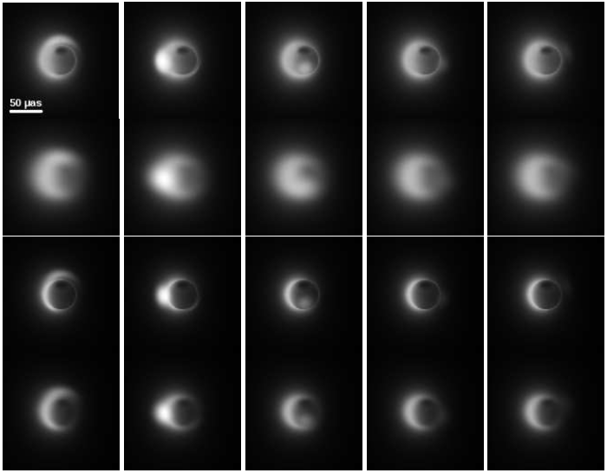
SgrA*
230 GHz
with interstellar scattering
345 GHz
with interstellar scattering
Different orbital phases of the hot spot →

Slide 26
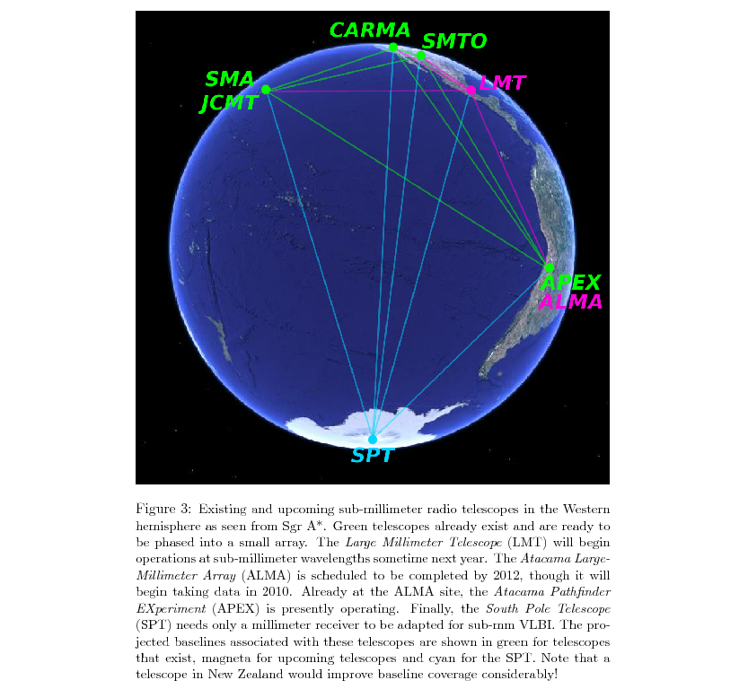
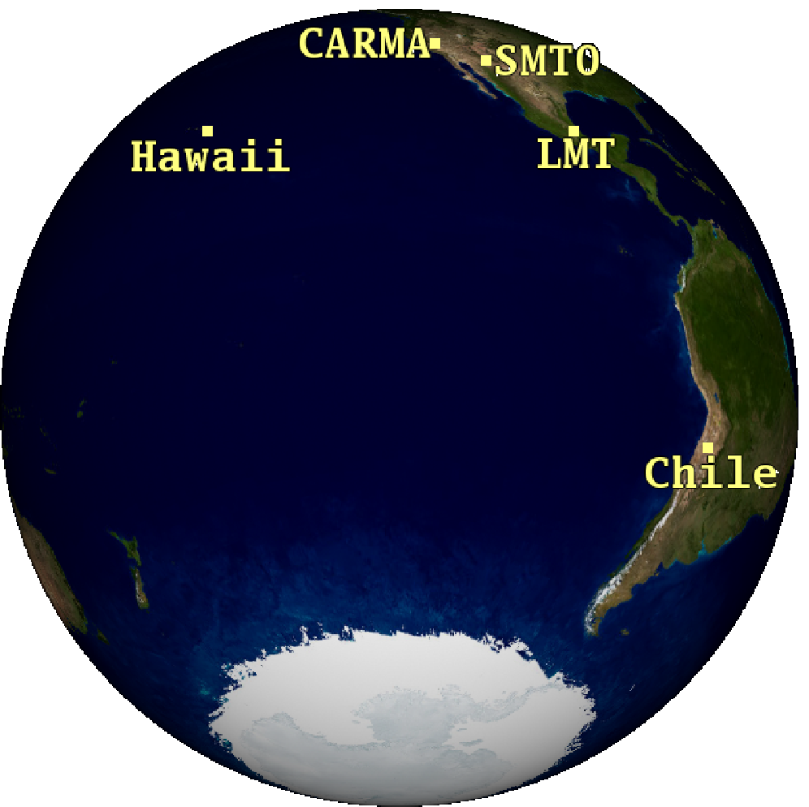
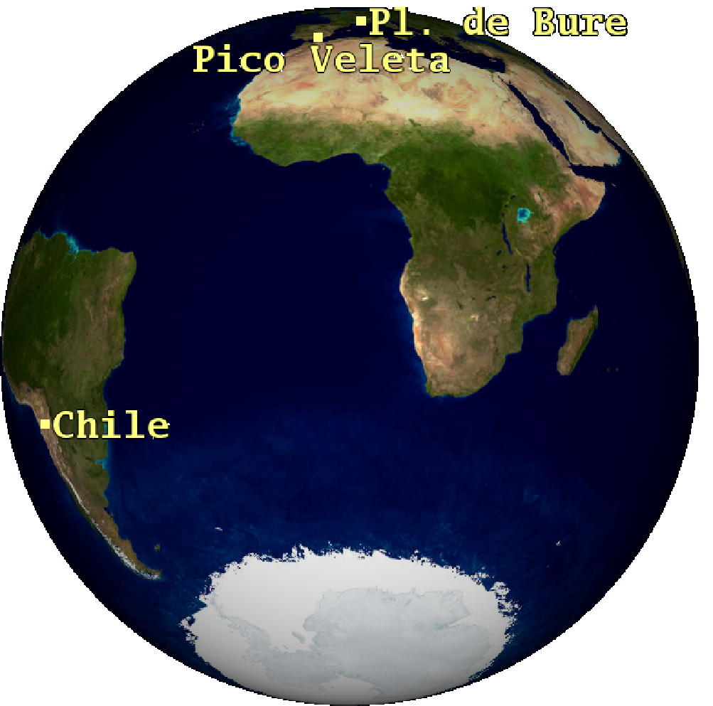
Very Long Baseline Interferometry (VLBI) at sub-millimeter wavelengths

Slide 27
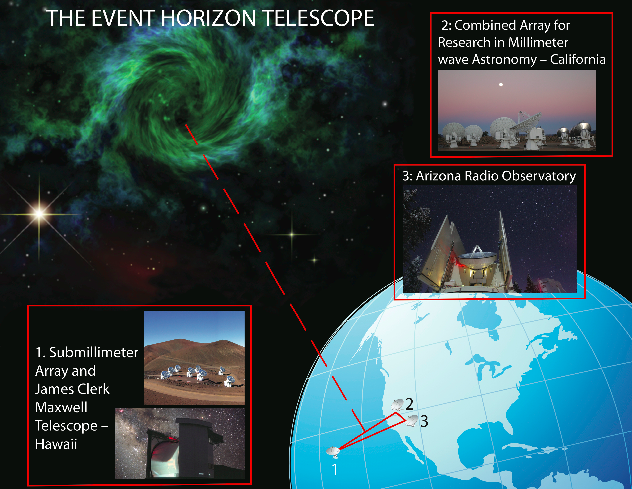
Event Horizon Telescope

Slide 28
Evidence for a Low-Spin BH in SgrA*
Broderick, Fish, Doeleman & Loeb 2010

Slide 29
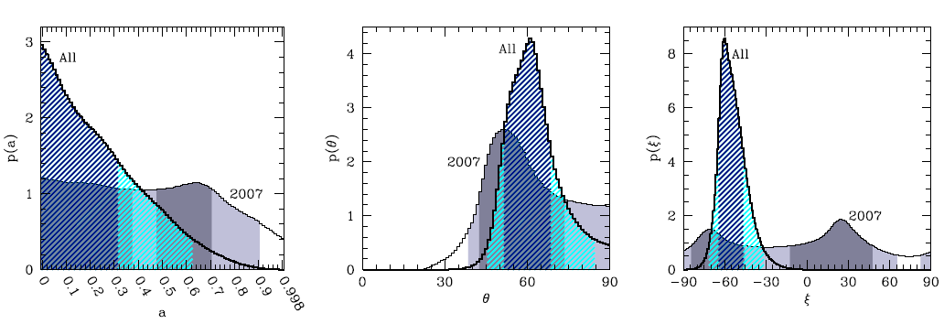

Slide 30

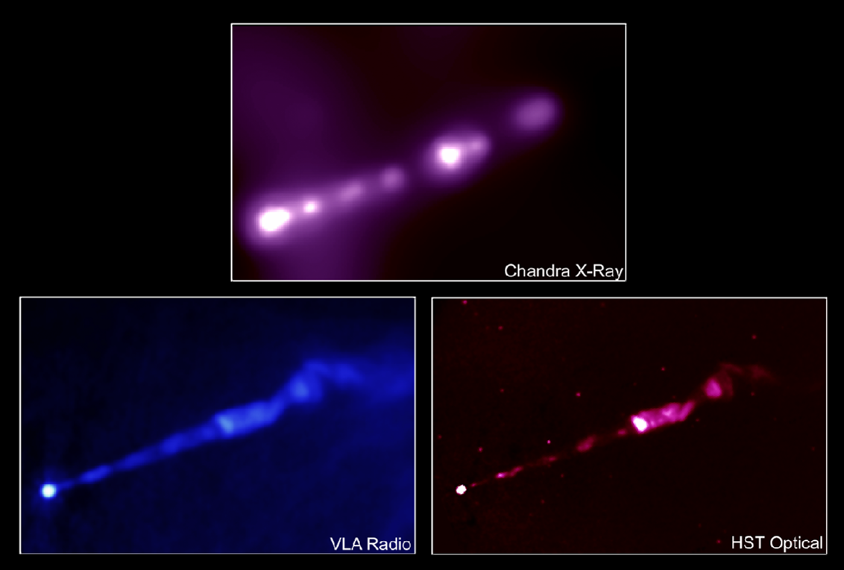

M87
(1400 times more massive than SgrA*)
(~2000 times farther than SgrA*)

Slide 31
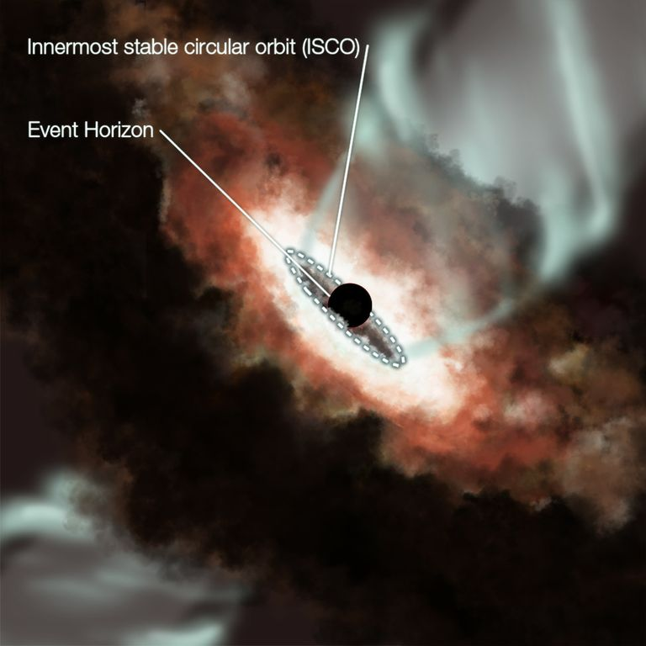
M87

Slide 32
(Broderick & Loeb 2008)
44GHz, (7 mm) VLBA Junor, Biretta, & Livio (1999)
Walker 2008

Slide 33
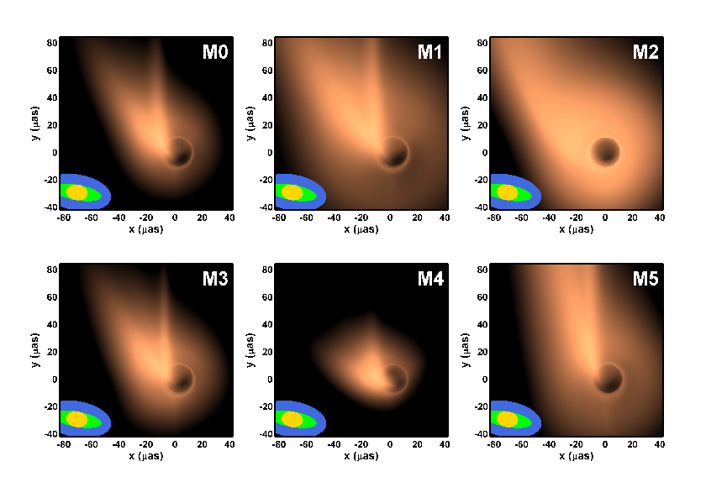
0.87 mm Images
US
+EU
+LMT

Slide 34
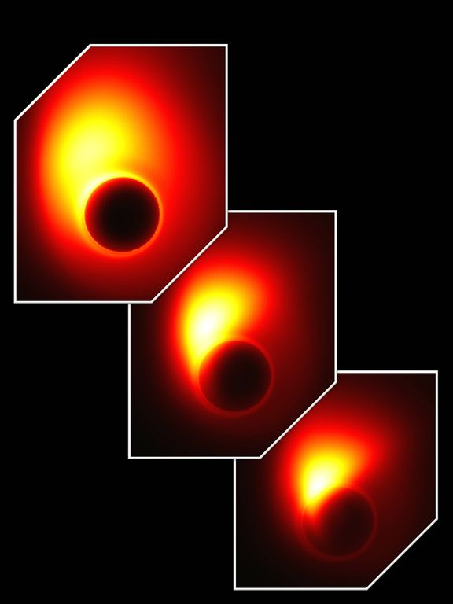
Different choices for the location of the jet base and black hole spin

Slide 35
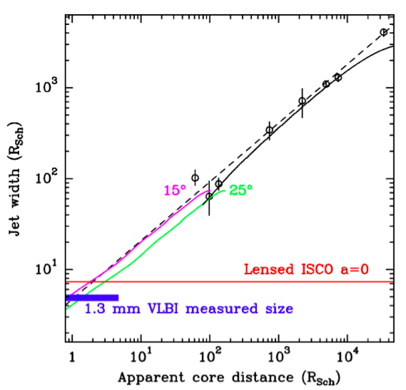
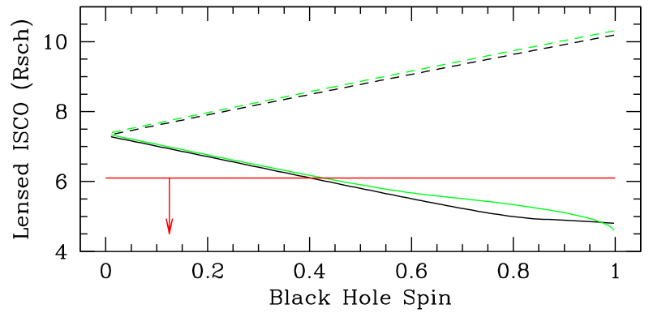
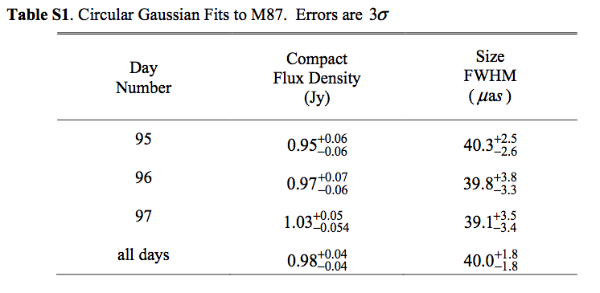
Detection of Jet Launching Structure in M87
a<0
a>0
Doeleman et al. (2012)

Slide 36
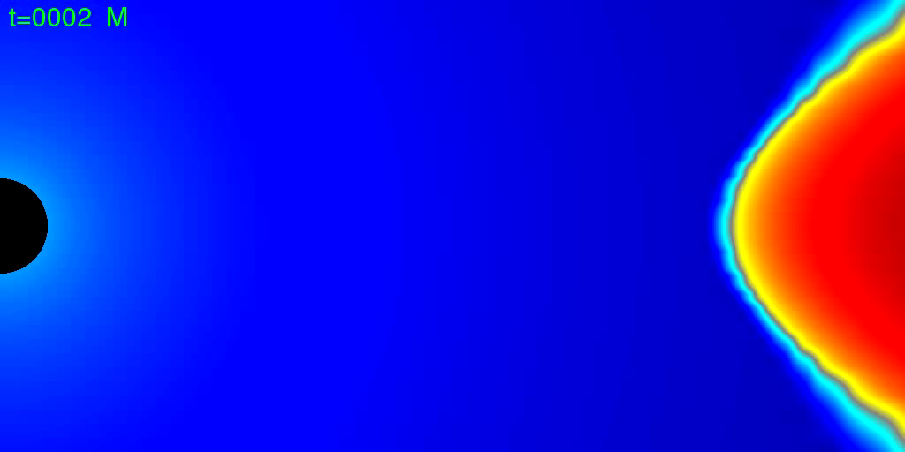
How do black holes accrete gas?
Penna et al. (2011)

Slide 37
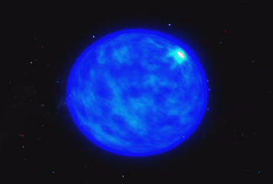
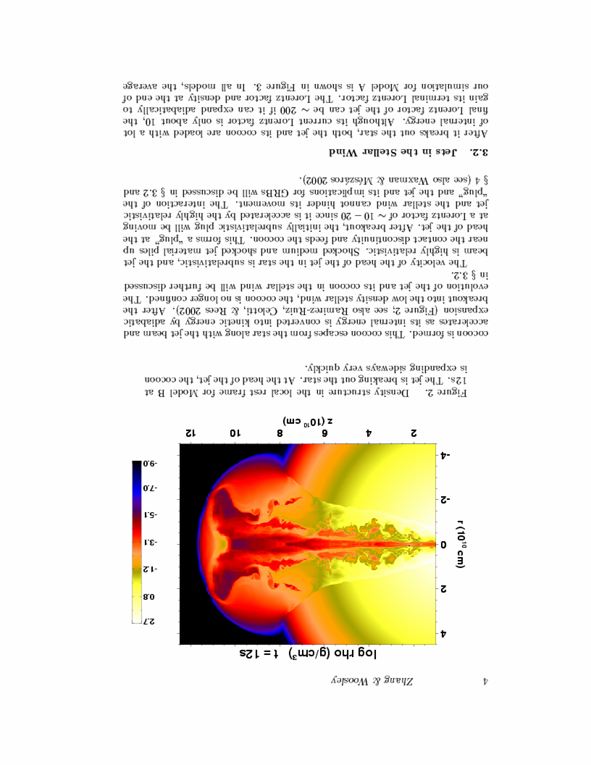
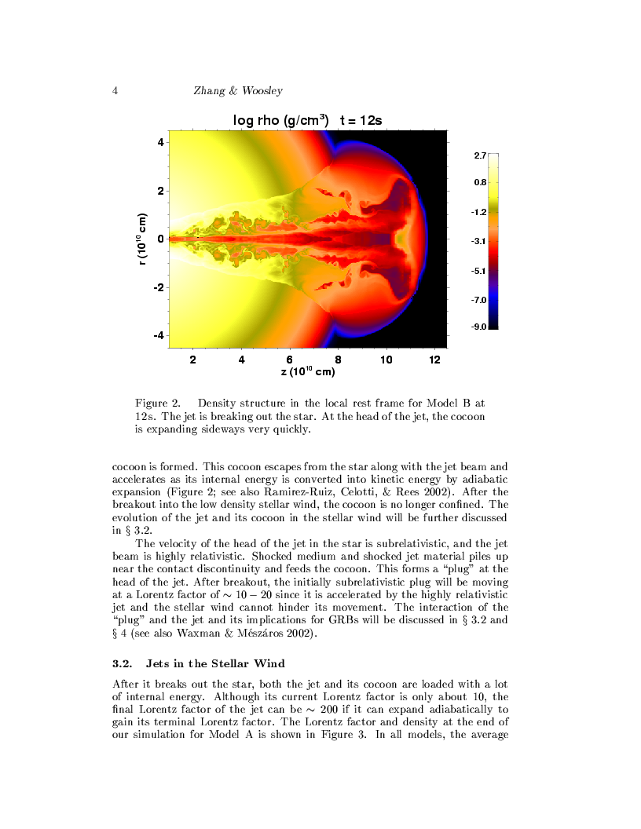
Gamma-Ray Bursts: Observing the birth of a black hole
Collapse of a Massive Star (accompanied by a supernova )
Existing finder: Swift; Proposed: JANUS, EXIST (high-z GRBs)

Slide 38
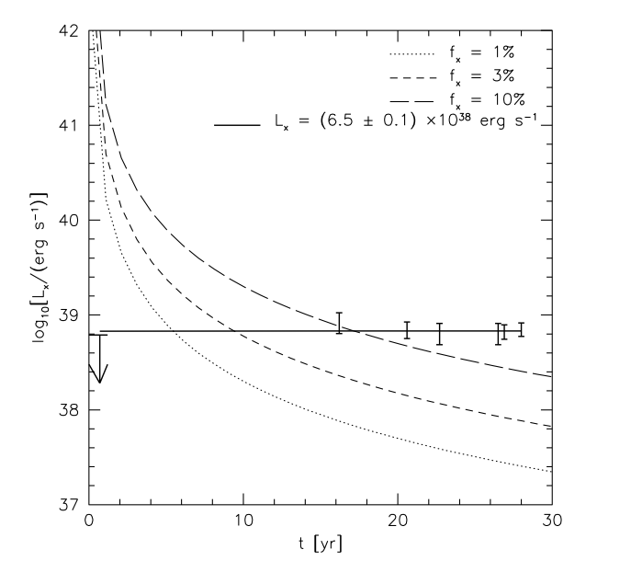

EVIDENCE FOR BLACK HOLE BIRTH:
persistent X-ray emission in SN1979C
Patnaude, Loeb, Jones (2010)

Slide 39
…but bigger black holes form at the centers of galaxies

Slide 40
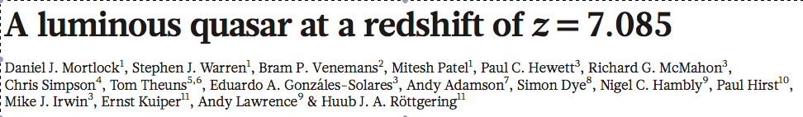
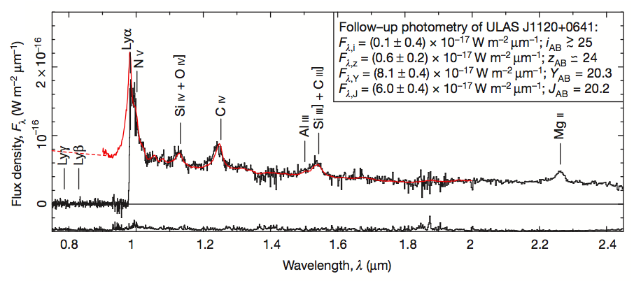
Black Hole Mass = 2 billion solar masses
Only 0.77 billion years after the Big Bang
Nature (2011)

Slide 41
What is a quasar?
A supermassive black hole which accretes gas and shines brightly. Typically found in the central region of a galaxy.

Slide 42
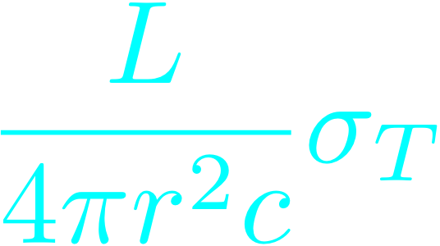
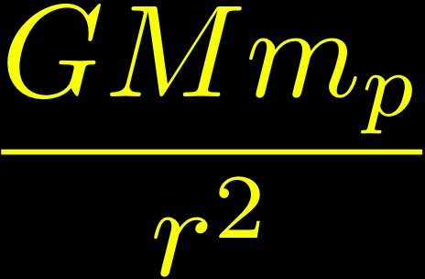

The Eddington Limit
Black Hole
Outward force
Inward force

Slide 43



Black Hole Growth
Starting from a stellar mass, there is barely enough time to grow the observed quasar black hole during the age of the Universe at z=7.1 for e=10%… but the radiative efficiency may be small due to trapping of radiation:

Slide 44
Correlation between black hole mass and velocity dispersion of their host spheroids

Slide 45
Why Are Quasars Short Lived?
Because they are suicidal!
Principle of Self Regulation: supermassive black holes grow until they release sufficient energy/momentum to unbind the gas that feeds them from their host galaxy
→Implies a correlation between black hole mass and the depth of the gravitational potential well of its host galaxy

Slide 46
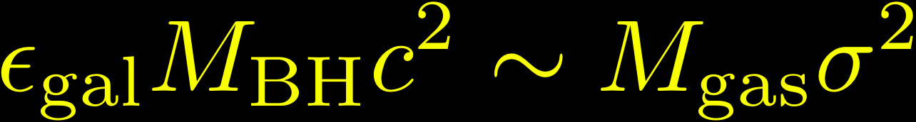
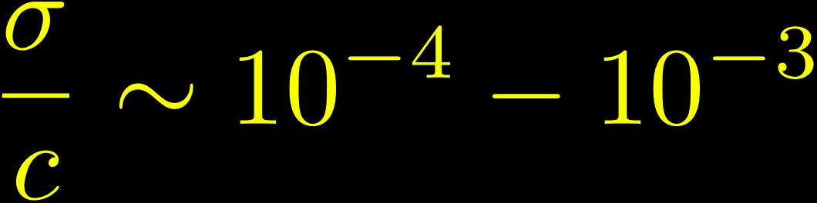
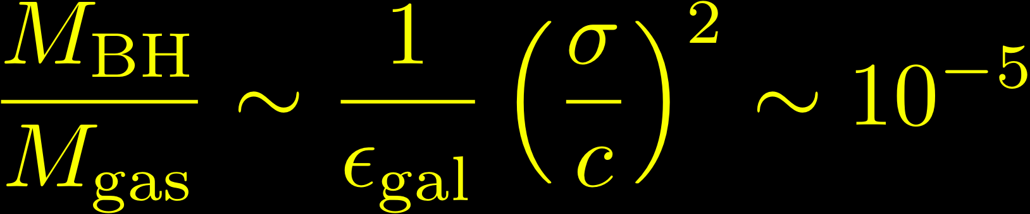
Unbinding the gas in a galaxy:

Slide 47
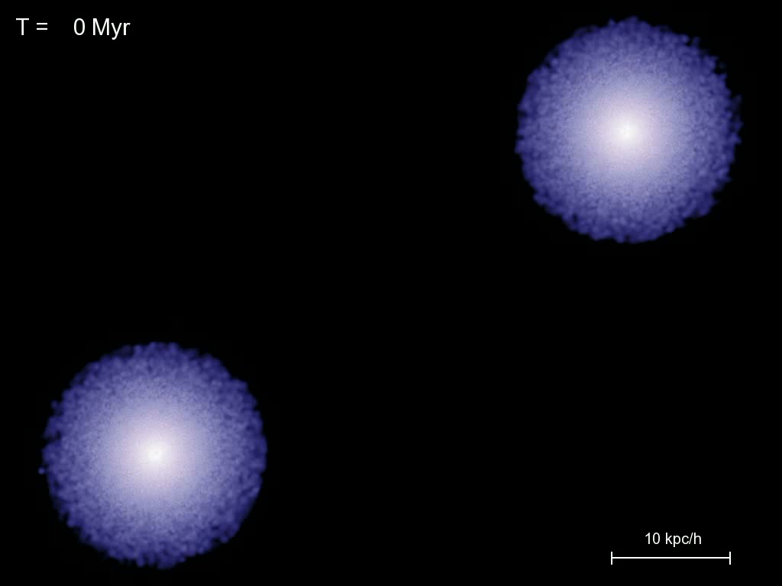
Computer Simulations of Quasar Feedback
Springel, Hernquist, Di Matteo et al. 2005

Slide 48
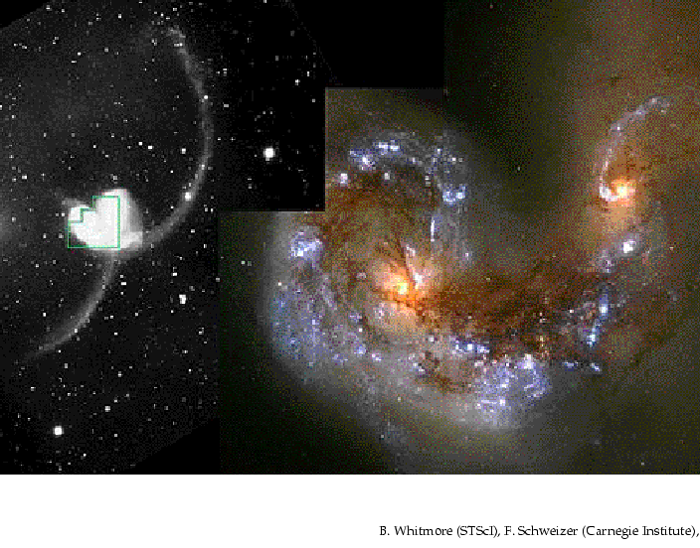
Black Hole Binaries due to Galaxy Mergers

Slide 49
Binary AGN with 1-10kpc separation at z<0.3
Shen et al. (2011)

Slide 50
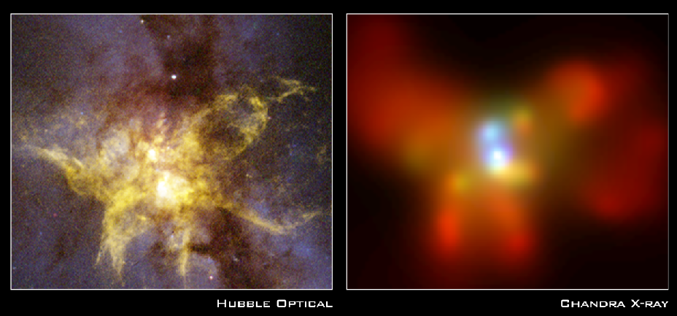
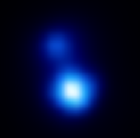
X-ray Image of a binary black hole system in NGC 6240
10kpc
z=0.025
Komossa et al. 2002

Slide 51
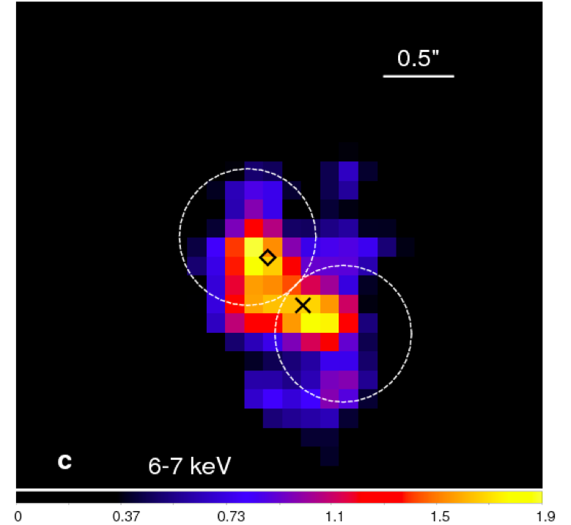
NGC 3393
Fabbiano et al. (2011)

Slide 52
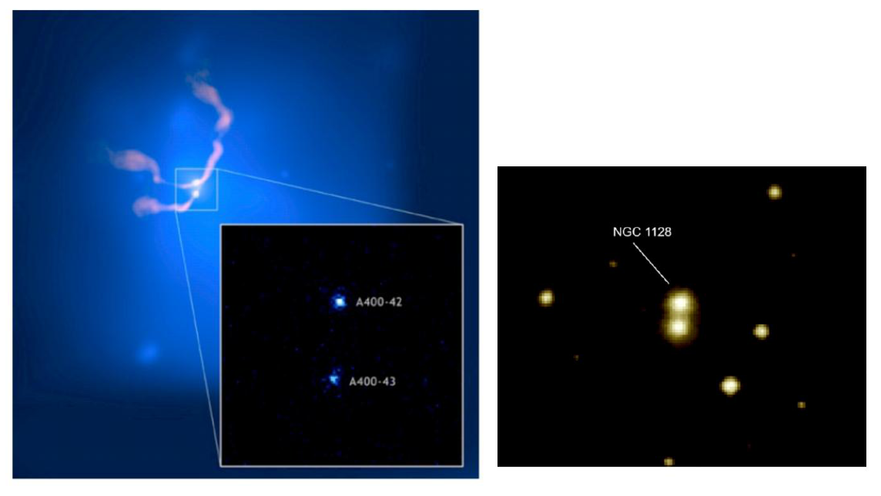
X-ray Cluster Abell 400
3C 75
NGC 1128

Slide 53
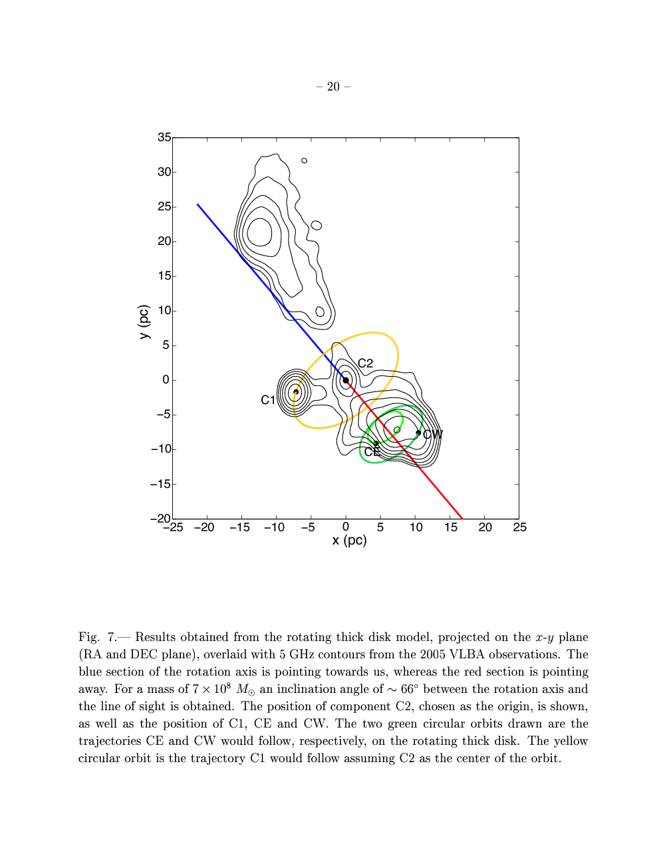
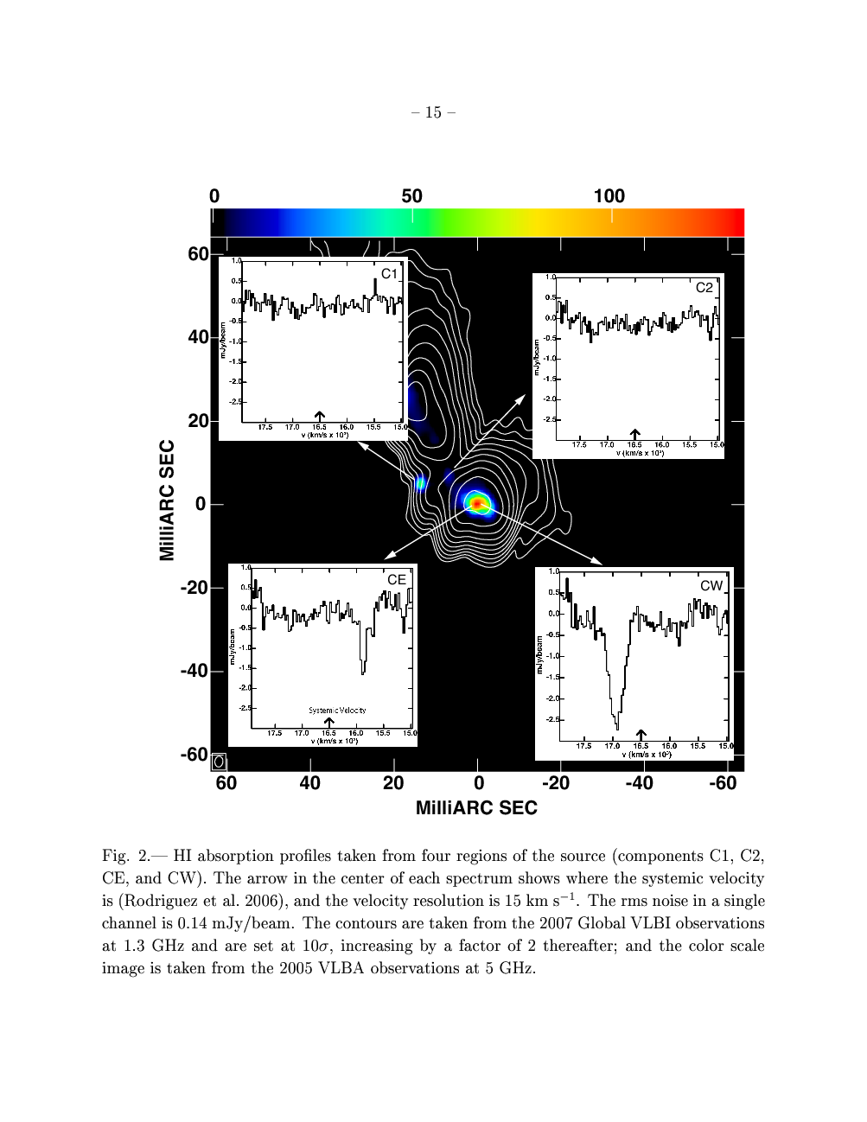

0402+379 (Rodriguez et al. 2006-9)
VLBI at 1.35 GHz
Projected separation: 7.3 pc,
Estimated total mass:

Slide 54
stars
stars
broad-line clouds
broad-line clouds
narrow-line clouds
narrow-line clouds

Slide 55
stars
broad-line clouds
broad-line clouds
narrow-line clouds

Slide 56
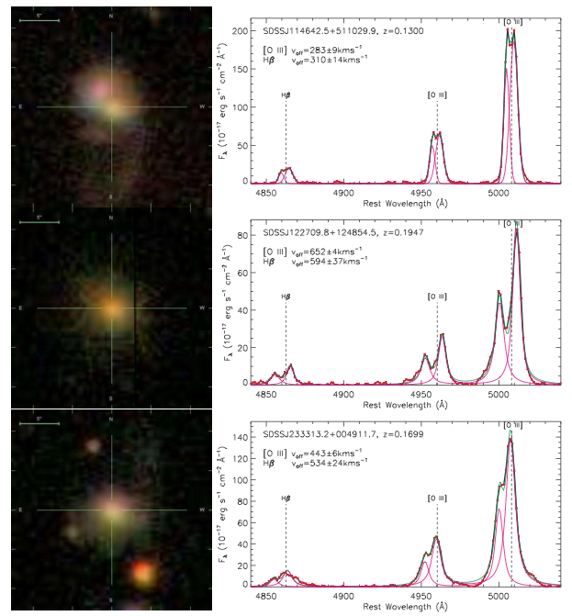
SDSS images & spectra of selected double narrow -line quasars
(Liu et al. 2009)

Slide 57
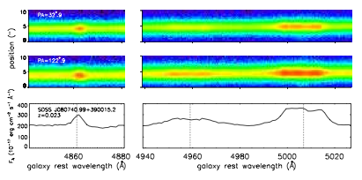





Comerford et al. (2012)

Slide 58

Double-peaked Narrow-Line Signatures of Dual Supermassive Black Holes in Galaxy Merger Simulations
Blecha, Loeb, & Narayan (2012)

Slide 59

Double Broad Lines: Reverberation
Shen & Loeb (2010)

Slide 60



Gas Accretion and Electromagnetic Emission from BH Binaries
Kocsis, Haiman, & Loeb ArXiv:1205.5268 (2012)

Slide 61


Multiple Black Holes
>2000 km/s
Kulkarni & Loeb 2011; Hoffman & Loeb 2007

Slide 62
Extreme Mass Ratio Inspirals (EMRIs)
Stellar mass BH or NS in an orbits around SMBH
Many orbital times in the eLISA/NGO band, allowing a precise determination of GR or astrophysical perturbations
The compact object may have formed or been trapped inside the accretion disk.

Slide 63



Gravitational Waves
source: BH/NS binaries
detector: laser interferometer (such as LIGO or eLISA)
Precision: one thousandth the diameter of a proton

Slide 64


Black Hole Recoil
Physics
Astrophysics
(Centrella et al. 2007)
(Blecha & Loeb 2009)

Slide 65
Gravitational Wave Recoil

Slide 66
Gravitational Wave Recoil
GWs
Anisotropic emission of gravitational waves → recoil

Slide 67
Gravitational Wave Recoil

Slide 68
A recoil candidate: CID-42
*spatial offset: ~2.5 kpc *velocity offset in NLR/BLR of H-beta: ~1,200 km/s *z=0.36
Civano et al. (2010)

Slide 69


Effect of Recoil on Black Hole Growth
Blecha, Cox , Loeb, & Hernquist 2010

Slide 70

Star Clusters Around Recoiled Black Holes in the Milky Way Halo
~100 BHs ejected during assembly of MW halo
Carry star clusters from cusp of host dwarf galaxy
Clusters characterized by compact size (~1pc) and high velocity dispersion (~10-100 km/s)
escape (dwarf) ~ 10 km/s << GW recoil~hundreds of km/s < escape(MW) ~ 500 km/s
O’Leary & Loeb 2008, 2010 arXiv:0809.4262 ; arXiv:1102.3695

Slide 71

Tidal Disruption of a Star by a Supermassive Black Hole

Slide 72



Tidal Disruption of Stars
Single BH rate per MW galaxy due to empty loss cone
BHs with swallow the star whole
Super-Eddington initial feeding rate:

Slide 73

Bound Star in a Pseudo-Newtonian Potential (e=0.8,beta=5)
Hayasaki, Stone, and Loeb 2012

Slide 74



EM Counterpart of LISA Sources: Tidal Disruption of Stars
“loss cone” filled by GW recoil
(Stone & Loeb 2010)

Slide 75

A Relativistic Jet from a TDE: Swift 164449.3+573451 (GRB110328A)
Bloom et al. 2011
Zauderer et al. 2011
*Synchrotron and X-ray peaks are emitted from different regions; bulk Lorentz factor~2-3

Slide 76



Observing Lense-Thirring Precession in Tidal Disruption Flares
days
log(spin)
a
Stone & Loeb (2011)

Slide 77


*Ionized cloud, ~3x10^5 cm^{-3}, ~100AU, electrons at 10^4K, dust at 550K, 3 Earth masses
Gillessen et al., Nature (2012)

Slide 78




Latest Data
Gillessen et al. , submitted (2012)

Slide 79

Br-gamma

Slide 80

Burkert et al. (2012)

Slide 81

“Pressure-Confined Cloud” Model
Schartmann et al. (2012)

Slide 82
Problem: why is the head moving on a ballistic orbit with no evidence for ambient ram-pressure?

Slide 83

Tidal Disruption of a Proto-Planetary Disk Around a Low-Mass Star
*Planets form near SgrA*
*Flags low-mass stars
Murray-Clay & Loeb (2012)

Slide 84

Physical Parameters
Low-mass star, born in circum-nuclear ring at ~0.04pc, and scattered into orbit a few Myrs ago.
Original
Current

Slide 85

Low probability for scattering if this represents the first passage, but high probability for multiple passages in which the gas cloud is rejuvinated every pericenter passage (from ~1AU).
Ionizing background from surrounding O-stars generates a ~10 km/s outflow from tidally-truncated disk of 1-10AU around M-dwarf (too faint to be observable).
Photoevaporation yields a wind mass loss rate:

Slide 86



HI
Br-pericenter
observed
observed
now
ionized

Slide 87



Hypervelocity Planets from Tidal Disruption of Stellar Binaries by SgrA*
Ginsburg, Loeb, & Wegner (2012)

Slide 88

Possible Outcome: Free Hypervelocity Planets

Slide 89

Transits of Hypervelocity Stars

Slide 90
Summary:
1. Direct imaging of the largest silhouettes of black holes (SgrA*, M87) will be achievable with upcoming radio telescopes within the next decade.

Slide 91
Summary:
2. Black hole binaries form in galaxy mergers and produce detectable gravitational waves
3. Coalescence of black hole binaries results in recoils and consequently: offset quasars, floating star clusters in the Milky-Way halo, enhanced rate for tidal disruption of stars

