Slide 1
Pivotal Discoveries in Radio Astronomy at Bell Labs
Robert W. Wilson
Harvard-Smithsonian Center for Astrophysics
(Bell Labs, retired)
Notes:
1
1
This ran ~55 minutes
In this talk I would like to tell the story of how a part of Bell Labs whose main goal was improving long distance communications made three major astronomical discoveries along the way.

Slide 2
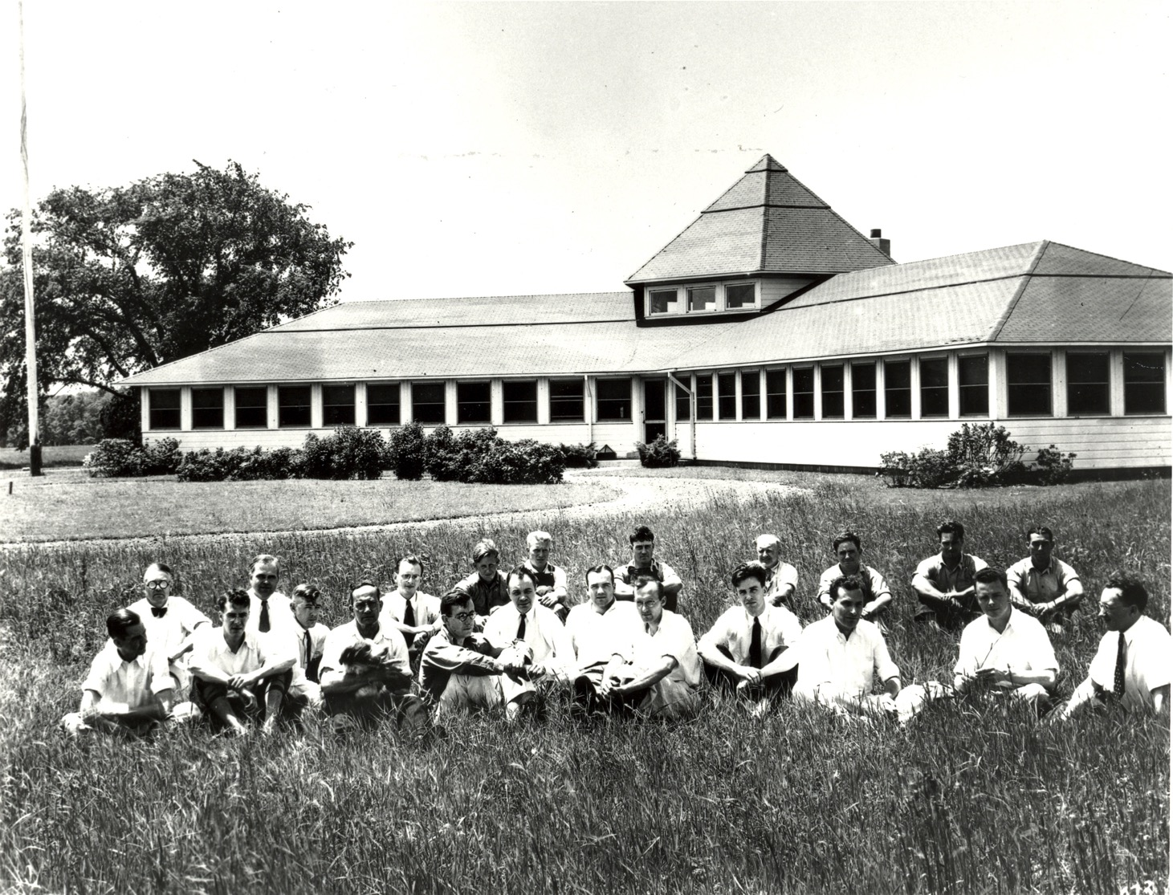
Notes:
In the 1920’s Bell Labs established field stations in NJ for radio research
The initial interest was using HF radio for transatlantic telephony
They were eventually concentrated in Holmdel, NJ. Their primary charter was research for long distance communications
In 1928 Art Crawford and Karl Jansky were hired and they initially roomed together.
1933 Turkey shed picture Crawford(far left) …Jansky Merlin Sharpless, King, Edmond Bruce, Al Beck(Horn-Reflector,far right)
Back row from left Englund Friis, Doug Ring (cellular Radio, switching scheme)
2

Slide 3
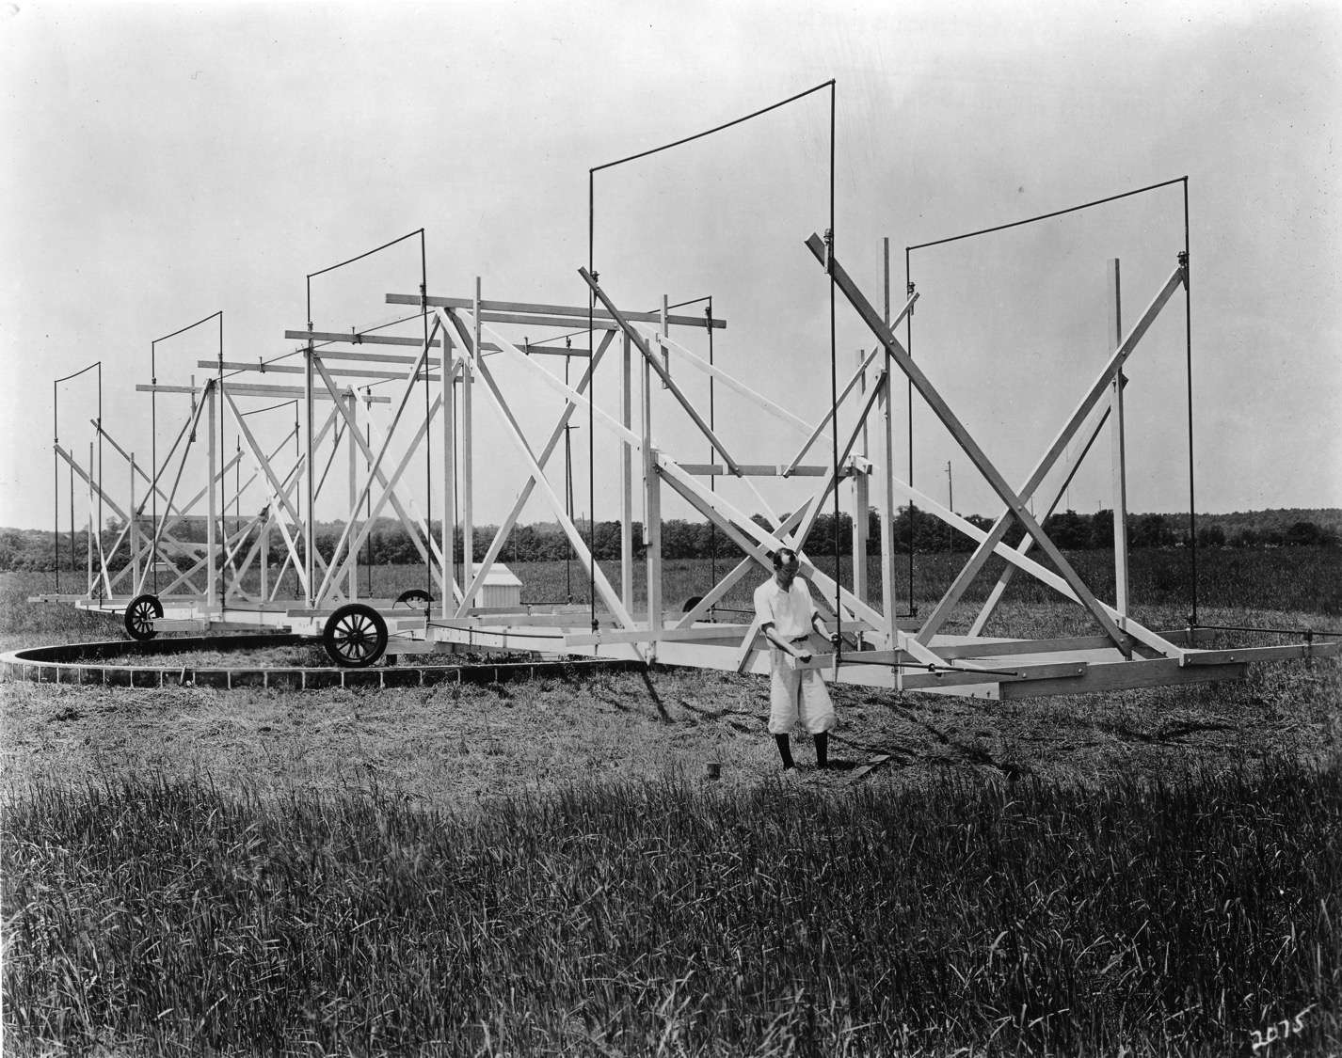
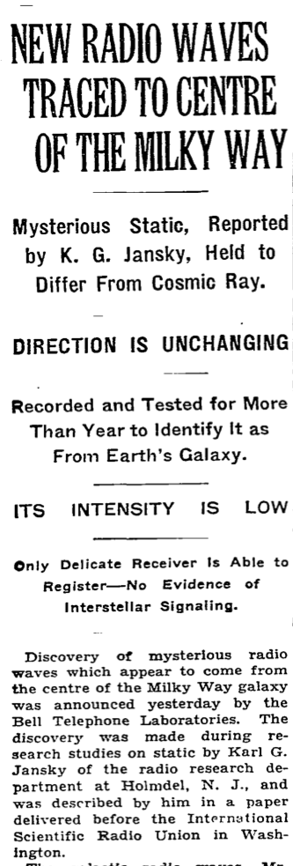
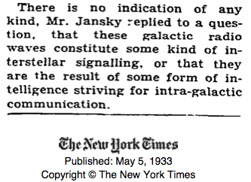
Notes:
3
Karl was tasked with understanding the sources of noise on proposed trans-Atlantic short-wave radio-telephone connections
He built this large (95’) rotating directional (Bruce) antenna and a sensitive radio receiver and recorded its output. 20.5 MHz, 14.6m
In addition to thunderstorms and man made noise, he found a hiss like noise which came from the same direction at about the same time every day
In 1933 after several years of observation he identified it as radio noise from the center of our Milky Way galaxy, starting the field of radio astronomy, first radio telescope v/m units not understood by astronomers
Not from alien civilization!
One more report of Star Stattic from MUSA in 1930s, probably Cygnus region
Unfortunately Karl died young from a chronic kidney disease and did not live to see radio astronomy become an important science
3

Slide 4
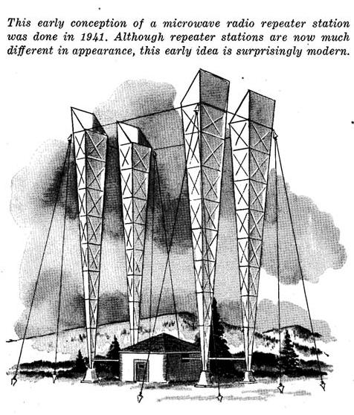
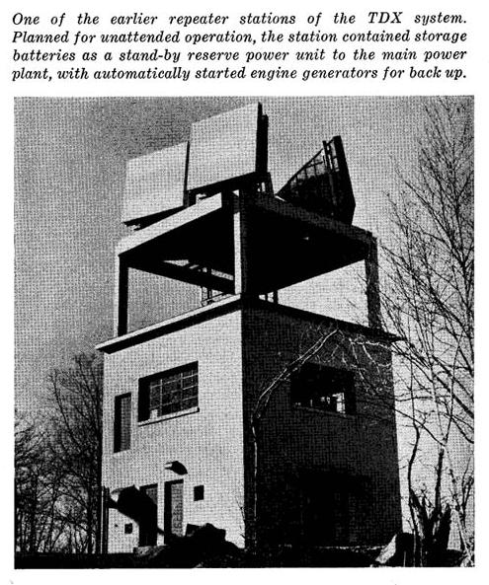
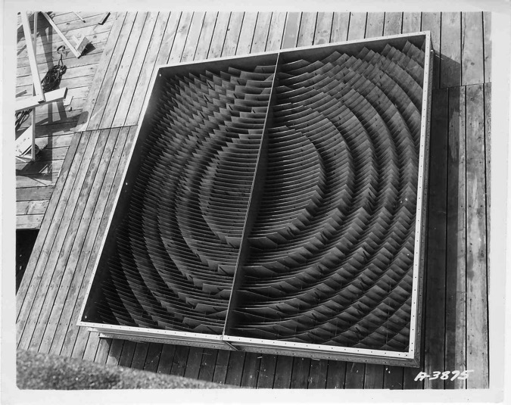
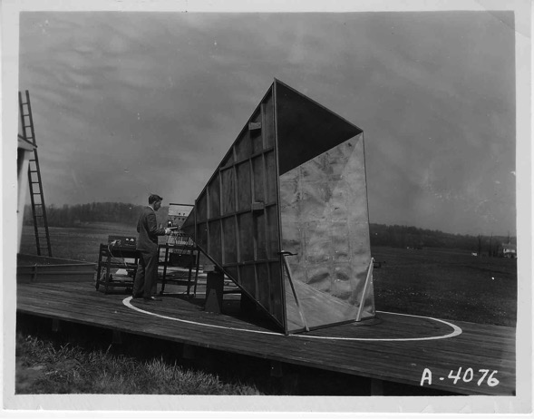
Notes:
4
The group started working on microwave relay
During WWII they worked on radar.
Microwave relay systems developed after WWII
How Al Beck invented the Horn-Reflector.

Slide 5
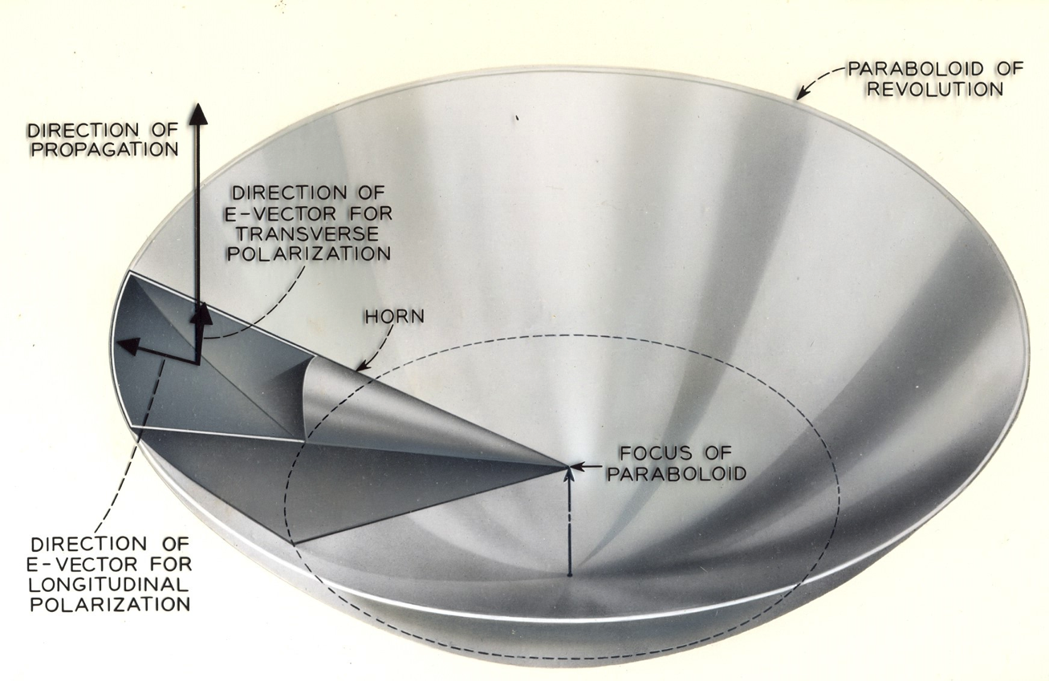
Notes:
Al Beck & Harold Friis invented H-R

Slide 6
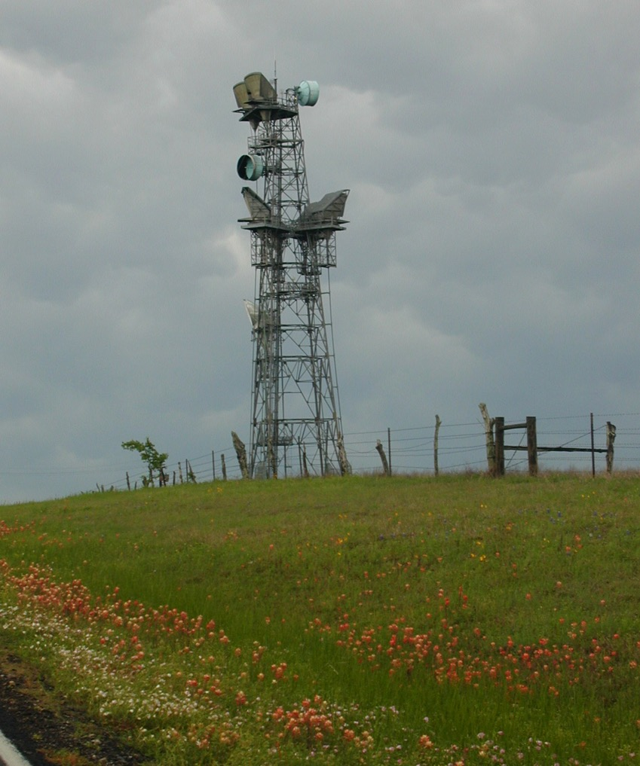
Notes:
6

Slide 7
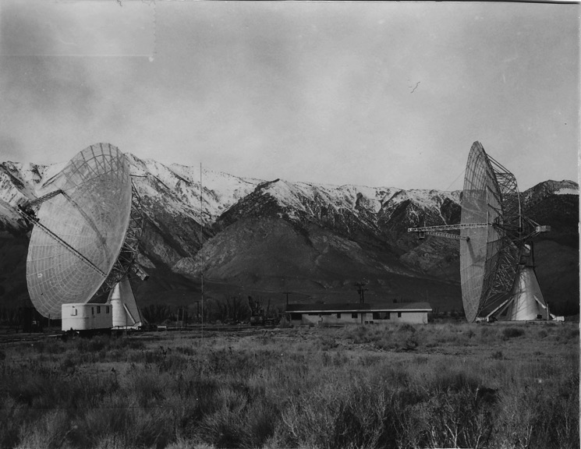
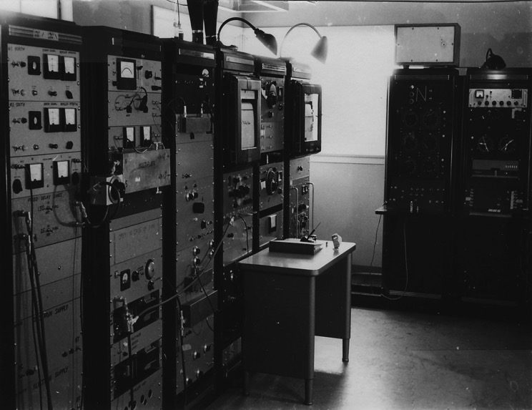
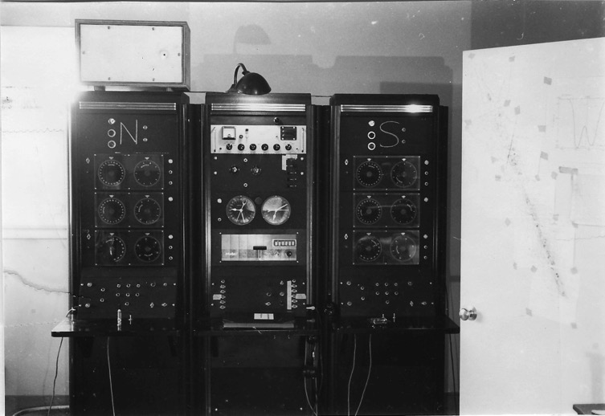
Notes:
In 1957 I went to Caltech for a PhD in Physics. Sputnik was launched that October.
I Joined the new Radio Astronomy group at Caltech.
My one cosmology course was taught by Sir Fred Hoyle and philosophically I liked the steady-state theory.
In my thesis I used one of the 90’ dishes of the interferometer to map the brightness of the part of the Milky Way we could see from the Owens Valley.
7

Slide 8
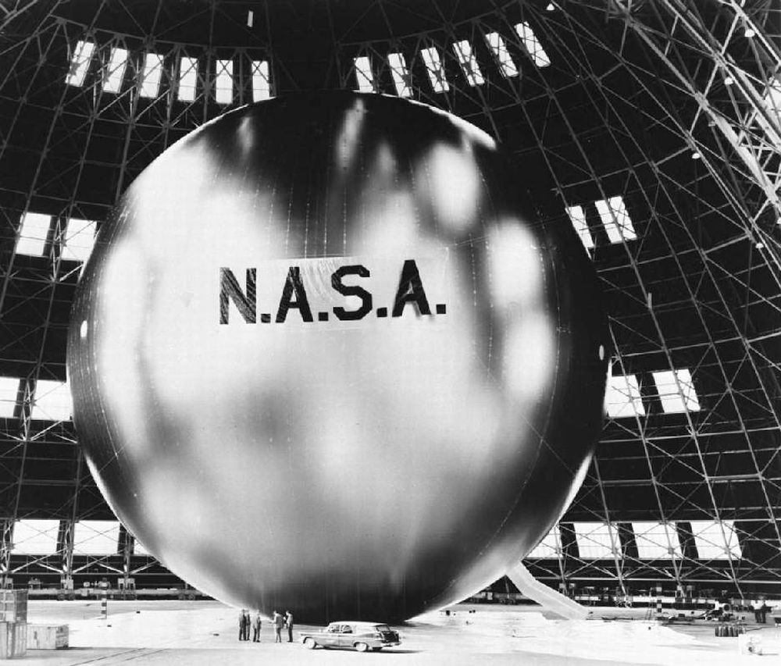
Notes:
8
John Pierce
Book on electron beam guns
communication theory, PCM with Barney Oliver and Claude Shannon
Supervised transistor team and coined the name
computer music
science fiction as J.J. Coupling
In 1955 John Pierce published a paper in ‘Jet Propulsion’ titled “Orbital Radio Relays” he was apparently unaware of Arthur C. Clark’s “Extra-Terrestrial Relays” in WW 1945
In 1957 Sputnik was launched and then in 1958 NASA proposed launching the 100’ diameter Echo balloon made of , 0.0005” aluminized mylar to measure the forces in orbit.
Bell Labs proposed using Echo as a first communications satellite.

Slide 9
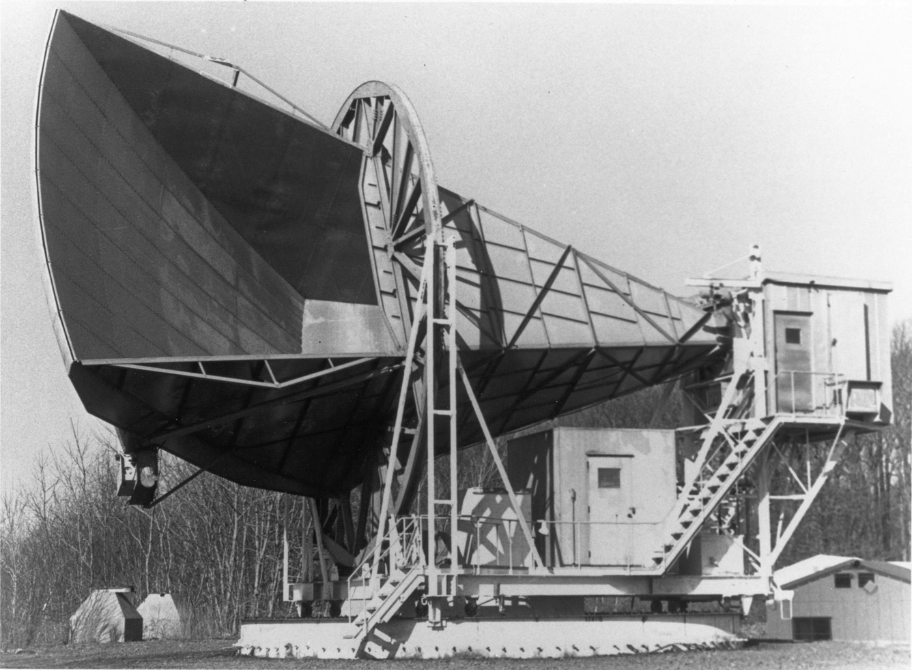
The 20 foot Horn-Reflector
Notes:
9
9
The return signal would be weak, so they would combine two Bell Labs inventions to form a low noise receiving system.
A ruby traveling wave MASER amplifier
A large horn-reflector antenna Art Crawford ( Receiver shielded)
Echo was launched and used as a microwave relay in 1960. Eisenhower’s voice was transmitted by JPL and received at Crawford Hill

Slide 10
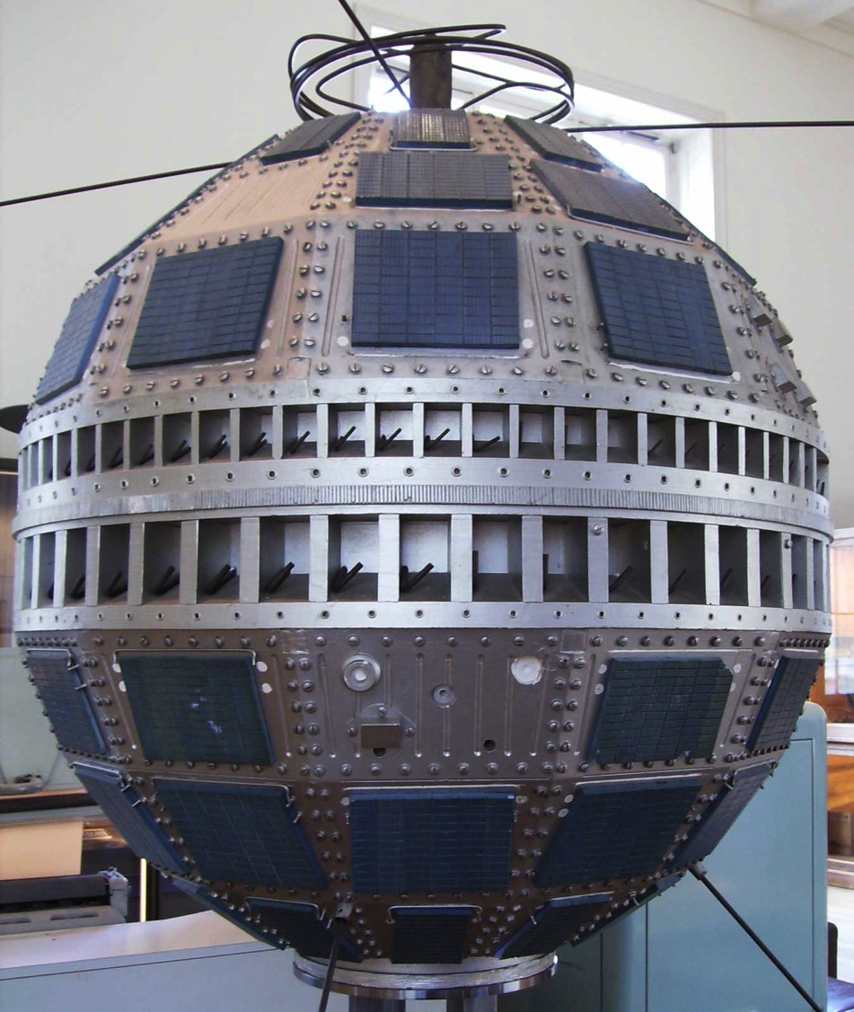
Notes:
10
Telstar was the first active communications satellite, launched in 1962
The 20’ H-R had a backup role and was equipped with a TWM.

Slide 11
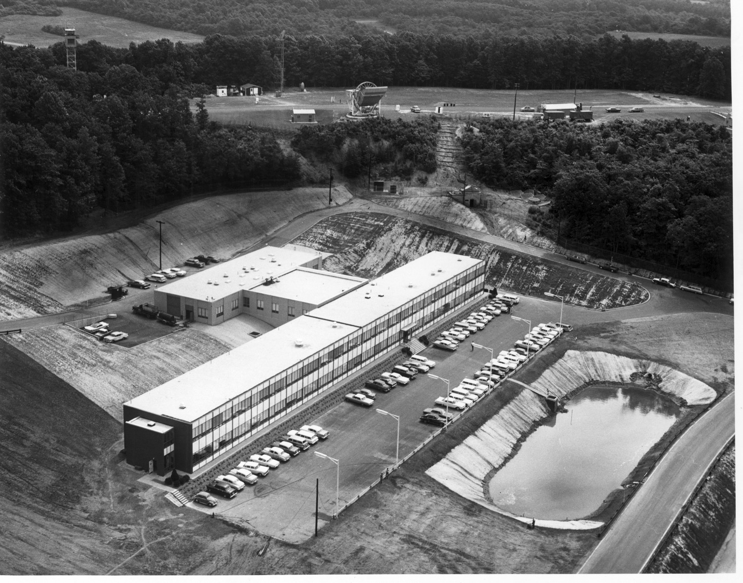
Notes:
After finishing my PhD and a one year post-doc I took a job at Bell Labs' Crawford Hill Lab in 1963.
Comsat had been created just before I came.
Arno Penzias was hired year earlier after he finished a radio astronomy thesis at Columbia with Charlie Townes.
Why did Bell Labs hire two radio astronomers? Art Crawford, Rudi Kompfner
The attraction to Arno and me was the research atmosphere, the generous support and the opportunity to use the 20 foot horn-reflector with very low noise traveling wave MASER amplifiers from Whippany.
Both Arno and I had used larger antennas for our theses, but the 20 foot horn-reflector had special properties.
11

Slide 12
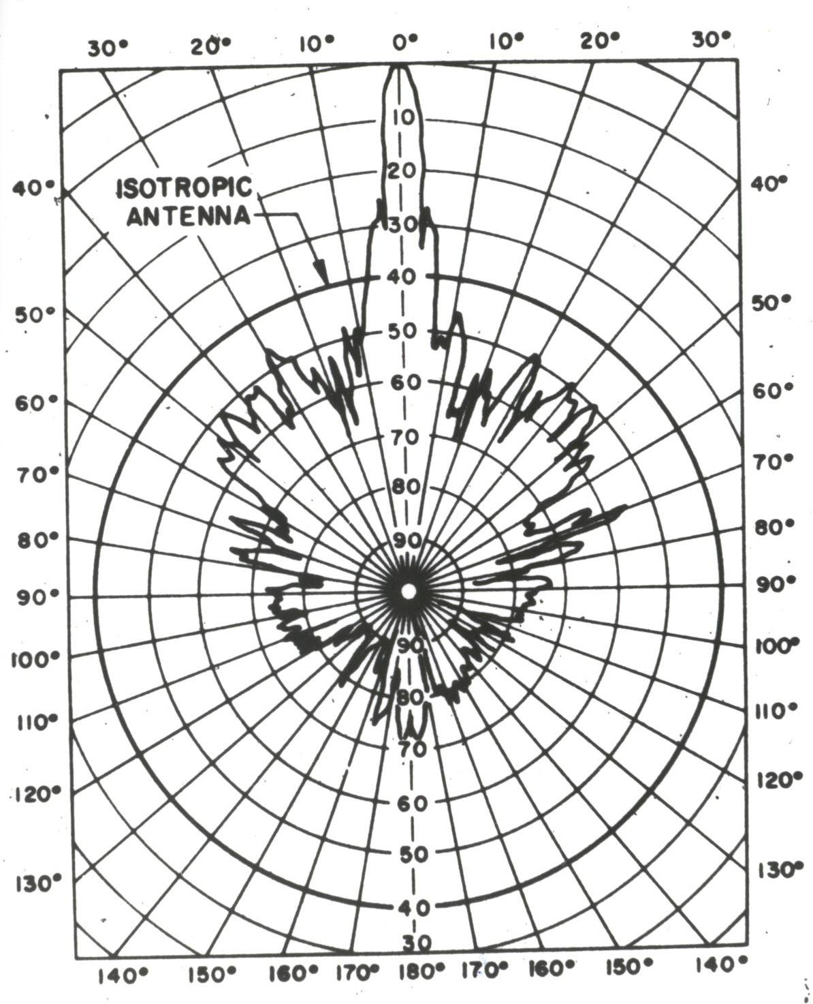
Notes:
Back lobes more than 30 dB below isotropic.
Small enough that we could measure its gain with a source in the far field.

Slide 13
Our Plans
Arno and I set out a series of measurements we wanted to make using the 20 foot horn-reflector, making use of its unique properties to make measurements others were not making. Among them were:
Measure the absolute strength of CasA and other sources at 4 GHz. This would be useful for astronomy and satellite systems.
Look for a halo of radiation around the Milky Way at 1.4 GHz and establish a zero level for extra-terrestrial radio radiation at that frequency.
Make a much better search for atomic hydrogen in galactic clusters than Arno had done at Columbia
Notes:
13
13
By starting with the existing Telstar 4 GHz system, we could do the useful measurement of CasA and a control measurement for the galactic halo.
We built the best measuring system we could:
Arno made a liquid helium cooled reference noise source.
I made an accurate switch for comparing the antenna to the reference and improved the stability of the measuring system.

Slide 14
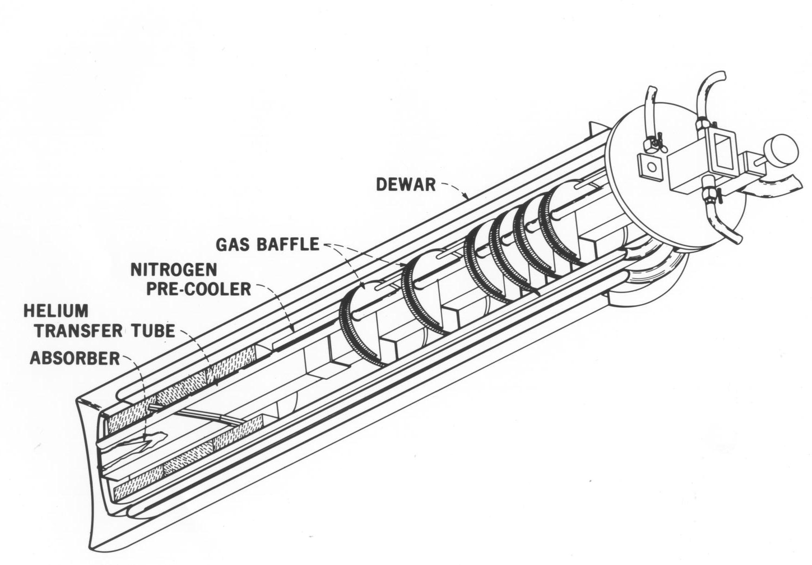
Notes:
14

Slide 15
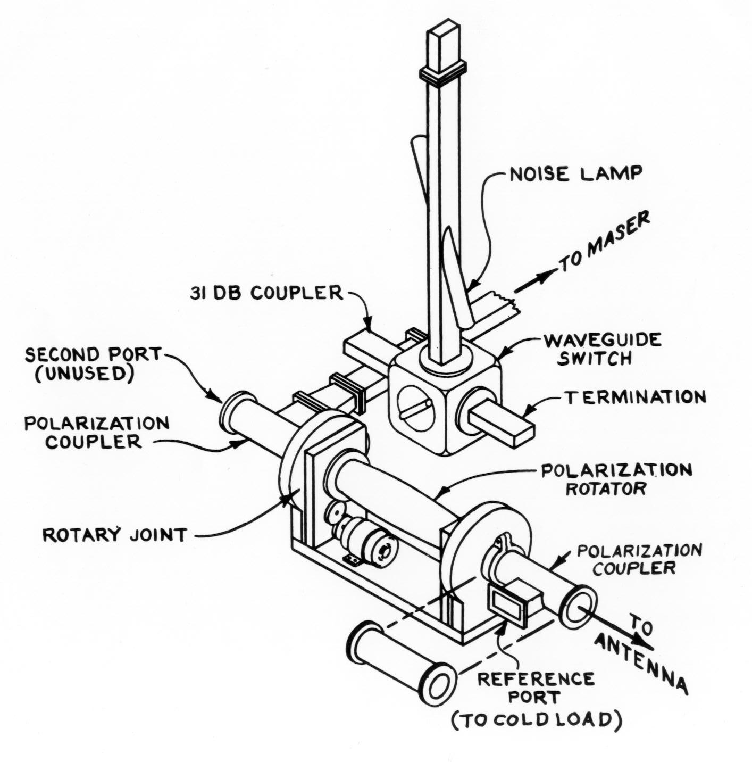

Slide 16
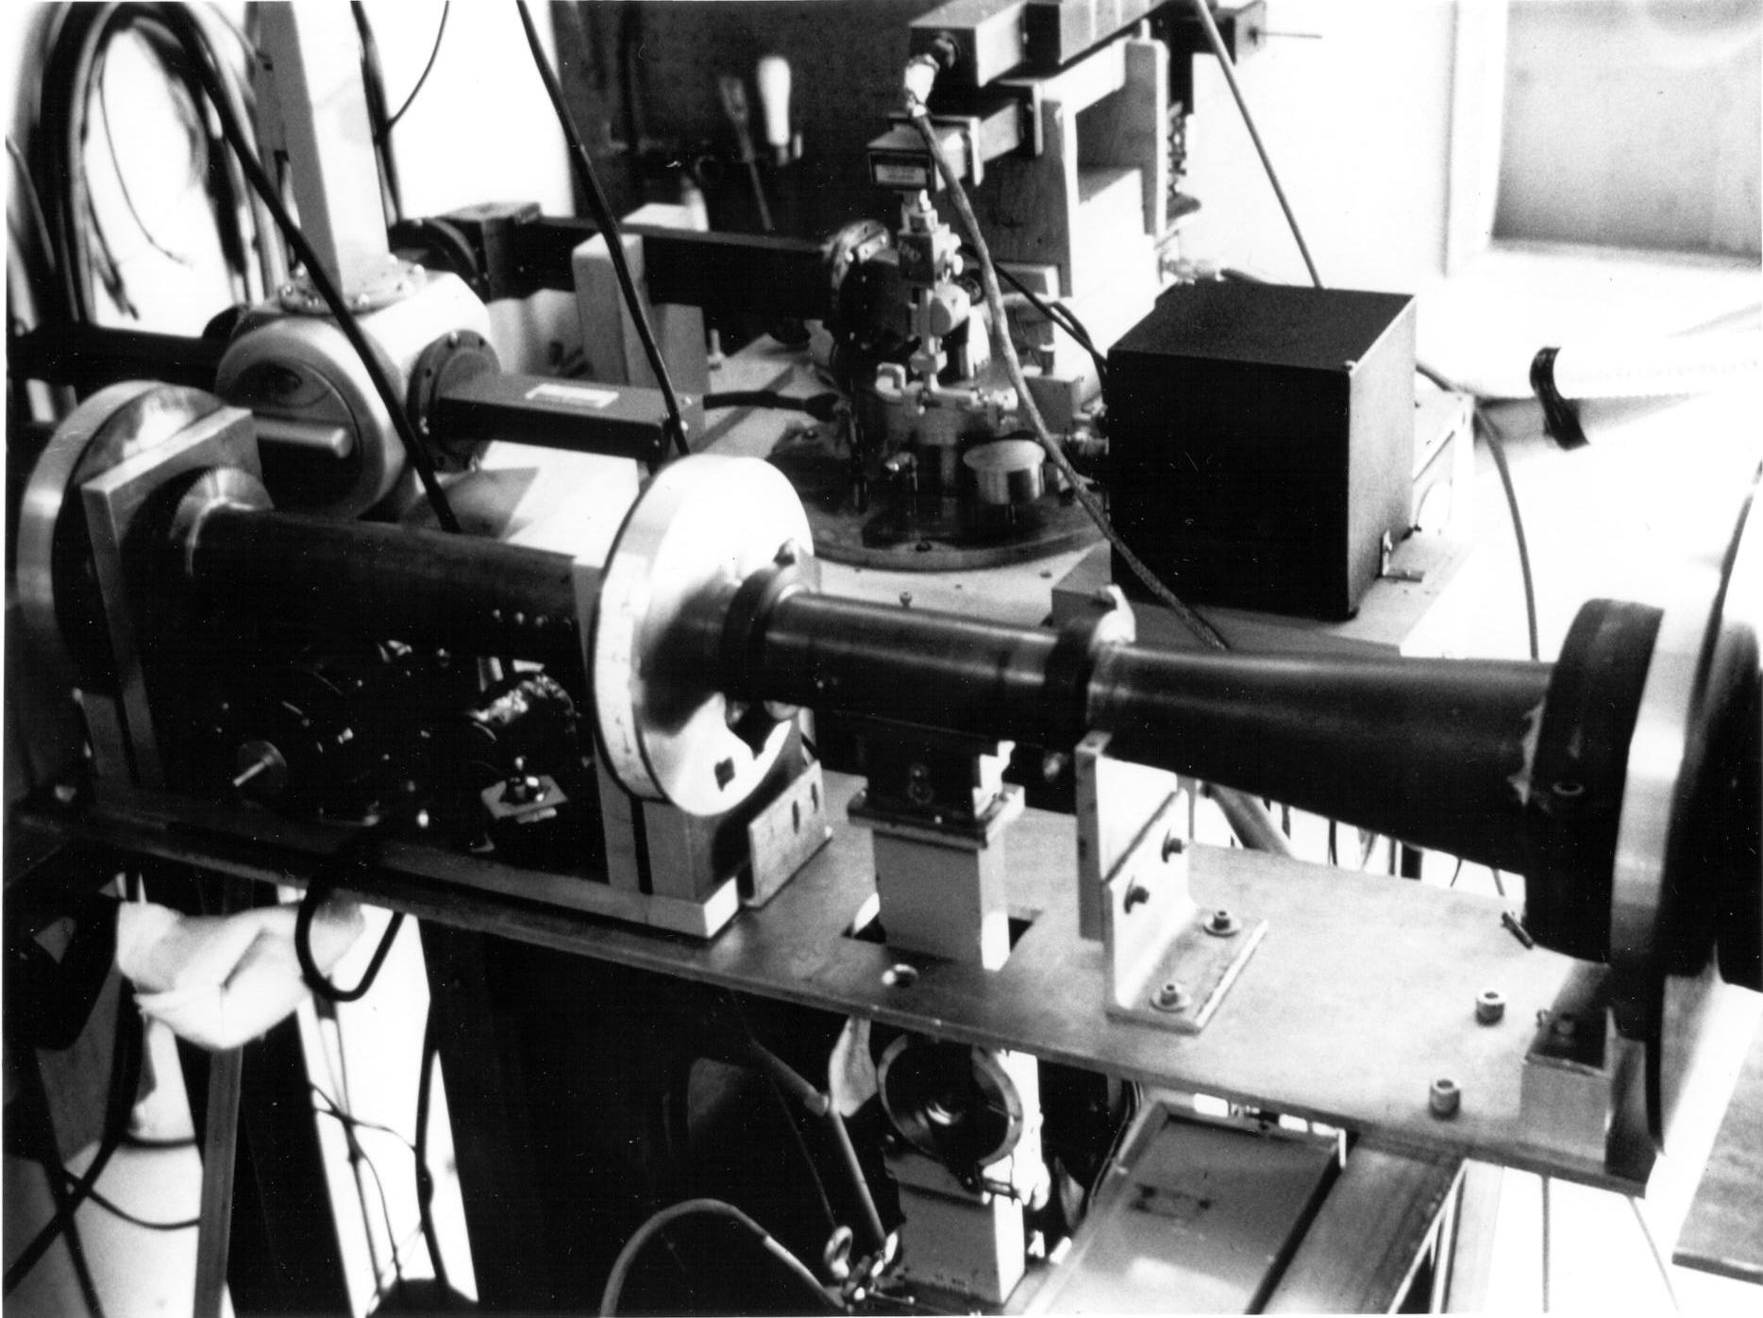
Notes:
Attenuator between cold load and polarization coupler

Slide 17
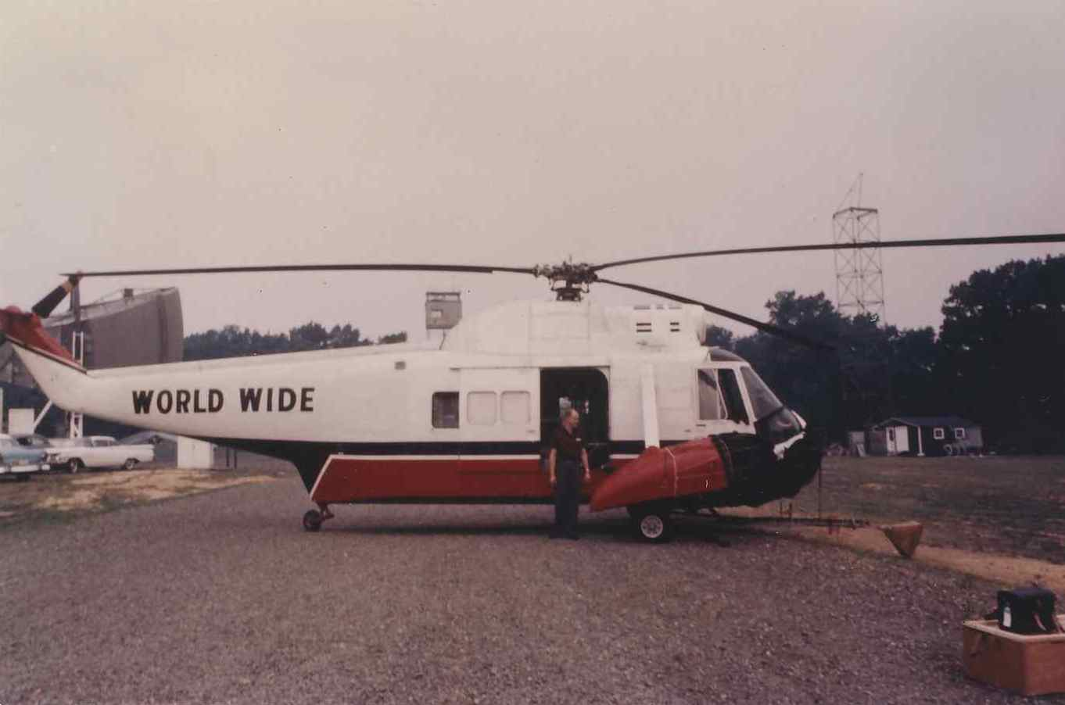

Slide 18
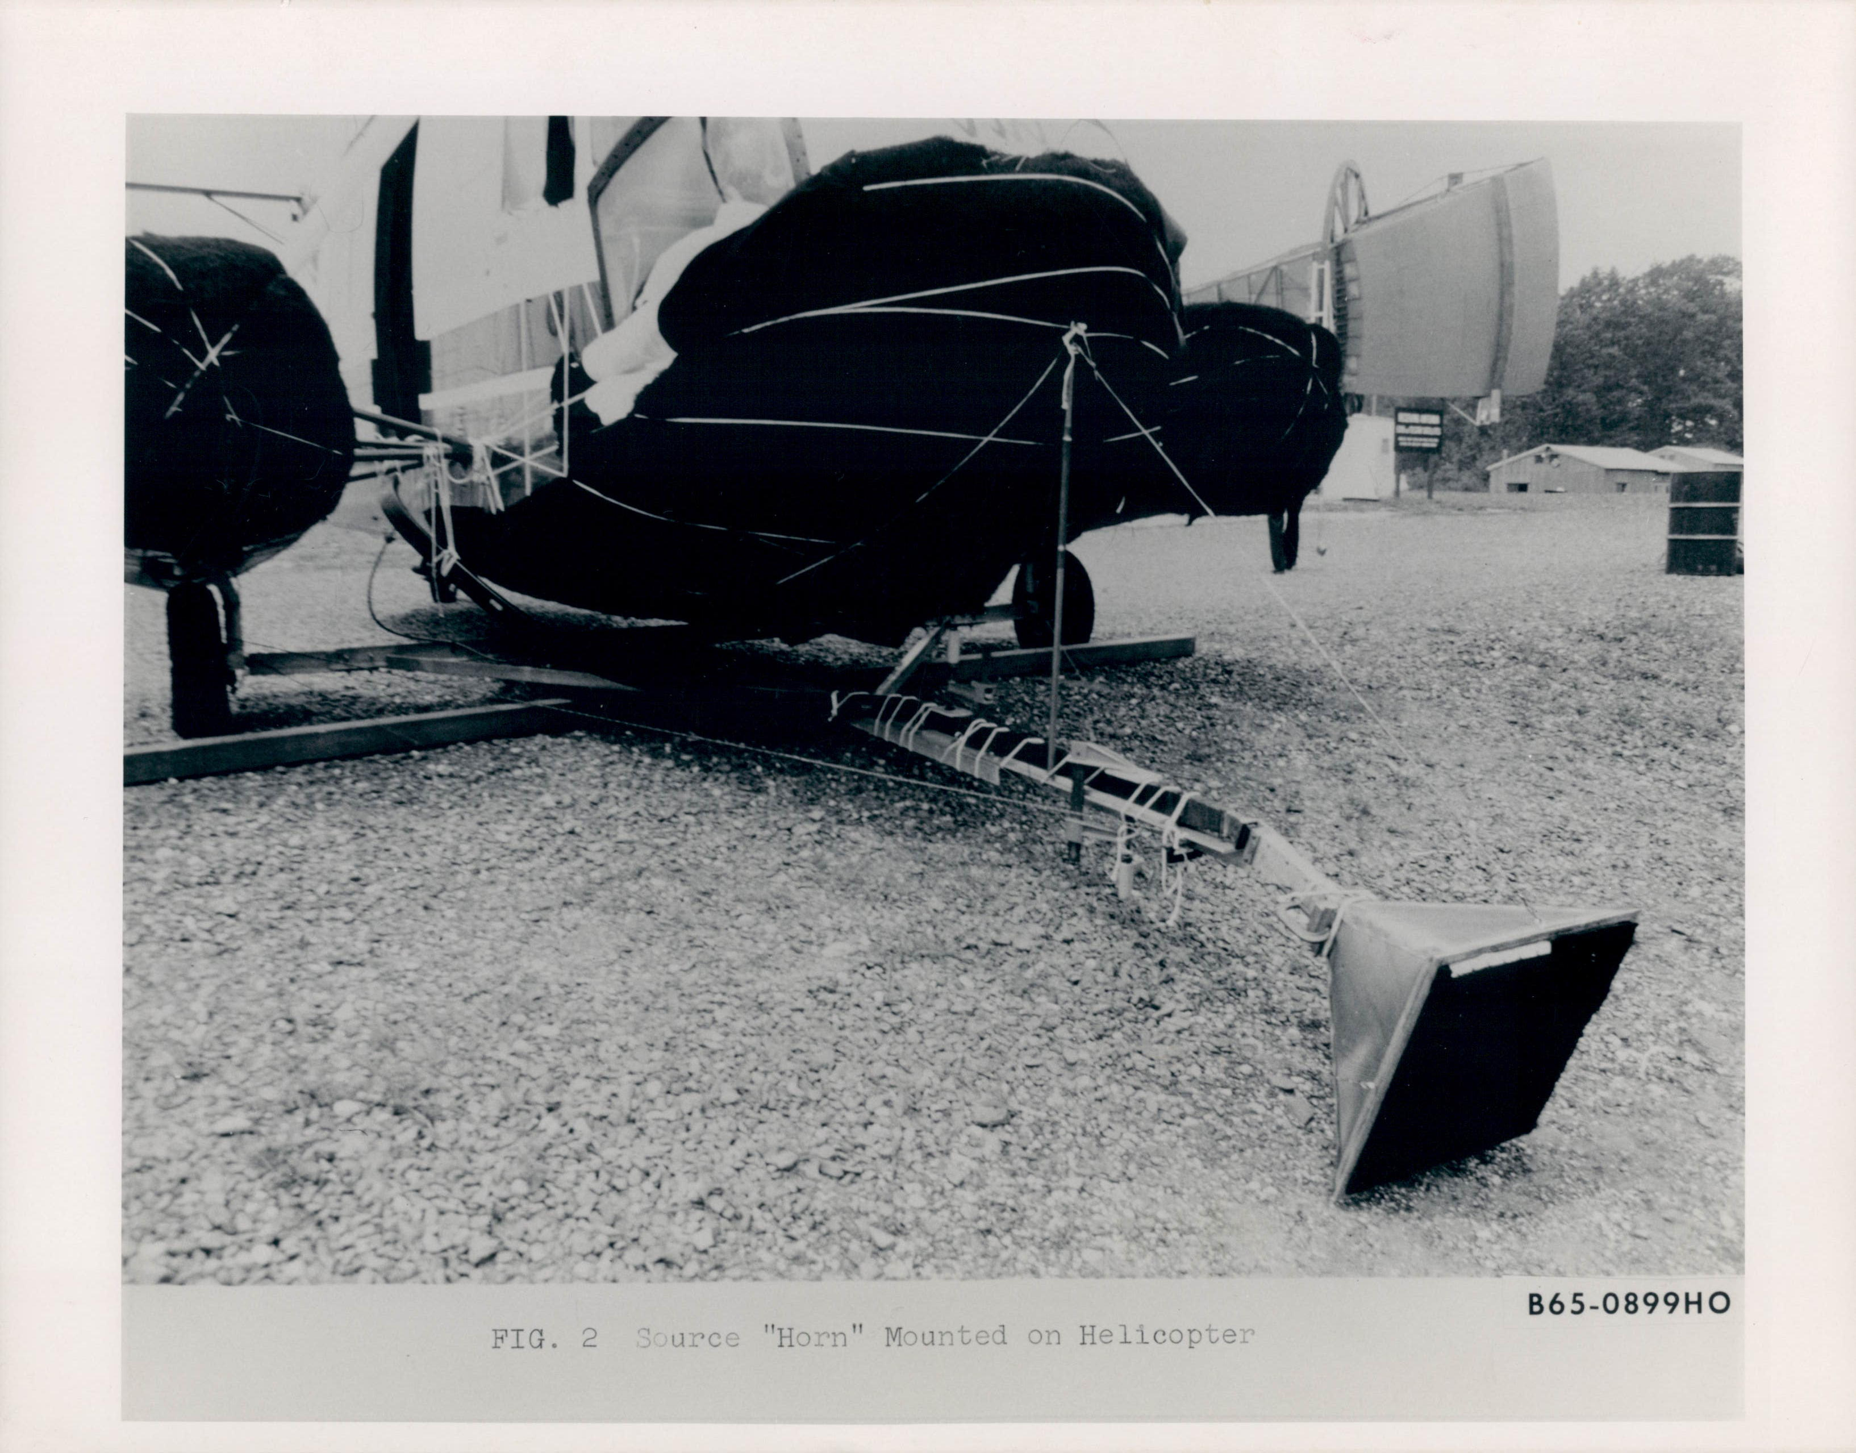

Slide 19
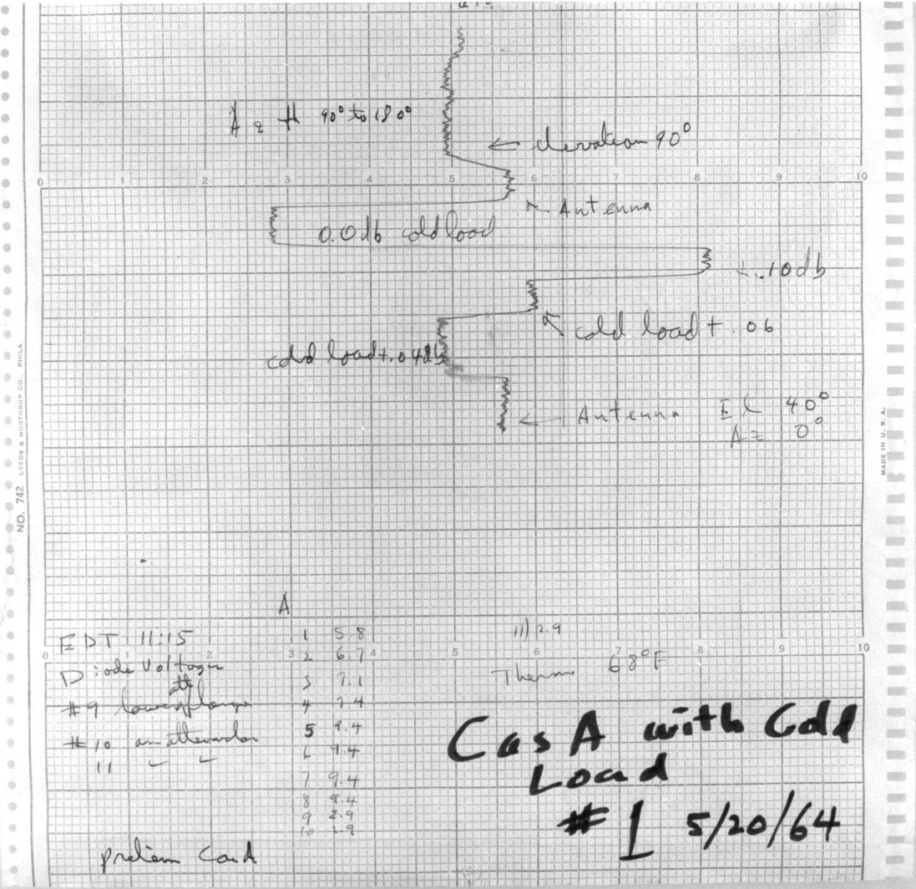
Notes:
19
This is a copy of the 1st measurement comparing the antenna to the cold load Arno and I made when we got our radiometer together.
Disappointing
Point out antenna and cold load
By this time Dave Hogg and I had accurately measured the gain of the 20-foot horn-reflector and the most important thing for us to do was to make the CasA measurement while that gain was still valid.
We spent 9 months improving our receiver, checking that several different ways of calibrating it gave consistent answers and accurately measuring the strength of several radio sources, including Cas A.
Ant temp same whether the Cold load just filled or almost out of helium
During that time the excess noise of 3.5K remained the same and we found no fault in our equipment or environment to explain it.

Slide 20
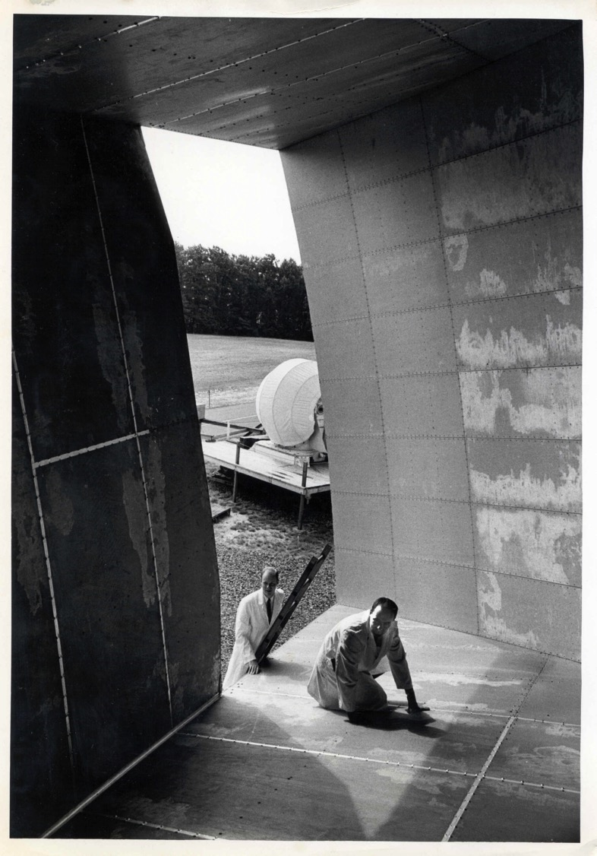
Notes:
After completing the CasA measurement we started cleaning up some parts of the antenna which we had not wanted to disturb earlier, including removing a pair of pigeons and their droppings. This had little effect.
20

Slide 21
Sources Which We Ruled Out
Atmospheric radiation
Man made noise (NYC on our horizon)
Pigeon droppings in our antenna
Imperfect walls of the antenna
The Starfish high altitude nuclear bomb test
Unknown solar system source
The Milky Way galaxy
The combined effect of known discrete sources

Slide 22
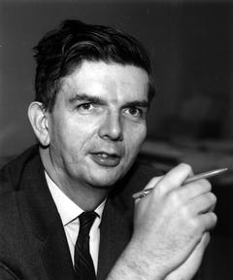
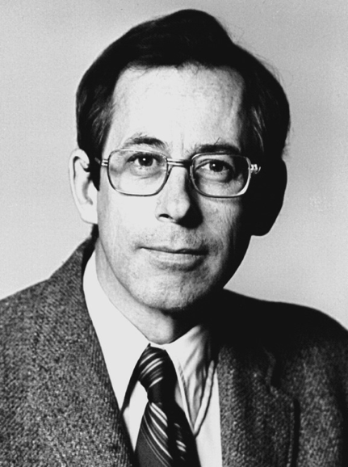
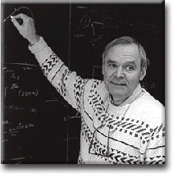
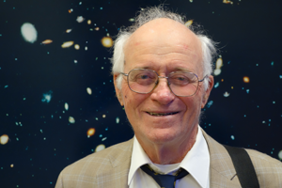
Dave Wilkinson
Robert Dicke
Jim Peebles
Bernie Burke
Notes:
We had eliminated almost every source of the excess noise we could think of when one Spring day in 1965 Arno called Bernie Burke
Dicke physicist who worked with microwaves and radar during WW2, but had become interested in gravity theory
The Princeton Gravity Group’s plans
Arno called Bob Dicke at Princeton ...
Arno and I were happy to have any explanation.
We and Dicke's group wrote two separate papers
We made one final check and submitted our paper.
May 20, 1965 two things happened. Walter Sullivan, my father’s visit

Slide 23
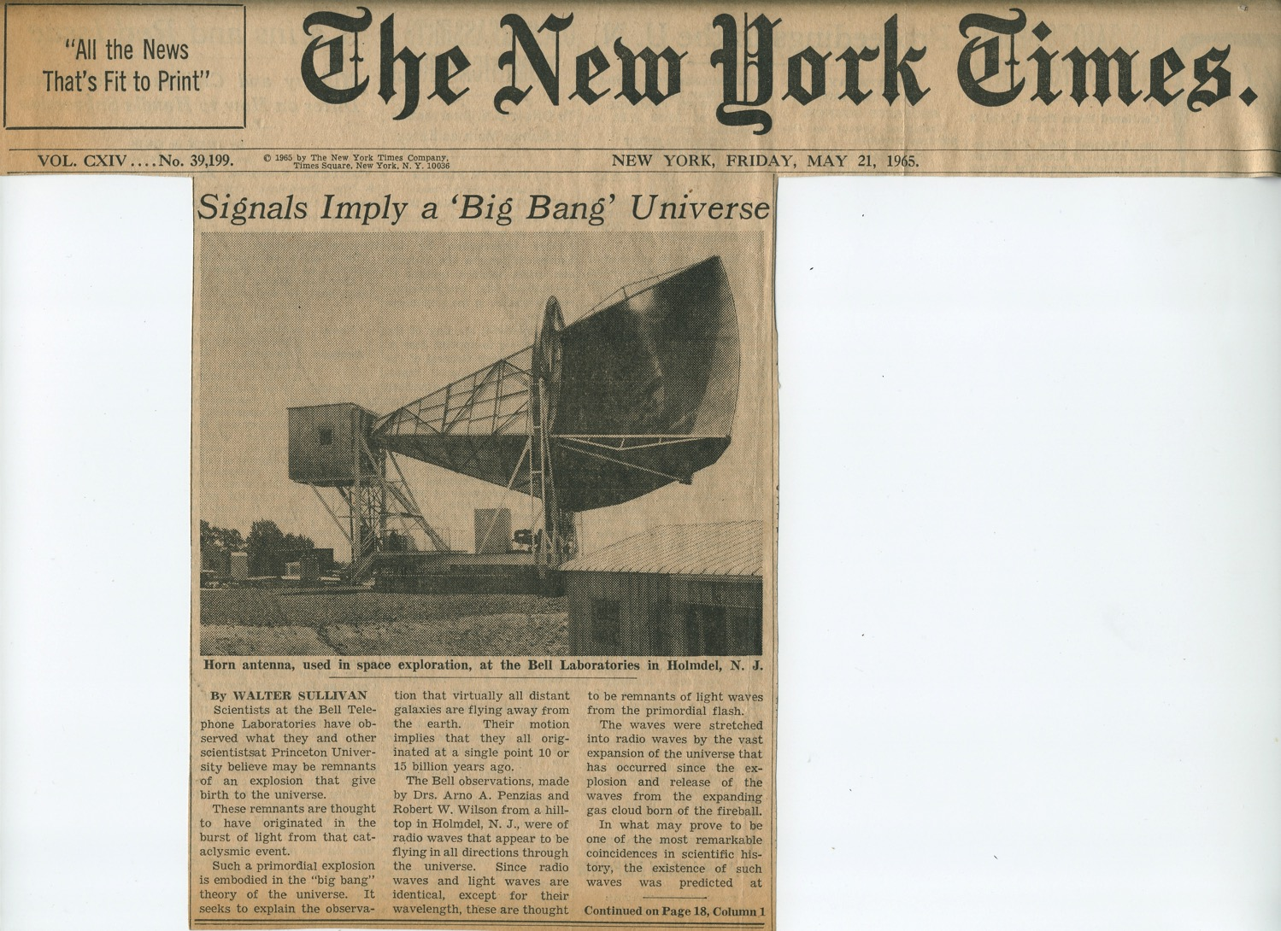
Notes:
This showed me that other people were taking the cosmology seriously.
Arno and I went to NY for a series of lectures on cosmology by Dennis Sciama, an early supporter of the Steady State theory
23

Slide 24
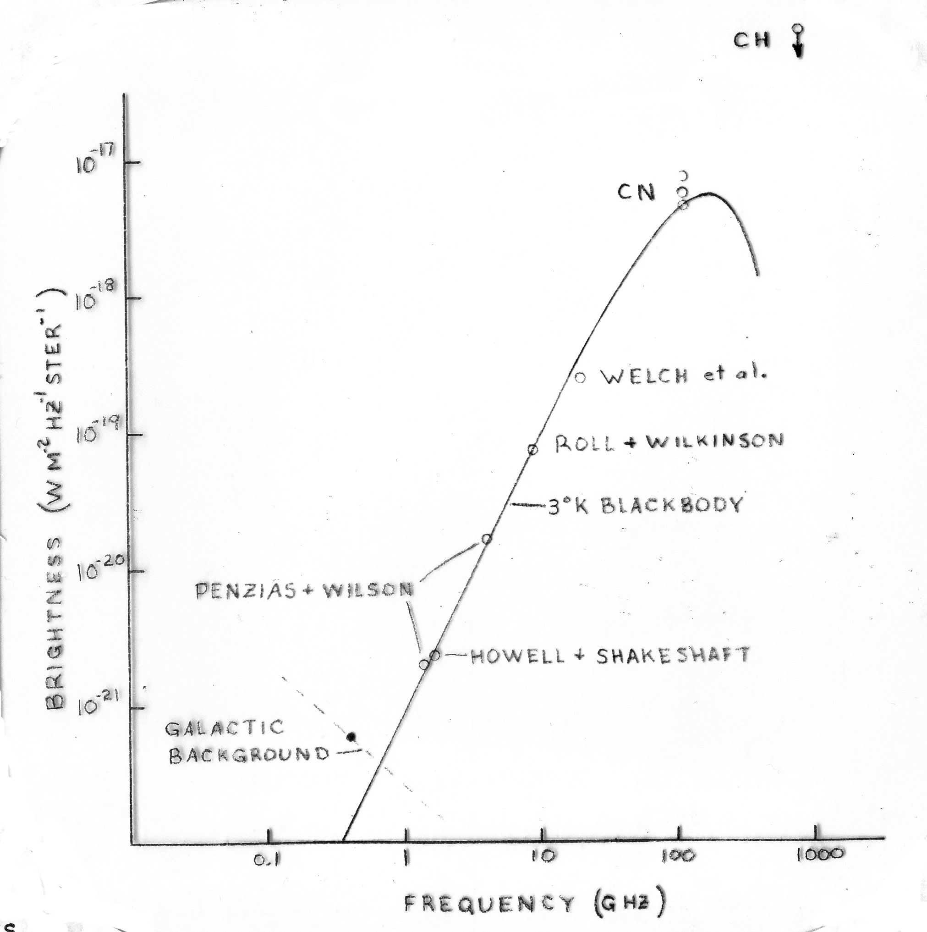
Measurements of the CMBR After a Year
Notes:
24

Slide 25
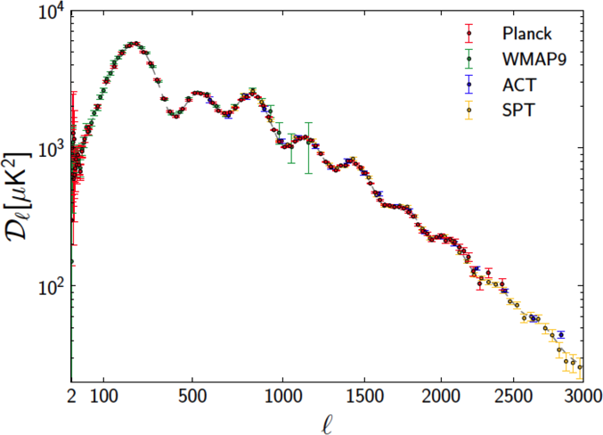
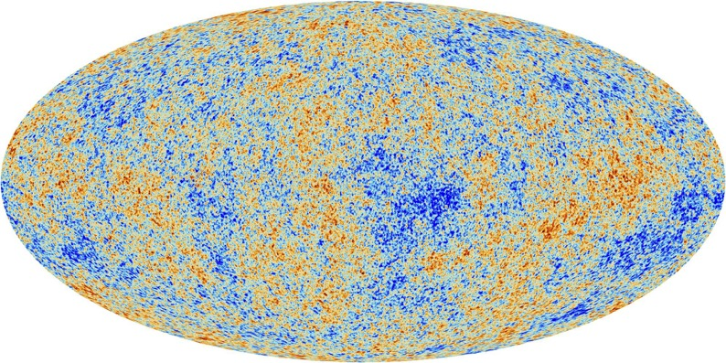
Baby Picture of the Universe at 379,000 Years
Cosmic Microwave Background (CMB)
The Cosmic Microwave Background as measured by the Planck Satellite
(±200 μK)
Spectrum of the brightness variations with fit by Cosmic Inflation (line)
Notes:
This is our best picture of the early univere.
Inflation followed by the big bang expansion turned quantum fluctuations into the brightness variations in this picture
Curve from LCDM model with 6 parameter fit
Hubble constant +-1.3%
The density fluctuations of galaxies agrees with the same theory
Although highly successful, the inflationary paradigm represents a vast extrapolation from well-tested regimes in physics. It invokes quantum effects in highly curved spacetime at energies near 10^16 GeV and timescales less than 10^−32 s.
Furthermore, we don’t know what 96%of the mas-energy of the universe is

Slide 26
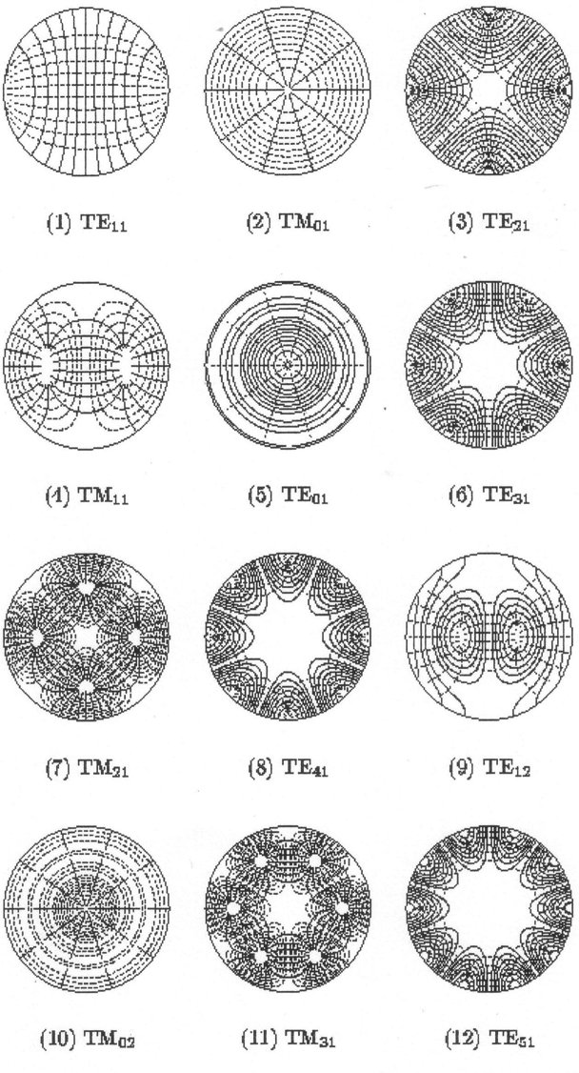
Notes:
26
1932 George Southworth demonstrated propagation through a waveguide (Raleigh, Barrow)
1933 Mead and Schelkunoff calculated low loss for circular electric modes
1934 Southworth moved to Holmdel from AT&T and Russell Ohl started investigating mm-wave detectors using a spark source.

Slide 27
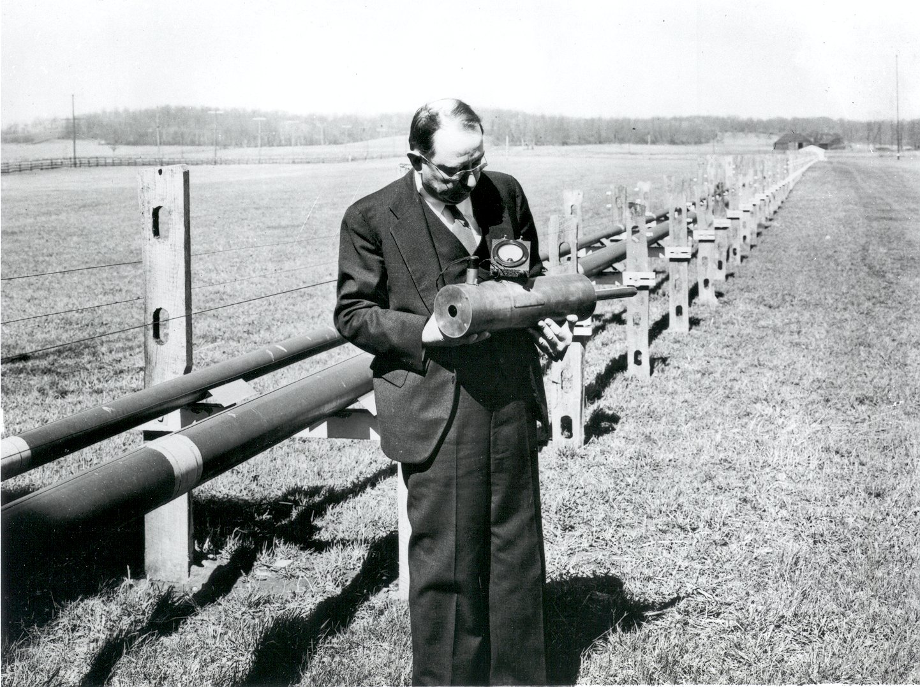
Notes:
27
The promise of wideband, low loss transmission of mm-waves through waveguide remained as a driving force at Holmdel, with interest increasing as the technology developed
When I joined Bell Labs at the newly completed Crawford Hill Lab in 1963 a mm-wave waveguide system was under intense development. It used 2” diameter waveguide which could propagate 38 to 120 GHz in the TE01 mode
By 1975 a system was developed and coast to coast communication was shown to be possible, but not yet needed.
By then the Crawford Hill group was working on optical communication (VLA)

Slide 28
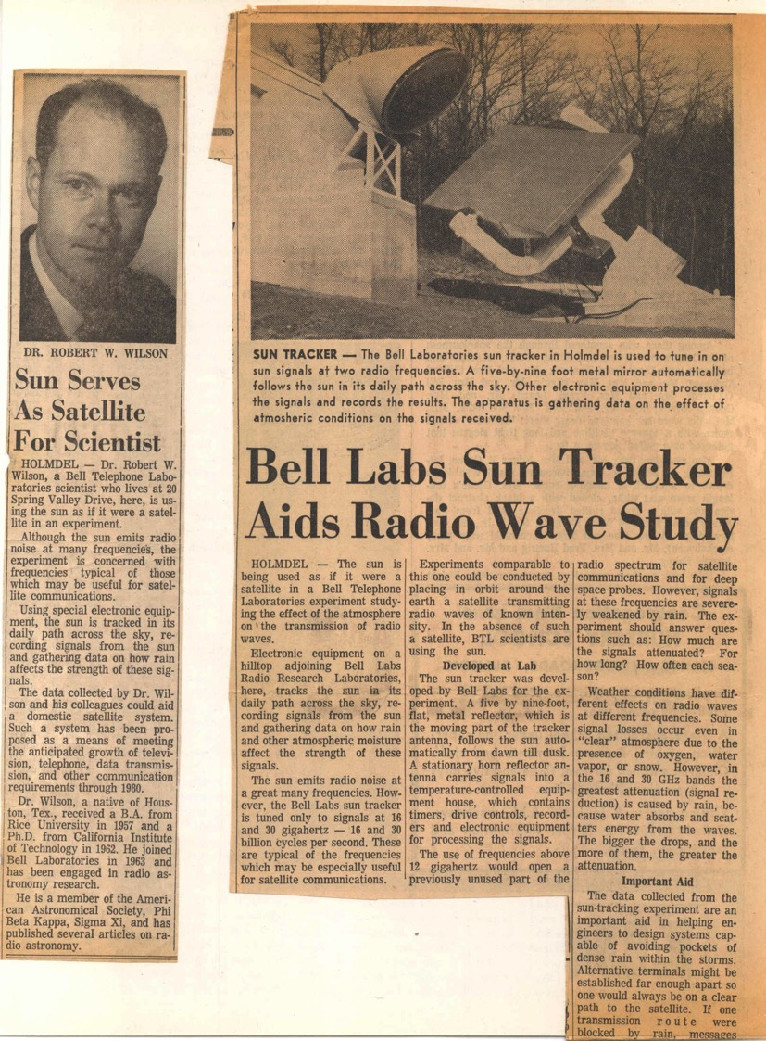
Notes:
1966 as the CMBR excitement was calming, Arno and I were reminded by our lab director that we were expected to work half time for the Bell System
We both took on communication related projects and our cm wave astronomy slowed
28

Slide 29
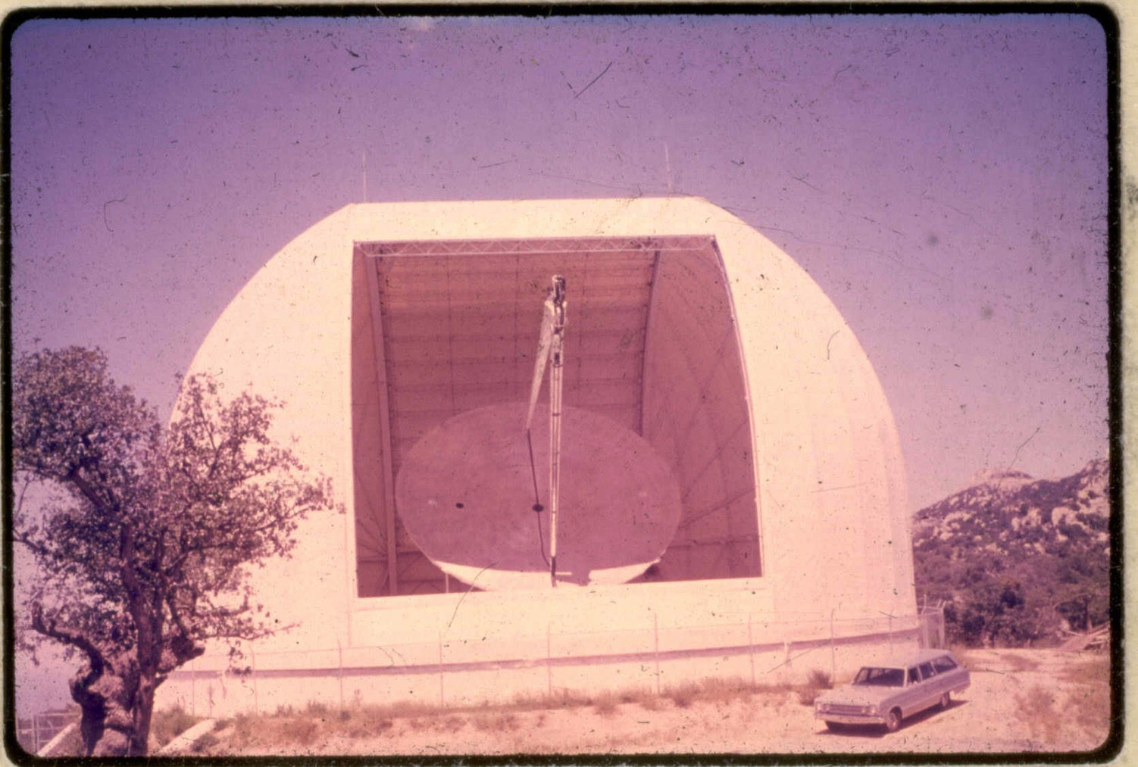
Notes:
29
29
Arno was doing some observing at NRAO and became more aware of the 36’ antenna at Kitt Peak which had been designed for mm-wave astronomy using Frank Low’s bolometers

Slide 30
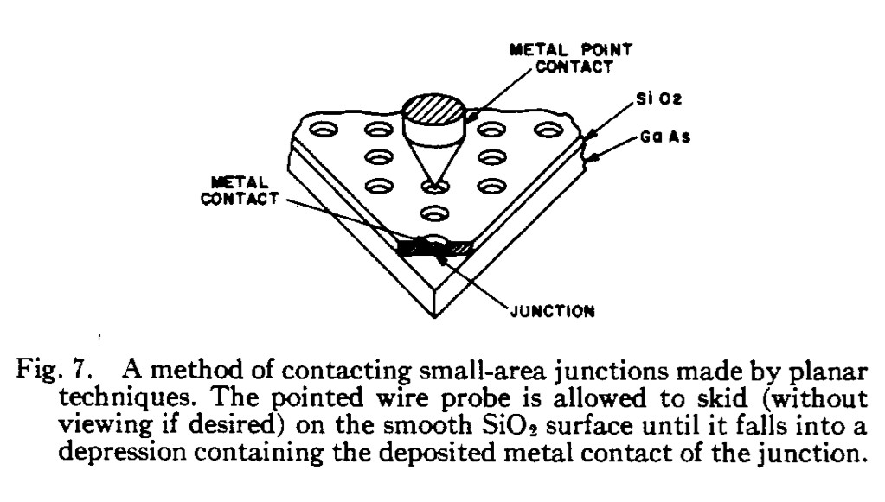
Notes:
30
Charlie Burrus in the mm waveguide group was making small area GaAs Schottky barrier diodes using some special tricks with the crude photolithography of the day (10um) to make 2 micron diodes
This year approaching 10 nm

Slide 31
Notes:
31
31
In 1968, using Sharpless mounts, Charlie made us an 80-90 GHz receiver which we took to Kitt Peak, but the telescope was not ready and very little science came out of that effort
We did show that it would be very difficult for discrete sources to make up the CMB.

Slide 32
The Next Step
We left the receiver with NRAO and Charlie Burrus supplied NRAO with diodes for several years
In 1970 the 36’ was ready for real observing
Arno invited Keith Jefferts (an atomic physicist) to join us to do millimeter wave spectroscopy
We decided that if we moved to the next smaller waveguide size there were several interesting molecules we could observe
Arno had been a student of Townes and was aware of his 1955 list of candidate molecules with CO on it.

Slide 33
Knowledge of the Interstellar Medium Prior to 1970
Synchrotron emission from very hot, low density regions (what Jansky found)
Ionized hydrogen (HII) regions - hot (~10,000K), low density
Atomic hydrogen – 50 to125K, <~ 100/cm3
Dust (holes in optical light and atomic hydrogen)
Molecular regions were not in the general consciousness (H2 forms on grains, self shielding if n > 100 cm-3, Solomon & Wickramashinge 1969)
Notes:
33

Slide 34
Known Molecules
CH, CN & CH+ 1937-1941 McKellar, Adams, Douglas & Herzberg
1955 Townes list of candidate molecules OH, NH3, H2O, CO
1963 OH, Weinreb, Barrett, Meeks & Henry (1968 Heiles in dark clouds)
1968 & 9 NH3, H2O Cheung, Rank, Townes, Thornton & Welch
1969 H2CO Snyder, Buhl, Zuckerman & Palmer
None of these pointed to extensive molecular clouds
Notes:
34

Slide 35
Astronomical Millimeter-wave Spectroscopy
Charlie Burrus made a new mixer in RG-8 waveguide rated for 90-140 GHz
Sandy Weinreb at NRAO offered to provide most of the auxiliary equipment we would need
Arno and I built a receiver around Charlie’s mixer
Sandy sent a front end box and control rack to Bell Labs
Keith Jefferts and I spent two busy weeks wiring our receiver to Sandy’s box and rack, but did not quite finish, shipped it
Keith, Sandy, and I went to the 36’ to get it working
Notes:
35
35

Slide 36
Each Part of the System Had its Own Way of Failing
Diodes - Bad contacts, poor performance
Klystron - Sparks, Jump out of lock, noise, low power, short lifetime ($5,000, 500 hour guarantee)
PLL - Transistors which drive the repeller fail, spikes from heater supply
Paramp - Unstable gain, oscillation, radar pickup
Beam switch - waveguide break
Antenna - Computer, Brakes, Sun sensitivity
After 3 unsuccessful days Sandy Weinreb had to leave; he was discouraged
Notes:
36
36

Slide 37
Success!
Keith and I got all of the parts working simultaneously in the lab later that day
Remarkably, they continued to work when we installed the receiver box at the focus of the 36’ antenna with much longer cables
I asked the operator to point to the Orion BN-KL region which was the most likely source on our list of candidate sources which was up at that time
Notes:
37

Slide 38
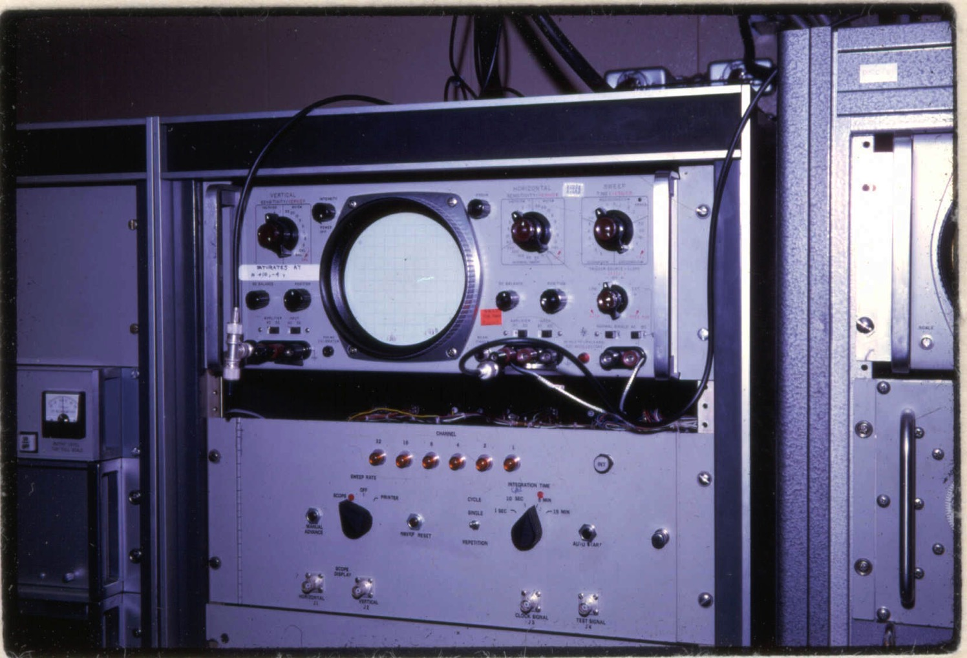
Notes:
38
38
I was watching the real-time display with a 2 second time constant on each channel of the filter bank
Each channel had an analog lock-in and integrator and had a unique gain and zero offset.
A multiplexer cycled through the channels and displayed them on this oscilloscope
When observing, it could integrate for many minutes, but at the end wrote the results to magnetic tape and cleared the integrators.
As I watched ...
The tapes could be read at the UA in Tucson, but there were no programs to handle the data.

Slide 39
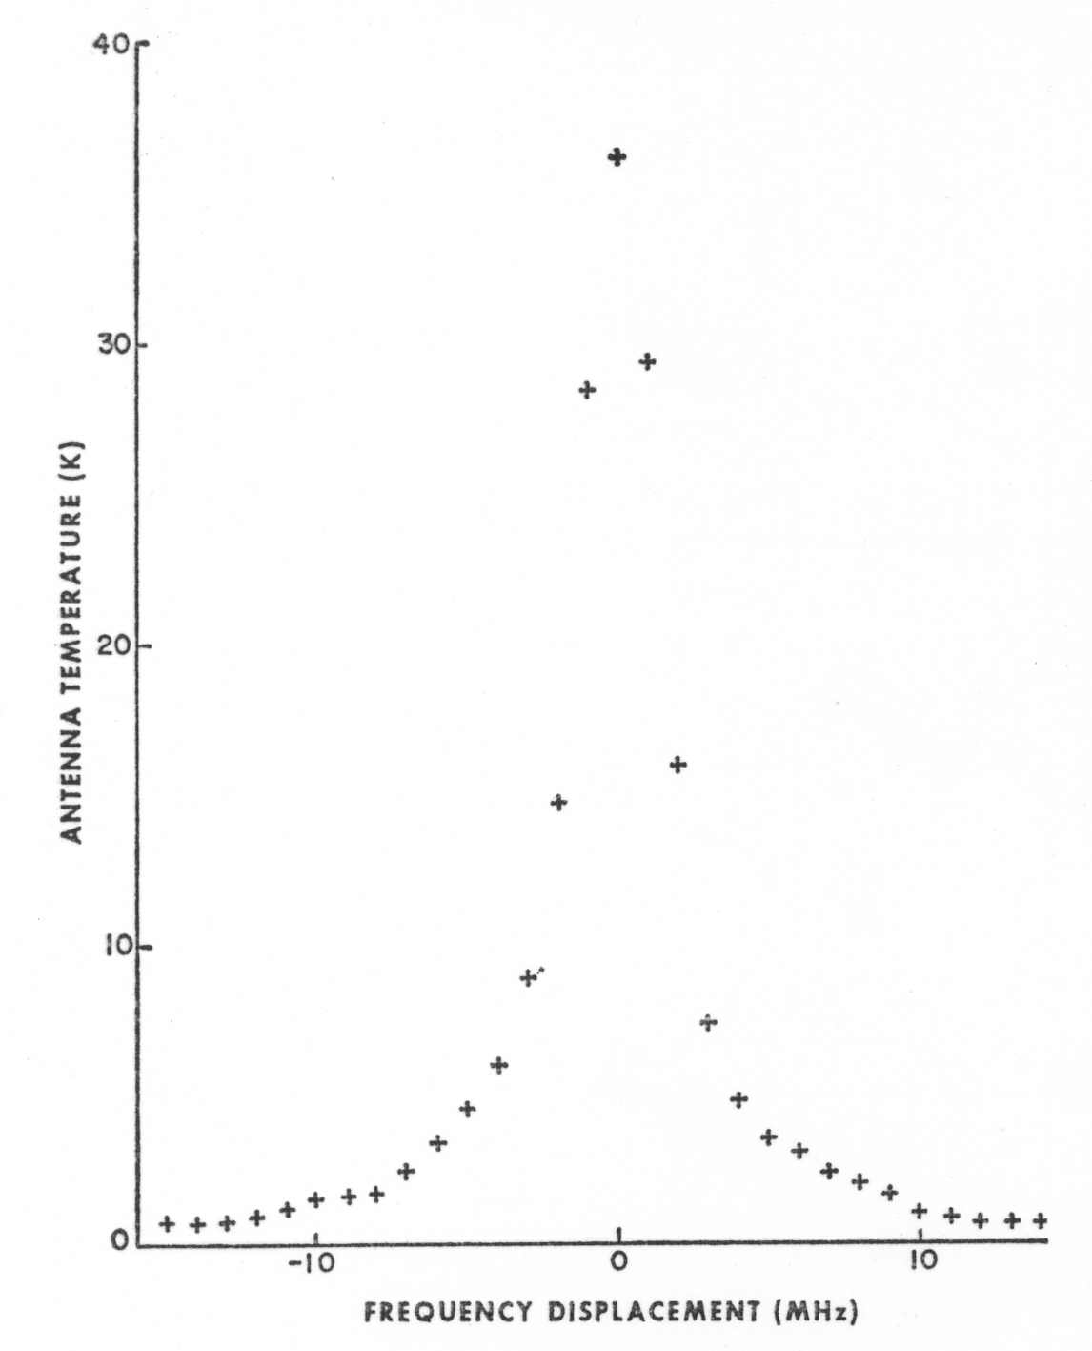
Notes:
Regret missing the broad wings. 1957 Ben Ziuckerman

Slide 40
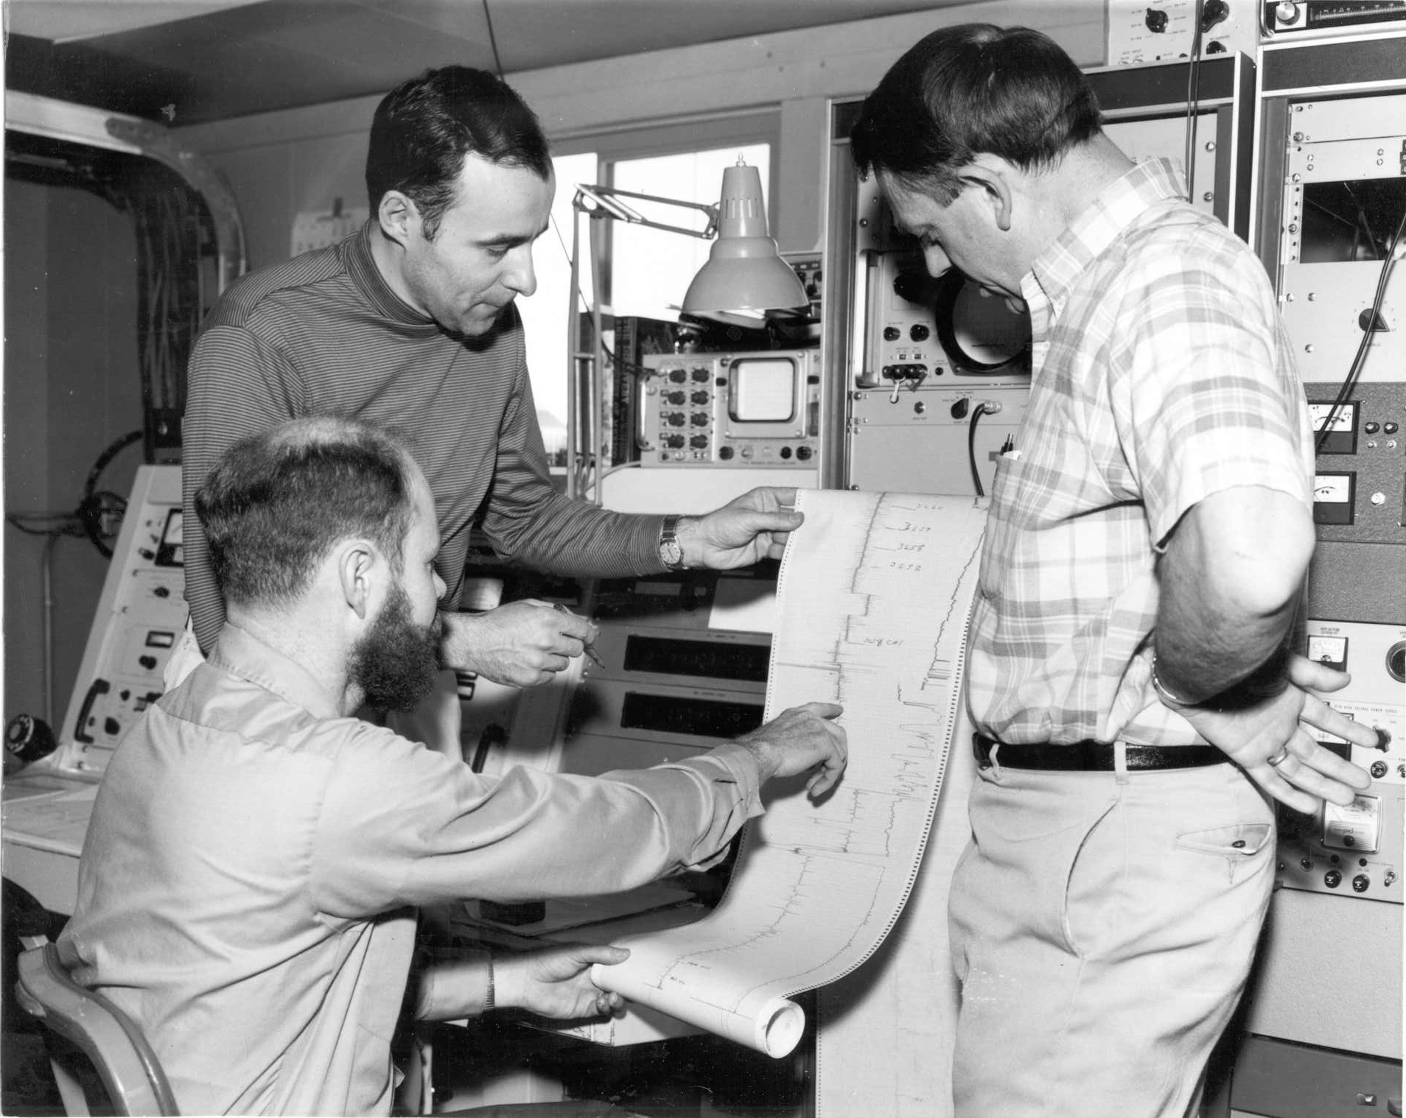
Notes:
Remarkably, our first observation was of the brightest CO source in the sky
After exploring it until it set we slept during what we have called dead time and then found CO in several galactic HII regions the next day
13CO
Millimeter-waves allowed rotational transitions of many species to be observed
It was an amazing time and a lot of fun
We had many joint projects with Pat Thaddeus and Phil Solomon and their students
We worked hard but there were a lot of new molecules and sources that provided instant gratification
Depressed after 24 hours of not finding anything new
40

Slide 41
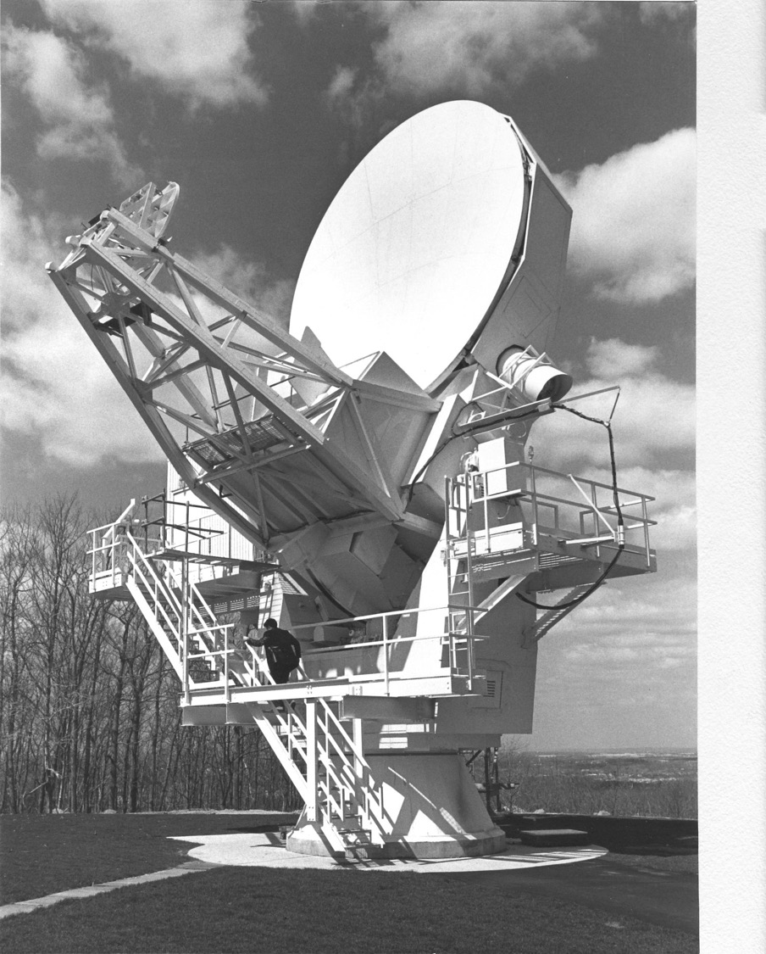
Notes:
We also planned the 7-meter antenna for Communications and Astronomy
Offset for a clean beam
Satellite work in bad weather, astronomy in good.
Once we had a solid state LO, we ran for 1/2 day or more unattended
41

Slide 42
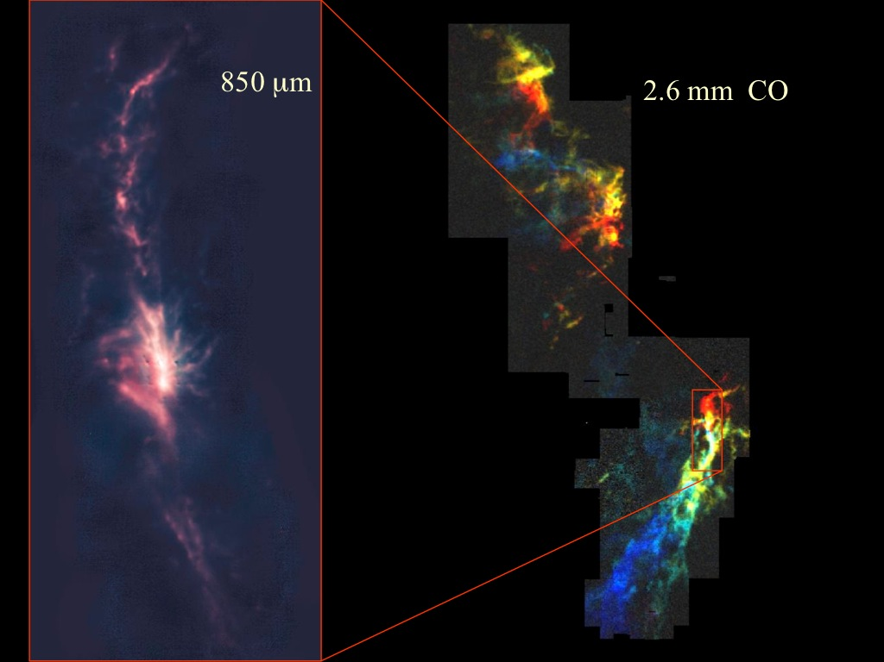
Notes:
We did astronomy intensively through the late ‘80s with the 7-meter
Orion Molecular cloud from which the Orion Nebula formed.
42

Slide 43
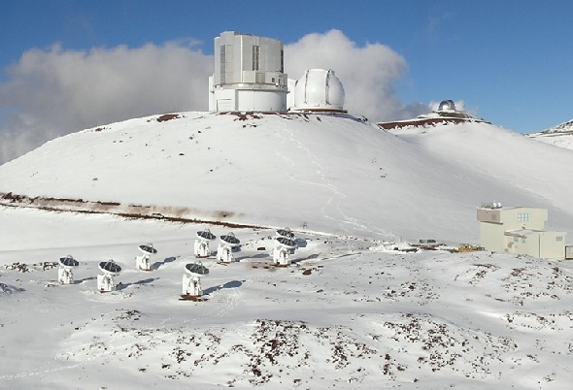
The SMA on Mauna Kea
Notes:
43
43
In 1994 I retired from Bell Labs and started working at the CfA and the SMA

Slide 44
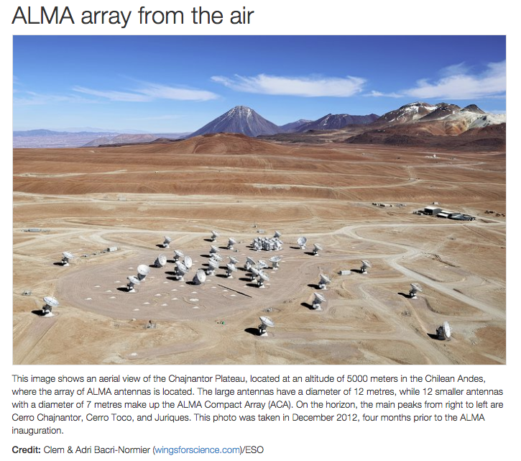
Notes:
After our discovery of CO, millimeter wave astronomy took off and NRAO proposed building a 25 m telescope
About 1980, NSF declared that they were not going to fund it.
The mm-wave community proposed an array like the VLA NSF bought in and the MMA project started
Eventually combined with European efforts along similar lines to propose what became ALMA
66 antennas 54 12m, 12 7m

Slide 45
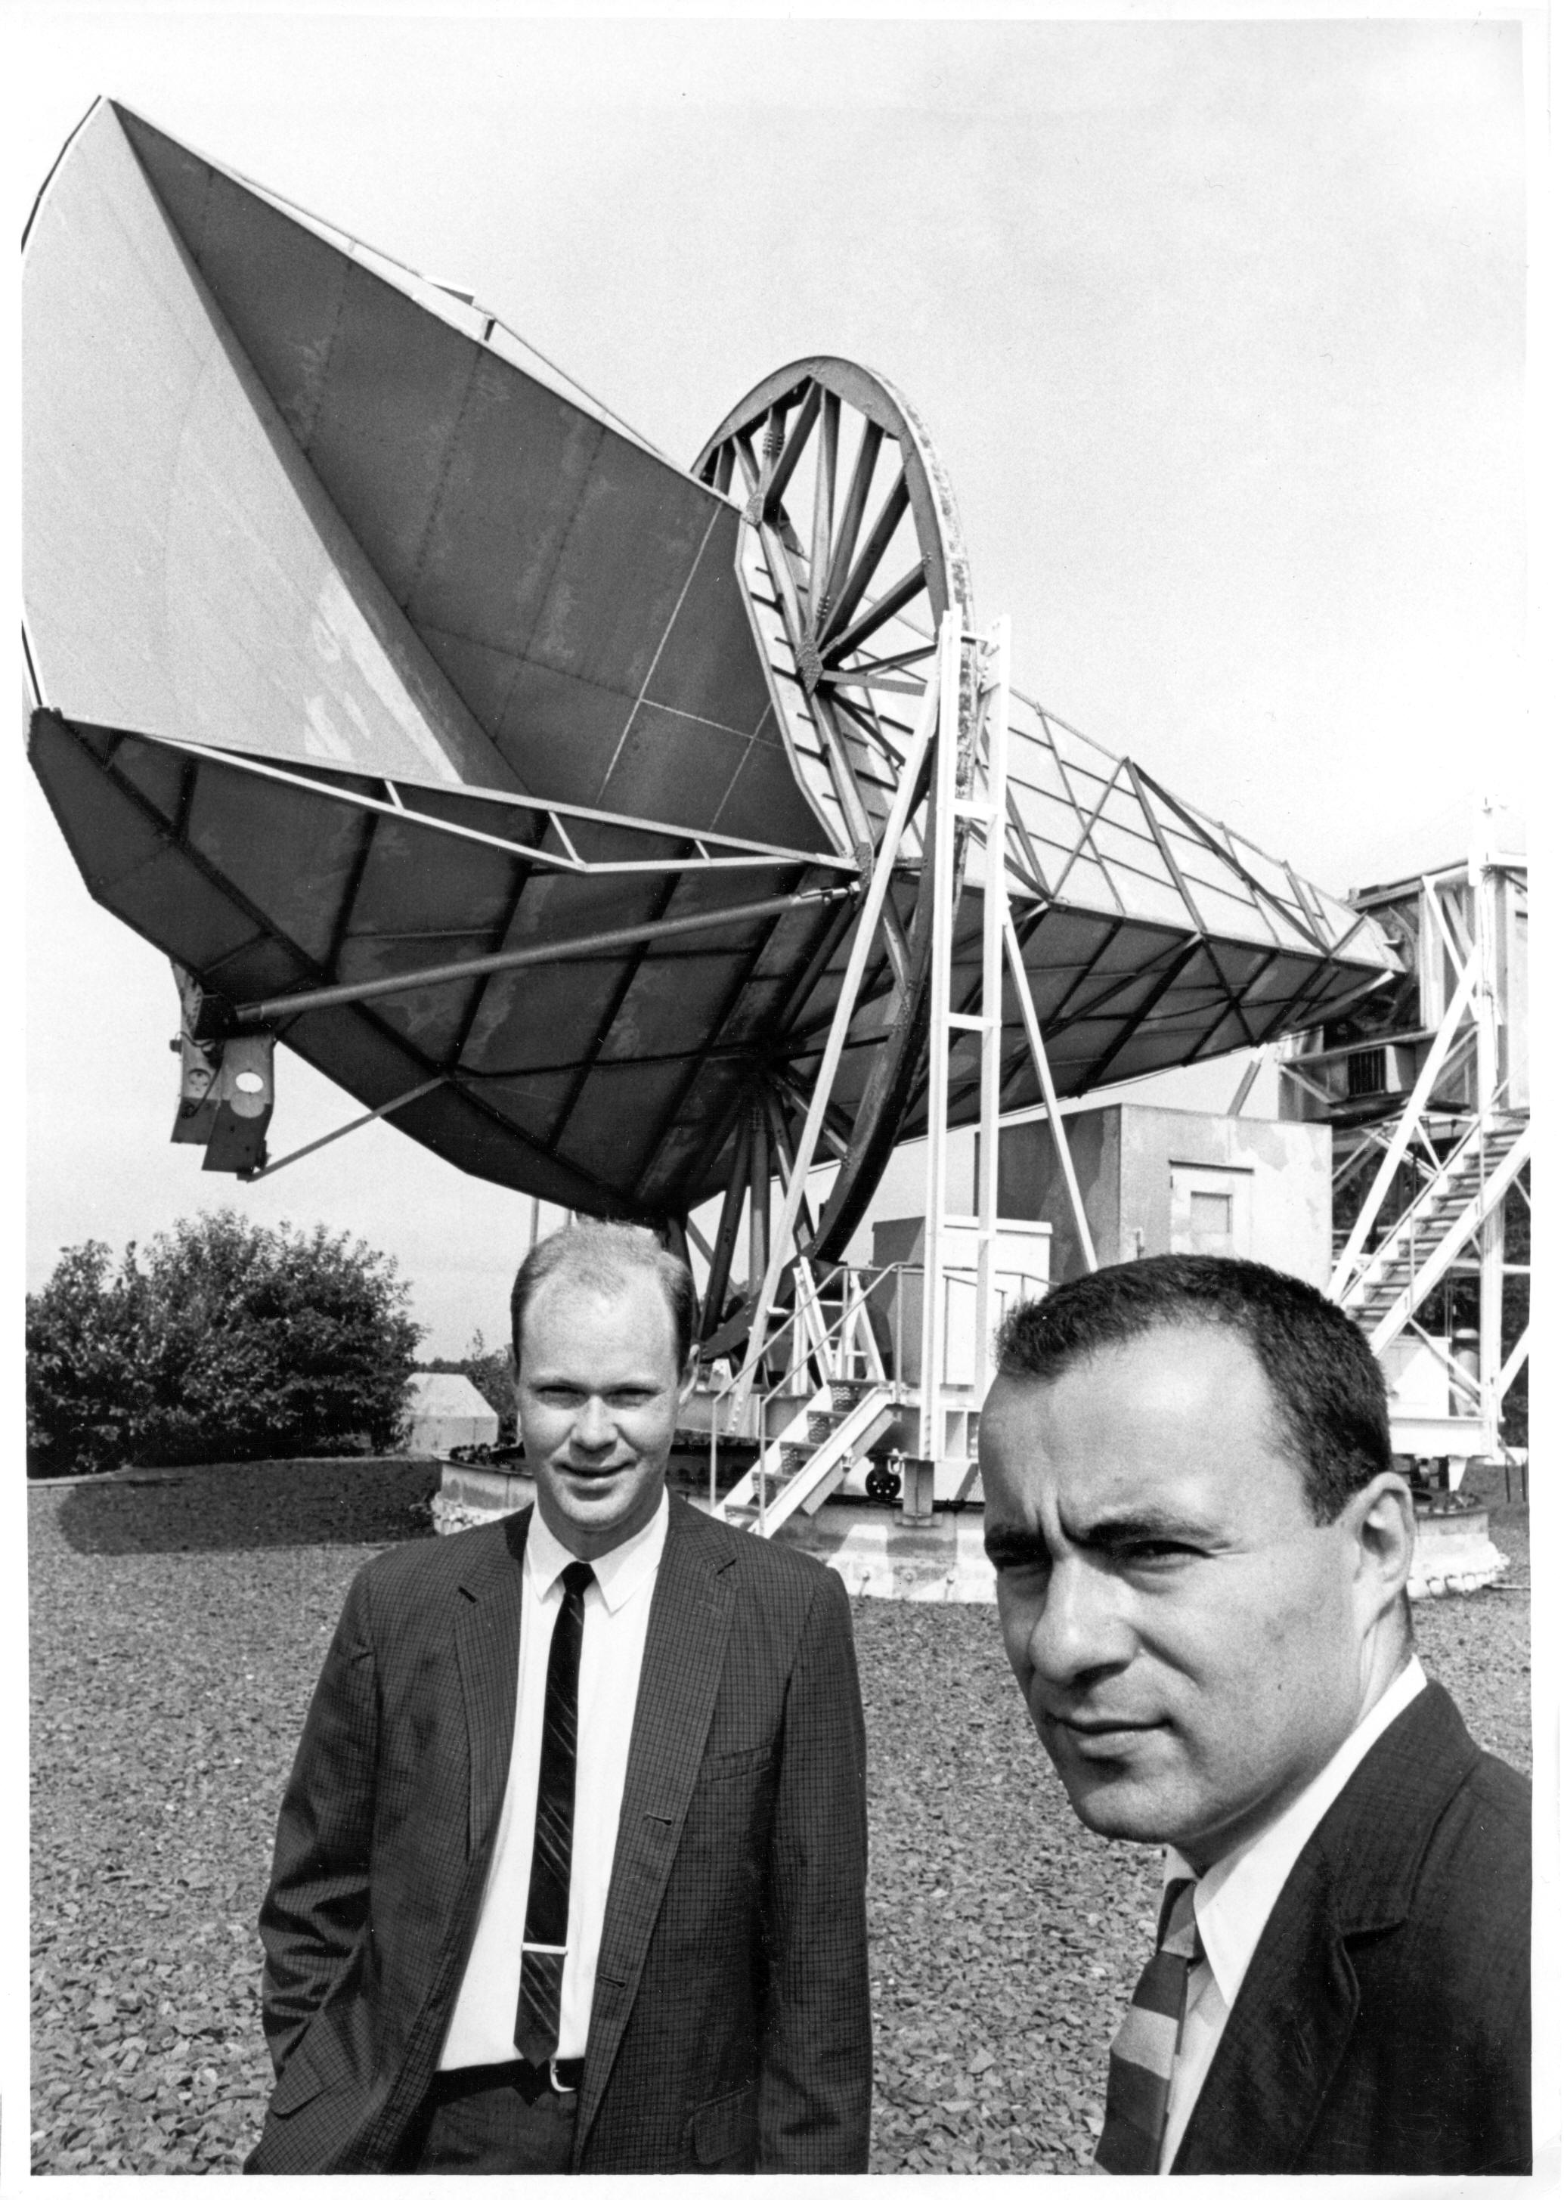
Notes:
45
45
Those guys in 1965 did not know how important the CMB would be
As you may have gathered from what I have said, there was no aha moment in discovering the CMB. Instead there was a long period of trying to identify the "problem" The importance of the CMB only became clear over the following years as theories and more sensitive receivers were developed. It is, however, very satisfying to look back and see that we did our job right and to see how much has been derived from the CMB.
The discovery of CO, however, brought almost instant gratification. Betsy's comment
I feel very lucky:
I had a job at Bell Labs with generous support and many helpful experts
I started my career when Radio Astronomy and cosmology were relatively new sciences but poised to blossom as technology developed.
When I entered the work force, the nation, perhaps shocked by Sputnik, and remembering the contribution of science to winning WW2, understood the value of science for its future and was willing to spend the money to be the world leader in science and technology.
It has been a wonderful ride.

Slide 46
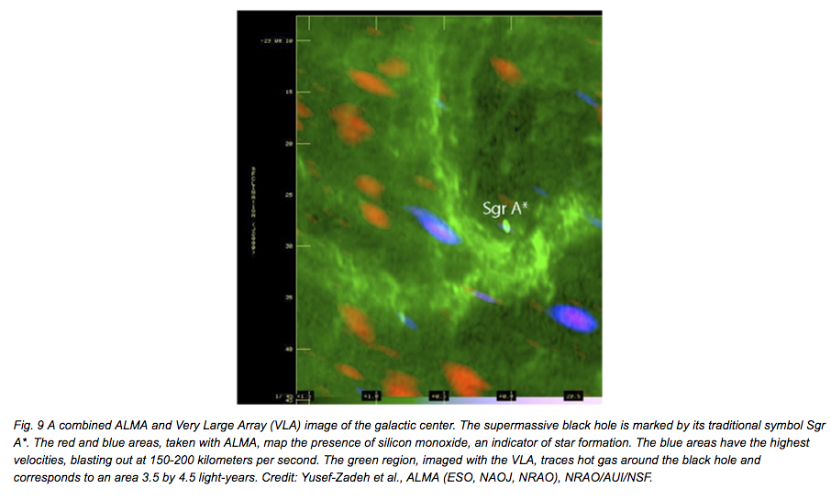
Notes:
Galactic center region
Green measured by the VLA traces hot gas around the super massive black hole
The blue and orange blobs are star forming regions observed by ALMA moving out at 150-200 km/s
It is interesting to see how Radio astronomy developed as advances in radio technology were made..
Bell Labs, with its commitment to understanding the fundamentals and ultimate limitations of the ideas for communications that they were working on as well as advancing science made 3 important discoveries which have had major impacts on Astronomy and cosmology
3 discoveries different
I think that Karl Jansky would be amazed at the current state of Radio Astronomy. Astronomer did not to understand it at the time.

